Slide 1
Permanent Magnet Quadrupoles and Dipoles for CLIC
Jim Clarke
on behalf of Alex Bainbridge, Norbert Collomb, Ben Shepherd, (STFC Daresbury Laboratory) and Michele Modena (CERN)
10th Jan 2017, Oxford

Slide 2
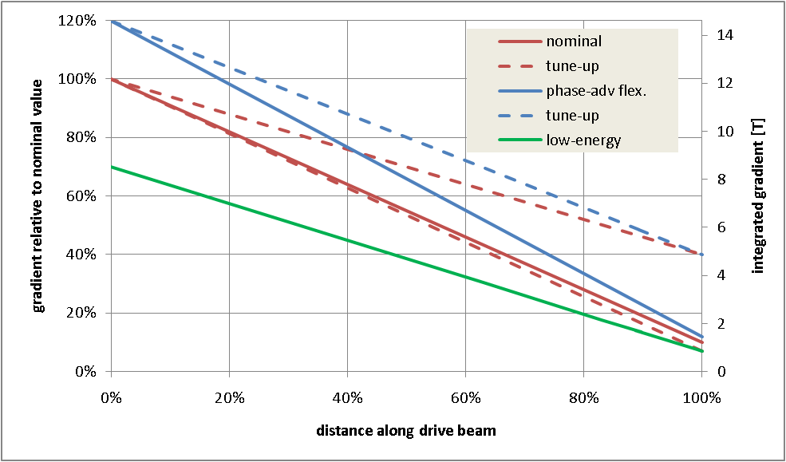
PM Quad Recap
We have developed PM alternatives for the Drive Beam Quads
  Two types were successfully prototyped to cover the full range required
Erik Adli & Daniel Siemaszko
Low Energy Quad
High Energy Quad
High energy quad – Gradient very high
Low energy quad – Very large dynamic range

Slide 3
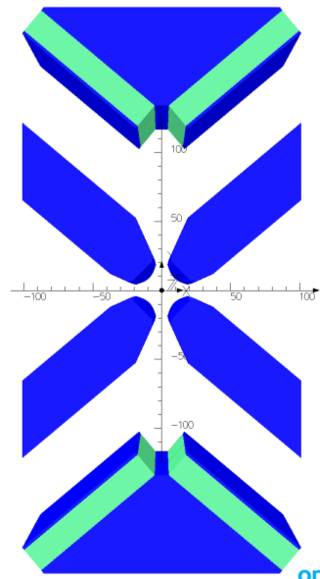
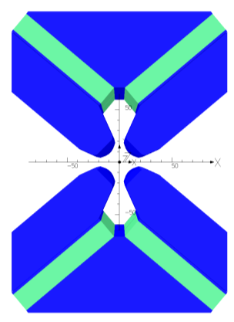
High Energy Quad Design
NdFeB magnets with B_{r} = 1.37 T (VACODYM 764 TP)
4 permanent magnet blocks each 18 x 100 x 230 mm
Mounted at optimum angle of 40°
Max gradient = 60.4 T/m (stroke = 0 mm)
Min gradient = 15.0 T/m (stroke = 64 mm)
Pole gap = 27.2 mm
Field quality = ±0.1% over 23 mm
Stroke = 64 mm
Poles are permanently fixed in place.
Stroke = 0 mm

Slide 4
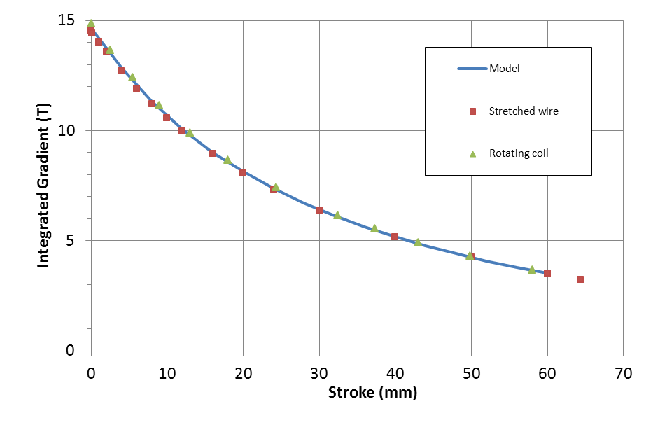
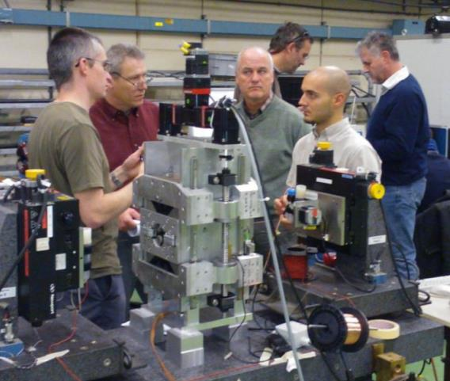
High Energy Quad
Measured Integrated Gradient
Gradient, Integrated Gradient, and Field Quality all good.
Main issue: Magnet centre moves with motion of PMs

Slide 5
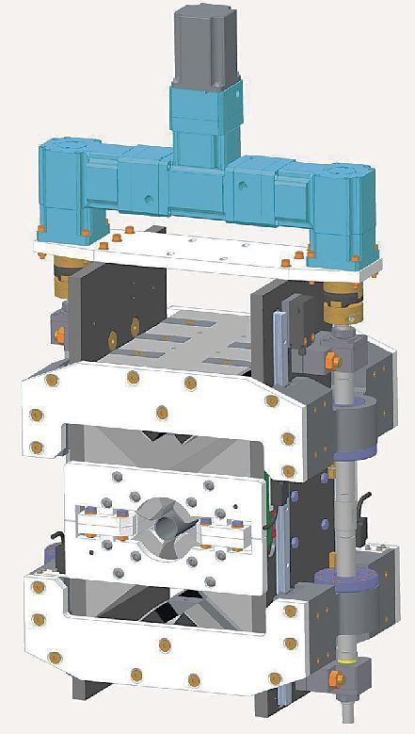
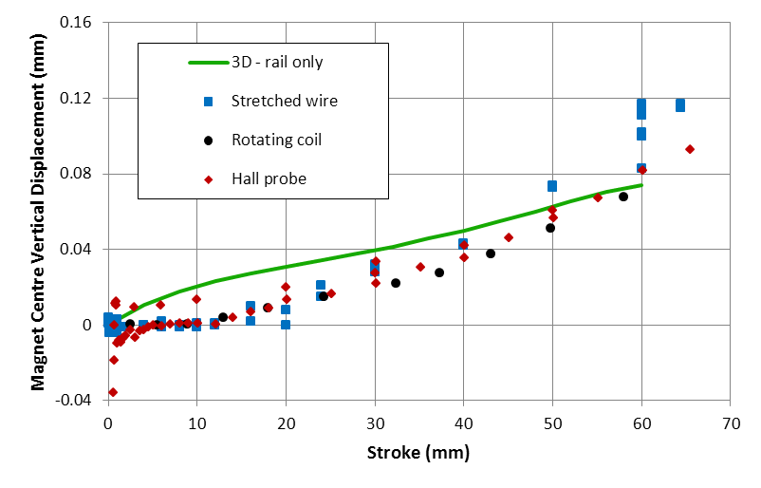
Magnet Centre Movement
The magnet centre moves upwards by ~100 µm as the permanent magnets are moved away by 64mm
3D modelling suggests this is due to the rails being ferromagnetic (µ_{r} ~ 100, measured) and not mounted symmetrically about the midplane – should be easy to fix
Motor/gearbox assembly may also be a contributing factor
Overview ●● Introduction ●●●●● Q1 ●●●◉ Q2 ○○○○ D1 ○○○○○ Summary ○○○○
Ben Shepherd — Vector Fields EUGM — Windsor, 2-3 June 2015

Slide 6
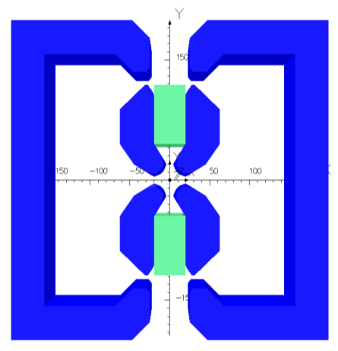
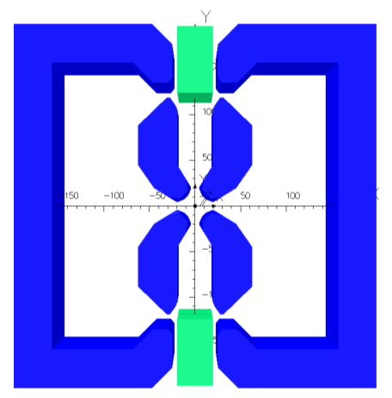
Low Energy Quad Design
Lower strength easier but requires much larger tunability range (x10)
Outer shell short circuits magnetic flux to reduce quad strength rapidly
NdFeB magnets with B_{r} = 1.37 T (VACODYM 764 TP)
2 permanent magnet blocks are 37.2 x 70 x 190 mm
Max gradient = 43.4 T/m (stroke = 0 mm)
Min gradient = 3.5 T/m (stroke = 75 mm)
Pole gap = 27.6 mm
Field quality = ±0.1% over 23 mm
Stroke = 75 mm
Poles and outer shell are permanently fixed in place.
Stroke = 0 mm

Slide 7
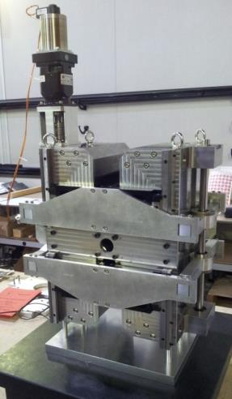
Low Energy Quad
Measured Integrated Gradient
Maximum gradient: 45.0 T/m
Minimum gradient: 3.6 T/m
Gradient, Integrated Gradient, and Field Quality all good.
Main issue: Magnet centre moves with motion of PMs

Slide 8
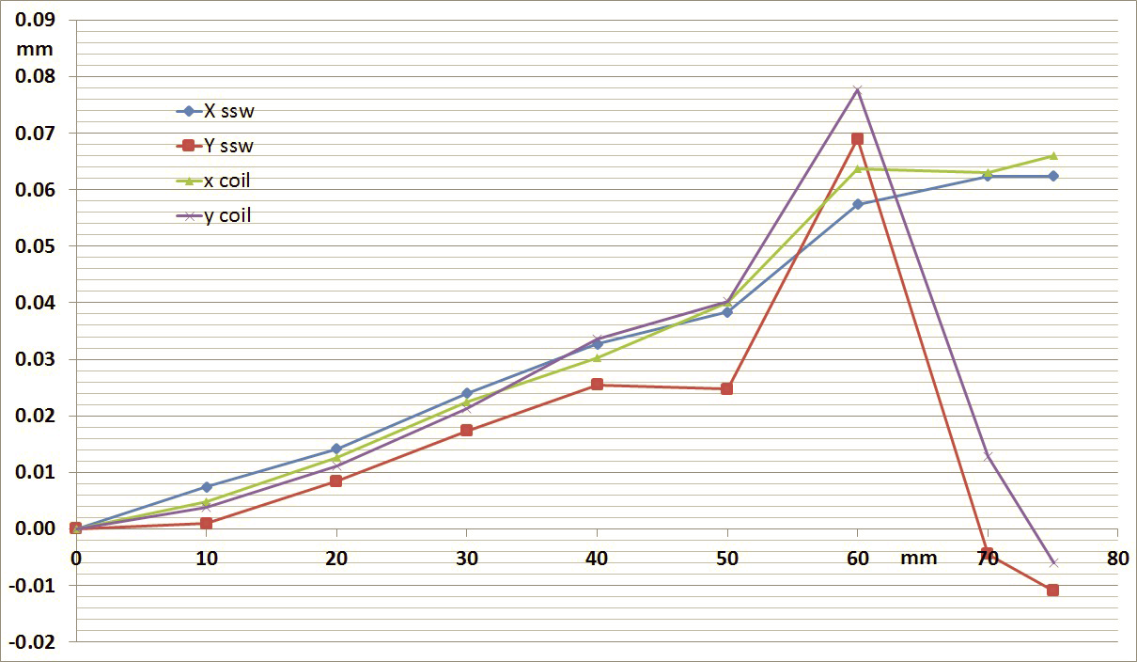
Measured Axis Movement
Good agreement between measurement methods
  stretched wire
  rotating coil
X axis moves in one direction
  Possible misalignment of outer shell?
Y axis moves up and then back down
  Harder to explain this…
We believe this motion is a mechanical rather than a magnetic effect
X (horiz)
Y (vert)
The magnet centre moves diagonally by up to ~100 µm as the permanent magnets are moved away by 75mm

Slide 9
CLIC PM Dipoles
Next we have investigated PM dipoles
  Drive Beam Turn Around Loop (DB TAL)
  Main Beam Ring to Main Linac (MB RTML)
Total power consumed by both types: 15 MW
Several possible designs considered for DB TAL (the most challenging of the two test cases)
Type | Quantity | Length (m) | Strength (T) | Pole Gap (mm) | Good Field Region (mm) | Field Quality | Range (%)
MB RTML | 666 | 2.0 | 0.5 | 30 | 20 x 20 | 1 x 10⁻⁴ | ± 10
DB TAL | 576 | 1.5 | 1.6 | 53 | 40 x 40 | 1 x 10⁻⁴ | 50–100

Slide 10
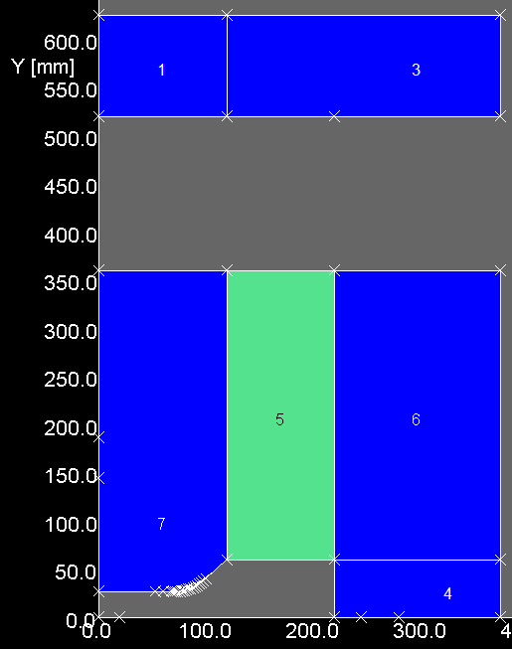
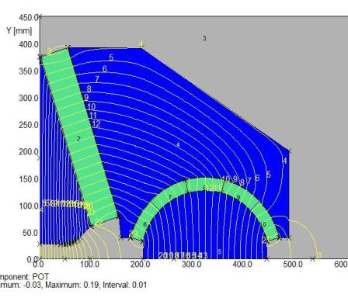
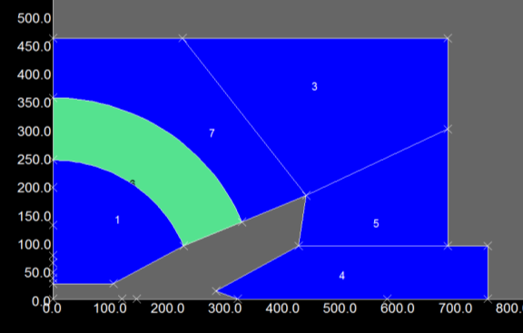
(Some of the) Dipole Options Investigated
Tuning by rotating steel and PM assembly → Huge torque required
(Design from SPring-8 (Watanabe, IPAC’14)) Tuning by moving top plate
→ Huge vertical forces
Tuning by moving steel plate to short circuit flux→ Large forces and field quality concerns

Slide 11
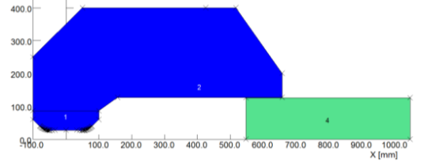
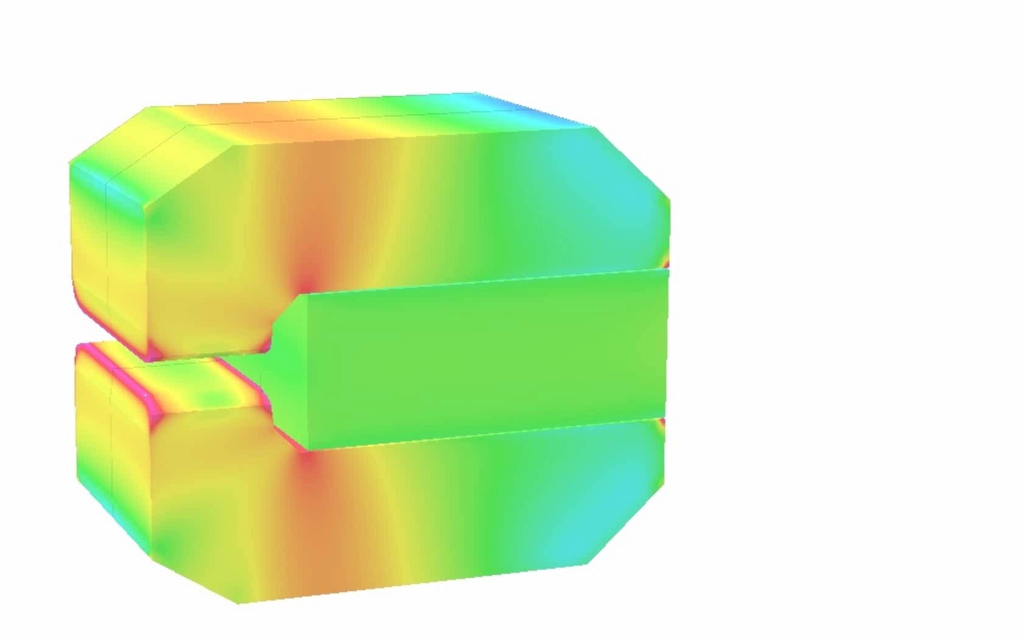
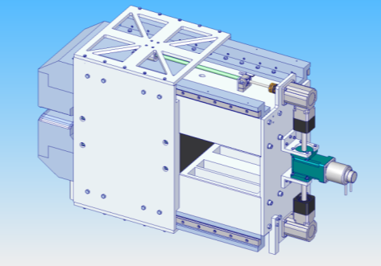
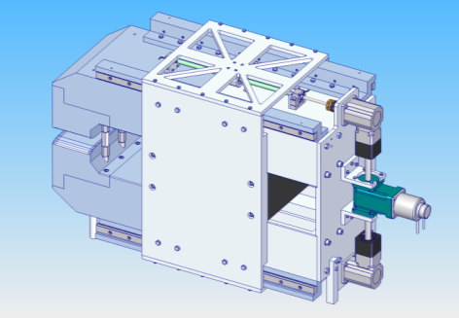
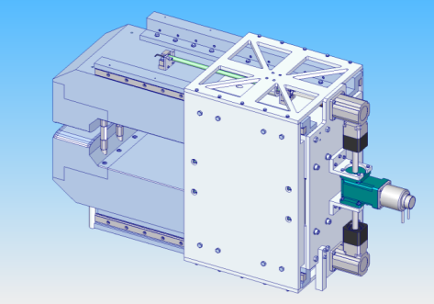
Selected Dipole Design
  Sliding PM in backleg
  Similar to low energy DBQ
  Rectangular PM
  Forces manageable
  C – shape possible
  Curved poles (along beam arc) possible
  Wide
  Large stroke
Sliding assembly using rails, stepper motor and a gearbox.
This should cope with the horizontal forces (27kN peak) and hold the Magnet steady at any point on a 400 mm stroke.

Slide 12
Dipole Prototype
Original plan was to build a 0.5m version of full size DB TAL magnet
However, cost far exceeded available budget (£100k)
So, instead we are building a scaled version
  Cost dominated by one off PM block costs (>50%)
  Will still demonstrate the tuneable PM dipole principle as well as achieving the same field quality and have the same relative tuning range.
Type | Length (m) | Max Field Strength (T) | Pole Gap (mm) | Good Field Region (mm) | Field Quality | Range (%)
DB TAL | 1.5 | 1.6 | 53 | 40 x 40 | 1 x 10⁻⁴ | 50–100
Original Prototype | 0.5 | 1.6 | 53 | 40 x 40 | 1 x 10⁻⁴ | 50–100
Scaled Prototype | 0.4 | 1.1 | 40 | 30 x 30 | 1 x 10⁻⁴ | 50–100
Note: Scaled Prototype weighs ~1500kg ! PM block is ~350kg!

Slide 13
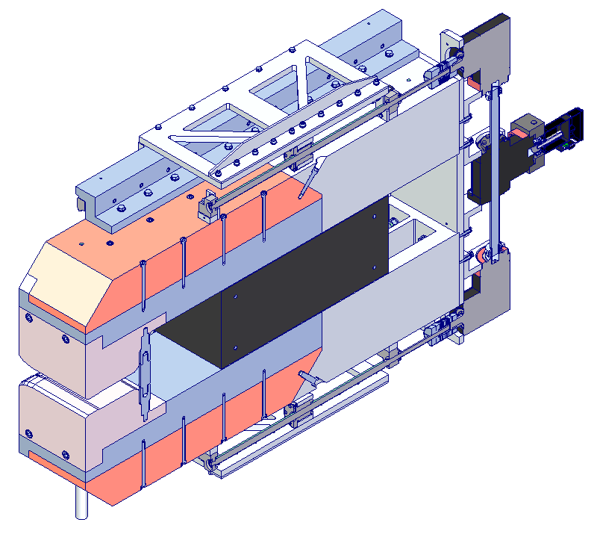
Prototype Dipole Overview
“T-gearbox”
Sideplate & Nut Plate Assembly
Motor
Section View
Right angle - gearbox
Principle:
The motor drives the ballscrews through a “T-gearbox” and “right angle gearbox”.
This moves the ballscrew nut which is connected via the housing to the Nut Plate Assembly.
This in turn moves the permanent magnet via the PM side-plates.
Permanent Magnet
Ballscrew Nut

Slide 14
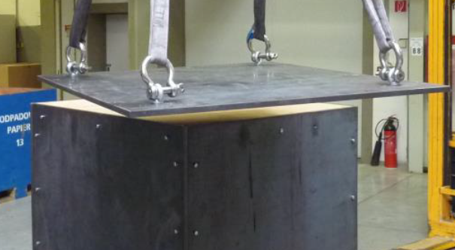
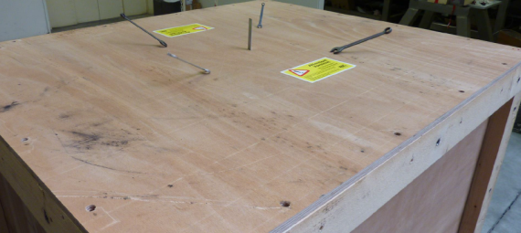
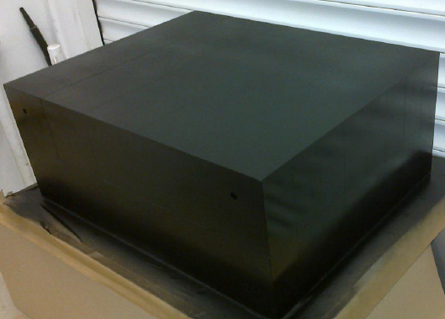
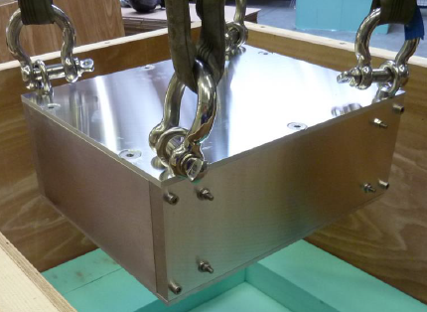
PM Block Details
Manufactured, measured & delivered by Vacuumschmelze
Magnet block dimensions are 500x400x200 mm, with 4 holes on 400mm axis for mounting tie rods.
Magnet material NdFeB, Vacodym 745TP (Br 1.38T)
Constructed from 80 (large!) individual blocks glued together (100x50x100mm)

Slide 15
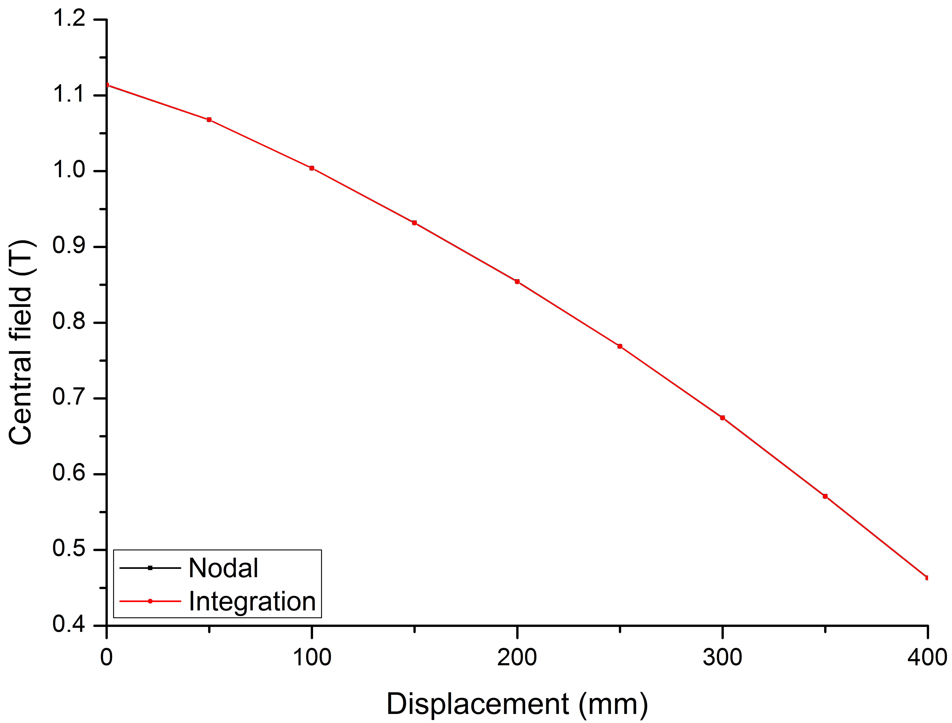
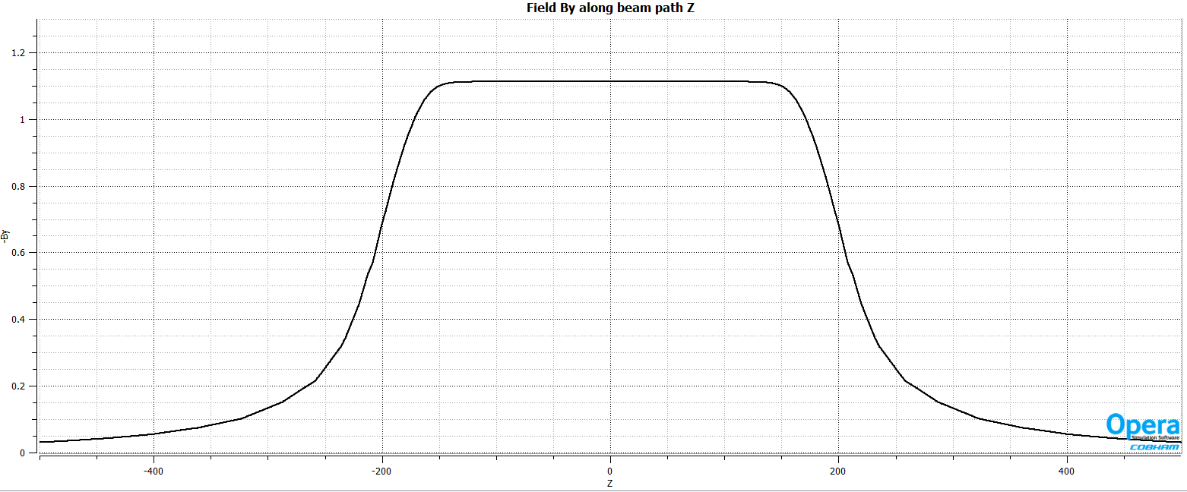
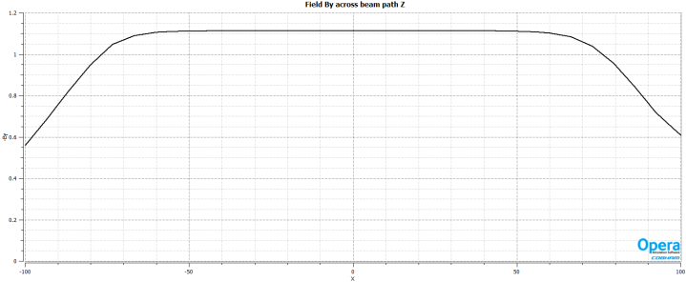
Predicted Field Strength
Peak field 1.11 T with field reducing to 50% at
magnet retraction of approximately 370 mm
Field is uniform along the beam path and transverse to it

Slide 16
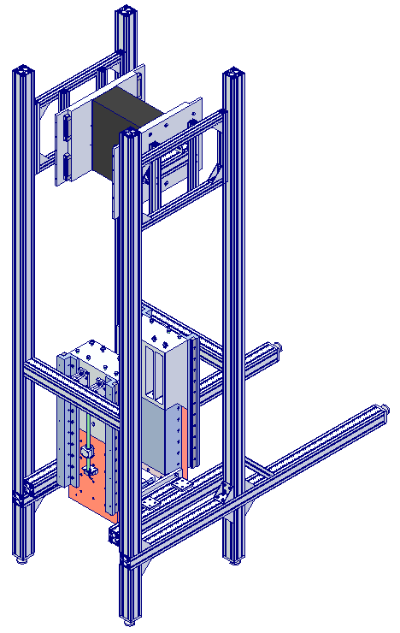
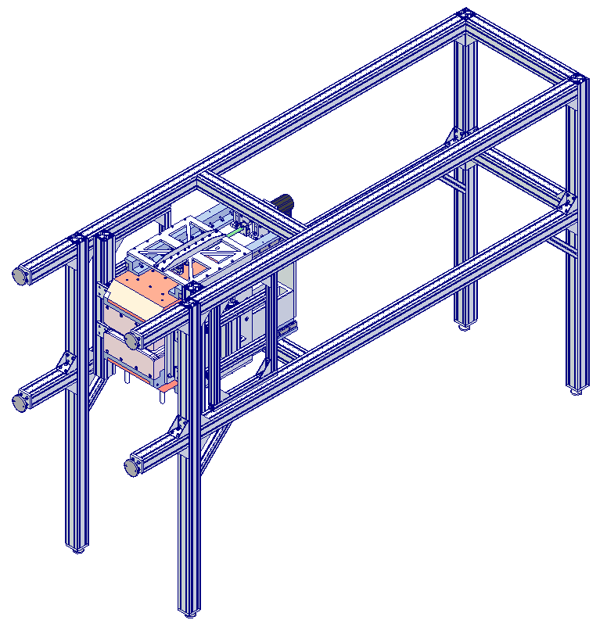
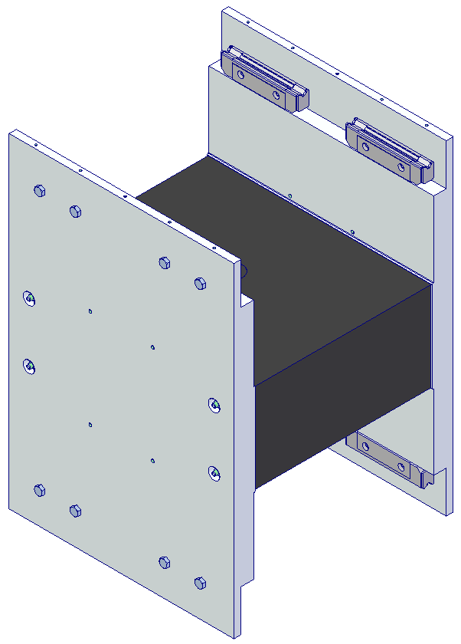
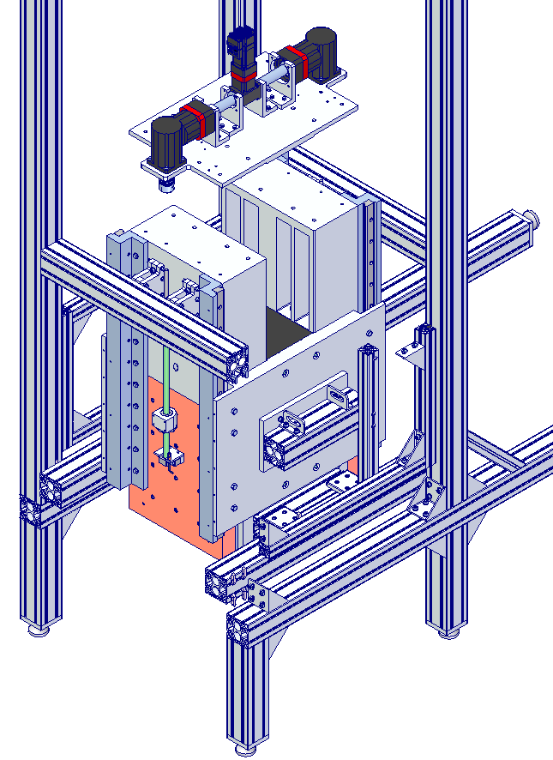
Prototype Progress
All externally procured items have been delivered
Assembly area being prepared (non-trivial) – specific safety training has been given to all staff involved
Assembly anticipated to be complete by early March 2017
Measurements (at DL only) and Report to follow immediately afterwards
Assembly Sequence

Slide 17
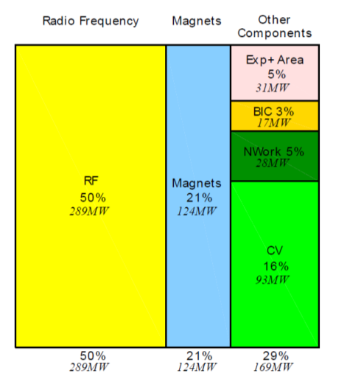
Future Work
CLIC Accelerator Study – Report from the 2016 Review Panel
“For the ESU [European Strategy Update], priority should be given only to developments aimed at cost and power reduction; an example are the permanent magnet quadrupoles that can potentially provide a 10% power reduction if implemented generally for the CLIC magnets. The Panel was however surprised of their high cost related to the complex design required for field adjustment and encourages the CLIC team in looking for simpler designs, involving both beam dynamics experts and magnet designers.”
Power consumption by technical systems for CLIC 3 TeV

Slide 18
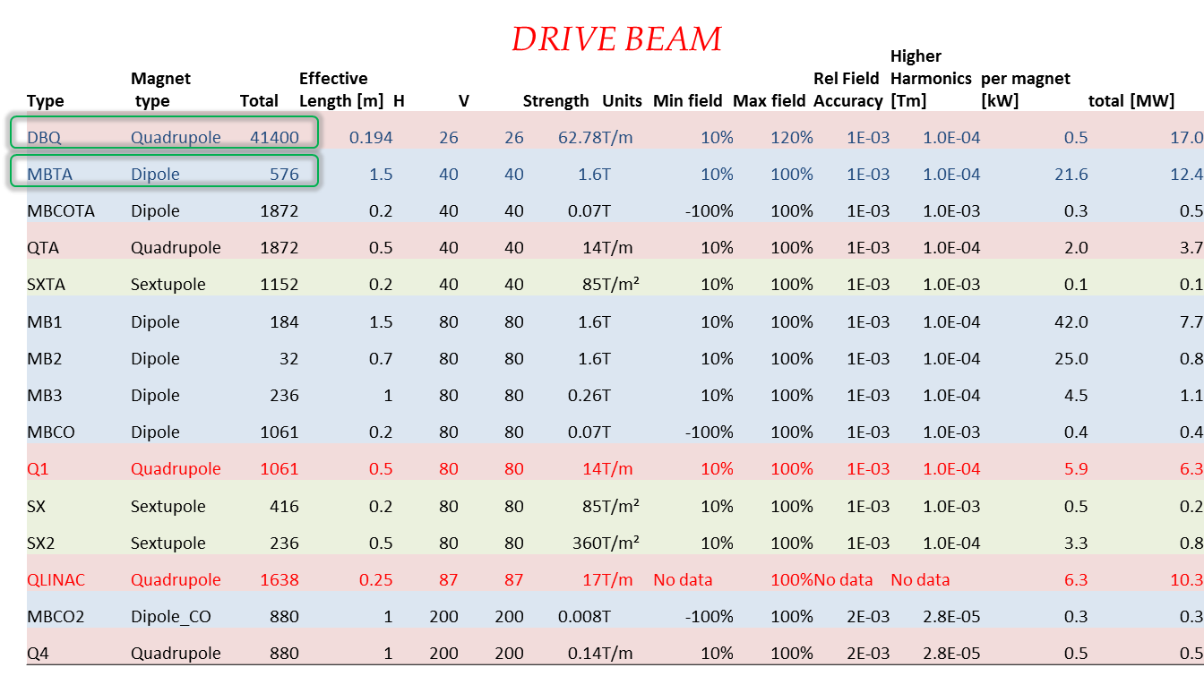
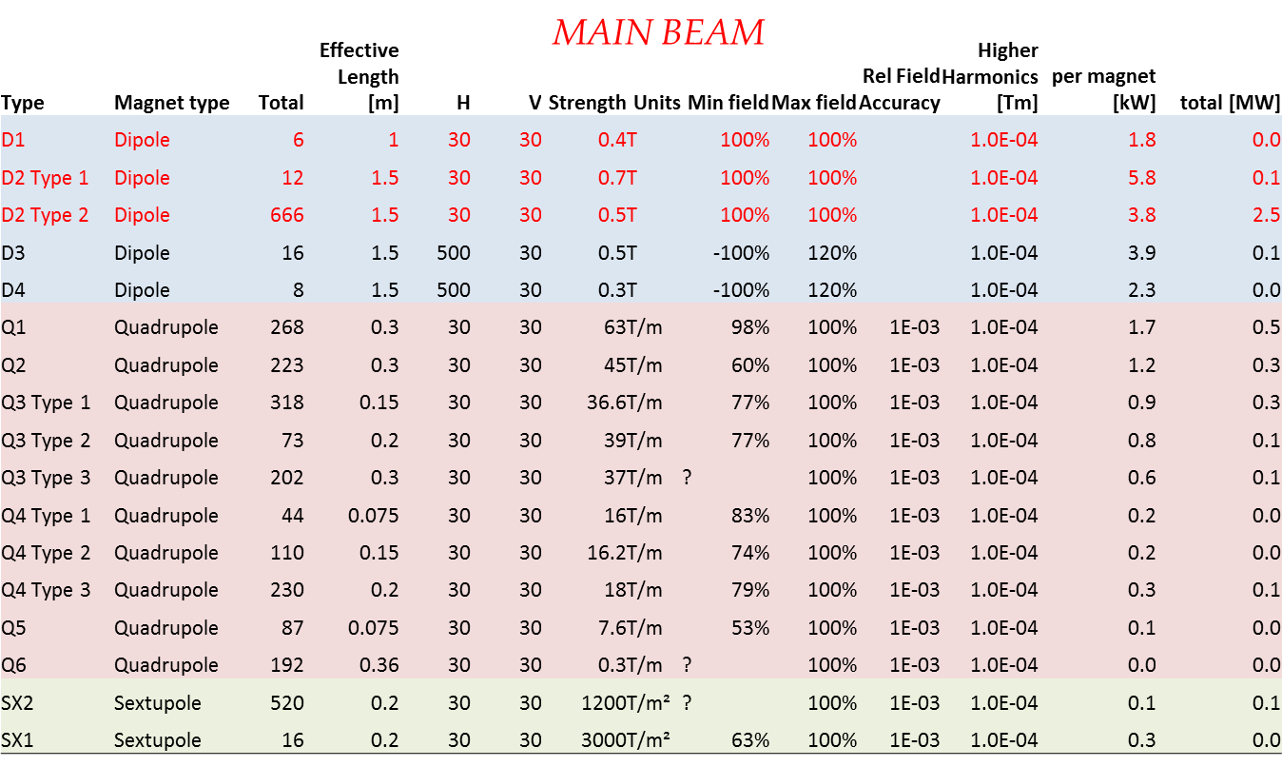
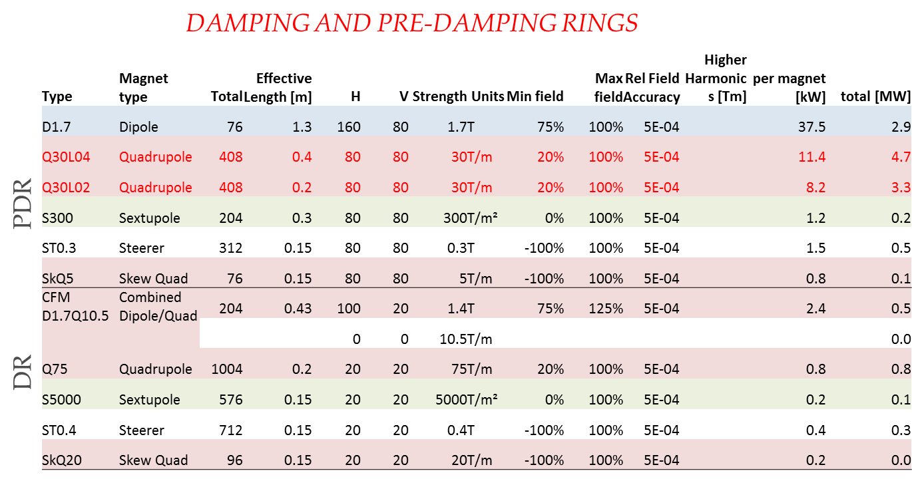
Quick Assessment May 2016
Several promising candidates rapidly identified (27MW)

Slide 19
Example Cost Reduction
Erik Adli & Daniel Siemaszko
60mm stroke
Wide tuneability is expensive – better to limit tuneability

Slide 20
Example Cost Reduction
25mm stroke
Erik Adli & Daniel Siemaszko
Reduced range of motion will help significantly – magnets can be modular – same intrinsic design but with different PM block sizes for example.
Magnet centre motion will reduce accordingly (though we would expect to fix this anyway!)

Slide 21
Example Cost Reduction
8mm stroke
Erik Adli & Daniel Siemaszko
Restricting the beam requirements will have a big impact – need to iterate with beam dynamics/lattice designers

Slide 22
Future Work Proposal
Paper Studies for Cost and Power Reductions:
Explore procurement cost reduction options for PMs
  Simplification of design
  “Modular” solutions
  Reduced motion requirements
  Reduced PM material volumes
  Specification iteration with lattice designers
Explore wider applicability of PM quads & dipoles across CLIC for operational cost and power reductions
  Work with lattice designers, providing guidance on PM feasibility, to optimise baseline – tweak lattice to suit PMs?
  Assess new magnet table and select suitable magnet families for PM magnetic & mechanical assessment
    Confirm cost and feasibility based upon current solutions
Question: Which option of CLIC should we focus on?

Slide 23
Resources
Two year paper study
CERN Request
  18 months of effort (£150k)
    12 months engineer
    6 months magnet designer
  Travel (£5k)
  Total £155k
STFC Funded
  9 months of effort (£75k)
    3 months engineer
    6 months magnet designer
  Total £75k

