Slide 1



Small site approaches - Sussex
GridP38 Collaboration Meeting
Sussex 7th April 2017
Jeremy Maris/Leonardo Rojas
University of Sussex

Slide 2
HPC origins
Research Computing within ITS established 2010
  Shared cluster with EPP
  Lustre (27 TB / 54 TB EPP)
  20 nodes (11 ITS / 8 EPP / 1 Informatics)
Shared management ITS and EPP
Expanded to other schools / research groups
Connectivity to JANET 2Gb
To cluster, multiple 1Gb

Slide 3
HPC current
Current cluster located in new (2011) DC
  QDR Infiniband interconnect
  27 x 12 core Westmere
  2 x 48 core AMD
  16 x 8 core Nehalem
  32 x 64 core AMD
  32 x 16 core 2.6GHz (Sandy Bridge onwards)
  4 GPU nodes (K20, K40)
  3 x 20 core E5-2630 v4 2.2GHz
  600TB Lustre, 8 OSS 19 OST
  Univa Grid Engine
  Total physical cores 3168
  Dedicated grid cores 256 (2114 HS06), 80TB Lustre
Connectivity to JANET 20Gb; to cluster multiple 1Gb

Slide 4
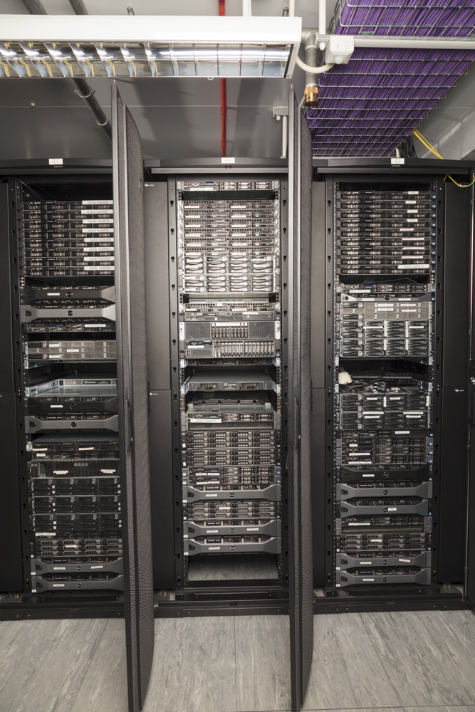
HPC DC
8 x 18kW racks
Water cooled doors
1MW generator
online UPS

Slide 5
HPC upgrade
New cluster
  Upgrade for mid-scale MPI
    Cosmology, CFD, Computational Chemistry, fMRI, EM
  Update fabric with Omni-Path for new nodes
  Replace 6 year old nodes
  LNET router to Infiniband for Lustre
  Bright Cluster Manager, Univa Grid Engine
  Hadoop on Lustre, Spark
  HPC nodes Centos 7.3, Grid nodes SL6.8
  Connectivity to JANET 20Gb; to cluster multiple 10Gb

Slide 6
HPC refreshed environment
  New cluster Centos 7.3
  Omni-Path interconnect
  62 x E5-2640 v3
  1 x E5-2690 v4
  physical cores 1020
From old cluster
  32 x 64 core AMD
  32 x 16 core 2.6GHz (Sandy Bridge onwards)
  4 GPU nodes
  3 x 20 core E5-2630 v4 2.2GHz
  physical cores 2620
  600TB Lustre
Total cores 3640
Dedicated grid cores 472 (4421 HS06) on SL6.8

Slide 7
HPC HSO6 shares
54k HSO6

Slide 8
HPC Architecture

Slide 9
GridPP
Maintain Grid Infrastructure
  Lustre shared file system
  Move SRM (Storm) from VM to new hardware (10Gbe)
  Cream, Apel, Argus, Bdii …
  XRootD
  Webdav
VO: ATLAS production, SNO+
Previous EPP sysadmin (Emyr, Matt) funded by MPS school
Last year, no EPP sysadmin.
Grid kept running by ITS Research Computing (3 FTE)
Now have Leo! + another sysadmin in Astronomy/Theory
More sysadmin resource so better reliability and scope for development (Monitoring, OpenStack, Ceph etc.)

Slide 10
GridPP – backfill
  Opportunistic use of idle CPU time via Singularity https://indico.cern.ch/event/612601/
    Current utilisation ~ 75%
    Perhaps ~750 core, 7000 HS06, extra grid resource
    Pre-emptables jobs best…
  Under used GPU nodes for CMS, LHCb ?

Slide 11
2018-2019 onwards
Maths and Physics storage renewal
  Replace 400TB obsolete Lustre storage
    Move to Omni-Path
    New MDS/MDT
    460TB (at least) new OST
    Probably using ZFS
Maths and Physics compute renewal
  Replace AMD 64 core nodes (9k HS06)

