Slide 1
LIU Wire Scanner Series Costs
Ray, Federico, Dmitry, William, Jonathan, Jose

Slide 2
Contents
Basis of costing
Cost of series electronics, acquisition and control
Cost of series mechanics
Other series costs
Cost analysis
  Total series costs
  Existing EVM costs
Analysis and options

Slide 3
Basis of costing
Assume standard CERN costing, i.e.
  No overhead for staff or existing infrastructure,
  No charge for other CERN services such as vacuum qualification and installation
Include all billed costs
  Cabling, design office, cleaning and leak detection,
Costing includes
  Additional FSU dedicated to the assembly, test, installation of the series
  Cost for the preparation of a dedicated assembly area (as requested to LIU)
Costing does not currently include
  Fellows, students funded by LIU

Slide 4
Electronics, acquisition and control
Slides from Federico, Jonathan, Jose

Slide 5
BWS series for LIU. Cost estimate
Project Start | Project Finish | Cost (18 tanks+18 instruments, no spares) | Cost (21 tanks + 22 instruments)
Mon 14/11/16 | Mon 02/07/18 | CHF 1,301,723 | CHF 1,430,328
Task | Cost (21 tanks + 22 instruments) | Cost (18 tanks+18 instruments, no spares)
Design of BWS for PS, SPS, PSB | CHF 18,360.00 | CHF 18,360.00
Critical raw material purchase | CHF 95,000.00 | CHF 95,000.00
Production Group 1 - Vacuum tanks* | CHF 305,760.00 | CHF 263,760.00
Production Group 2 - Stepped chamber + shaft** | CHF 226,724.00 | CHF 188,724.00
Production Group 3 - Conventional machining | CHF 93,640.00 | CHF 77,640.00
Production Group 4 - Acquisition Mechanics | CHF 51,800.00 | CHF 51,800.00
Special Components | CHF 73,272.00 | CHF 65,272.00
Commercial components purchase | CHF 326,350.00 | CHF 305,600.00
Supporting systems + fixation | CHF 89,080.00 | CHF 89,080.00
Auxiliary vacuum pipes | CHF 106,632.00 | CHF 106,632.00
Assembly of instruments | CHF 20,400.00 | CHF 19,125.00
Vacuum qualification | CHF 10,560.00 | CHF 9,000.00
Calibration | CHF 5,100.00 | CHF 4,590.00
Installation | CHF 7,650.00 | CHF 7,140.00
*1 x Vacuum tank = 14000 CHF
**1 x Stepped chamber + shaft = 9500 CHF
Courtesy: Dmitry Gudkov

Slide 6
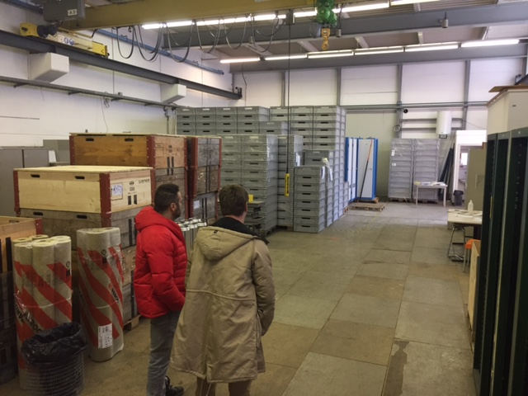
Other costs
Dedicated assembly area:
  Could be in B.283, currently occupied by BL section, but there is room to share
  Would need significant renovation – perhaps the installation of a closed semi-clean area.
  First cost estimate at 50-100 kCHF
  Would need to be operational by end 2017
Prototype PS scanners
  Requested by the project for installation in YETS 17-18
  Mechanical materials ordered, production scheduled for 2 instruments + 2 tanks
  Estimate cost ~150 kCHF

Slide 7
Total series costs
‘Baseline’ series estimate is the sum of the estimates from mechanics and electronics plus assembly area
Unit costs:
  ~72 kCHF for the mechanics
  ~61 kCHF for the electronics (control, acquisition, cabling)
  ~133 kCHF for an installed, working instrument
Includes the spares agreed with the project
Should be a ‘reasonable upper bound’, but excluding any margin for unforeseen technical or other issues
 | Baseline estimate (kCHF)
Series electronics | 1379
Series mechanics | 1430
Assembly area | 100
Total series | 2909

Slide 8
Existing situation in APT
Includes
  Costs of development and design,
  Prototypes in the SPS, PSB,
SPS budget situation (*) is not clear
  Budget code is mixed with the LIU BGI
Budgeted series production costs are:
  ~50 kCHF for mechanics (cf. 72 estimate)
  ~15 kCHF for electronics (cf. 61 estimate)
‘Paid’ numbers do not include costs for the PS prototypes
 | Budget (kCHF) | Paid (kCHF)
PSB (64023) | 970 | 403
PS (64033) | 500 | 49
SPS (64040)* | 532 | 666
Totals | 2002 | 1118

Slide 9
Budget scenarios
‘Baseline’ scenario
Baseline cost with all spares and FSU manpower
Includes costs already paid in APT for BWS (and BGI)
‘Series only’ scenario
Baseline cost with no spares (-129 kCHF for mechanics, -158 kCHF for electronics) or FSU (-150 kCHF)
No budget or costs for design and prototyping (‘clean slate’ for the series production
 | Budget (kCHF) | Cost (kCHF)
Baseline cost |  | 2909
Design + proto |  | 1118
PS protos |  | 250
Baseline budget | 2002
Totals | 2002 | 4277
Balance |  | -2275
 | Budget (kCHF) | Cost (kCHF)
Baseline cost |  | 2472
Design + proto |  | 0
PS protos |  | 250
Baseline budget | 1514
Totals | 1514 | 2722
Balance |  | -1208

Slide 10
Issues with APT
The cost of design and development was underestimated
  488 kCHF budget in APT, ~1370 expected cost
  Only 220 kCHF was budgeted for a PSB prototype, whereas they have been installed in all 3 machine
The series costs estimates are higher than expected, particularly the electronics
  44% increase for mechanics, but 400% for electronics

