Slide 2
LIU FWS Electronics Budget
J.Emery, F.Roncarolo – 10-Jan-2017

Slide 3
Intro
Best budget estimation so far, based on
Prototypes (SPS, PSB, PS) cabling costs scaled to new locations
VME, VFC, GEFE ‘standard’ expected cost
Power electronics as for prototypes
‘Standard’ electronics design office charges
Need for test systems and spares

Slide 4
Cables
Position | Scanner name | estimated length |  | estimated price based on length | Copper TID | Optical TID | line total | Machine total
PSB
4x | 4L1 | 65 |  | - | 58200 | 9773 | 67973
4x | 11L1 | ? |  | - | 0 | 10000 | 10000 | 77973
PS |  |  |  | Estimation based on PS54
PS54 | 54 | 150 |  | - | 19100 | 13639 | 32739
PS64 | 64 | 250 |  | 54565 |  |  | 54565
PS65 | 65 | 250 |  | 54565 |  |  | 54565
PS68 | 68 | 230 |  | 50199.8 |  |  | 50199.8
PS85 | 85 | 220 |  | 48017.2 |  |  | 48017.2 | 240086
SPS |  |  |  | Estimation based on SPS517 / 1.5 (less cables)
51740 | 517 | 88 |  | - | 22420 | 13000 | 35420
41677 | 416H | 190 |  | 50983.3 |  |  | 50983.33
41677 | 416V | 190 |  | 50983.3 |  |  | 50983.33
51995 | 519H | 215 |  | 57691.6 |  |  | 57691.67
51995 | 519H | 215 |  | 57691.6 |  |  | 57691.67 | 252770
867 | Calibration and test bench |  |  | Estimation (half the cables of PS installation)
 |  |  | 220 | 9550 |  |  | 9550 | 9550
 |  |  |  |  |  | Total injectors | 580379
4 scanners in 11L1 included?
Estimated cost based on prototype and scaling on cable length
Is this correct? i.e.: cost is dominated by copper or manpower
Estimated cost based on prototype and scaling on cable length / 1.5

Slide 5
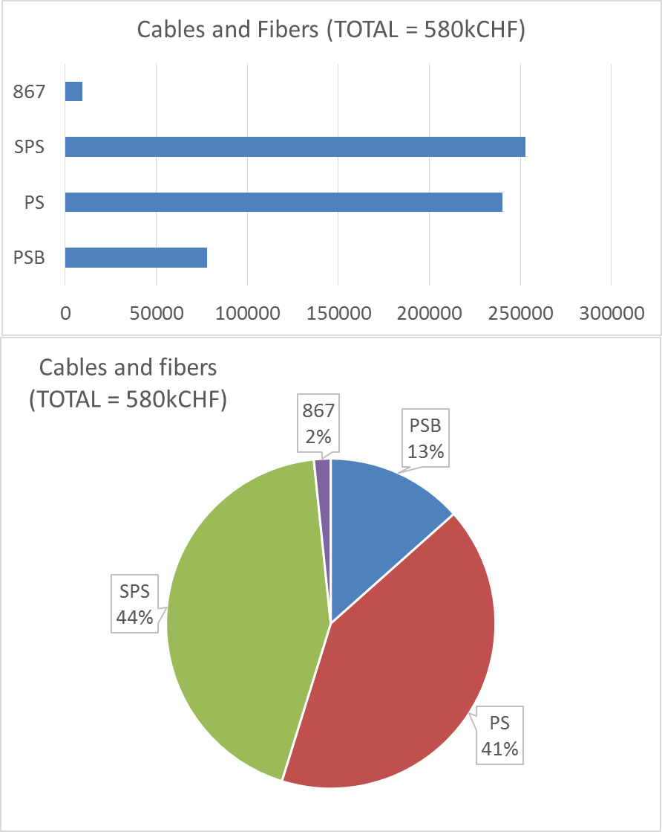
Cables
Prototypes cables:
  5 for motors ctrl and wire signal + 15 for Acq.
Series cables (per device)
  3 for motors ctrl and wire signal + 6 for Acq.
  Can reduce Acq. Signals to 1 HV cable per PMT (1 to 4 PMT foreseen per device)
    It means GEFE everywhere

Slide 6
Electronics
VME crate (4 scanners) | cost | quantity | line total
ELMA crate | 3000 | 1 | 3000
CPU MAN + CTR | 2500 | 1 | 2500
 |  |  | 5500
OASIS systems (1 scanner) | cost | quantity | line total
Fast ADC channel | 2000 | 2 | 4000
 |  |  | 4000
Control electronics (1 scanner) | cost | quantity | line total
VFC-HD | 1500 | 2 | 3000
BWS mezzanine | 1800 | 1 | 1800
BWS Inverter | 1000 | 1 | 1000
BWS DC bus charger | 250 | 1 | 250
Capacitor | 200 | 2 | 400
Sinus filter | 305 | 1 | 305
connectors | 500 | 1 | 500
cables, relay, fan | 200 | 1 | 200
Power supplies | 200 | 1 | 200
crate (surface & tunnel) | 300 | 2 | 600
Front panels | 100 | 2 | 200
Cabling and assembly (h) | 50 | 30 | 1500
Test and validation | 50 | 8 | 400
 |  |  | 10355
Acquisition electronics (1 scanner) | cost | quantity | line total
VFC-HD | 1500 | 1 | 1500
Fast ADC mezzanine (4 CH) | 2000 | 1 | 2000
Custom analog front-end | 1000 | 1 | 1000
GEFE card (if tunnel digitalisation is done) | 1500 | 1 | 1500
4 Channels HV VME card | 1700 | 1 | 1700
photomultipliers | 600 | 4 | 2400
Mechanical assembly | 500 | 1 | 500
 |  |  | 10600

Slide 7
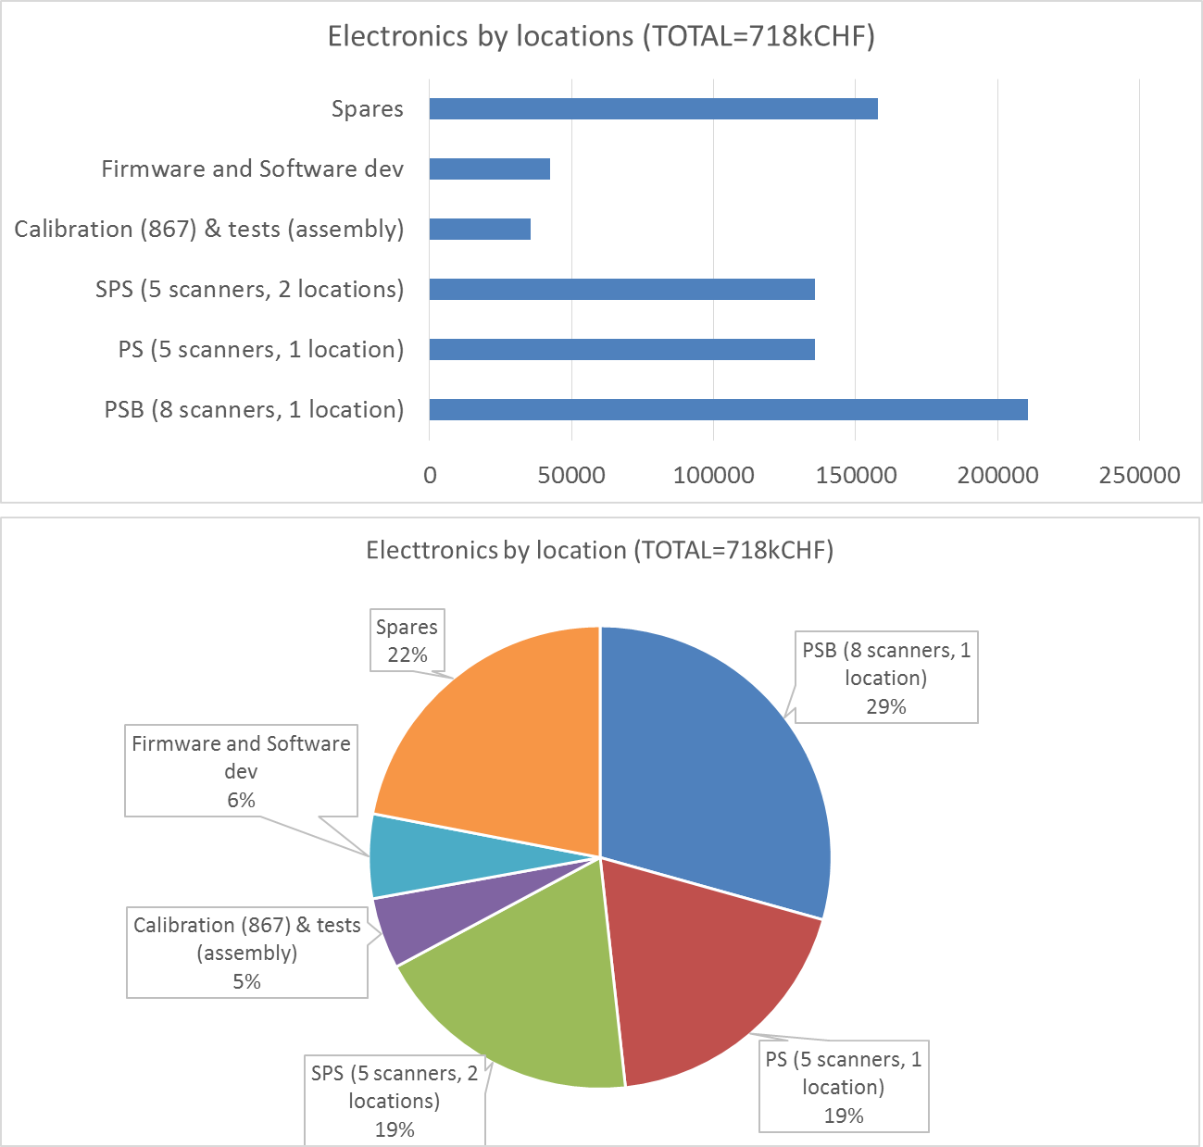
Electronics by ‘Locations’

Slide 8
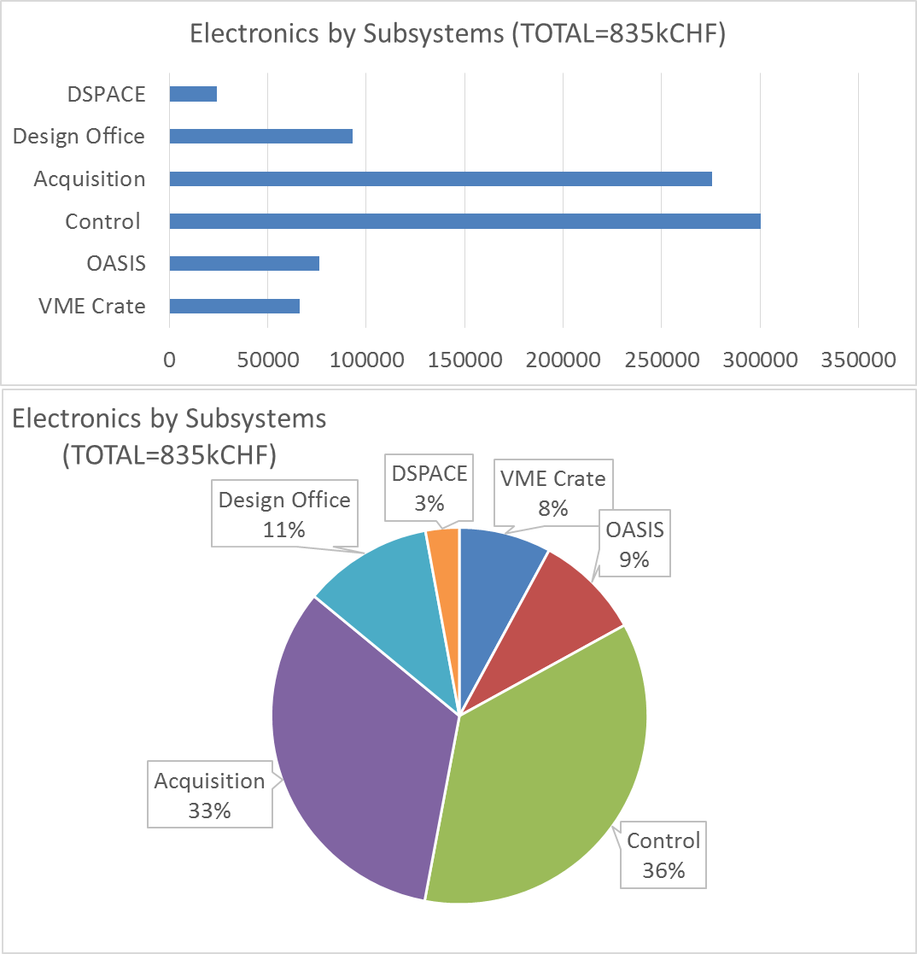
Electronics by ‘Sub-systems’

Slide 9
Acquisition system
Two options
  Digitize in the tunnel (GEFE)
    transport to the VME with optical fibers
    Still need PMT HV cables
    Can GEFE be powered in the tunnel? If not, need multi-wire cable
  Digitize in the VME
    Need more than 1 copper cable to the surface, per PMT

Slide 10
Design Office and DSPACE
Design office costs and tools | cost per iteration | quantity | line total
BWS mezzanine | 10000 | 2 | 20000
BWS Inverter | 10000 | 2 | 20000
BWS DC bus charger | 4000 | 2 | 8000
Tester mezzanine | 5000 | 2 | 10000
Tester inverter and charger | 5000 | 2 | 10000
BWS Assembly Intelligent drive | 5000 | 1 | 5000
BWS acquisition analog front end | 10000 | 2 | 20000
 |  |  | 93000
DSpace control system for serie testing/validations | cost | quantity | line total
Dspace base system | 20000 | 1 | 20000
Computer for the test system | 1200 | 1 | 1200
Resolver control system | 1000 | 1 | 1000
Basic inverter | 2000 | 1 | 2000
 |  |  | 24200

Slide 11
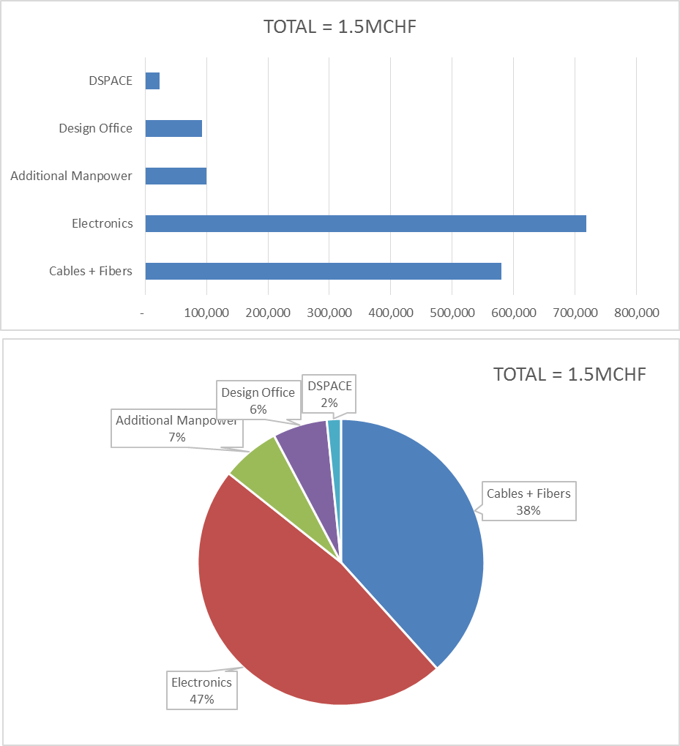
Grand Total (Electronics)
PSB (8 scanners, 1 location) | line total
Cables copper and fiber optics | CHF 77,973.00
Electronics | CHF 210,640.00
PSB (5 scanners, 1 location) | line total
Cables copper and fiber optics | CHF 240,086.00
Electronics | CHF 135,775.00
SPS (5 scanners, 2 locations) | line total
Cables copper and fiber optics | CHF 252,770.00
Electronics | CHF 135,775.00
Design, production and tests costs | line total
Design office costs and tools | CHF 93,000.00
DSpace control system for serie testing/validations | CHF 24,200.00
Spares, development, tests and calibration (7 systems) | line total
Cables copper (867) | CHF 9,550.00
Electronics | CHF 235,705.00
Additional man power | line total
Technician for procurement, prod. and tests (6m) | CHF 50,000.00
Technician for installation and validations (6m) | CHF 50,000.00
Grand total | CHF 1,515,474.00
Already charged (Cables for proto SPS, PS, PSB) | CHF 136,132.00
To be funded | CHF 1,379,342.00

Slide 12
Discussion
Total estimated cost of cables ~=0.5MCHF
  Need to check with EN-EL accuracy of this estimation, copper costs vs manpower, possible savings
  Need to be sure about PSB 11L1 cables are included
GEFE or not GEFE likely with little impact on budget
1 PMT vs 4 PMT per system impact ~= 40-50kCHF saving
Design Office 100k (to be checked?)
OASIS, recent (new) request from OP = 80kCHF?
Spares ~= 150 kCHF
Apart from copper cables and fibers TIDs, how much did we spend already?
…..

