Slide 1
Accelerators and Technology Sector Seminar

Slide 2


Nanostructured materials for particle beams: the example of ISOLDE targets
João Pedro Ramos
http://www.joaopedroramos.com
PhD supervisors: Prof. Paul Bowen, Dr. Thierry Stora
26th of January, 2017
Accelerators and Technology Sector Seminar
PhD Public Defense

Slide 3
Structure
ISOLDE at CERN
Production of isotopes at ISOLDE
Overview target materials
Nanomaterials at ISOLDE
Outlook

Slide 4
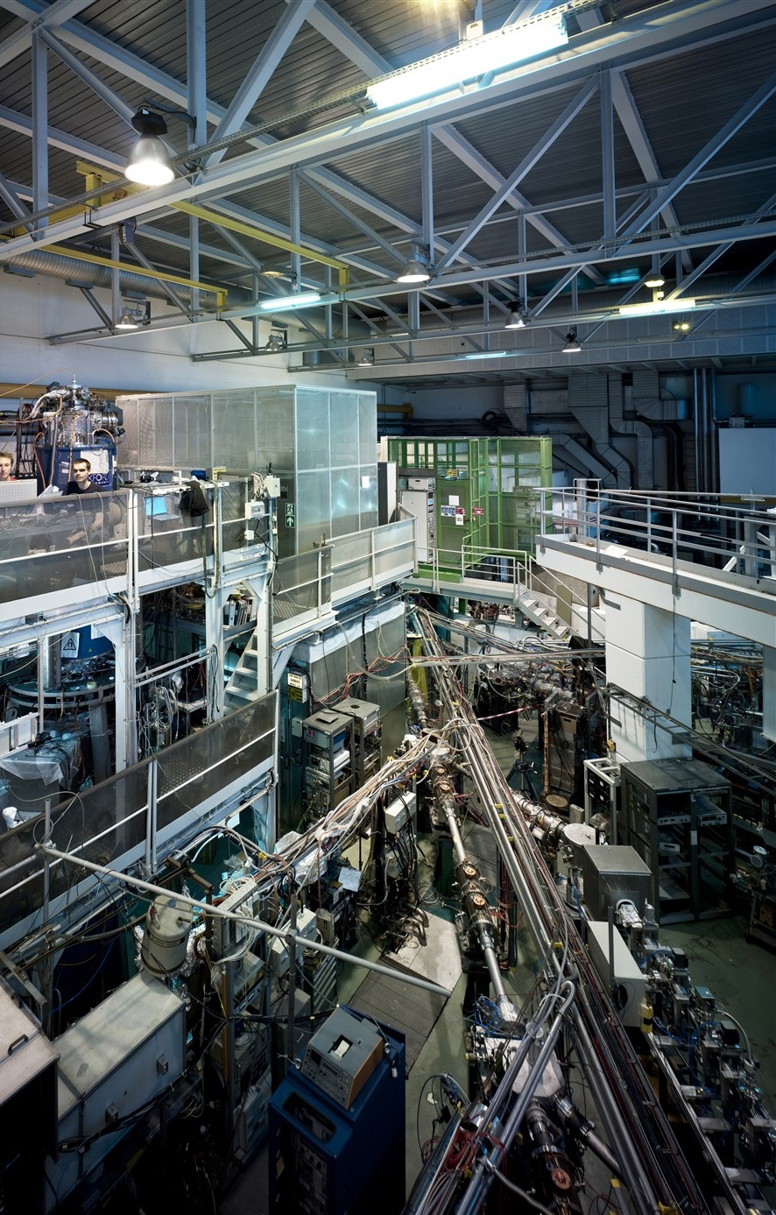

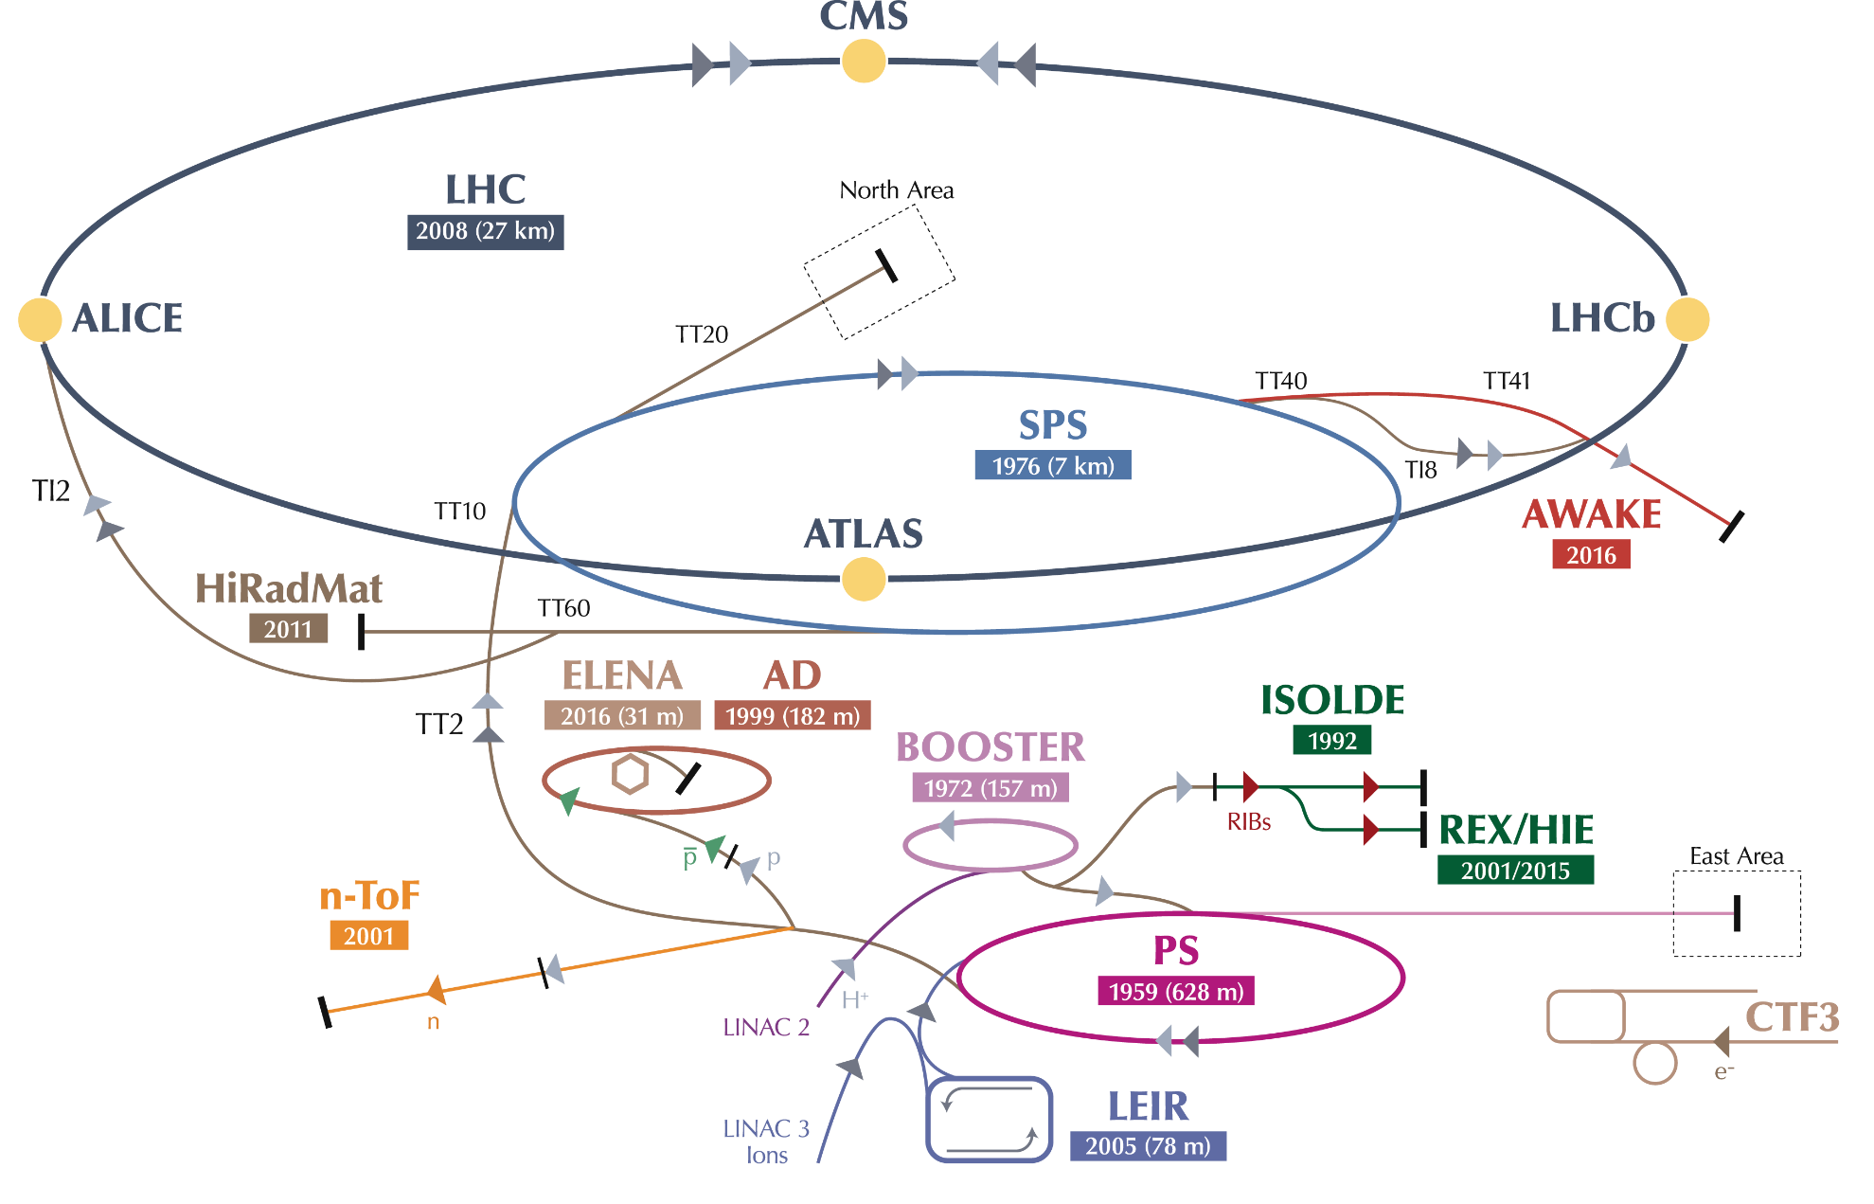
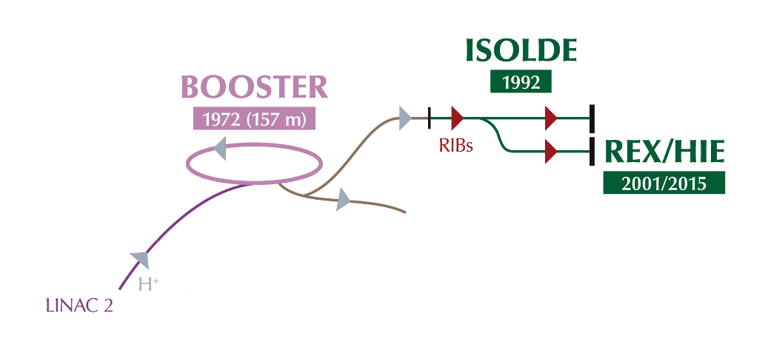
at CERN
Isotope Separator OnLine Device
Produces Radioactive Ion Beams (RIB)
Approved by the CERN council in 1964
  Supplied by the SC with 600 MeV protons
  Then by the PSB in 1992 with 1.0 GeV (later 1.4 GeV)
RIBs are used for studies in:
  Nuclear physics
  Atomic physics
  Solid state physics
  Astrophysics
  Life sciences

Slide 5
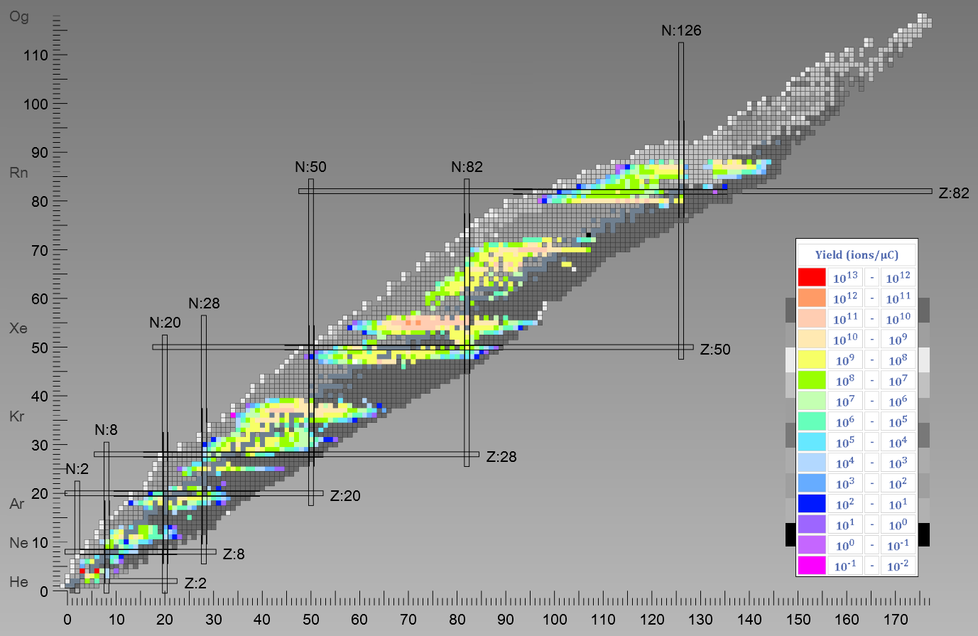
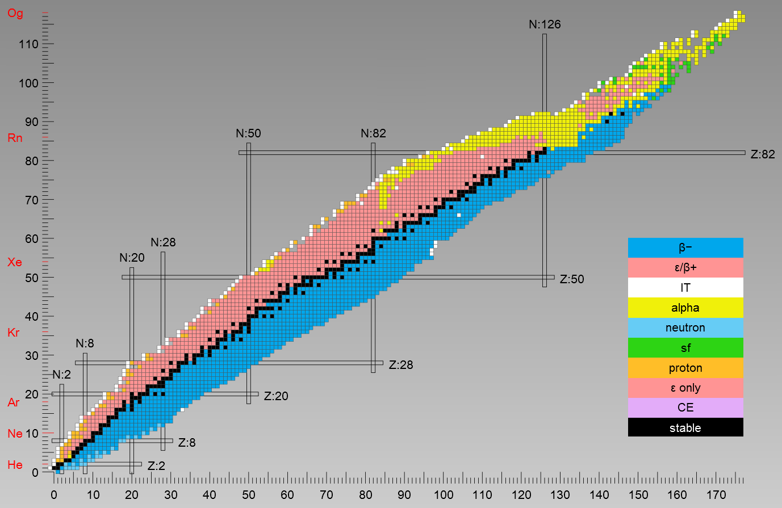
How many isotopes?
Predicted
~6000
Discovered
~3000
ISOLDE
~1000
Elements
74
t_{1/2}
>tens of ms
*nuclide chart from Nucleonica
*J. Ballof, ISOLDE database yields

Slide 6
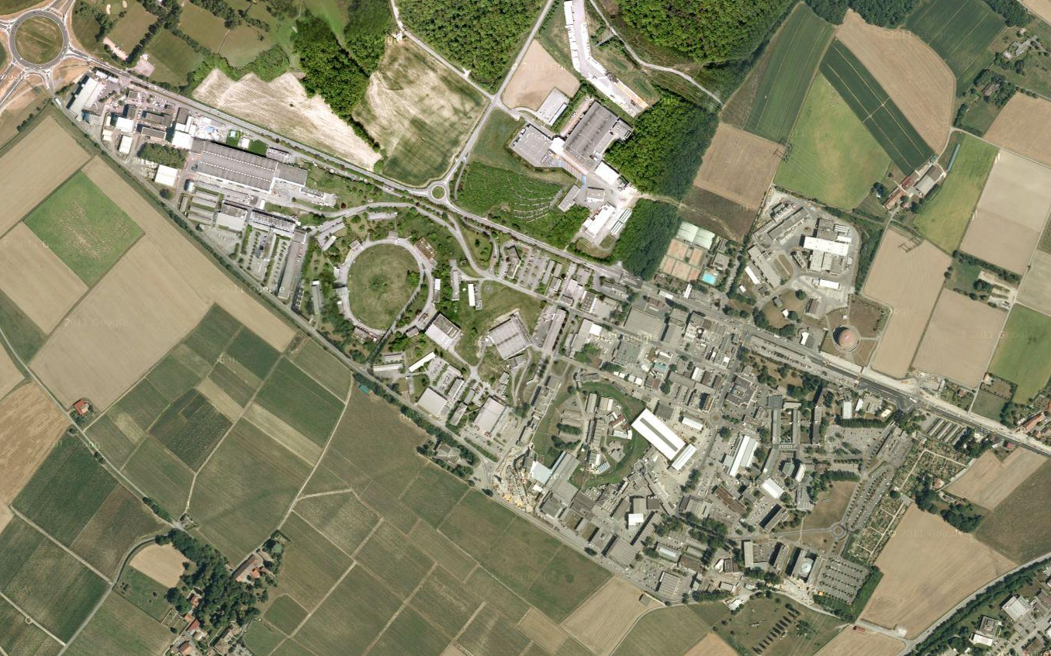



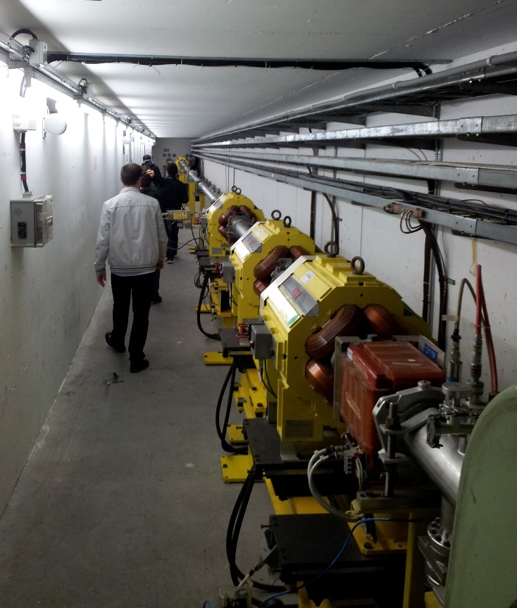
at CERN
Operates ~8 months/year, 24/7
ISOLDE
ISOLDE takes ~50% of CERN protons
PSB
PS
LINAC2
~50 staff – maintain/operate the facility
A few students and fellows
~450 users for physics in more than 90 experiments

Slide 7
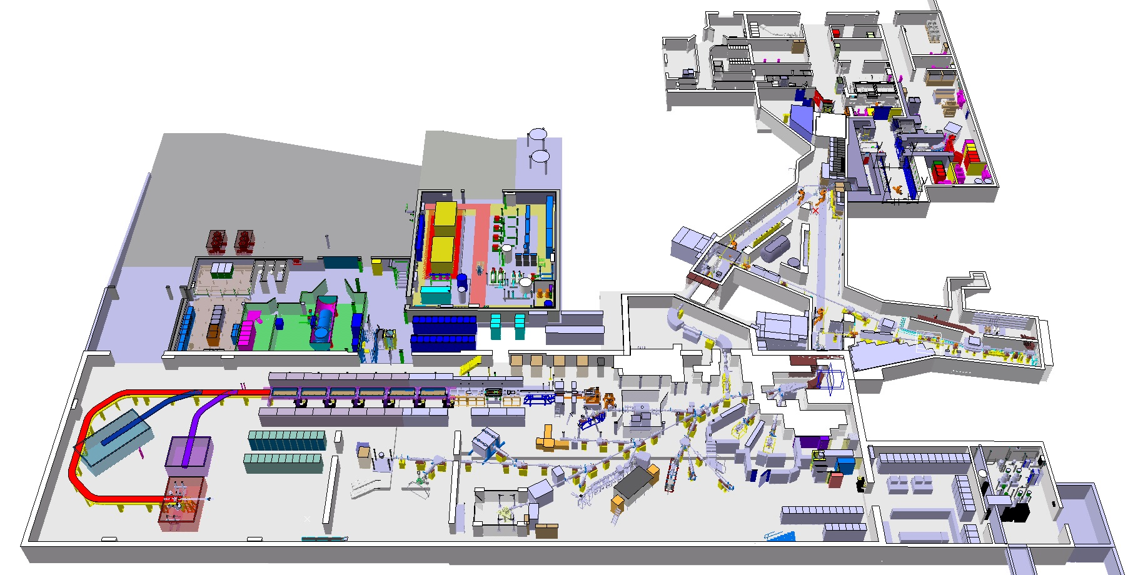






Facility
Protons (1.4 GeV)
Low energy RIBs (up to 60 keV)
Radioactive laboratory
Class A
MEDICIS
High energy RIBs (up to 10 MeV/u – A/q=4.5)
Pulsed protons (1.2 s)
1.4 GeV
3.3x10¹³ protons per pulse
HRS
High Resolution Separator
Route Democrite
High Energy RIB
Target area
Route Einstein
Low energy RIB
GPS
General Purpose Separator
*picture courtesy of M. Delonca

Slide 8
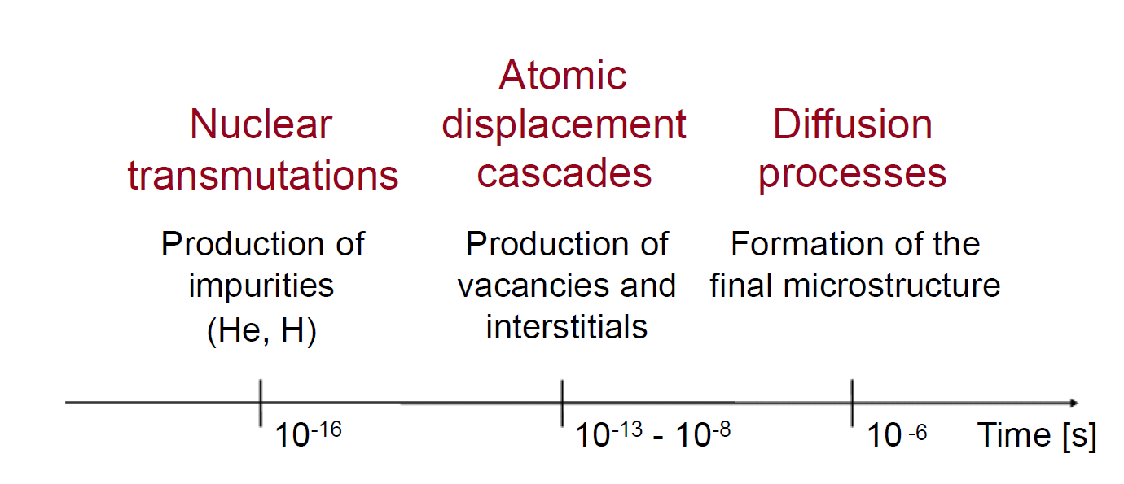
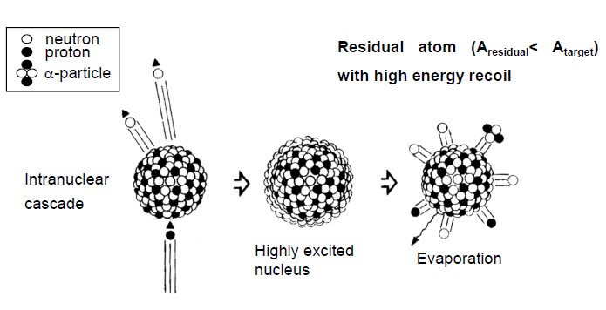
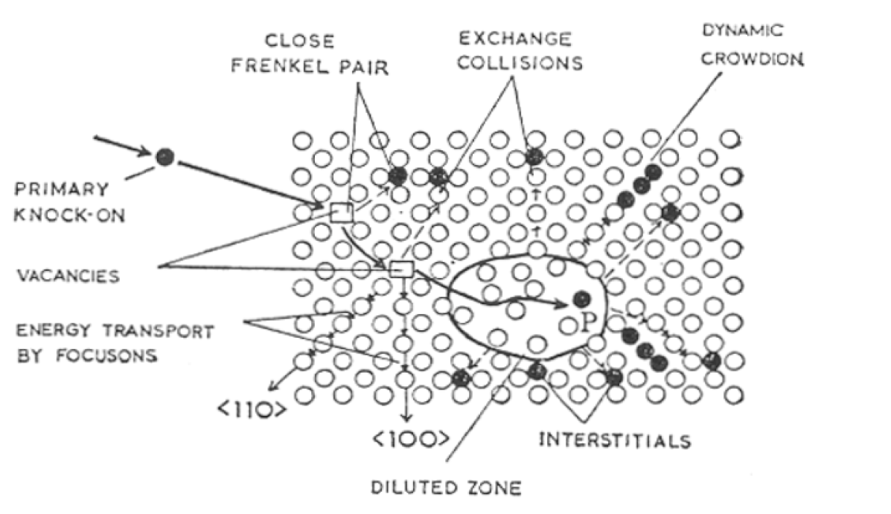
Beam interaction with target
Beam power deposition – pulsed beams!
230 ns
2.3 μs
Thermomechanical stresses and shockwaves
João Pedro Ramos | 26/01/2017
A&T Sector Seminar | Public Defense
Booster pulse pictures from PhD Thesis, R. Wilfinger

Slide 9
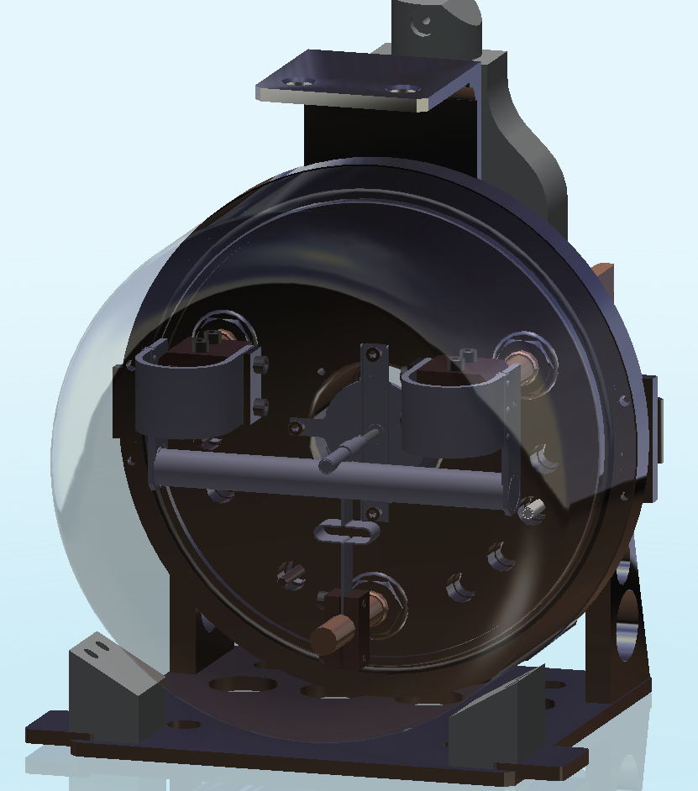
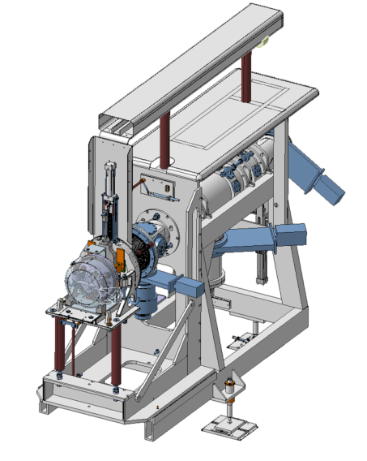
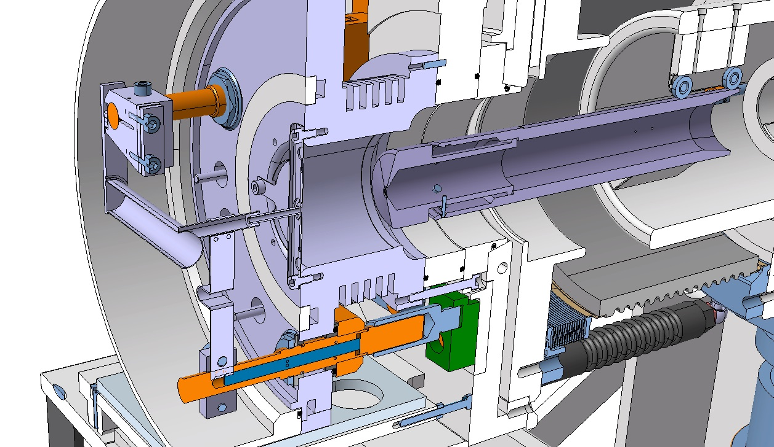
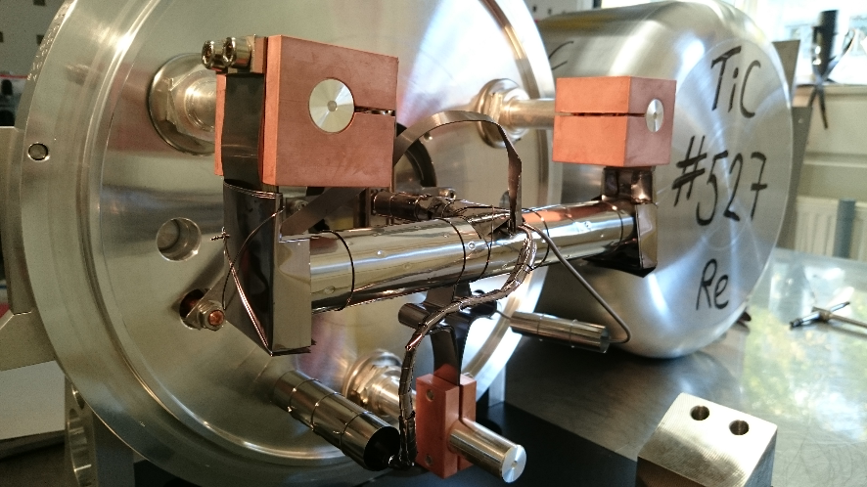
Target Unit – Heart of
Transfer line
20 cm
Target
ISOLDE Frontend
Target station
Ion Source
*pictures courtesy of M. Delonca and J. Montano

Slide 10

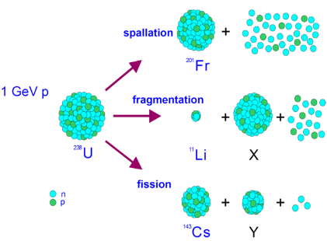
Target Unit – Heart of
Primary beam
Radioisotopes
Beam power
2.8 kW in average
1.2 GW (pulse length 2.3 μs)
  ~10% deposited
Ions
What is the sound of proton impact on target?
Vacuum
spallation
Air
1.4 GeV
proton
²⁰¹Fr
fragmentation
¹¹Li
²³⁸U
fission
X
*picture and animation courtesy of M. Delonca
¹⁴²Cs
Y

Slide 11
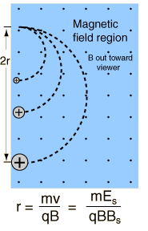
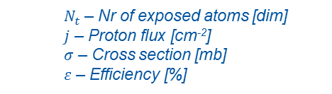


ISOL Isotope Separation
OnLine
Extraction electrode
Extraction optics
Mass separator
Proton
Target unit
Ion Source
Radioisotopes have finite half-lives!
Transfer line
+/- 8V
Pulsed
Protons
500 A
20 cm
up to 2300 °C
+/- 9 V
Target heating (1 – 2kW), <~10% beam power
1000 A
1. Production
4. Ionization
$$Beam Int.=σ.j.Νt.ε$$
2. Diffusion
5. Mass Separation
$$ε={ε_{diff}ε}_{eff}{ε_{is}ε_{sep}ε}_{trans}$$
3. Effusion
6. Transport
$N_{t}$ – Nr of exposed atoms [dim]
$j$ – Proton flux [cm⁻²]
$σ$ – Cross section [mb]
$ε$ – Efficiency [%]

Slide 12
ISOLDE target materials
Material requirements
  High production cross section of the isotope(s) of interest
  Stability at high temperatures
  Chemically stable and inert
  Resistance to radiation damage
  Rapid diffusion and effusion rates of the element(s) of interest
Number of targets in the last 16 years at ISOLDE:
Sn, Pb,...
Molten – 6%
Oxides – 16%
CaO, ZrO₂,…
Operation temperature limitations:
  Sintering (preserve target microstructure)
  Limited reactivity with surrounding materials
  Reduced stable beam contaminants (chemical impurities)
  Moderate equilibrium vapor pressure compatible with ion source (10⁻² Pa)
Metals – 23%
Ta, Ti,…
UC₂-2C, SiC,…
Powders, pellets or liquid form

Slide 13
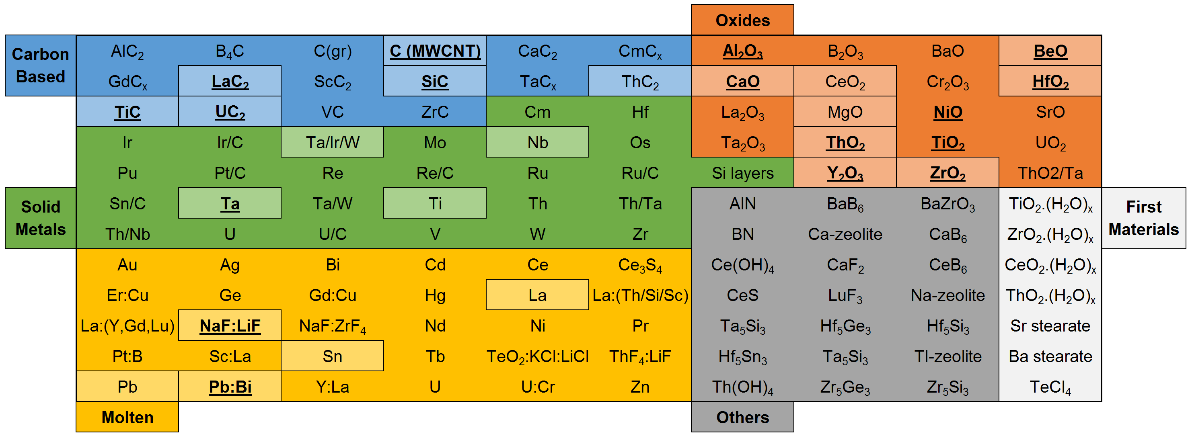
Target Materials
120 Materials (possibly more) were tested and/or used as ISOL targets!
In squares – currently used at ISOLDE
Underlined and Bold – had some kind of material development
J.P. Ramos, PhD Thesis, EPFL/CERN (2017)

Slide 14
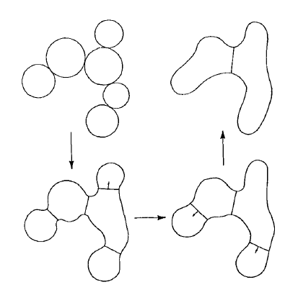
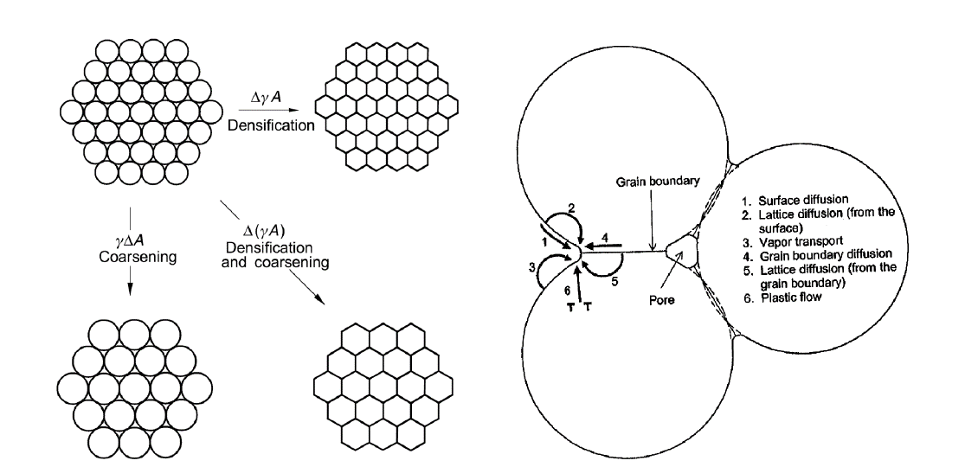
What is sintering?
Temperature - time
The smaller the particle size (larger surface area) the higher the sintering driving force
!
Main reason why nanomaterials were discarded in the past for ISOL target application
Micrometric materials
0.5 to 0.8T_{m}
Sintering temperature (densify):
Defined in function of the material melting point (T_{m})
Nanomaterials
0.2 to 0.4T_{m}
!
Sintering can be affected by irradiation (defect creation)

Slide 15
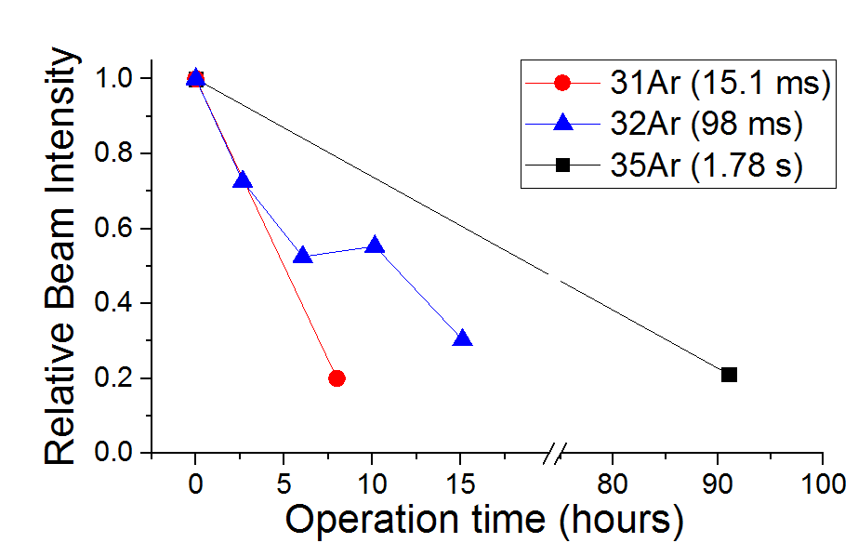
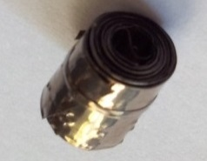
Target material influence on beam intensity?
Very often
However during operation
Arrhenius dependance of effusion and diffusion with temperature
or even low from the beginning
Expected beam intensity
35Ar (1.78 s)
Targets are traditionally operated at very high temperatures (close to the materials melting point)
32Ar (98 ms)
31Ar (15.1 ms)
Target material degradation
Melting/Sublimation
Sintering
Grain size increase
Reduction of porosity

Slide 16




Target material influence on beam intensity?
In most cases ${ε_{diff}ε}_{eff}$limit by far the yields.
Time
Can we stabilize porous nanostructures at high temperatures?
Not found in the literature
Needed R&D
1
4
3
2
Nano materials sinter faster
Reduce operation temperature to stabilize
Diffusion/Effusion
Diffusion limited release:
$$λ ≤2μ$$
$$ε_{diff}=\frac{3}{π}\sqrt{\frac{μ}{λ}} ,μ=\frac{π^{2}D}{r^{2}}$$
r /10
$ε_{diff}$x10
Same T!
1 μm
Operation T
Grain size/Porosity
10x smaller!
Porous nanomaterials campaign started ~10 years ago (ISOLDE is 50 years old)
  Shorter diffusion lengths
  Higher porosity
100 nm
Diffusivity
(rate of diffusion)
t_{1/2} = 1 s
1s – 50%
2s – 25%
3s – 12.5%
4s – 6.25%
Diffusion lengths
Assess microstructure stability

Slide 17
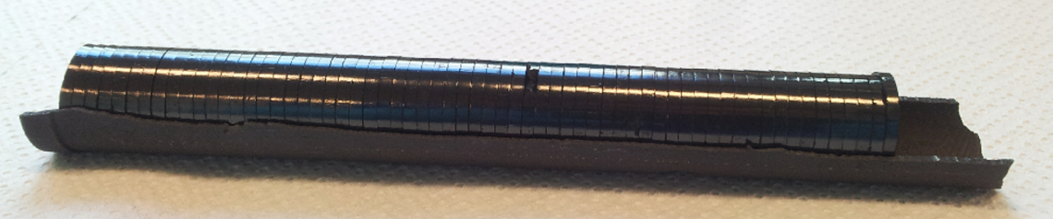
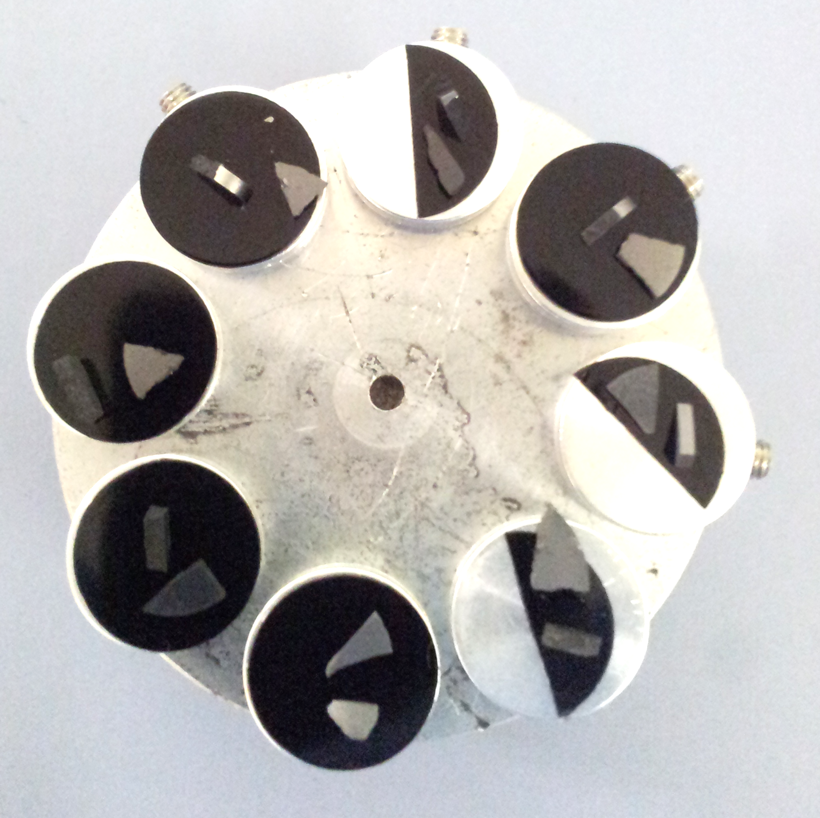
What about the material microstructure?
Electron microscope of the EN-MME-MM group, at CERN
As Feynman said: “There is plenty of room at the bottom”!
200 nm
660 nm
0.67 mm
100 μm
2.0 μm
200 x
20 μm
31 x
100 000 x
10 000 x
30 000 x
1 000 x

Slide 18
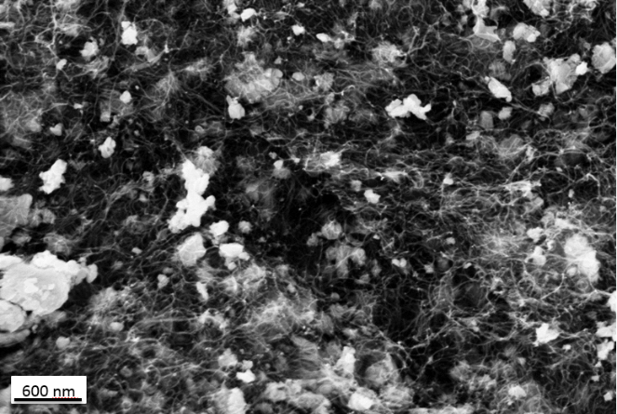
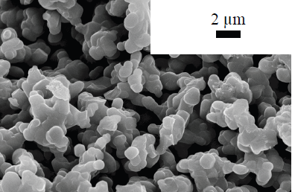
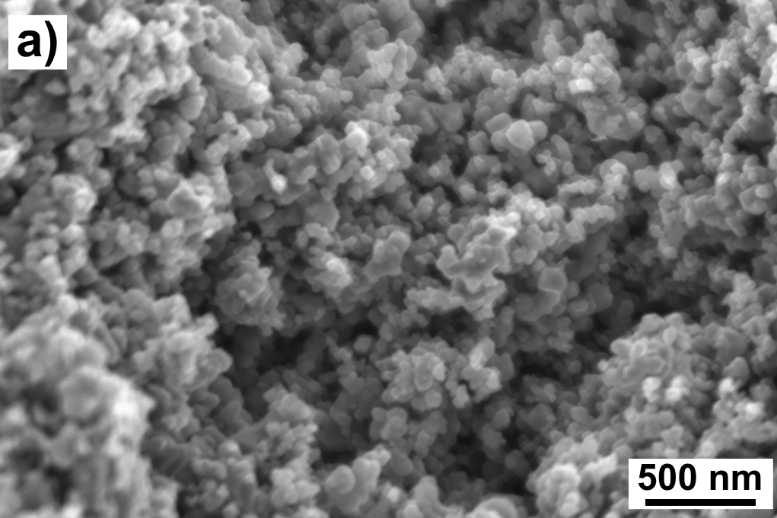
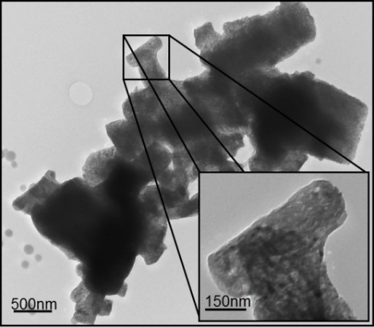
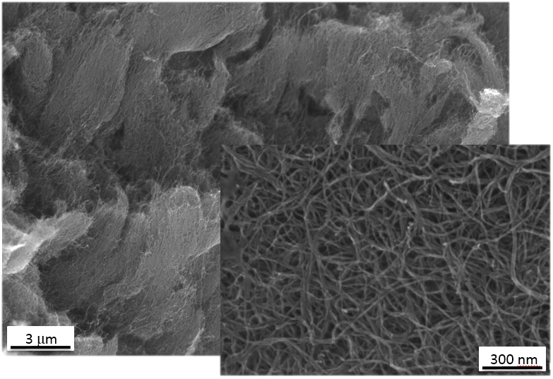
Nanomaterials
Reactive sintering and microstructure stabilization
Acquired and tested
Microstructure stabilization
UC₂ + 2C – A. Gottberg, et al.
SiC - S. Fernandes, et al.
TiC+CB – J.P. Ramos, et al.
2010
Nov - 2014
Nov- 2014
*submicron
*1st nanomaterial at ISOLDE
Nov- 2014
Apr- 2015
2011
Synthesis
CaO – J.P. Ramos, et al.
LaC₂ + 2C – J. Guillot, et al.
MWCNT – C. Seiffert, et al.
Identifying suitable target nucleus
and chemical compound
Engineering desired
microstructure
Stabilizing microstructure at high temperature and high-power irradiation
2-5 years per material
Post-irradiation material analysis
Online tests
Studying diffusion and release properties
A&T Sector Seminar | Public Defense

Slide 19
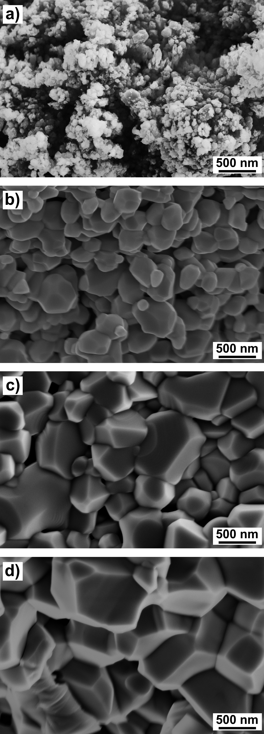
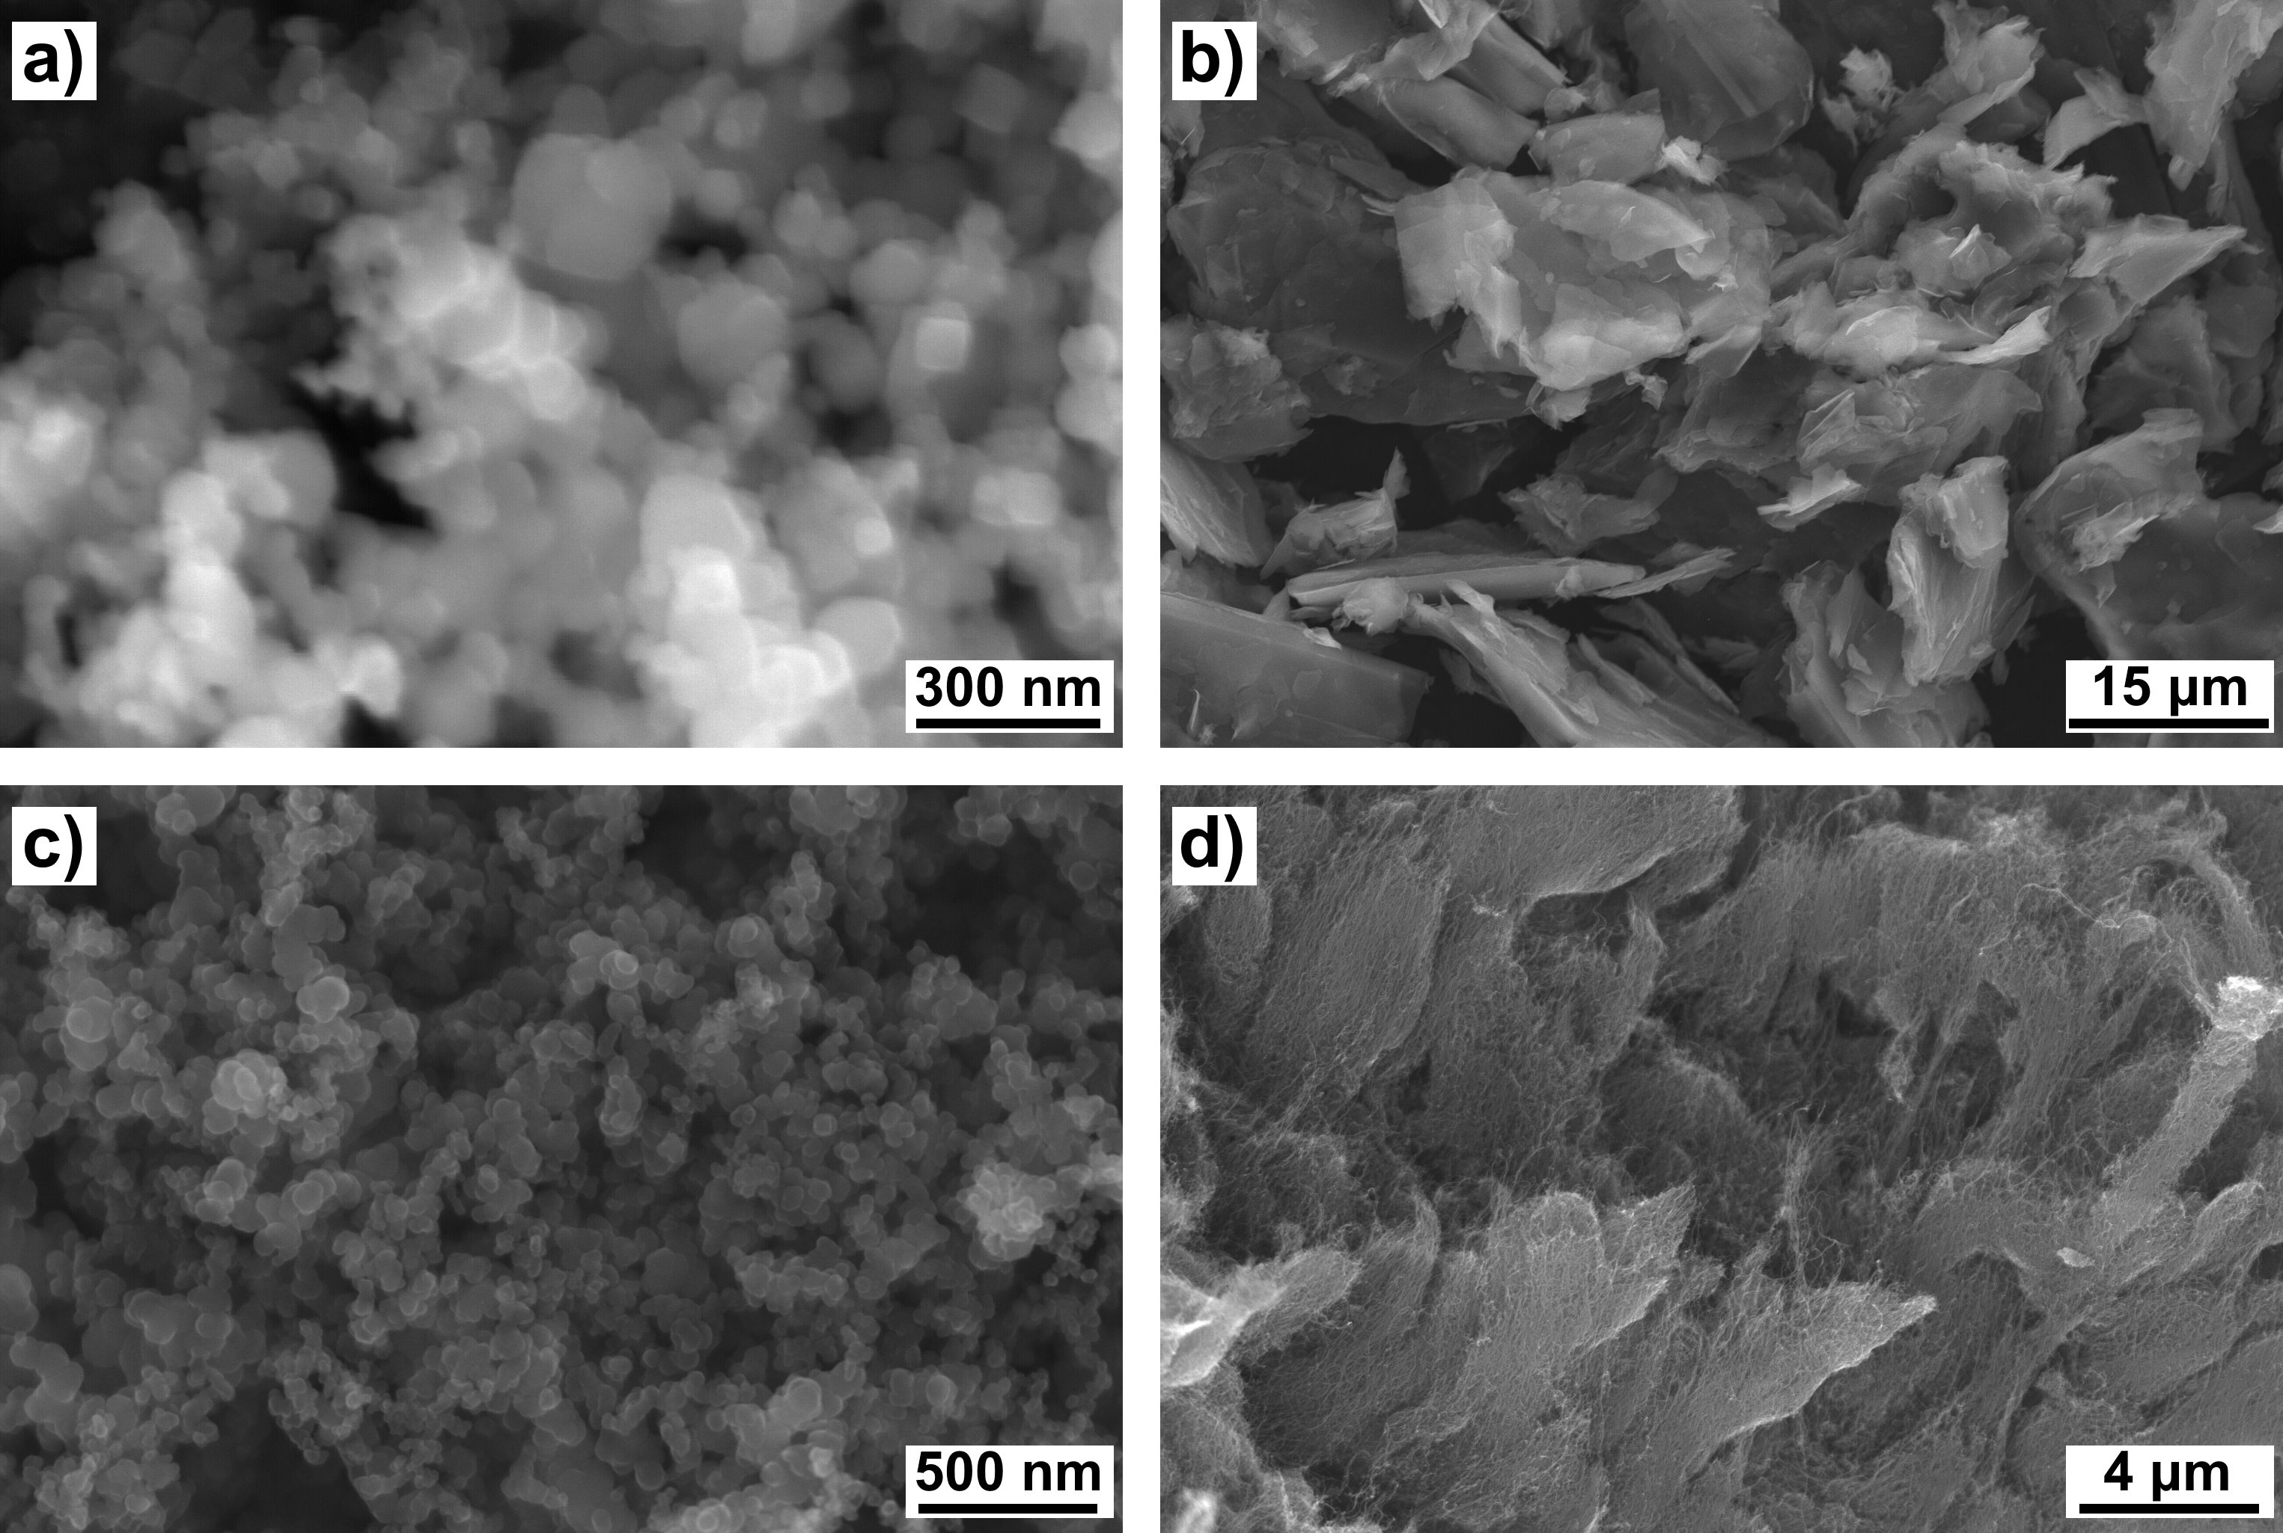
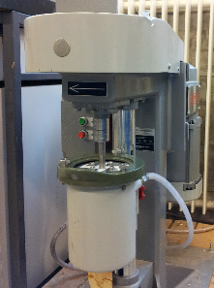
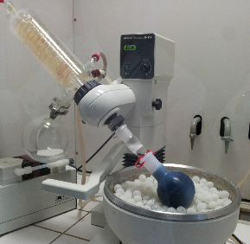
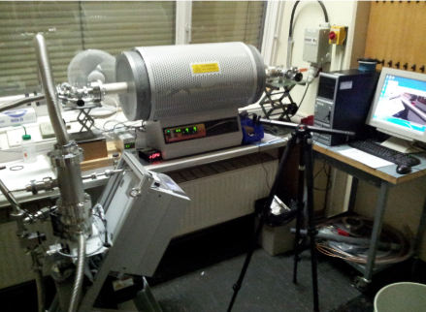
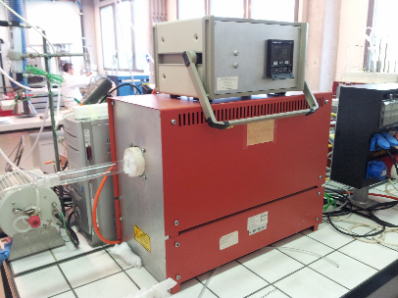
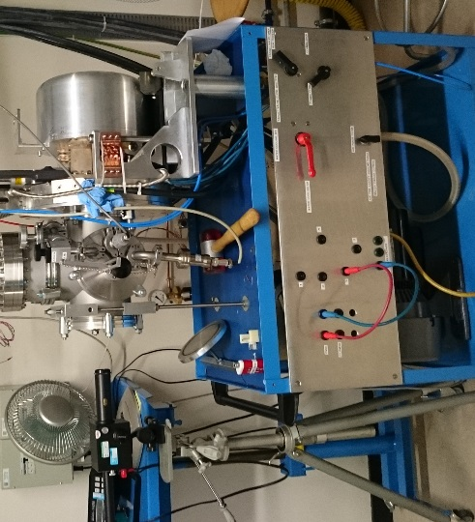
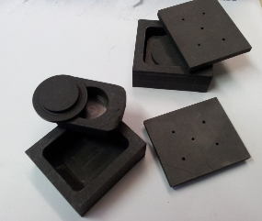
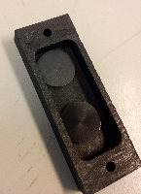

TiC nanocomposite – from A to Z
C
TiC
TiC
+
or
TiC
TiC
or
TiC
C
1800 °C
TiC
TiC
C
TiC
TiC
TiC
TiC
C
TiC
(80 – 120 nm)
Graphite
(~16 µm)
Carbon Black
(~40 nm)
C Nanotubes
(~10 nm x 1.5 μm)
TiC
Co-milling
Deaglomeration and pressing
Polymer (PVP) decomposition
Drying
Thermal treatment
Characterization
J.P. Ramos, PhD Thesis, EPFL/CERN (2017)
Mixture done in isopropanol with 5 wt.% pyrrolidone as dispersant

Slide 20
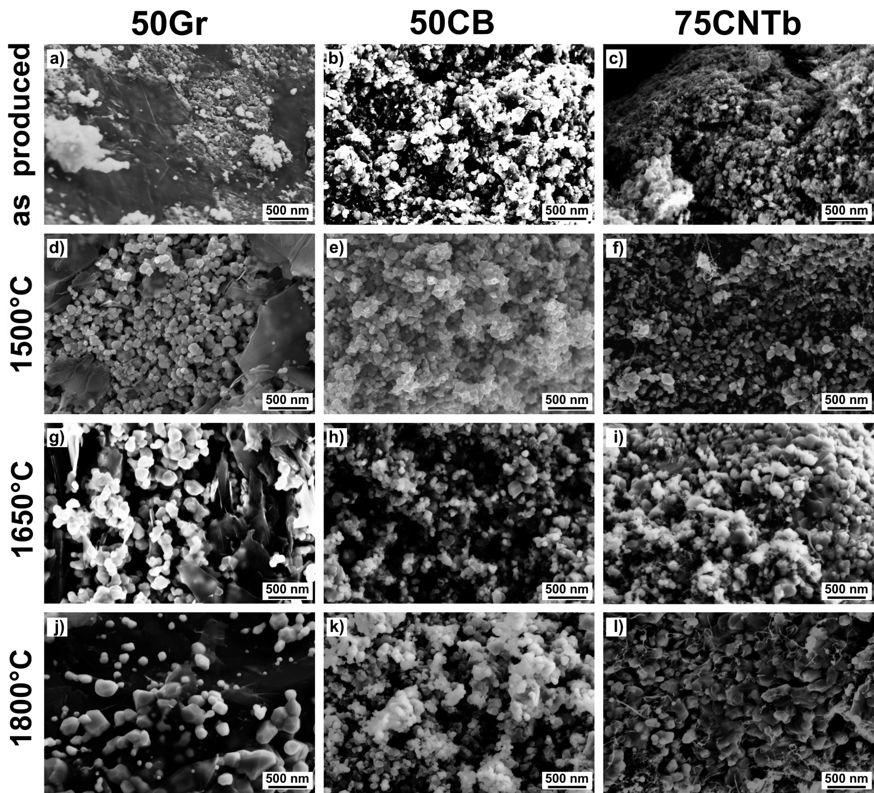
50 vol.% Graphite
50 vol.% C Black
75 vol.% CNT
TiC milled
TiCm
Carbon very successfully hinders the sintering of TiC
32.8 m² g⁻¹
36.6 m² g⁻¹
49.4 m² g⁻¹
29.1 m² g⁻¹
as produced
43 nm
43 nm
46 nm
48 nm
13.0 m² g⁻¹
22.1 m² g⁻¹
23.0 m² g⁻¹
2.3 m² g⁻¹
In most cases nanometric TiC is stable at high temperatures
1500 ºC
59 nm
52 nm
52 nm
107 nm
10.2 m² g⁻¹
19.7 m² g⁻¹
17.4 m² g⁻¹
0.3 m² g⁻¹
TiC crystallite < 100 nm
for isotope release
1650 ºC
64 nm
58 nm
47 nm
122 nm
7.7 m² g⁻¹
16.7 m² g⁻¹
12.0 m² g⁻¹
0.1 m² g⁻¹
1800 ºC
João Pedro Ramos | 26/01/2017
A&T Sector Seminar | Public Defense
134 nm
76 nm
138 nm
277 nm

Slide 21
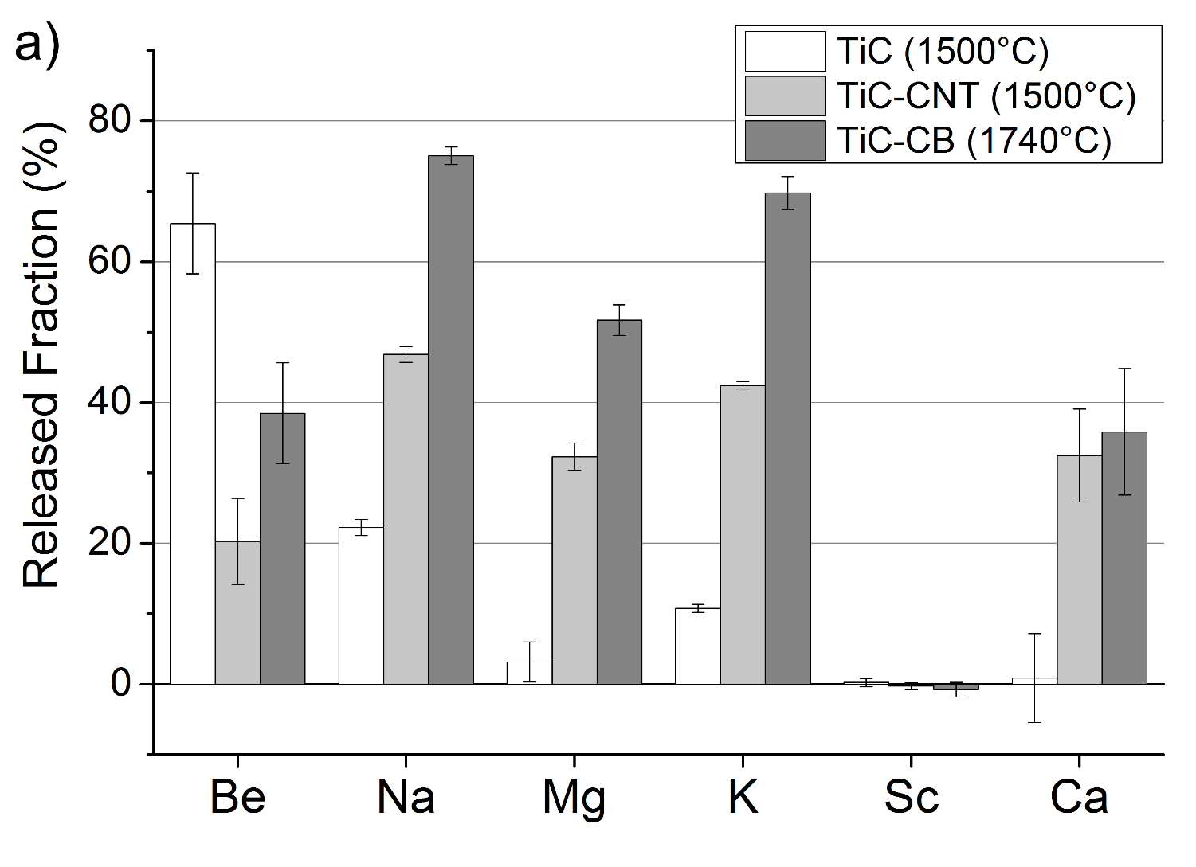
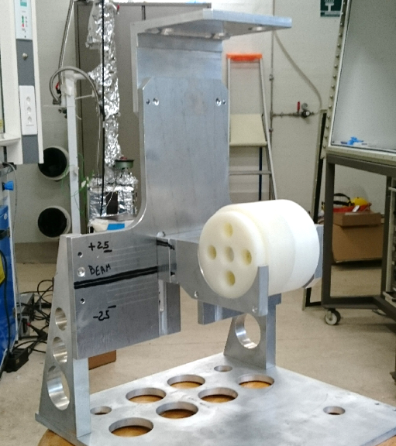

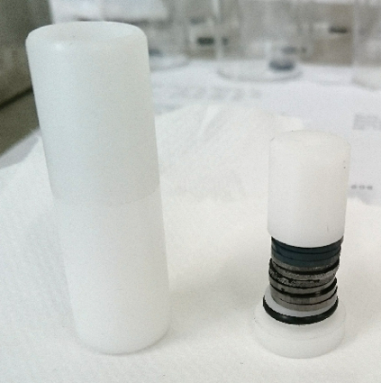
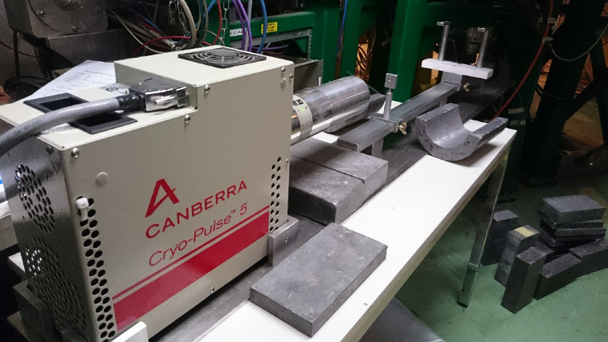

TiC – release testing
Protons
Be: probable reaction with C
Na, Mg and K: well released
Sc: not released, carbide formation
João Pedro Ramos | 26/01/2017
A&T Sector Seminar | Public Defense

Slide 22
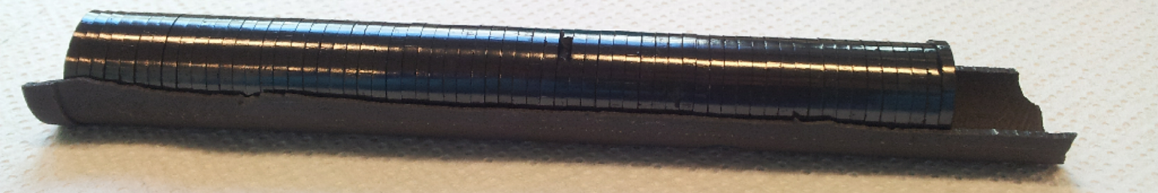

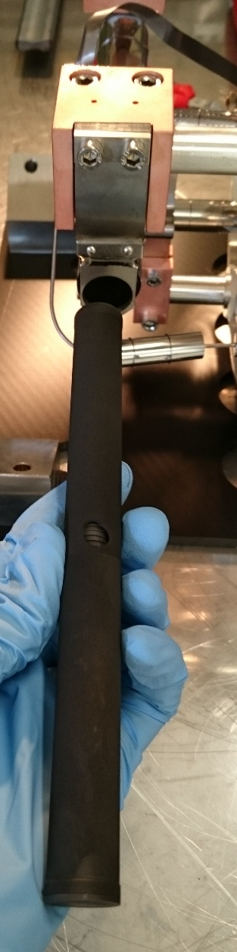
Prototype
Material scaled up to make a full target
500nm
João Pedro Ramos | 26/01/2017
A&T Sector Seminar | Public Defense
J.P. Ramos, PhD Thesis, EPFL/CERN (2017)

Slide 23
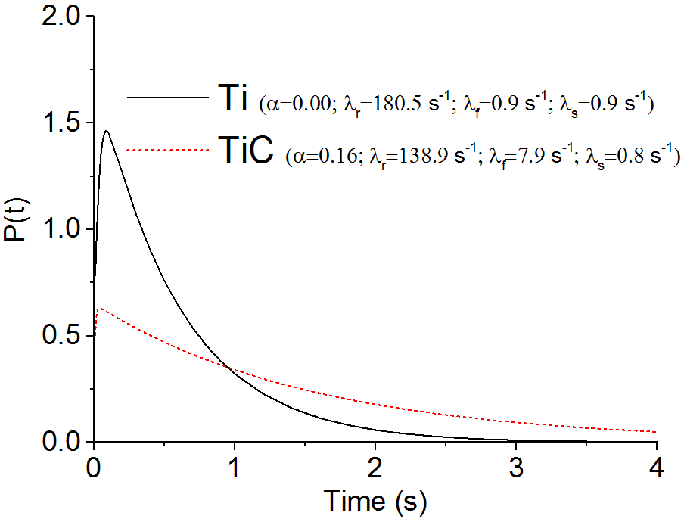
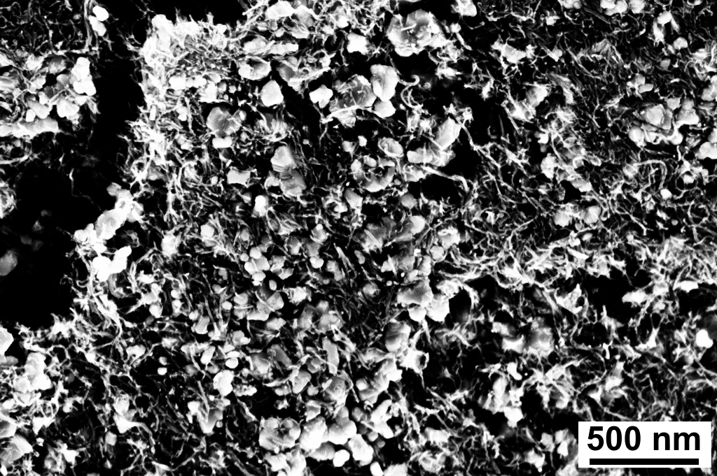
Prototype – Online results
Proton
Target tested online at ISOLDE at 4 different temperatures, from 1300 to 2000 °C
Pulsed
Protons
Na (1.07 s)
Beams extracted:
Li (high)
Na (very high)
K (similar)
Ca (much lower)
Very stable beam intensities over time.
(unlike current Ti-based targets)
Ti metal foils
TiC nanocomposite
Probable chemical reaction with carbon black
New
Proton impact
João Pedro Ramos | 26/01/2017
A&T Sector Seminar | Public Defense

Slide 24

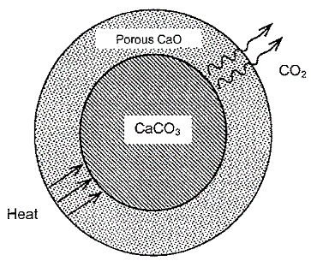

Calcium Oxide
CaO
CaCO₃
800ºC – 2 h
Vacuum (base P=10⁻³ mbar)
650 nm
Grain size ~1 μm
Grain size ~40 nm
35Ar
Operation temperature reduced to keep nanostructure!
$$CaCO_{3} →CaO+CO_{2}$$
Pseudomorphous reaction
J.P. Ramos, et. al., Ceramics International 41 (6) (2015), 8093-8099.
J.P. Ramos, et al., NIMB 320 (2014), 83-88
J.P. Ramos, Master Thesis, Univ. Aveiro/CERN (2012)

Slide 25
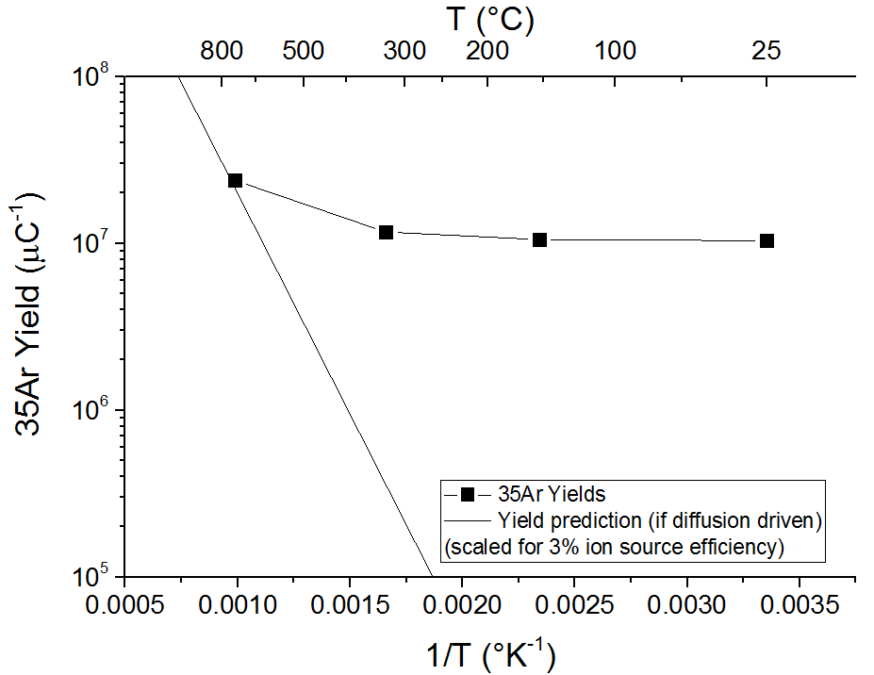
CaO – Beams from a cold target
35Ar beam intensity (/μC)
Recoil energy of 35Ar
9.23±1.77 keV
FLUKA
CaO particles are around 40 nm
10 nm 35Ar⁺ average range in CaO
Release doesn’t follow the classic diffusion-effusion
New release mechanism
thanks to the nanomaterial
*only possible with volatile elements
J.P. Ramos, et al., NIMB 376 (2016), 81-85.

Slide 26






Carbon Nanotubes – Boron Beams
Melting point 2070 °C
Reacts with other elements to form refractory compounds
Boron reacts promptly with fluorine forming a volatile molecule BF_{x}
Source of F - Injection of SF₆ in the target container
4352.1 m²
> 60% Football field
14.85 g of MWCNT
Specific Surface Area
293.1 m²/g
Area 7140 m² (68 x 105 m) – FIFA recommendation
C. Seiffert, et al., to be published.
C. Seiffert, PhD Thesis, CERN-THESIS-2014-332.

Slide 27




Uranium based materials
  Uranium carbide targets are the most used at ISOLDE (>60% of beam time).
nanoUCx
Standard
Grow graphene in metal surfaces
Ultimate goal – grow it on U foils (oxidation protection and avoid adsorption of other atoms/molecules)
Uranium Oxide (micron sized)
Uranium Oxide (micron sized)
milled
+Graphite
  Uranium Oxide (120 nm)
+CNT
PhD of M. Nazarova
up to 1800ºC
up to 1800ºC
𝑈𝑂₂+6𝐶→𝑈𝐶₂+2𝐶+2𝐶𝑂
𝑈𝑂₂+6𝐶→𝑈𝐶₂+2𝐶+2𝐶𝑂
and with K. Novoselov
500nm
  Very porous structure (75%)
  Much less prone to sinter than conventional UC₂ targets (micrometric UC₂ + Graphite)
  Release rates on many isotopes improved.
Graphene on Ta
*similar (not nanoUCx)
João Pedro Ramos | 26/01/2017
A&T Sector Seminar | Public Defense

Slide 28

Outlook
Target materials investigation brings high output for physics
More beam! More isotopes! Less waste!
Good stability of nanomaterials is probably related with their ability to self heal the irradiation induced defects
Application in other beam intercepting devices
ISOL nanomaterials are a niche research topic:
Can be applied to other ISOL facilities
Similarities to fusion reactor blanket technology
Nuclear reactors - release know-how
João Pedro Ramos | 26/01/2017
G. Ackland, Science (80-. ). 327 (2010) 1587–1588
A&T Sector Seminar | Public Defense

Slide 29
Thank you! Merci! Obrigado!
CERN | EPFL | Thierry Stora | Paul Bowen | Ana Senos | Alexander Gottberg | Wonjoo Hwang | Tânia Mendonça | Michal Czapski | Jochen Ballof | Julien Guillot | Melanie Delonca | Yisel Martinez-Palenzuela | Ricardo Augusto | Christoph Seiffert | Silvain Badie | CERN Library | Carlos Morais | Jacques Lemâitre | Heinrich Hofmann | Fabien Sorin | Marijana Mionic | Yves Leterrier | David Geissbϋhler | Zhangli Hu | LTP Laboratory | Universidade de Aveiro | Cristina Fernandes | Maria João Bastos | Carla Pinho | Célia Miranda | Artur Sarabando | Manuela Fernandes | Isabel Antunes | Filipe Oliveira | STI-RBS Section | Richard Catheral | Bernard Crepieux | Michael Owen | Matteo Vagnoni | Ermanno Barbero | Ana Paula Bernardes | Camille Lemesre | Ans Pardons | Joachim Vollaire | Alexandre Dorsival | Uli Köster | ISOLDE Operation | ISOLDE Physics | RILIS | MME-MM Section | Stefano Sgobba | Floriane Leux | Barbora Bartova | Dora Rio | Filipe Martins | Gabriel Ribeiro | Luís Alberty | Paulo Marques | Vitor Gouveia | Monika Stachura | Silvia Aguilera | Elvis Fournasiere | Sérgio Pina | Rogério Roque | André Santos | Francisco Duarte | Evangelina Neves | João Riço | Virgílio Pinto | Olinda Pinto | Tiago Ramos | Tânia Viegas | Paulo Ramos | Mariana Graça Ramos | Elsa Ramos | João Margaça Ramos | Diana Pinto Ramos
João Pedro Ramos | 26/01/2017
A&T Sector Seminar | Public Defense

