Slide 1
LINAC4 Reliability Run
ESS – CERN meeting 12/01/2017
Jan Uythoven
Thanks to all people involved

Slide 2
LINAC4 Reliability Run
See also half day workshop on 30/11/2016: https://indico.cern.ch/event/588169/
Goal
  Prove that LINAC4 availability requirement of 95 % can be reached
  Identifying weakest systems and start improvements
  First step to routine operation with organisational structure
  Comparison with LINAC4 availability modelling
Actors
  Operations
    Need to run under realistic conditions from the final control room (CCC) with operators instead of RF experts
    Training of operators and testing of control system tools
    Will provide initial input of fault statistics
  Experts
    Setting-up, supervision, repairs
  Availability experts
    Organisation, defining goals, modus operandi
    Detailed fault bookkeeping and checking against availability model

Slide 3
How and When. Open Questions
Beam 24/7 on LINAC4 main dump
  No standby service outside normal working hours → adapt statistics
  Weekends ? Specialists ?
2017 & 2018
  Expect need several weeks before RR to determine beam parameters. Run different cycles for different users interleaved
  Interleaved with periods for repair and modifications
  Expect will extend the RR to 2018 (several months)

Slide 4
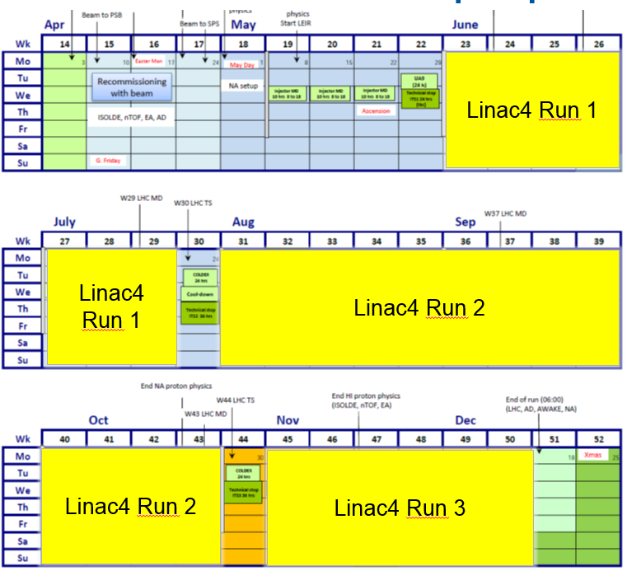
Synchronise with Technical Stops of the accelerator complex

Slide 5
Discussion Points
Standby intervention nights and weekends
Fault tracking via logbook and Accelerator Fault Tracking Tools
Training of operators
Development of Controls Tools for Operators.
Standard beam parameters for operation
  Different for different periods
  Different cycles for different future clients simultaneously
Regular measurements of these parameters: how often, how and what to do with it
How much time do the RF experts need to do the regulations and debugging before we have stable operation ?
  Debugging ≠ Reliability Running

