Slide 1



SEARCH FOR SUPERSYMMETRY AND DARK MATTER
Netzwerk Teilchenwelt Projektwochen 2017
Sophie Li
Supervisor: Philipp König, Universität Bonn
27.10.17, CERN

Slide 2
(Cosmic)
Notes:
Rotational velocities of galaxies
Bullet cluster

Slide 3
Supersymmetry
(Particle)
Notes:
new symmetry between fermions and bosons
Super-partners for each
Fermions s is added in front of the SM name, turning a quark into a squark, an electron into a selectron
Suffix ino is appended
Parameters 120
Impossible to look for

Slide 4
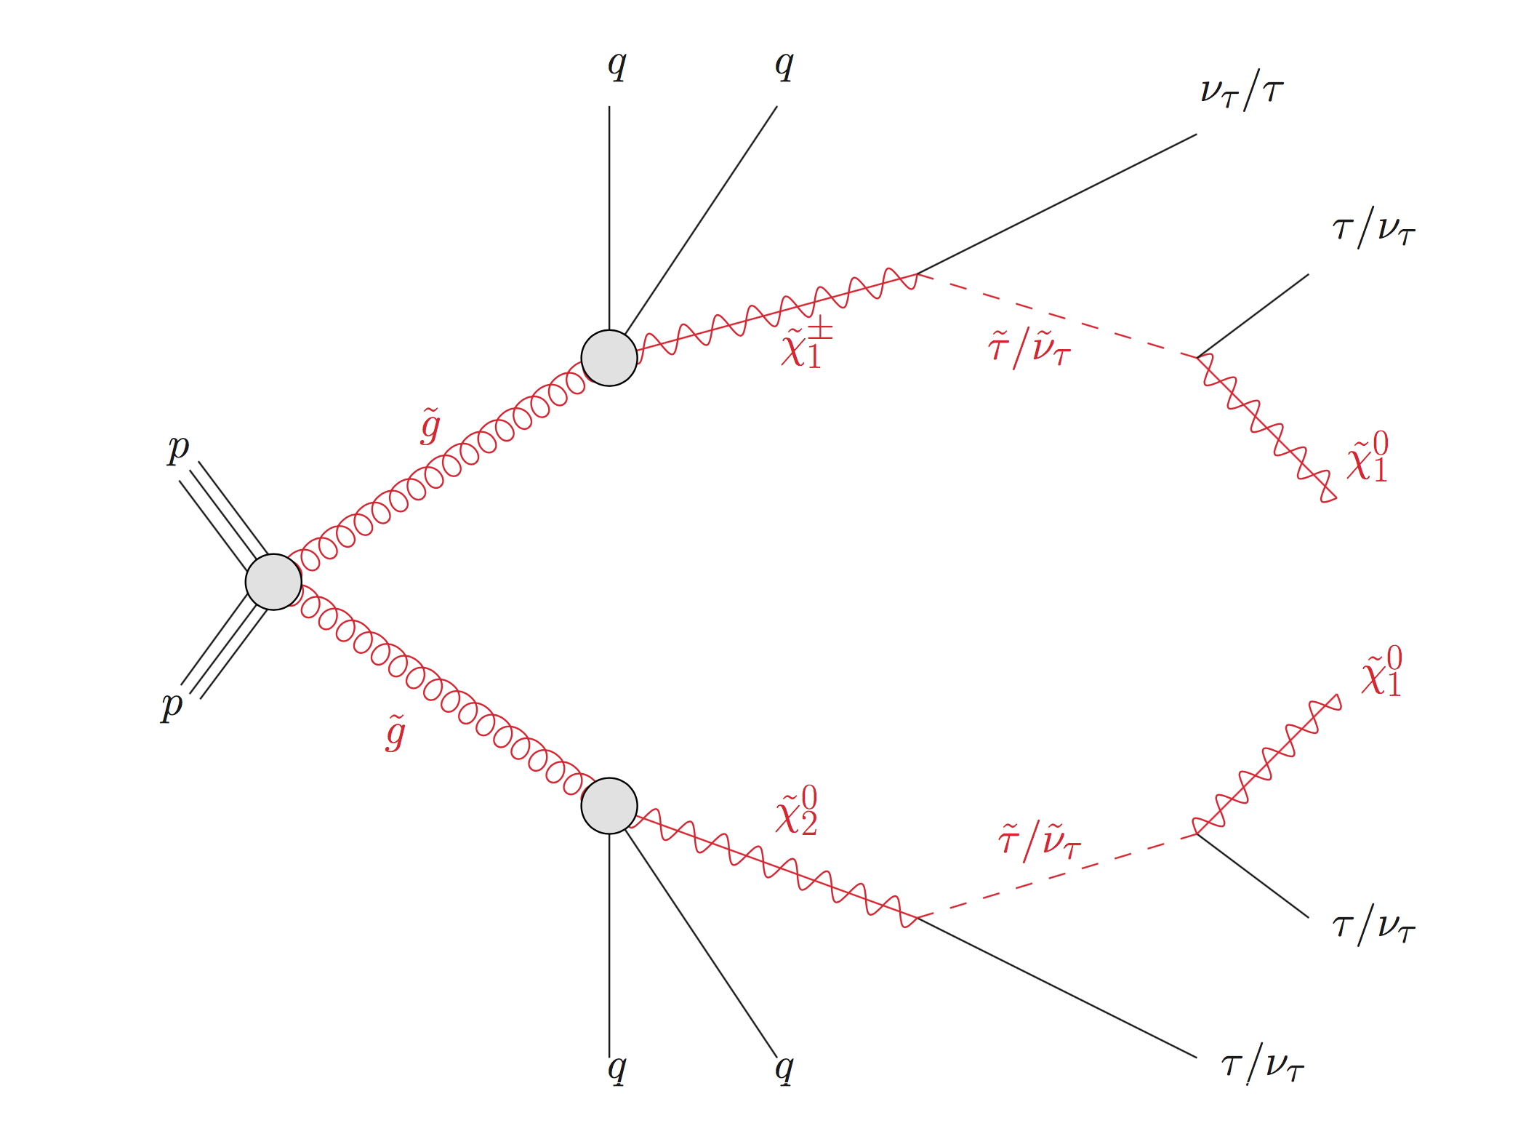
Simplified Model
Jets
Taus
Missing Energy
(König)
Notes:
- Assumptions: Decrease in parameter → Simplification
Signature + Topology
Lightest Supersymmetric Particle → Stable, Neutral, massive → Dark matter??
Taus, jets…

Slide 5
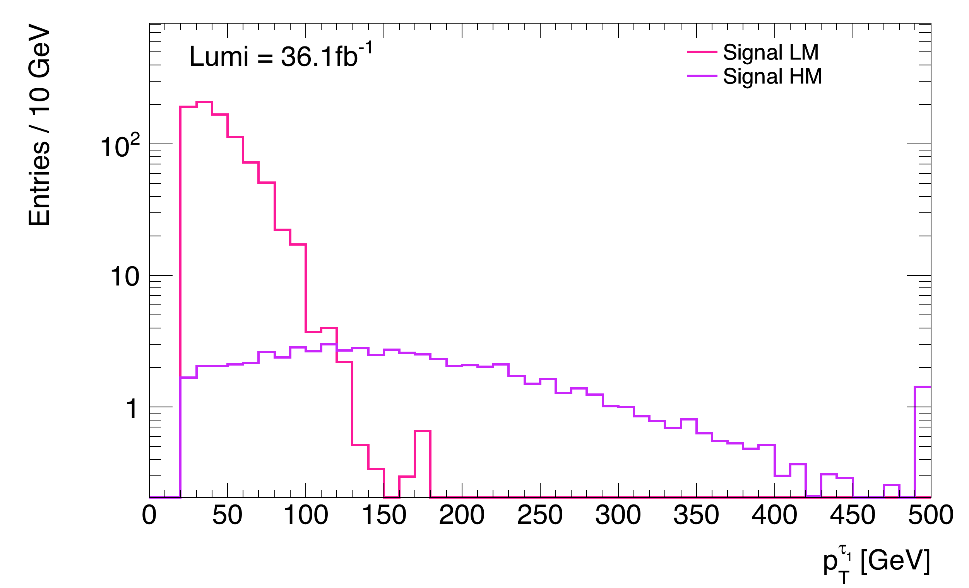






Signals
Compressed$∆m$ Signal Region
$\tilde{g}$: 1065 GeV
${\tilde{χ}}_{1}^{0}$: 825 GeV
High$∆m$ Signal Region
$\tilde{g}$: 1705GeV
${\tilde{χ}}_{1}^{0}$: 345 GeV
Notes:
All mass scenarios are equally relalised
Compressed: (Pink) Small mass diffrence → limited energy to produce and boost particle in final state → Low PT
Pt from leading tau
High difference: → Purple

Slide 6
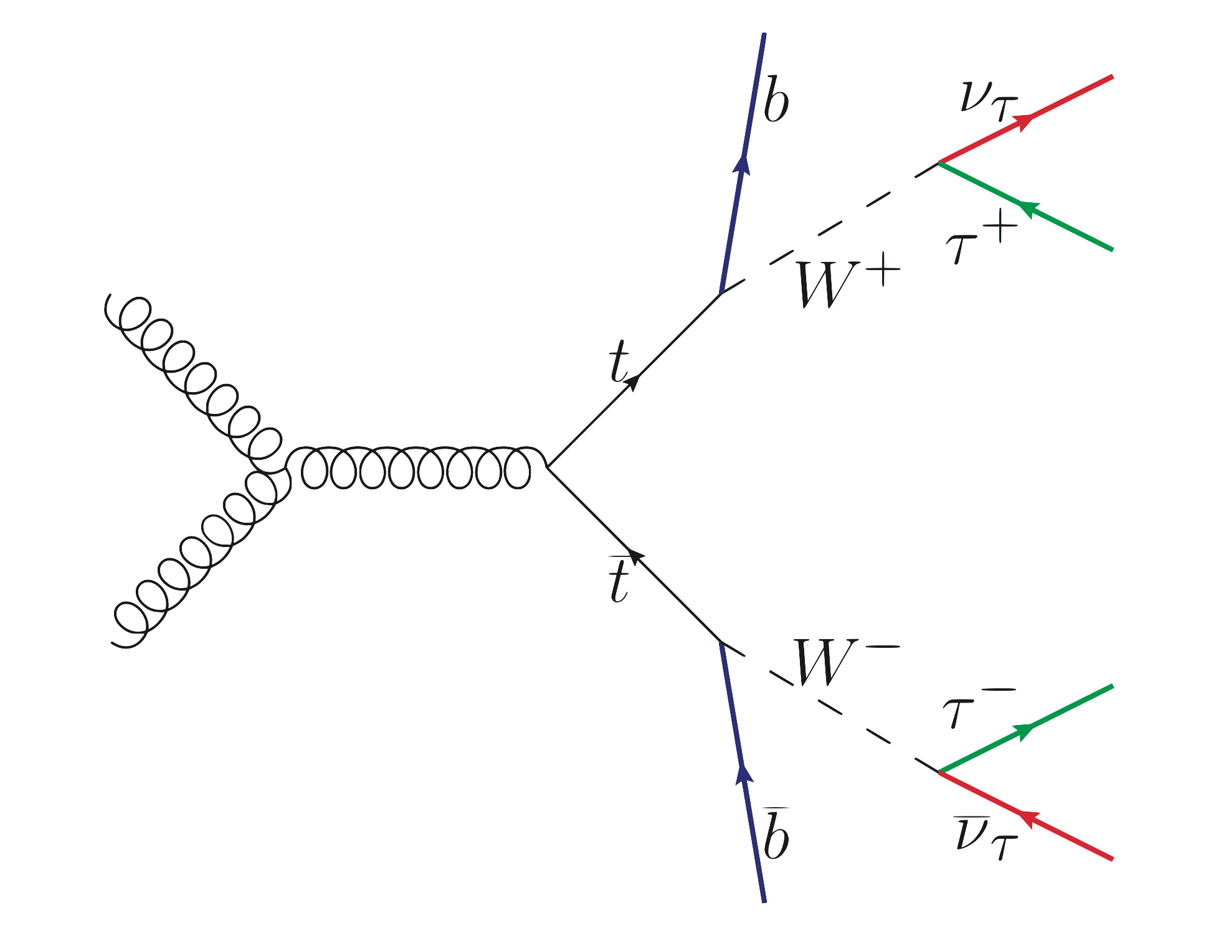
Backgrounds
Taus
Jets
Missing Energy
QCD
W Bosons
Z Bosons
Top/Anti-top
Other Processes
(Schaepe)
Notes:
Explain QCD background

Slide 7
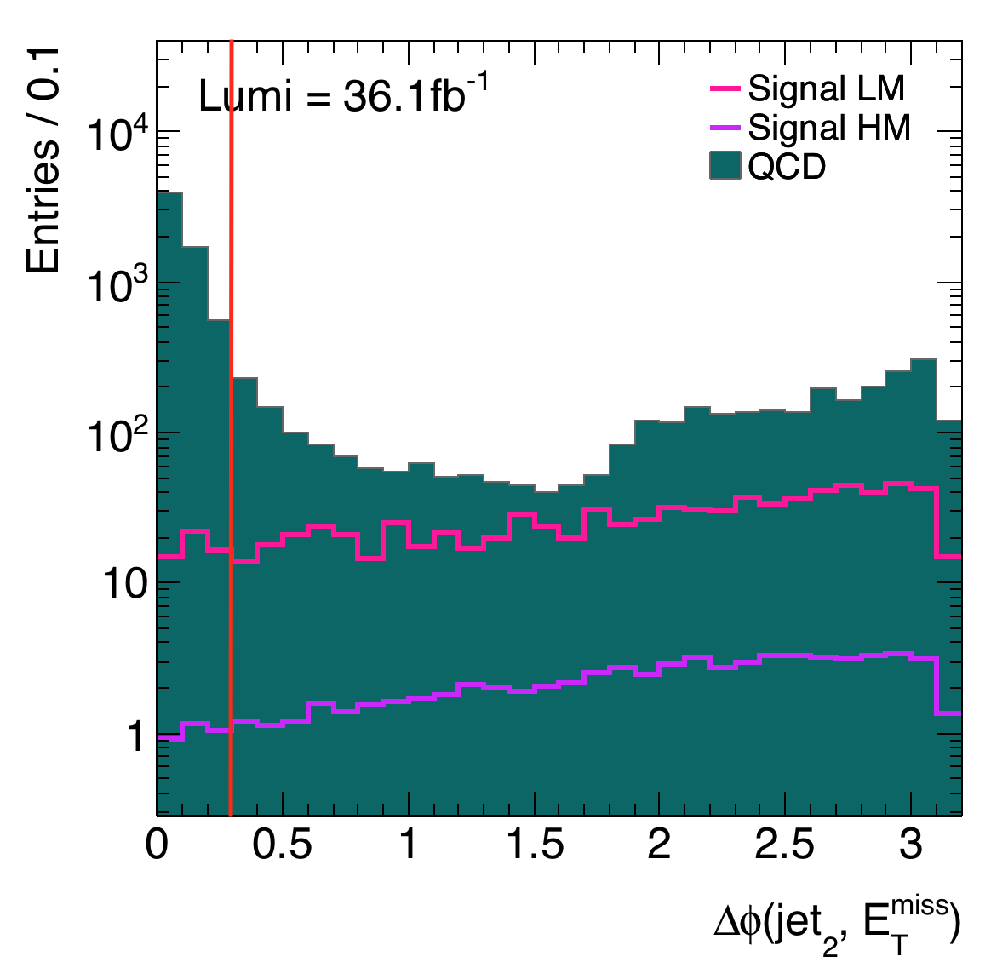
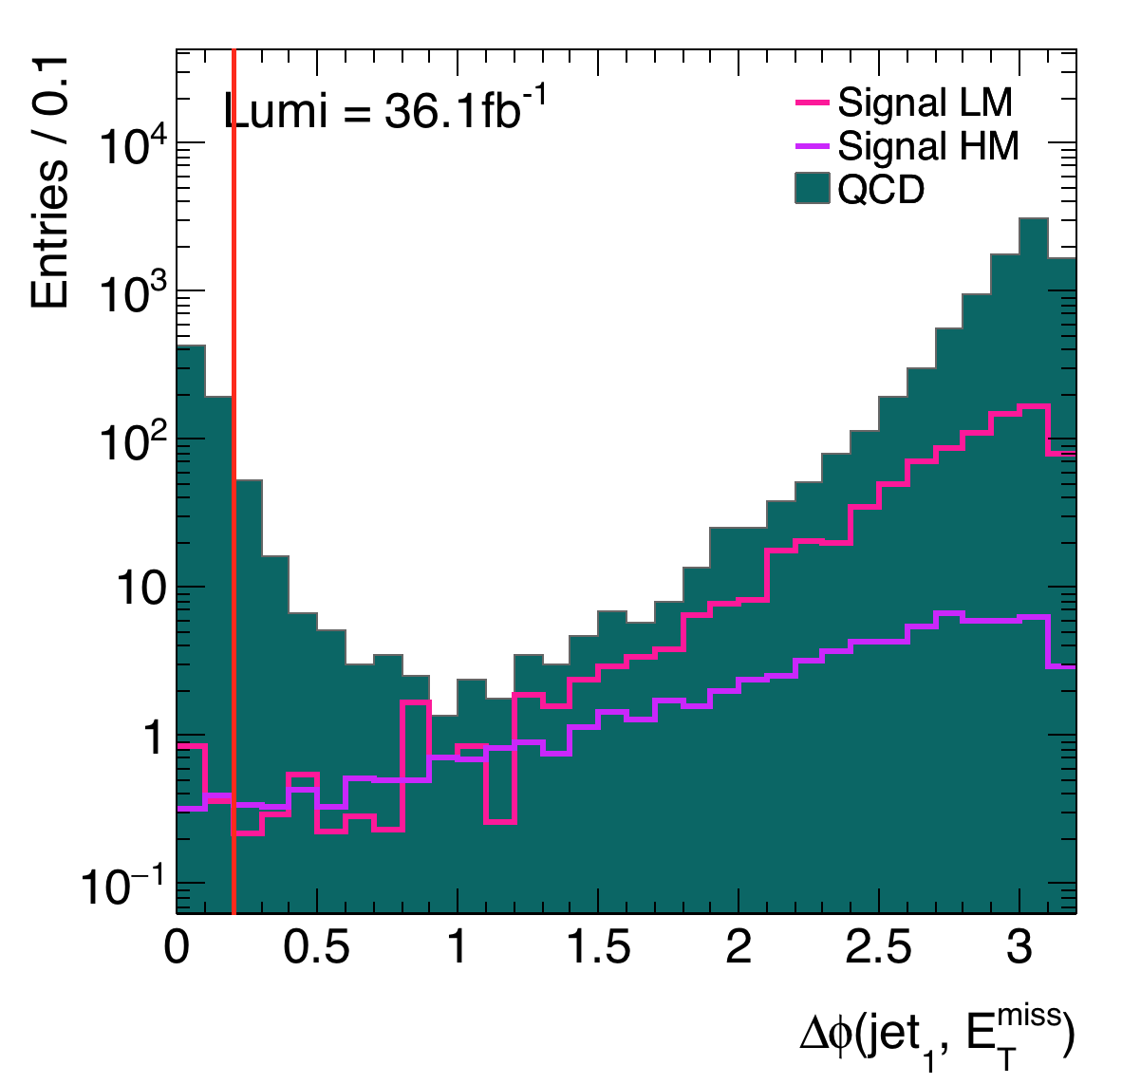


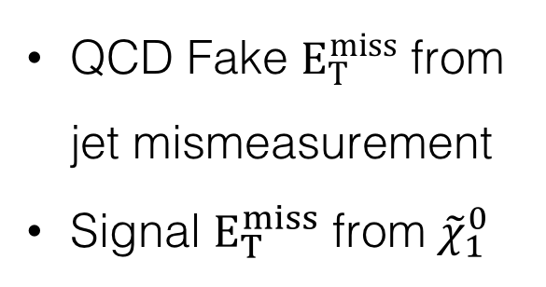
QCD Background
$∆ϕ\left({jet}_{1}, E_{T}^{miss}\right)>$ 0.2 GeV
$∆ϕ\left({jet}_{2}, E_{T}^{miss}\right)>$ 0.3 GeV
QCD Fake $E_{T}^{miss}$ from jet mismeasurement
Signal $E_{T}^{miss}$ from ${\tilde{χ}}_{1}^{0}$
Notes:
High cross-section
Easily reduced
Uncorelated

Slide 8
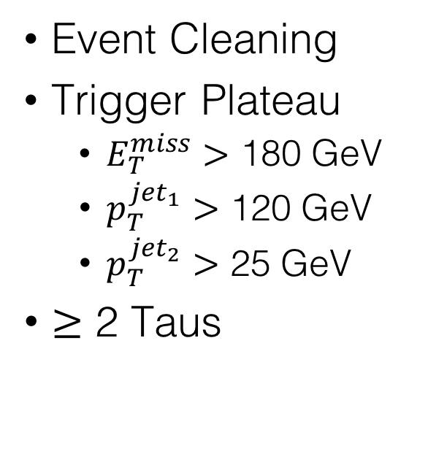
Preliminary Cuts
Event Cleaning
Trigger Plateau
  $E_{T}^{miss}>$ 180 GeV
  $p_{T}^{{jet}_{1}}>$ 120 GeV
  $p_{T}^{{jet}_{2}}>$ 25 GeV
$≥$ 2 Taus
Tau Reconstruction
Distinguish between taus and jets
Boosted Decision Tree
Notes:
EC: Well Reconstructed
Trigger Plateau: Trigger selects signatures which look similar to presented model
Need missing energy
Need jets
Boosted Decision Tree:
Machine Learning
Multiple Variables

Slide 9
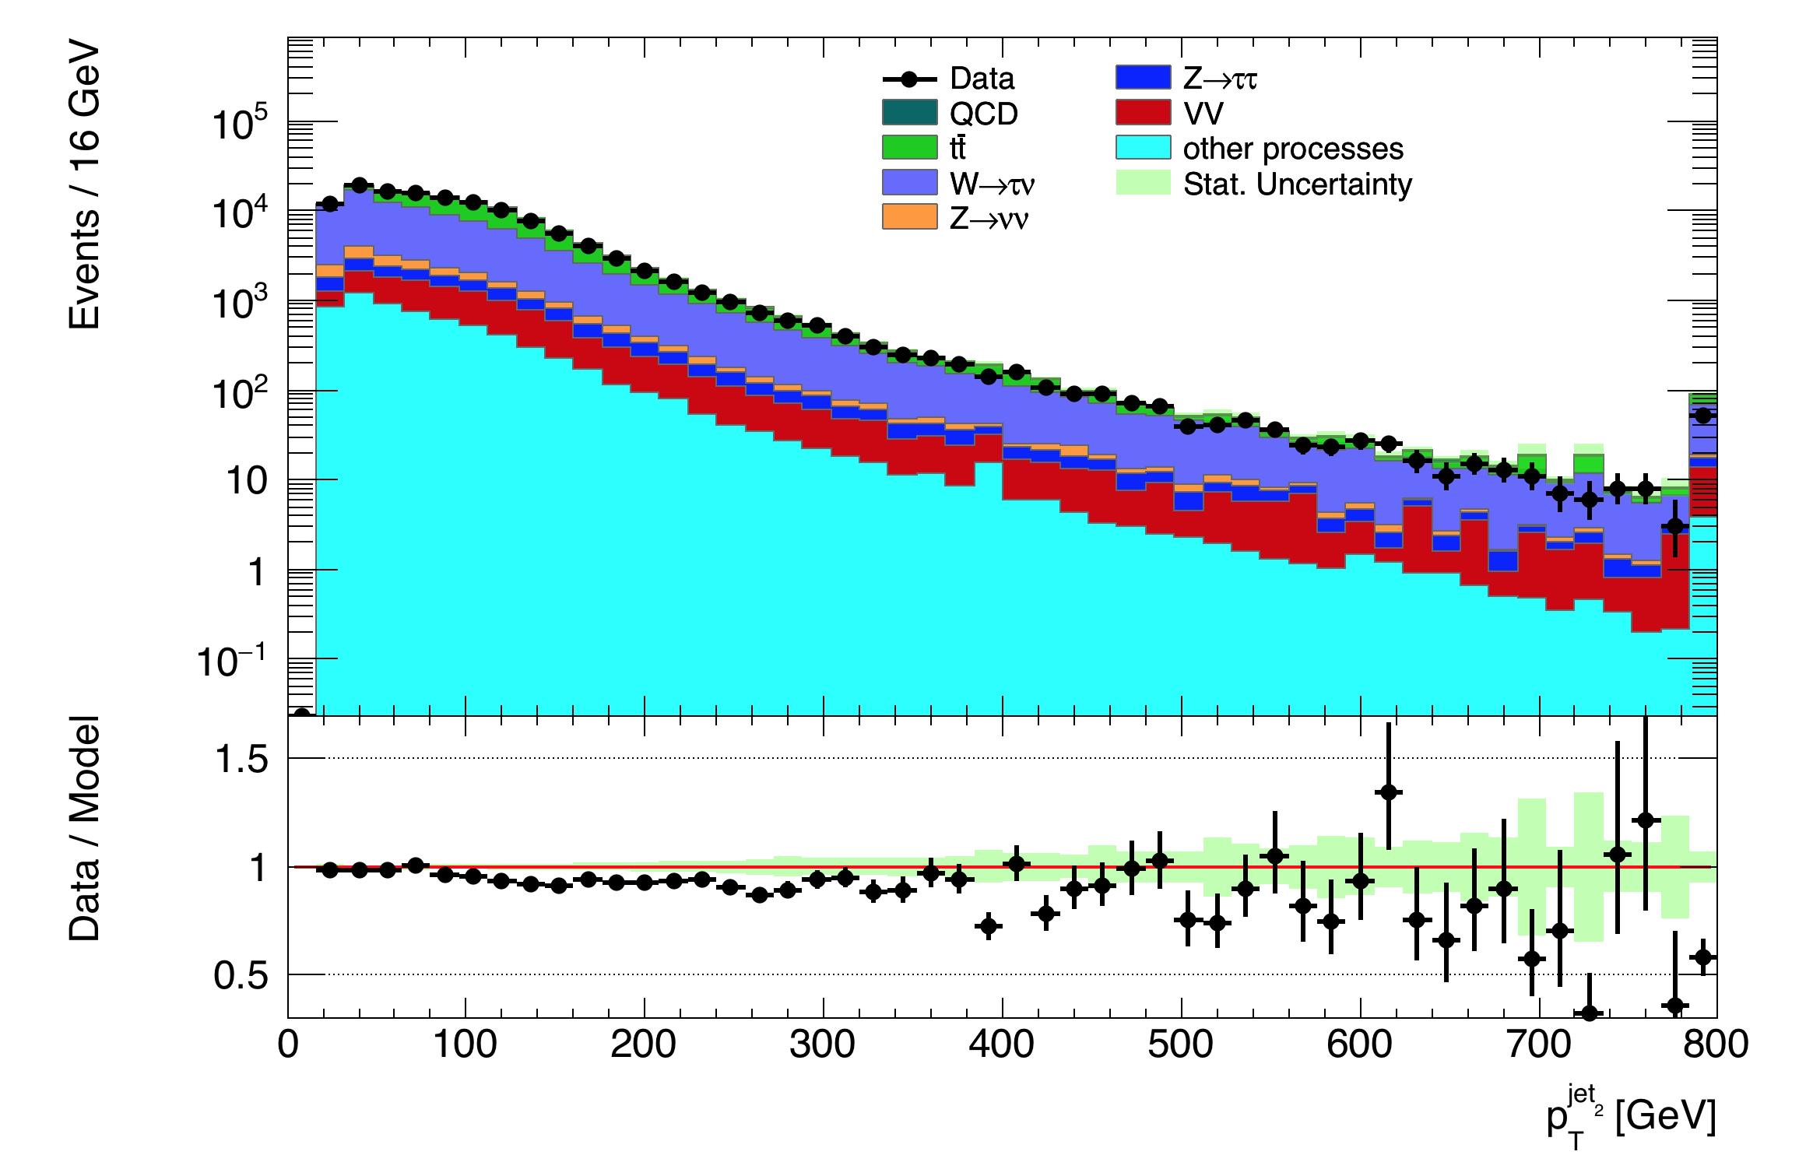
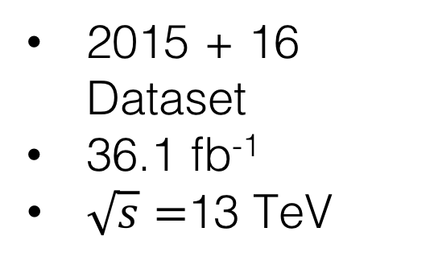
Data Monte Carlo Comparison
2015 + 16 Dataset
36.1 fb⁻¹
$\sqrt{s}=$13 TeV
Notes:
Have we understood/ properly simulated the background?
Compare Data to Monte Carlo samples
Good Agreement
Find certain regions → enrich signal over background → Dark Matter
Different Variables

Slide 10
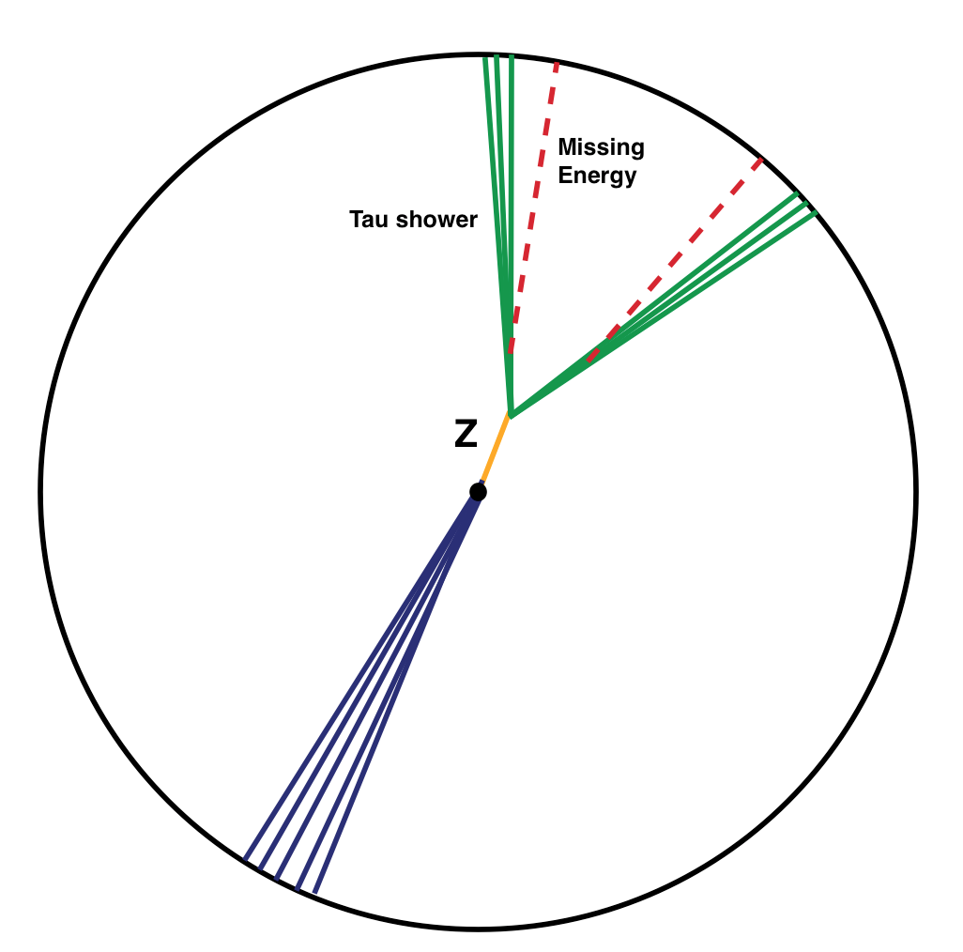
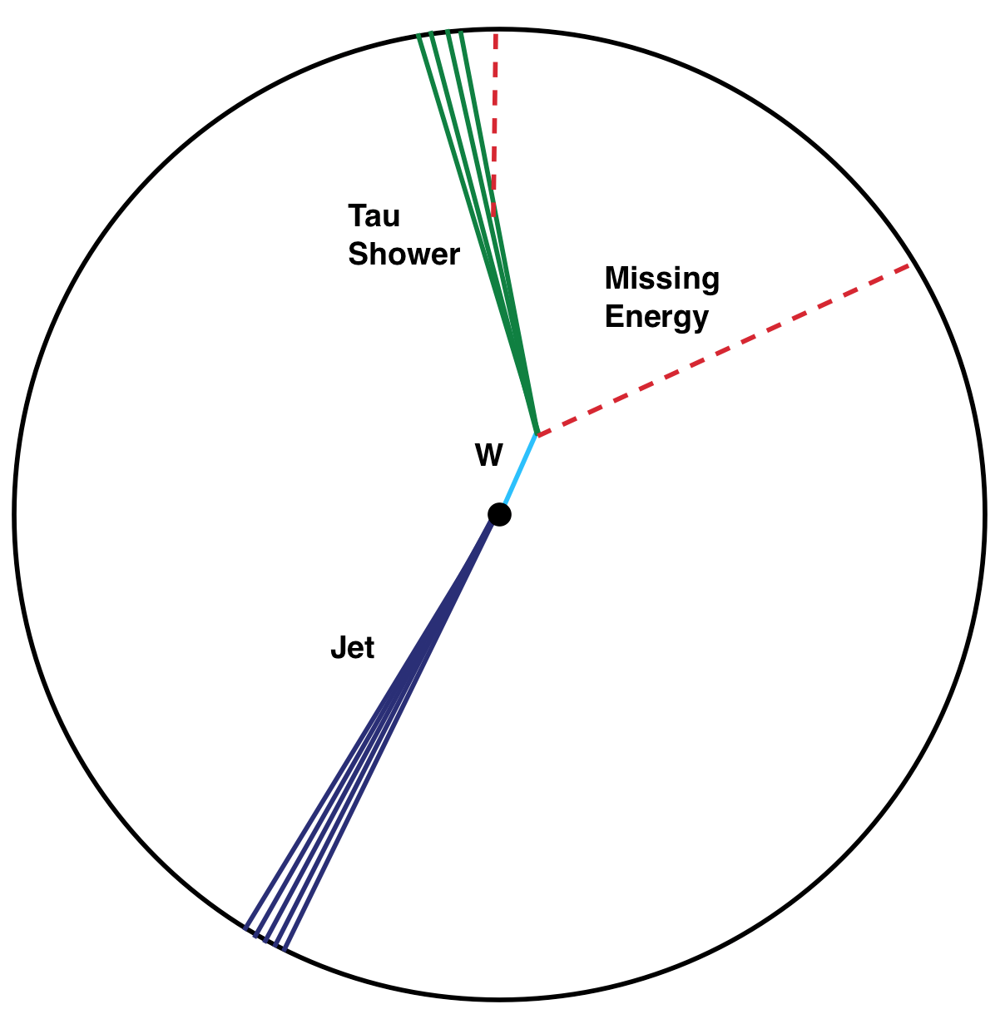
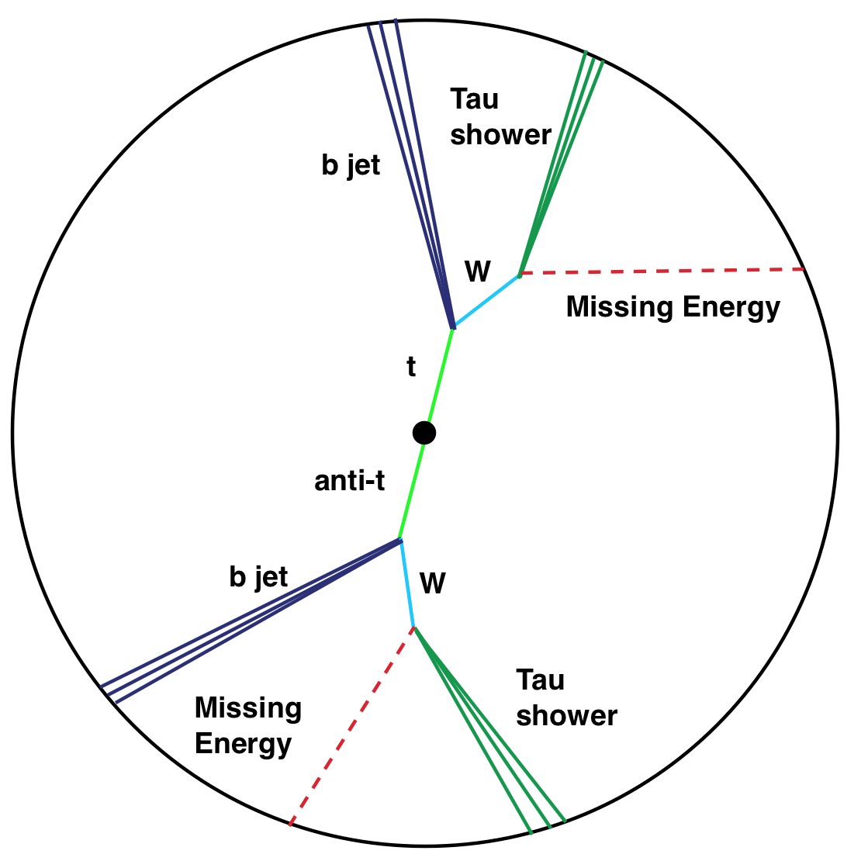



HM Cut 1: Tau transverse mass
Transverse mass $m_{T}^{τ}= \sqrt{2p_{T}^{τ}E_{T}^{miss}(1−\cos{(Δφ\left(τ,p_{T}^{miss}\right))}}$
$$Z \underset{→}{ } τ^{+}+τ^{−}$$
$$W \underset{→}{ } τ+\overline{ν}$$
$$t\underset{→}{ } b+W^{+}$$
Notes:
Z → Tau Tau
Recoil Jet → Trigger requires 1 hard jet
Event is Boosted

Slide 11
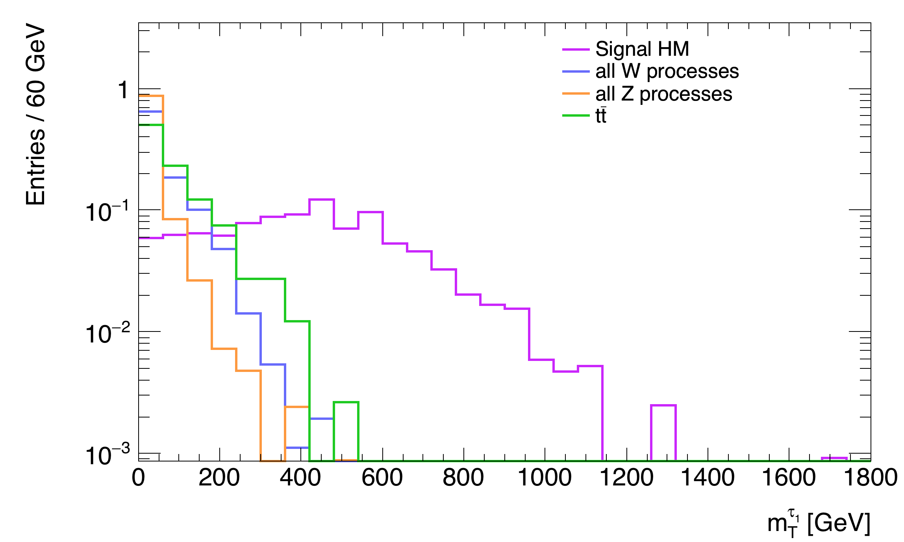
HM Cut 1: Transverse mass

Slide 12
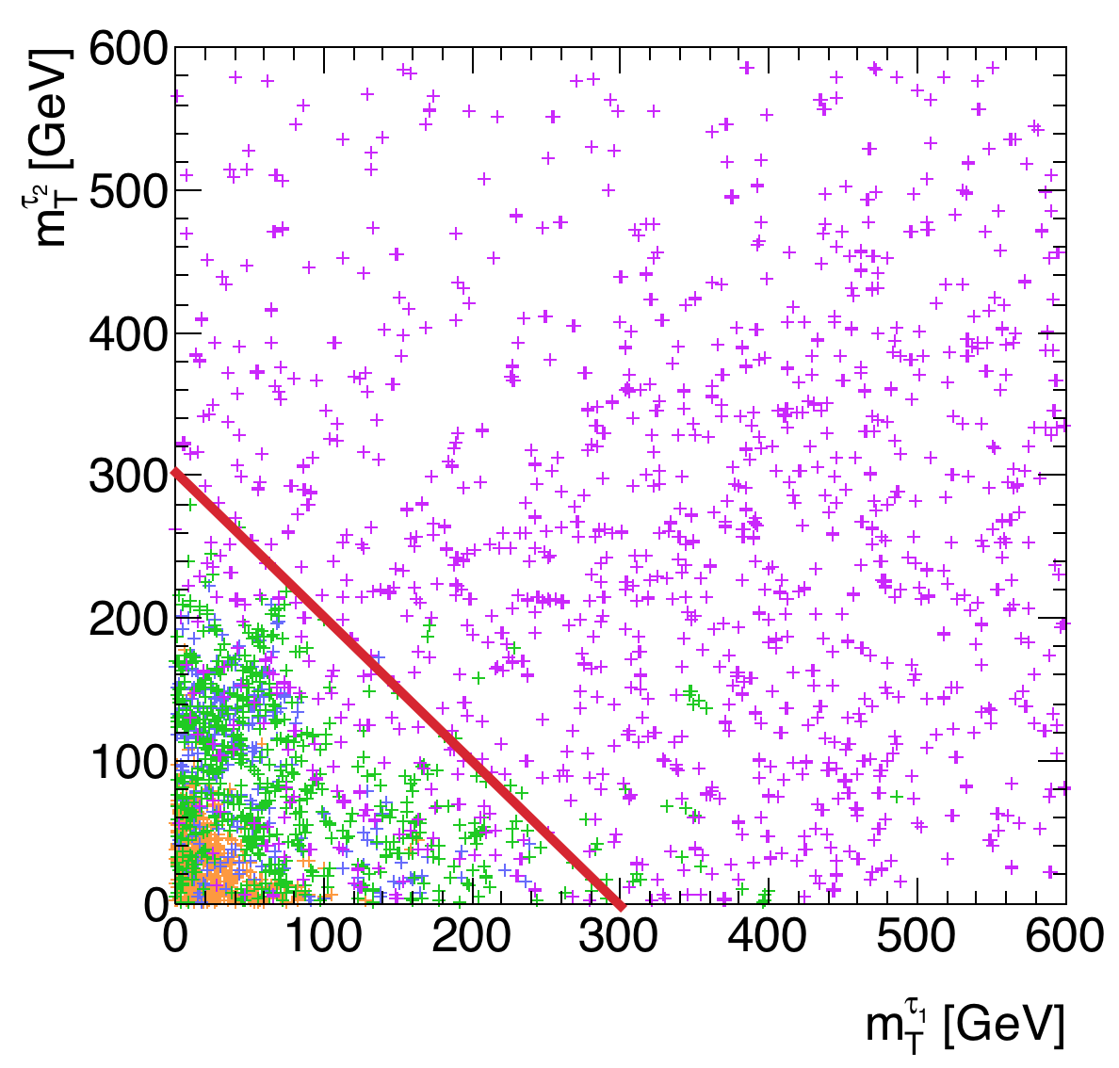
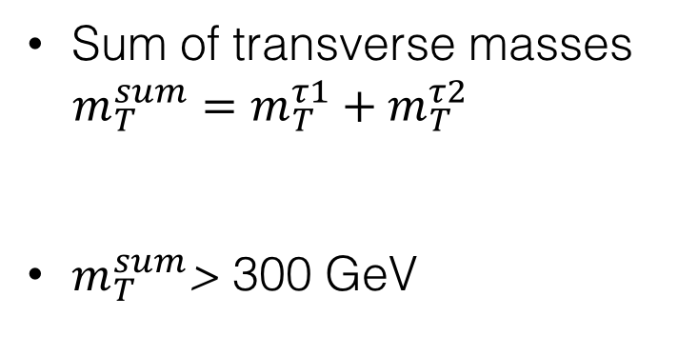
HM Cut 1: Transverse mass
HM Signal
All Z Processes
All W Processes
top/Anti-top
Sum of transverse masses $m_{T}^{sum}=m_{T}^{τ1}+m_{T}^{τ2}$
$m_{T}^{sum}$> 300 GeV

Slide 13
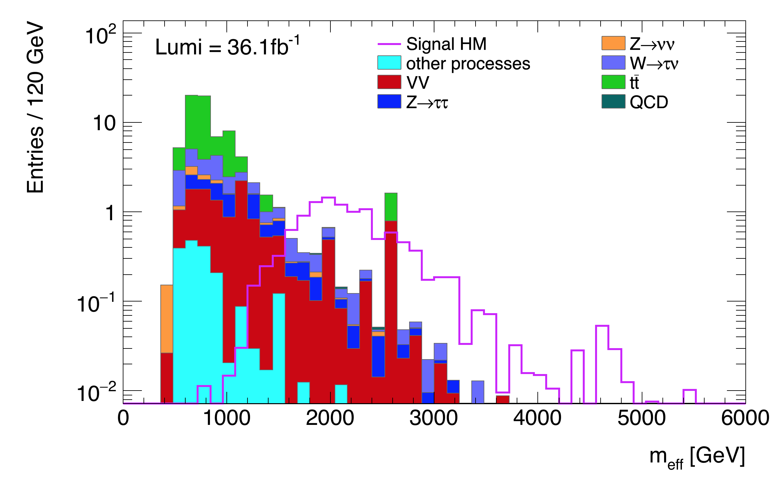
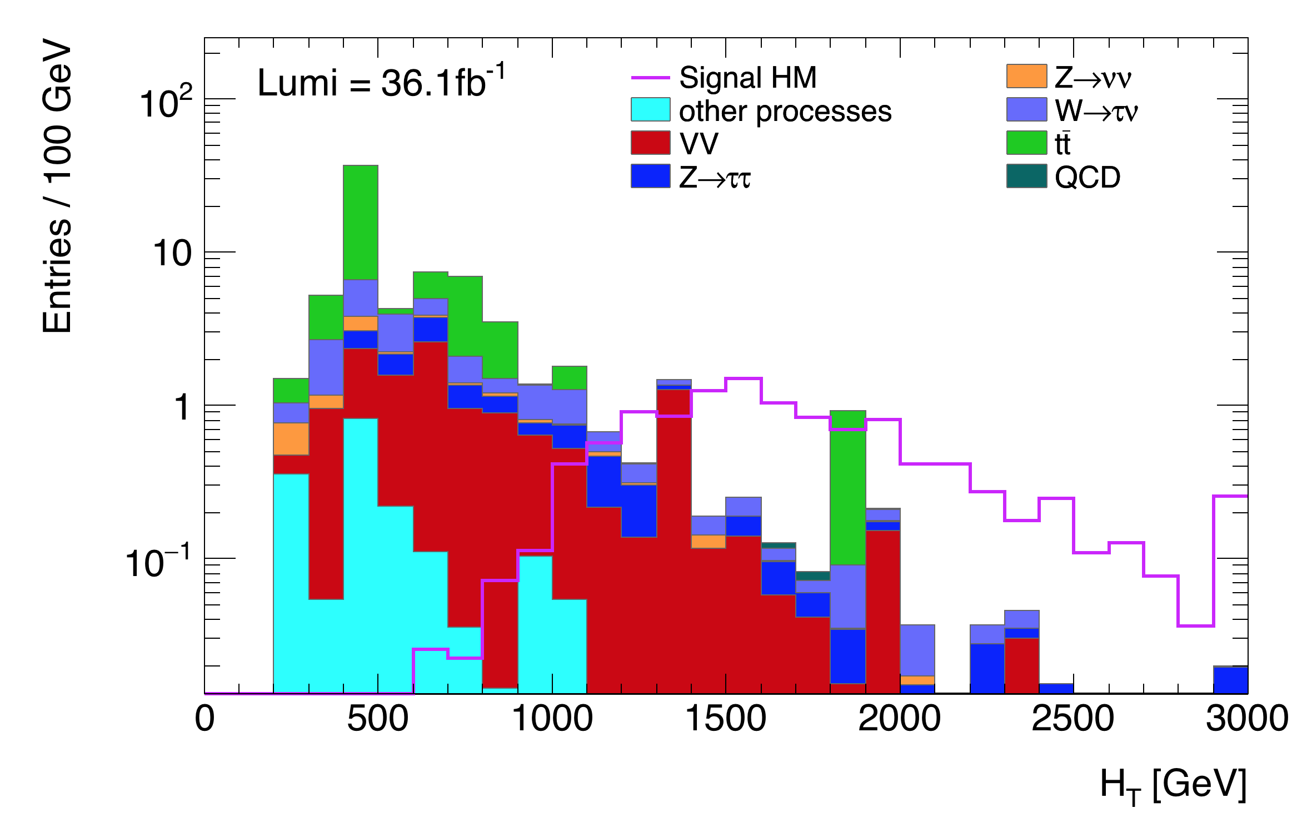

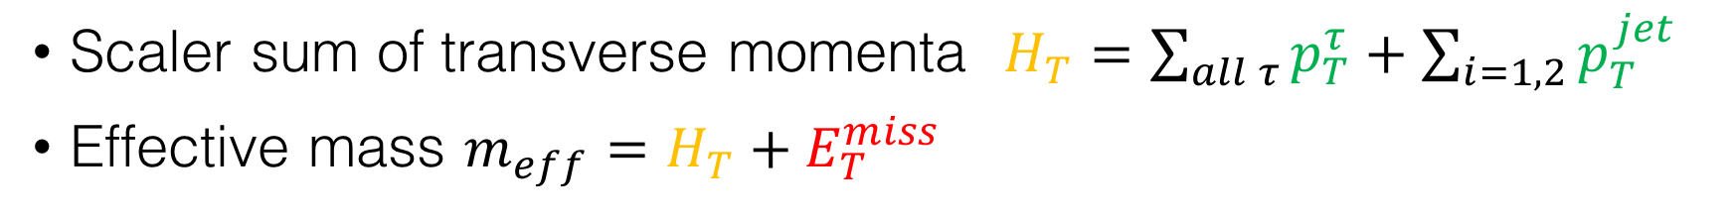
HM Cut 2: $m_{eff}/H_{T}$
Scaler sum of transverse momenta $H_{T}=\sum_{all τ}{p_{T}^{τ}}+\sum_{i=1,2}{p_{T}^{jet}}$
Effective mass $m_{eff}=H_{T}+E_{T}^{miss}$
Notes:
Higher energies → Separate signal from the background

Slide 14
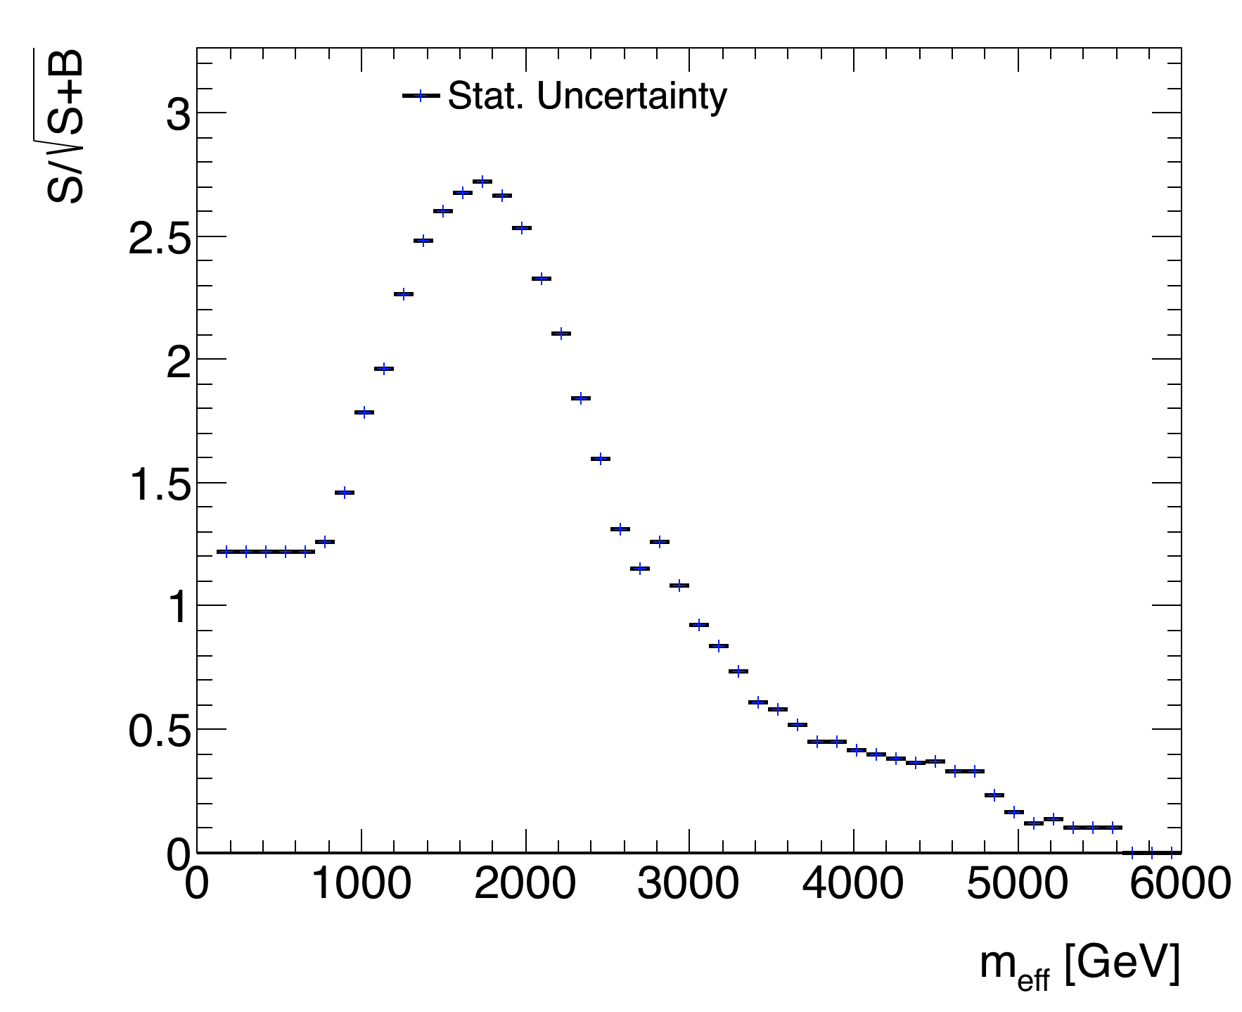
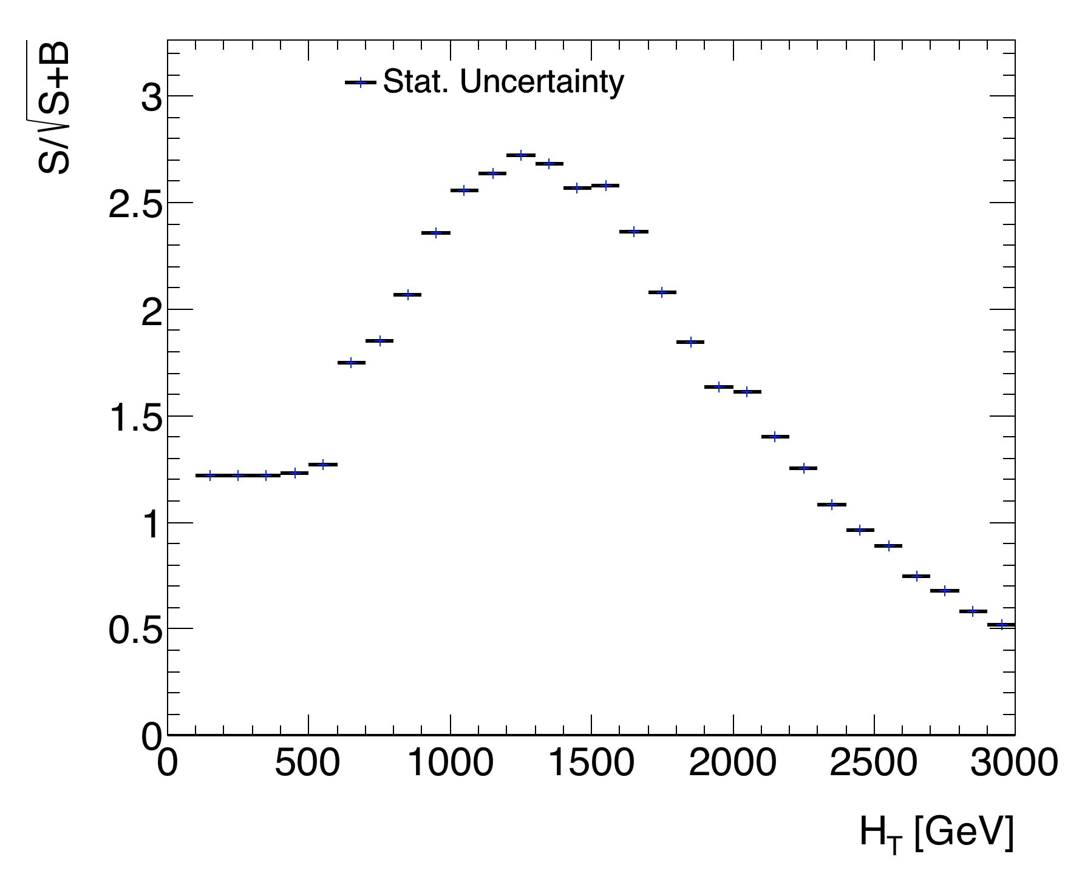

HM Cut 2: $m_{eff}/H_{T}$
Greater significance
Notes:
Small diffrence!

Slide 15
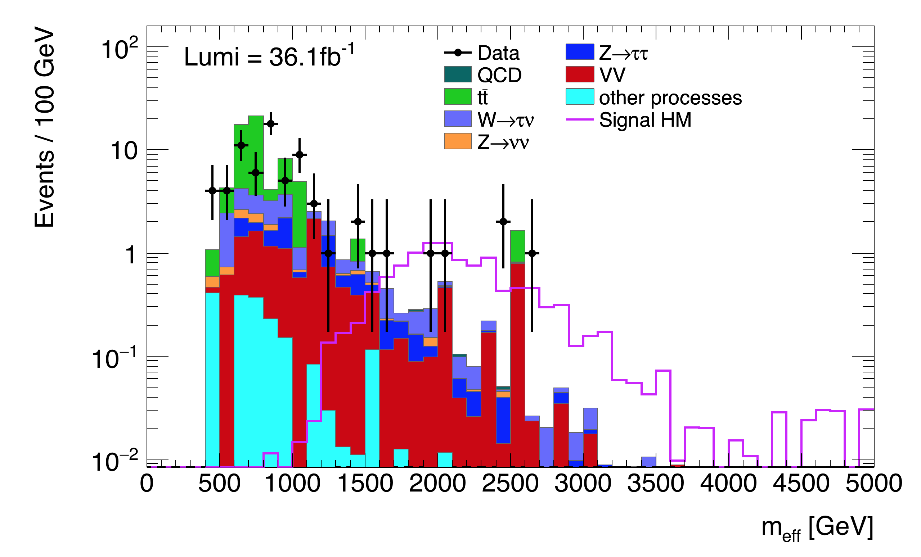


Data Comparison
Effective mass $m_{eff}=H_{T}+E_{T}^{miss}$
 | Count Number
Signal | 9.29
Background | 3.53 ± 1.88
Data | 5
$m_{eff}$> 1750 GeV

Slide 16
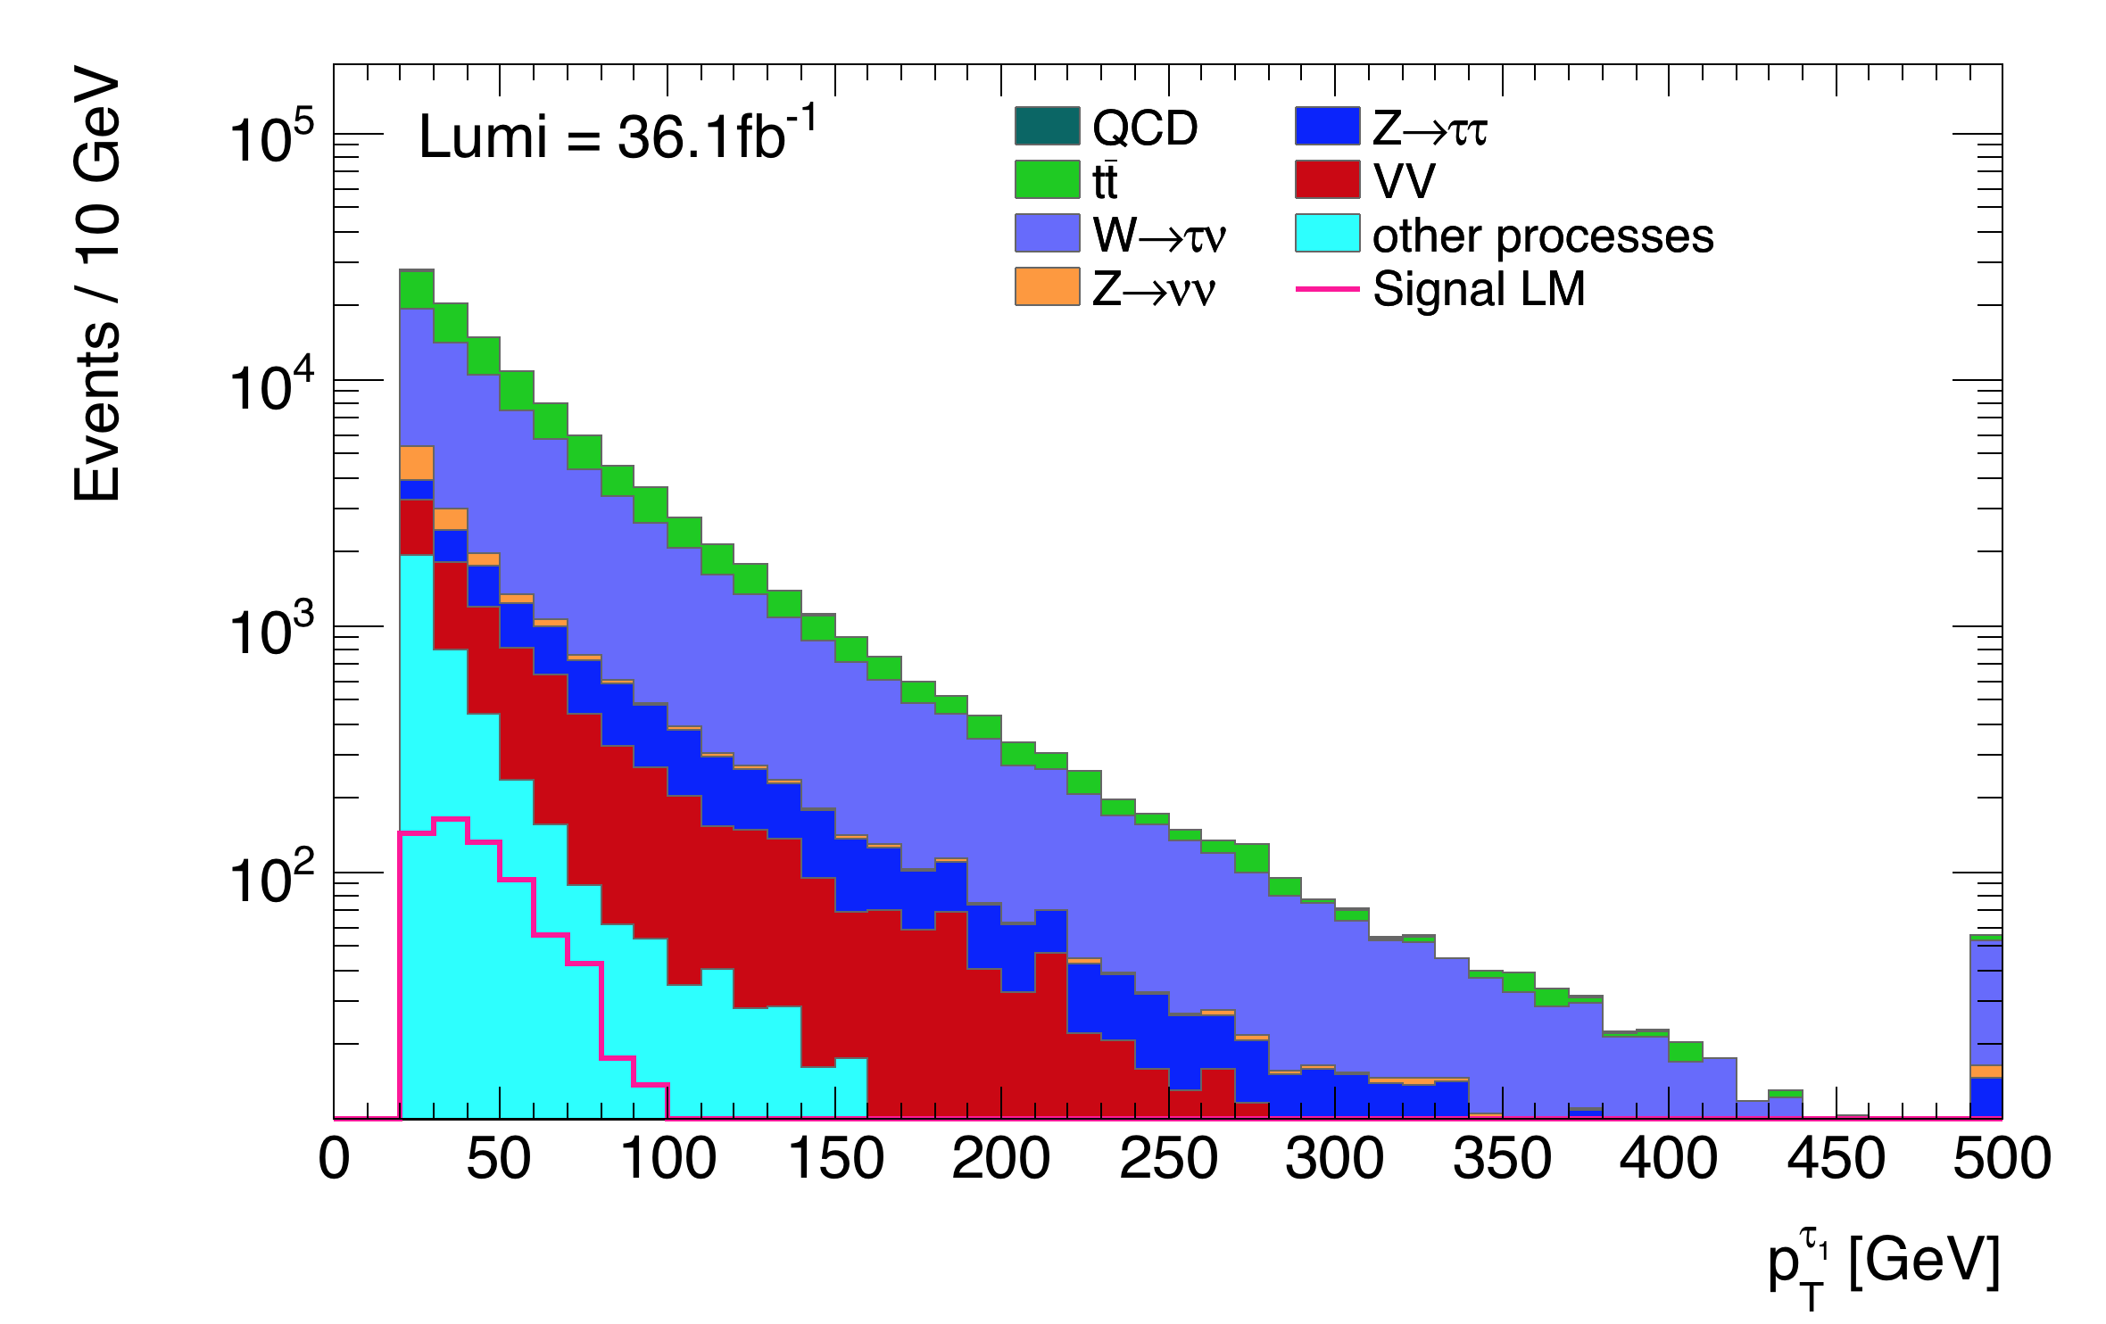
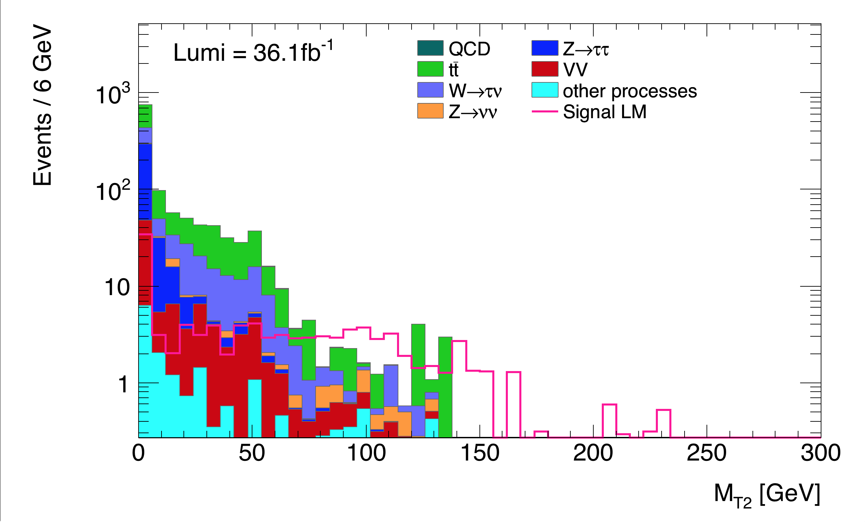
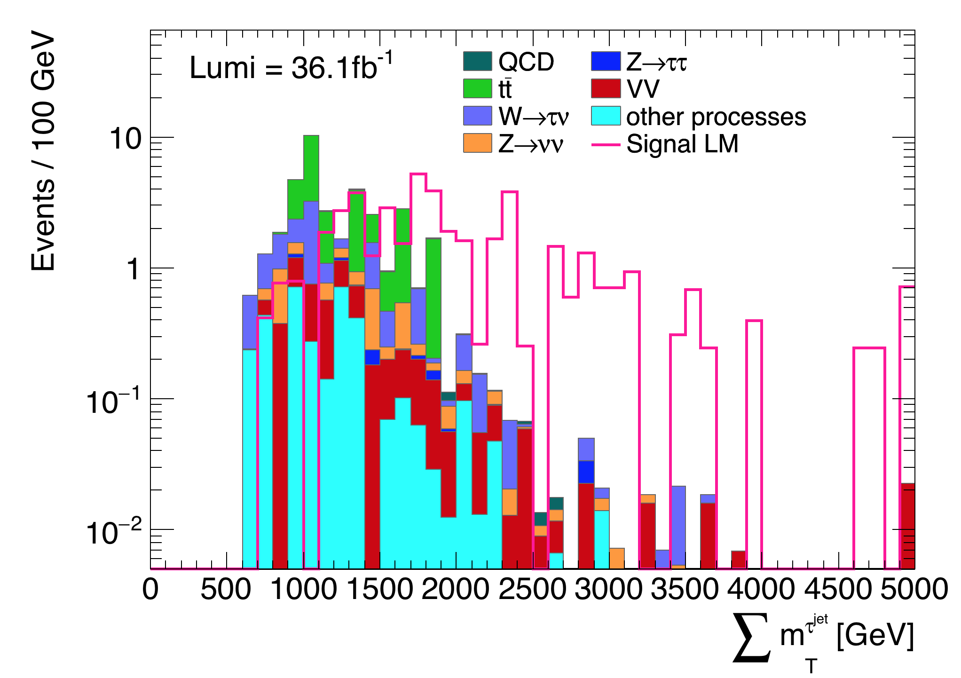
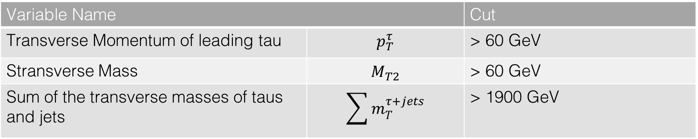
Compressed Signal Region Cuts
Variable Name |  | Cut
Transverse Momentum of leading tau | $$p_{T}^{τ}$$ | > 60 GeV
Stransverse Mass | $$M_{T2}$$ | > 60 GeV
Sum of the transverse masses of taus and jets | $$\sum{m_{T}^{τ+jets}}$$ | > 1900 GeV

Slide 17
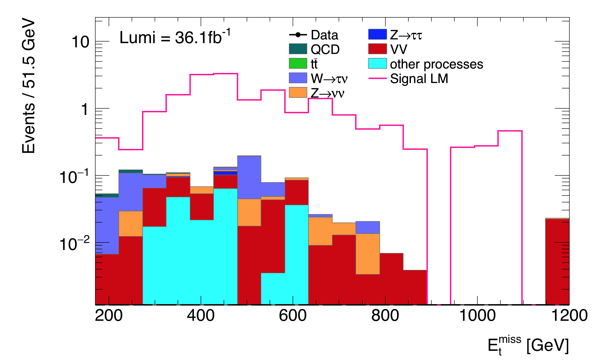

Data Comparison: Low$∆m$ Signal Region
 | Count Number
Signal | 18.56
Background | 1.05 ±1.02
Data | 0

Slide 18
Summary, Conclusion and Outlook
Search for Dark Matter
Supersymmetry → Possible Model
Signal Regions for 2 different mass scenarios
No results beyond expected SM Background
Exactly 1 Tau
Other possible decay chains
Electroweak SUSY production
More Lumi → Higher mass scenarios
No Dark Matter found
…Yet

Slide 19
Thank you!
Special thanks to the organizers of Netzwerk Teilchenwelt,
Philipp König
and all others at Bonn University

Slide 20
Works Cited
“Cosmic Microwave Background.” Planck Mission, European Space Agency, 21 Mar. 2013, planck.cf.ac.uk/results/cosmic-microwave-background.
König, Philipp. “Simplified Models with High Dimensionality in the Search for Supersymmetry at the ATLAS Experiment.” Experimentelle Teilchen Physik , Rheinische Friedrich-Wilhelms-Universität Bonn, Heinische Friedrich-Wilhelms-Universität Bonn, Sept. 2016, www.lhc-ilc.physik.uni-bonn.de/ergebnisse/dateien/t00000079.pdf?c=t&id=79.
“Particle Physics Theory.” Particle Physics Theory, University of Glasgow, School of Physics and Astronomy, www.physics.gla.ac.uk/ppt/bsm.htm.
Schaepe, Steffen. “Search for Supersymmetry in Tau Lepton Final States with the ATLAS Detector.” Uni Bibliotek Bonn, Rheinische Friedrich-Wilhelms-Universität Bonn, Rheinische Friedrich-Wilhelms-Universität Bonn, June 2015, hss.ulb.uni-bonn.de/2016/4238/4238.pdf.

Slide 21


Slide 22
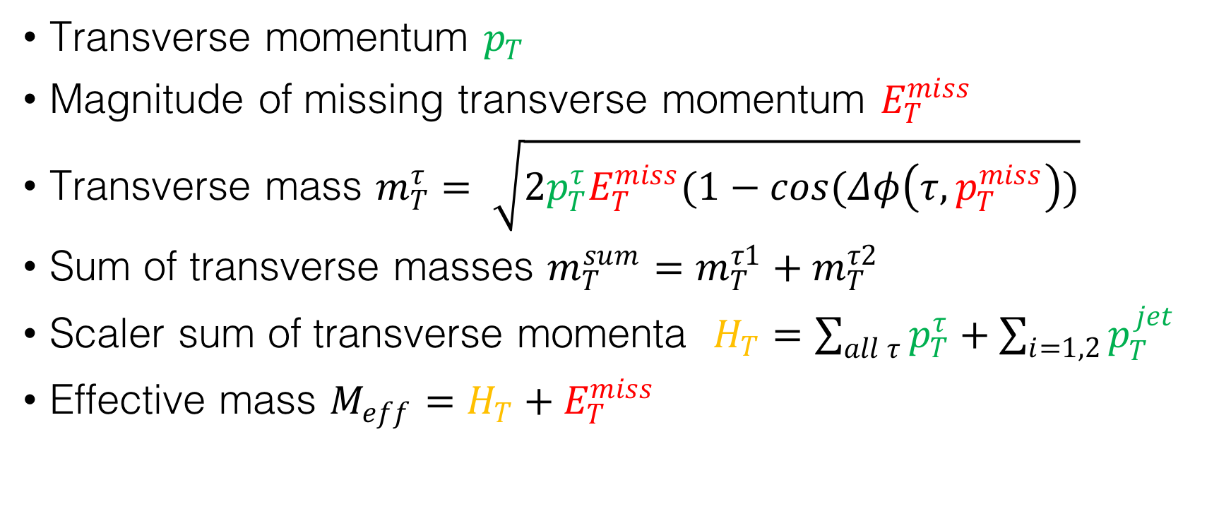
Important Kinematic Variables
Transverse momentum $p_{T}$
Magnitude of missing transverse momentum $E_{T}^{miss}$
Transverse mass $m_{T}^{τ}= \sqrt{2p_{T}^{τ}E_{T}^{miss}(1−\cos{(Δφ\left(τ,p_{T}^{miss}\right))}}$
Sum of transverse masses $m_{T}^{sum}=m_{T}^{τ1}+m_{T}^{τ2}$
Scaler sum of transverse momenta $H_{T}=\sum_{all τ}{p_{T}^{τ}}+\sum_{i=1,2}{p_{T}^{jet}}$
Effective mass $M_{eff}=H_{T}+E_{T}^{miss}$

Slide 23


LM Cut 1: $p_{T}^{τ_{1}}$
$p_{T}^{τ_{1}}<$ 100

Slide 24
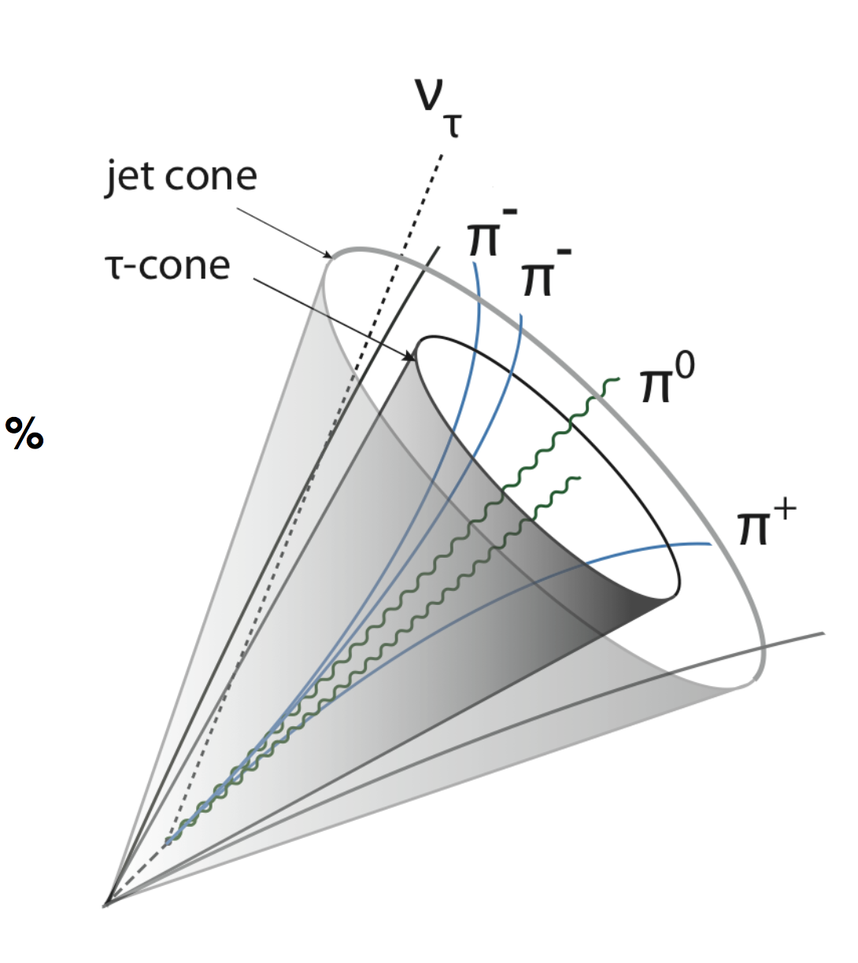
Variable 1
Signal Variable 2
Signal Variable 4
Bkg Variable 5
Bkg Variable 3
Signal Variable 6
Signal Variable 7

Slide 25
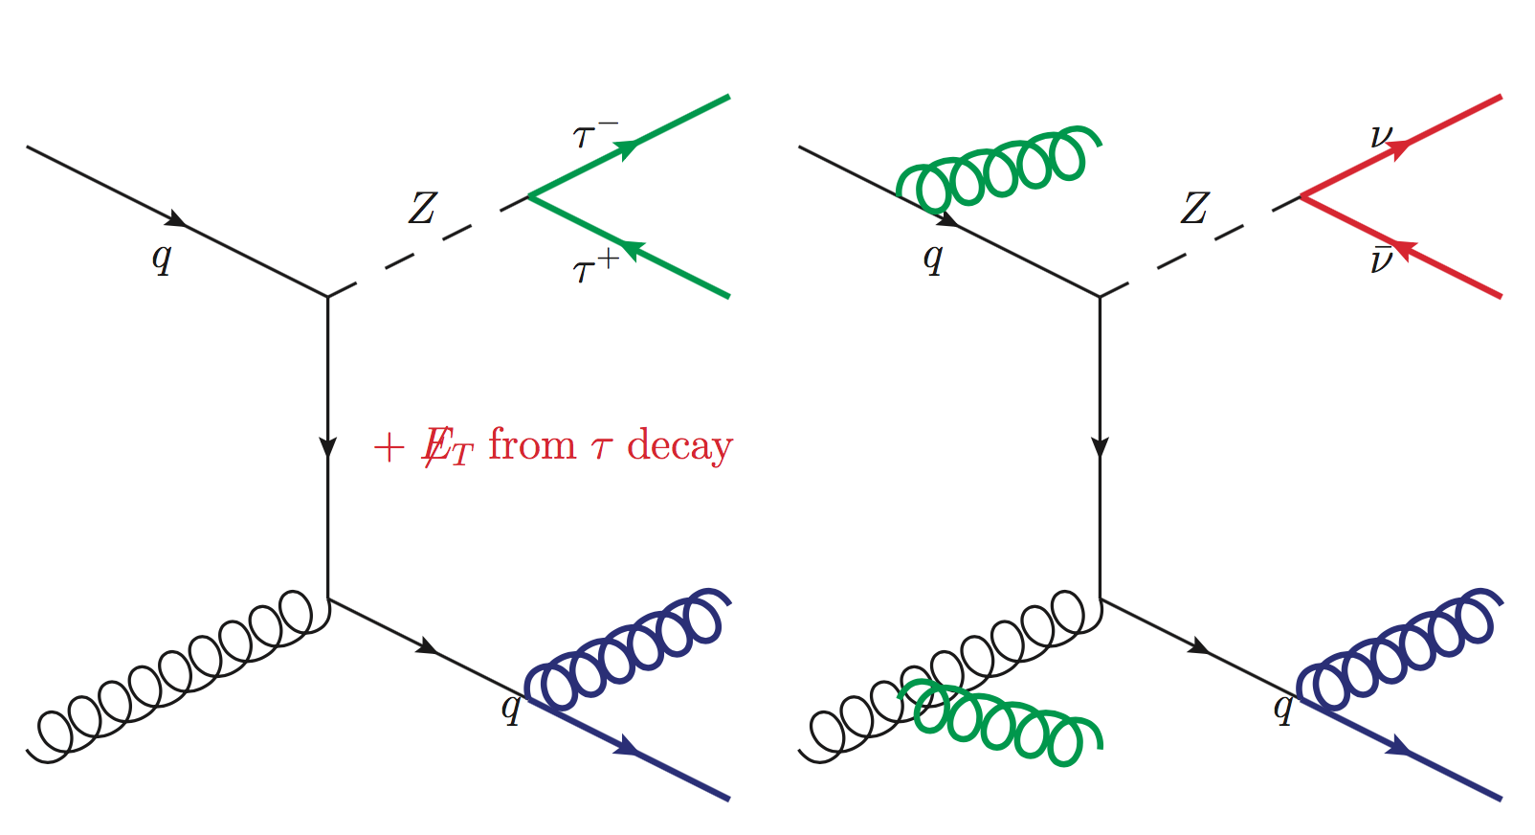
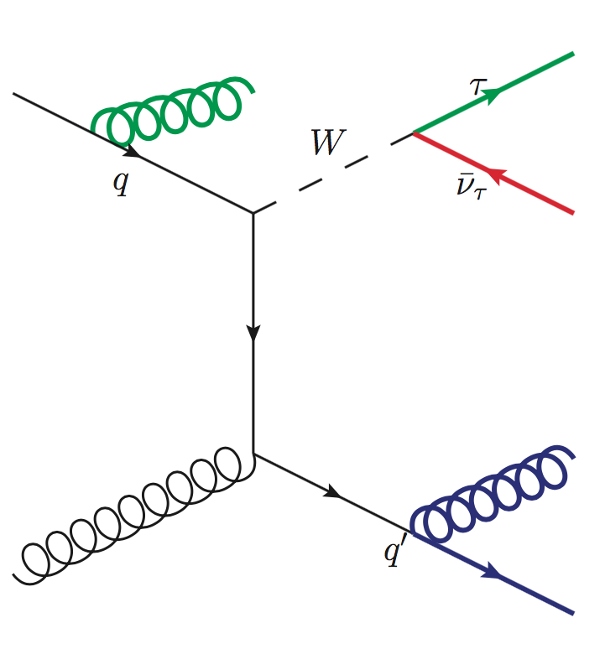
W Boson and Z Boson
Taus, Jets, Missing Energy
(Schaepe)
Notes:
Add Legend

Slide 26
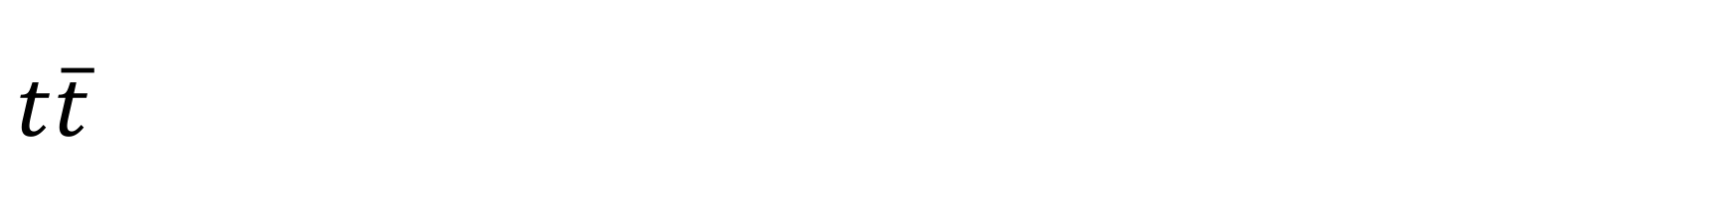
$$t\overline{t}$$
Taus Jets Missing Energy
(Schaepe)
Notes:
Choose 1, bottom 1

Slide 27
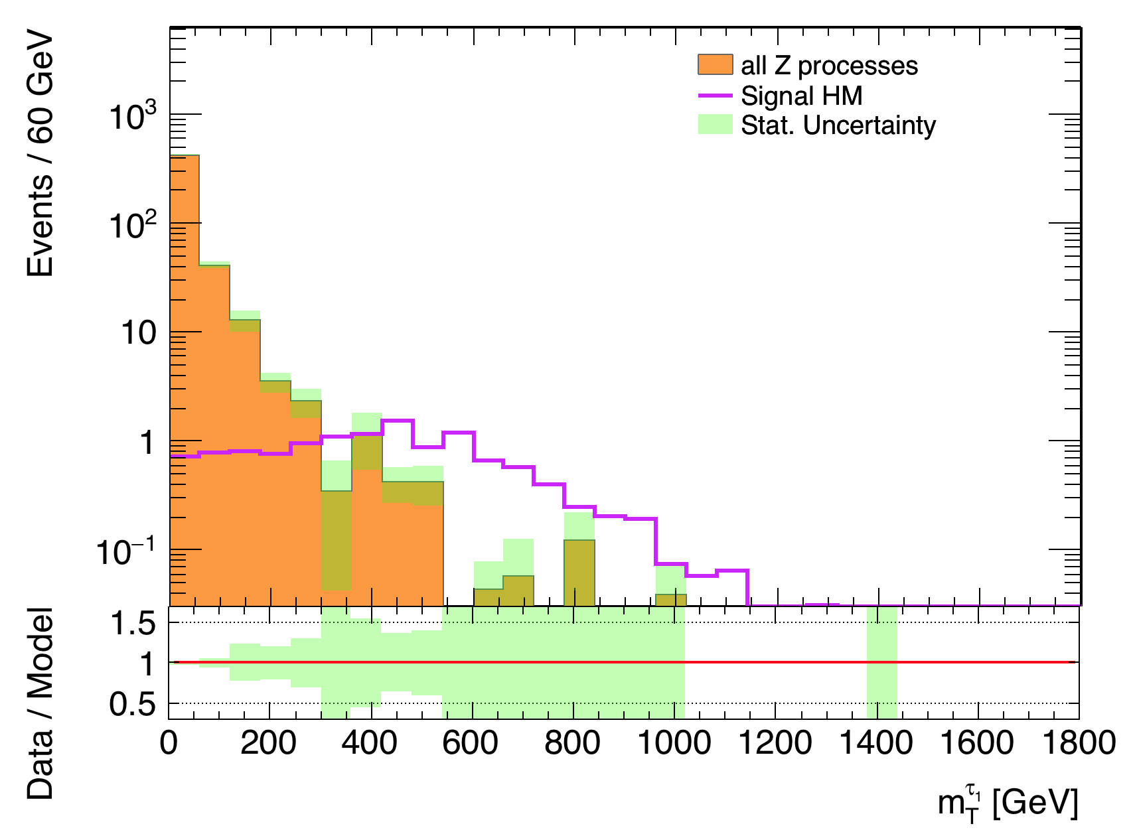

HM Cut 1: Transverse mass
Transverse mass $m_{T}^{τ}= \sqrt{2p_{T}^{τ}E_{T}^{miss}(1−\cos{(Δφ\left(τ,p_{T}^{miss}\right))}}$
$$Z \underset{→}{ } τ^{+}+τ^{−}$$
Notes:
Larger angle = smaller cosine = larger multiple = larger transverse mass

Slide 28
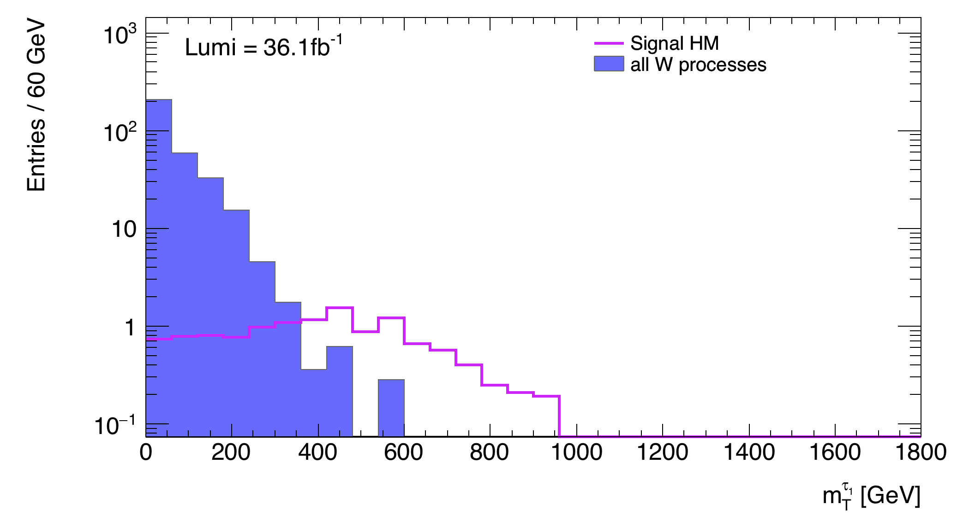

HM Cut 1: Transverse mass
Transverse mass $m_{T}^{τ}= \sqrt{2p_{T}^{τ}E_{T}^{miss}(1−\cos{(Δφ\left(τ,p_{T}^{miss}\right))}}$
$$W \underset{→}{ } τ+\overline{ν}$$

Slide 29

HM Cut 1: Transverse mass
$$t\underset{→}{ } b+W^{+}$$

Slide 30
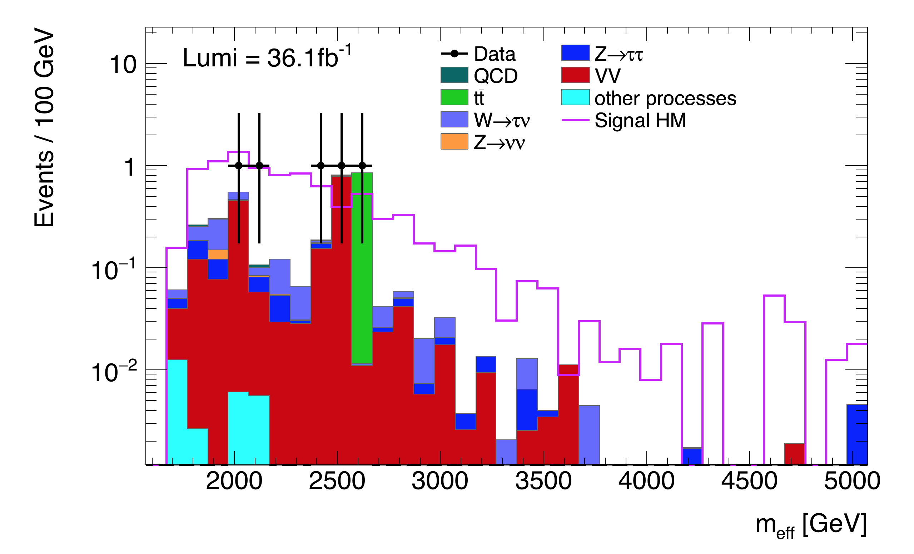

Data Comparison: High$∆m$ Signal Region
 | Count Number
Signal | 9.29
Background | 3.53 ± 1.88
Data | 5
Notes:
Count the events through integration
Error → Poisson

Slide 31
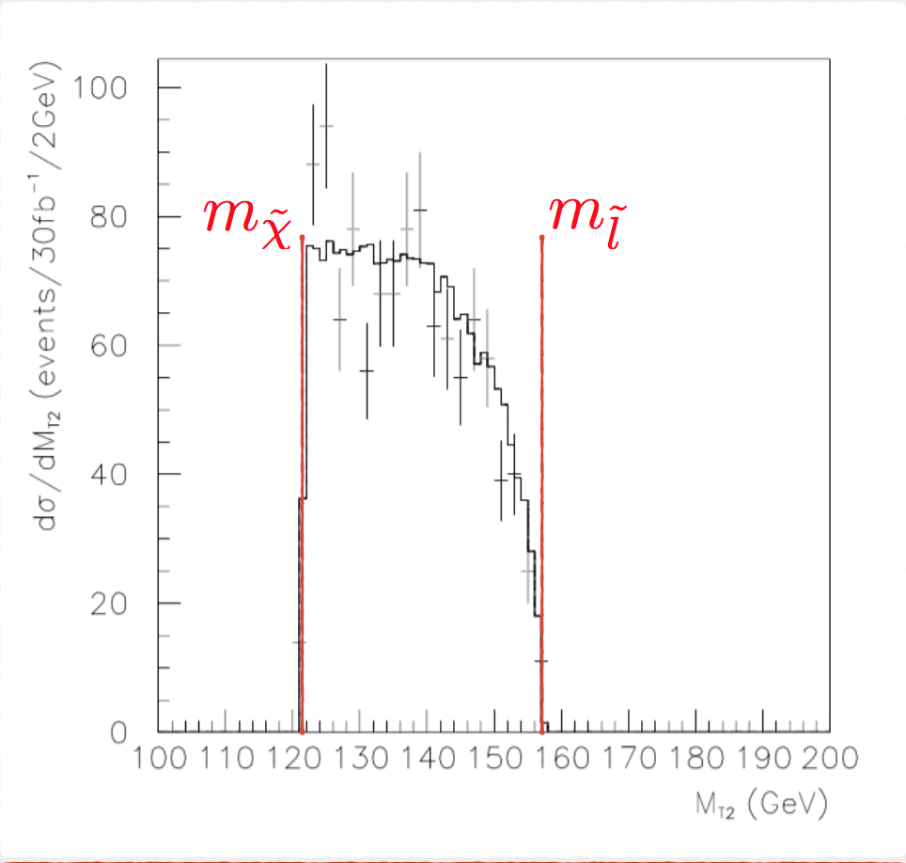
Stransverse Mass
momenta of two visible particles, missing transverse momentum
Bound for the masses of an unseen pair of particles
Notes:
MT2 is a function of the momenta of two visible particles and the missing transverse momentum in an event.
used to bound the masses of an unseen pair of particles which are presumed to have decayed semi-invisibly into particles which were seen

Slide 32

LM Cut 2: Stransverse mass $M_{T2}$
Notes:
MT2 is a function of the momenta of two visible particles and the missing transverse momentum in an event.
used to bound the masses of an unseen pair of particles which are presumed to have decayed semi-invisibly into particles which were seen

Slide 33
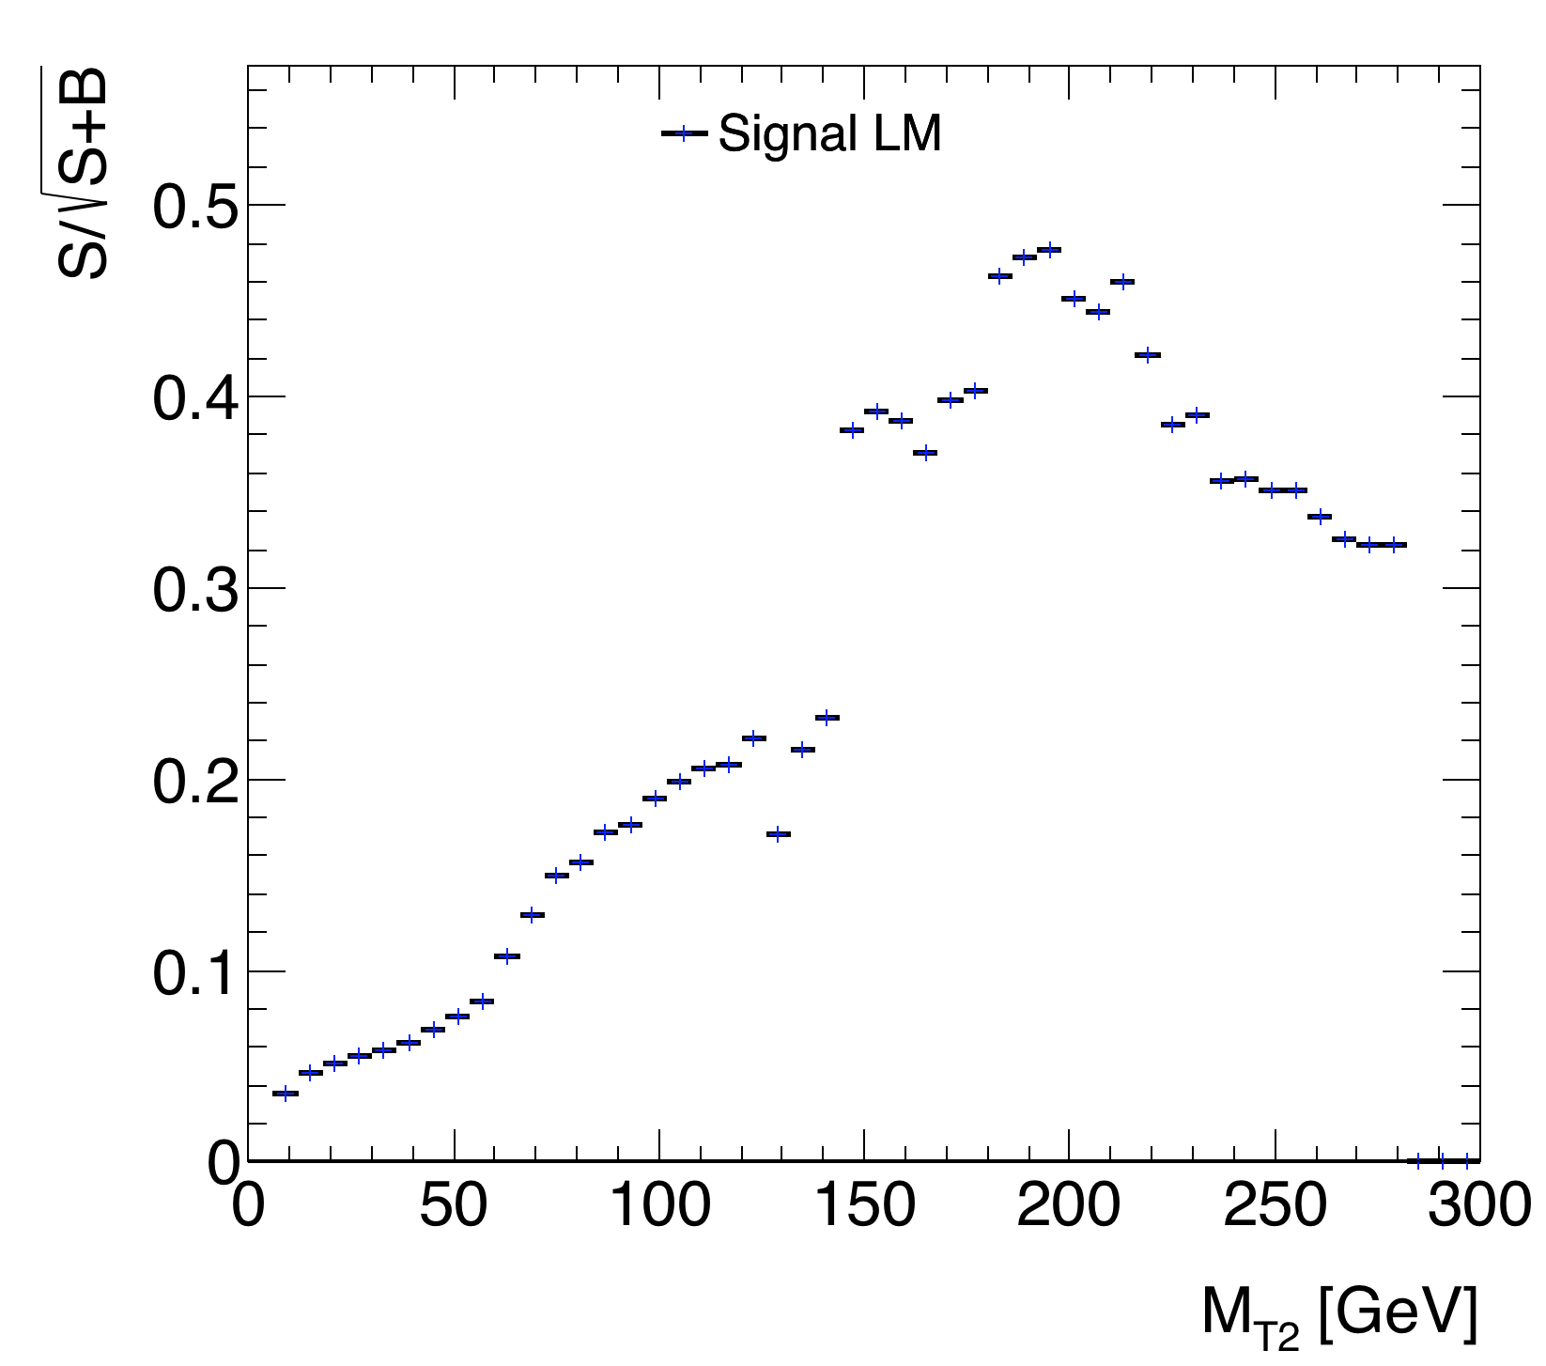

LM Cut 2: Stransverse mass $M_{T2}$

Slide 34
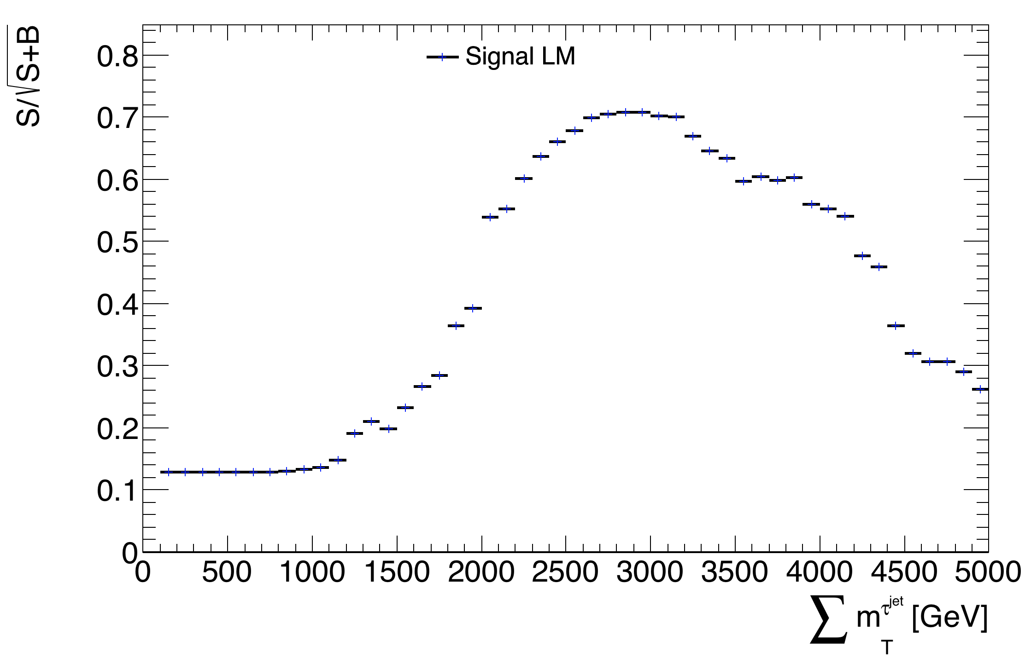

LM Cut 3: $\sum{m_{T}^{τ^{jet}}}$
Cut

Slide 35
Contents
Introduction and Motivation
Model
Backgrounds
High Mass Signal Region
Low Mass Signal Region
Conclusion and Outlook

