Slide 1
SMB-SE-DOP Section
SMB-SE/Anual group meeting/20170120
M. Poehler

Slide 2
DOP – Section mandate
“The DOP section is responsible for Civil Engineering design, Geographic and Patrimony data in the following categories:
the study and design of Civil Engineering works (underground, surface and special works, piping networks, roads and landscaping); the 2D integration, the modeling of structures in 3D Catia; the support to project manager and work requester
the administration of the CERN Geographic Information System (GIS), the update, archive and diffusion of the CERN base maps (sites, parcels, roads, networks, buildings, tunnels, rooms, …) and the patrimony data; the land surveying activities;
The support for project manager and work requester, for technical specifications, cost estimations, and blanket contract (data base of technical specifications and prices)
The management of external relations with the technical offices of the local authorities.
SMB-SE/Anual group meeting/MPOEHLER/20170120

Slide 3
DOP – Section organigram (01.12.16)
Section Leader: M. Poehler
Deputy SL: E. Perez-Duenas
Assistant project : A. Lacarcel*
Design Office
CE Processes
Patrimony
and Site Information
Ingénieur structure
Raul FERNANDEZ
Projeteurs AutoCad-Catia
Ludovic BARTHELEMY
Patrick RIEDO
Poste à pourvoir
Projeteurs contrat cadre
Sertec-1**
Sertec-2**
Sertec-3**
Sertec-4***
Sertec-5***
Pini-1 **
Pini-2 **
Ingénieur «processes»
Eliseo PEREZ-DUEÑAS
Technicien «processes»
Stéphanie RICHARD
Ingénieur Géomètre
Youri ROBERT
Géomaticien
Nicolas GUILHAUDIN
Klaudyna Kaja WROCHNA*
Technicien
Samuel ZELER
Francois VILLAGRASSA
Technicien contrat cadre
C201/BE**
C201/BE**
* VIA, Fellow, stagiaire, COAS ou autres contrats
** Personnel en prestation de service
***Personnel en prestation de service détaché
SMB-SE/Anual group meeting/MPOEHLER/20170120

Slide 4
SMB-SE DOP Section
Patrimony and External relations
Consolidation program execution
Mainly machine
Project execution
Mainly tertiary
Studies for future accelerators
and existing tunnel structures
Works, Operation and Maintenance
Important interaction
with all other section
SMB-SE/Anual group meeting/MPOEHLER/20170120

Slide 5
SMB-SE DOP Section
Design office
Patrimony and site information
CE Processes
External relations with the technical offices of the local authorities
SMB-SE/Anual group meeting/MPOEHLER/20170120

Slide 6
DOP Design - Office
Number of request
 | 2013 | 2014 | 2015 | 2016
Graphic studies | 65 | 90 | 180 | 200
Structural studies | 195 | 240 | 275 | 300(*)
(*) 75% complete, 15% ongoing, 10% canceled by requester
Type of studies
(Approx. values)
SMB-SE/Anual group meeting/MPOEHLER/20170120

Slide 7
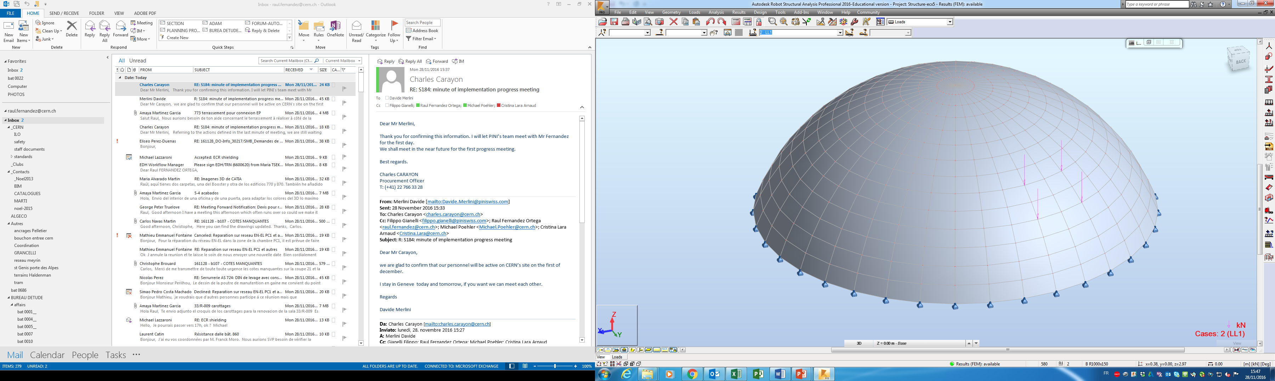
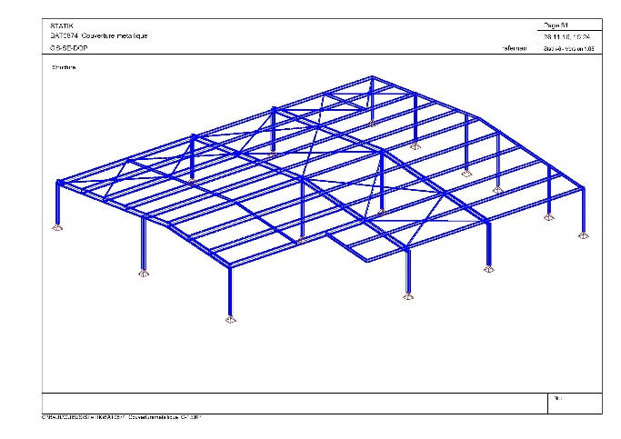
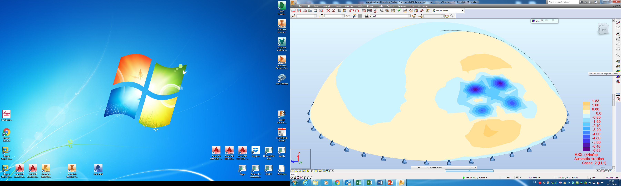
DOP Design - Office
Static verifications
Construction designs
Feasibility studies
Standards requests
Design assessment
Reinforced concrete
Steel structure
External layouts
Architectural design
Refurbishment
Detailing
Bld-201_Study for the
Installation of the new boilers
Bld 101-PS_New HVAC
equipment on the roof
Bld 899-ECA5_Hanging
Loads from the dome
Bld-874-CCC_Temporary cover
SMB-SE/Anual group meeting/MPOEHLER/20170120

Slide 8
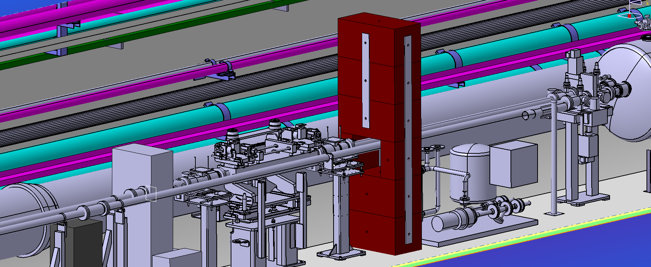
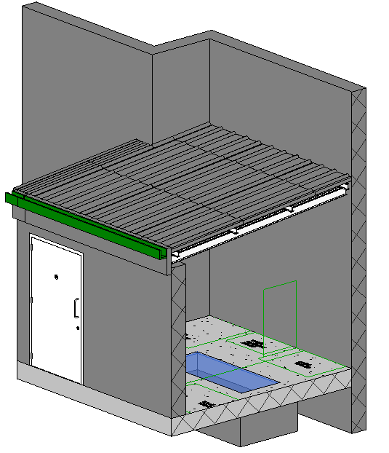
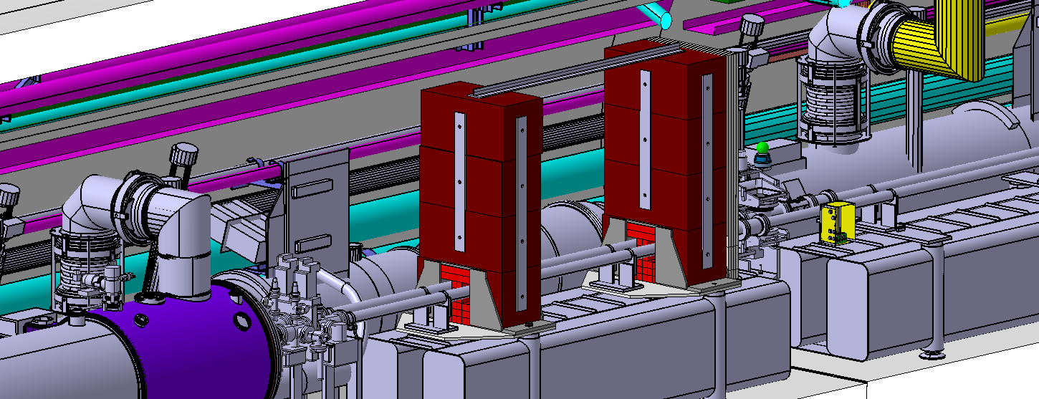
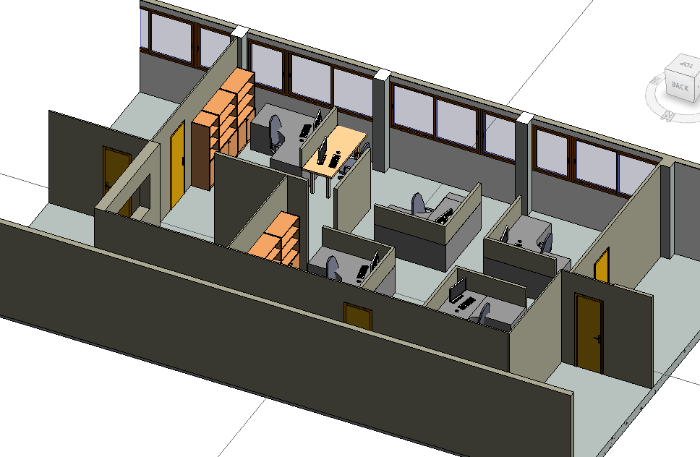
DOP Design - Office
Static verifications
Construction designs
Feasibility studies
Standards requests
Design assessment
Reinforced concrete
Steel structure
External layouts
Architectural design
Refurbishment
Detailing
Shielding stability at point 1 (RR17)
Study buffer zone in BA80
Bld 73. Refurbishment study of alternatives
SMB-SE/Anual group meeting/MPOEHLER/20170120

Slide 9
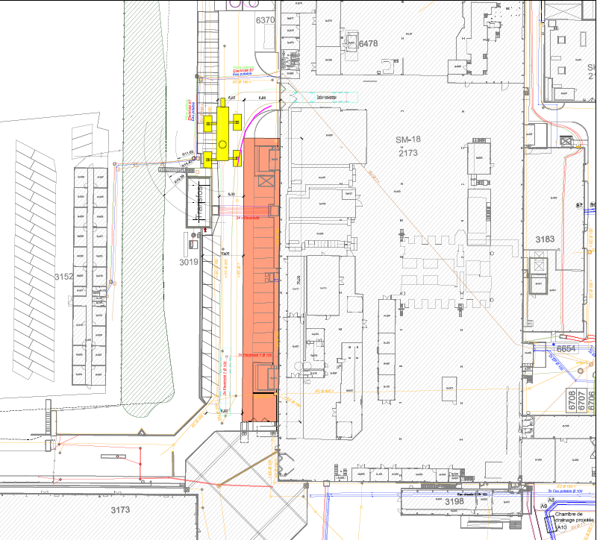
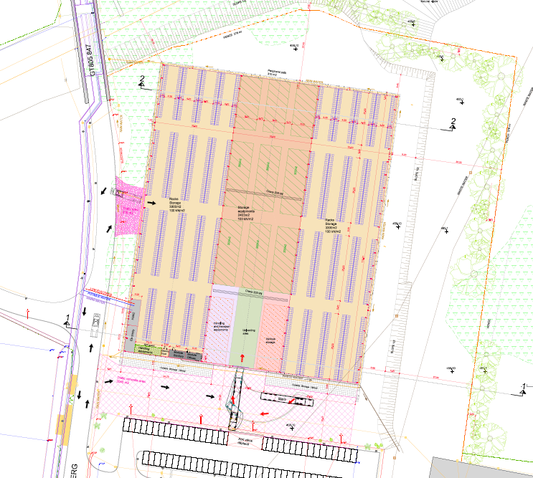
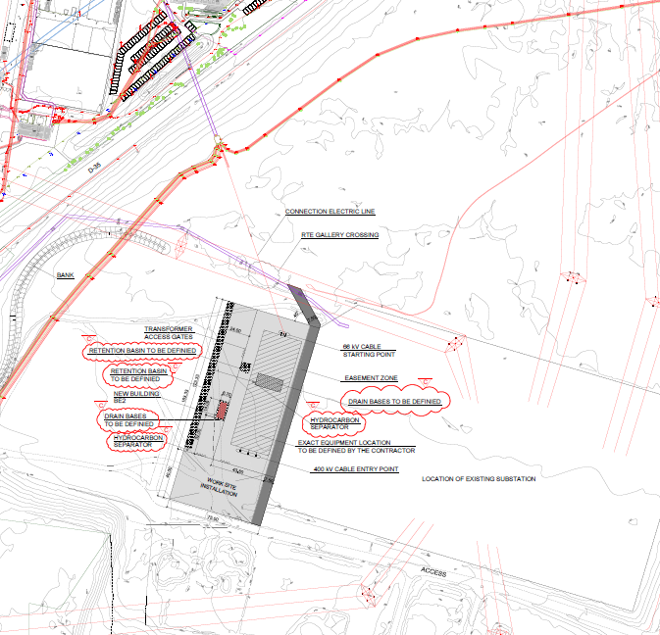
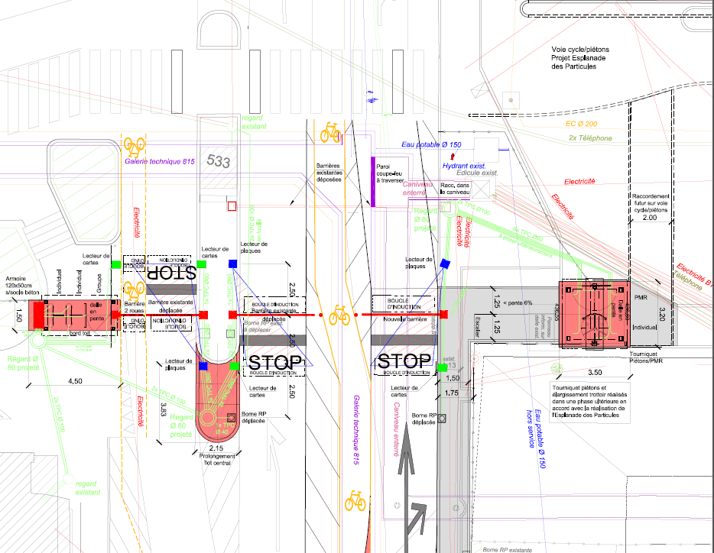
DOP Design - Office
2D Drawings – Studies and Projects (~200 requests/year)
SM18 Extension
Feasibility studies
Preliminary designs
Construction designs
Tender designs
Coordination designs
Archive drawings Research of drawings
New storage building
In Prévessin (Bld 947)
Studies for the
New substation BE2
Refurbishment of the Entrance B
SMB-SE/Anual group meeting/MPOEHLER/20170120

Slide 10
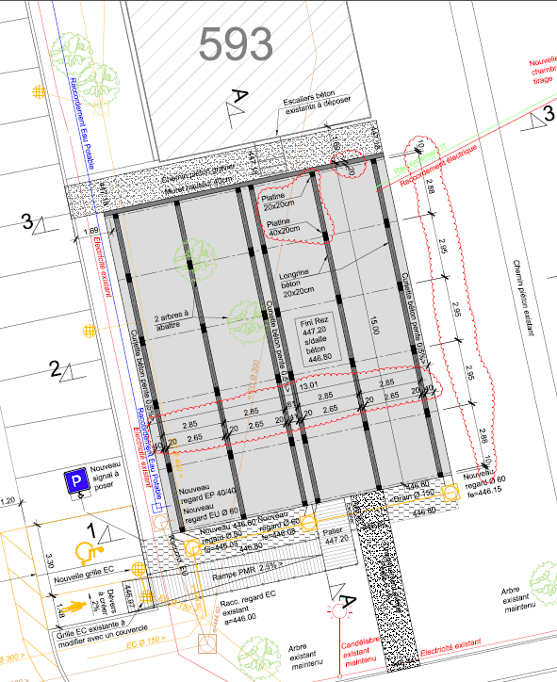
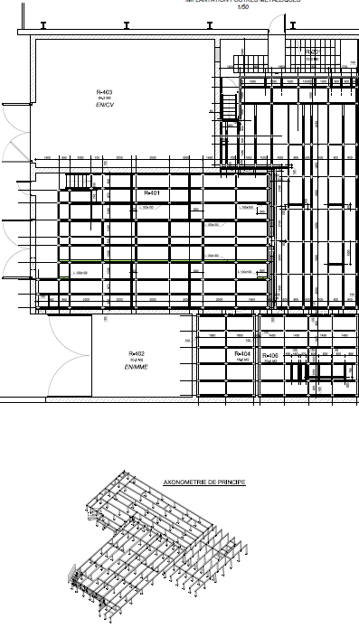
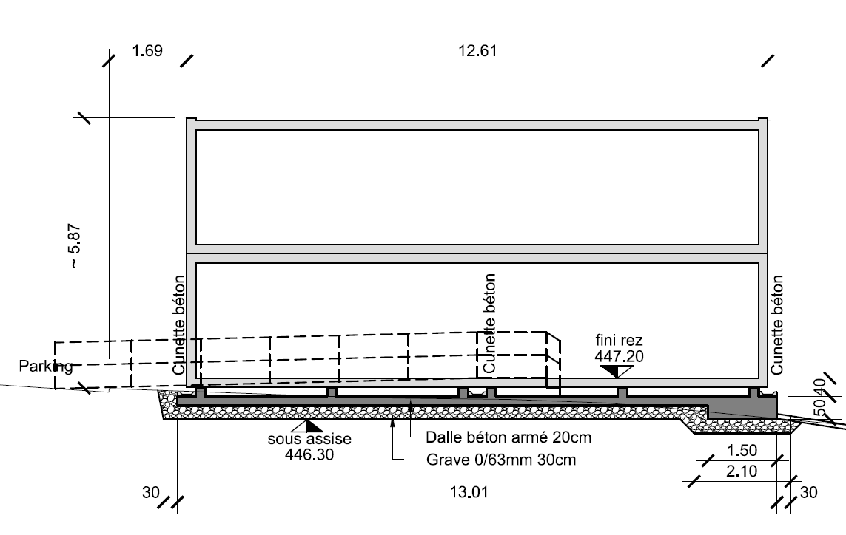
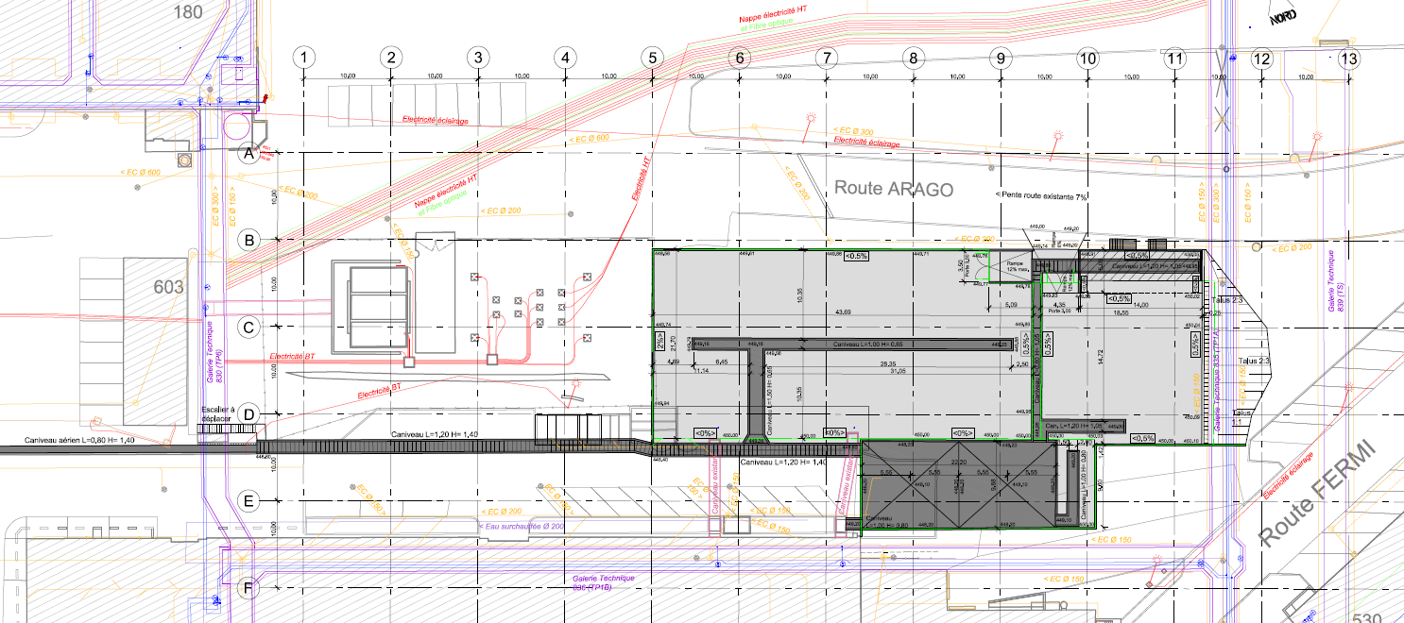
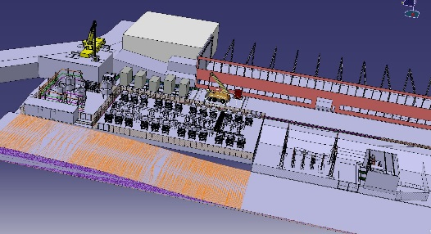
DOP Design - Office
2D Drawings – Studies and Projects (~200 requests/year)
Basement for modular building.
Training center-bld 693
Feasibility studies
Preliminary designs
Construction designs
Tender designs
Coordination designs
New MEQ59 sub-station
Refurbishment of building 232.
New ME91 sub-station false floor
SMB-SE/Anual group meeting/MPOEHLER/20170120

Slide 11
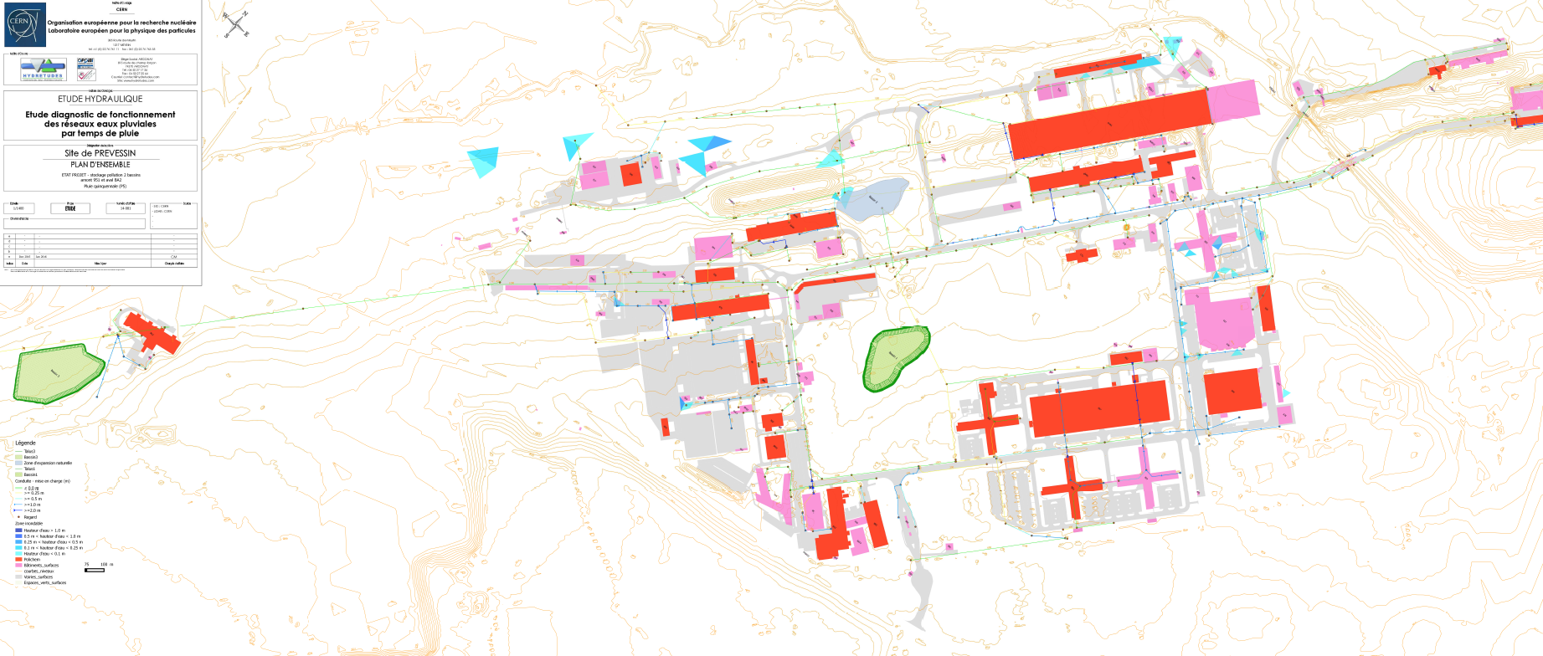
DOP Design - Office
PoliChem Working Group
Working group for the prevention of liquid and chemical pollution in collaboration with all the departments
  Liquid products in the central store and waste disposal management
  Petrol stations
  Sewage Network (included oil separators and retention basins)
  Hydraulic studies
Network modification
at Point LHC-7
Study for the risk mitigation in the Prévessin site and BA-2
SMB-SE/Anual group meeting/MPOEHLER/20170120

Slide 12
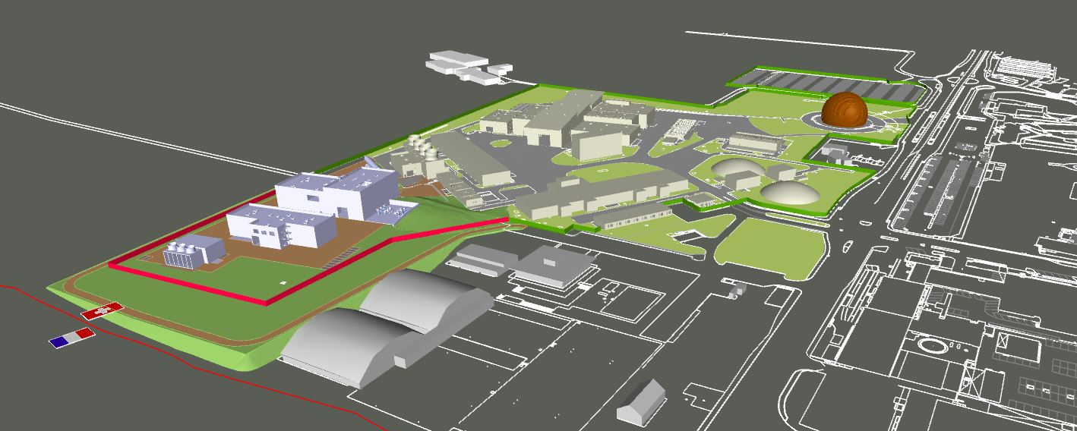
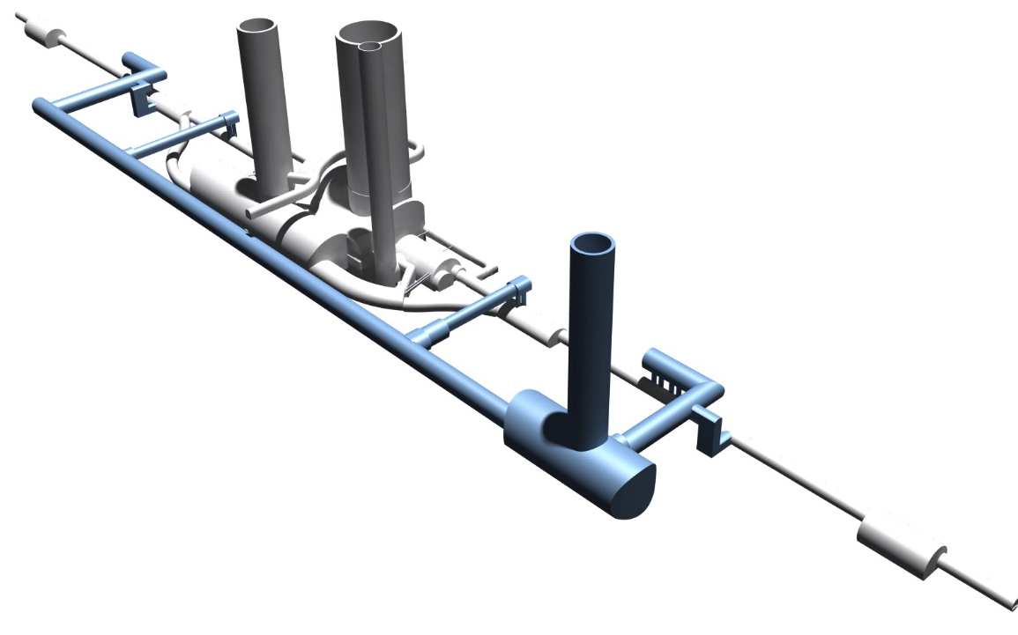
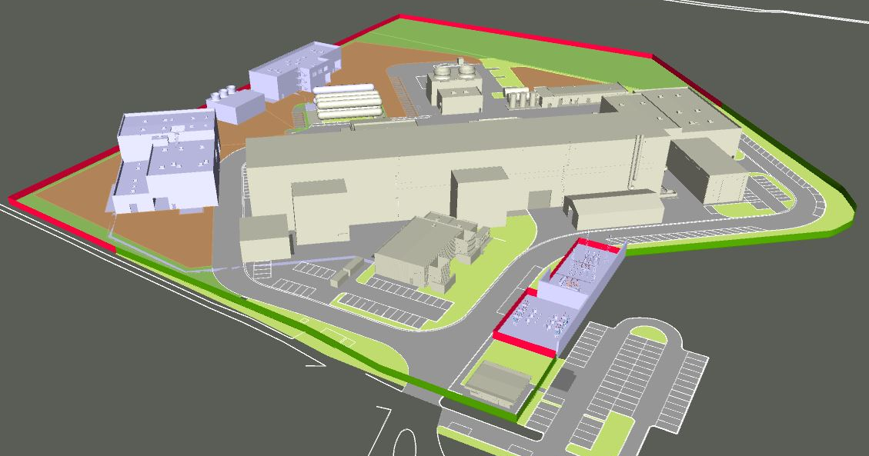
DOP Design - Office
HL-LHC project in point LHC-1 and LHC-5
3D model Point 1.
Surface buildings
3D model
Underground infrastructure
3D model Point 5.
Surface buildings
SMB-SE/Anual group meeting/MPOEHLER/20170120

Slide 13
DOP Design - Office
HL-LHC project. Example for point LHC-5
Conception
Collaboration
Design
Coordination
Integration
SMB-SE/Anual group meeting/MPOEHLER/20170120

Slide 14
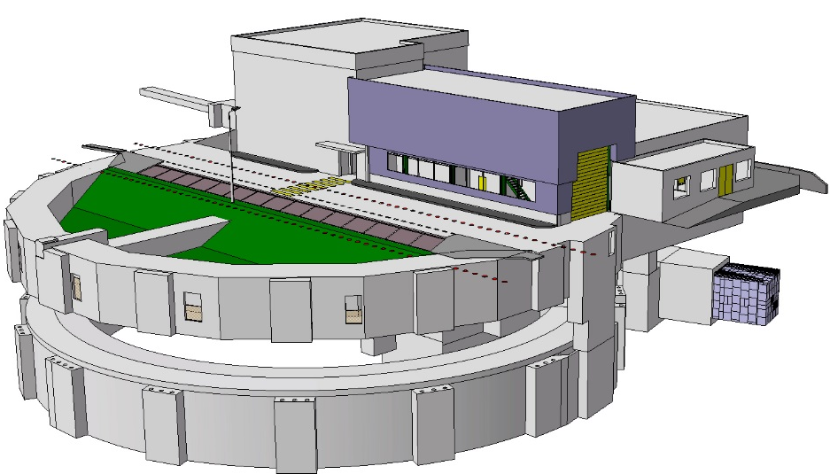
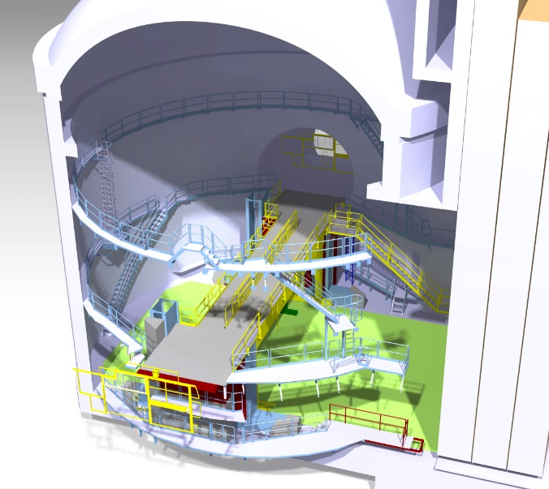
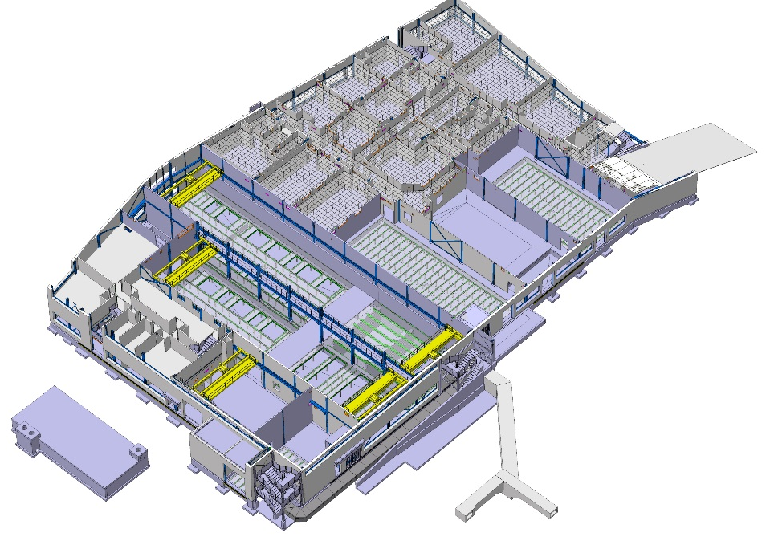
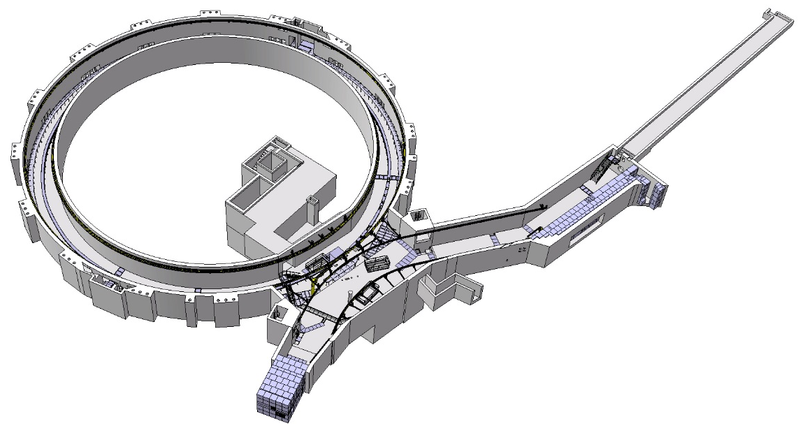
DOP Design - Office
3D Models – Studies and Projects (~50 requests/year)
ECX-5 New beam dump
Booster complex
BLD 107
Booster-PS connection
SMB-SE/Anual group meeting/MPOEHLER/20170120

Slide 15
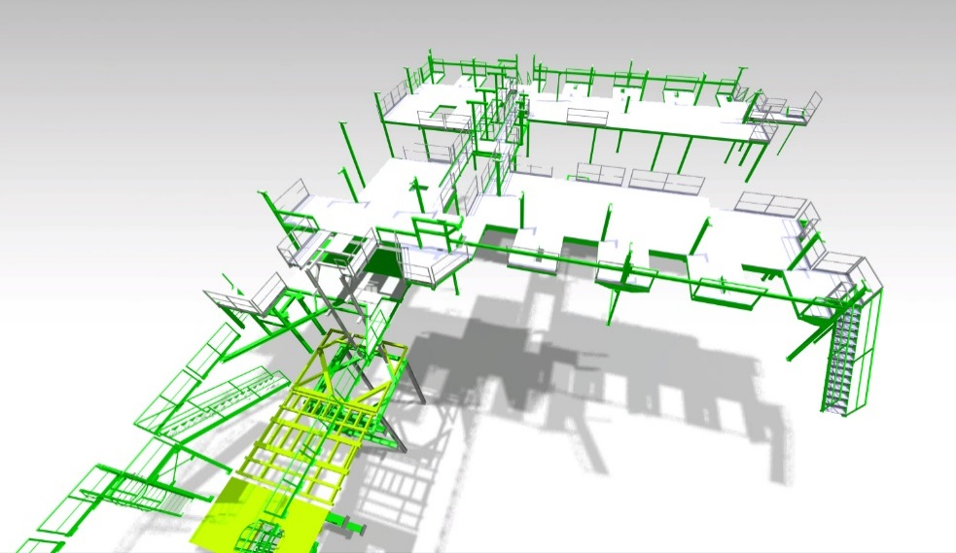
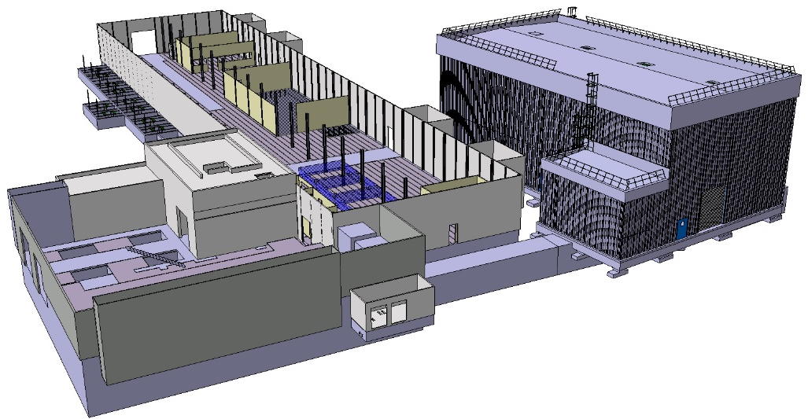

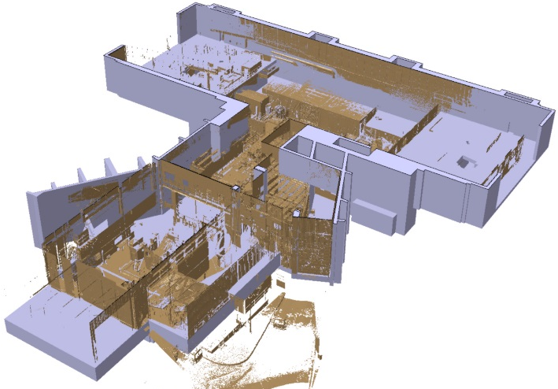
DOP Design - Office
3D Models – Studies and Projects (~50 requests/year)
BA3-BB3-BAF3
SM18-CLUSTER D
ISR-RWTC
BLD 184
BLD 107
SMB-SE/Anual group meeting/MPOEHLER/20170120

Slide 16
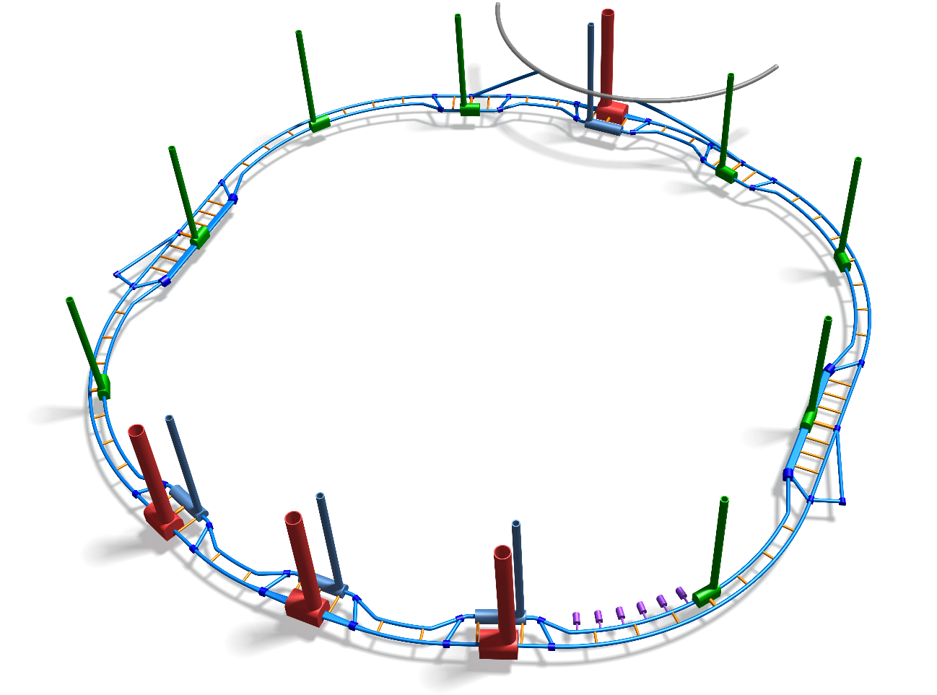
DOP Design - Office
FCC – preliminary studies
SMB-SE/Anual group meeting/MPOEHLER/20170120

Slide 17
DOP Design - Office
Frame contracts
Civil Engineering and Architectural Consultancy Services
Value in KCHF/Year | BOMA-BAC (22%) | GEOS (50%) (Architecture) | GEOS (15%) (Engineering) | ATKINS (13%)
2014 | 240 | 165 | 0 | 95
2015 | 40 | 120 | 190 | 65
2016 | 15 | 430 | 105 | 175
Design services (Draftsmen)
  7 persons working on CERN site in the DOP section
  2 persons collaborating in other services (HL-LHC; ALICE)
  Collaborations with different projects:
    HL-LHC (Underground and surface infrastructures
    CATIA Integration models (Booster, LINAC, PS, SPS, LHC, LIU)
    ISR-RWTC (radioactive waste treatment center)
    FCC (Future Circular Colider)
    Buildings 107, 311 (magnetic measurements), 887 (CENF), 773 (New IT Hub)
    PoliChem working group
SMB-SE/Anual group meeting/MPOEHLER/20170120

Slide 18
DOP Design - Office
Internal invoicing jobs (2016)
Project | Value (CHF)
RWTC-ISR (Radioactive Waste Treatment Center) | 32.000
Consolidation projects | 60.000
Modification CERN entrance | 5.000
New CSA installation | 3.000
HL-LHC | 190.000
Building 947 for storage | 8.200
SM18 extension | 16.000
New building 107 | 50.000
Total: | 364.200
SMB-SE/Anual group meeting/MPOEHLER/20170120

Slide 19
DOP Design - Office
Jobs distribution (2016)
 | N° studies (~) | N° working hours
PROJECTS-DIVERS (DOP) | 93 | 2845
SMB-SE-CEB | 75 | 4100
SMB-SE-FAS | 4 | 100
SMB-SE-PO | 13 | 960
INTEGRATION | 25 | 2265
HL-LHC | 1 | 2500
HL-LHC | Ludovic, Sertec1, PS1
Building 107: | Patrick, Sertec 1, Sertec 2
Building 311: | Patrick, Sertec 2, Raul
ISR-RWTC | Sertec 5, Raul
Building 887-Extension | Patrick, Sertec 1
FCC | Sertec 1, Sertec 5
PoliChem working group | Raul, Sertec 4
Civil models for Integration | Sertec 3, Sertec 2
SMB-SE/Anual group meeting/MPOEHLER/20170120

Slide 20
DOP Design - Office
PREPARED FOR THE REFURBISHMENT OF BUILDING 5
Creation of the 2D drawings, sections, etc
Support to make decisions
3D views and renders
Creation of the
3D model
Link to data sheets and
Specifications on EDMS
Bill of quantities.
By type, material, etc.
Identification of elements
by type (ex: a type of door)
Data extraction (excell, etc.)
SMB-SE/Anual group meeting/MPOEHLER/20170120

Slide 21
DOP Design - Office
Objectives 2017
Strengthen support to other sections through streamlines/standard procedures/templates.
Service oriented and client satisfaction
Increment of the number of studies completed and a maximum register of information in EDMS
Implantation of the first phase of BIM (Working in 3D models, even with external contractors)
BIM projects (3D models): 50% of the main projects buildings/works developed in REVIT
Use of service-now to follow the advancement of the studies and register them
Increase capacity of design integration
2017 - Resources
1 Civil engineer
5 CAD-Revit draftsmen
3 CATIA draftsmen
Technical student (BIM implementation)
Personnel 2016
Needs 2017
(in addition)
Fellow – Civil Engineer Support (Structural calculations, reports, studies)
Cad and Revit support (to be defined with the main project baseline)
SMB-SE/Anual group meeting/MPOEHLER/20170120

Slide 22
SMB-SE DOP Section
Design office
Patrimony and site information
CE Processes
External relations with the technical offices of the local authorities
SMB-SE/Anual group meeting/MPOEHLER/20170120

Slide 23
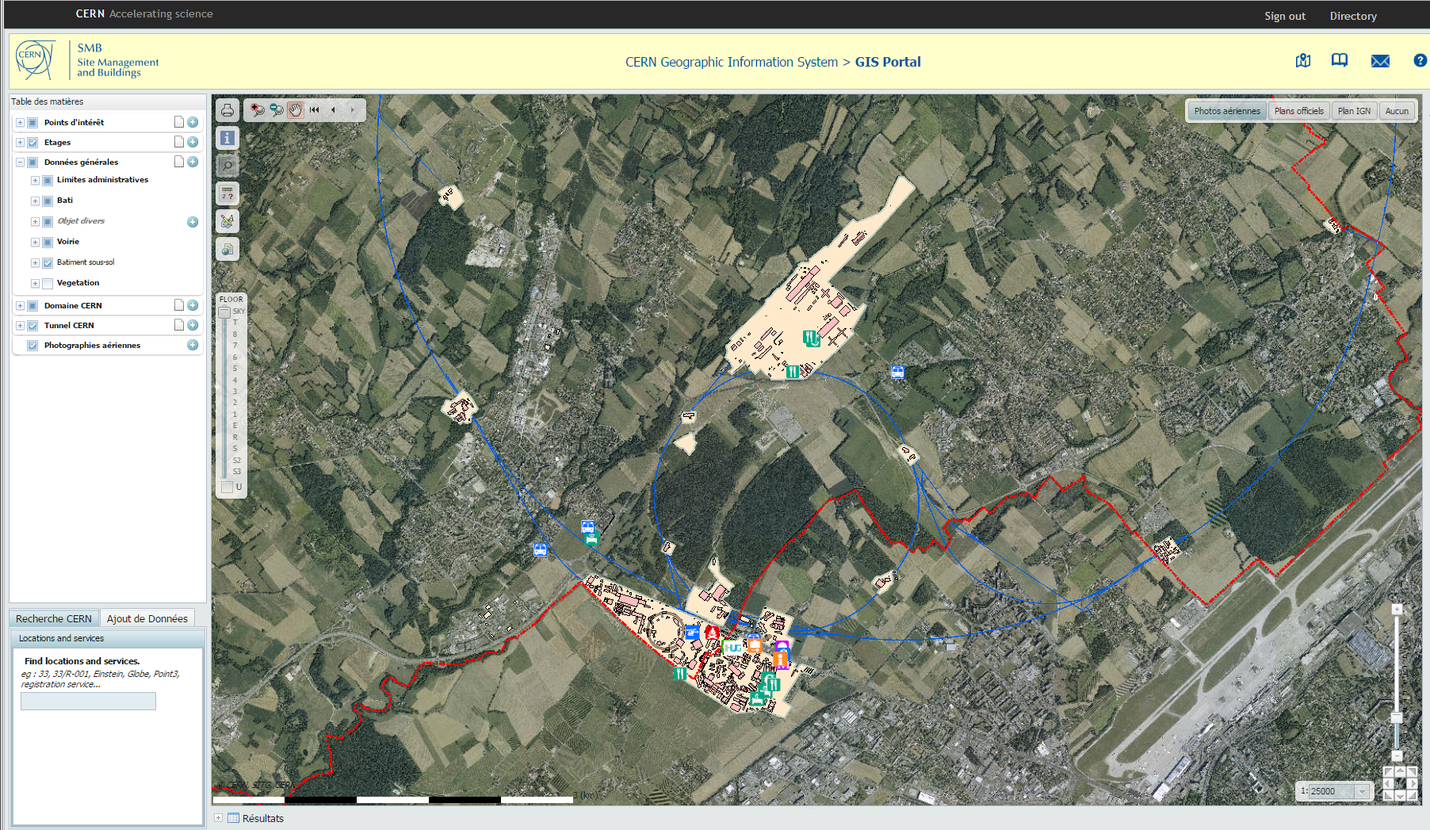

The Team and the mandate
DOP Patrimony and site inform.
General contact : Youri Robert
GIS portal infrastructure: Nicolas Guilhaudin
GIS and 3D projects : Klaudyna Wrochna
Modular buildings rental and archived plans: François Villagrassa
Topography: Samuel Zeler
Maps, DICT and Others: C201/BE
Floor Maps: C201/BE
SMB-SE/Anual group meeting/MPOEHLER/20170120

Slide 24
DOP Patrimony and site inform.
ISP in number of «Snow tickets»
Total=955
SMB-SE/Anual group meeting/MPOEHLER/20170120

Slide 25
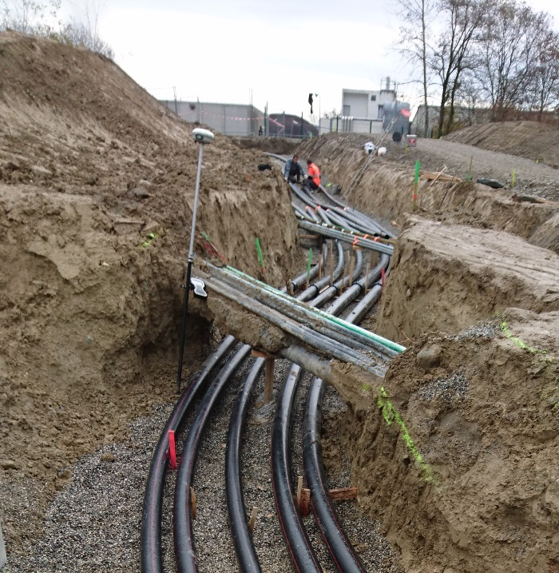
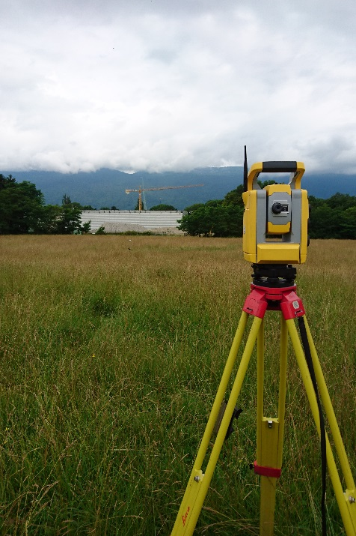
DOP Patrimony and site inform.
2016 Main achievements
Survey and Topography
50 set out (“implantations”) and land surveys for new buildings or networks.
90 land surveys for updates of CERN maps and new projects
10 specific calculations (cubic, profiles,..)
High precision GPS
Survey of Hi-lumi new networks
Land Survey for future 947
SMB-SE/Anual group meeting/MPOEHLER/20170120

Slide 26
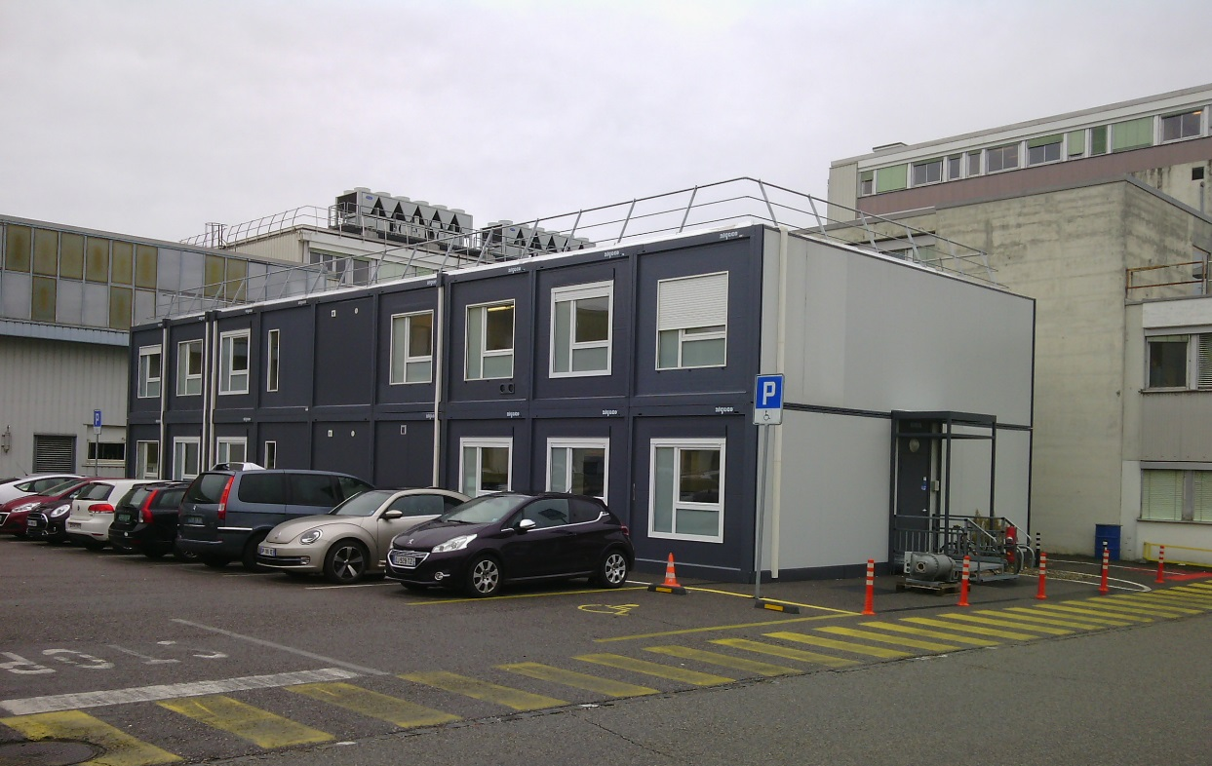
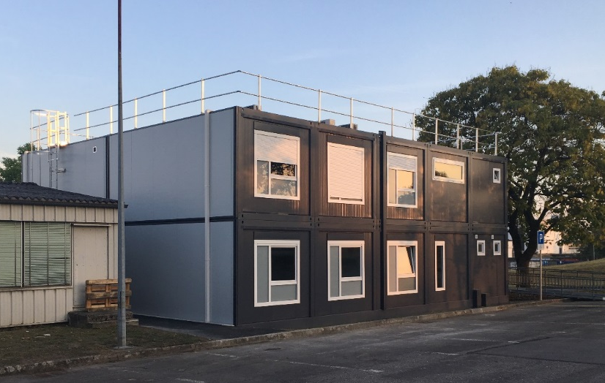
DOP Patrimony and site inform.
2016 Main achievements
Modular Buildings leasing (baraques)
23 Contract rental (2500 m2 )
Major achievements:
- Swing Space 653
- Class room 693
- 107 lifebase
Swing space 652
Class room 693
SMB-SE/Anual group meeting/MPOEHLER/20170120

Slide 27
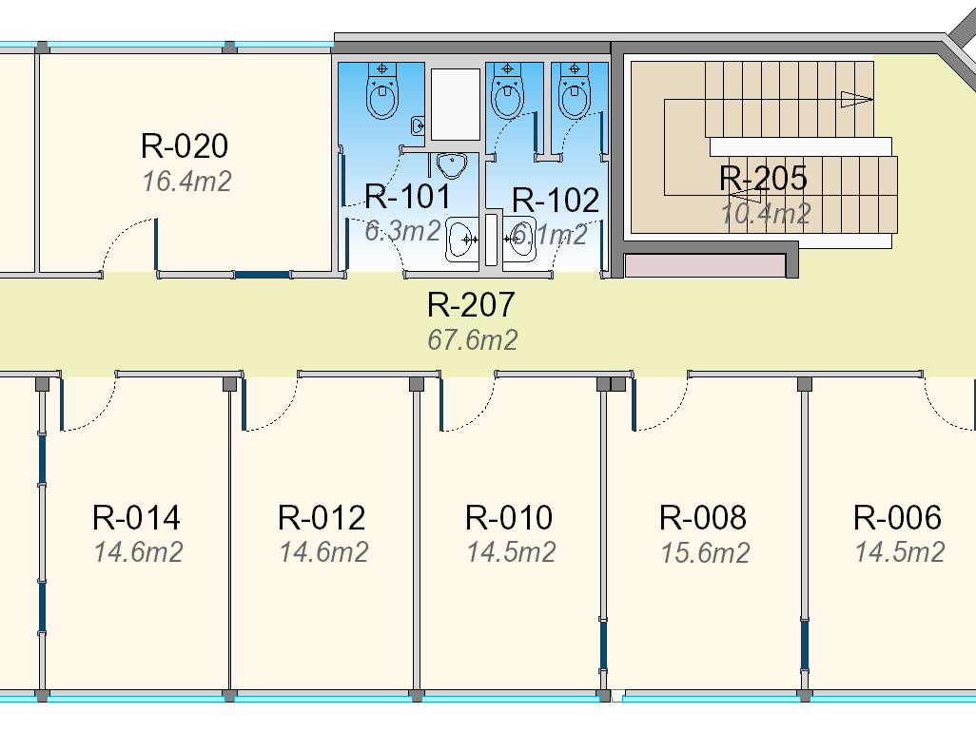

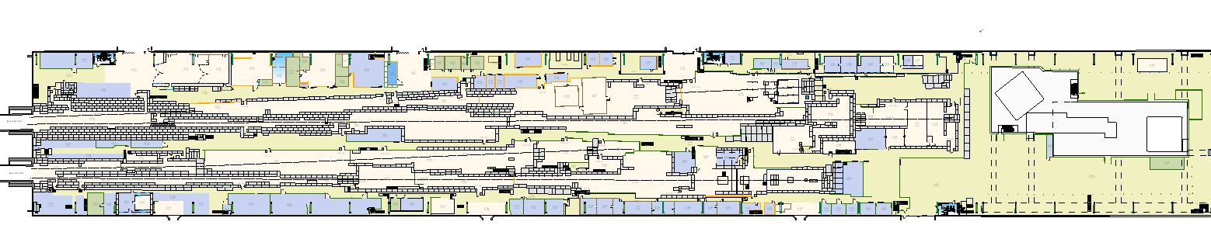
DOP Patrimony and site inform.
2016 Main achievements
Floor Maps
176 requests processed (+ 25%)
22 feedbacks
New colors and display
EHN1 (887) Ground floor with new extension
SMB-SE/Anual group meeting/MPOEHLER/20170120

Slide 28

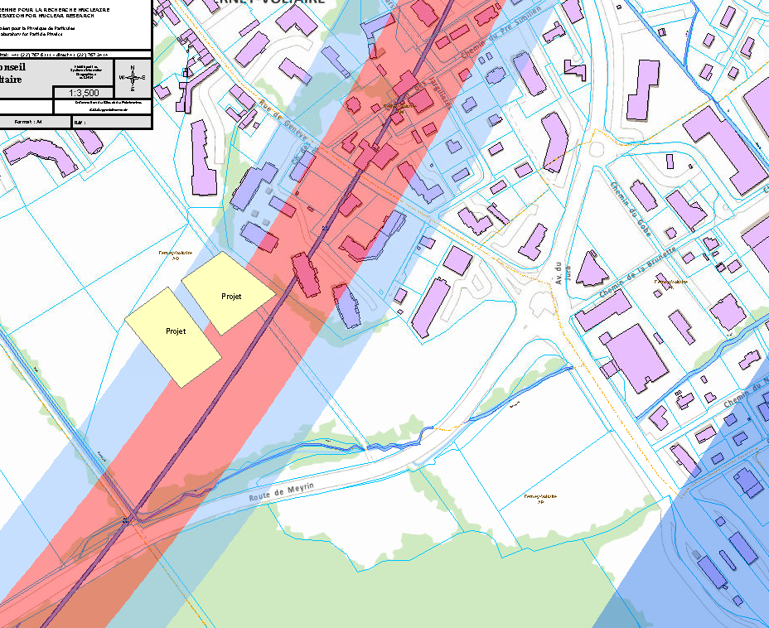
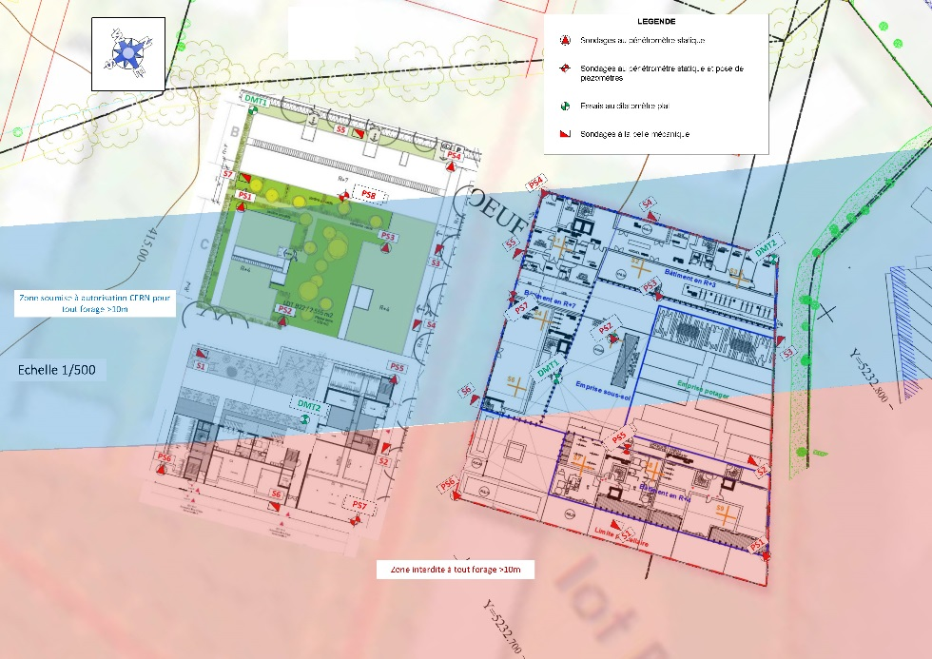
DOP Patrimony and site inform.
2016 Main achievements
3 Digging authorisations and following, next to the tunnel
5 Study and authorisations for building permits next to the tunnel
250 DICT* studied and replied
* Déclaration d’Intention de Commencement de Travaux
Digging authorisations
Zac Ferney Genève innovation
SMB-SE/Anual group meeting/MPOEHLER/20170120

Slide 29
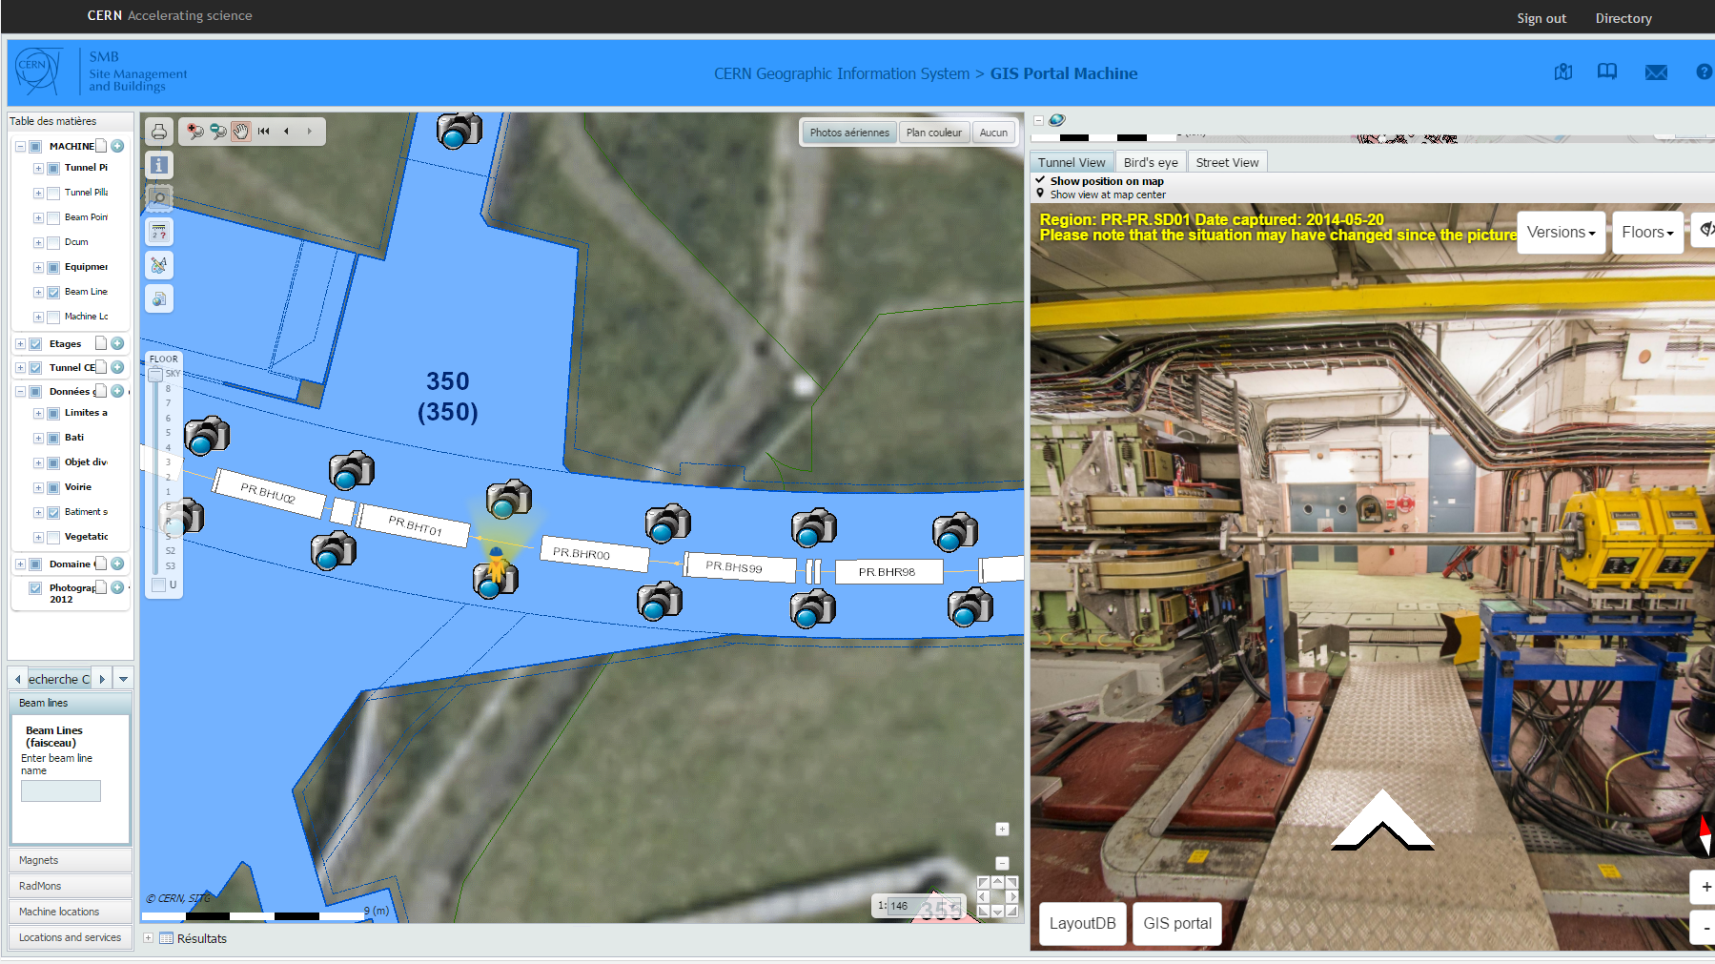

DOP Patrimony and site inform.
2016 Main achievements
GIS Portals
EN/ACE Tunnel Panoramic picture integration (coming soon on GIS Portal)
Just like Google Street view, the
icon
indicates the position of the 360° picture in the map and its orientation.
It can be moved to any place where there is a picture
SMB-SE/Anual group meeting/MPOEHLER/20170120

Slide 30
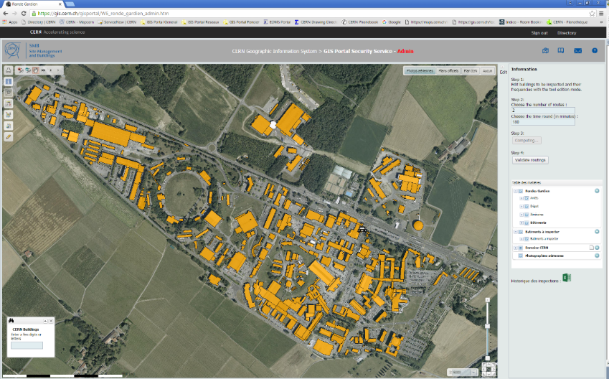
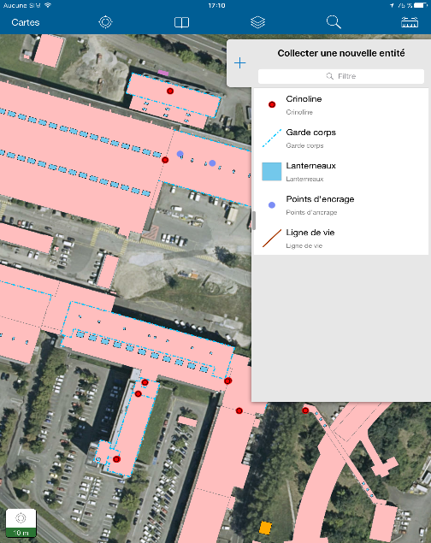

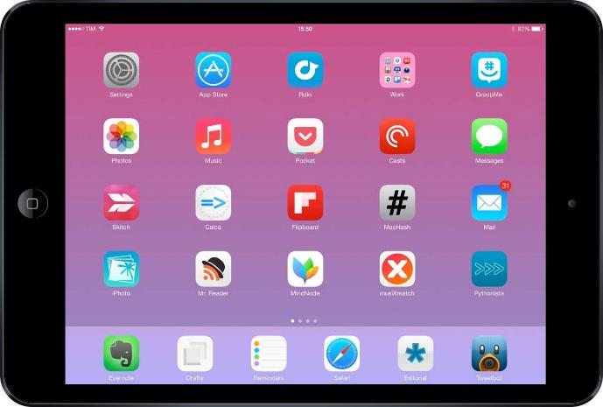
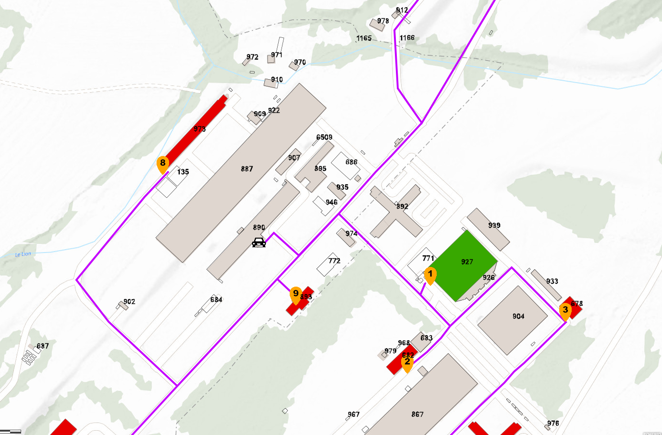
DOP Patrimony and site inform.
2016 Main achievements
GIS PORTALS - mobile
Offline mobile Apps for data edition (roof security equipment inventory)
Prototype App for Security guards (in production in 2017)
(Provide optimised routes for security inspections according to customs criterias)
Offline mobile edition
Security guards mobile and desktop
SMB-SE/Anual group meeting/MPOEHLER/20170120

Slide 31
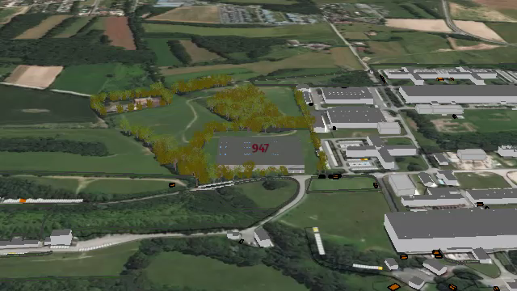
DOP Patrimony and site inform.
2016 Main achievements
3D videos for building simulation
775
947
SMB-SE/Anual group meeting/MPOEHLER/20170120

Slide 32
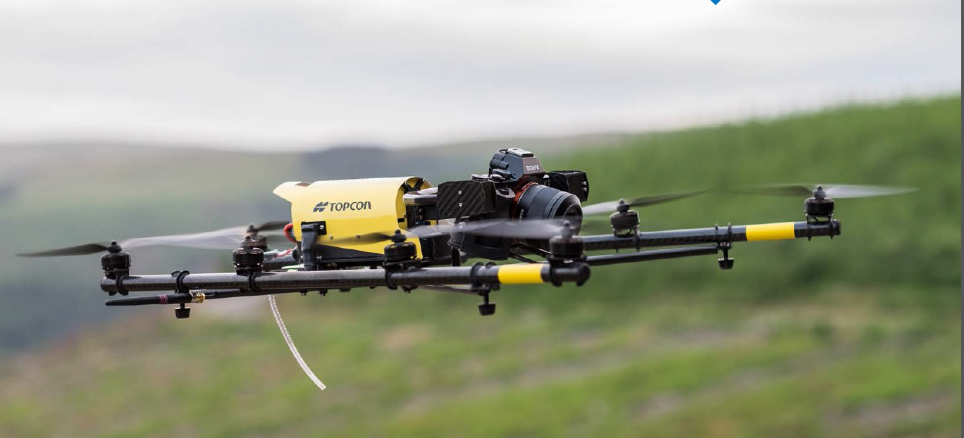
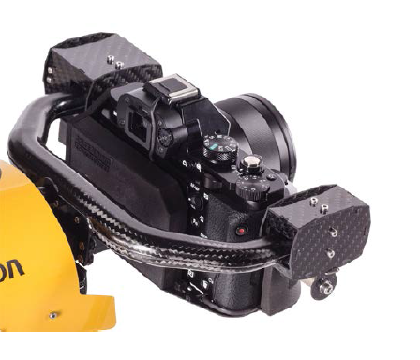
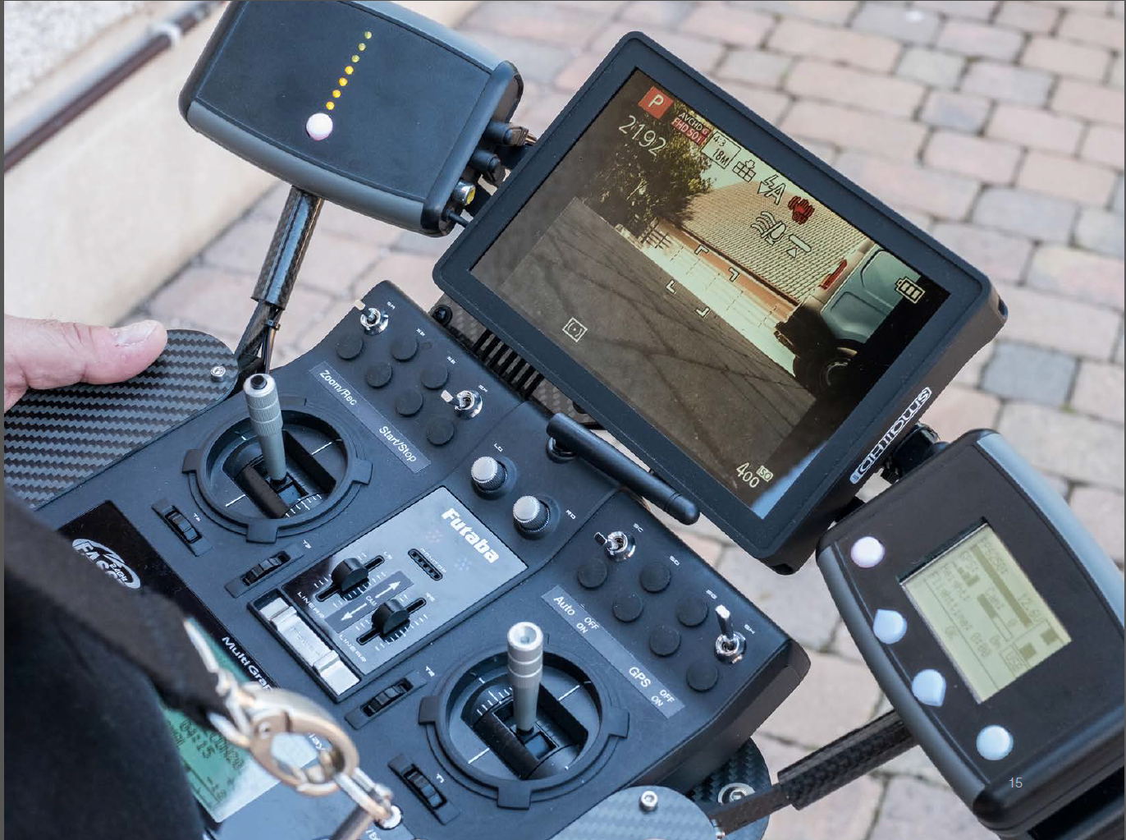
DOP Patrimony and site inform.
2017 Objectives
Land survey and topography
-Land survey and orthophotos from UAV* (Drone) * Unmanned Aerial Vehicle
SMB-SE/Anual group meeting/MPOEHLER/20170120

Slide 33

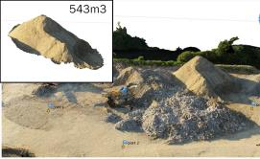
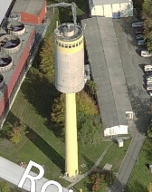
DOP Patrimony and site inform.
2017 Objectives
Main UAV intended uses
Land survey:
        Topographic measurement (->creation Digital Terrain Model)
        Digitalisation from orthophoto
        Cubic calculation
3D terrain modelling:
        Update of the 3D building database
        Picture for building Textures
Inspection:
      Façade, roof, crack inspection or monitoring (exe: globe, cooling towers, water tower)
      Thermic inspection : gaz leaks, insulation analysis
Update of site orthophotos
Any aerial picture for communication:
SMB-SE/Anual group meeting/MPOEHLER/20170120

Slide 34
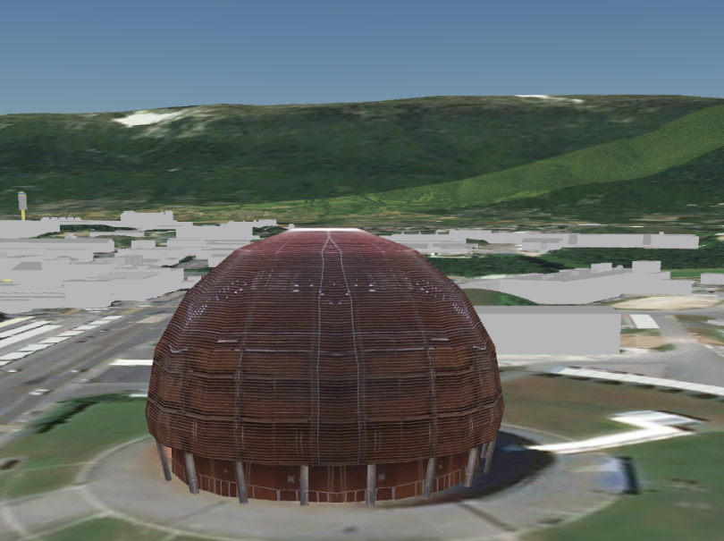
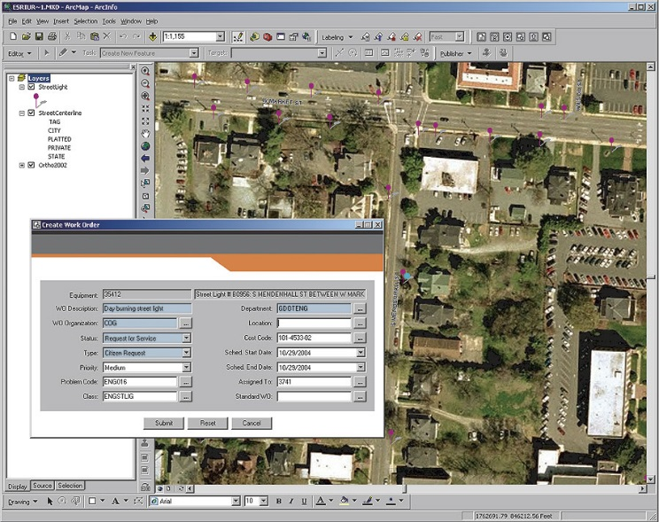

DOP Patrimony and site inform.
2017 Objectives
GIS infrastructure
- Infrastructure consolidation (speed and Server redundancy)
- Integration with InforEAM
- Creation of a 3D database and web site
Example of 3D web site
New GIS Infrastructure
Example of InforEam Integration
SMB-SE/Anual group meeting/MPOEHLER/20170120

Slide 35
SMB-SE DOP Section
Design office
Patrimony and site information
CE Processes
External relations with the technical offices of the local authorities
SMB-SE/Anual group meeting/MPOEHLER/20170120

Slide 36

DOP Processes
The team
Processes engineer: Eliseo Perez-Duenas
Processes technician: Stéphanie Richard
SMB-SE/Anual group meeting/MPOEHLER/20170120

Slide 37

DOP Processes
The mandate
fully drawing up or in collaboration with SE group sections and others Departments of technical specifications (MS,PE and IT),
to draw up blanket contracts,
to draw up IPPs (Infrastructure Project Proposal),
cost estimates for CE projects,
supporting and advising SMB-SE construction teams,
set up of DB for Description and Quantity Estimates, unit prices and firms.
SMB-SE/Anual group meeting/MPOEHLER/20170120

Slide 38
DOP Processes
The Team
Processes Service
EPD
EPD
Cost Estimations
Market Survey
Price Enquiries for Consultants and CE works
Call for Tenders
Call for Tenders support for other Departments
-IPP
SR
Cost Estimations
Price Enquiries for Consultants and CE works
Call for Tenders
Call for Tenders for Blanket Contracts CE
IPP (947)
SMB-SE/Anual group meeting/MPOEHLER/20170120

Slide 39


DOP Processes
2016 Main Achievements
Market Surveys processed (2015 & 2016):
Pont ISR
2015 Group SMB-SE
Total MS…………….. 5
DOP-Processes…… 2
40%
60%
15%
2016 Group SMB-SE
Total MS…………….. 19
DOP-Processes…… 16
85%
Building 107
SMB-SE/Anual group meeting/MPOEHLER/20170120

Slide 40


DOP Processes
2016 Main Achievements
Price Enquiries processed (2015 & 2016):
2015 Group SMB-SE
Total PE…………….. 15
DOP-Processes…… 4
2016 Group SMB-SE
Total PE…………….. 10
DOP-Processes…… 3
30%
70%
Building 689
SMB-SE/Anual group meeting/MPOEHLER/20170120

Slide 41


DOP Processes
2016 Main Achievements
Call for Tenders processed (2015 & 2016):
2015 Group SMB-SE
Total IT…………….. 10
DOP-Processes…… 6
40%
60%
Building 947
2016 Group SMB-SE
Total IT…………….. 15
DOP-Processes…… 9
40%
60%
Building 90
SMB-SE/Anual group meeting/MPOEHLER/20170120

Slide 42

DOP Processes
2016 Main Achievements
cost estimations:
- more than 50 estimations per year
technical requests from all Departments
about buildings and civil engineering items,
SMB-SE/Anual group meeting/MPOEHLER/20170120

Slide 43

DOP Processes
2016 Main Achievements
to draw up IPPs (Infrastructure Project Proposal)
- processed 15 proposals in 2016 (total 22)
32%
68%
SMB-SE/Anual group meeting/MPOEHLER/20170120

Slide 44


DOP Processes
2016 Main Achievements
Preparation in collaboration with others Departments of technical specifications (MS, PE and IT)
Electrical substation BE-2
Building 775 New HUB
SMB-SE/Anual group meeting/MPOEHLER/20170120

Slide 45




DOP Processes
2016 Main Achievements
set up of DB for Description and Quantity Estimates, Unit Prices and Firms.
SMB-SE/Anual group meeting/MPOEHLER/20170120

Slide 46

DOP Processes
2016 Main objectives
In collaboration with IPT, preparation of standards of MS, PE and IT,
Finishing the remaining new blanket contracts,
Monitoring the internal IPPs process,
Standard cost estimates based in the DB,
Complete the DB of CE data.
SMB-SE/Anual group meeting/MPOEHLER/20170120

Slide 47
SMB-SE DOP Section
Design office
Patrimony and site information
CE Processes
External relations with the technical offices of the local authorities
SMB-SE/Anual group meeting/MPOEHLER/20170120

Slide 48








SMB-SE DOP Section
External relations with the technical
offices of the local authorities
Permis de construire – 6 permis de construire en 2016 (HL-LHC)
Comité Quadri-partite – Comité Transport et environnement
Suivi des PLUi
Nouveau carrefour de l’entrée du Site CERN Prévessin
Piste cyclable route de l’Europe – MO Commune de Prévessin
COPIL Gestion des déblais du Pays de Gex
Prolongation TCMC (douane – Saint Genis Pouilly)
BHNS (Bus à Haut Niveau de Service) Gex – Ferney
Projet Hilumi - Groupe de travail autorités FR
ZAC de Ferney – Autorisation de forage
Instruction des permis de construire et des declarations de forage
COPIL – Contrat Corridors – vert et bleu
SMB-SE/Anual group meeting/MPOEHLER/20170120

Slide 49









External relations with the technical
offices of the local authorities
Permis de construire – 3 permis de construire en 2016 (HL-LHC))
Forum Agglo-Genève – F. sur le Grand Genève entre représentants de la société civil
Géothermie 2020
Prolongation TCMC (Globe – douane)
Microsoft Hololens
SITG : membre de la commission technique
SITG : membre du forum utilisateurs
Projet Hilumi - Groupe de travail autorités CH
Recensement architectural du CERN Meyrin - Office du Patrimoine
PACA (Périmètres d'aménagement coordonné d'agglomération) – Cercle de l’innovation
SMB-SE/Anual group meeting/MPOEHLER/20170120

Slide 50
SMB-SE DOP Section
Design office
Patrimony and site information
CE Processes
External relations with the technical offices of the local authorities
Some projects
SMB-SE/Anual group meeting/MPOEHLER/20170120

Slide 51





SMB-SE DOP Section
Some on going projects – BAT 90
Schedule of the work: janv. 2018
june 2020
SMB-SE/Anual group meeting/MPOEHLER/20170120

Slide 52



SMB-SE DOP Section
Some on going projects – new green data center
Planning of the works : april 2018 – December 2019
Some on going projects – new crossroad Prévessin
Planning of the works : april 2017 – November 2018
SMB-SE/Anual group meeting/MPOEHLER/20170120

Slide 53

SMB-SE DOP Section
Some on going projects
Esplanade des particules
Planning of the works : april 2017 – November 2018
SMB-SE/Anual group meeting/MPOEHLER/20170120

