Slide 1

Sensitivity of integrated luminosity for beam parameter change
F. Antoniou, R. De Maria, S. Fartoukh, N. Karastathis, Y. Papaphilippou, D. Pellegrini, K. Sjobaek
WP2 meeting, 17/01/2017

Slide 2
Outline
Xing angle choice during levelling
Impact on levelling (β* vs. separation)
Experience 2016:
  Luminosity lifetime, blow-up, impact on estimated performance
  Levelling tests
  Availability
Projection on integrated luminosity performance

Slide 3
Global DA scanning of parameters
Tracking set-up:
  HL-LHC optics v1.2, half available crab voltage
Octupoles set to 0, chromaticity of 3, nominal tunes
IP1, IP5 and IP8 head-on, IP2 seperated (halo collisions)
Assuming constant (round) emittance of 2.5μm
Tracking with SixTrack for 10⁶ turns and estimating DA (minimum over 5 angles)
Scanning of crossing angle vs. β* and vs. separation, for various intensities
Superimposing luminosity curves for the various parameters
S.Fartoukh, N. Karastathis, D. Pellegrini

Slide 4
Global DA scanning of parameters
Tracking set-up:
  HL-LHC optics v1.2, half available crab voltage
Octupoles set to 0, chromaticity of 3, nominal tunes
IP1, IP5 and IP8 head-on, IP2 separated (halo collisions)
Assuming constant (round) emittance of 2.5 μm along stable beams
Tracking with SixTrack for 10⁶ turns and estimating DA (minimum over 5 angles)
Scanning of crossing angle vs. β* and vs. separation, for various intensities
Superimposing luminosity curves for the various parameters
Target DA of 6 σ, as simulation scenario is optimistic (no errors, no octupoles, low chromaticity,…)
S.Fartoukh, N. Karastathis, D. Pellegrini

Slide 5
Start of levelling N_{b} = 2.2 x 10¹¹
Full crossing angle could be reduced to 440 μrad (~19.4 σ separation @ 65 cm β*), keeping the 6 σ DA and the luminosity at 5 x 10³⁴ cm⁻² s⁻¹
Even for min. β* of 20 cm @ 510 μrad, DA ~5.5 σ
For 7.5 x 10³⁴ cm⁻² s⁻¹, the leveling could start at 40 cm with a crossing angle of 480 μrad (16.6 σ)
S.Fartoukh, N. Karastathis, D. Pellegrini

Slide 6
During levelling, N_{b} = 1.9 x 10¹¹
Full crossing angle could be reduced to 340 μrad (~13.1 σ separation @ 50 cm β*), keeping the 6 σ DA and the luminosity at 5 x 10³⁴ cm⁻² s⁻¹
For 7.5 x 10³⁴ cm⁻² s⁻¹, a DA of 6 σ is obtained with a crossing angle of 440 μrad (13.2 σ @ 30 cm)
S.Fartoukh, N. Karastathis, D. Pellegrini

Slide 7
During levelling, N_{b} = 1.6 x 10¹¹
Full crossing angle could remain at 340 μrad (~11 σ separation @ 35 cm β*), keeping the 6 σ DA and the luminosity at 5 x 10³⁴ cm⁻² s⁻¹
For 7.5 x 10³⁴ cm⁻² s⁻¹, a DA of 6 σ is obtained with a crossing angle of 430 μrad (10.5 σ @ 20 cm, i.e. reaching the end of β* levelling)
S.Fartoukh, N. Karastathis, D. Pellegrini

Slide 8
End of levelling, N_{b} = 1.275 x 10¹¹
Full crossing angle should be increased to 380 μrad (~9.3 σ separation @ 20 cm), keeping 6 σ DA and luminosity of 5 x 10³⁴ cm⁻² s⁻¹
S.Fartoukh, N. Karastathis, D. Pellegrini

Slide 9
Extra levelling, N_{b} = 1.25 x 10¹¹
Some extra levelling time can be gained by levelling with the crossing angle at DA close to 6 σ and constant β* of 20 cm
S.Fartoukh, N. Karastathis, D. Pellegrini
Notes:
May further include a small crossing angle vs

Slide 10
A few remarks
Crossing angle can be reduced during levelling to 6 σ DA, reducing pile-up density and triplet irradiation
Full crabbing can be achieved with two cavities (max kick of 380 μrad) for currents < 2 x 10¹¹ almost through the whole levelling process
Some small leveling time (and performance) can be gained @ 20 cm, by levelling with the crossing angle
Need to complement the DA simulations down to 15 cm especially for the ultimate scenario and span also lower crossing angles

Slide 11
Performance
Estimate impact in integrated luminosity and pile-up density for nominal and ultimate, for mentioned “crossing adaptive levelling”
X. Buffat, HL-LHC meeting 2016

Slide 12
Separation levelling N_{b} = 2.2 x 10¹¹
β* kept constant while levelling the luminosity by separation
For 5 x 10³⁴ cm⁻² s⁻¹, the leveling could start at 1.8 σ separation with a large crossing angle of 550 μrad (13.4 σ)
For 7.5 x 10³⁴ cm⁻² s⁻¹, the leveling could start at 1.2 σ with a crossing angle of 580 μrad (14.2 σ)
S.Fartoukh, N. Karastathis, D. Pellegrini

Slide 13
Separation levelling N_{b} = 1.9 x 10¹¹
DA seems quite independent on separation
For both nominal (1.6 σ separation) and ultimate (1 σ separation), a crossing of 500 μrad (12.2 σ) maintains DA
S.Fartoukh, N. Karastathis, D. Pellegrini

Slide 14
Separation levelling N_{b} = 1.6 x 10¹¹
DA seems again quite independent on separation
For 5 x 10³⁴ cm⁻² s⁻¹, the leveling could continue with a 1.2 σ separation with a crossing angle of 450 μrad (11 σ)
For 7.5 x 10³⁴ cm⁻² s⁻¹, the leveling can stop @ a crossing angle of 440 μrad (10.8 σ)
S.Fartoukh, N. Karastathis, D. Pellegrini

Slide 15
Separation levelling N_{b} = 1.275 x 10¹¹
Separation levelling for nominal scheme ends @ 380 μrad (~9.3 σ)
S.Fartoukh, N. Karastathis, D. Pellegrini

Slide 16
Separation levelling N_{b} = 1.2 x 10¹¹
The same crossing angle levelling scheme can be pursued as before to gain some extra levelling time and optimize performance
S.Fartoukh, N. Karastathis, D. Pellegrini

Slide 17
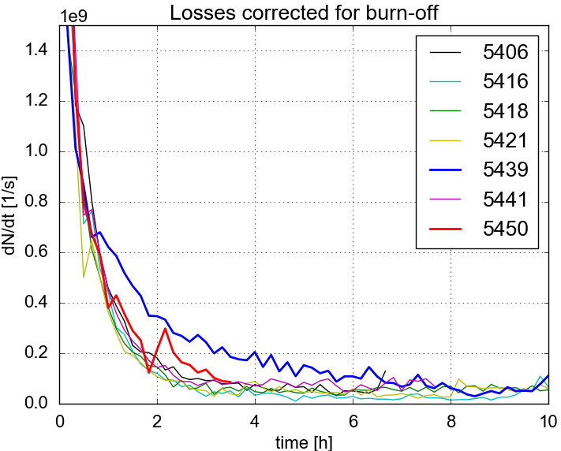
Levelling experience in 2016
  Levelling by separation demonstrated in test fills during 2016
    Fine tune adjustments and reduction of octupoles/chromaticity necessary to improve lifetime during levelling
  Satisfying possible request of experiments or when reaching cryogenics’ limit
  Changing X-angle from fill-to-fill (adapt H/V emittance ratio or increase peak luminosity) or levelling during stable beams (range of 60 μrad in X/2-angle)
F.Antoniou
D. Pellegrini

Slide 18
Beam losses
F.Antoniou, Evian 2016

Slide 19
Beam losses
F.Antoniou, Evian 2016

Slide 20
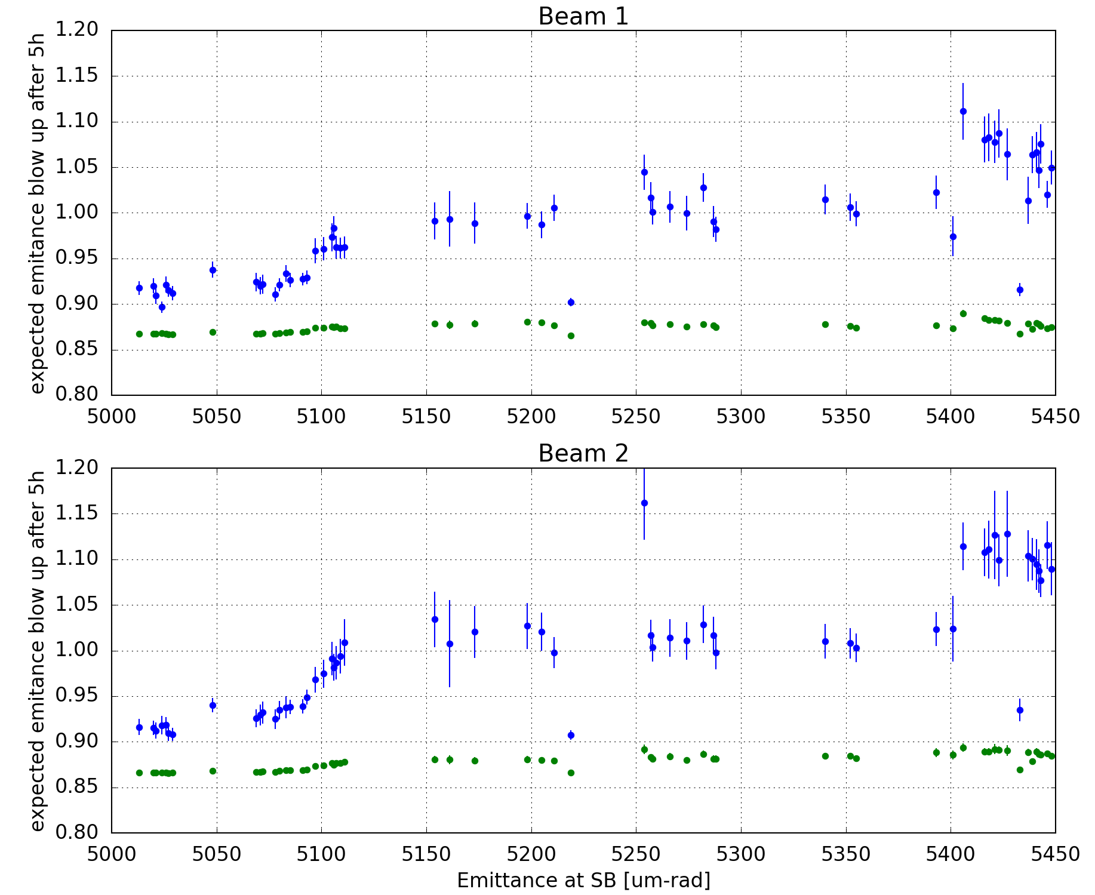
Expected Emittance blow-up
F.Antoniou

Slide 21
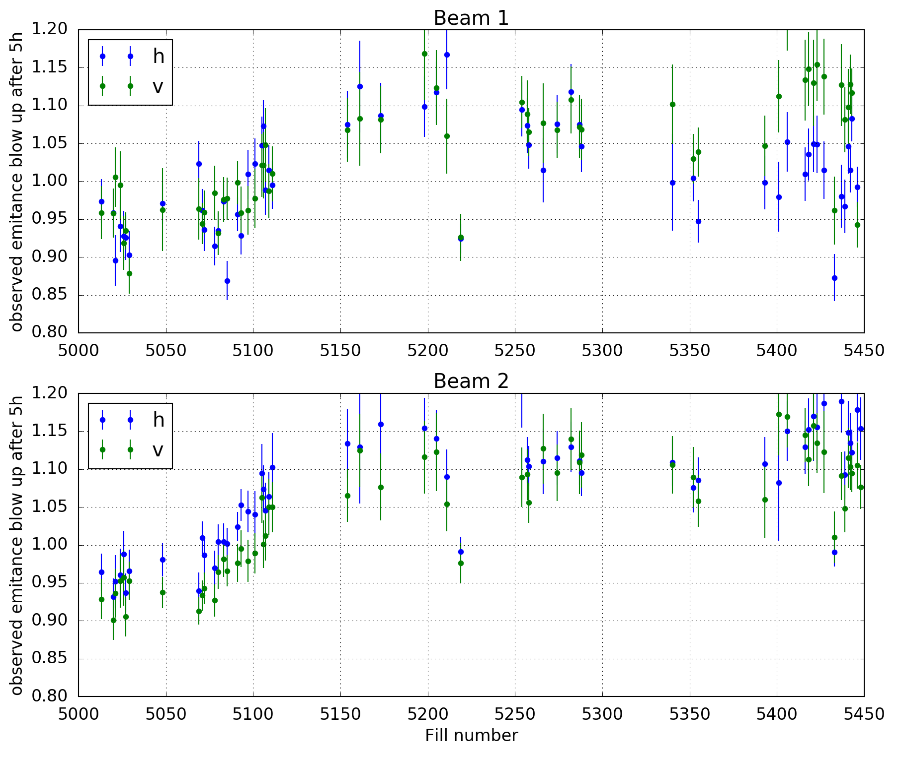
Observed Emittance blow-up
F.Antoniou

Slide 22
Observed Emittance blow-up
F.Antoniou

Slide 23
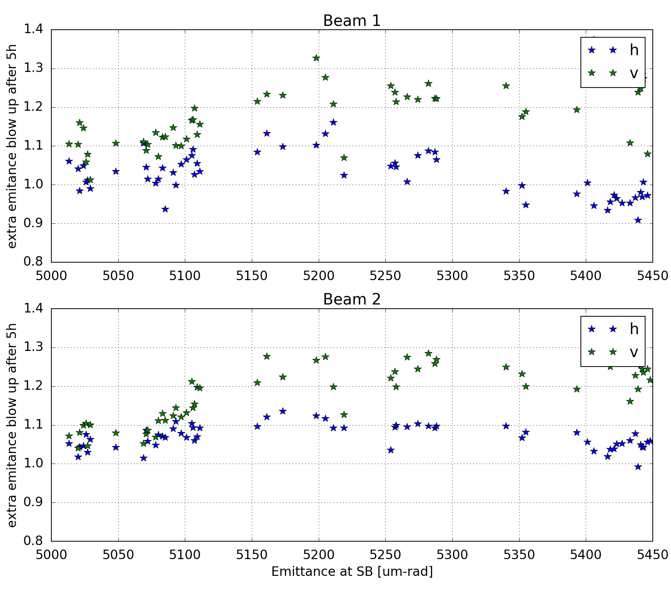
Extra Emittance blow-up
F.Antoniou

Slide 24
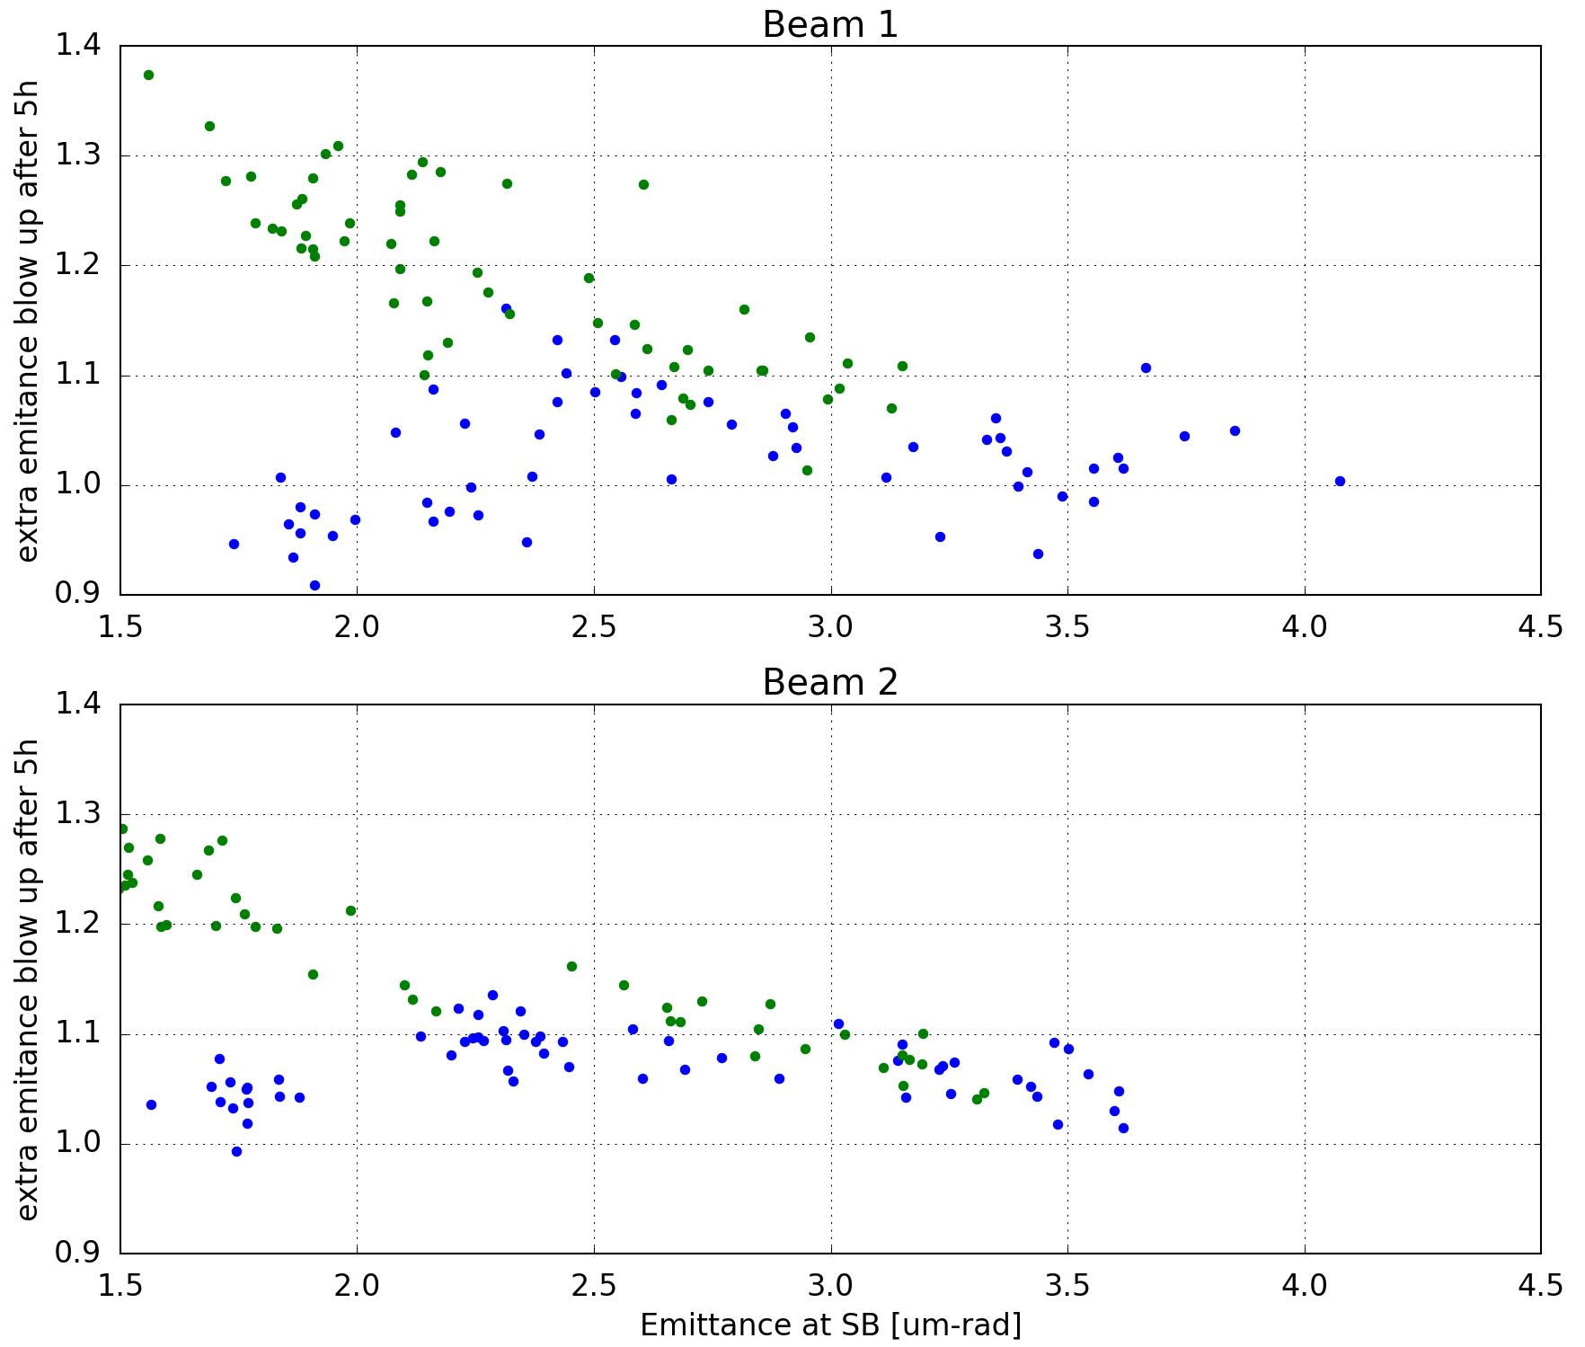
Extra Emittance blow-up
F.Antoniou

Slide 25
Luminosity loss
F.Antoniou

Slide 26
Availability

Slide 27
Remarks
Based on observation from 2016
  Estimate luminosity evolution for HL-LHC scenarios by assuming an extra blow-up growth rate based on the data
    Correlated with brightness?
  Including realistic evolution from injection to stable beams
  Including availability observed in 2016

Slide 28
Impact of LHCb polarity - octupoles

Slide 29
Effect of octupoles and LHCb
Tune scans for 550A octupole and LHCb on with good polarity, end of levelling parameters, nominal scheme
DA quite limited…
N. Karastathis, D. Pellegrini

Slide 30
Effect of octupoles and LHCb
Tune scans for 0 octupole and LHCb on with good polarity, end of levelling parameters, nominal scheme
Recovering DA towards the diagonal
N. Karastathis, D. Pellegrini

Slide 31
Effect of octupoles and LHCb
Tune scans for -550 octupole and LHCb off, end of levelling parameters, nominal scheme
DA even more improved
N. Karastathis, D. Pellegrini

Slide 32
Effect of octupoles and LHCb
Tune scans for -550 A octupole and LHCb on, with “good polarity” end of levelling parameters, nominal scheme
DA degraded especially close to 3rd and 10th order resonances
N. Karastathis, D. Pellegrini

Slide 33
Effect of octupoles and LHCb
Tune scans for -550 A octupole and LHCb on, with “bad polarity” end of levelling parameters, nominal scheme
DA degraded mostly close to 10th order resonances
N. Karastathis, D. Pellegrini

Slide 34
Summary

Slide 35
Thanks for your attention

