Slide 1
High Gradient Laser Plasma Accelerating Structure WP3
Brigitte CROS – Zulfikar NAJMUDIN

Slide 2
Main actions since last SC meeting
WP3 milestone report MS3.1
  First task (Design plasma structures: injector & accelerator) of WP3 completed with this report: plasma components for LPI and LPAS were analysed and current performances compared to Eupraxia design parameters
  Final draft delivered to management team
  Overleaf file was used for collaborative work
  Contributions from CNRS, ICL, U. Oxford, CNR

Slide 3
Main conclusions of report MS3.1
Gas cells as media for LPI
Waveguides for LPAS: channel-GICT can be used
Laser quality and stability essential for reliable operation
Efforts on plasma (density) stabilisation required: more experimental data necessary
LPI: combination of schemes (III and density gradient) for control of electron bunch
Acceleration of externally injected electrons: more experimental data necessary

Slide 4
Next steps
In the 2 next tasks of WP3 (MS reports in October 2017):
  pre-selected schemes will be analyzed in detail for experimental implementation in the beamline
  diagnostics (plasma, accel field, electrons, laser)
Topics to discuss with other WP at the collaboration week:
  Simulations for selected schemes (WP2)
  Laser quality and stability (WP4, WP2)
  Electron coupling (WP5, WP2)

Slide 5
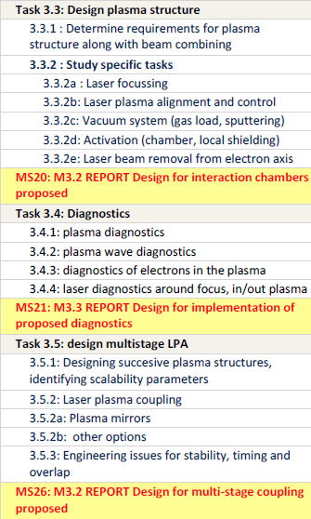

Other tasks
MS20: end October 2017
MS21: end October 2017
MS26: end July 2018
End October 2018

