Slide 1



Testing and Commissioning bmg chambers in ATLAS
Ezra Lesser, Dr. Tiesheng Dai, 8-Mar-2017

Slide 2
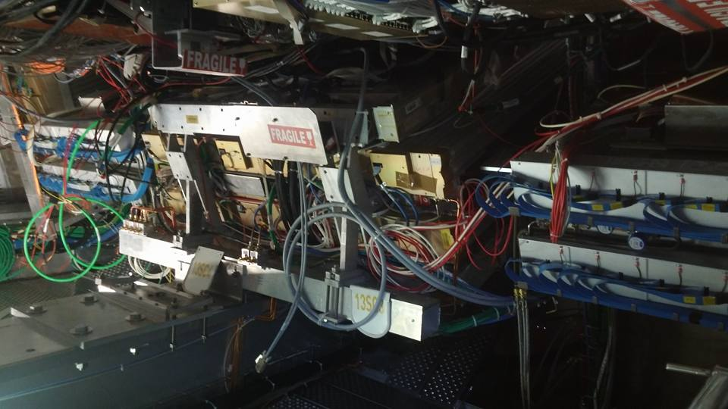
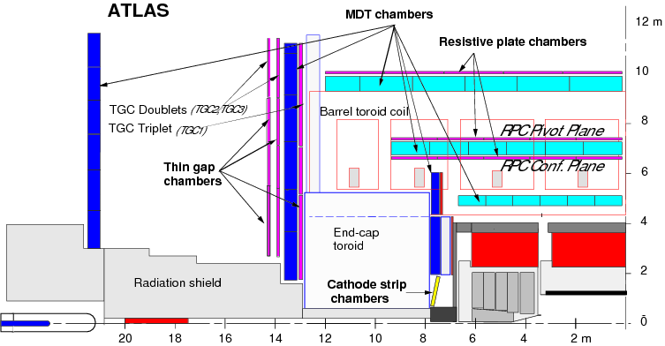
All new BMG Chambers have been installed
12 chambers: 6 on A-side, 6 on C-side
  Split between sectors 12 and 14
Electronics installed
  CSM cables (JTAG / TTC) attached, HV/LV power, etc.
Currently replacing coolant systems and BME chamber

Slide 3
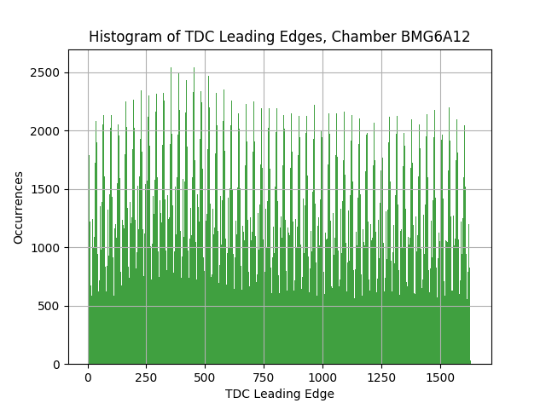
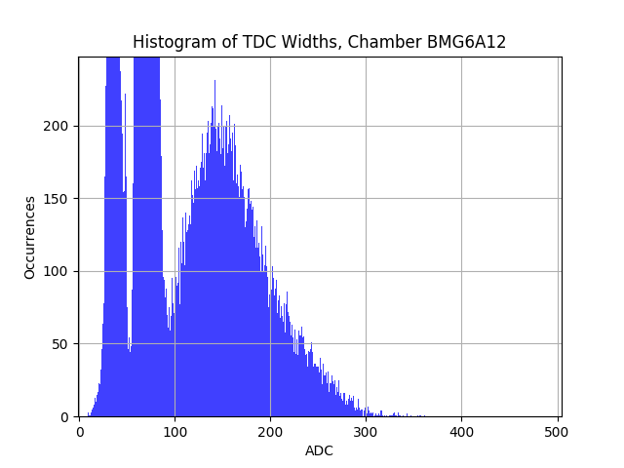
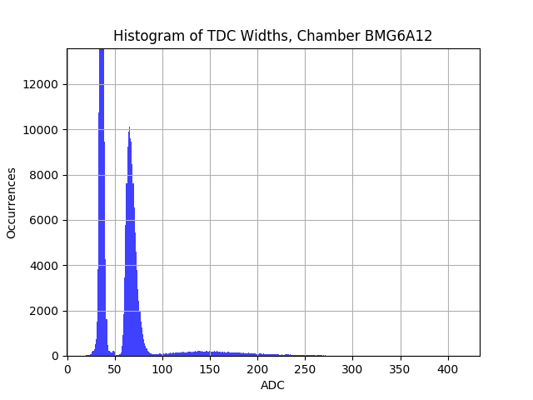
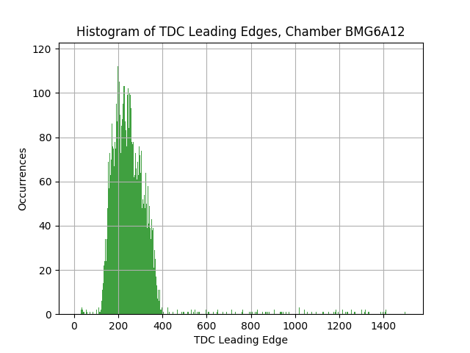
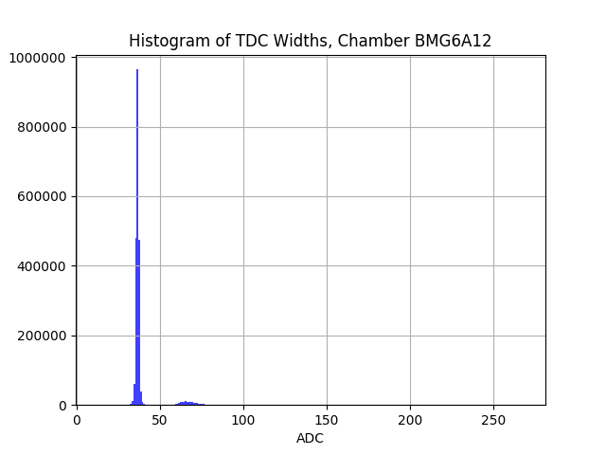
Checking TDC and ADC Distributions
Expect some data from cosmic muons
Adjust chamber timing to proper region
  If timing is incorrect, trigger will only pick up noise or very few cosmic tracks
Can compare rates and widths to nearby chambers
  ADC roughly gives you gain, TDC confirms spectrum for cosmic

Slide 4
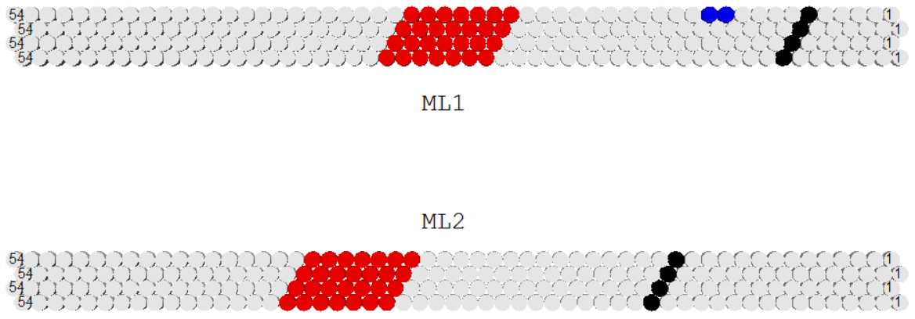
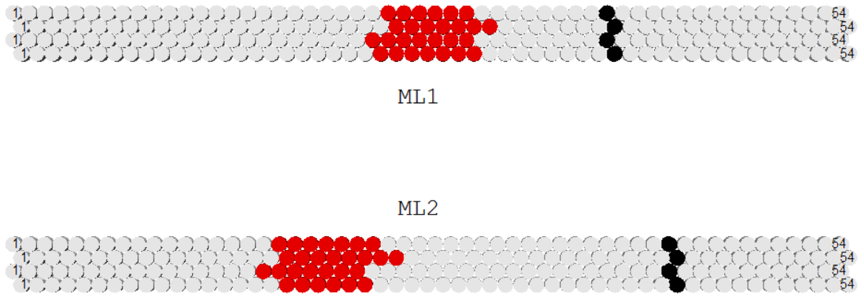
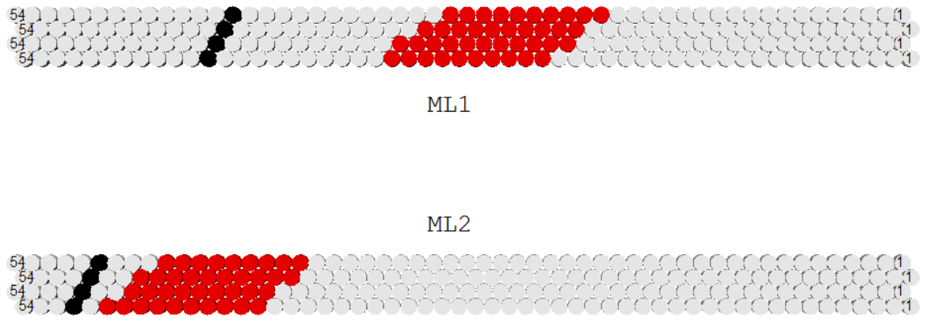
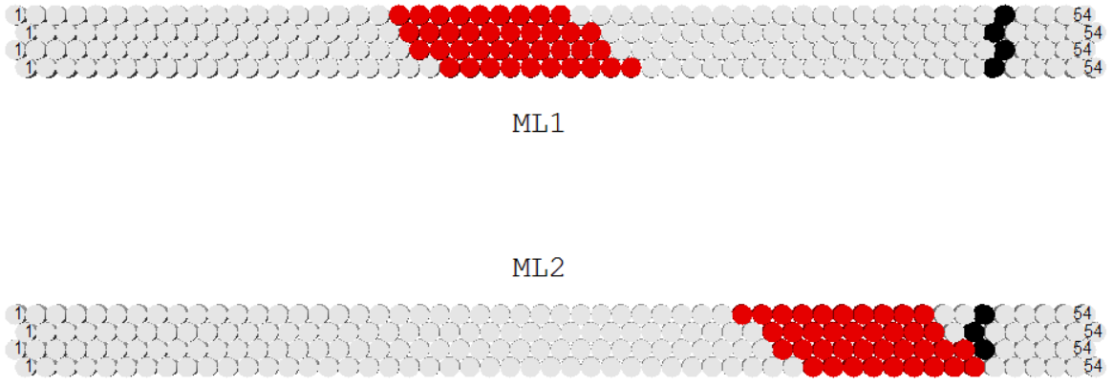
Checking channel mappings
Must individually check each chamber that mezzanine and channel maps to where we expect it inside the chamber
Select cosmic particles by looking for matching segments
  Write program to look through millions of events and find cosmic ones
  So far, after adjustments, everything looks good!
Must also check mapping for HV, LV, T/B sensors
BMG6C14
BMG2A12
BMG6A14
BMG2A14

Slide 5
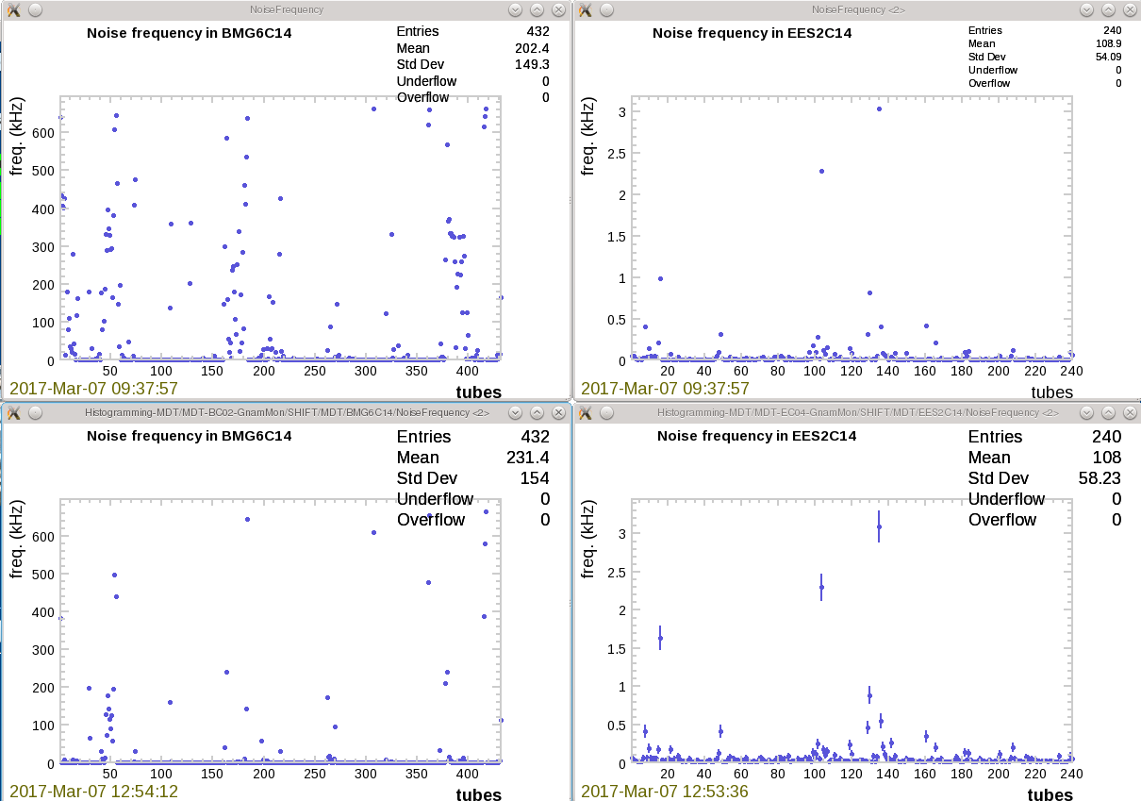

DEALING WITH NOISE
BMG chambers currently have unexpectedly large amounts of noise
We have tested HV, LV, nearby alignment sensors, grounding problems
  Greatest success of noise reduction from switching LV PS with nearby endcap chamber
  Still looking for definitive noise source …
  However, even with this noise we can see cosmics and take data

Slide 6
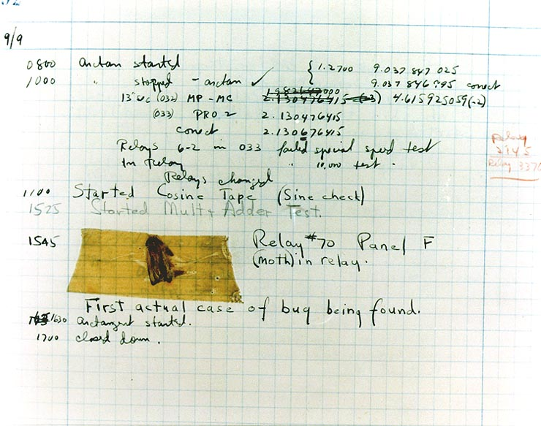
Constant hardware debugging …
Fixing various errors in installation and analysis:
  Example: One chamber would not initialize, thought we might have fried all mezzanines during LV grounding cable installation; turned out to be software bug
  Example: Many error words from two mezzanines in BMG6A12; replaced mezzanines, appears to be fixed
  Example:

Slide 7
Future tasks
Identify and try to fix sources of noise in BMG
  Most important, and not negligible!
Ensure all mappings are correct and that data is usable for collaboration
  Also requires checking HPTDC versus AMT decoding is what is expected
General maintenance on whole MDT system

