Slide 1


Installation and Commissioning of BMG Chambers in the ATLAS Detector at CERN
Ezra Lesser, Dr. Tiesheng Dai
18 April 2017

Slide 2
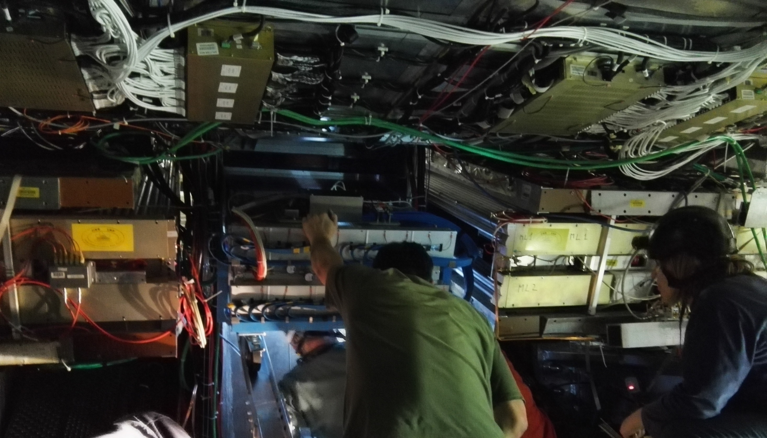
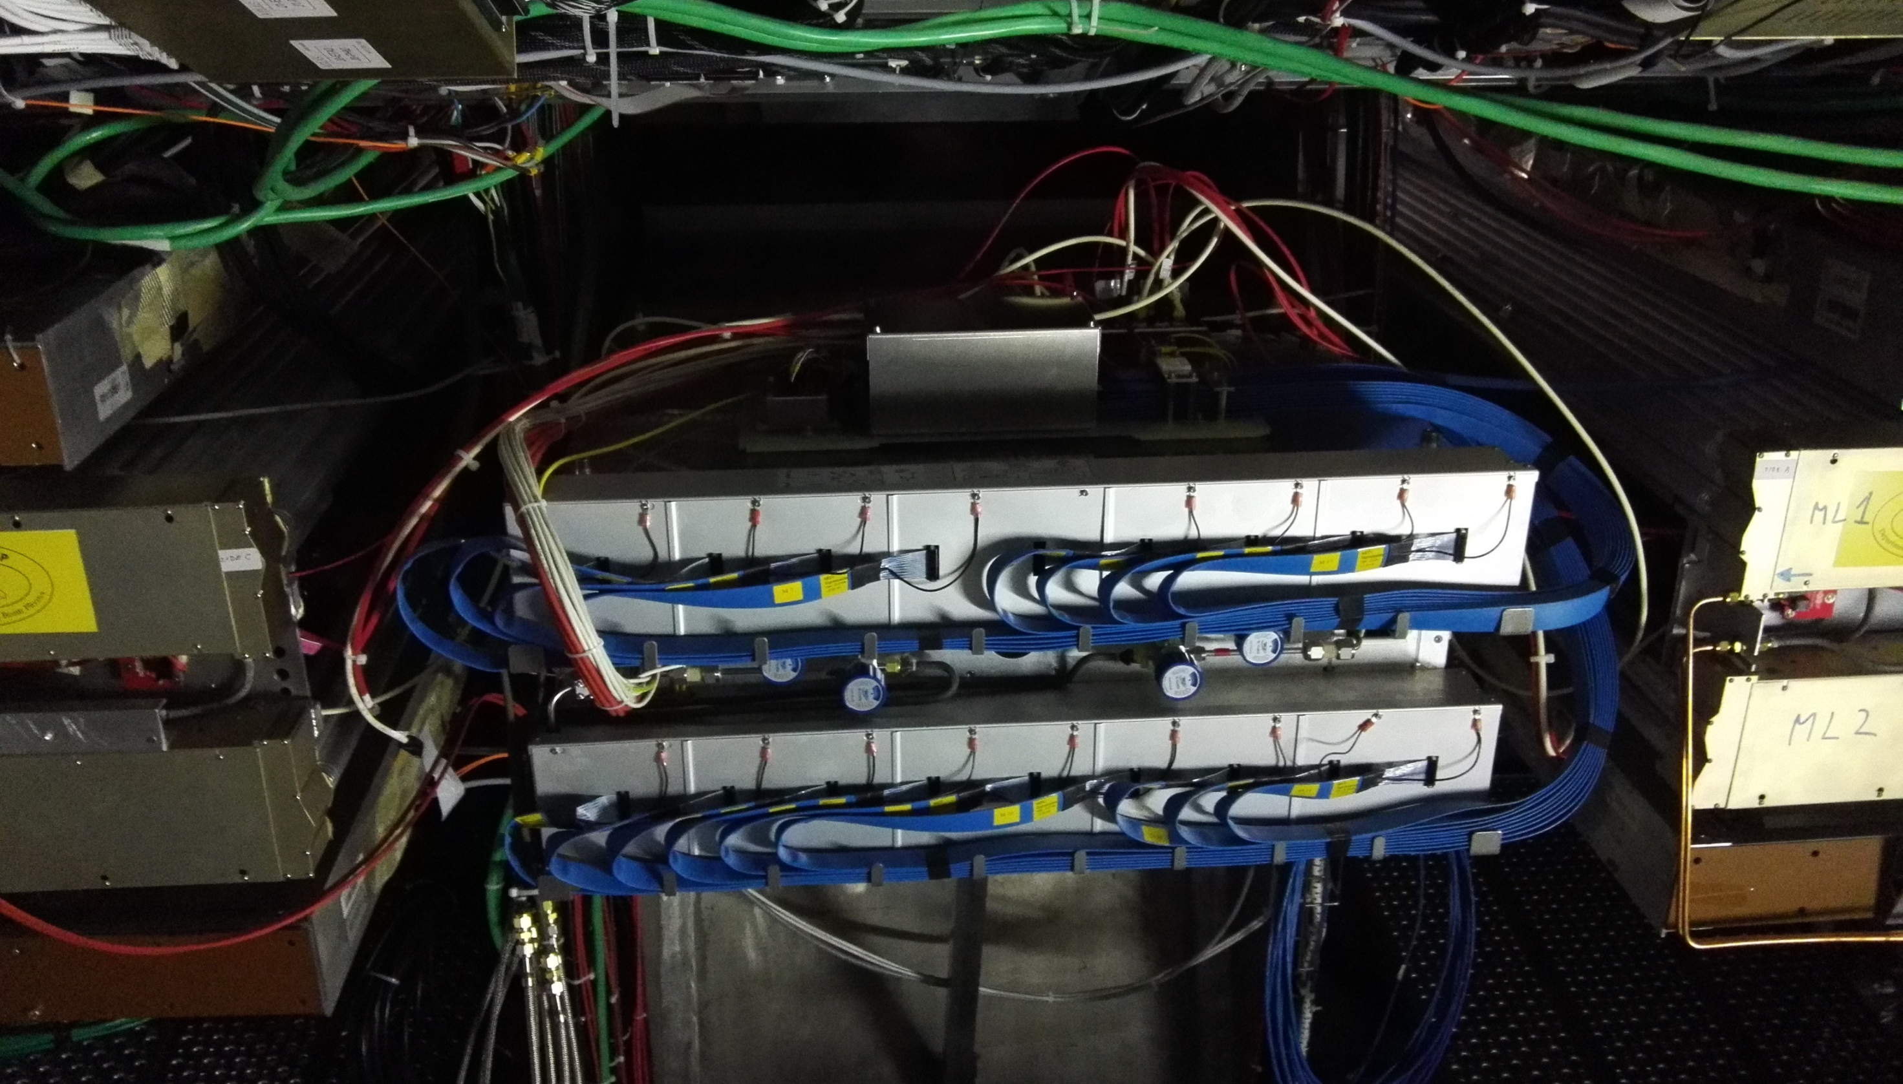
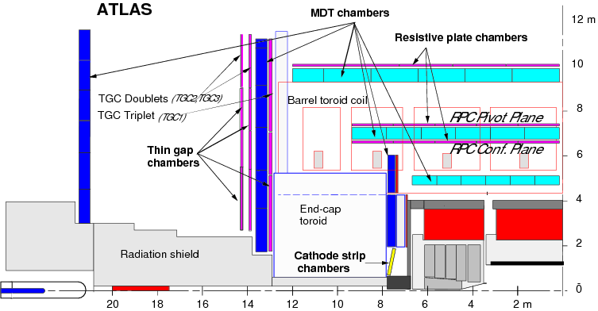

ATLAS Muon Detection
All BMG chambers have been installed!

Slide 3
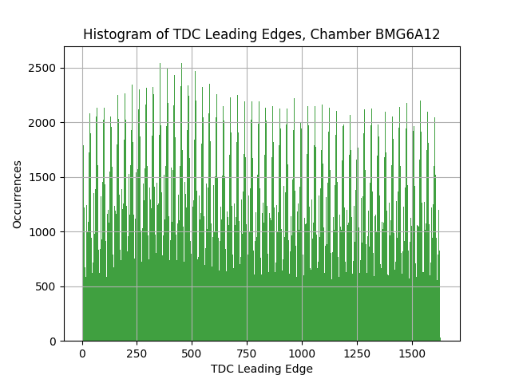
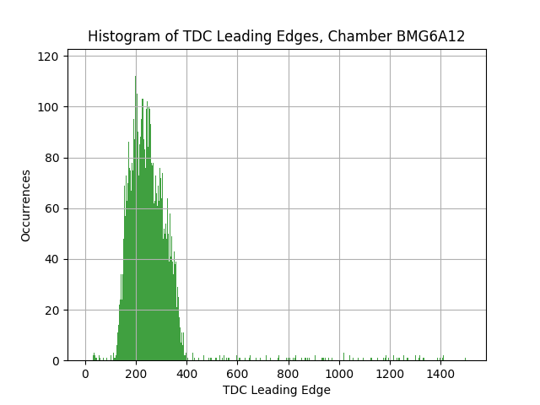
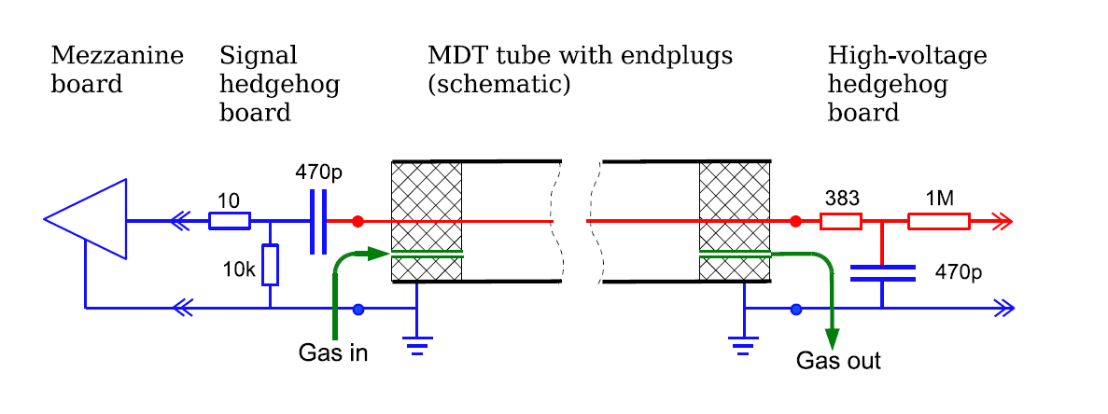





Principles of detection
Drift tube cross section:
Monitored drift tube (MDT)
  Calculate track from multiple tubes in chamber
Small muon drift tube (sMDT)
  Used in muon detector upgrade
$$e^{−}$$
$$μ^{±}$$
$$R$$
$$r$$
Radius of closest interaction $r$ can be calculated from time-to-digital converter (TDC) measurement in relation to detector’s calculated reference point $T_{0}$
T₀

Slide 4
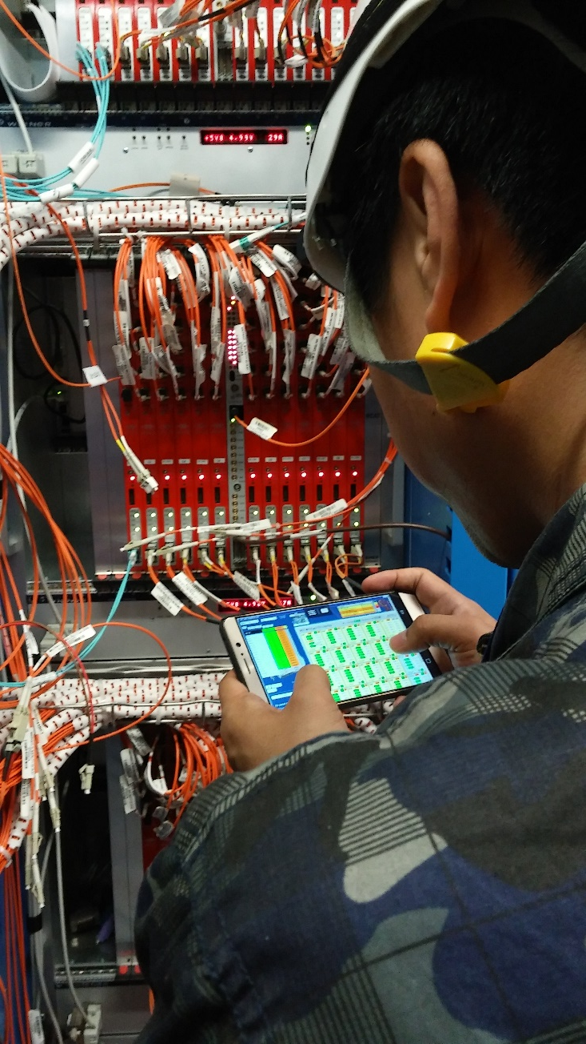
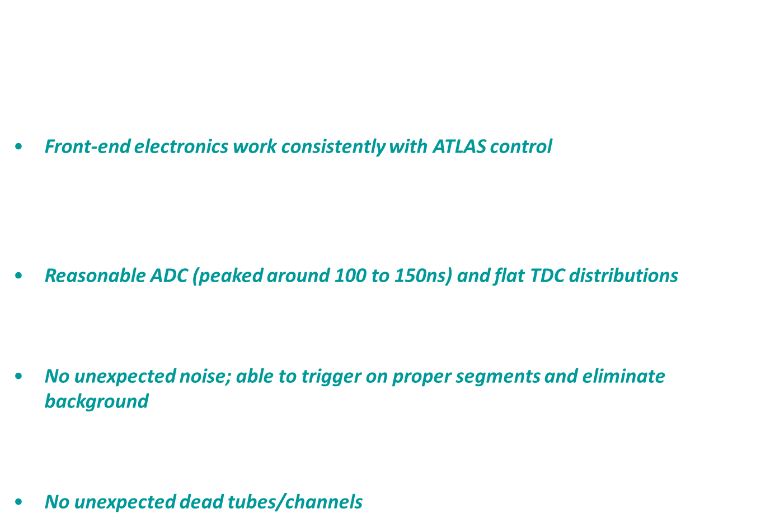
Commissioning new muon detectors
Functional alignment system and consistent results from with survey, and adjust chamber to final position
No gas leak
Front-end electronics work consistently with ATLAS control
Sensors continue to monitor $\vec{B}$-field, temperature and voltage to ensure reasonable readout
Reasonable ADC (peaked around 100 to 150ns) and flat TDC distributions
Mapping for LV, HV and readout is correct and verifiable
No unexpected noise; able to trigger on proper segments and eliminate background
Chamber hold HV 2730V with low dark current
No unexpected dead tubes/channels

Slide 5
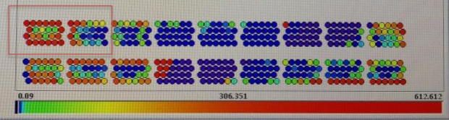
Review of last update
All BMG chambers have been installed
  6 on each side of ATLAS (12 total)
  All have integrated into detector control system (DCS)
  LV / HV / Channel mappings confirmed
Lots of unexplained noise

Slide 6
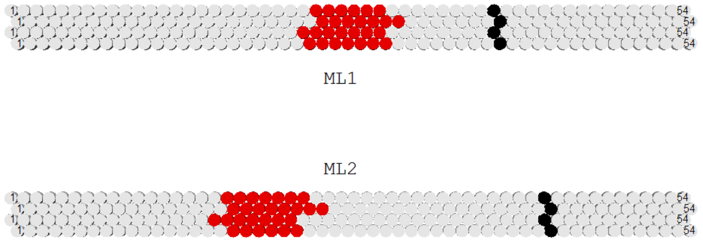
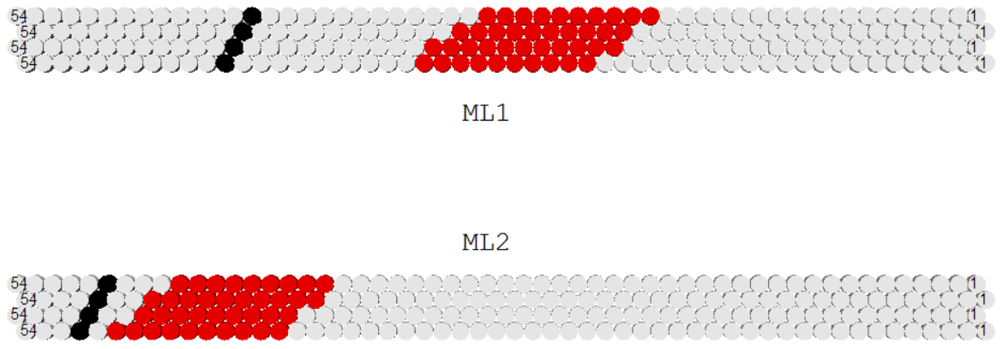
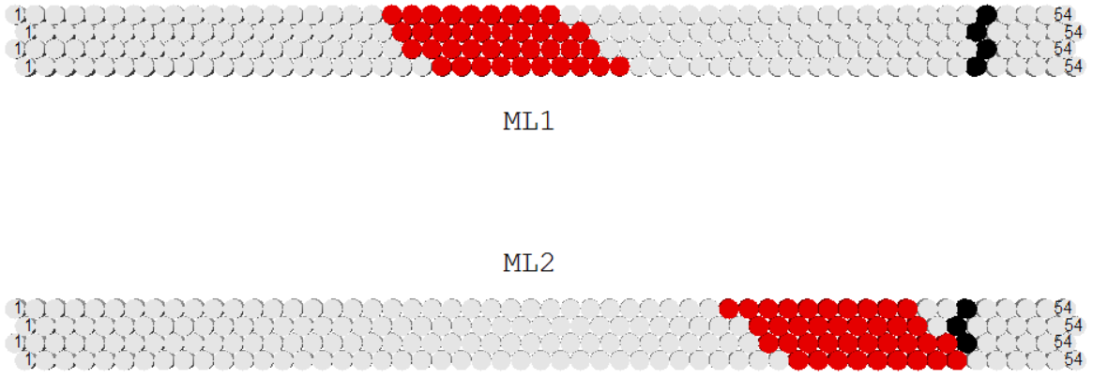
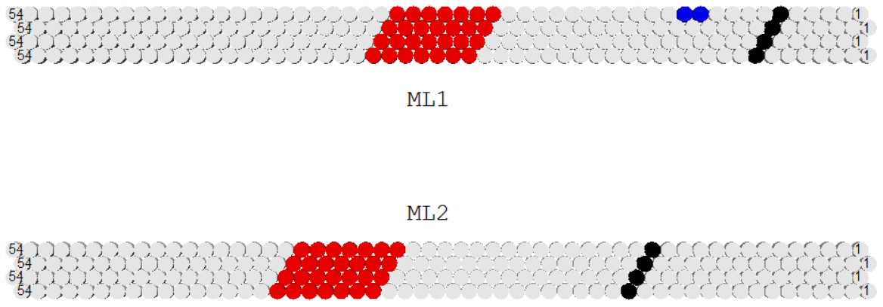
Checking channel mappings
Must individually check each chamber that mezzanine and channel maps to where we expect it inside the chamber
Select cosmic particles by looking for matching segments
  Write program to look through millions of events and find cosmic ones
  Everything looks good – cosmic muon tracks can be roughly found
Must also check mapping for HV, LV, T/B sensors
BMG6A14
BMG2A14
BMG6C14
BMG2A12

Slide 7
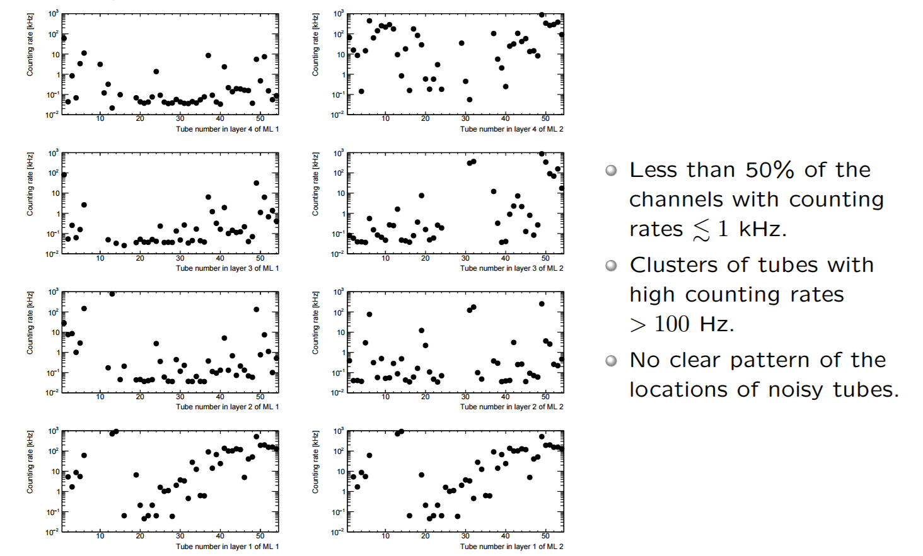
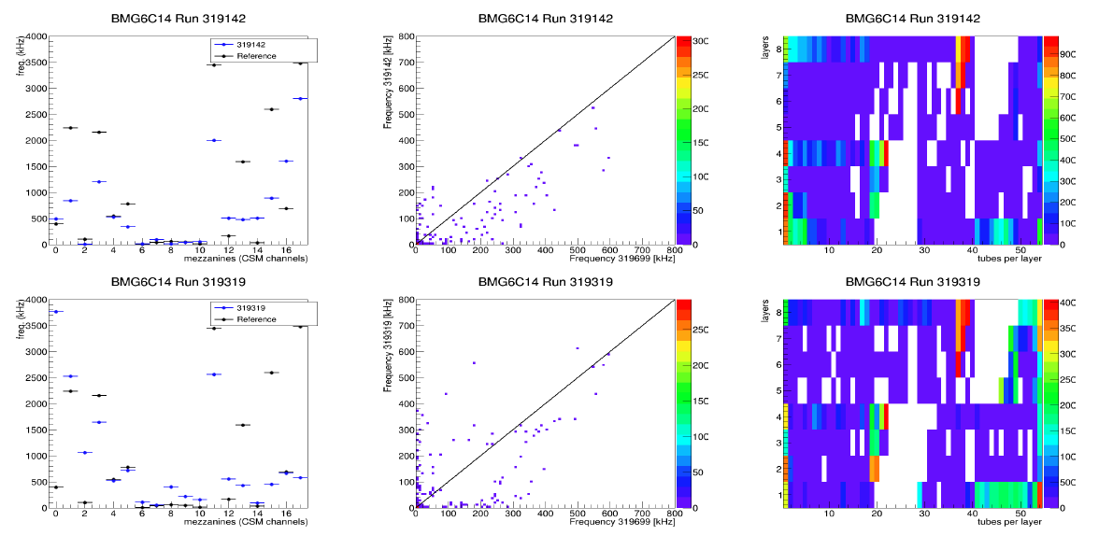
Elaboration on BMG Noise
BMG-6C-14
In Munich
Chambers built at Max Planck Institut für Physik (MPI) in Munich
High noise seen in above-ground tests, extraordinary noise seen after installation (some tubes of order 1 MHz)
  Usually require that any tube over 5 kHz must be investigated
Interesting signatures of the BMG noise:
  Specific pattern unaffected by our tests
  Not as bad in BME (also use sMDT, but old-type TDC)
  Only significantly decreased by changes to LV power supply
Plots by Oliver Kortner, MPI
Plots by Karri DiPetrillo, Harvard University

Slide 8
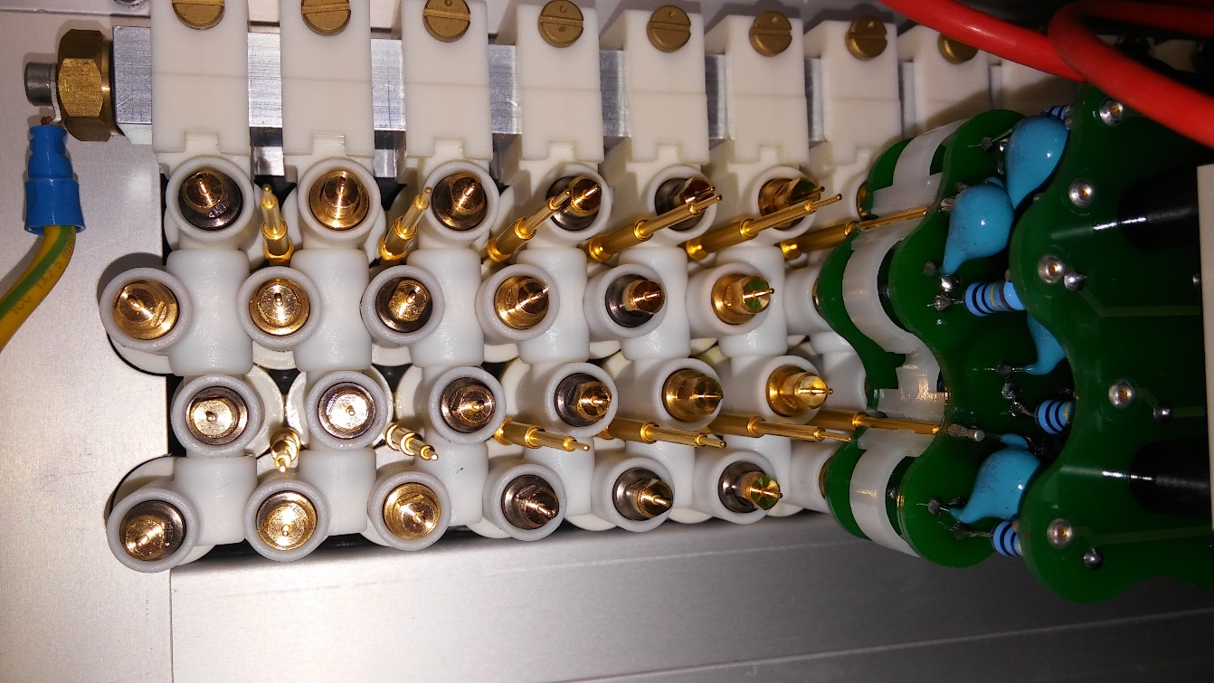
Noise tests completed at CERN:
Tightening grounding pins
  Multiple loose, some missing
  Some cannot be repaired
Unplug nearby alignment
sensors and devices
Chambers rotated to access HV side
  Multiple runs with jumpers / hedgehog cards removed: no change in noise pattern, no decrease in noise
  Actually, after this intervention, noise got slightly worse

Slide 9
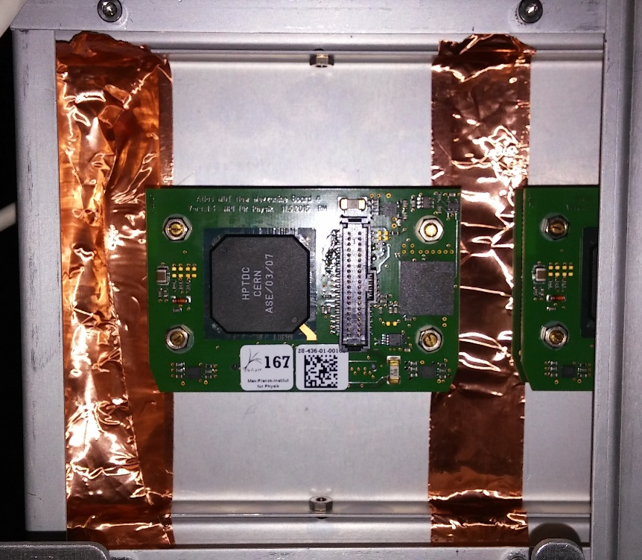
Noise tests completed at CERN (cont.):
Replacing / exchanging mezzanine cards
Experimentations with grounding
  Removing / replacing safety ground with BME chamber ground
  Isolating all cabled ground connections on the chamber
  Continuity checks with DVM
HPTDC mezzanine card shielding
  Removing
  Adding more
… Nothing has helped!

Slide 10
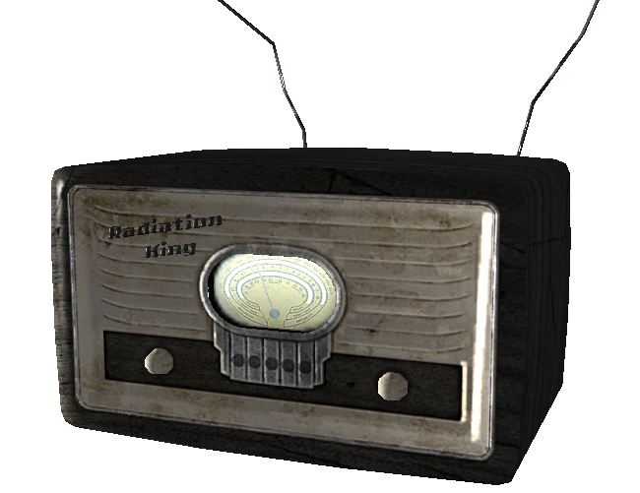
Possible causes for noise
Unexplained grounding issues
  Problem between analog/digital ground on mezzanine card
  Problem between ATLAS frame isolation to chamber
  … ??? …
  Correlations between noisy channels
Inherent weakness in chamber/electronics design
Environmental effects

Slide 11
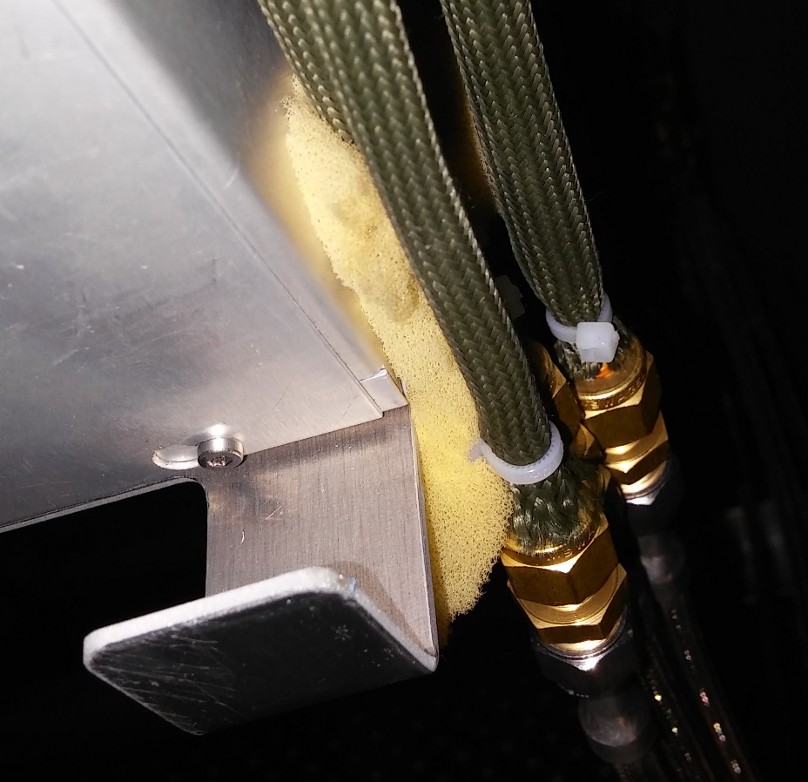
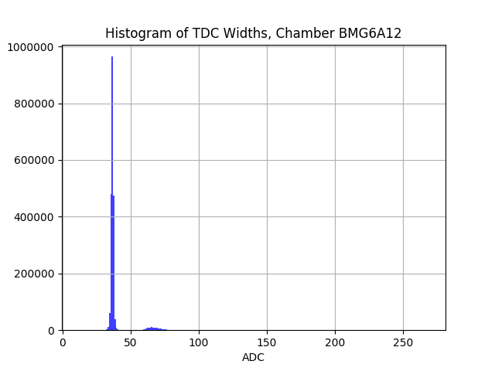
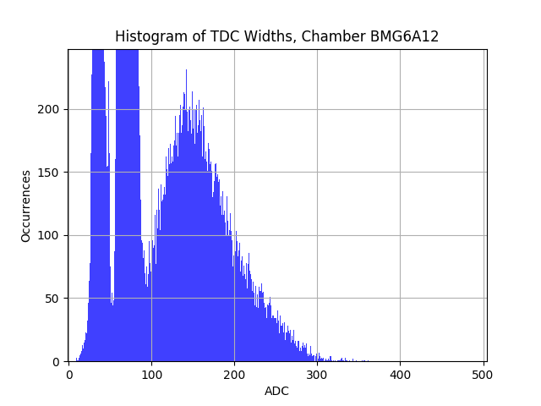
Tests will continue …
Experimentations with different grounding connections and schematics
Can still use chambers for interesting physics, even though they are noisy

Slide 12
Other work being done
Muon (MDT) system repair and maintenance
  Hardware/software faults, replacement
Testing new mezzanine (old-type TDC) cards made at MPI
  Finding optimal thresholds
    Cutting for threshold range
  Checking noise rates
  Scanning for linearity
  Program to parse information from output of Tiesheng’s custom software

Slide 13



Thank You!
@CERN: Dr. Tiesheng Dai, Dr. Zhen Yan, Dr. Steven Goldfarb, Karri DiPetrillo, Rongkun Wang
@UM: Dr. Jean Krisch, Dr. Thomas Schwarz
UM Physics Student Services Office (SSO)
The Lounsbery Foundation

