Slide 1
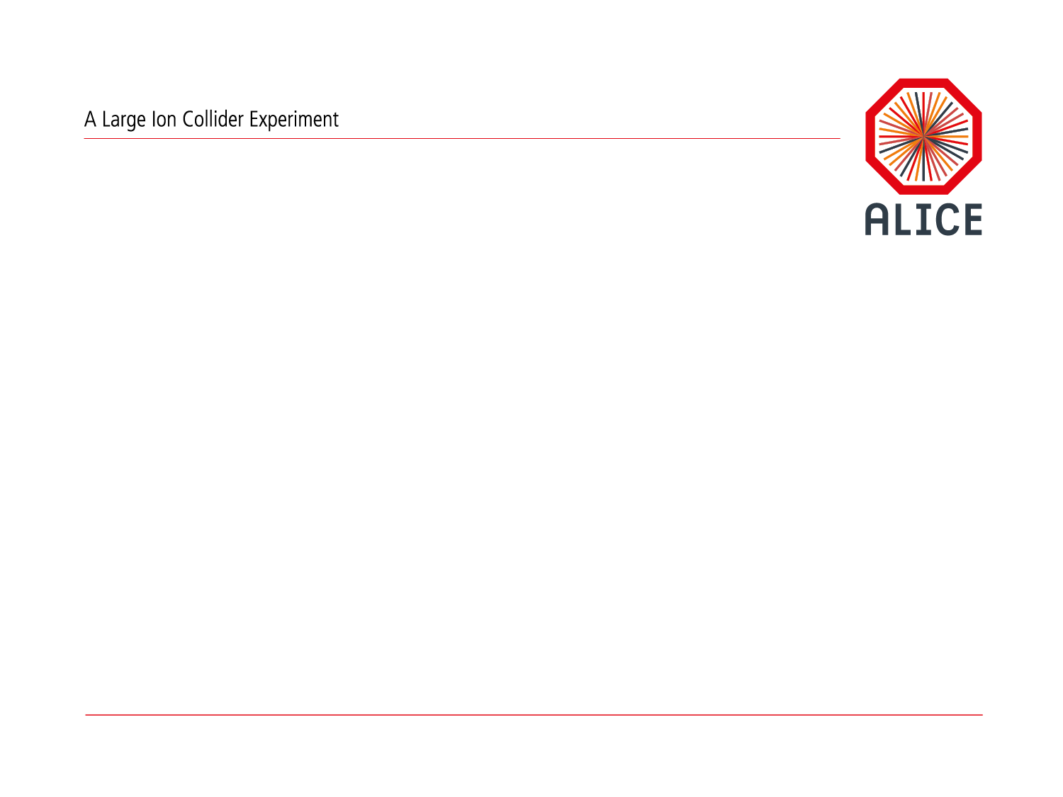
ALICE Upgrade for
Run 3 and Run 4
L. Betev

Slide 2
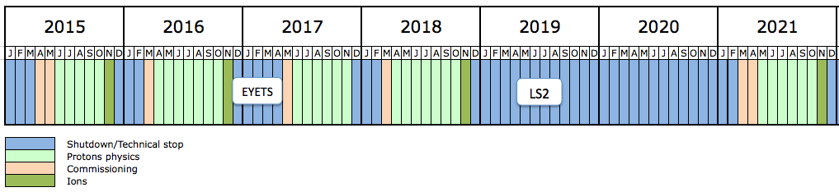
CERN Schedule
4 years
LS1 Run 2 LS2 Run 3
LS2 2019-2020
  Upgrades of ALICE and LHCb
LS3 2024-2026
  Upgrades of ATLAS and CMS (HL-LHC)
ALICE upgrade ready in Spring 2021 – 4 years from now, fits well with the CERN openlab next project phase

Slide 3
ALICE O² in a nutshell
Unmodified raw data of all interactions shipped from detector
to online farm in triggerless continuous mode
Requirements
LHC min bias Pb-Pb at 50 kHz
~100 x more data than during Run 1
Physics topics addressed by ALICE upgrade
  Rare processes
  Very small signal over background ratio
  Needs large statistics of reconstructed events
  Triggering techniques very inefficient if not impossible
50 kHz > TPC inherent rate (drift time ~100 µs)
Support for continuous read-out (TPC)
  Detector read-out triggered or continuous
HI run 3.3 TByte/s
Baseline correction and zero suppression
Data volume reduction by zero cluster finder. No event discarded.
Average compression factor 6.6
500 GByte/s
Data volume reduction by online tracking.
Only reconstructed data to data storage.
Average compression factor 5.5
90 GByte/s
New computing system
Read-out the data of all interactions
Compress these data intelligently
by online reconstruction
One common online-offline
computing system: O²
Paradigm shift compared to approach for Run 1 and 2
90 GByte/s
Data Storage: 1 year of compressed data
Bandwidth: Write 90 GB/s Read 90 GB/s
Capacity: 60 PB
20 GByte/s
Tier 0, Tiers 1 and
Analysis Facilities
Asynchronous (few hours) event reconstruction with final calibration

Slide 4
Data flow & processing (1)
Detectors electronics
Trigger and clock
TPC
…
ITS
…
TRD
Detector data samples
synchronized
by heartbeat triggers
Raw data input
FLPs
O(100)
FLPs
Buffering
Local aggregation
QC
First-Level
Processors (FLPs)
Time slicing
Local processing
Sub-Time Frames
Data Reduction 0
e.g. clustering
Calibration 0
on local data,
ie. partial detector
Tagging
Synchronous
Load balancing & dataflow regulation
Frame dispatch
Partially compressed
sub-Time Frames
EPNs
Time Frame building
O(1000)
Full Time Frames
Detector reconstruction
e.g. track finding
Calibration 1
on full detectors
e.g. space charge distortion
Event Processing
Nodes (EPNs)
Global processing
Sub-Time Frames
Time Frames
Compressed Time Frames
AOD
Data Reduction 1
QC
Quality Control
Compressed Time Frames
QC data
Storage
O²/T0/T1
T0/T1
Storage
Archive
CTF
AOD

Slide 5

Data flow & processing (2)
Compressed Time Frames
O²/T0/T1
T0/T1
Sub-Time Frames
Time Frames
Compressed Time Frames
AOD
Storage
Archive
Storage
CTF
AOD
Quality Control
Compressed Time Frames
ESD, AOD
QC data
O(1)
O²/T0/T1
Global
reconstruction
Calibration 2
Reconstruction
passes
and event extraction
Event extraction
Tagging
Asynchronous
CCDB Objects
Condition & Calibration Database
AOD extraction
QC
ESD, AOD
Event Summary Data
Analysis Object Data
O(10)
T2
AOD
Reconstruction
Event building
AOD extraction
QC
Simulation
CTF
Simulation
O(1)
Analysis Facilities
Analysis
Analysis
Storage
AOD
Histograms,
trees

Slide 6
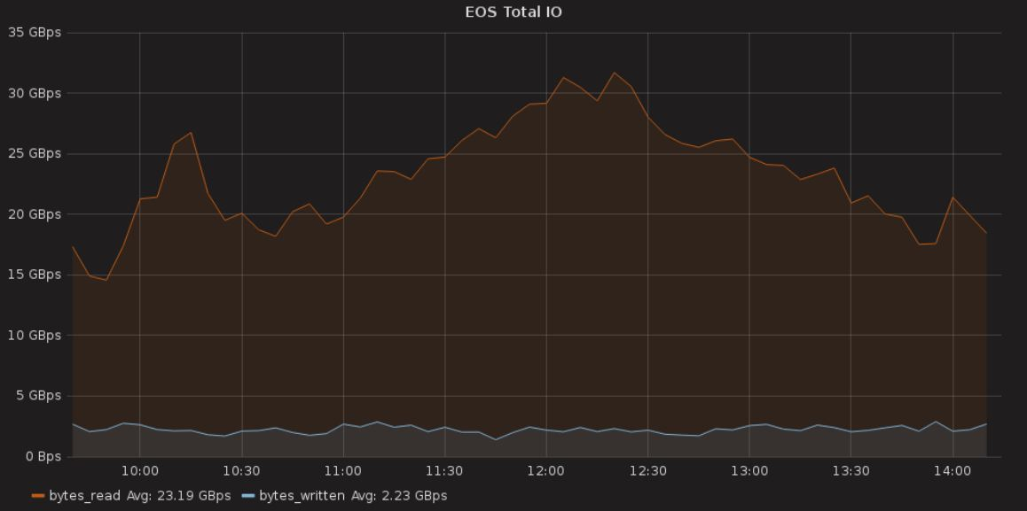
Challenges
Rates to storage – write 90GB/sec , read 20GB/sec out (+ delta)
Capacity – 60PB in a single instance (first year)
High availability – on the critical path for data taking
Complex interactions with various systems – experiment/Grid/analysis
Current experience (borrowed from EOS)
ALICE needs factor 4 in rate in 2021 (reversed)

