Slide 1
First EP-NU Meeting
Albert De Roeck

Slide 2
Welcome
Welcome to the EP-NU group!
Most of you are transferred now to EP-NU. More on that later today.
Plan a meeting on analysis & related tools/computing roughly every two weeks. Also occasion to bring up some interesting topics on physics (workshop reports, etc.). Are Thursday mornings ok? Then next meetings can be 2/2 and 16/2
Invited are EP-NU members and invited friends/close collaborators (check with ADR)

Slide 3
EP-NU Meetings
Topics in concert with the EP-NU mandate (see later)
Including news eg on on manpower, opportunities, eg summer students or technical students, meetings etc.
Typical topics
  Discussion/reports on analysis & tools (reco/sim…) work ongoing/starting in the group.
  Reports on meetings and workshops
  Occasional, interesting new topics and developments. Can invite external speakers
  Computing issues that affect us all..?
  New members introducing themselves
  Other ideas? Let me know!

Slide 4
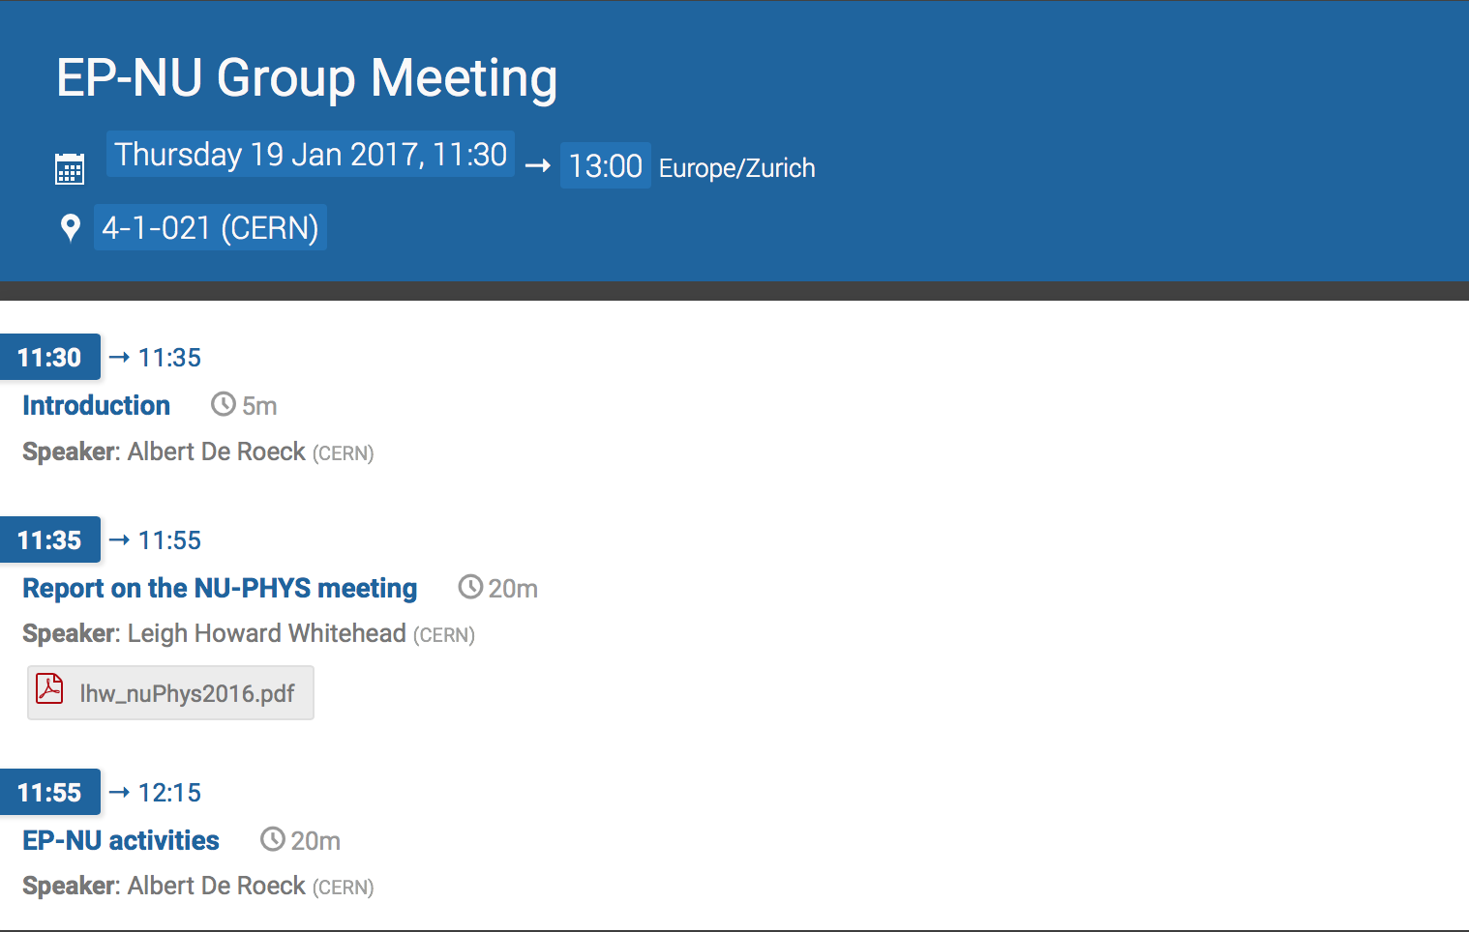
Today’s Agenda

Slide 5
EP-Nu Activities
We are a new group, and are still exploring in which directions to expand
We have however already some engagements and involvements which
we should honour of course.
But we should also discuss future developments

Slide 6
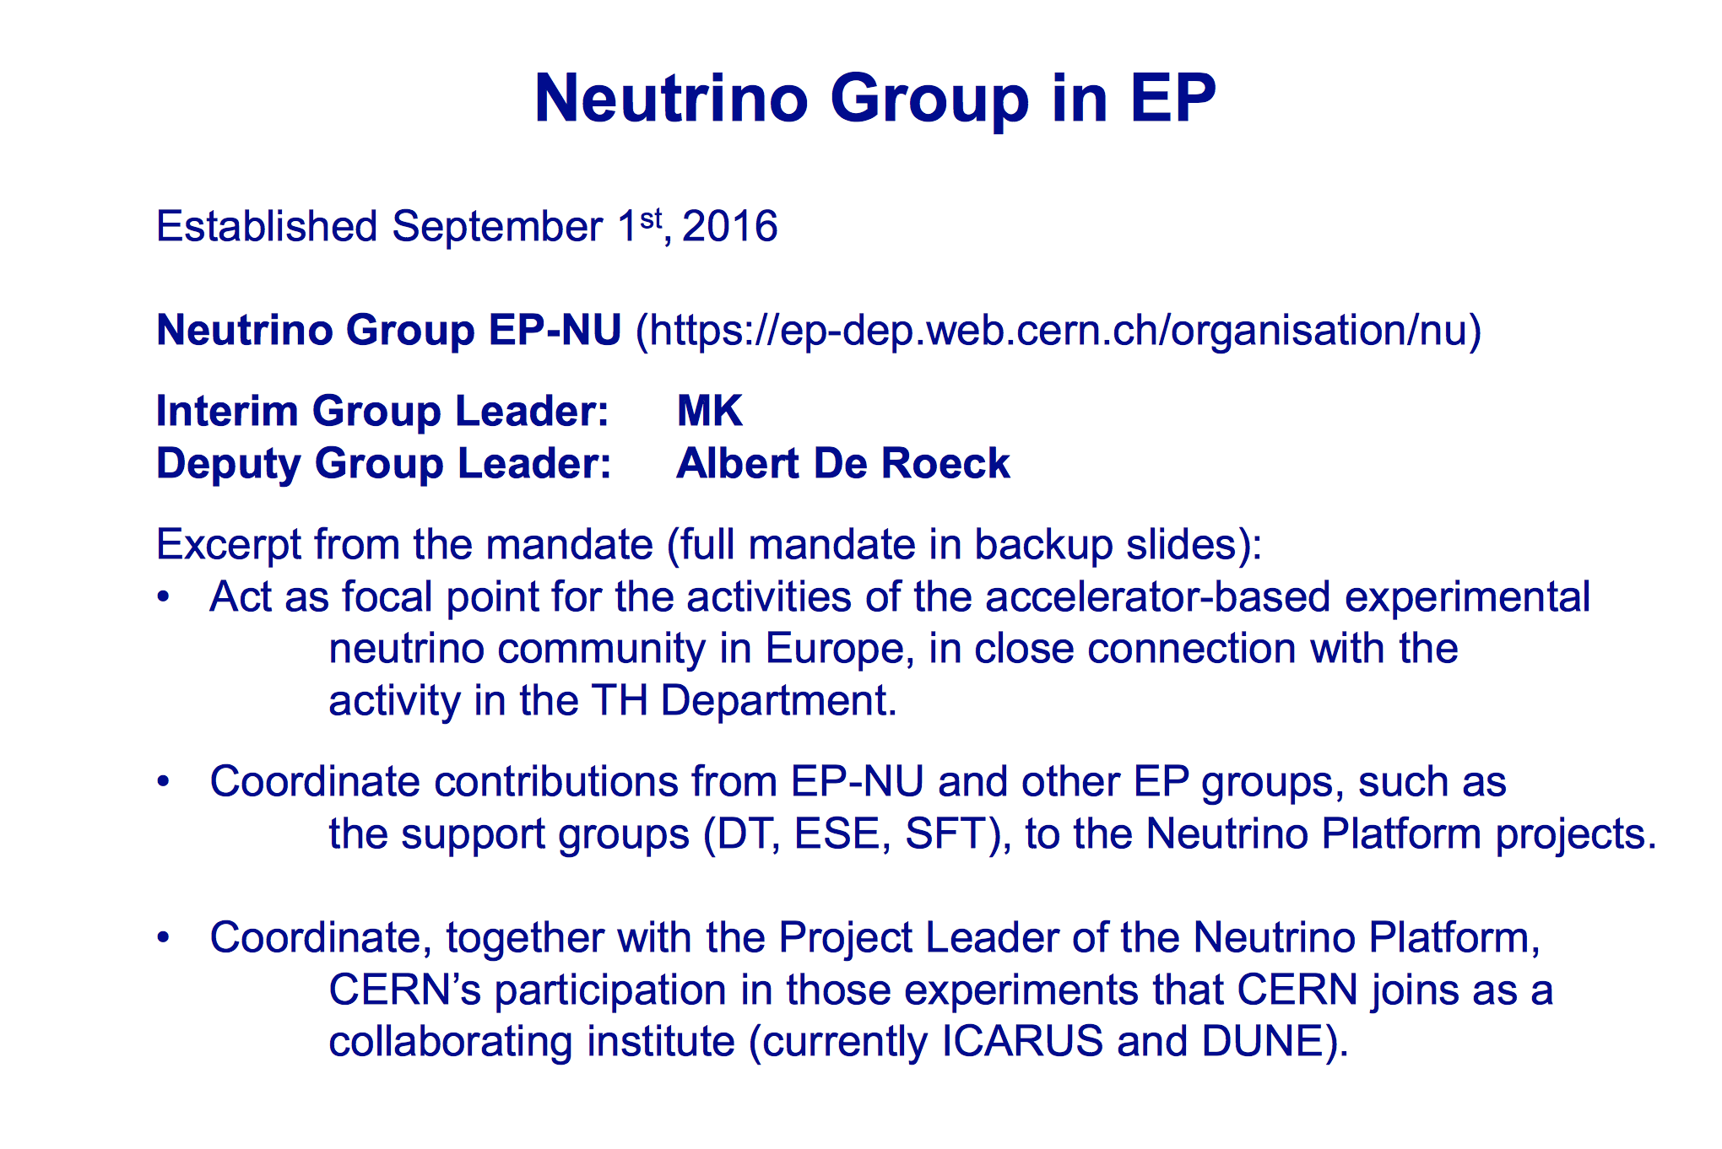
From Manfred/Faculty Meeting

Slide 7
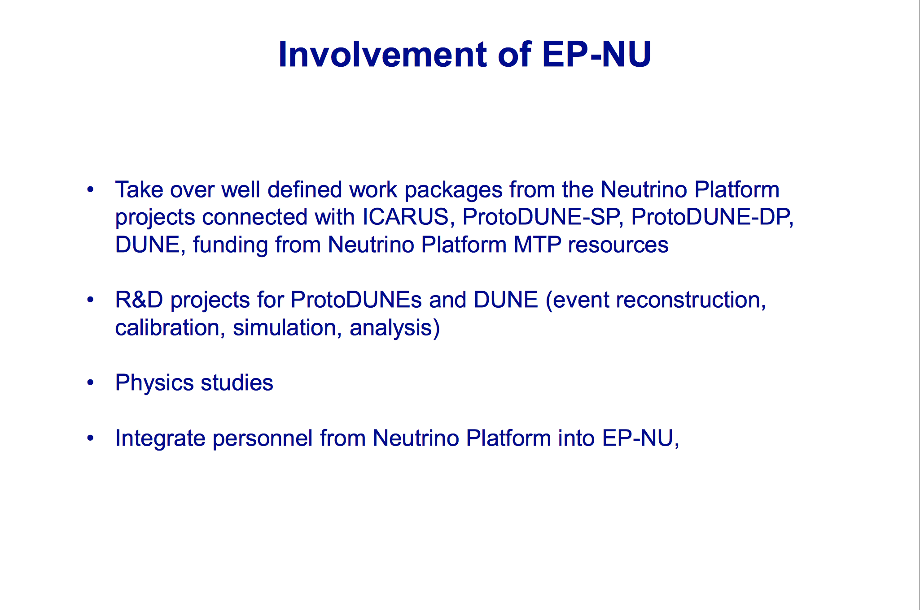

Slide 8
News on people
New people coming: (Almost) all people from the platform.
One new graduate student coming for 6 months
Boston Univ. abroad undergrad program: 2 students for 6-8 months. Arriving today. Want to work on LarTPC
Two (presently) CMS people expressed interest to join in the Deep Learning effort for LarTPC reco/DUNE
Should we ask for Technical students? Eg to help with the computing/DAQ/… Then we should write project proposals
Summer Students! It is now time to think of asking for a summer student/prepare a project. (deadline start of February). Will send a mail with instructions
Interest from research fellows (private contacts)!!
LDs: have to pass through the committees. But we can encourage people to try so.
Visitors…?

Slide 9
Upcoming events
We have a common EP/TH meeting on 20/2. Meeting meant to find communalities/synergies between our work and their expertise. Input on topics welcome!
Theory Institute 27/3-31/3. Program under discussion in TH.
Academic training on neutrino physics in March by Stefania and Pilar in March
And…

Slide 10
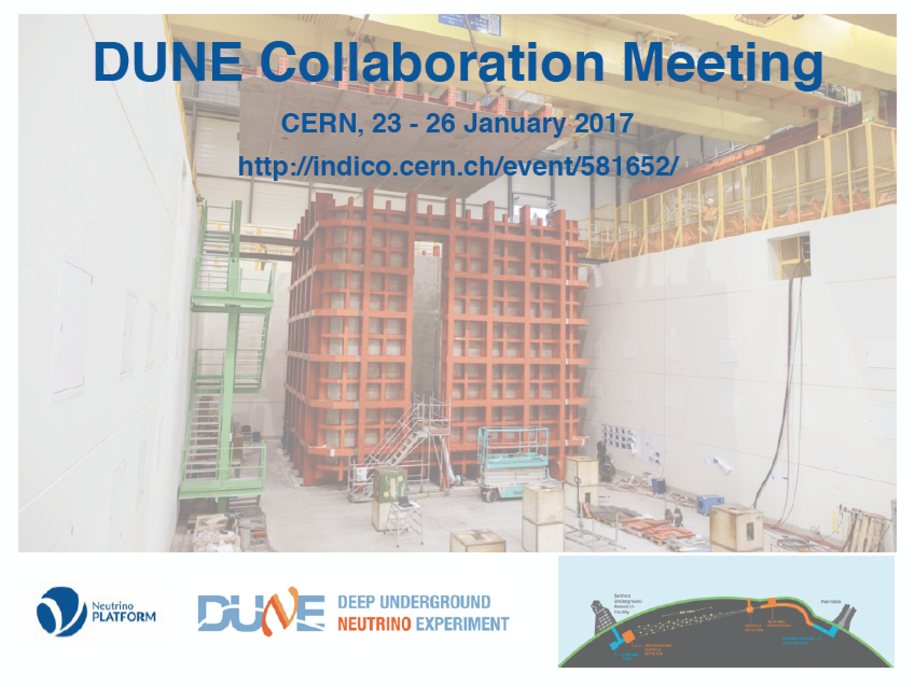

Slide 11
DUNE Collaboration meeting
Next week @CERN !!
Expect like 250 participants. Lot’s of work
  Participate if you can. Registration fee and dinner will be covered, but you have to register for both
Key issue: making sure vidyo & rooms work all right
  Can use some help in checking the rooms at the start of the parallel meetings (4 parallel meetings each day on Tuesday and Wednesday) Some of you are already in these meetings or even organizing them
Note that the DUNE week starts on Sunday with the ND detector pre-meeting. Could be of interest for us

Slide 12
Projects: Initial discussion
DUNE: Activities at several levels
  ProtoDUNE SP We have some ongoing activities on reconstruction/simulation/physics/ computing
  ProtoDUNE DP? Do we have an involvement?
  Physics TDR of DUNE: will need manpower.
  DUNE Near Detector? See below.
ICARUS: Data analysis in 2018? SB planning meetings
LOI high pressure TPCs. (EP-DE now also on board)
  ND for Dune?: meeting in a few days@ CERN/workshop FNAL
  T2K upgrade? Following meetings/new fellows/Stefania interested. Should we explore this option?
Workshop with TH on precision/systematics of NDs and neutrino scattering processes?

Slide 13
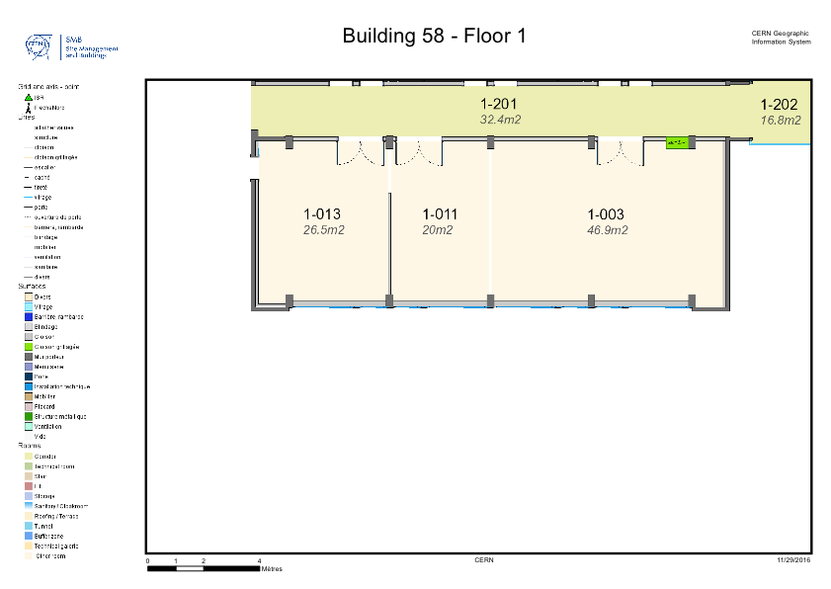
New Room/area
Should give space for 12 people
We have to start thinking on how to use it best
More space will be needed with time.

Slide 14
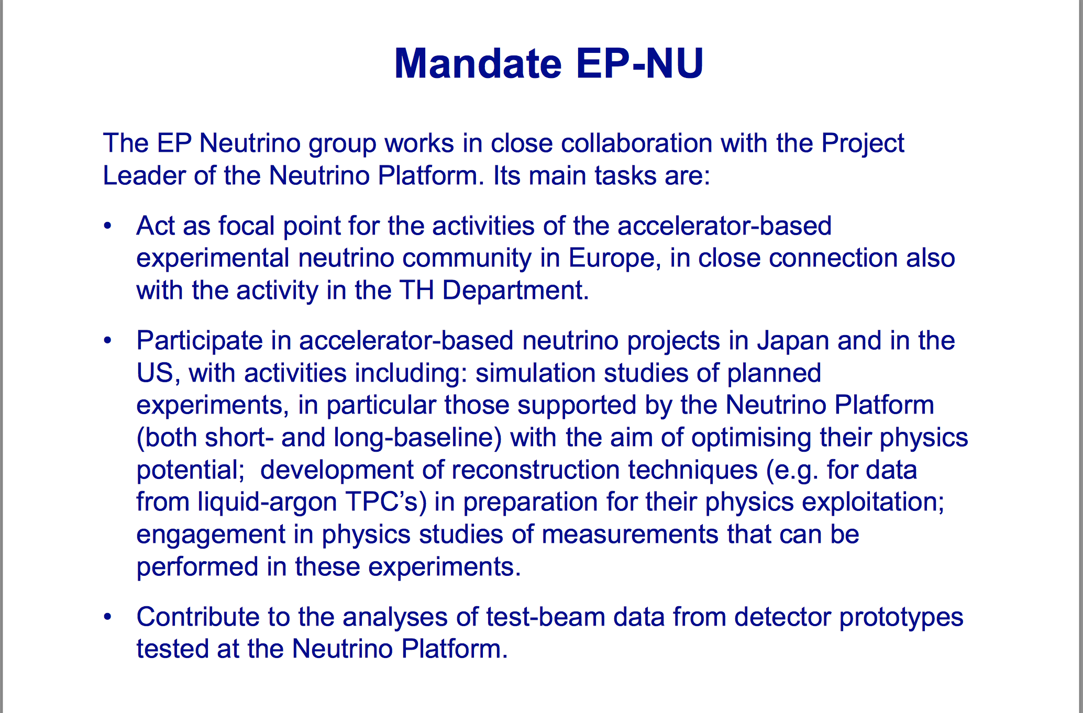

Slide 15
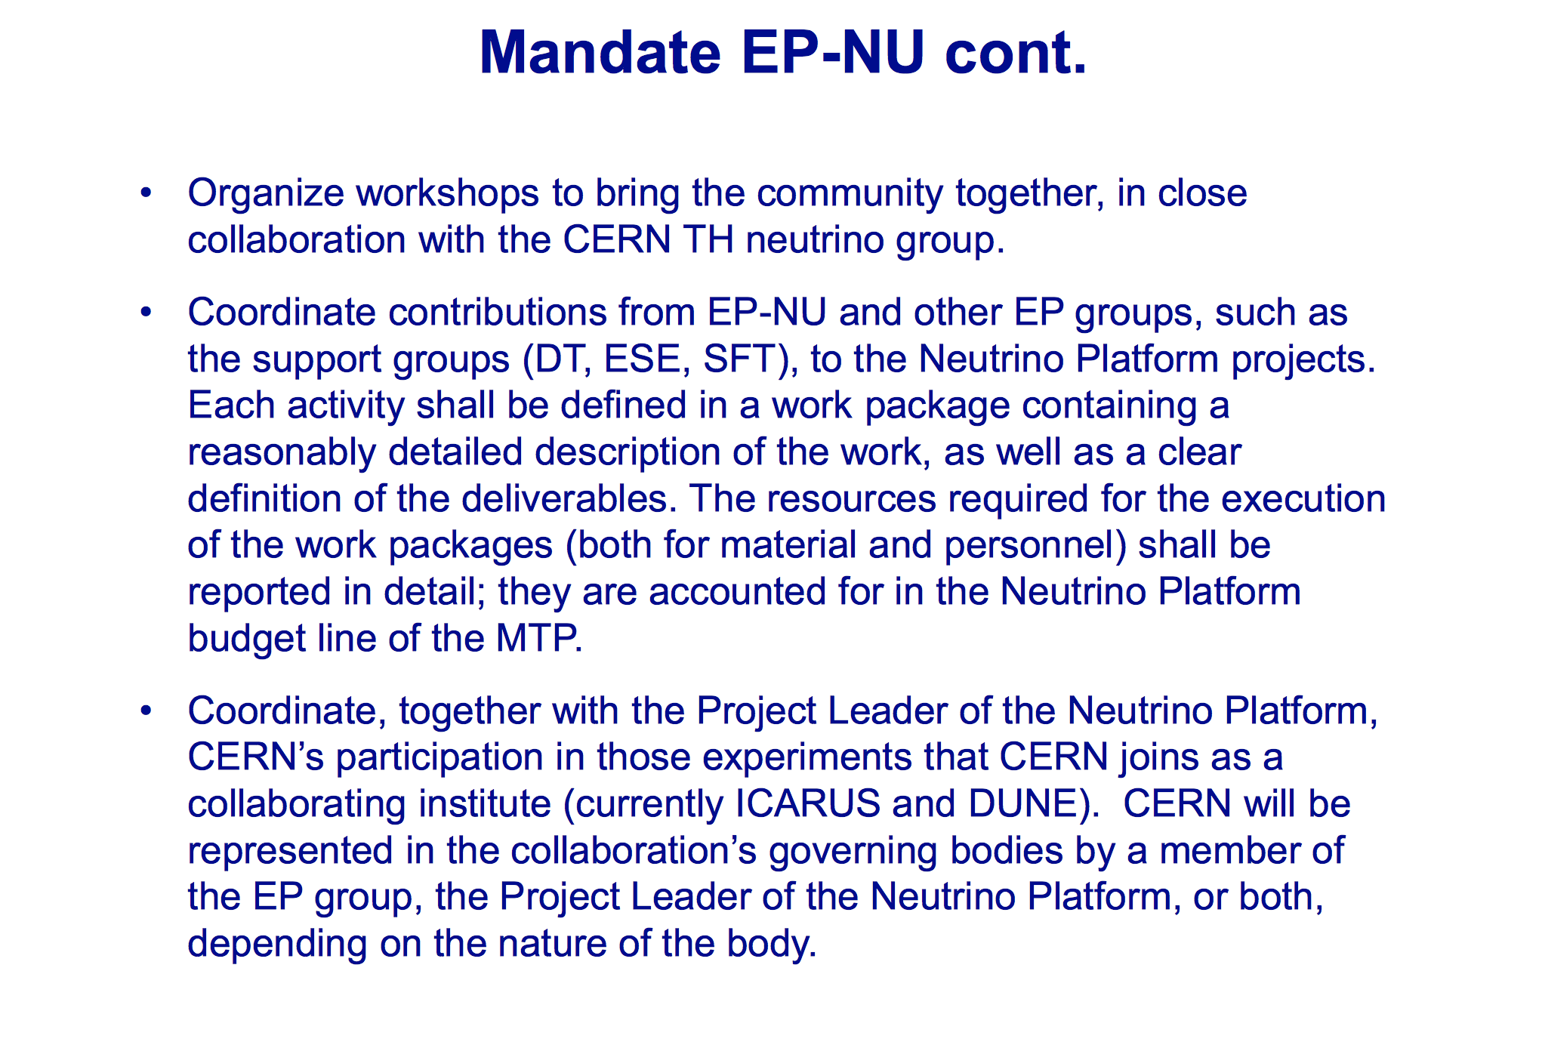

Slide 16
Mandate of the EP-Nu group
Act as beacon and attraction pole for the activities of the accelerator-based experimental neutrino community
Support a group for experimental neutrino physics at CERN to participate in accelerator based neutrino experiments worldwide
Contribute to the analyses of test-beam data from detector prototypes tested at the Neutrino Platform.
Organize workshops to bring the community together, in particular in close collaboration with the TH neutrino group at CERN..
Coordinate contributions from EP-NU and other EP groups, such as the support groups (DT, ESE, SFT), to the Neutrino Platform projects.
The EP Neutrino group should work in close collaboration with the project leader of the Neutrino Platform and be connect closely connected with the activity in the Theory Department.

Slide 17
Together with the Project Leader of the Neutrino Platform, the EP neutrino group will coordinate the CERN participation in those experiments that CERN joins as a collaborating institute (ICARUS and DUNE at this time). The representation of CERN will be represented in the collaboration will be executed by a member of the EP group, the Project Leader of the Neutrino Platform, or both, depending on the nature of the body. In particular, a member of the EP group will participate in the Collaboration Boards to represent of CERN’s interests as a collaborating institute. Participation of CERN as a collaborating institute in other experiments that use the Neutrino Platform may be considered on a case-by-case basis, but would require separate agreement by the CERN management.

Slide 18
The scope of the group will cover topics such asP erform simulation studies of planned experiments in the worldwide neutrino programme, in particular those participating in the Neutrino Platform (both short- and long-baseline), with the aim of optimising their physics potential. Develop reconstruction techniques (e.g. for data from liquid-argon TPCs) to prepare for the physics exploitation. Develop analysis tools and contribute to the analysis frameworks of the experiments. Engage in physics studies on measurements that can be performed in these experiments In future this group can also play a role in the trigger studies and computing challenges for the experiments

Slide 19
Varia
Summer students-> group this is the time to collect our Summer Student projects for the 2017 season.
Technical students (eg computing and software)
Fellows: was contacted/T2K?
Hosting of visitors. Need organization with Marzio? Mores space?

Slide 20
Summer Students
CERN EP department has been allocated a quota of 94 Member State (MS) students (+3 for TH department) for the 2017 Summer Students program (there will also be a comparable number of Non-Member State (NMS) students, projects that are not allocated MS students may be assigned students from this group). CMS is likely to receive some 25 (MS) + 25 (NMS) students. In order to ensure that the EP department provides an adequate number of good supervisors, CERN Users are encouraged to participate in the supervision of Summer Students. Supervisors are expected to be resident at CERN for most of the duration of the projects, in particular for the first weeks, and are responsible for organizing adequate replacement supervision when absent from CERN for more than a few days. CERN Users are encouraged to propose projects for summer students; for administrative reasons, they are asked to provide the name of a Staff Member as alternative contact. It is possible to foresee more than one student per project, although given the expected oversubscription of students, this should be considered very exceptional. Administration and financing of the summer students is taken care of by the HR department.

Slide 21
Summer Students
Please find below instructions on submitting proposals for summer student projects for the summer of 2017. When submitting your proposal, please fill all fields - start the description of your project (at least 5 lines) with the word CMS! - indicate the type of computing training (if any) that may be beneficial for the prospective student - specify the approximate ratio of physics/engineering/computing content of the project (as percentages) - indicate the expected training value to the student of the project proposal - indicate the computing skills required
You can submit your request using the Project Proposal form available on the Web via http://hrapps.cern.ch/auth/f?p=112:1

