Slide 1
Tips and tricks
16.02.2017 – E.Urrutia

Slide 2
Curve length parameter

Slide 3
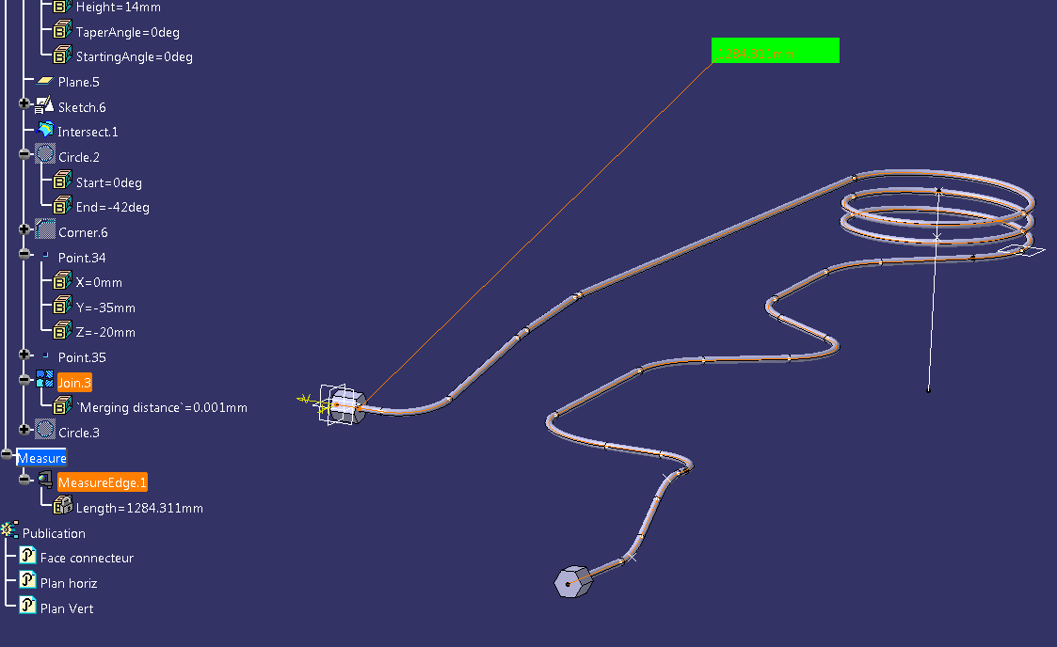
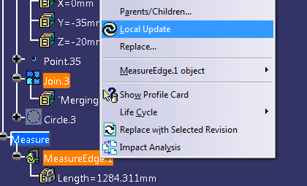
Curve length parameter
Information parameter for different uses in CatPart
First possibility to have curve length measure in the tree via «Measure Item» tool, but some inconvcenients :
- Visual pollution (need to be hidden)
- Need to be updated manually after modification

Slide 4
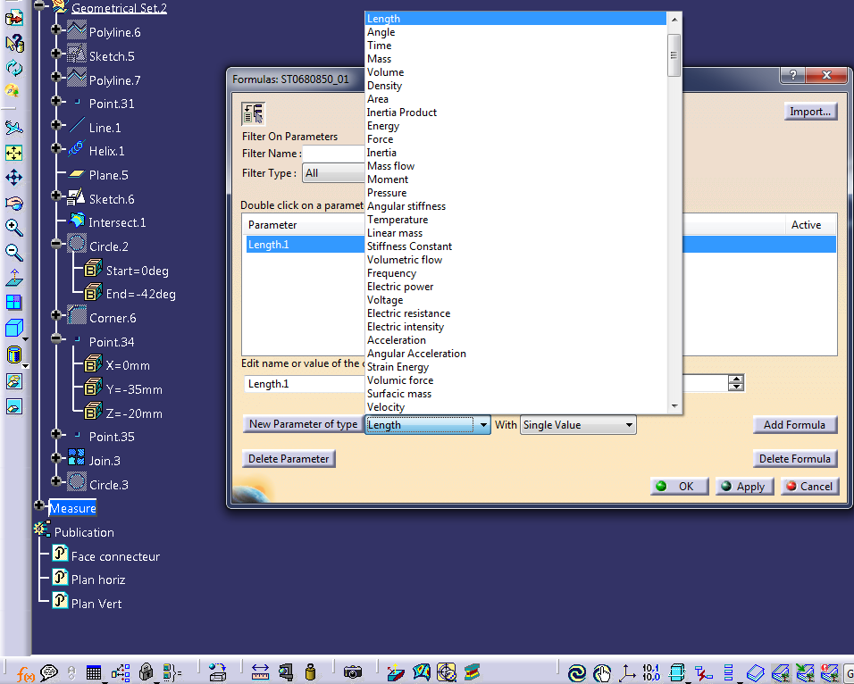
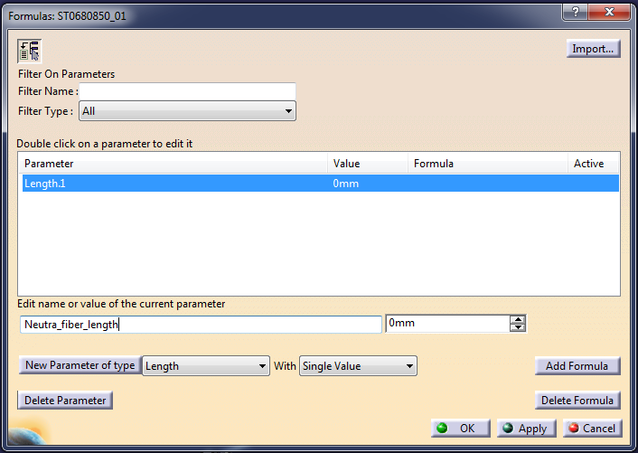

Curve length parameter
Information parameter for different uses in CatPart
Other possibility : use length parameter to display and use curve lentgh for design
2
3
4
5
1

Slide 5
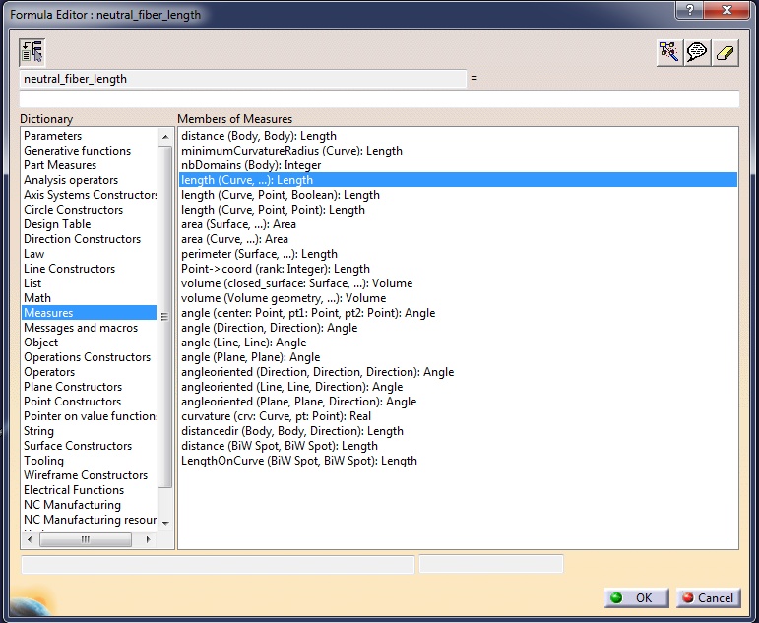
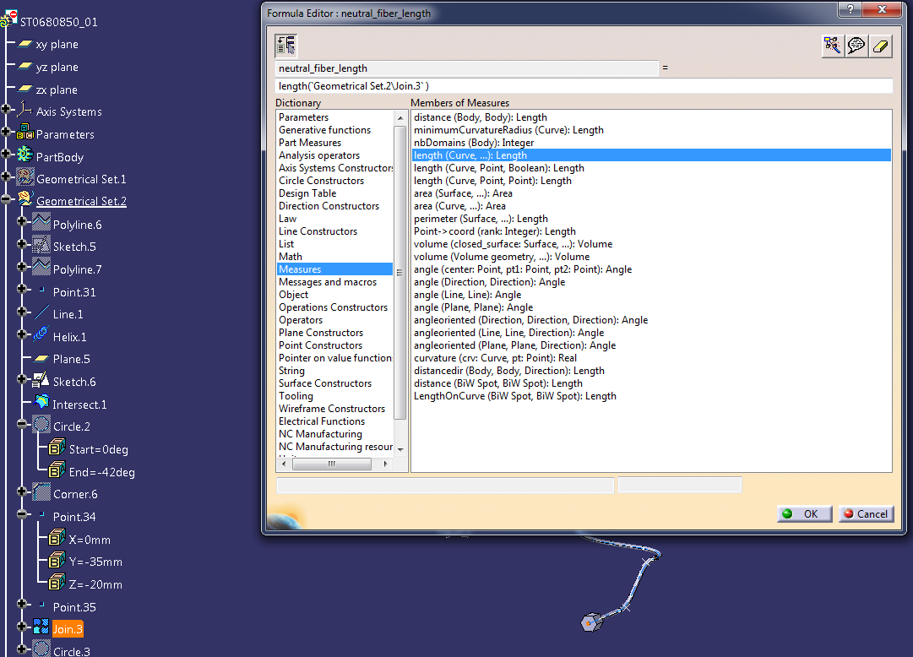
Curve length parameter
Information parameter for different uses in CatPart
Browse dictionnary and double click on length (curve,…) parameter
Then double click on object to measure in the tree

Slide 6
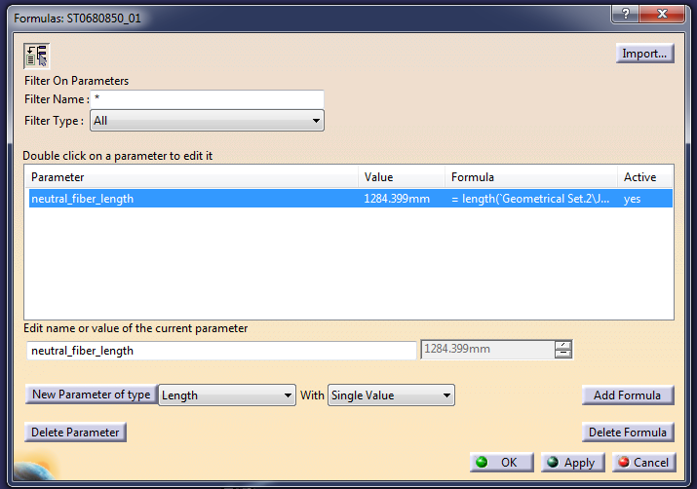
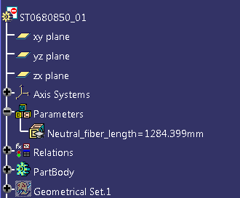
Curve length parameter
Information parameter for different uses in CatPart

Slide 7
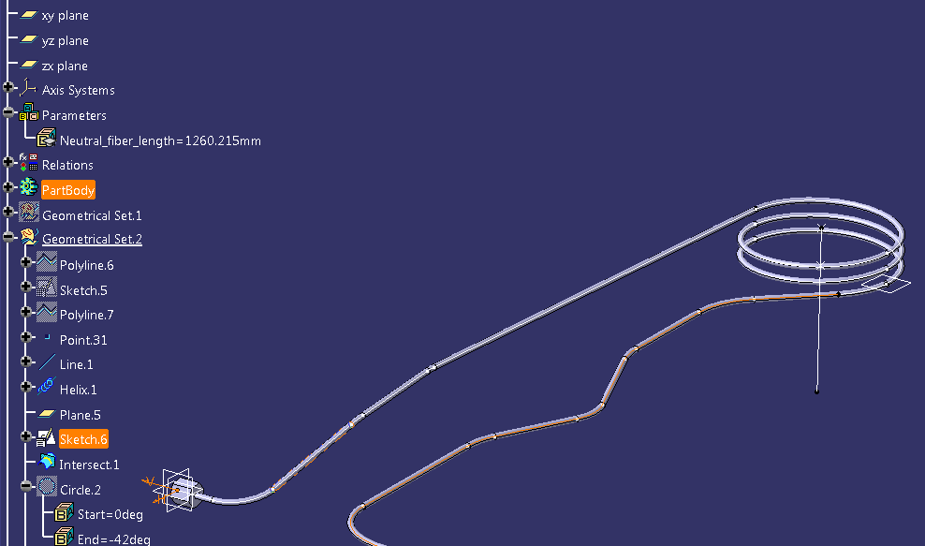
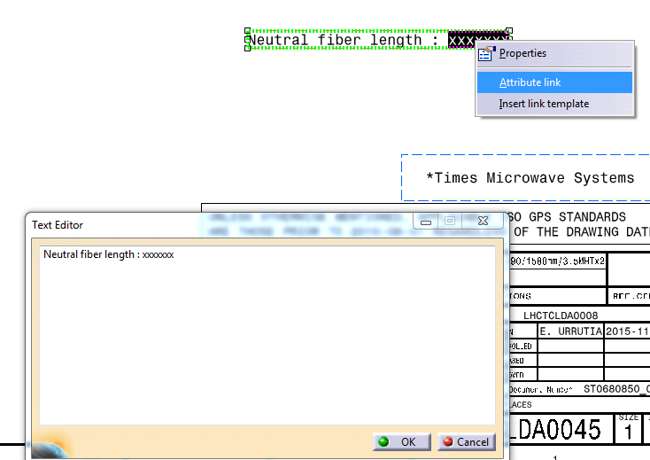
Curve length parameter
Information parameter for different uses in CatPart
Length parameter is updated in the same time of geometry after modification
Possibility to use this parameter for linked text in drawing model

Slide 8
Pattern functionalities

Slide 9
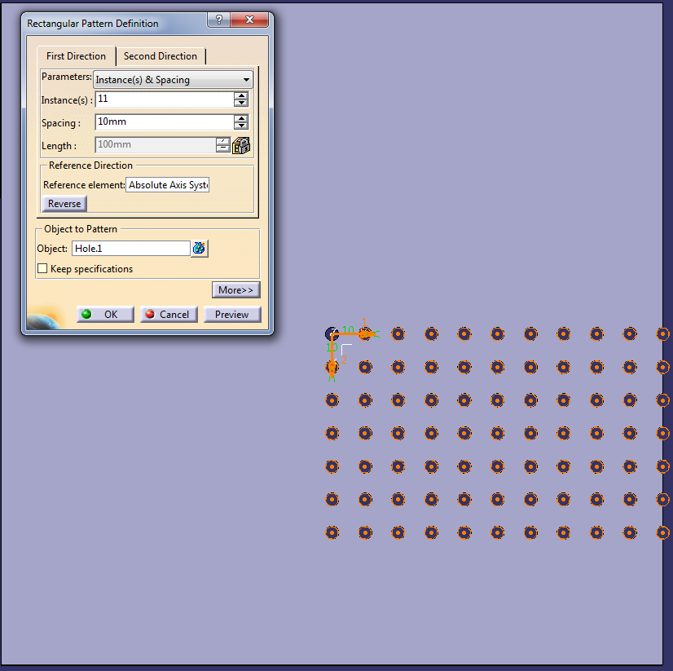
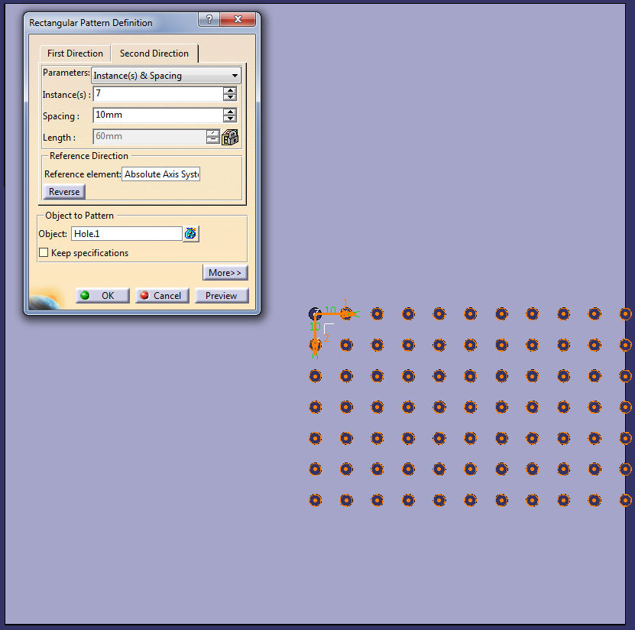
Pattern repartition by default
11
7

Slide 10
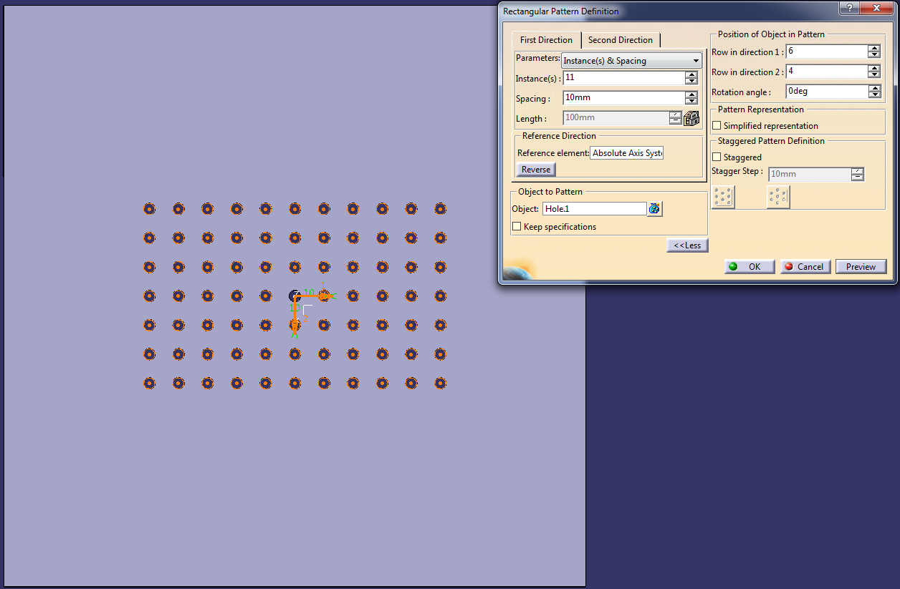
Pattern reordered repartition
11
4
7
6

Slide 11
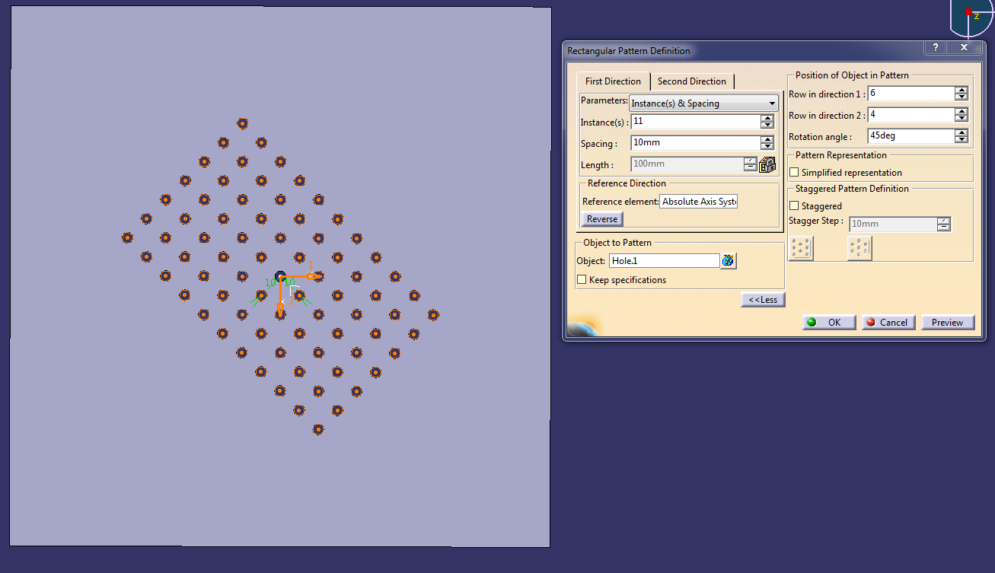
Pattern reordered repartition with angle
45°

Slide 12
Add feature in pattern definition (under condition) demo

Slide 13
Caution with translate tool in part demo

