Slide 1
CAD Service Status
Marta Garcia Carnero
CAD services

Slide 2
Index
CAD support state
Works on going
Trainings
FAQs

Slide 3
CAD support state
CAD support -1
  Our college Cristo left cad support
  We try to continue offering the support and tours as usual
Thanks for your understanding if your requests sometimes will take longer to answer.

Slide 4
Works on going
New Lifecycle
  Updating the tool with the pilot project feedback
  Interested in the pilot project? (Contact CAD Support or GUCS)
      Opportunity to learn and prepare the subject
      Possibility to give feedback before the implementation
      Training from the CAD support
      Priority in the support of related problems
Do you think you have a use case that might not have been covered?
CONTACT US TO VERIFY AS SOON AS POSSIBLE

Slide 5
Works on going II
New CDD number tool
  In internal test phase
  In 3Ds and ITEMs Possibility to
    Set a CDD number
    Get an existing CDD number
    Remove a CDD number
  From SmarTeam or the Dashboard
  In the 2Ds the procedure will be done as today via CartWeb

Slide 6
Works on going III
Implementing the «exception» of getting a CDD number for a drawing that doesn’t exist yet in SmarTeam
ITEM
in SmarTeam
3D
in SmarTeam
Drawing
in CDD
3D representing the drawing
of CDD but NOT generating it
Must be OTHER
Get a CDD number in the ITEM to be able to generate a BOM list
of the assemblies using this 3D

Slide 7
Trainings
Trainings coming
  CATIA basics :
  1 session in EN. starting the 27/02/2017: Full
  1 session in EN. starting the 15/05/2017: 1 place available
  1 session in FR. starting the 11/09/2017: 8 places available
  SmarTeam:
  1 session in EN. starting the 19/06/2017: 4 places available
  1 session in FR. starting the 18/09/2017: 8 places available
More sessions can be created! Please make us know your needs
Do not wait until your collaborators arrive, anticipate
Sessions on demand (~4 persons)
  CATIA Sheet Metal Design
  CATIA Advance drafting
  CATIA kinematics
  CATIA Sheet Metal Design
  New Life cycle (1/2 day) for pilot project and to access to the tool

Slide 8
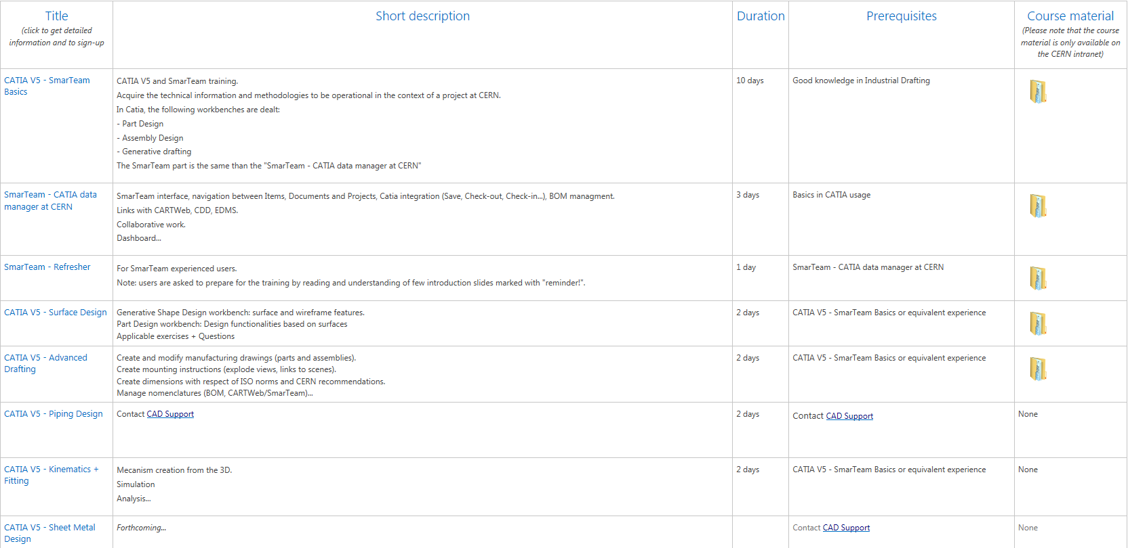
Trainings
For more info:
https://cad-support.web.cern.ch/training/Pages/default.aspx

Slide 9
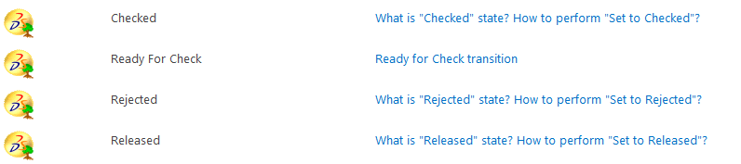
New FAQs
New Life cycle
Knowledge
Assembly design
Drafting

Slide 10
Thank you!!
Questions?

