Slide 1









FIM4R v 2.0
Notes:
1

Slide 2
Background
The first workshop was held at CERN in June 2011 (https://indico.cern.ch/event/129364),
the second at RAL in November 2011 (https://indico.cern.ch/event/157486),
the third at ISGC in February 2012 (https://indico.cern.ch/event/177418),
the fourth at MPI Psycholinguistics Nijmegen in June 2012 (http://www.clarin.eu/events/3501),
the fifth at PSI Villigen in March 2013 (http://indico.psi.ch/event/2230),
the sixth at CSC in Helsinki in October 2013(https://refeds.org/meetings/oct13/index.html),
the seventh at ESRIN in Franscati in April 2014 (https://indico.cern.ch/event/301888/),
the eighth at CERN on 3-4th February 2015 (https://indico.cern.ch/event/358127).
the 9th FIM4R meeting 30th November 2015 (http://fim4r.daasi.de/)
Through these workshops, the research communities have converged on a common vision for FIM, enumerated a set of requirements and proposed a number of recommendations for ensuring a roadmap for the uptake of FIM is achieved. These points have been documented in a paper (https://cdsweb.cern.ch/record/1442597).
Fulltext is: https://cdsweb.cern.ch/record/1442597/files/CERN-OPEN-2012-006.pdf
https://indico.cern.ch/event/358127/
2

Slide 3
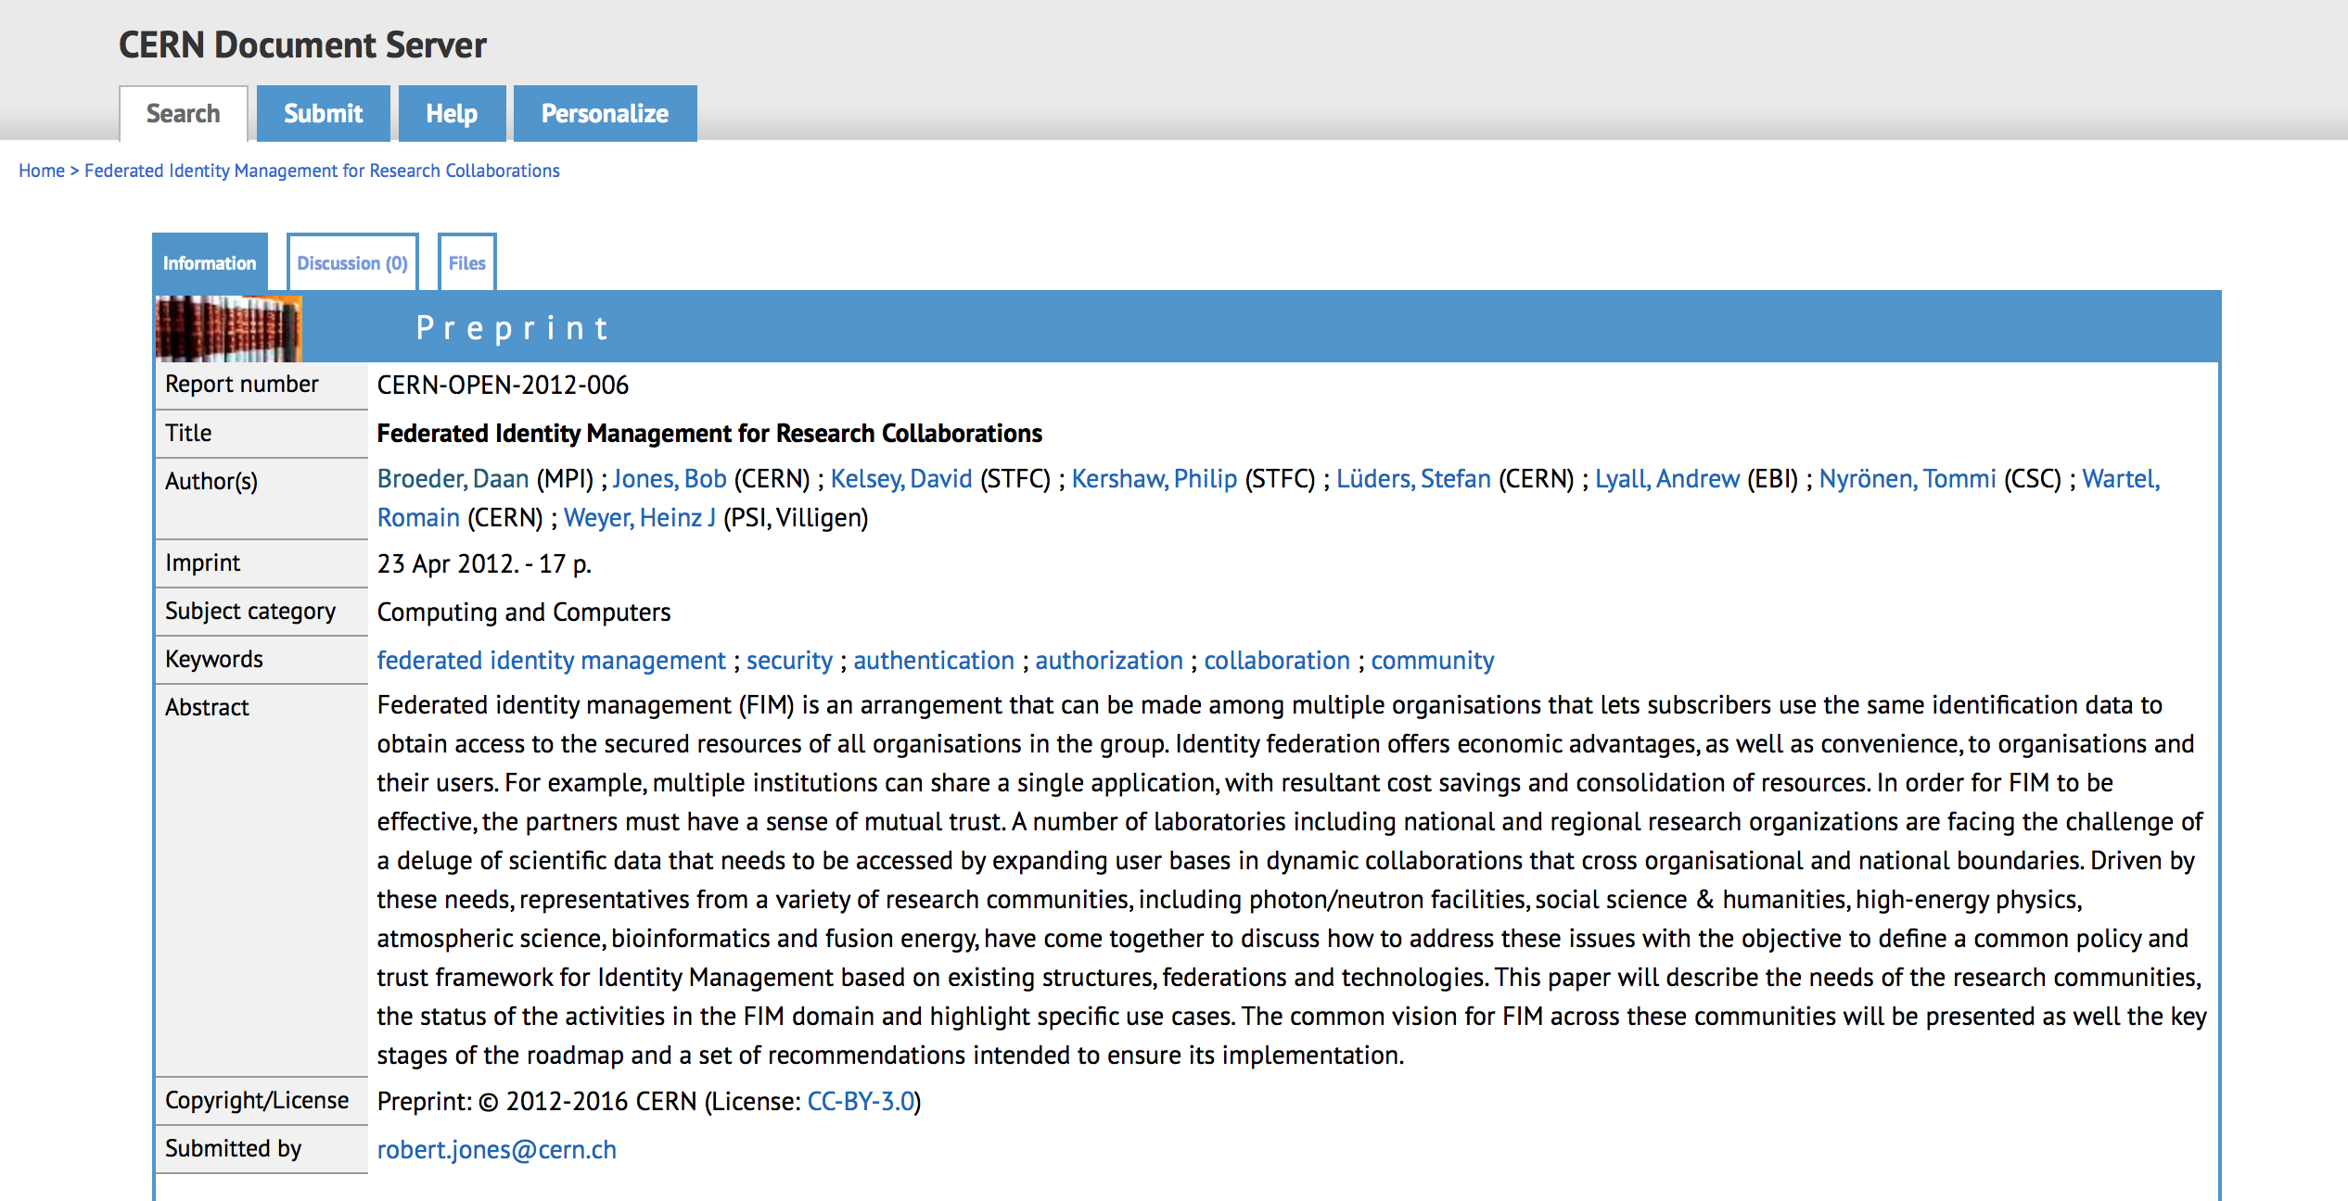
Background
Requirements documented published in 2012 and now due an update!
3

Slide 4
Agenda 1/4
Monday Feb. 20
11:00 → 11:20 | Introduction | Peter Gietz, Hannah Short
11:20 → 11:40 | LIGO Update | Scott Koranda
11:40 → 12:00 | ELIXIR Update | Michal Prochazka
12:00 → 12:20 | WLCG Update | Hannah Short
12:20 → 12:40 | DARIAH Update | Peter Gietz
12:40 → 13:00 | INAF Update | Alessandro Costa
13:00 → 14:10 | Lunch

Slide 5
Agenda 2/4
14:30 → 14:50 | Umbrella Update | Stefan Paetow
14:50 → 15:10 | Security Incident Response | Tom Barton
15:10 → 15:30 | Snctfi | Dave Kelsey
15:30 → 15:50 | Coffee

Slide 6
Agenda 3/4
15:50 → 16:10 | Accounting Data Protection | Uros Stevanovic , Irina Mikhailava
16:10 → 16:30 | Data Protection Code of Conduct | Mikael Linden
16:30 → 16:50 | EGI Update | Peter Solagna
16:50 → 17:10 | EUDAT Update | Willem Elbers
17:10 → 18:10 | FIM4Rv2 Document Plans
19:00 → 21:00 | No-host Dinner

Slide 7
Agenda 4/4
Tuesday, Feb 21 |  | ¶
09:00 → 09:20 | AARC I and II | David Groep
09:20 → 09:40 | AARC Blueprint Architecture | Christos Kanellopoulos
09:40 → 10:00 | Publishers & IAM | Heather Flanagan
10:00 → 10:20 | Kantara OTTO WG 4 OAUTH2 | Colin Wallis
10:20 → 10:40 | Next Steps

Slide 8
2012 Requirements
User friendliness (high)
Browser & non-browser federated access (high).
Bridging communities (medium).
Multiple technologies with translators including dynamic issue of credentials (medium).
Implementations based on open standards and sustainable with compatible licenses (high).
Different Levels of Assurance with provenance (high).
Authorisation under community and/or facility control (high).
Well defined semantically harmonised attributes(medium).
Flexible and scalable IdP attribute release policy(medium).
Attributes must be able to cross national borders(high).
Attribute aggregation for authorisation(medium).
Privacy and data protection to be addressed with community-wide individual identities(medium)
8

Slide 9
2012 Requirements: how have we done?
User friendliness (high) - Good but varies wildly, citizen scientists partially addressed
Browser & non-browser federated access (high). – Mostly requires web intervention
Bridging communities (medium). – eduGAIN addresses R&E but little interaction with commercial/social
Multiple technologies with translators including dynamic issue of credentials (medium).
Implementations based on open standards and sustainable with compatible licenses (high).
Different Levels of Assurance with provenance (high).
Authorisation under community and/or facility control (high).
Well defined semantically harmonised attributes(medium). – R&S, not so much for other attributes
Flexible and scalable IdP attribute release policy(medium). – R&S seems to have reached happy medium
Attributes must be able to cross national borders(high). - Good work from AARC but GDPR problematic for intergovernmental organisations
Attribute aggregation for authorisation(medium). – Case by case basis
Privacy and data protection to be addressed with community-wide individual identities(medium)
9

Slide 10
2012 Recommendations
Recommendations to the research communities
  Conduct Risk Analysis
  Run Pilot Studies coordinated by experts
Recommendations to the technology providers
  Separation of Authorization and Authentication
  Credentials revocation
  Attribute delegation to the research community
  Standardise efforts in Levels of Security/Assurance
Recommendations to funding agencies
  Fund FIM technologies that are focused on solving the described needs of the research communities
10

Slide 11
2012 Recommendations: how have we done?
Recommendations to the research communities
  Conduct Risk Analysis – SCI
  Run Pilot Studies coordinated by experts - AARC
Recommendations to the technology providers
  Separation of Authorization and Authentication – as per attribute delegation
  Credentials revocation
  Attribute delegation to the research community – partially done within the context of pilots
  Standardise efforts in Levels of Security/Assurance – Minimal LoA, Sirtfi
Recommendations to funding agencies
  Fund FIM technologies that are focused on solving the described needs of the research communities – AARC/AARC2
11

Slide 12
Recommendations 2017
Address command line and non-web use cases
Integrate FIM with existing Community Membership Management Tools
Build operational security
Support GDPR adequacy certification for intergovernmental organisations
Commercial IaaS interaction
Make FIM a production service and a corner stone of the European Open Science Cloud
…
12

Slide 13
So what do we want to do?
Basically we have two options:
  Create a new version of the document
    Less work?
    Are all original authors available?
  Write a new document, referencing the old one
    We could write a summary of what had happened
    We could then formulate some new requirements and recommendations
13

Slide 14
Next Steps
Run a 10th FIM4R Workshop to start (yes we are in that workshop now)
When else to meet?
  Feedback @ RDA Session in April, Barcelona
  Where else?
Who? Representatives of Research Communities and Infrastructures
Timeline?
14

