Slide 1
The EGI CheckIn service
Peter Solagna – EGI Foundation
10th FIM4R Workshop

Slide 2
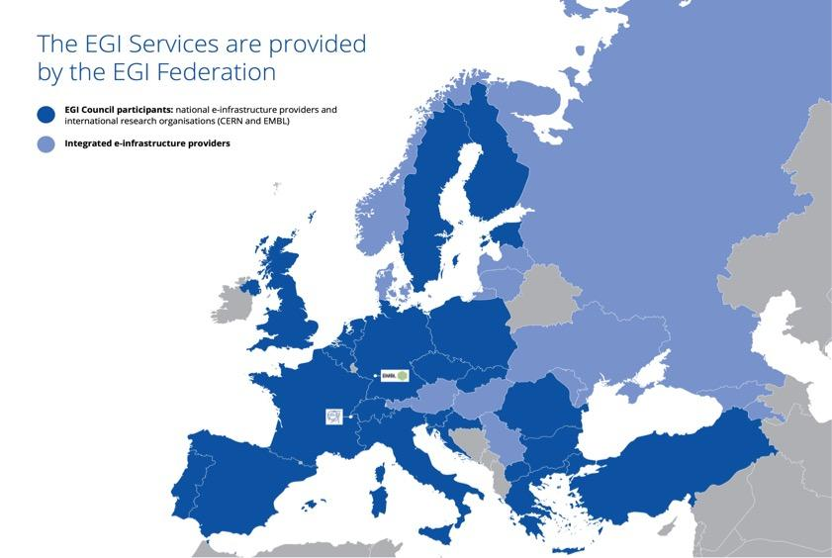


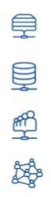









680,000
Cores
258,000
Terabytes of online storage
~40,000
Users
~200
Virtual Organizations
~300
Resource centers

Slide 3
The AAI Challenges in EGI
Many users - Many Identity Providers
Many distributed Service Providers
  Scalable authentication mechanisms
Trust chain between Users (IdPs) and SPs - and vice-versa
“Groups” and “roles” authorization mechanisms, that differentiate users capabilities to a given service.

Slide 4


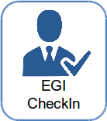

The goals of CheckIn
Federated Identity Access Management (IAM) solution for research communities.
Combine multi-protocol federated access and flexible group/Virtual Organization management capabilities in one single platform
Enable users to transparently access distributed federated service providers.
Minimize overhead for end users, communities and service providers.
Implement the AARC blueprint
Identity
Providers
IdP
Service
Providers
SP

Slide 5
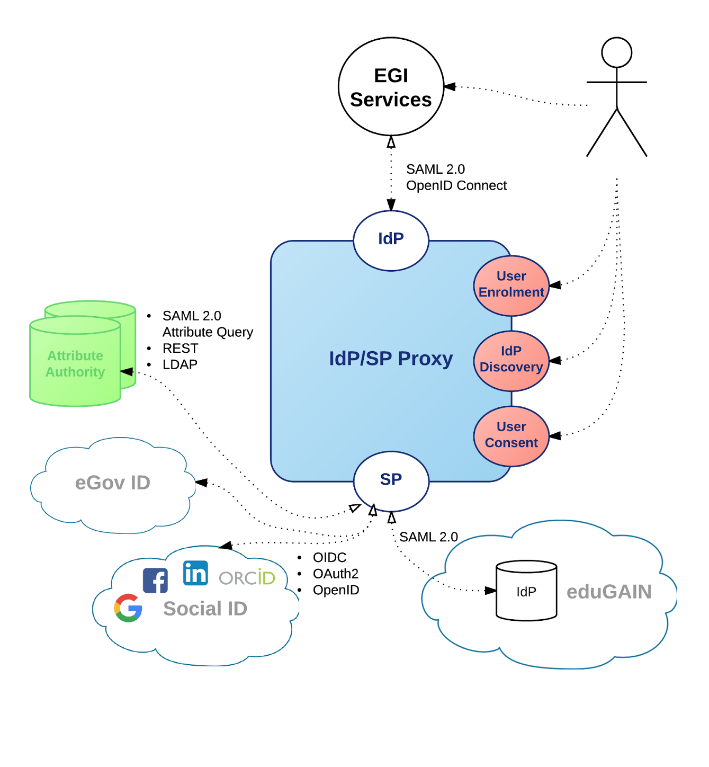
CheckIn today
Available via eduGAIN
IdP Discovery
User Enrolment
User Consent
Support for LoA
Attribute Aggregation
  SAML2.0 Attribute Query, REST, LDAP
Support for OIDC/OAuth2 Providers
  Google, Facebook, LinkedIn, ORCID
Support for OIDC/OAuth2 services
Experimental support for eIDAS

Slide 6






How EGI trust model evolves? (X.509 only)
Who are you?
Users hold a certificate
TRUST
Community
attributes
“User A”
TRUST
What’s your group and/or role?
EGI Services
Virtual
Organization

Slide 7













How EGI trust model evolves? (CheckIn)
IdPs
Who are you?
User may have
Several credentials
Social ID
EGI CheckIn
SPs
EGI Services
User Community services
Trust
Trust
Certificates
Trust
Attribute Authority
Attribute Authority
Attribute Authority
What’s your group and/or role?

Slide 8
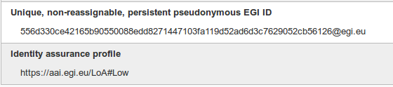
Enabling uniform authentication:
EGI UID
EGI User ID is created by the CheckIn service at the moment of the user’s first connection - User registers in the EGI CheckIn.
EGI CheckIn service “generates” the EGI User ID based on the unique user identifier attribute released by the user IdP (any of the following: “eduPersonUniqueId”, “ePPN”, or “ePTID”).
EGI User ID is:
  personal, persistent, non-reassignable, non-targeted, globally unique, opaque
Attributes released by the IdP (SAML assertions)
Mail | Display name | Given name | Surname | Distiguished name
EGI CheckIn
service

Slide 9
Enabling uniform authentication:
Level of assurance management
The minimum LoA to access an EGI service is defined by the EGI’s policies
  Similarly the community defines the LoA to access their services
CheckIn does:
  Calculate the LoA provided by the IdP based on the information provided
    The LoA can be a combination of multiple sources of information
  Provide the LoA information to the SP in a uniform classification
  Allow a SP to express its expectations for the LoA at which a user should be authenticated.

Slide 10

Enabling uniform authentication:
The LoA categories
Null
Social credentials with no vetting, no unique ID
A
eduGAIN IdP
Low risk services with no data storage
B
eduGAIN IdPs that comply with R&S and Sirtfi
Example of usage scenarios:
Example of usage scenarios:
Access to open data
Example of usage scenarios:
Demos and training with short time access
Run pre-defined applications through science gateways
Access PaaS on the cloud
C
IdP that meets ‘B’ plus the equivalent of IGTF “BIRCH” LoA (identity vetting)
Example of usage scenarios
Submit custom applications to HTC
Manage virtual machines
Access sensitive data
The LoA categories are still a topic under discussion in AARC. CheckIn will implement the results of the discussion

Slide 11
Enabling uniform authorization: attributes harmonization
Only entitlements from trusted attribute authorities are passed to the SPs
VO
AA
“VO”
AA
CheckIn

Slide 12


Enabling uniform authorization: attributes harmonization
Only entitlements from trusted attribute authorities are passed to the SPs
Entitlements are translated into uniform syntax
VO 1
AA
VO 2
AA
CheckIn
urn:mace:egi.eu:<authority-fqdn>:<group>:<role>@<vo>

Slide 13
Enabling uniform authorization: attributes harmonization
Only entitlements from trusted attribute authorities are passed to the SPs
Entitlements are translated into uniform syntax
Entitlements clashes are prevented with univocal scoping
VO 1
AA
VO 2
AA
SoftwareManager
CheckIn
Software Manager
VO1: Software Manager
VO2: Software Manager

Slide 14
Credential translation to X.509
CheckIn service is integrated with the RC Auth Online CA to provide X.509 credentials:
  The CI Logon delegation service makes possible to implement secure provisioning of X.509 credentials to science gateways, portals and other applications.
  Workflow designed in the AARC project.
RC Auth is an accredited certification authority in the IGTF federation.
  It will be accepted in all EGI services, and in all the other federations accepting IGTF certificates.
All the users holding credentials with a sufficient level of assurance are able to access RC Auth certificates through the CheckIn Service
  LoA ‘B’: R&S and Sirtfi compliance (or demonstrated equivalent LoA)
EGI CheckIn
CI Logon
RC Auth
EGI Services

Slide 15

Transparent VO managmenet
Translation of VO information into VOMS proxyes (from SAML/OIDC)
Provisioning of VOMS information through SAML and OIDC interfaces
X.509 Credentials
VOMS Service
SAML/OIDC Credentials
Attribute service
CheckIn

Slide 16

CheckIn is integrated in the AAI ecosystem
CheckIn
eduGAIN
B2ACCESS
ELIXIR AAI
e-Infrastructure AAI
RI AAI
eduGAIN
R&S

Slide 17
Integration with the ELIXIR AAI
Enable access for ELIXIR users to:
  EGI configuration database (GOCDB)
    Only for the members of the ELIXIR group: “Community:Compute:Grid site managers”
  Virtual appliance registry (AppDB)
    For the members of the “vo.elixir-europe.org”
    Entitlements from ELIXIR AAI identify the members or the managers of the VO, with different capabilities
  Raising the LoA for the users holding the entitlements above
Under testing
  Access to Fedcloud resources using OIDC
GOCDB
ELIXIR AAI
EGI CheckIn
IdP
AppDB
Fedcloud

Slide 18
Integration with other AAI platforms
EPOS:
  Integrated as an IdP for EPOS users (still in the test environment but can be moved to production upon request)
  In the future CheckIn will reuse the Unity connector (see LToS use case) to allow EPOS users to access EGI services
EUDAT:
  CheckIn will be integrated as both an IdP and an SP with EUDAT B2ACCESS to support the following cross-infrastructure use cases:
  - EGI users accessing EUDAT (web and non-web) resources using their EGI CheckIn ID
  - EUDAT users accessing EGI (web and non-web) resources using their EUDAT
  B2ACCESS ID
  Both use cases to be implemented by end of 2017Q1 in the context of AARC
ARIA, structural biology
  Integrated as an IdP in CheckIn
First VO fully integrated: LToS
  Integrated as an IdP for LToS users ➔ VO fully accessible through CheckIn
  CheckIn has developed a Unity connector to get LToS VO membership information and generate entitlements (supported use case: AppDB uses vm_operator role of LToS users for AuthZ)

