Slide 1


Electron cloud instability studies for the LHC
A. Romano, G. Iadarola, G. Rumolo
Many thanks to: X. Buffat, P. Dijkstal, K. Li, L. Mether, E. Métral

Slide 2
Outline
Overview on my PhD work
  Topics studied
  Ongoing studies
  Activities and conferences
Electron cloud induced instability in the LHC during collisions at 6.5TeV
  Instability observations: background and history
  Simulations studies and challenges
  Comparison of simulation results with the available experimental observations
Highlights from ongoing studies and next steps

Slide 3
Outline
Overview on my PhD work
  Topics studied
  Ongoing studies
  Activities and conferences
Electron cloud induced instability in the LHC during collisions at 6.5TeV
  Instability observations: background and history
  Simulations studies and challenges
  Comparison of simulation results with the available experimental observations
Highlights from ongoing studies and next steps

Slide 4
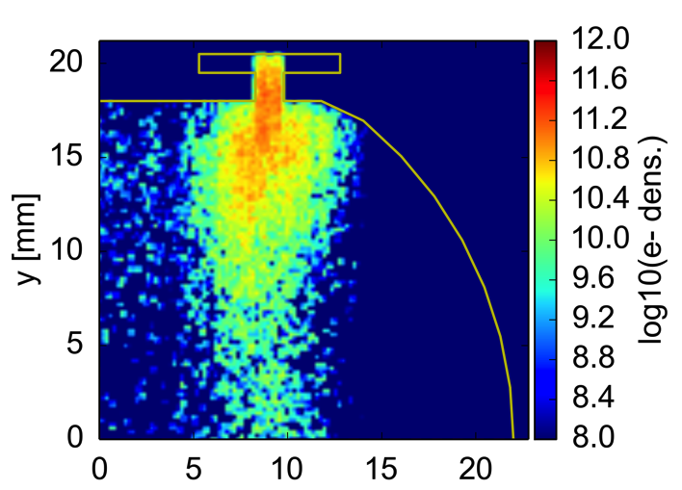
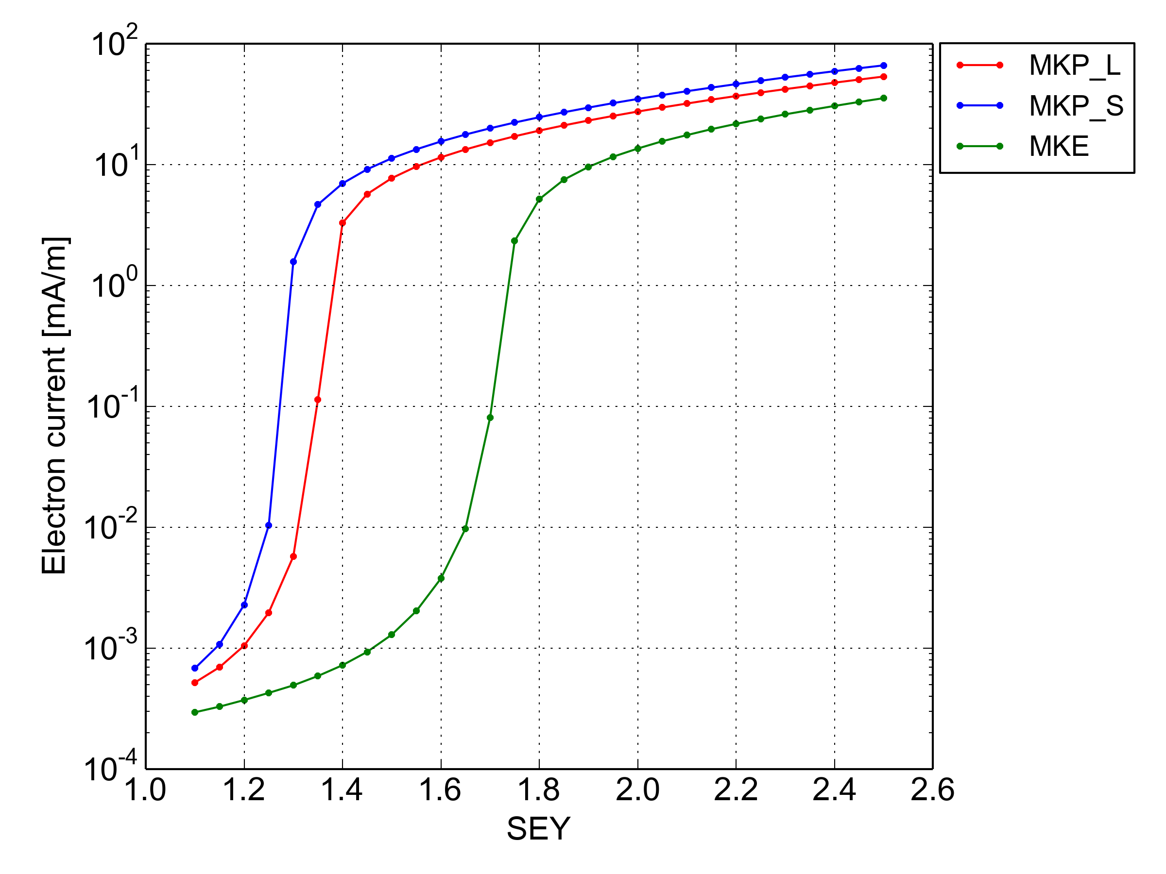
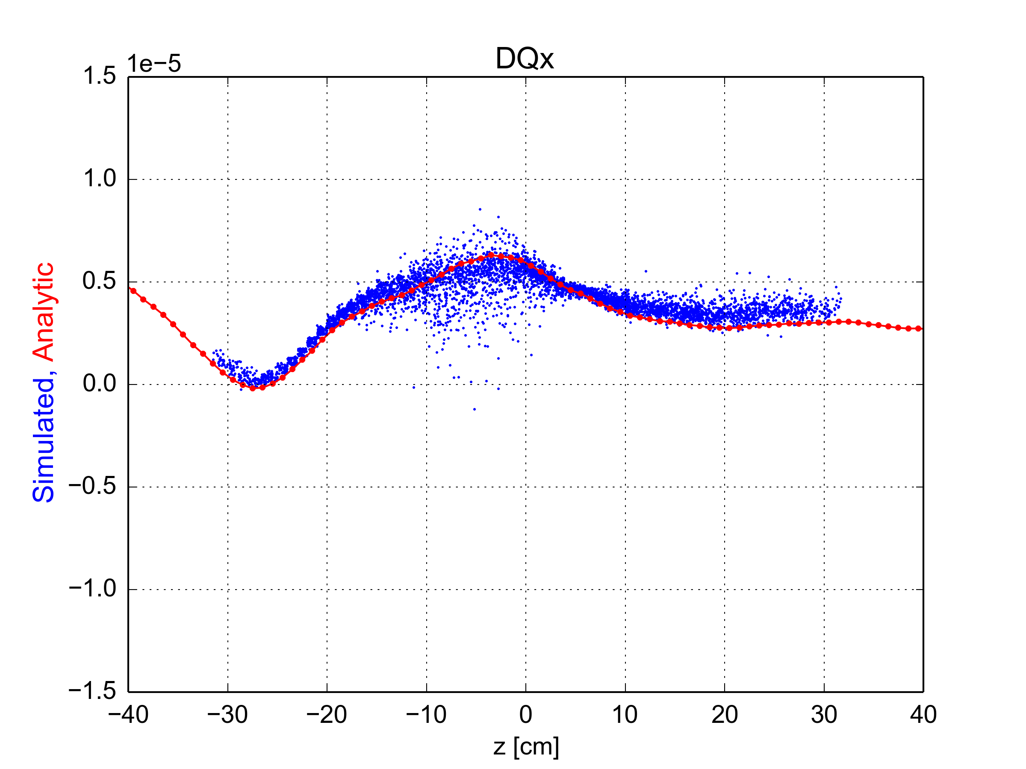
My PhD work
TOPICS STUDIED SO FAR
ELECTRON CLOUD BUILD-UP
  Effect of the LHC beam screen baffle on the electron cloud buildup (Electron_cloud_Meeting_18.09.15, Proceedings_IPAC16)
  Electron cloud build up simulations in the SPS MKP and MKE (MKP_Strategy_Meeting_30.06.16, MKP_Strategy_Meeting_7.11.16)
ELECTRON CLOUD EFFECTS ON THE BEAM DYNAMICS
Incoherent effects
  Effect of the electron cloud on the tune footprint in the LHC arcs at injection energy (LBOC_Meeting_27.10.15)
  Effect of the electron cloud on the tune footprint in the LHC Interaction Regions at high energy (Electron_Cloud_Meeting_3.06.16)
Simulated detuning does match with the analytical equation

Slide 5
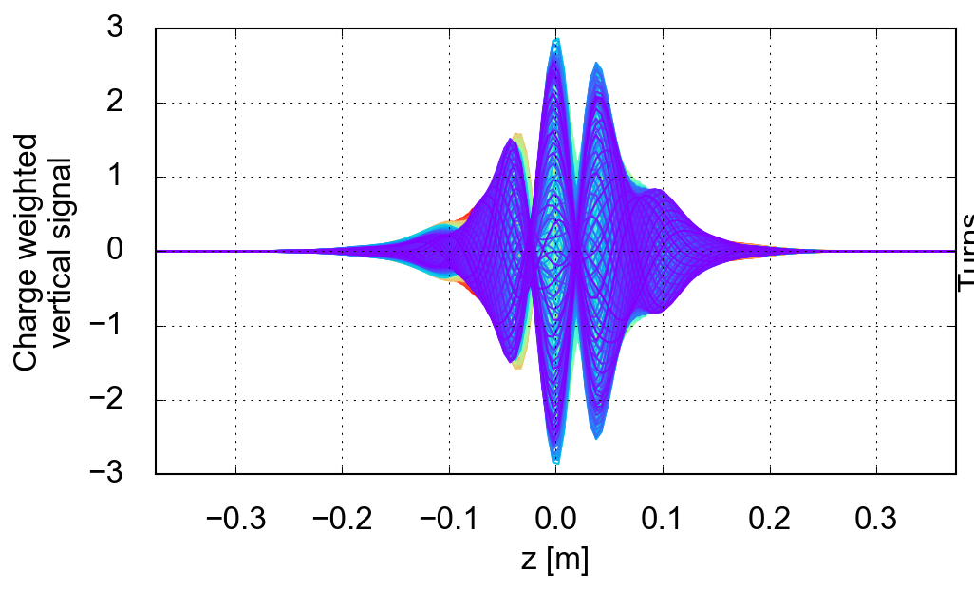
My PhD work
  Coherent effects
  Overview on the Electron cloud effect on the LHC beam dynamics (e.g preliminary results obtained using new developed tools) (Electron_Cloud_Meeting_30.09.16)
  Investigations on the electron cloud impact on the observed instabilities at high energy (1/2_Day_Internal_review_29.11.16)
  Subject of this presentation and potential peer reviewed paper
2. ONGOING STUDIES
ELECTRON CLOUD EFFECTS ON THE BEAM DYNAMICS (coherent and incoherent effects)
  Understanding of the EC driven instabilities in the arcs together with chromaticty, octupoles and transverse feedback → long simulations run to approach the time scale of machine observations
  3. ACTIVITIES and CONFERENCES
  Experiment at LHC (MD, Scrubbing run)
  KWT (2015, 2016, 2017), IPAC ‘17, ICFA

Slide 6
Outline
Overview on my PhD work
  Topics studied
  Ongoing studies
  Activities and conferences
Electron cloud induced instability in the LHC during collisions at 6.5TeV
  Instability observations: background and history
  Simulations studies and challenges
  Comparison of simulation results with the available experimental observations
Highlights from ongoing studies and next steps

Slide 7
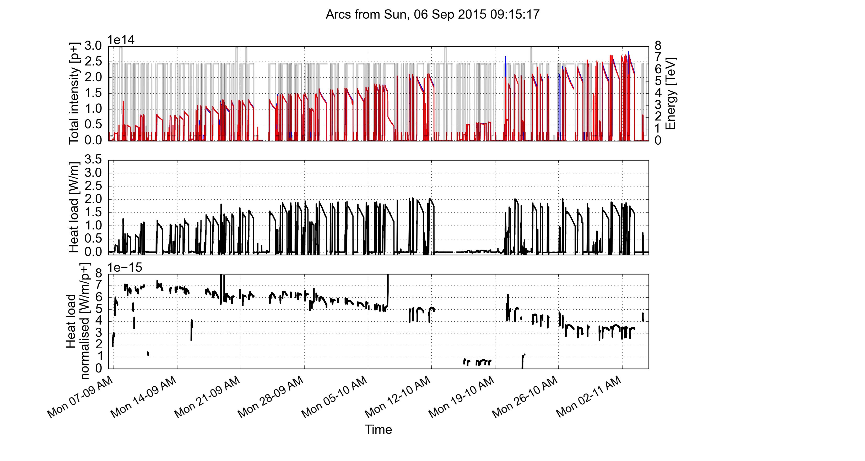
Key findings for instabilities in 2015
2015 was successful for LHC operation: deployment of the 25 ns beams and operation at 6.5 TeV → stable foundation for the 2016 physics run but the e-cloud remains still a challenge for the machine operation
  scrubbing is not sufficient to achieve a full e-cloud suppression → but conditioning effect throughout the year has been observed
2015
(See G.Iadarola_Chamonix2017 talk)

Slide 8
Key findings for instabilities in 2015
2015 was successful for LHC operation: deployment of the 25 ns beams and operation at 6.5 TeV → stable foundation for the 2016 physics run but the e-cloud remains still a challenge for the machine operation
  scrubbing is not sufficient to achieve a full e-cloud suppression → but contiditiong effect throughout the year has been observed
  Establish operable machine settings to ensure the beam stability
    Chromaticity: Q’_{H,V} = 15/15
    Octupoles current: ~20 A → corresponds to ΔQ_{oct,spread} ~ 1 x 10⁻³
    Transverse feedback: high gain, maximum achievable bandwidth
  Further studies has been carried out in order to evaluate the contribution of these settings, together with the detuning induced by the e-cloud, on the tune footprint

Slide 9
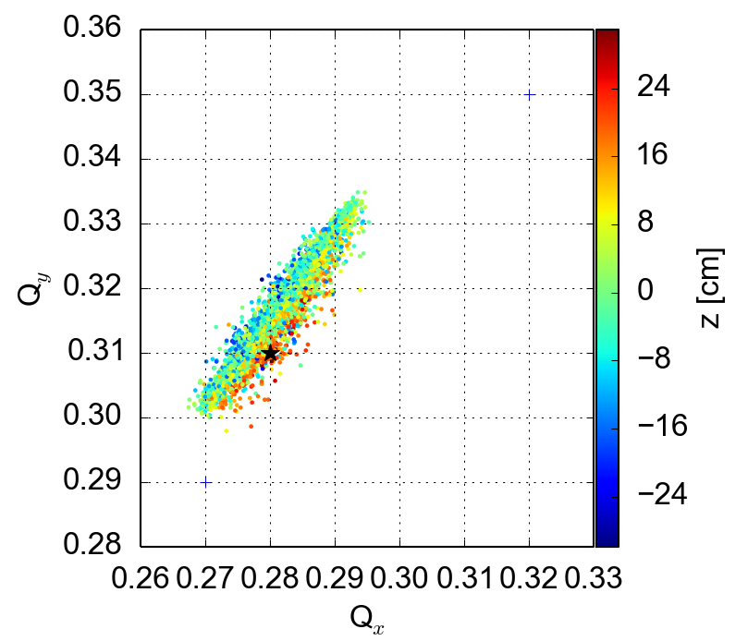
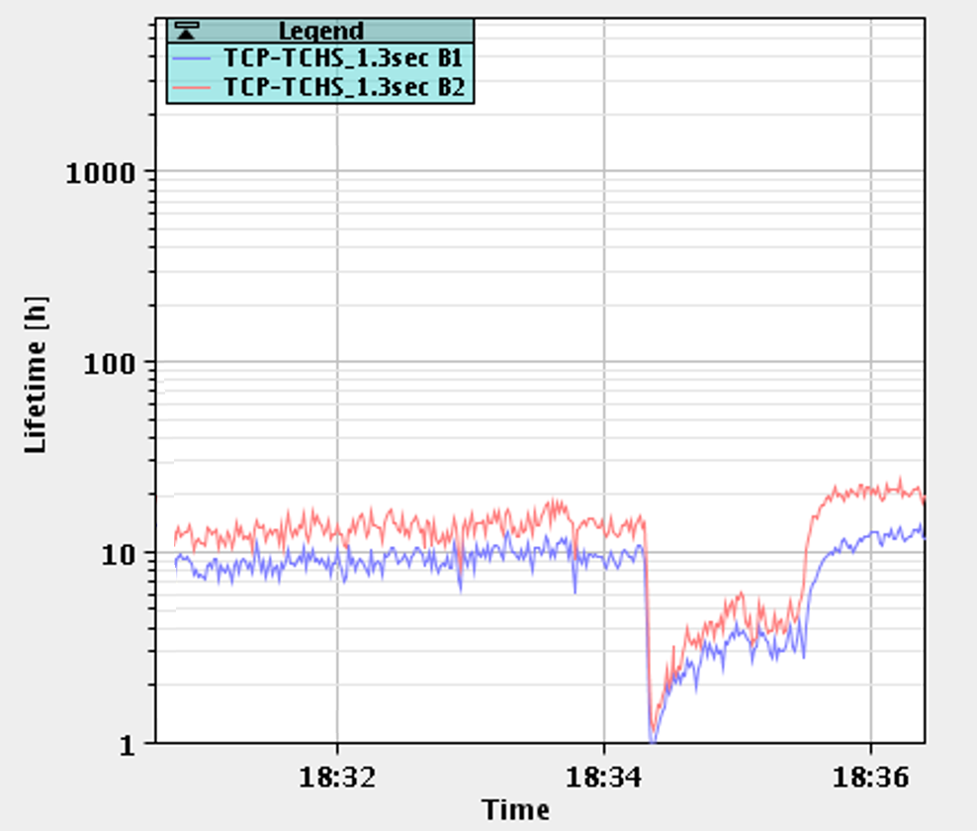
Key findings for instabilities in 2015
2015 was successful for LHC operation: deployment of the 25 ns beams and operation at 6.5 TeV → stable foundation for the 2016 physics run but the e-cloud remains still a challenge for the machine operation
  scrubbing is not sufficient to achieve a full e-cloud suppression → but contiditiong effect throughout the year has been observed
  Establish operable machine settings to ensure the beam stability
    Chromaticity: Q’_{H,V} = 15/15
    Octupoles current: ~26 A
    Transverse feedback: high gain, maximum achievable bandwidth
  Further studies have been carried out in order to evaluate the contribution of these settings, together with the detuning induced by the e-cloud, on the tune footprint
    large tune footprint at injection which could reach the third order resonance
Q’=15/20, Octupole at 20A , EC central density in dipoles 5 x 10e11 e/m3
Q’v=15
Qv=.305
Q’v=10
Qv=.305
Q’v=15
Qv=.300
Optimization of the working point to improve life time and avoid linear coupling

Slide 10
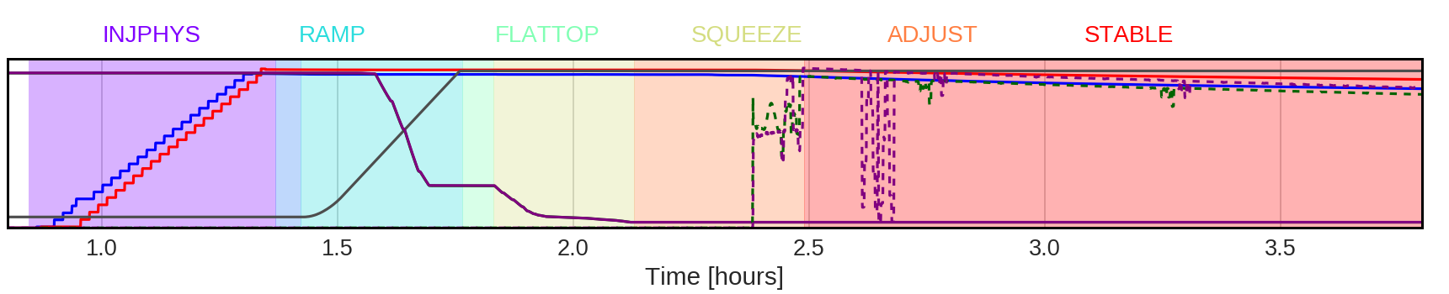

Moving from 2015 into 2016 LHC operation
In 2016, all performance optimizing measures worked out in 2015 have been applied
Observations at the beginning of the run
  in spite of high value of chromaticity (15 units in both planes) and high Landau octupoles current, a new type of instability was showing up after few hours in stable beam (i.e stable condition with collisions in the experiments)
LHC beam mode:
Instability observations
E-cloud?

Slide 11
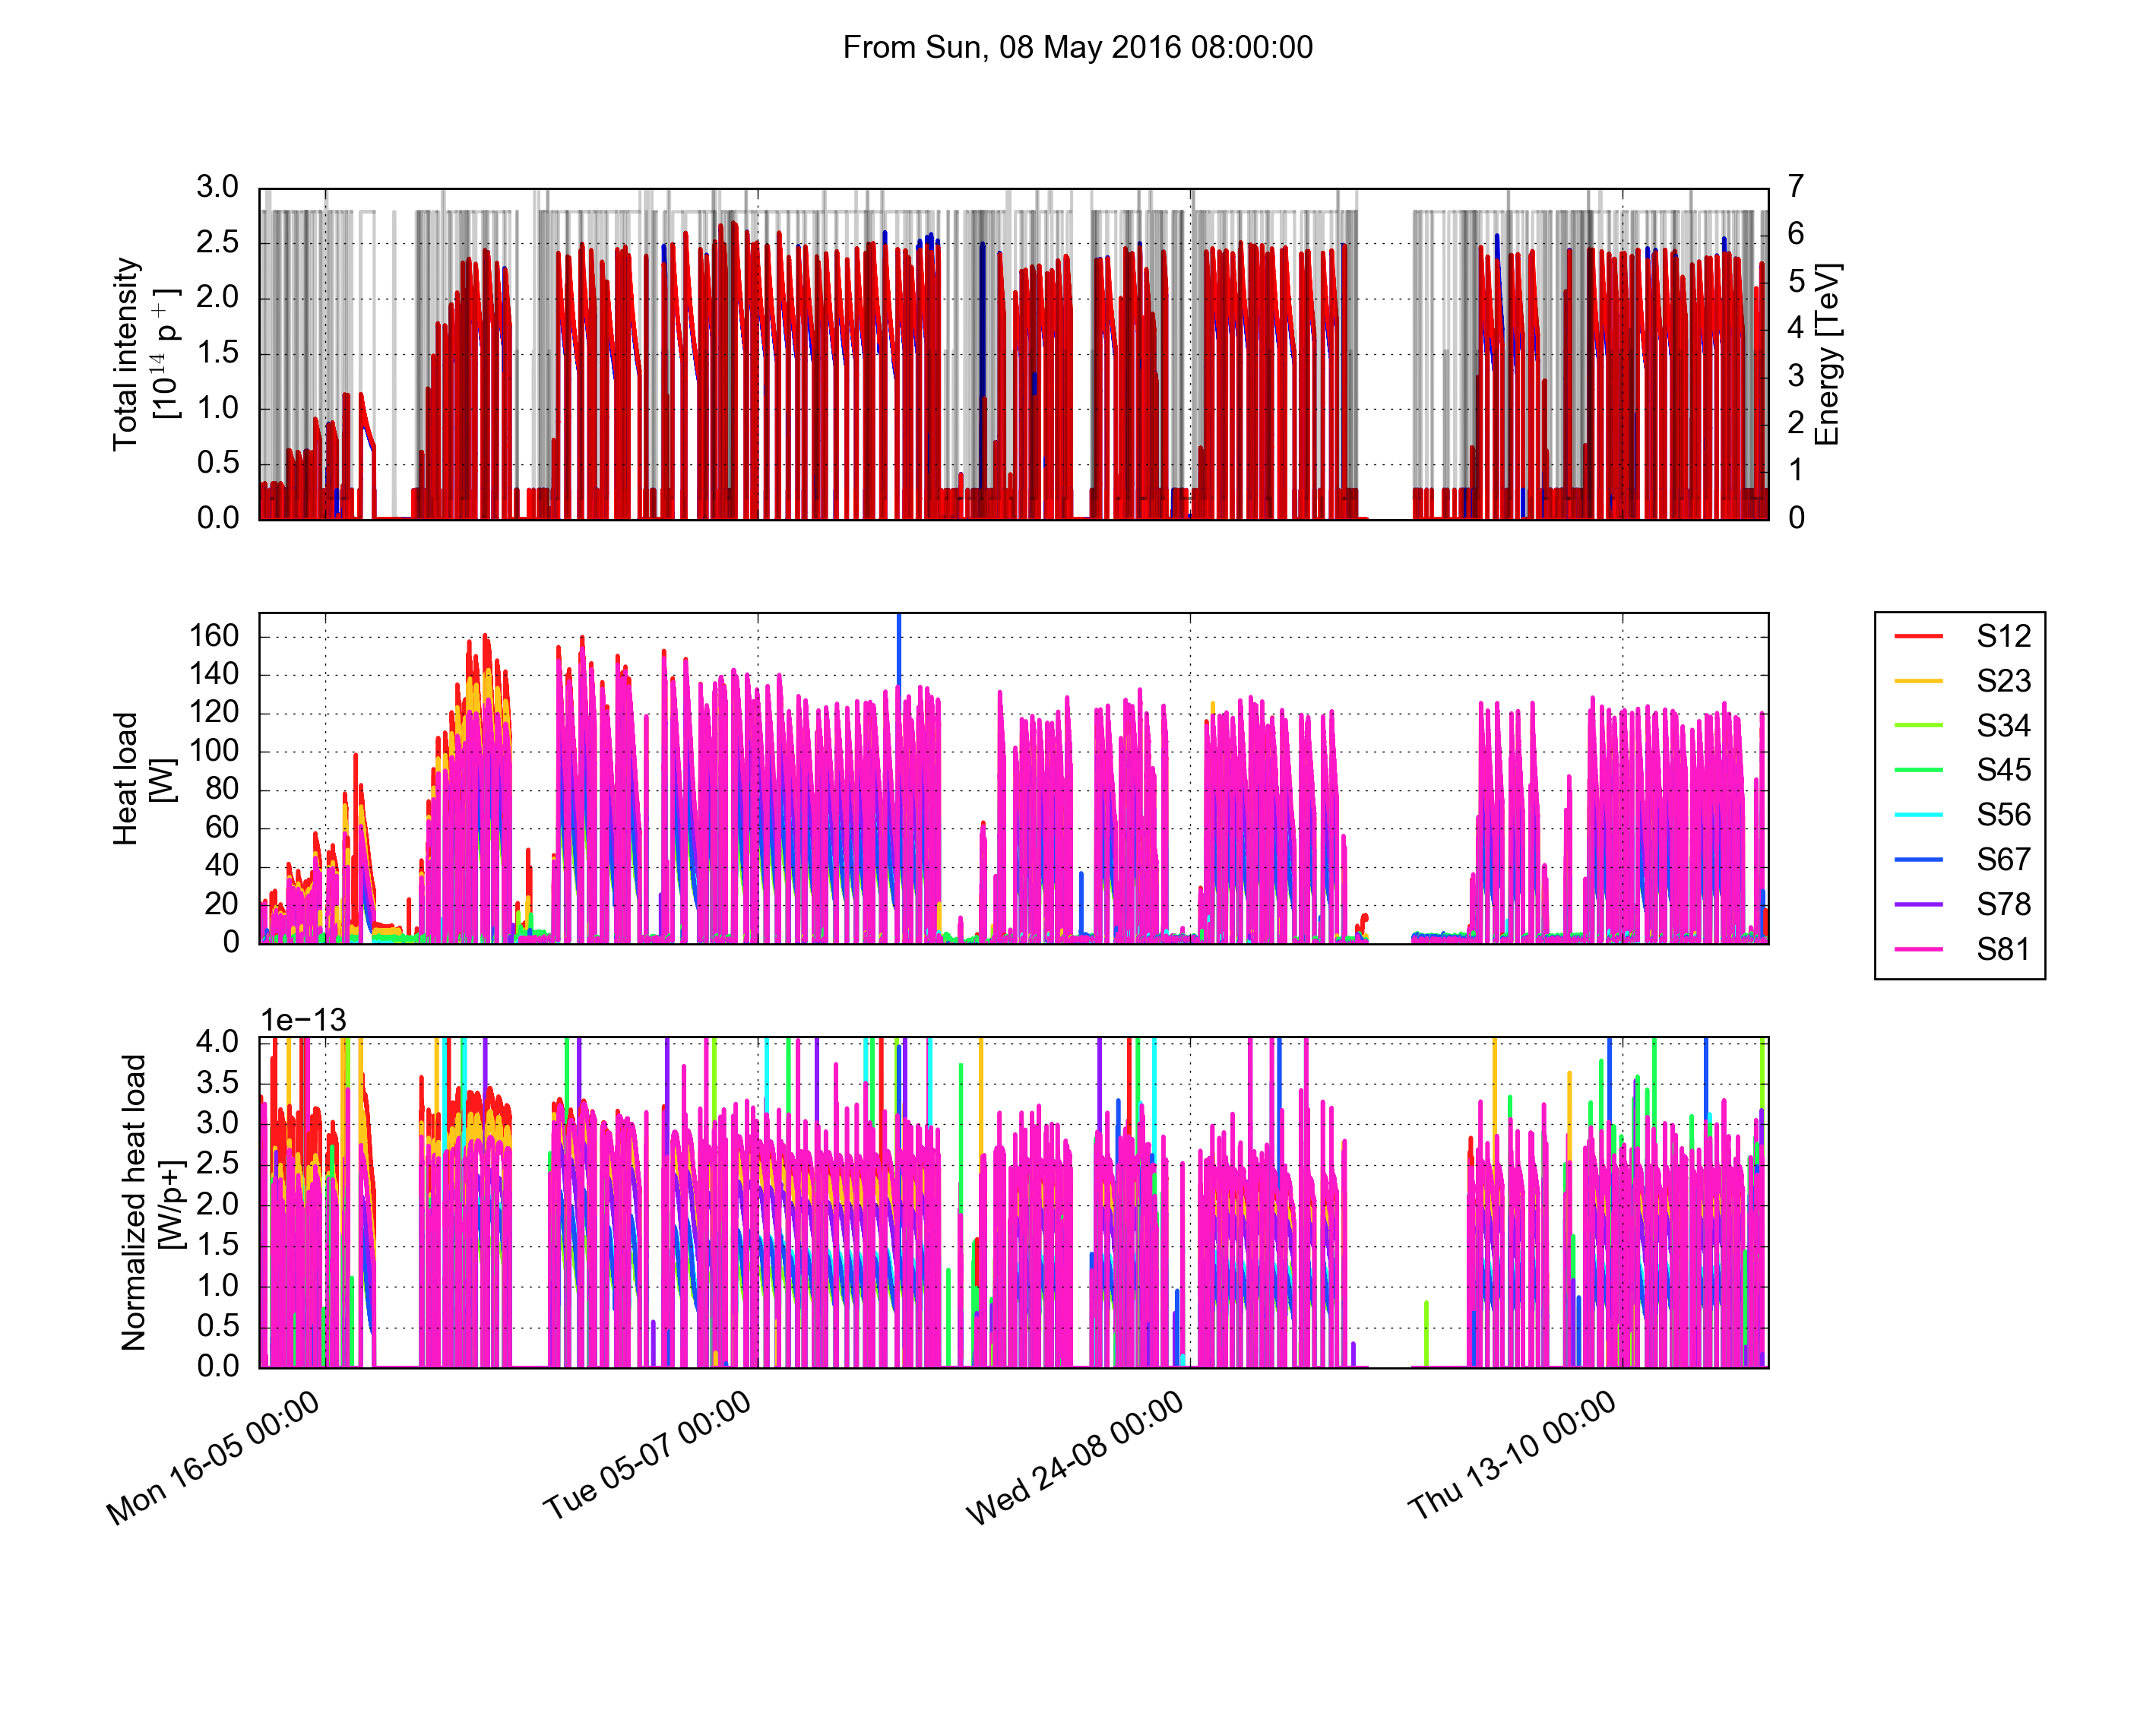
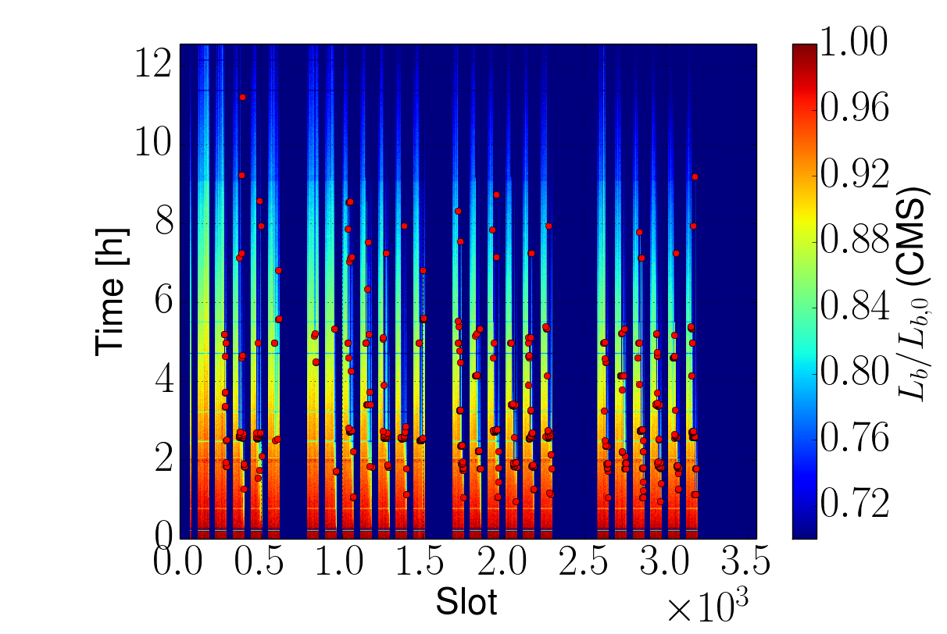
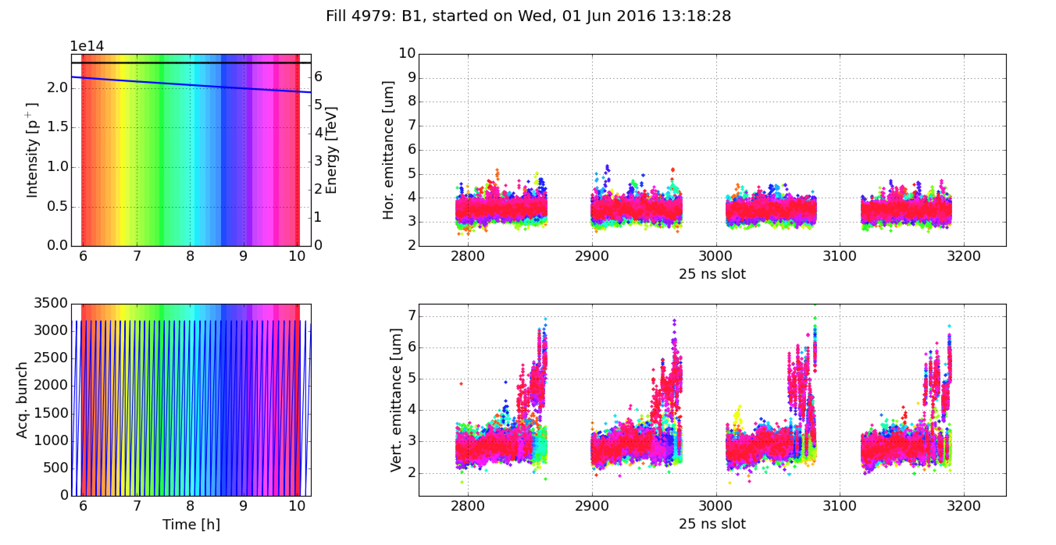
Instabilities observation in stable beam - history
72 bpi
2x48
BCMS
Red spots are the unstable bunches
11/05/16
Instabilities were observed in collisions at 6.5 TeV in most of the fills with trains of 72b.
Several bunches blew-up in the vertical plane, as observed on bunch by bunch luminosity and BSRT data → affecting only bunches at tails of the trains (e-cloud?)
X. Buffat
Fill 4979 - Beam 1
Notes:
BSRT: Beam Synchrotron Radiation Telescope
Beam transverse profile monitoring with synchrotron

Slide 12
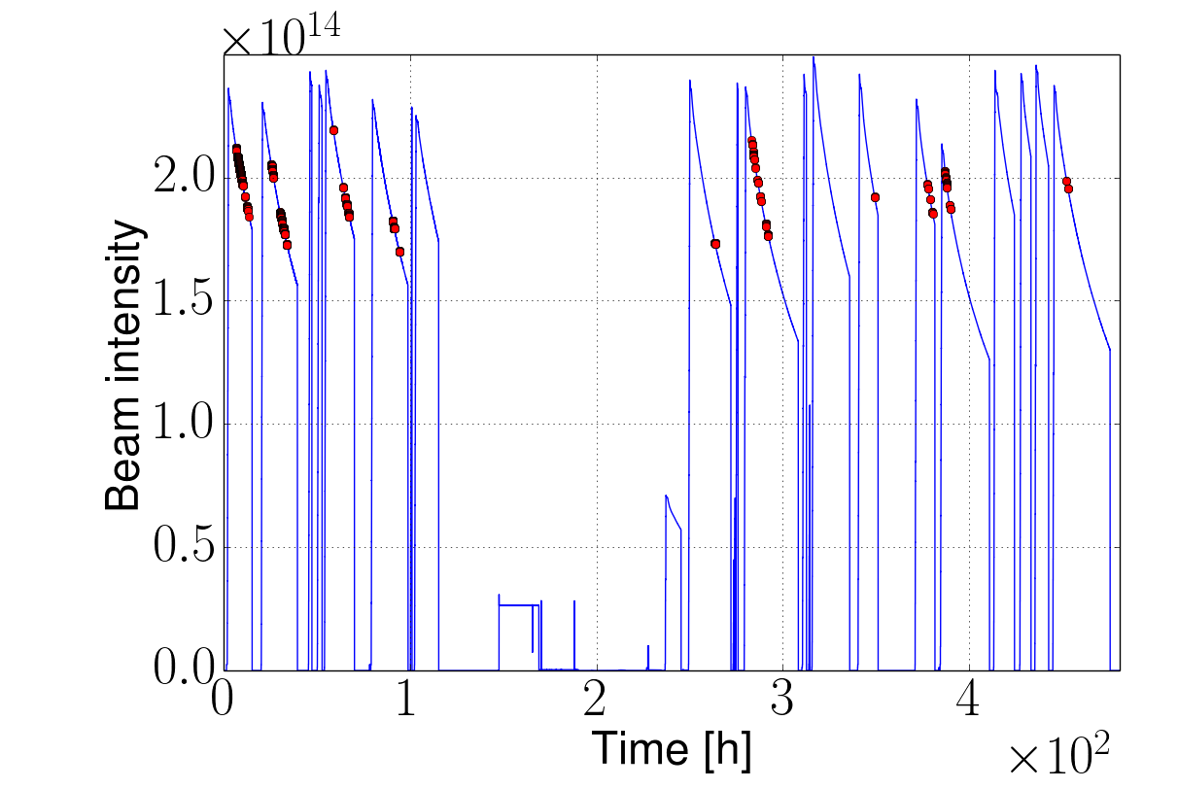
Instabilities observation in stable beam - history
72 bpi
2x48
11/05/16
Instabilities were observed in collisions at 6.5 TeV in most of the fills with trains of 72b.
Several bunches blew-up in the vertical plane, as observed on bunch by bunch luminosity and BSRT data → ecloud?
Data analysis showed that most of instabilities occurred for bunch intensities between 0.7e11 and 1.1e11
X. Buffat
Notes:
First observations were made during the intensity ramp-up of the physics fills with trains of 72 bunches. These instabilities affected almost all fills with more than 601bunches and intensities between …... Per bunch, as shown in the plot on your right

Slide 13
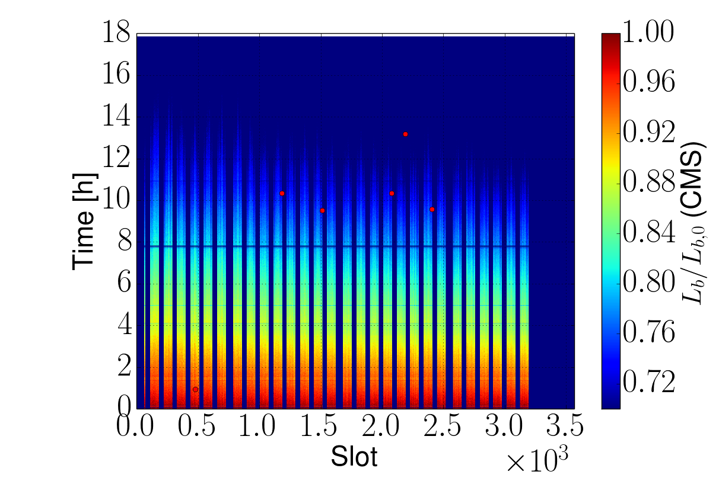
Instabilities observation in stable beam - history
72 bpi
2x48
Fill 4964, Q’_{v} = 15
02/06/16
Vertical chromaticity increased from 15 to 22 units after going in collision
  blow-up mitigated, instability still sporadically detected on the bunch-by-bunch luminosity data
  clear improvement on the number of unstable bunches
Fill 4988, Q’_{v} = 22
12
X. Buffat
Notes:
INTENSITY RAMP UP

Slide 14
Instabilities observation in stable beam - history
72 bpi
2x48
25/06/16 ...
Physics fills with trains of 48b
  No instability observed
  Vertical chromaticity brought down to 15 units in collision still with no sign of instability
Notes:
INTENSITY RAMP UP

Slide 15
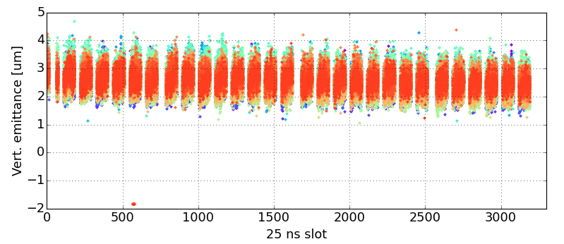
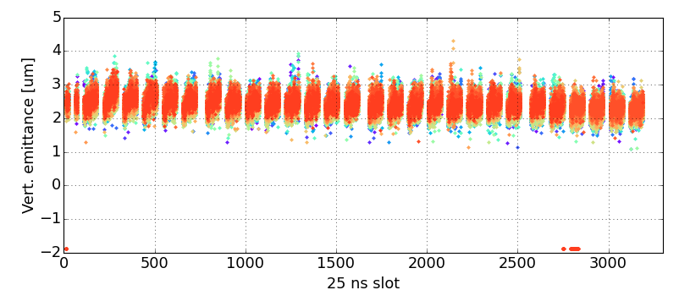
Instabilities observation in stable beam - history
72 bpi
2x48
19/08/16
MD fills with trains of 72b. and bunch intensities 1.1e11, 0.9e11 and 0.7e11
Chromaticity could be reduced to 5 units in stable beams without any sign of instabilities (scrubbing?)
L. Mether
Notes:
INTENSITY RAMP UP

Slide 16
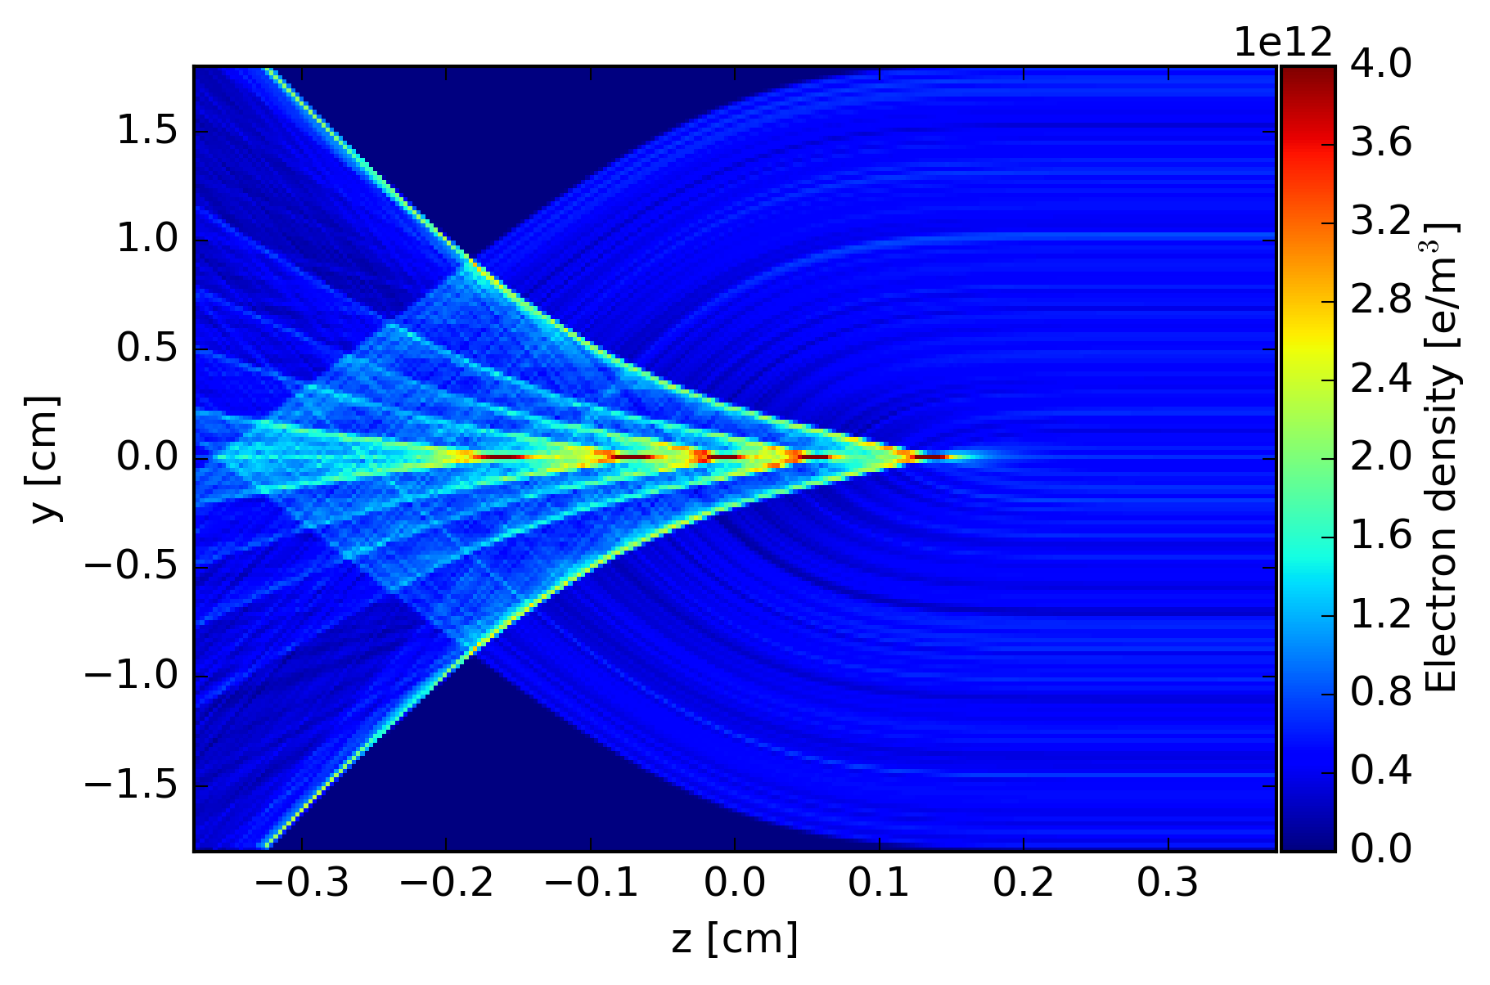
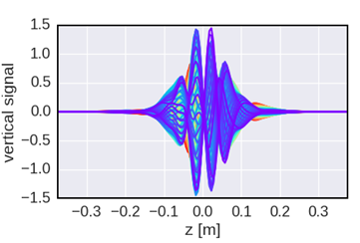
Electron cloud driven instabilities
How the e-cloud can drive an instability?
When a proton bunch passes through an e-cloud, electrons are attracted towards the transverse center of the beam
    electron density increases within the bunch inducing coherent bunch oscillations, e.g transverse instability
Understanding of these phenomena relies on numerical simulations (PyECLOUD-PyHEADTAIL)
In space: small beam (~100 μm) in a big chamber (4 cm)
In time: 1 ns for the e⁻ motion, 1 to 10 s for instability development
Multi-scale problem:
Electron density during a bunch passage
e-cloud driven instability

Slide 17
Simulation studies
Recent work at CERN focused on increasing the performance of our simulation tools:
  Introduced a “ telescoping” grid in the Particle in Cell solver
  Exploit parallel computing through a new parallelization layer (PyPARIS)
Typical simulation study: ~400 CPU cores (8-16 cores per job)
  Allowed gaining new insight on scenarios that were previously inaccessible (e.g. 10k turn simulations for LHC at 6.5 TeV)
Long term effects, like incoherent emittance growth and interplay with other non-linearities, are practically unexplored in simulations (computationally very heavy)

Slide 18
Simulation studies
To check the potential role played by the e-cloud on the instabilities observed in stable beam, long simulation runs have been carried out → more than 10k turns (~1 s) to approach the timescale of the instabilities observations (~2.5s) → 3-4 weeks of computing time on the CNAF cluster
  Simulations were performed using realistic machine settings and a beam parameters
Machine and beam settings:
Beam parameters: 1.0e11 ppb, 1 ns bunch length, 2.5 μm transverse emittance
    Octupole current set to 470 A → corresponds to ΔQ_{oct,sread} ~ 1 x 10⁻⁴
Chromaticity 15/15
Transverse damper (100 turns of damping time)
E-cloud configurations:
e-cloud in dipoles: uniform electron density scan → good approximation*
e-cloud in quadrupoles: self consistent simulation from buildup (SEY 1.30) → significant impact on the EC pinch dynamics **
  * H. Bartosik, proceedings of the ECLOUD12 Workshop, Elba, 2012
  **G. Iadarola, presentation at Joint HiLumi-LARP Meeting, Fermilab, 2015

Slide 19
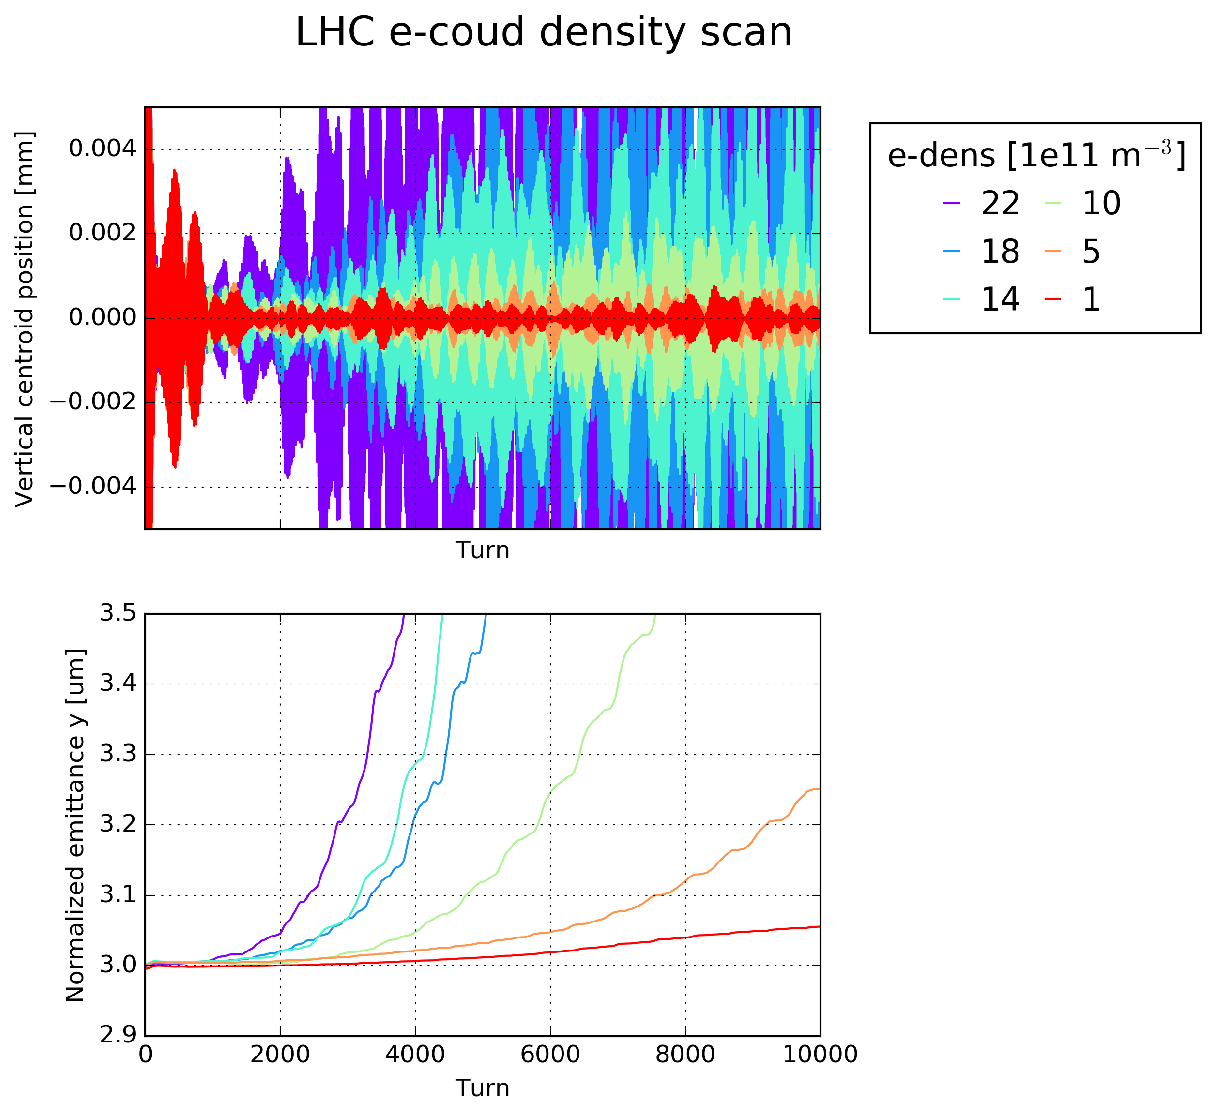
Simulation studies: 1e11 p/bunch
An electron density of 5x10¹¹ p/m³ in the central region of the dipoles is sufficient to induce a vertical instability (in spite of the high chromaticity and high octupole settings)
EC dipoles
EC quadrupoles
Chromaticity
Oct.
Damper
Sim.Turns
Density scan
SEY 1.30
15/15
470 A
100 turns
10k

Slide 20
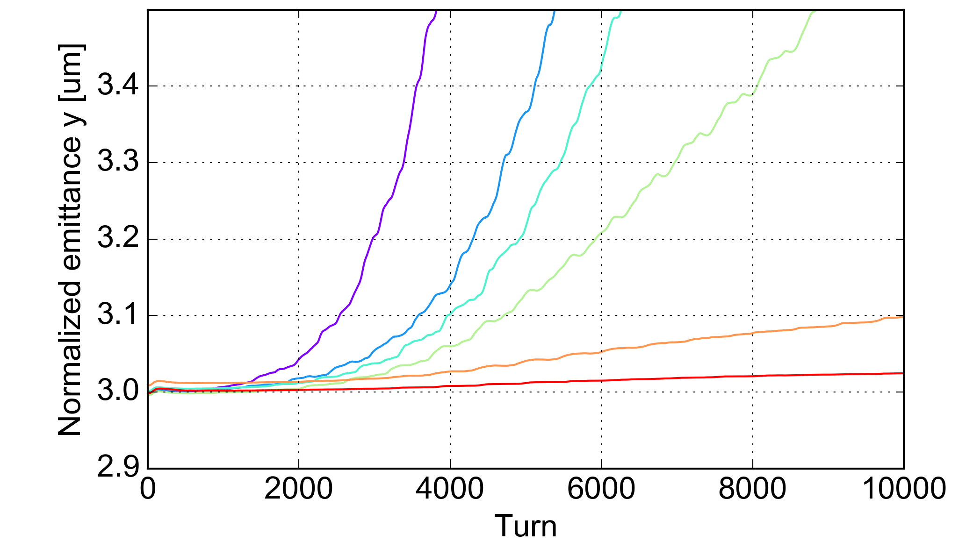
Simulation studies: 1e11 p/bunch
An electron density of 5x10¹¹ p/m³ in the central region of the dipoles is sufficient to induce a vertical instability (in spite of the high chromaticity and high octupole settings)
Increasing Q’_{v} up to 22 units, the emittance growth becomes slower, expecially at low electron densities
This instability could not be detected over our usual simulation runs of 500-1000 turns → we need run more than 10k turns for a better understanding of the instability process
Q’_{v} = 15
Q’_{v} = 22
EC dipoles
EC quadrupoles
H Chromaticity
Oct.
Damper
Sim.Turns
Density scan
SEY 1.30
15
470 A
100 turns
10k

Slide 21
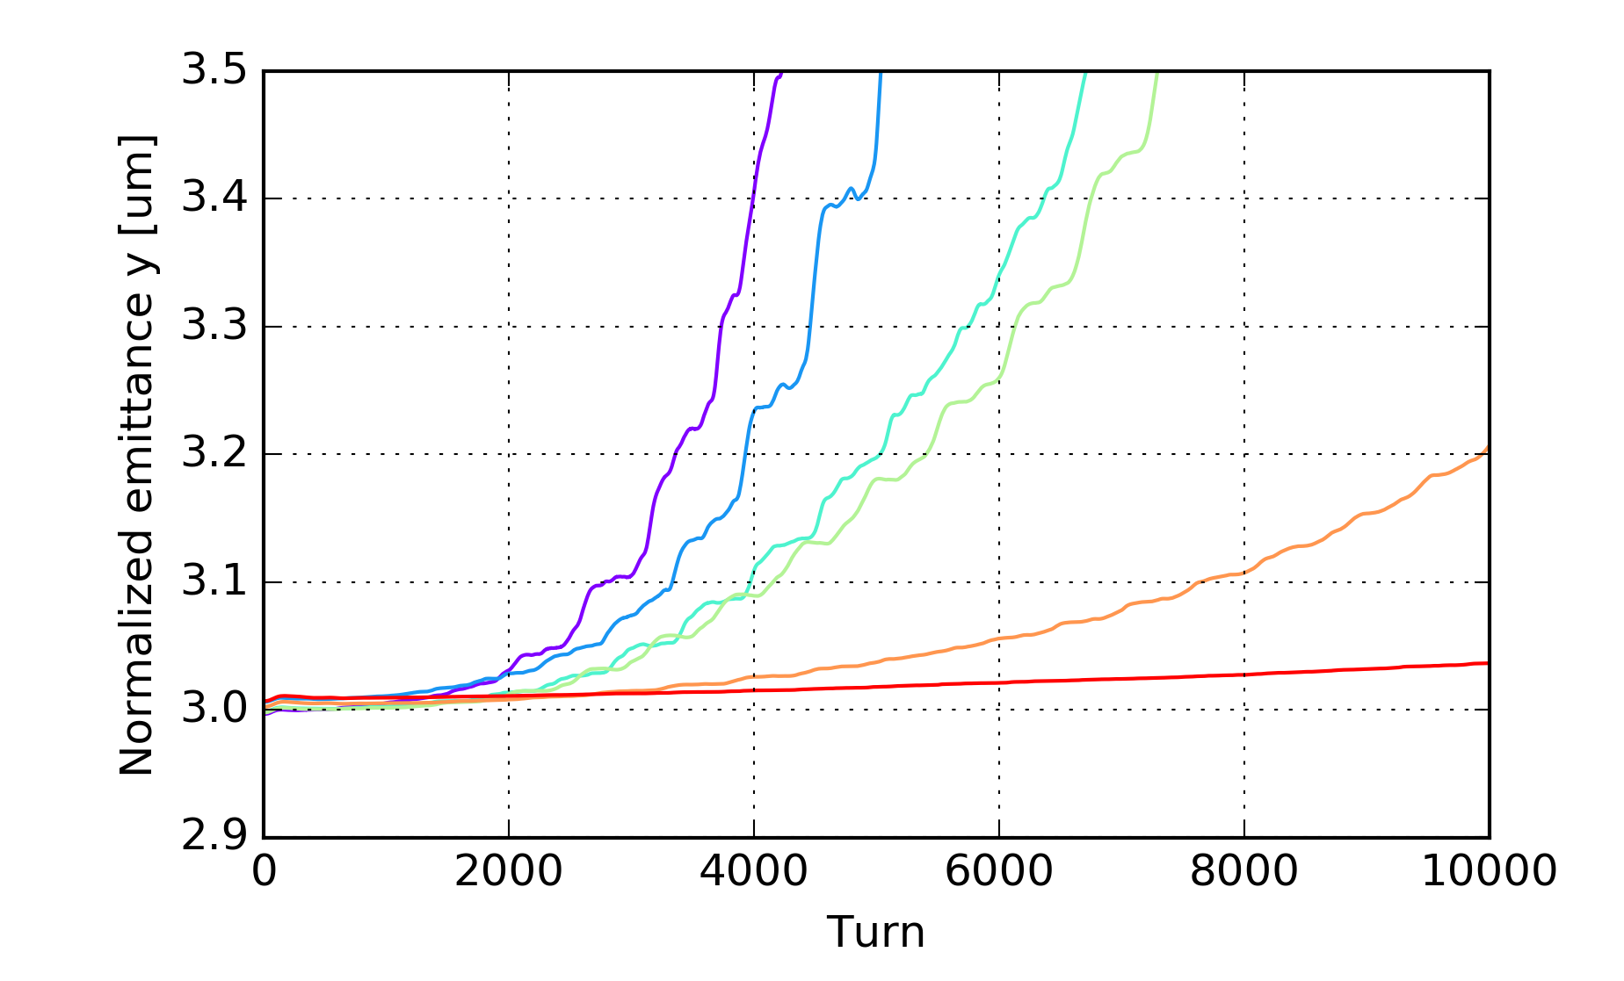
Simulation studies: different bunch intesity
In the machine instabilities were observed for bunch intensities below than 1e11 ppb
The impact of the beam intensity on the instability threshold has been investigated by running the same simulations with beam intensity of 0.7e11 ppb
  → Instability threshold basically unchanged!
1.0e11 p/bunch
0.7e11 p/bunch
EC dipoles
EC quadrupoles
Chromaticity
Oct.
Damper
Sim.Turns
Density scan
SEY 1.30
15/15
470 A
100 turns
10k

Slide 22
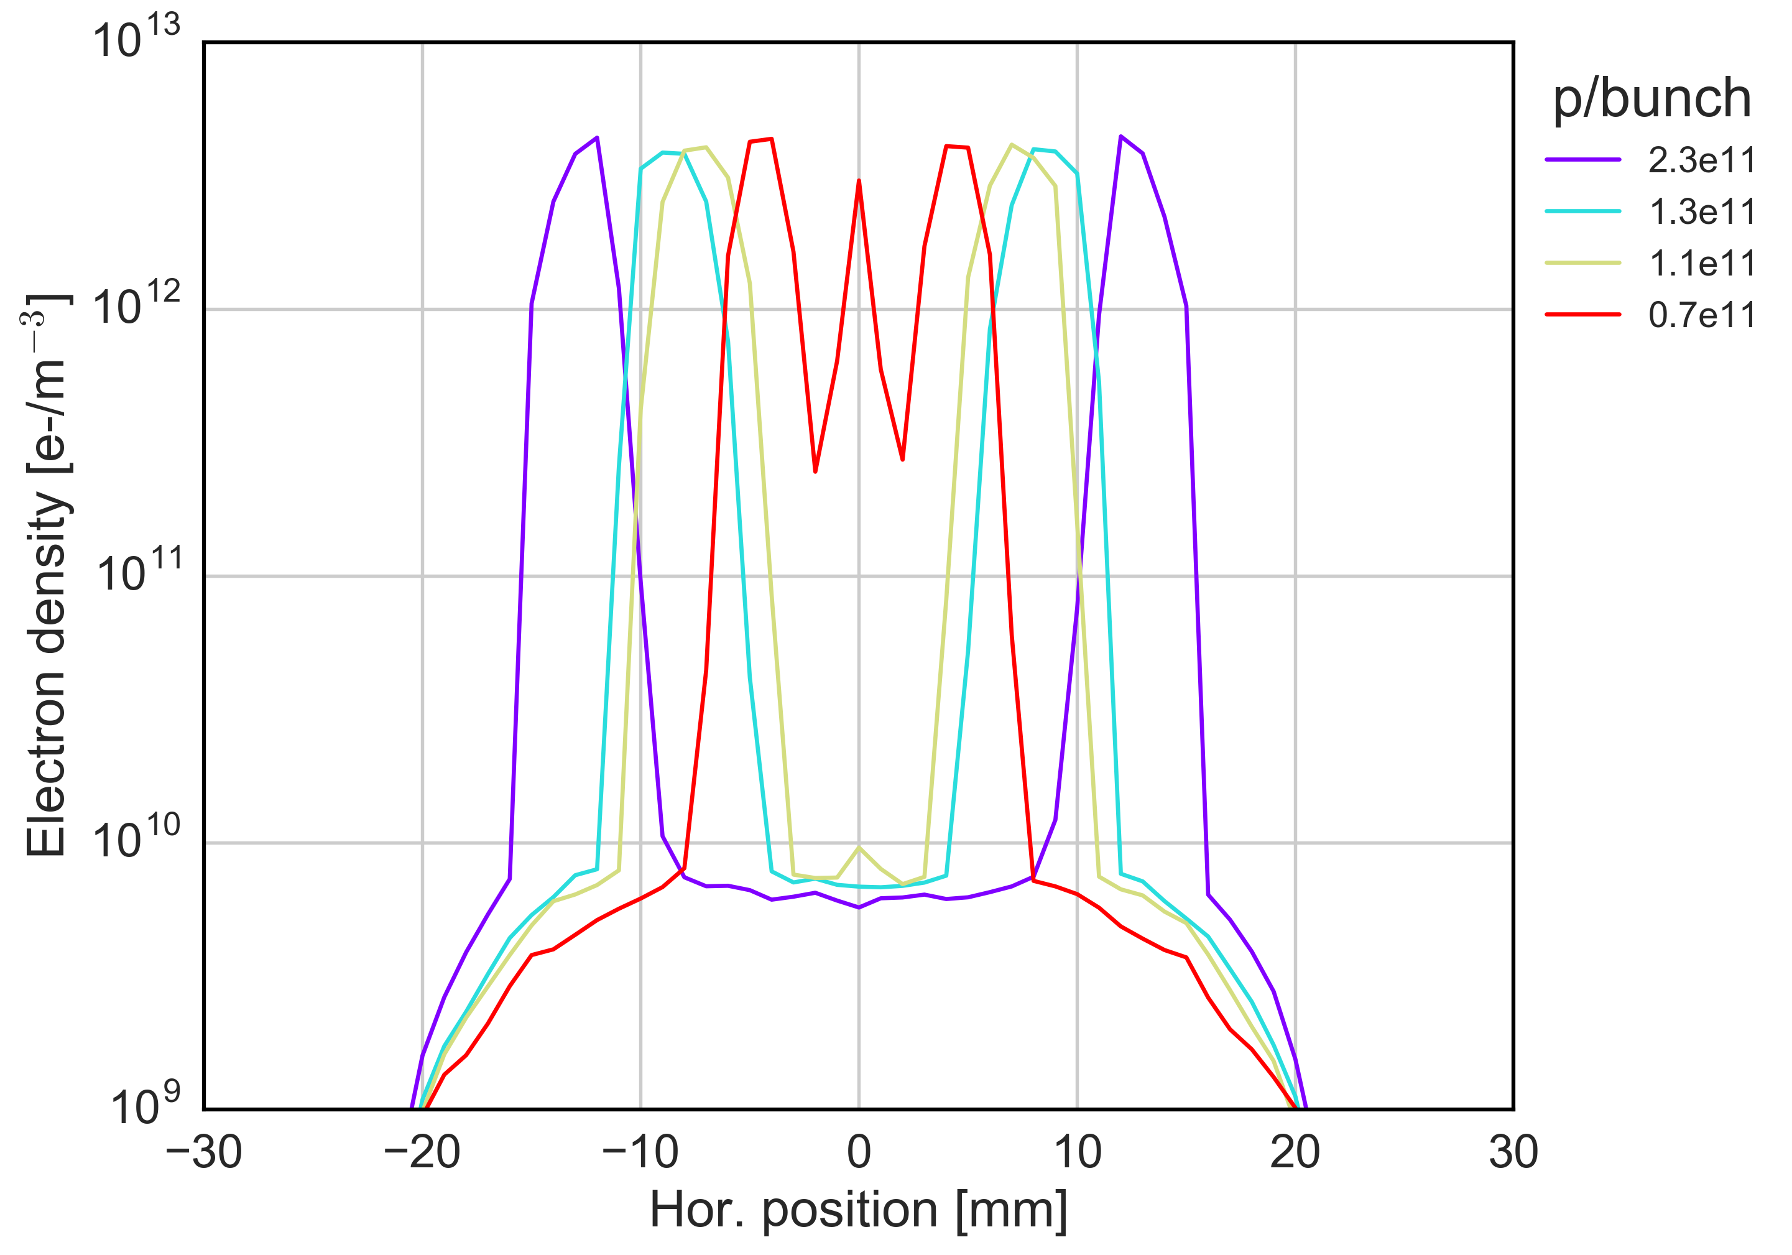
Central density from PyECLOUD simulations
From PyECLOUD simulations we can estimate the electron density profile in the dipoles for different beam intensities
  → When the bunch intensity decreases, the central density increases significantly
Simulations settings
SEY_{DIP} = 1.4
1 ns bunch length
2.5 um transverse emittance

Slide 23
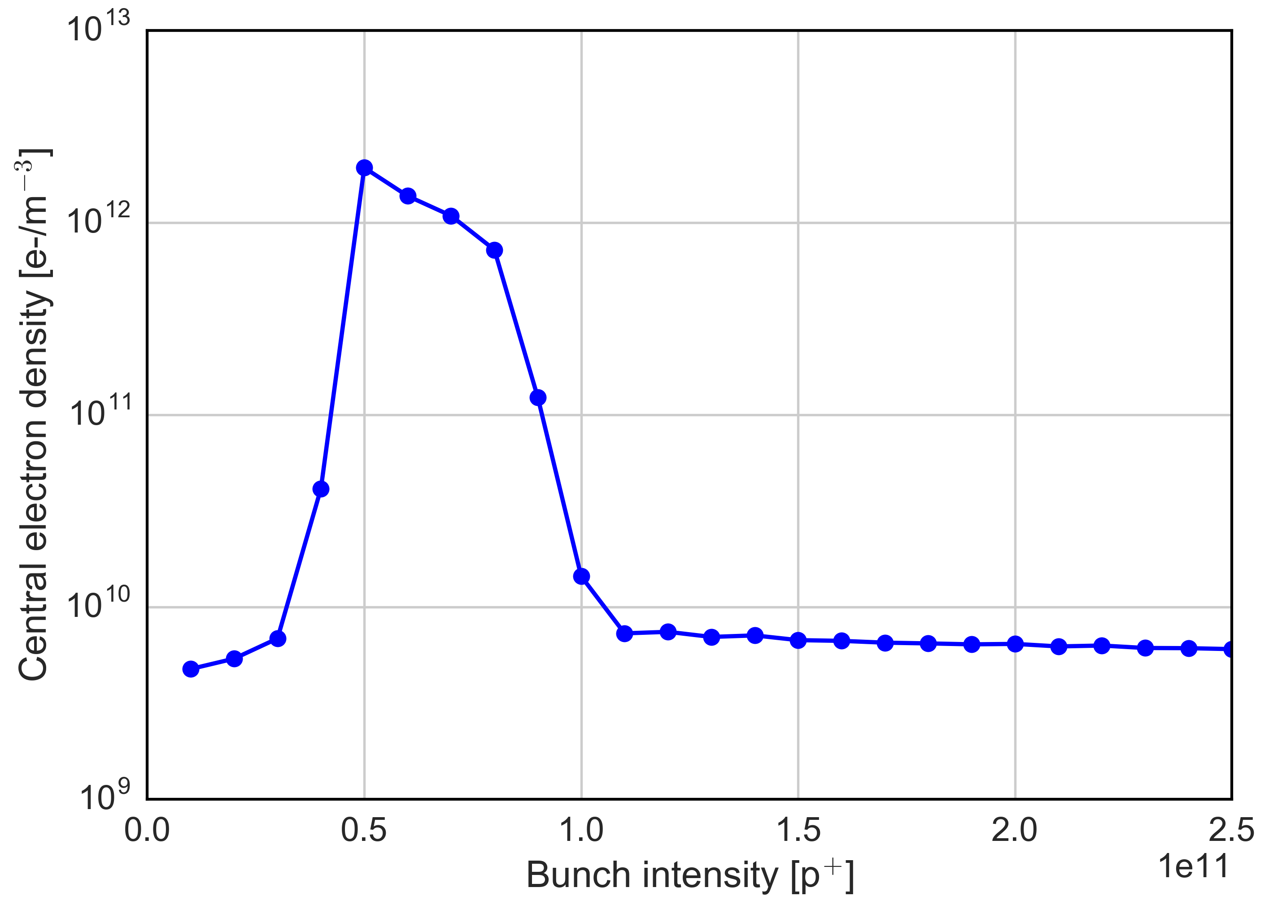
Central density from PyECLOUD simulations
0.7e11
Instability threshold estimated by PyEC-PyHT simulations
1.0e11
For bunch intensities below than 1.0e11 ppb, the central density increases rapidly crossing the instability threshold
For bunch intensities larger than 1.0e11 ppb, the estimated electron density is well below the instability threshold

Slide 24
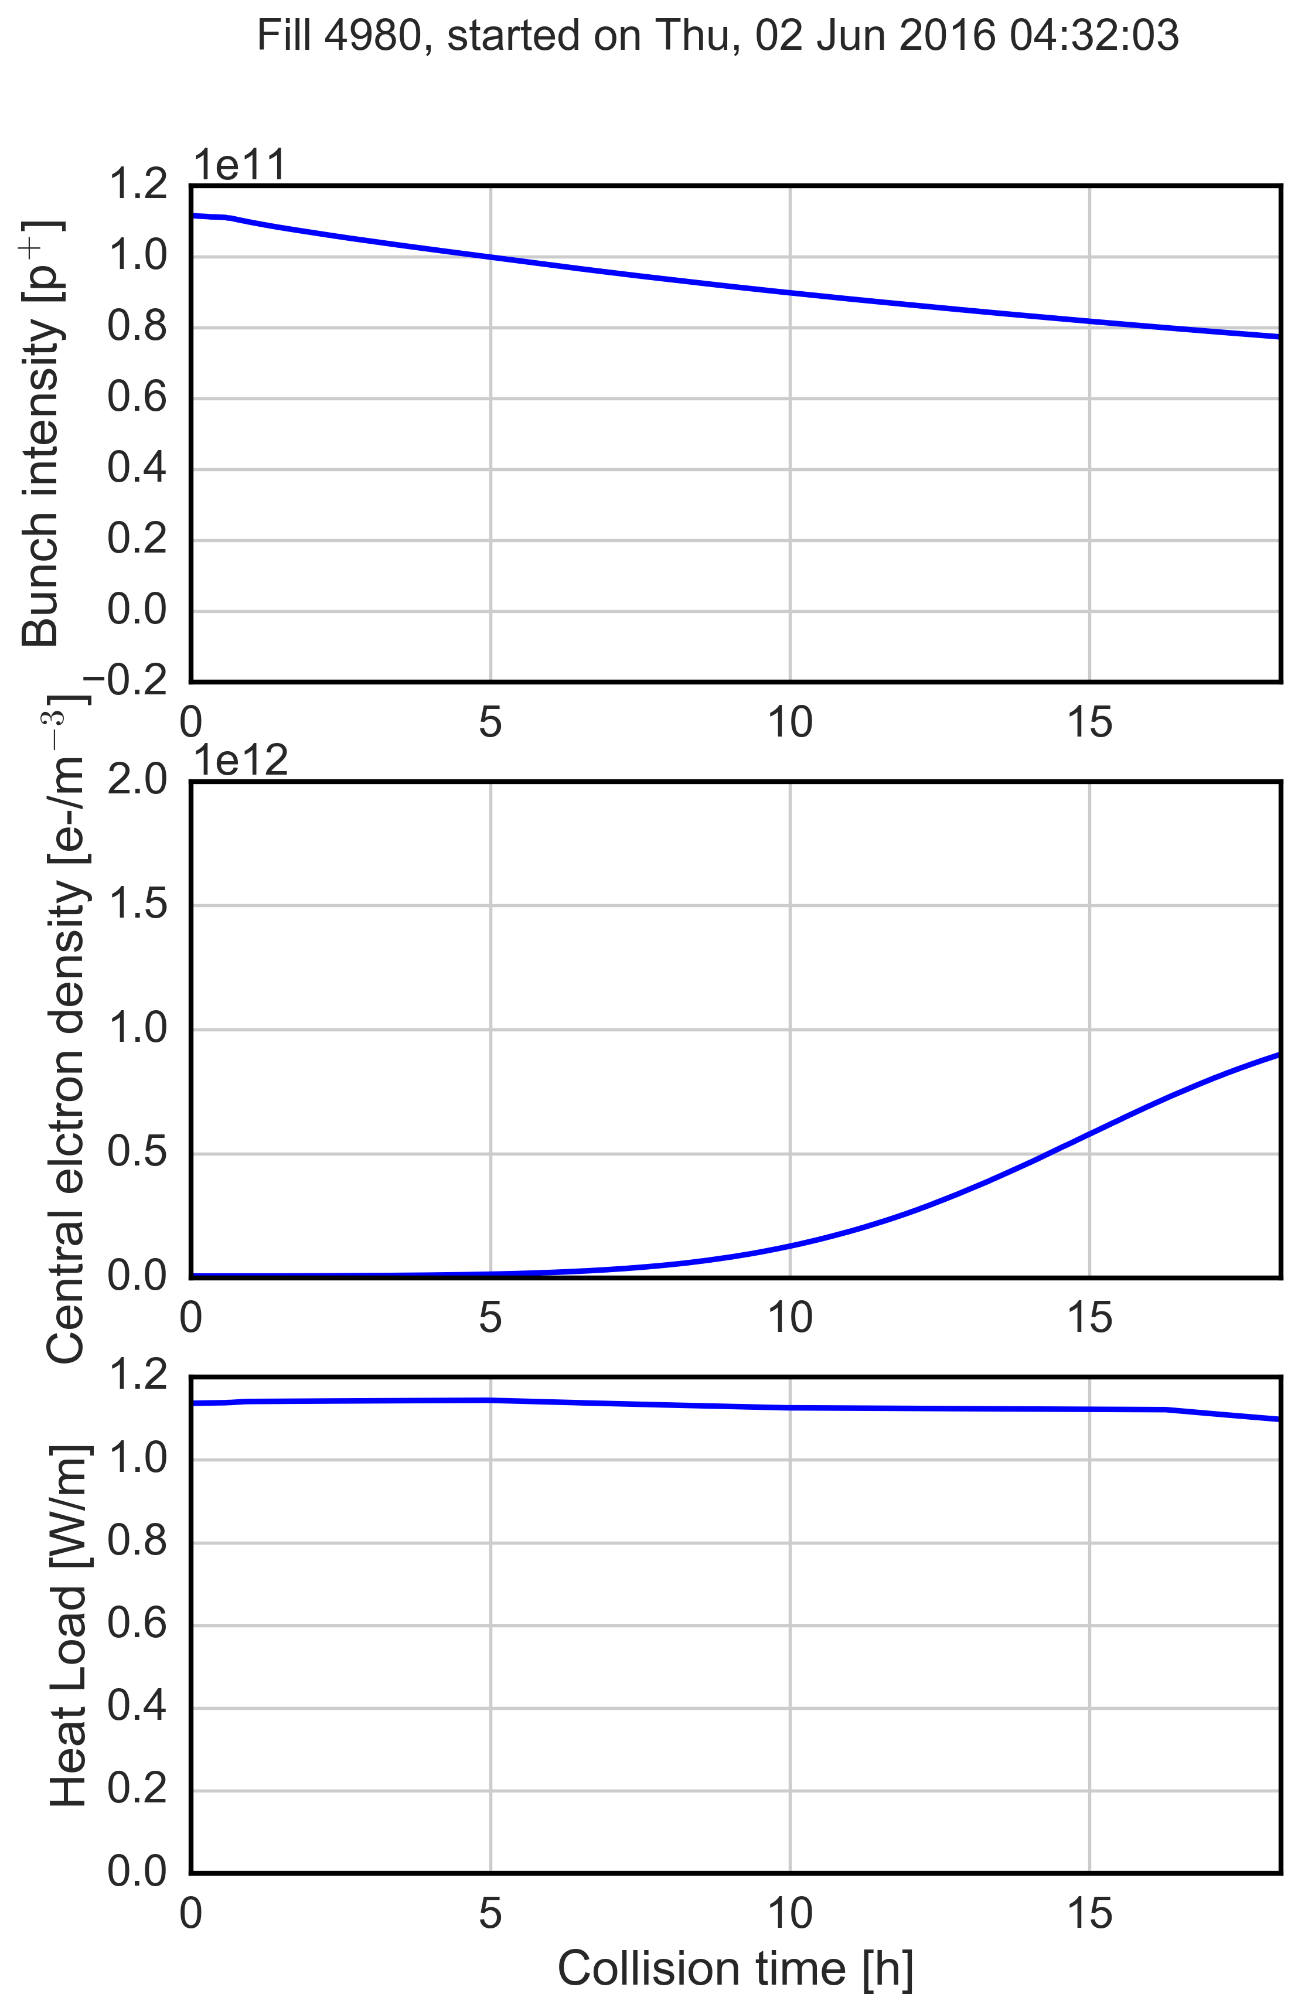
Central density from PyECLOUD simulations
Physics fill where we observed instabilities
Average bunch intensity (between B1 and B2) during the collisions has been used to infer the evolution of the central density
As measured in LHC
From PyECLOUD simulations (SEY_{dip}= 1.40)
Evolution of the central electron density: the central density increases over the fill time and crosses the instability threshold when the intensity has dropped to ~0.8e11 p/bunch
Instability threshold
Good agreement between machine observations and simulations results

Slide 25
Summary and conclusions
In spite of the high chromaticity and high octupole settings, a vertical emittance blow up of bunches at the end of the 72b trains was observed during the stable beam in most of the fills at the beginning of the year
  An increase of the vertical chromaticities after going in collision was needed to avoid instabilities
The potential role of the e-cloud has been investigated in simulation
  According to machine observations, two different settings for the beam instensity were simulated showing a weak dependence of the instability thresholds on the bunch intensity
Build-up simulation results showed that when the beam intensity decreases, the electron density in the center can become sufficiently high to drive an instability

Slide 26
Outline
Overview on my PhD work
  Topics studied
  Ongoing studies
  Activities and conferences
Electron cloud induced instability in the LHC during collisions at 6.5TeV
  Instability observations: background and history
  Simulations studies and challenges
  Comparison of simulation results with the available experimental observations
Highlights from ongoing studies and next steps

Slide 27
Ongoing studies
GOALS FOR ONGOING STUDIES:
check the impact of the EC in the LHC arcs (dipoles and quadrupoles) both at injection and flattop on the beam stability (e.g nominal LHC bunch)
  → at injection, the work has been done in collaboration with Kevin Li
improve the understanding of machine settings on the instability threshold → chromaticity, octupoles and trasverse feedback are simulating together with the EC
→ A full picture of the EC driven instabilities in the arcs and an optimiziation of machine settings to ameliorate LHC operation!

Slide 28
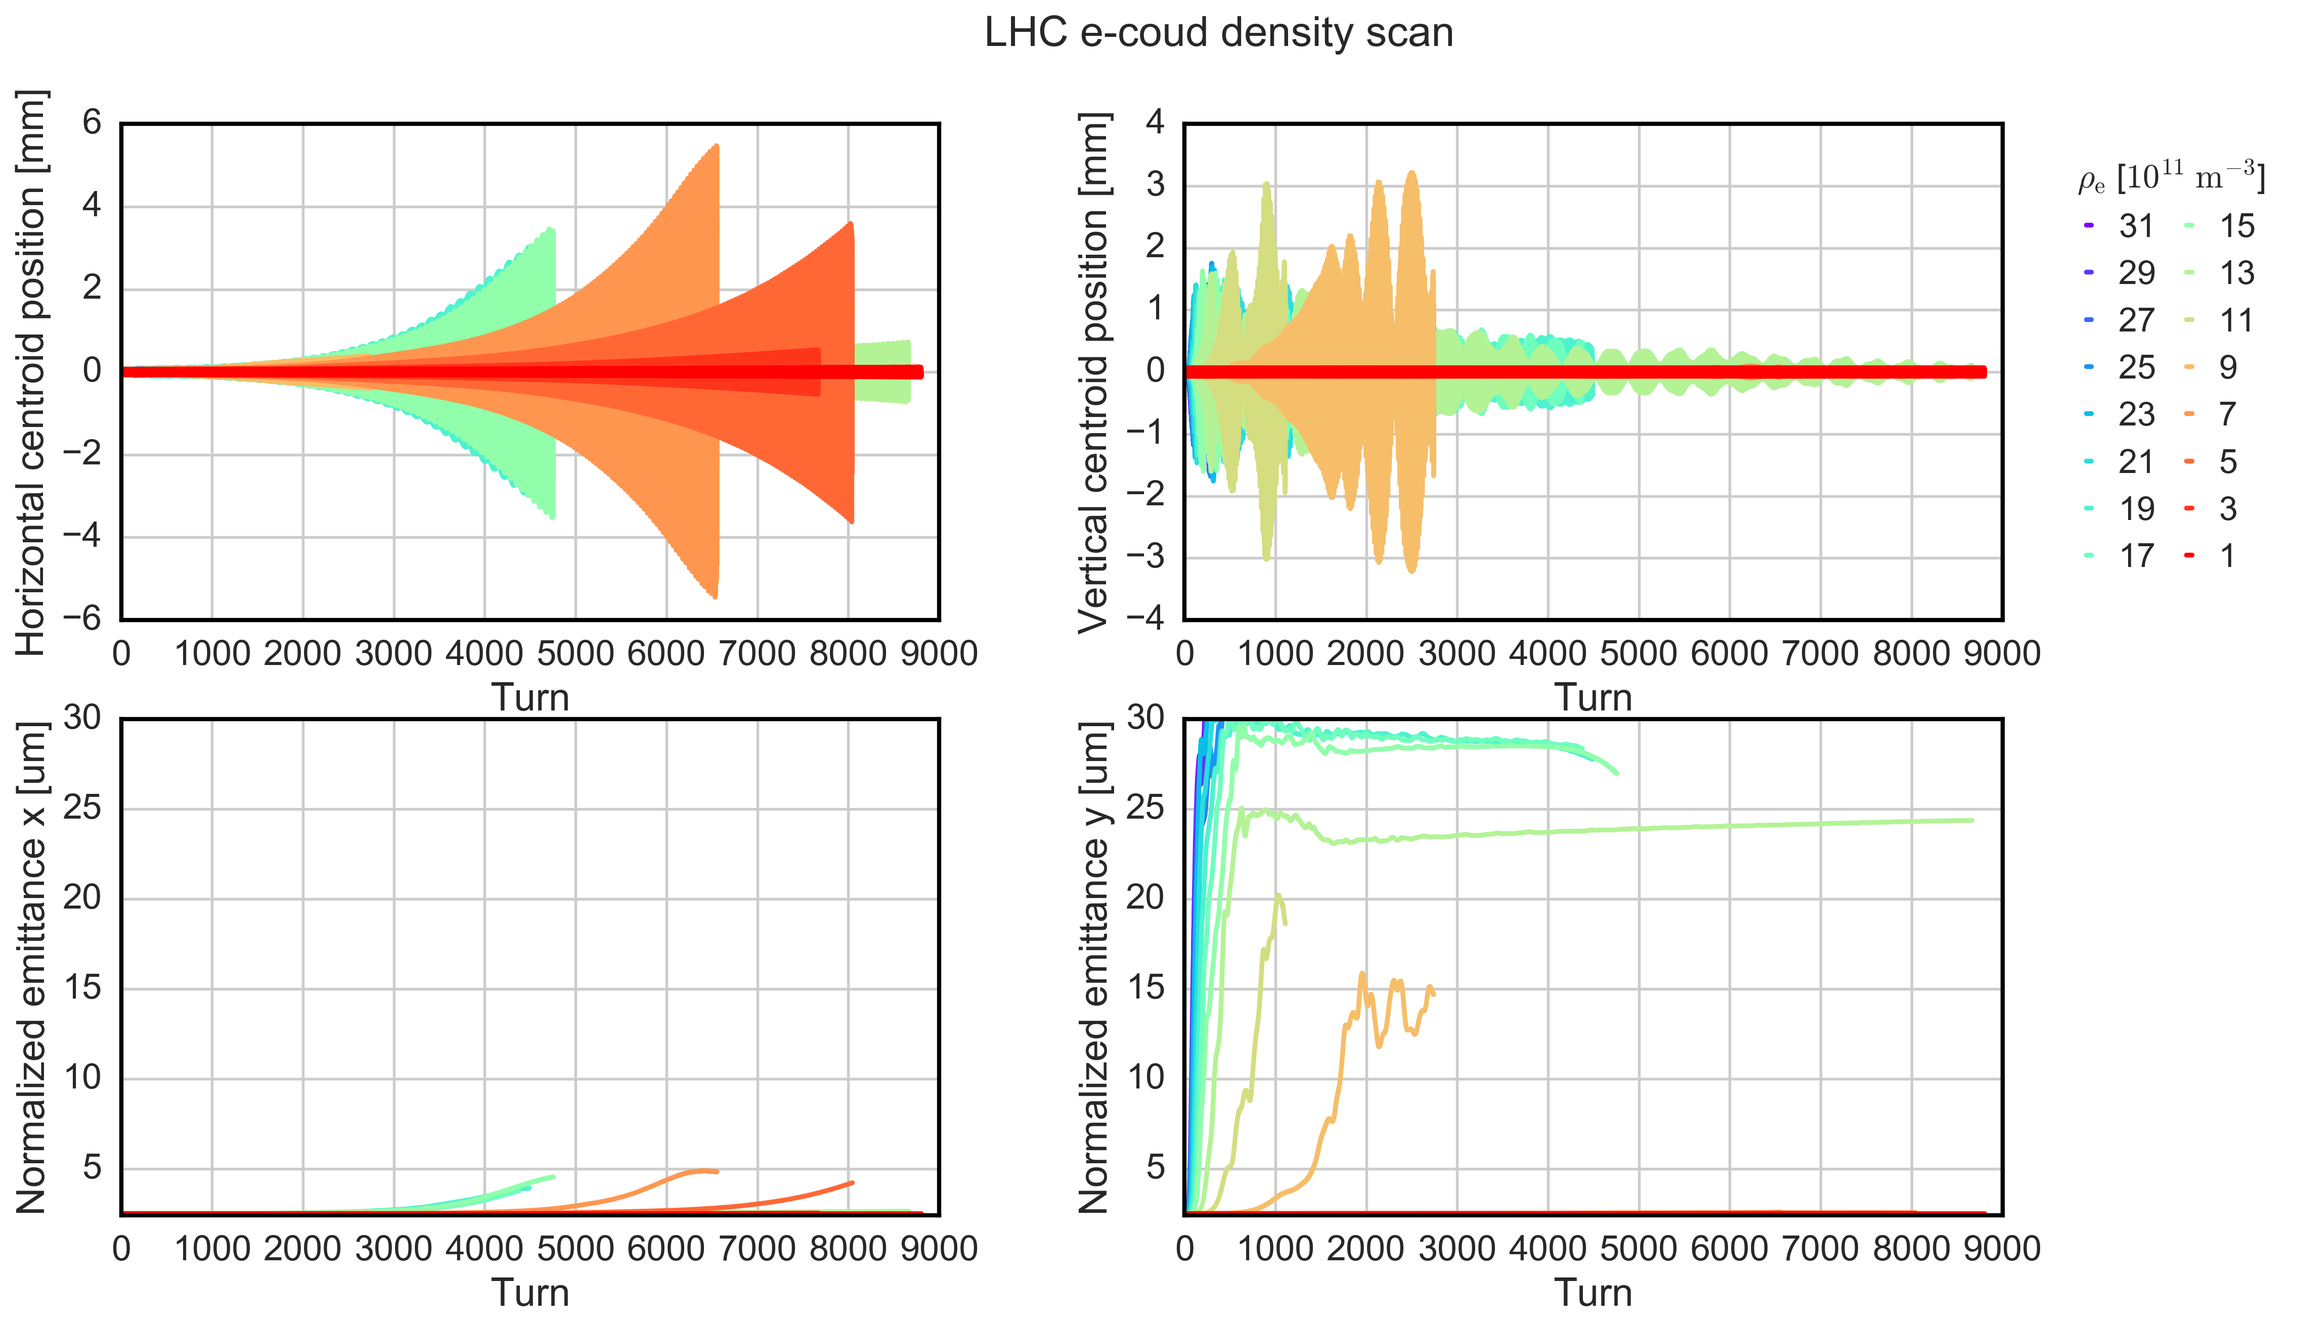
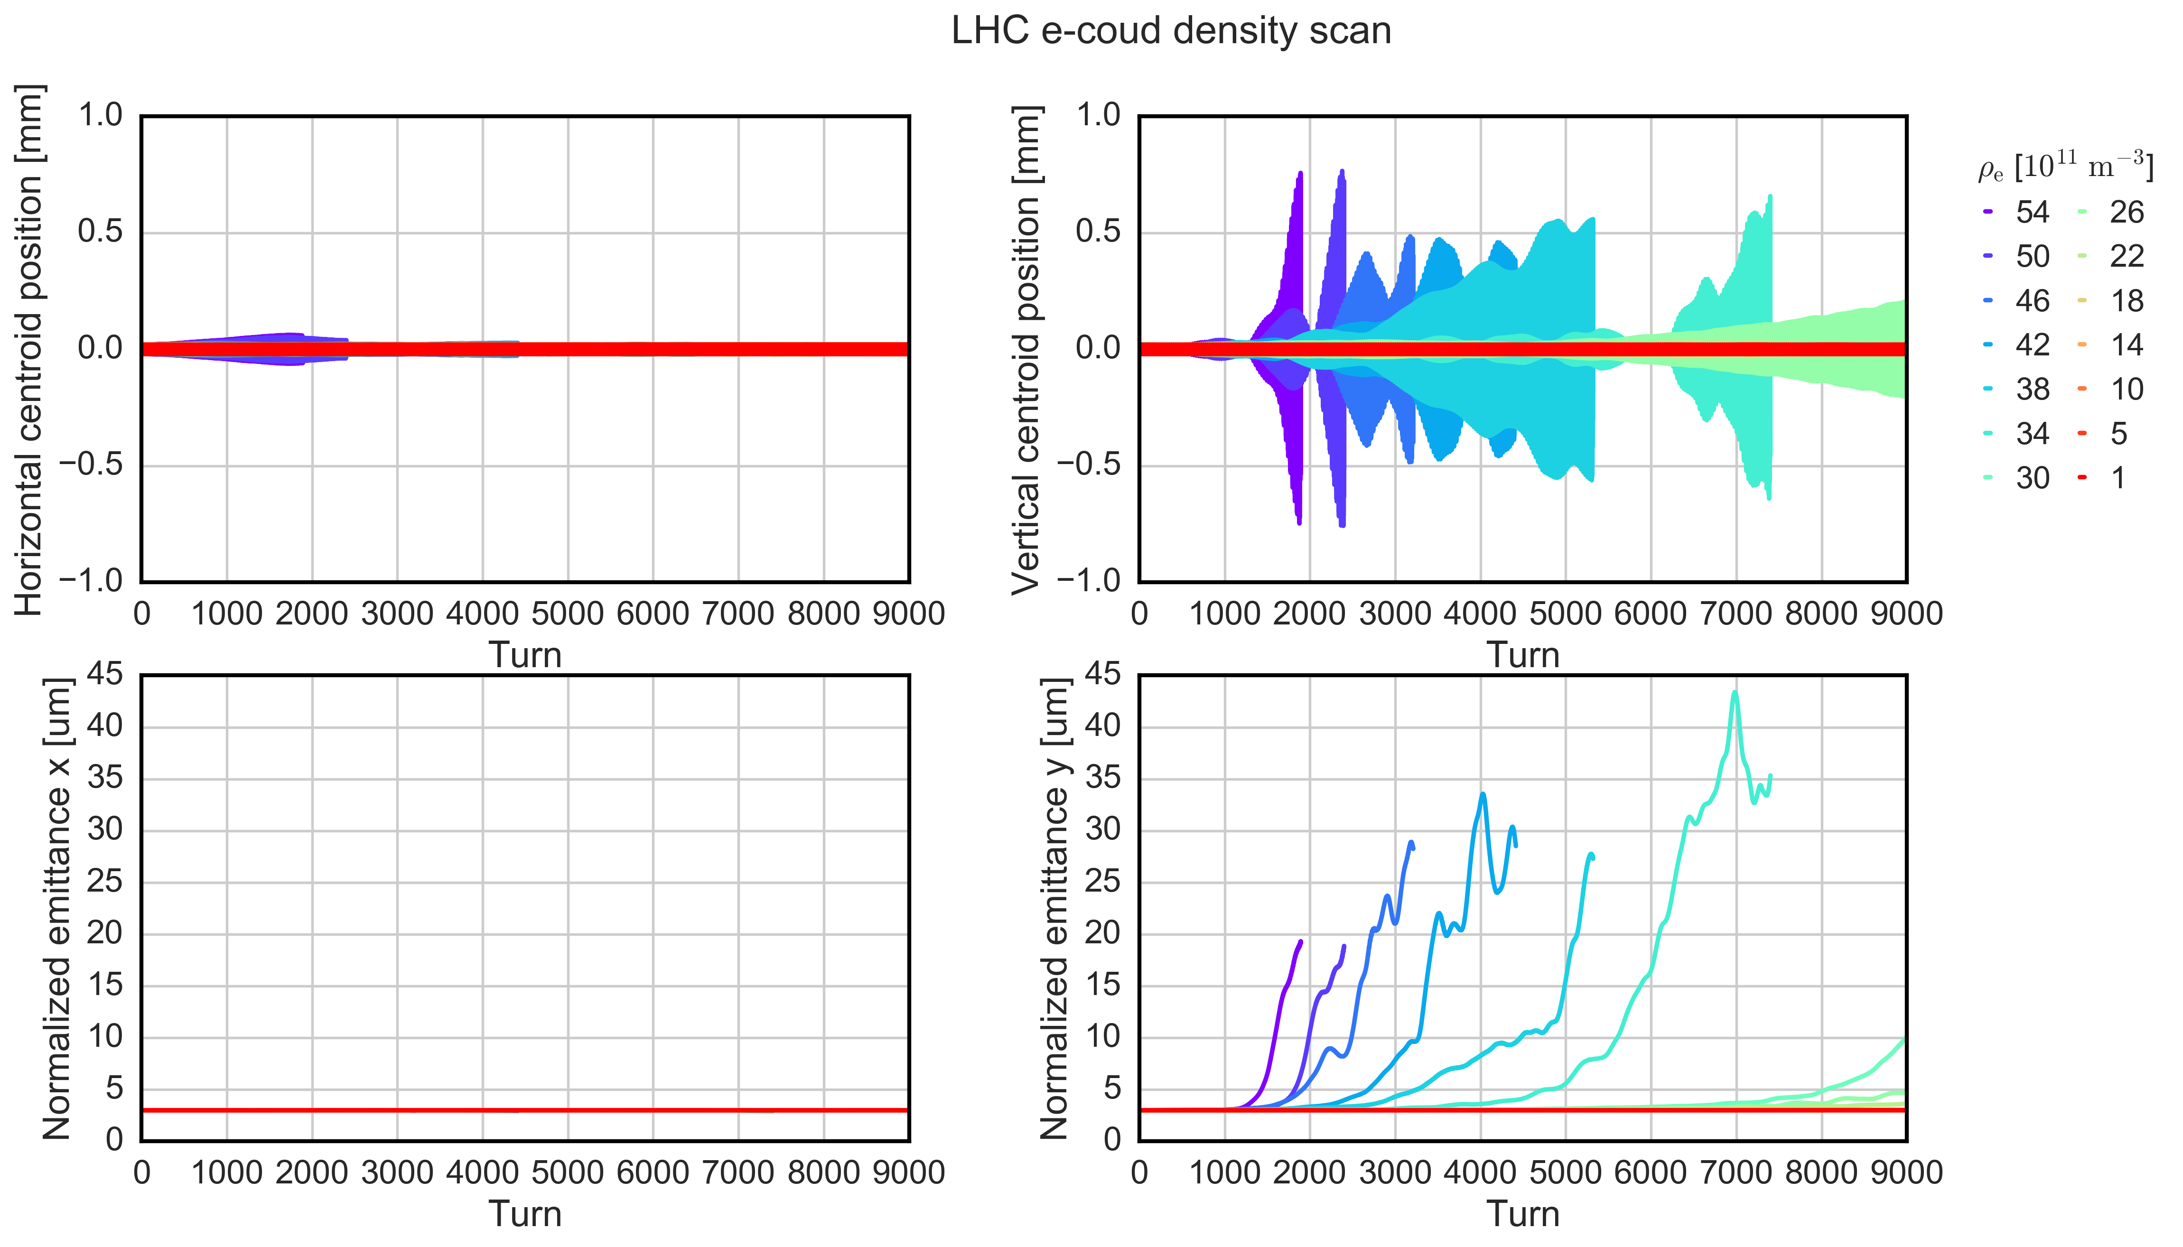
450 GeV vs 6.5 TeV: e-cloud in arc dipoles
INJECTION: both planes are unstable → H instabilities are much slower (~2000 turns )
FLATTOP
FLATTOP: vertical plane predomintly unstable

Slide 29
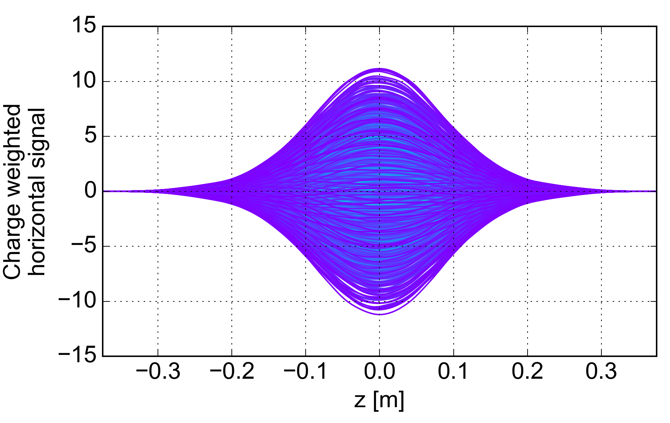
450 GeV vs 6.5 TeV: e-cloud in arc dipoles
INJECTION: both planes are unstable → H instabilities are much slower (~2000 turns )
Horizontal instabilities are mode-0 like → they are not observed in the machine because are damped by the transverse feedback
Vertical instabilities develop for higher frequencies which can not be dealt by the stranverse feedback
FLATTOP
FLATTOP: vertical plane predomintly unstable

Slide 30
450 GeV vs 6.5 TeV: e-cloud in arc dipoles
EC instability threshold defined as density needed to generate 10% emittance growth over 9000 turns
INJECTION
H. threshold ~ 5e11
V. threshold ~ 7e11
FLATTOP
V. threshold ~ 2.6e12

Slide 31
450 GeV vs 6.5 TeV: e-cloud in arc dipoles
EC instability threshold defined as density needed to generate 10% emittance growth over 9000 turns
INJECTION
H. threshold ~ 5e11
V. threshold ~ 7e11
Comparison with the estimated EC density from PyECLOUD (SEY_{dip} 1.4):
  Injection: Estimated density ~5e8 < instability th
  Flattop: : Estimated density ~2e10 < instability th
  → No EC induced instabilities can be explained over 9000 turns
At flattop Large EC densities are needed to drive an instability → effect of the beam rigidity
FLATTOP
V. threshold ~ 2.6e12

Slide 32
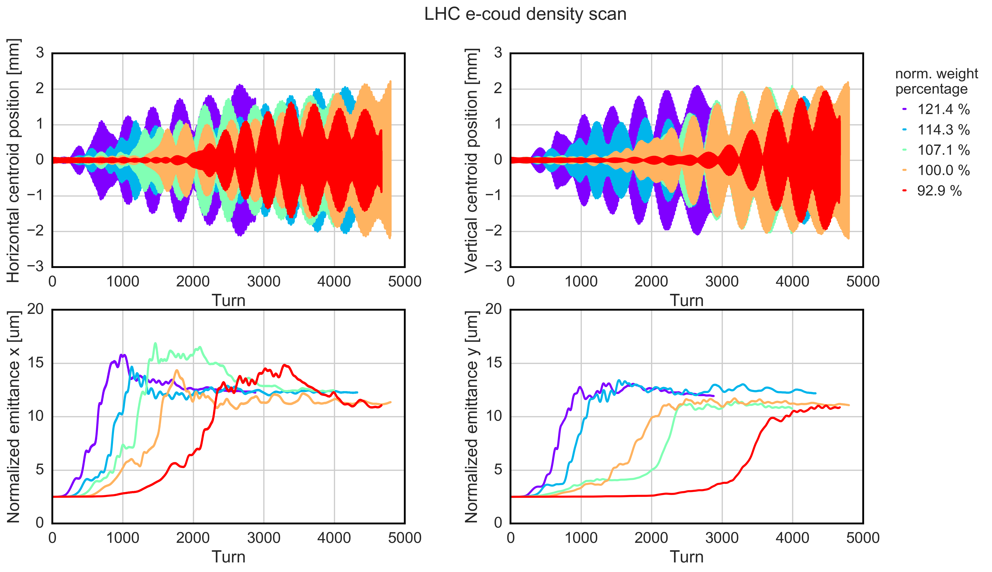
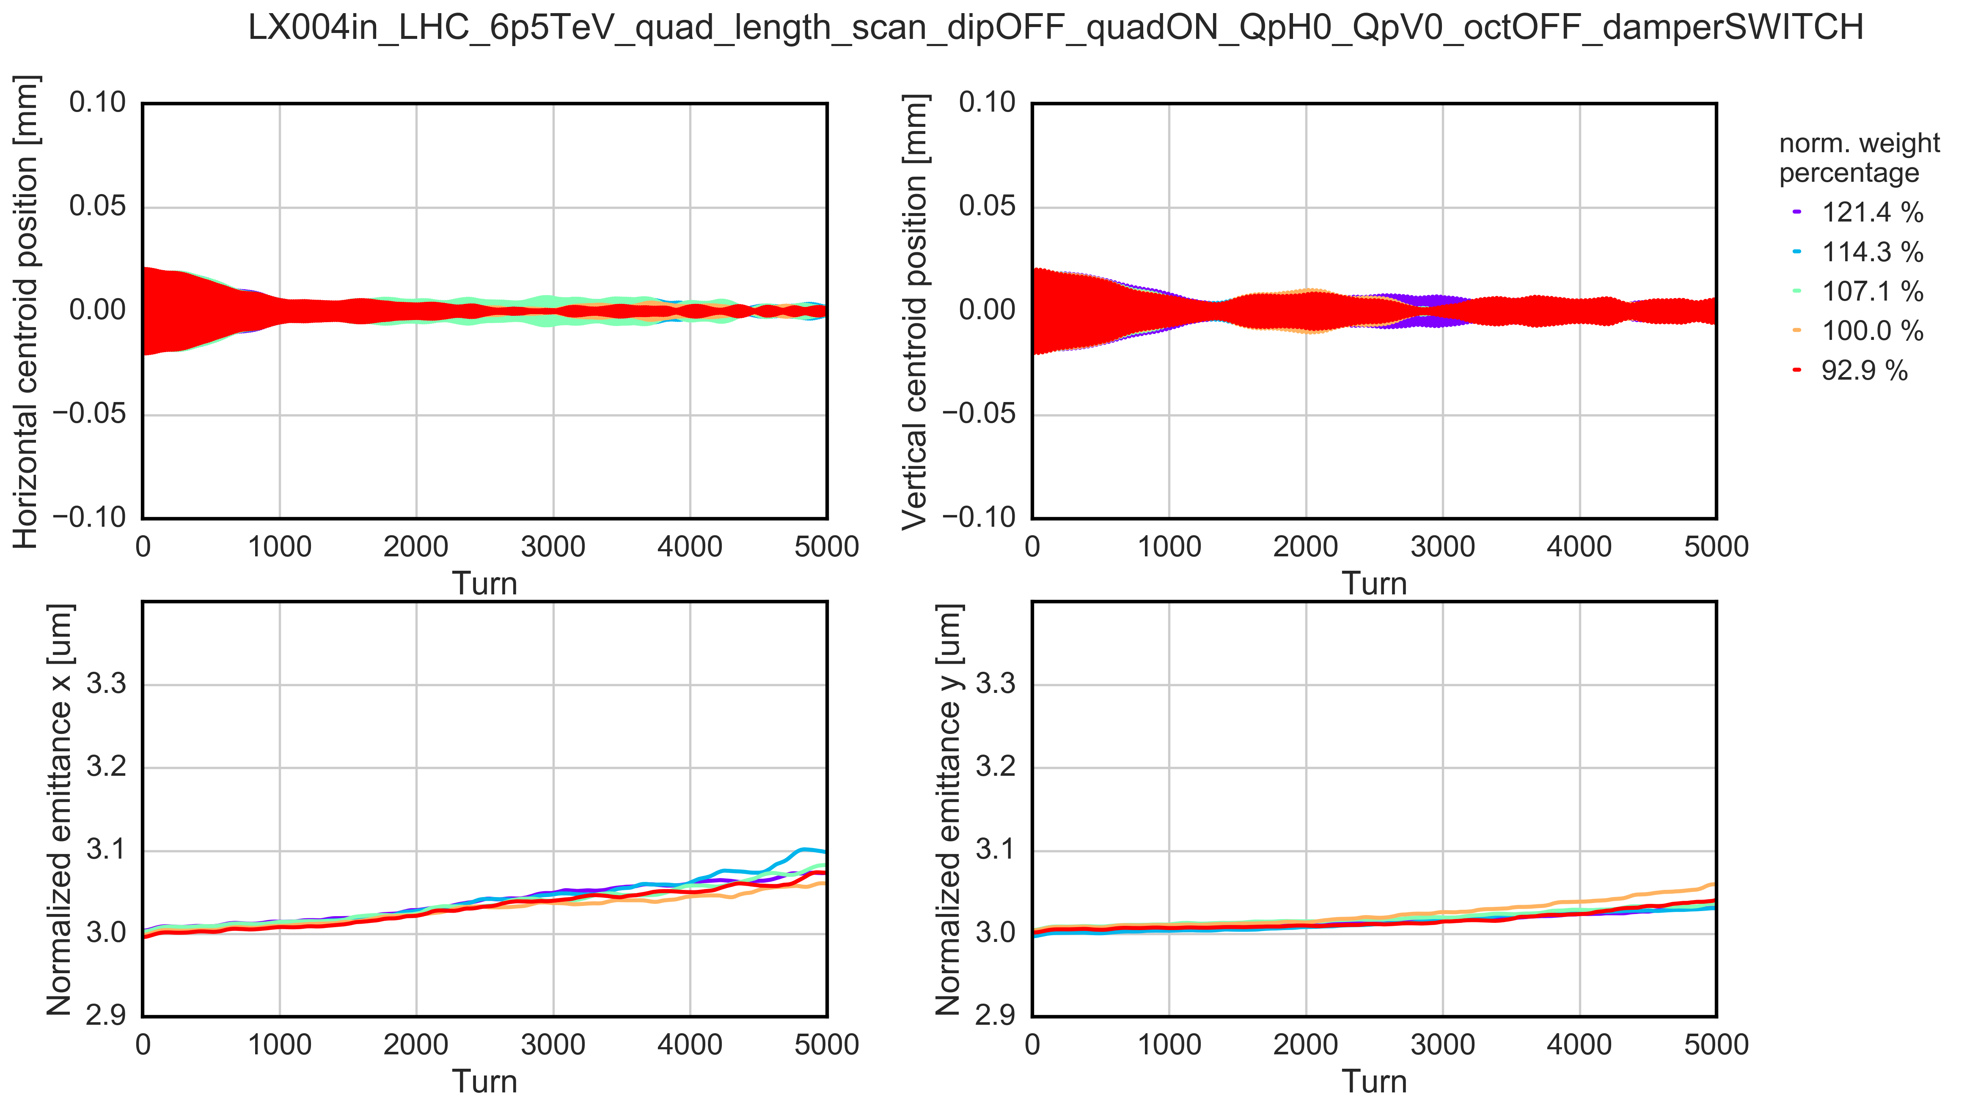
450 GeV vs 6.5 TeV: e-cloud in arc quadrupoles
INJECTION: both planes are simmetrically unstable
FLATTOP: no clear instability can be detected

Slide 33
450 GeV vs 6.5 TeV: e-cloud in arc quadrupoles
EC instability threshold defined as density needed to generate 10% emittance growth over 5000 turns
INJECTION
FLATTOP
v

Slide 34
450 GeV vs 6.5 TeV: e-cloud in arc quadrupoles
EC instability threshold defined as density needed to generate 10% emittance growth over 5000 turns
INJECTION
Sensitivity of the instability threshold to the quadrupoles weight
  Injection: instability threshold below the effective weight → very sensitive
  Flattop: no emittance blown-up is observed
  → EC in quadrupoles key driver of instability at injection
Strong impact of the beam rigidity on the beam stability
FLATTOP
v

Slide 35
Summary and further studies
Electron Cloud
EC in DIPOLES
Estimated EC density < instability th
Instabilitiy observations cannot be explained (over 9000 turns) by the EC in dipoles alone → unless the beam intesity decreases
Chromaticity
Landau octupoles
Transverse feedback
Next steps → How different machine settings together with e-cloud affect the beam stability?
EC in QUADRUPOLES
key driver of instabilities at injection → at flattop due to the magnetic rigidity of the beam no clear instability can be observed
EC in DIPOLES

Slide 36
Thanks for your attention

Slide 37
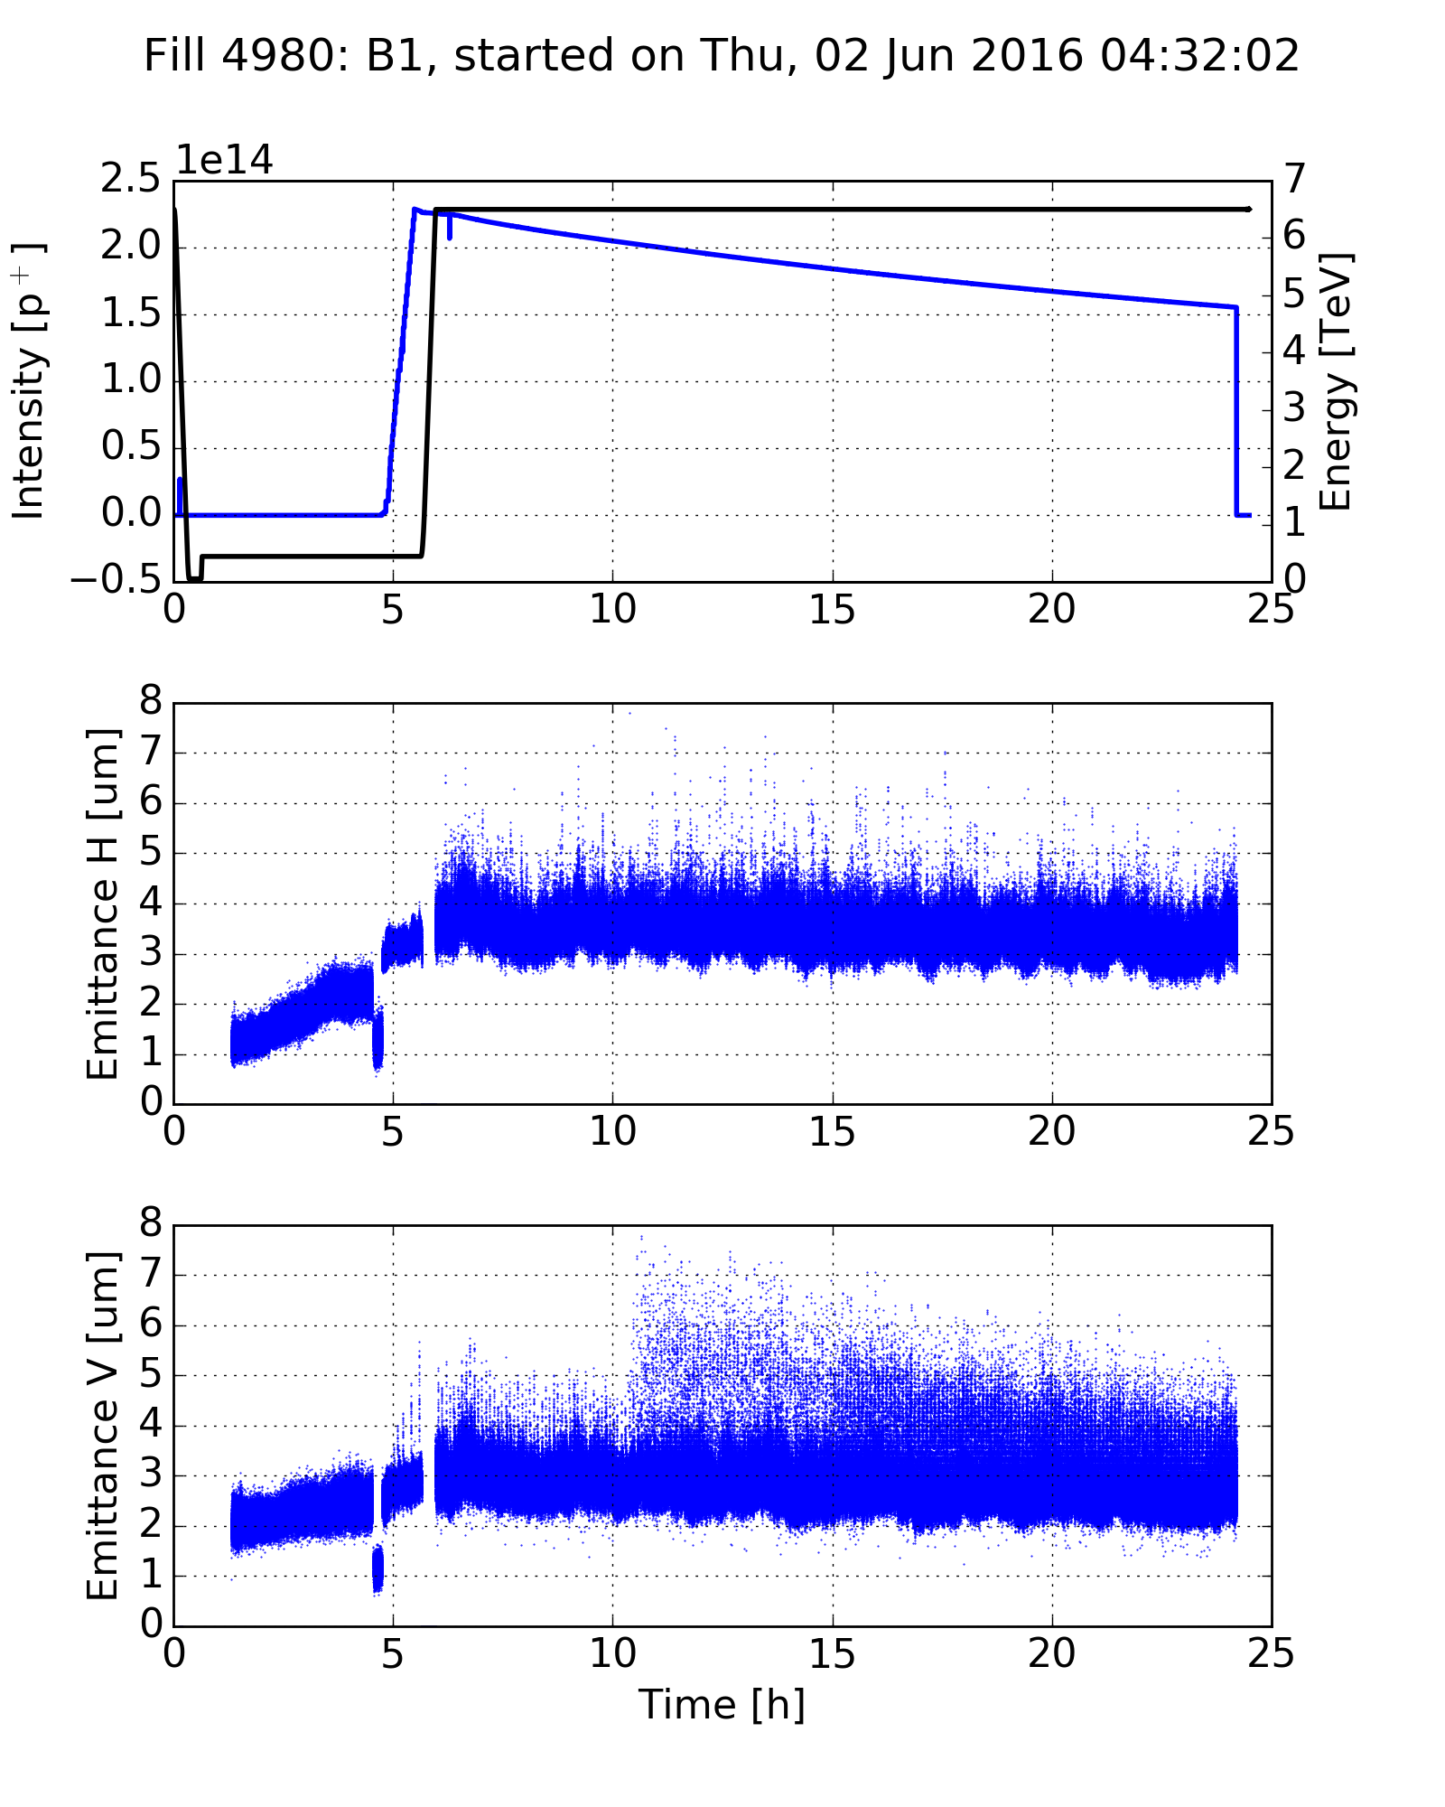
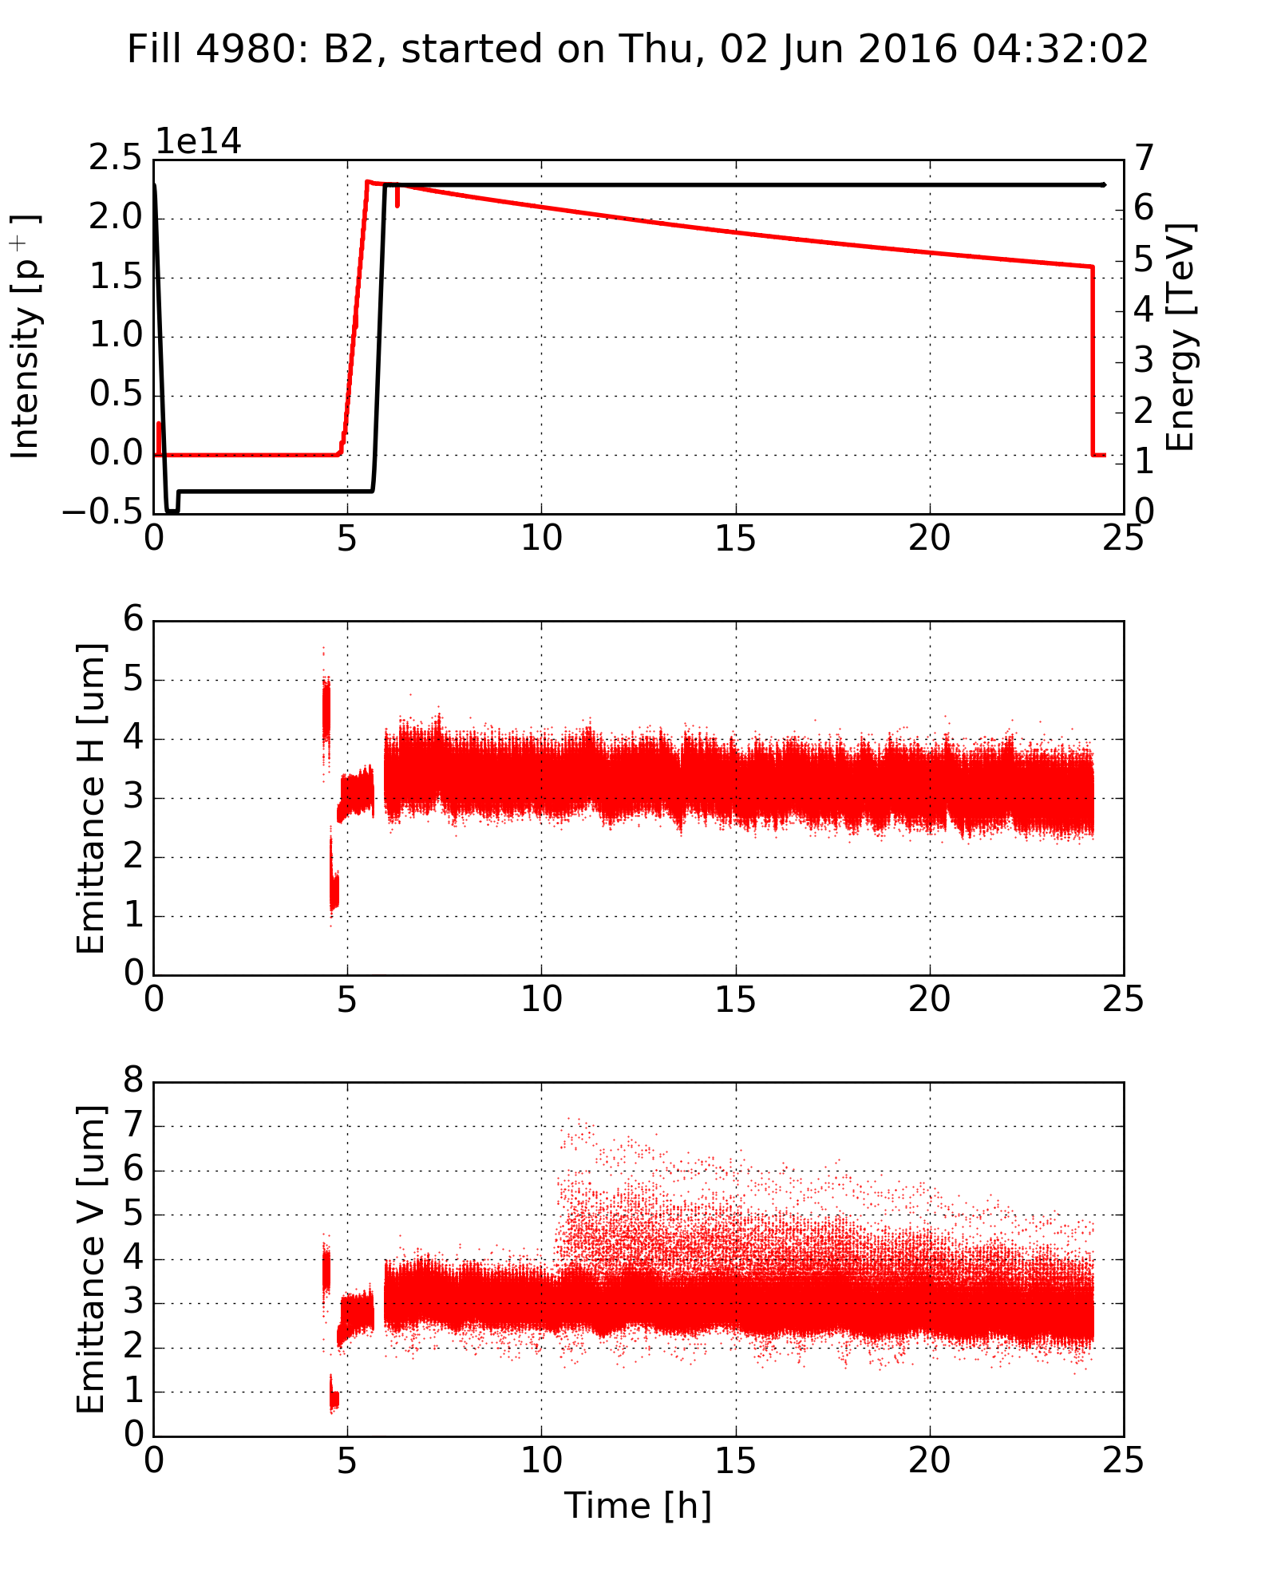
Instabilities in stable beam

Slide 38
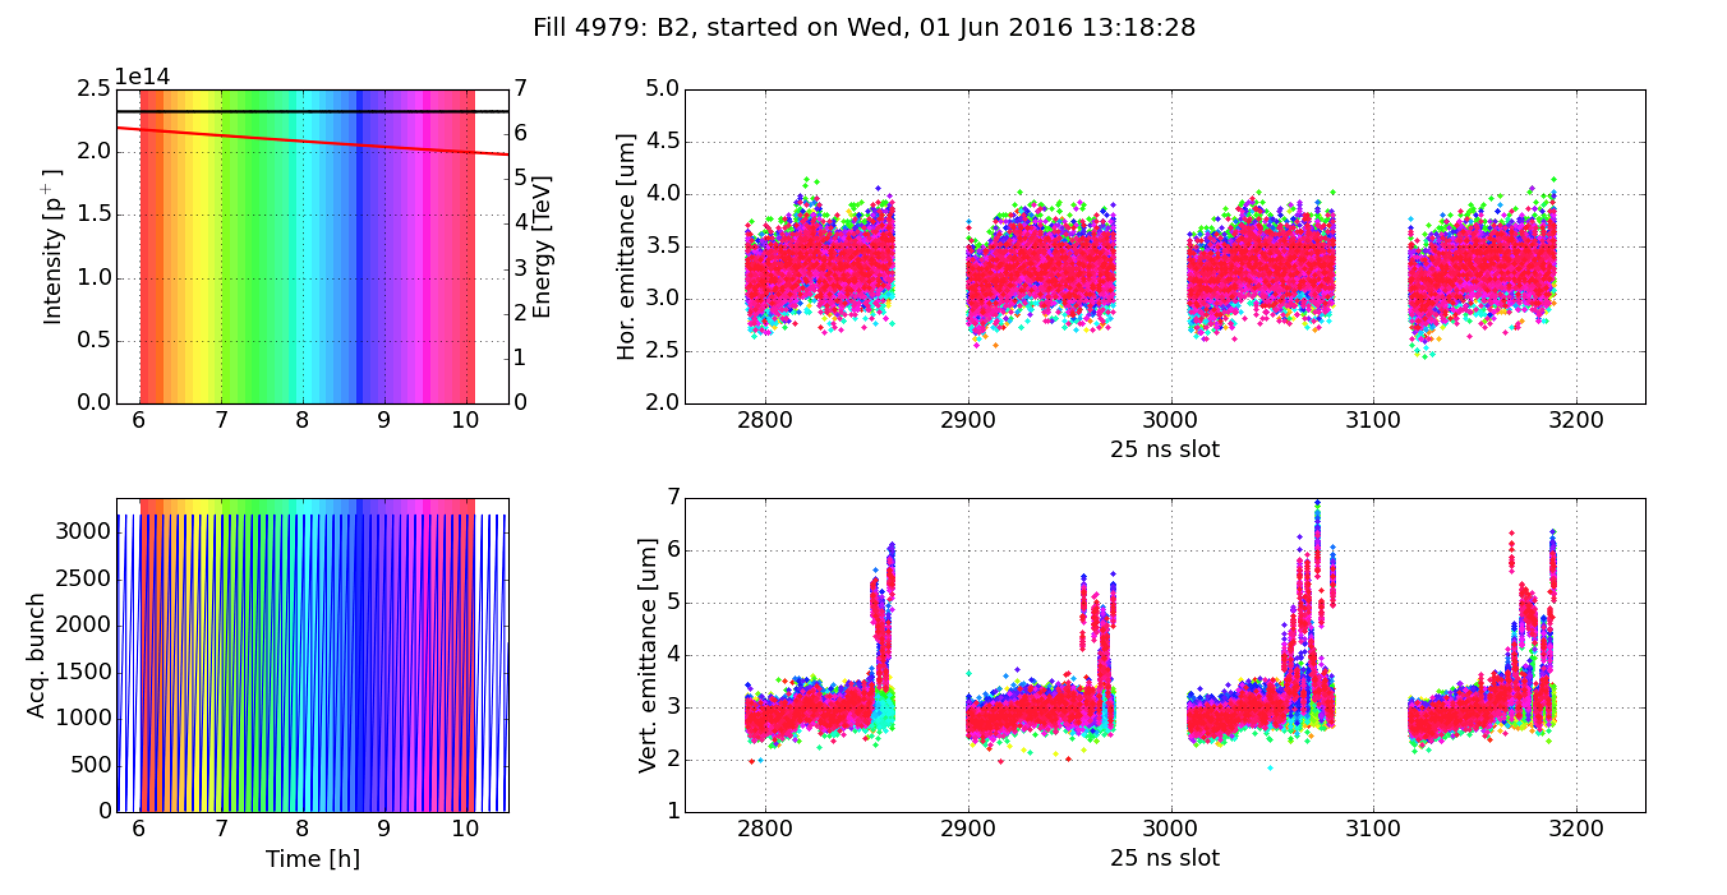
Instabilities in stable beam
Fill 4979 – Beam 2

Slide 39
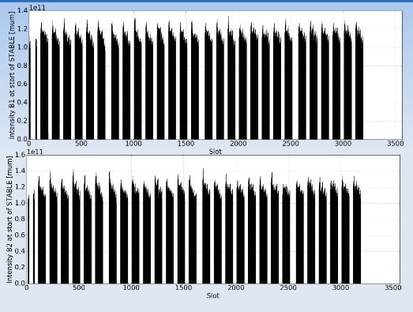
Instabilities in stable beam – beam intesity
X. Buffat

Slide 40
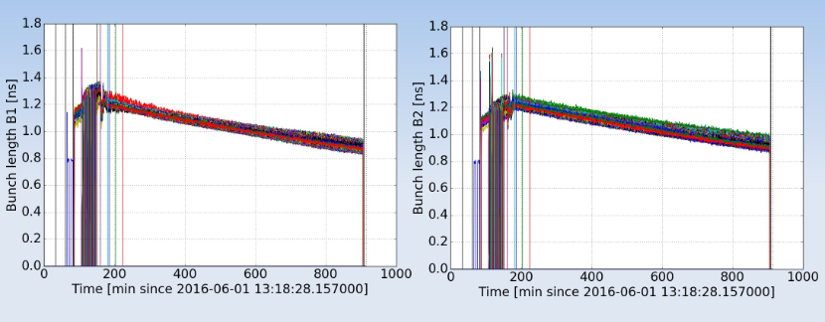
Instabilities in stable beam – bunch length
X. Buffat

Slide 41
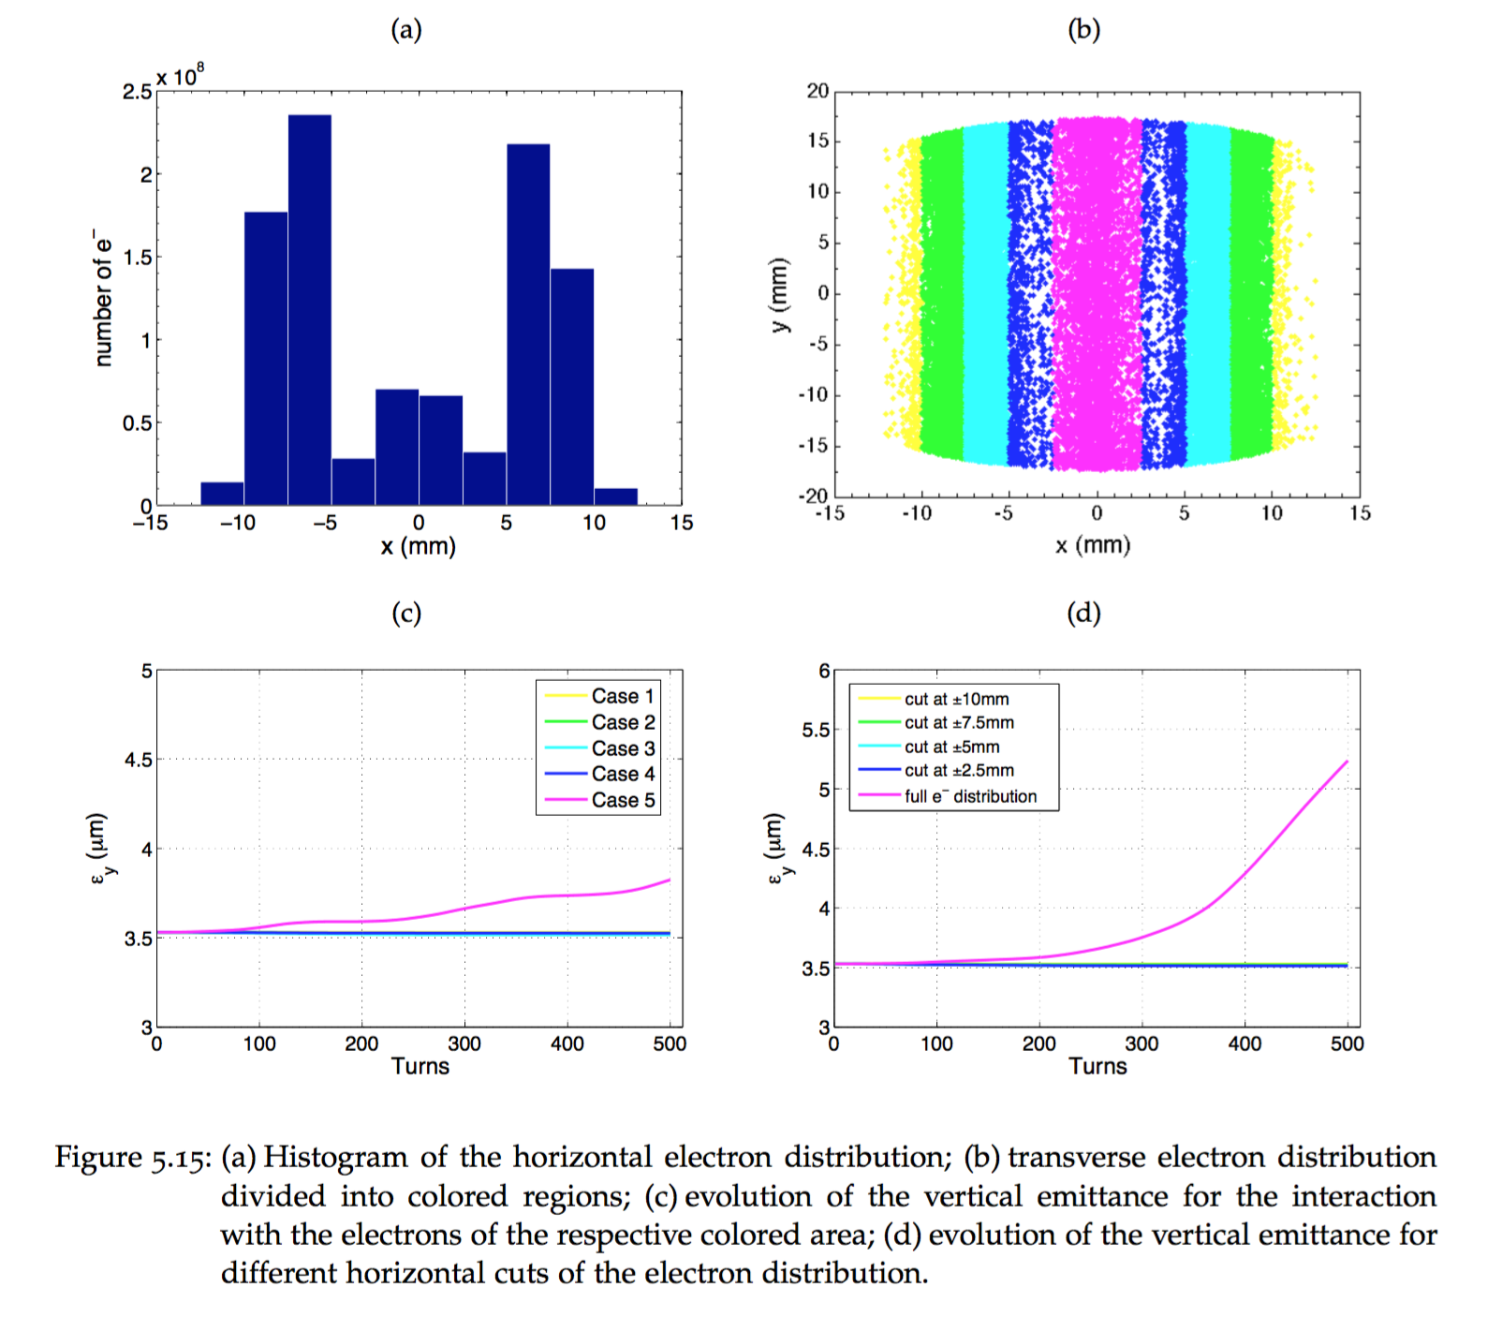
HEADTAIL simulations
Fast vertical instability is driven by the central density of electron in dipoles

Slide 42
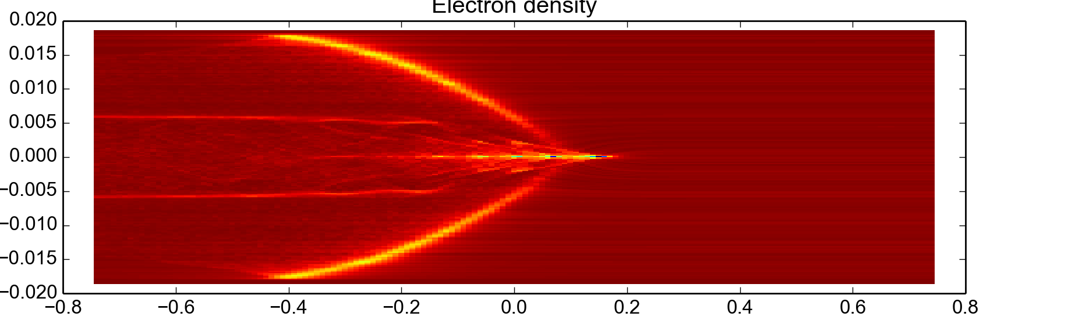
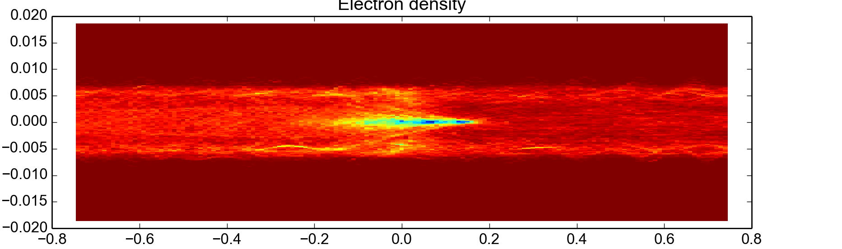
Arc Quadrupoles: realistic e⁻ distribution
First test performed with self consistent distribution from buildup simulation
  Electrons trapped along the magnetic lines → pinch is attenuated
Uniform initial distribution
y [m]
z [m]
Initial distribution from buildup simulation
y [m]
z [m]

Slide 43
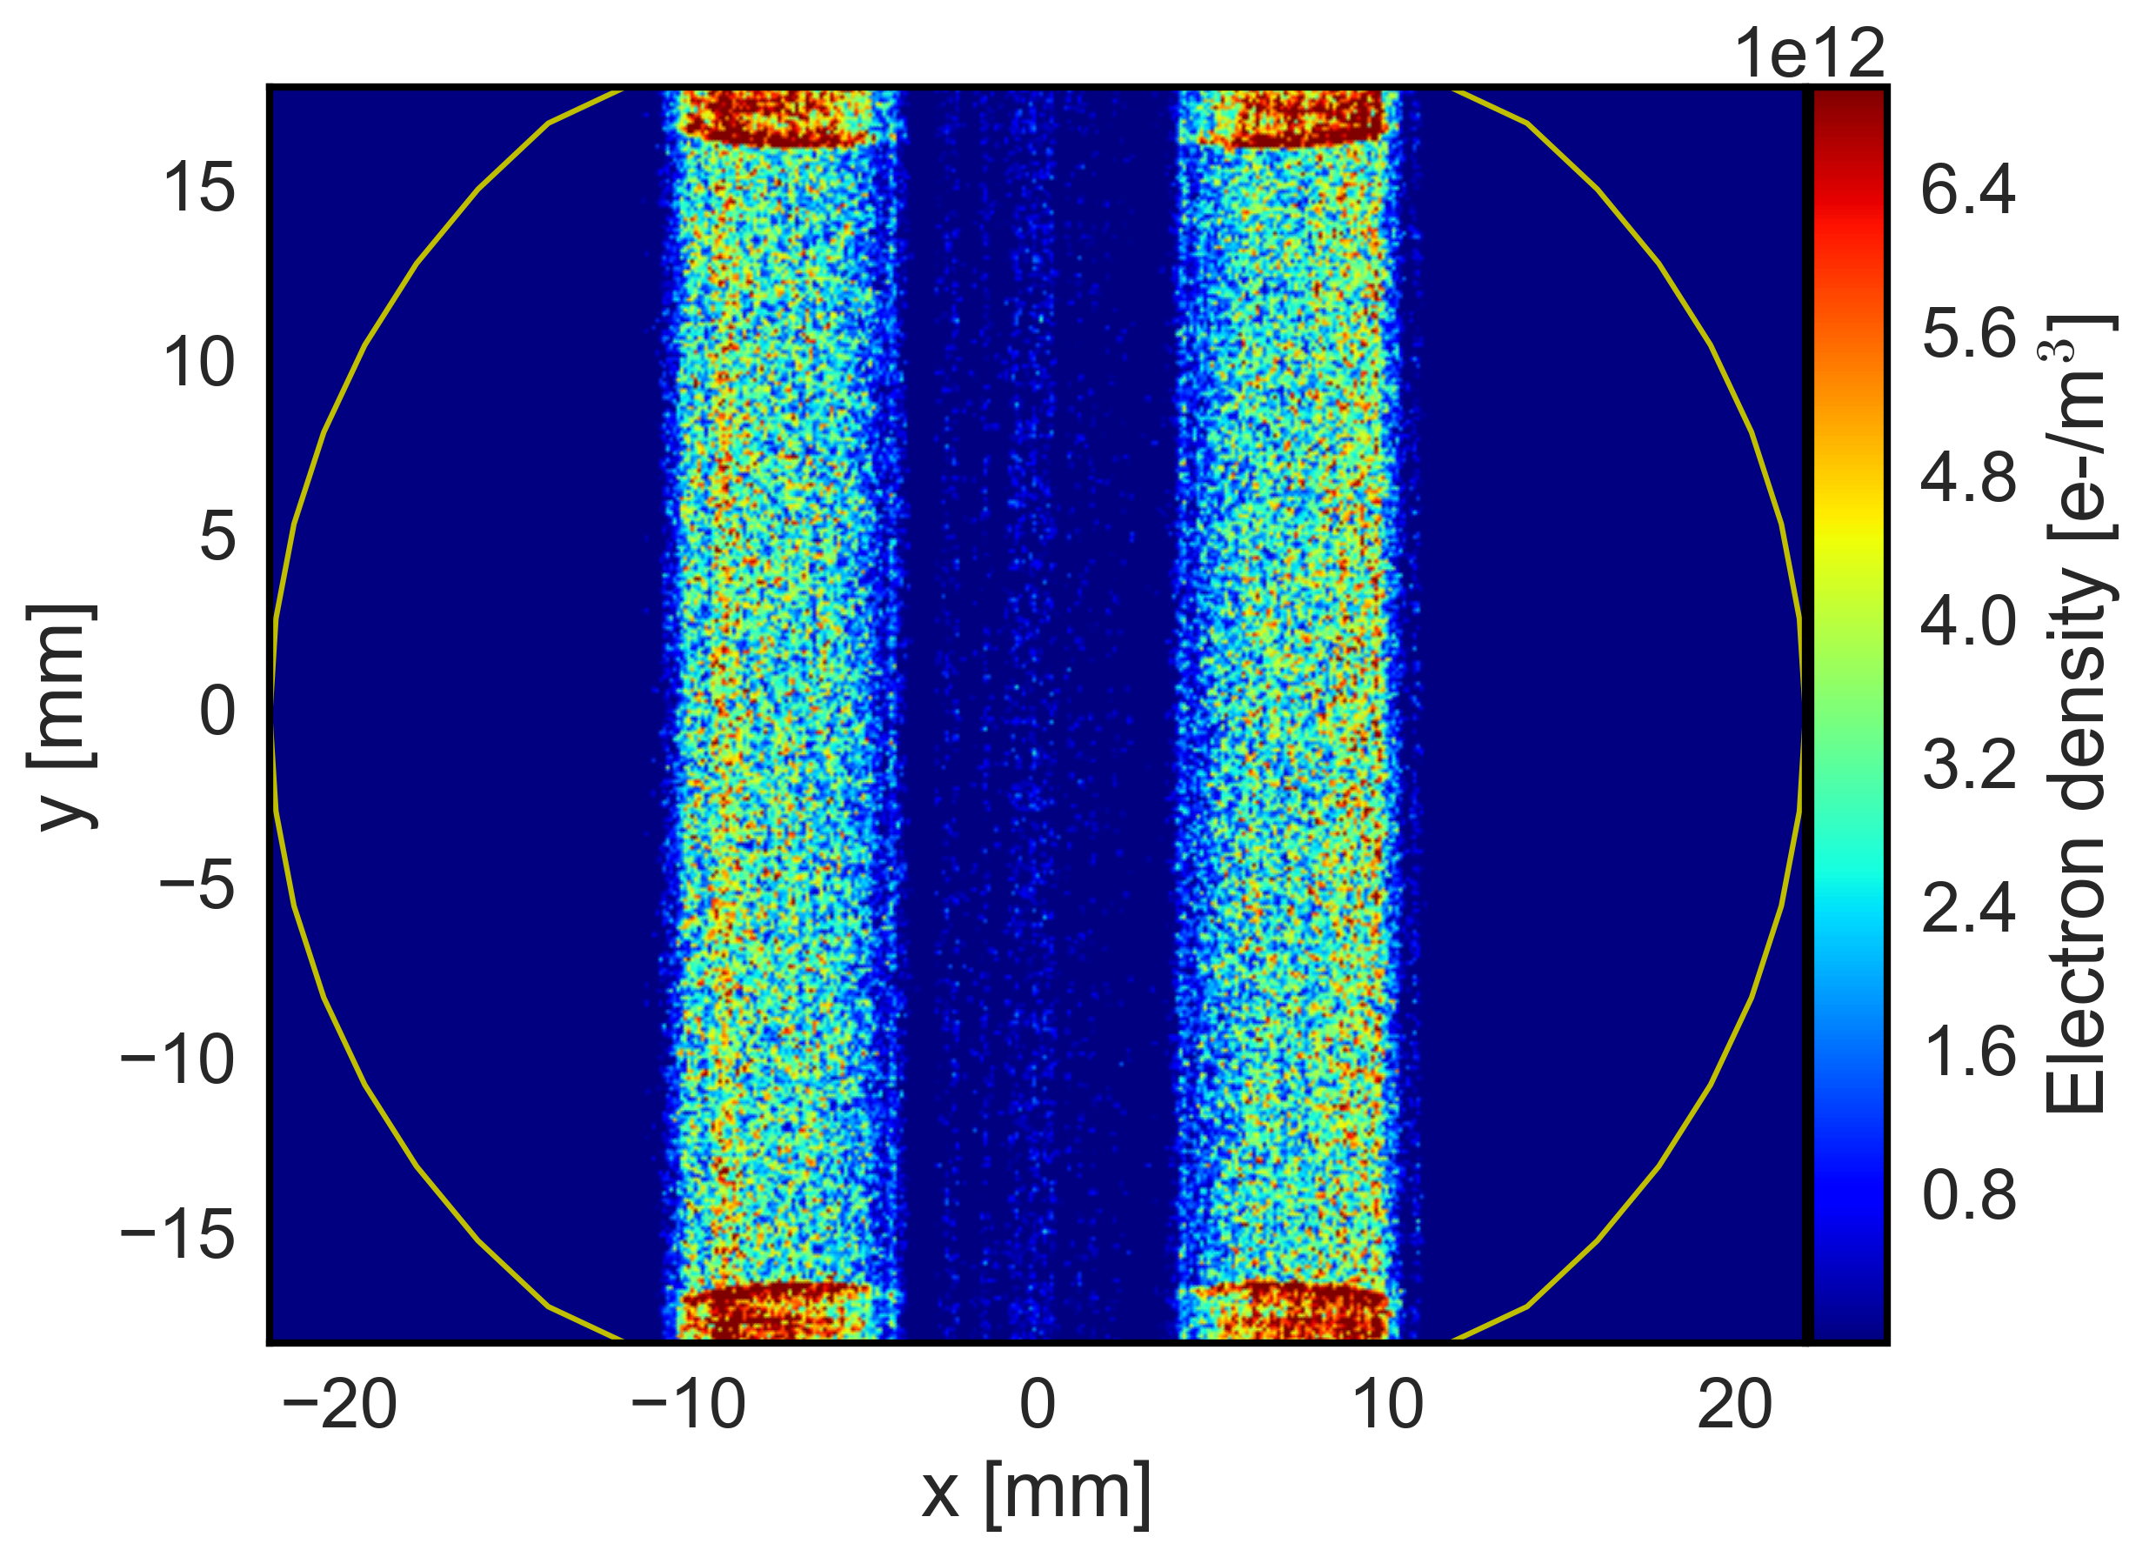
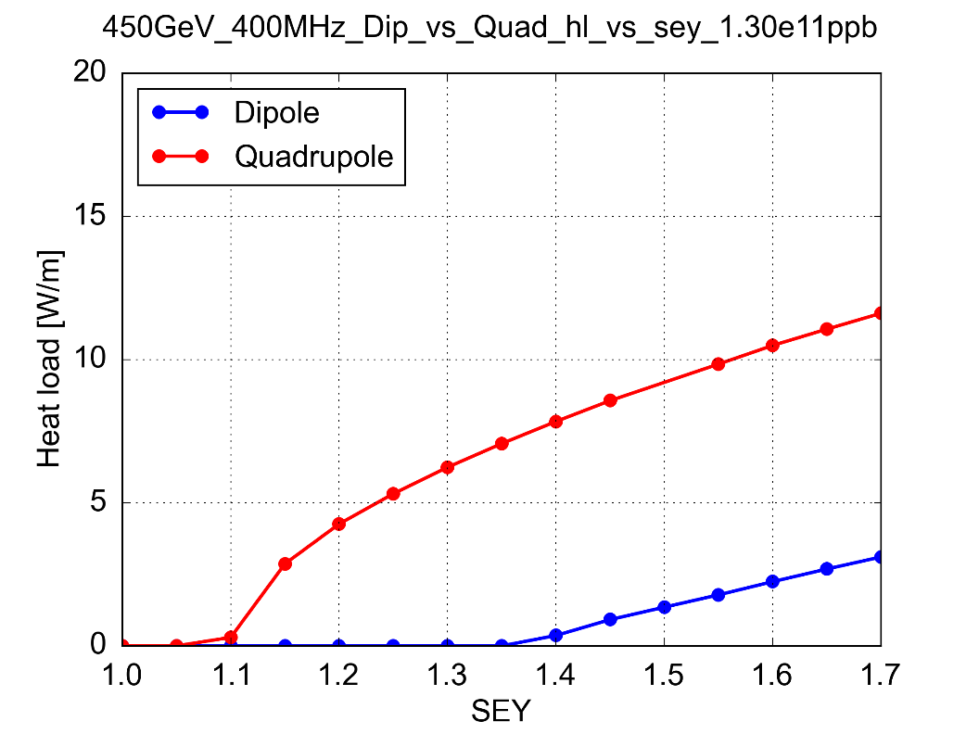
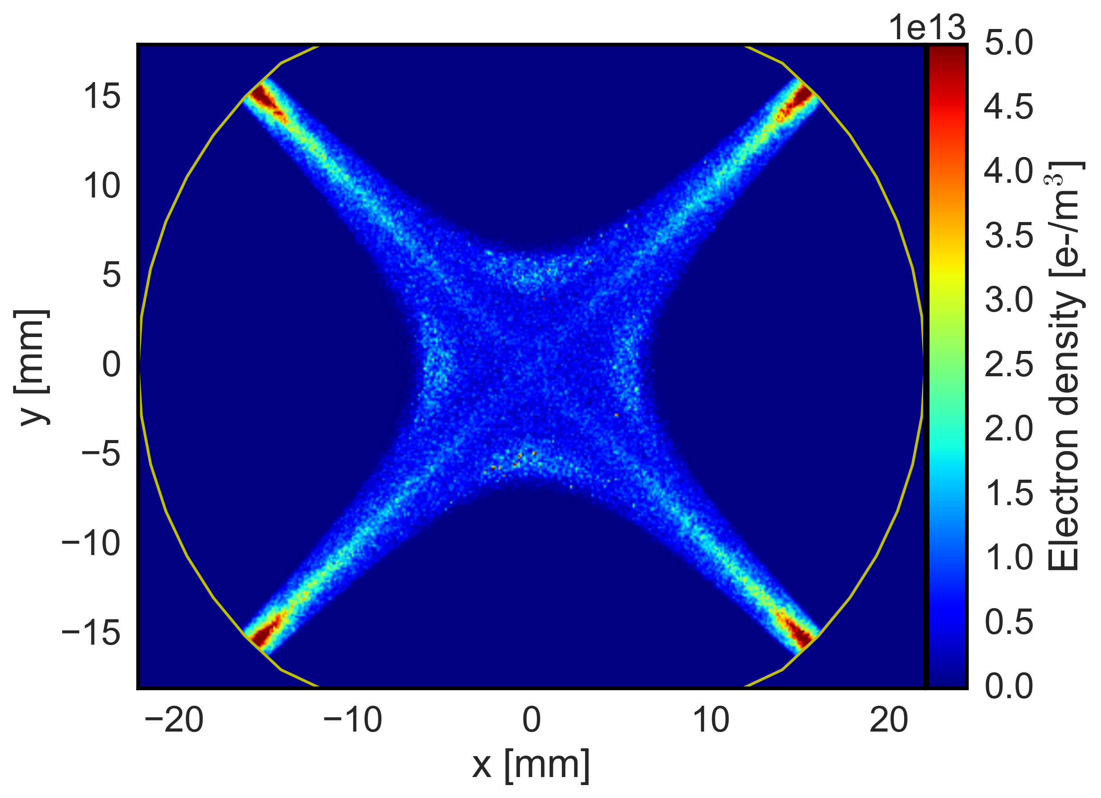
Magnetic field
LHC Arc Dipole
Electron trajectories are strongly influenced by externally applied magnetic fields
Electrons spin around the field lines
In quadrupole magnets magnetic trapping can occur with electrons surviving several bunch passages being accelerated up to a few keV
  Much stronger heat loads compared to dipoles
LHC Arc Quadrupole
Maximum Secondary Electron Yield (δ_{max})

Slide 44
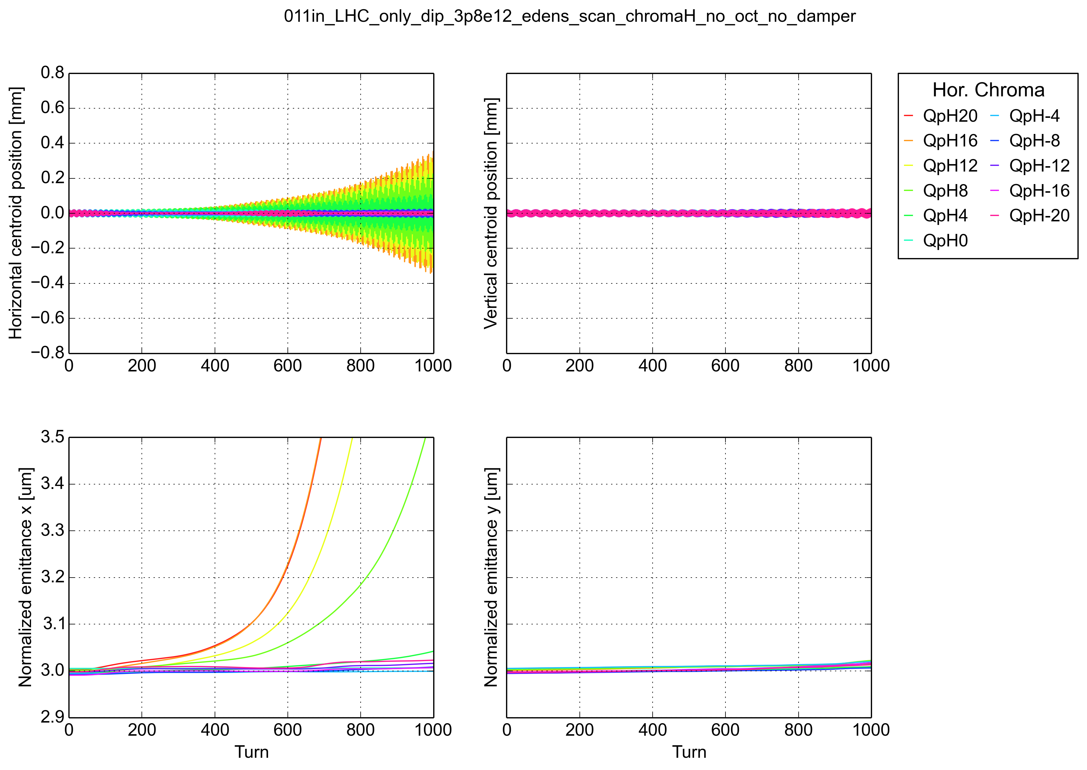
Horizontal instabilities @ 6.5TeV
EC only in dipoles→ density fixed at 3.8e12
Horizontal chromaticity is scanned between -20 and 20
Vertical chromaticity is kept at 0
No emittance blown up observed in the vertical plane
Strong horizontal emittance growth when increasing the horizontal chromaticity

Slide 45
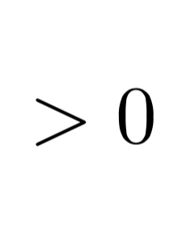
Horizontal instabilities – Possible mechanism
Transverse wake function (dipolar)
Stability criterion for mode-0 assuming constant wake (see Chao, eq. 6.216)
Sign of the wake
Stability condition
(above transition)
W_{x}<0, i.e. tail gets kicked in phase w.r.t. the head displacement
Positive chromaticity
W_{x} >0, i.e. tail gets kicked in counter-phase w.r.t. the head displacement
Negative chromaticity

Slide 46
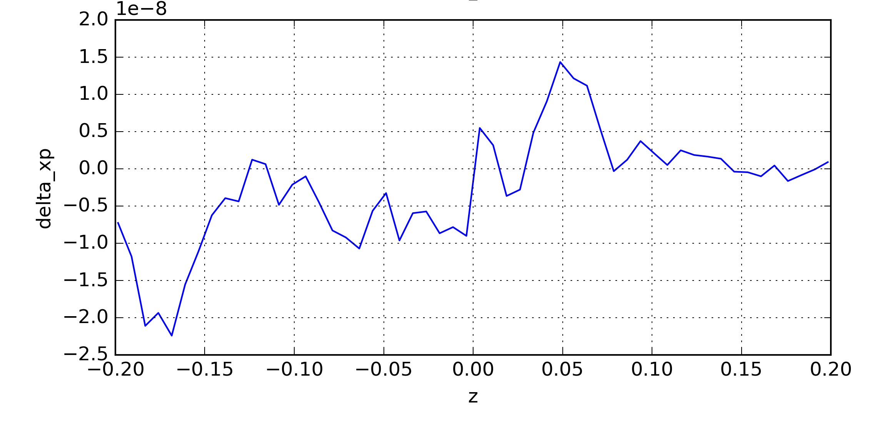
Horizontal instabilities – Possible mechanism
Bunch tail
Bunch head
Δx α σ _{x}
(e.g positive head displacement)
Δx’ <0
Tail gets kicked in counter - phase with the head displacement so we need negative chromaticity for stabilizing

Slide 47
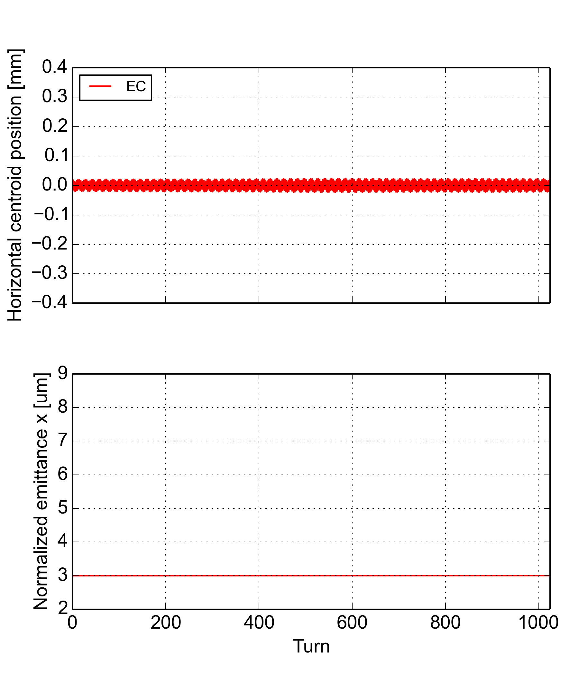
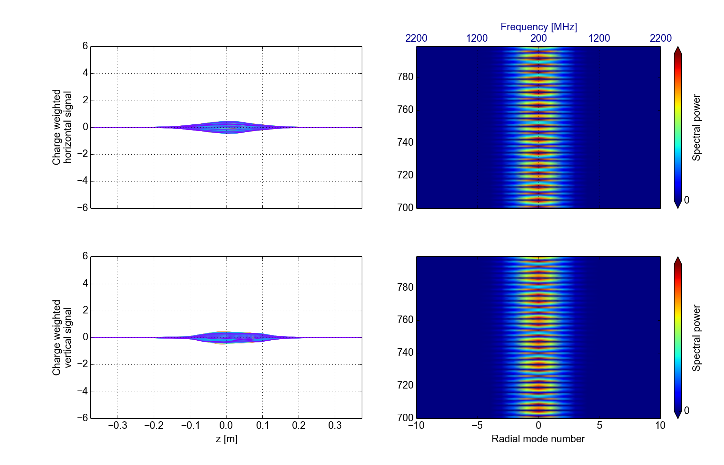
Horizontal instabilities – effect of the damper
EC density 3.8e12
EC dip

Slide 48
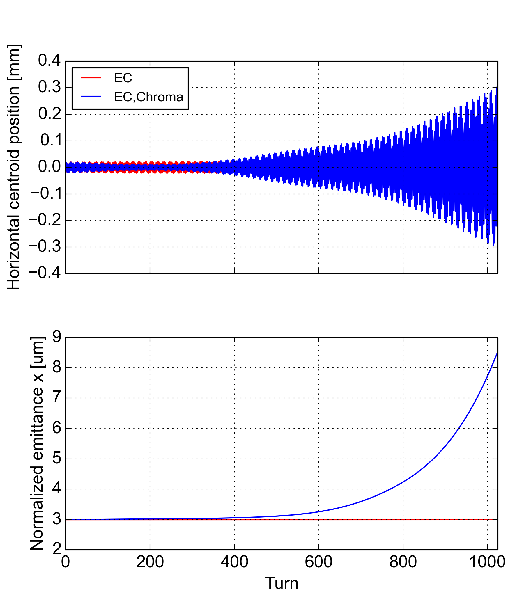
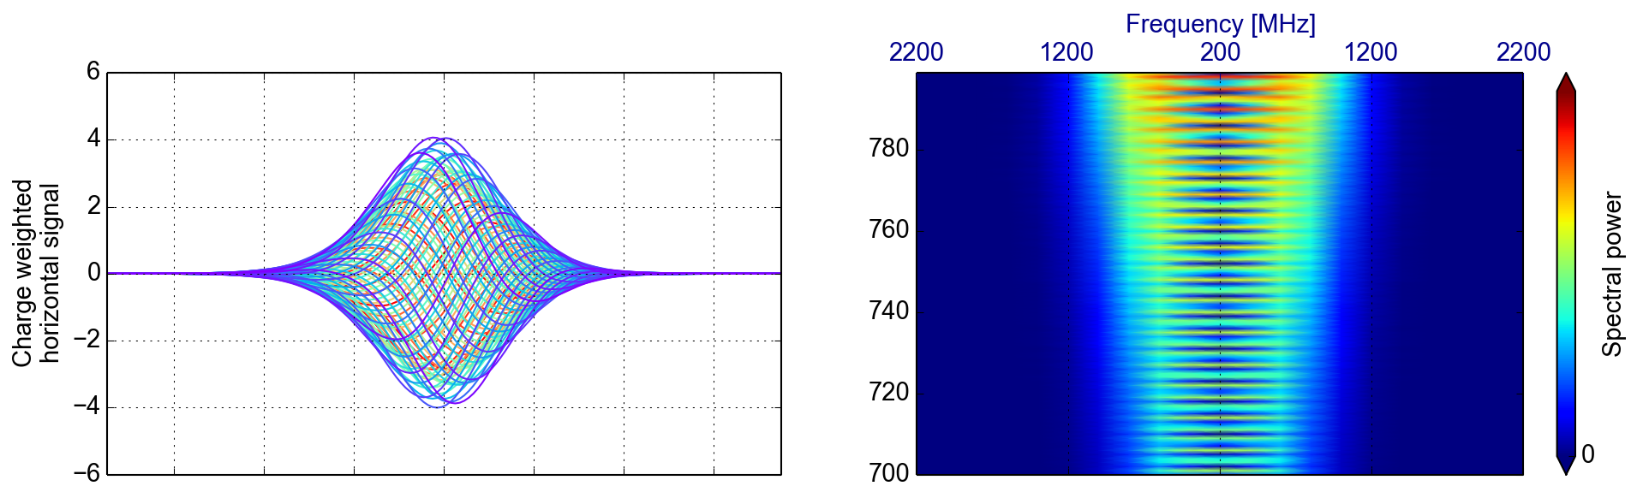
Horizontal instabilities – effect of the damper
EC density 3.8e12
EC dip
EC dip, Chroma

Slide 49
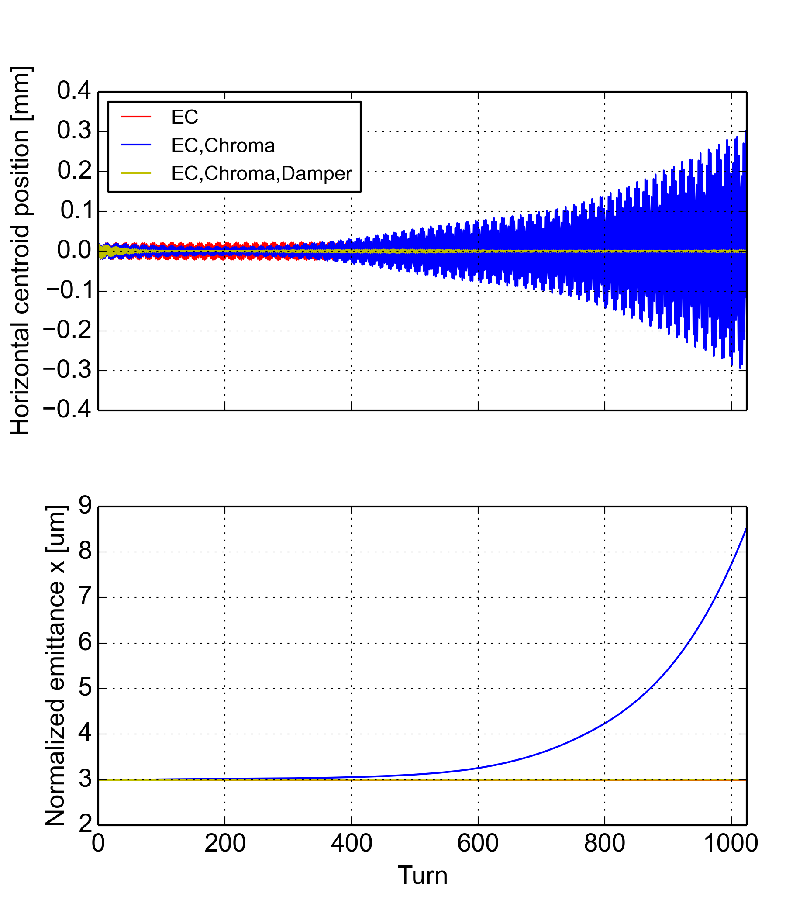
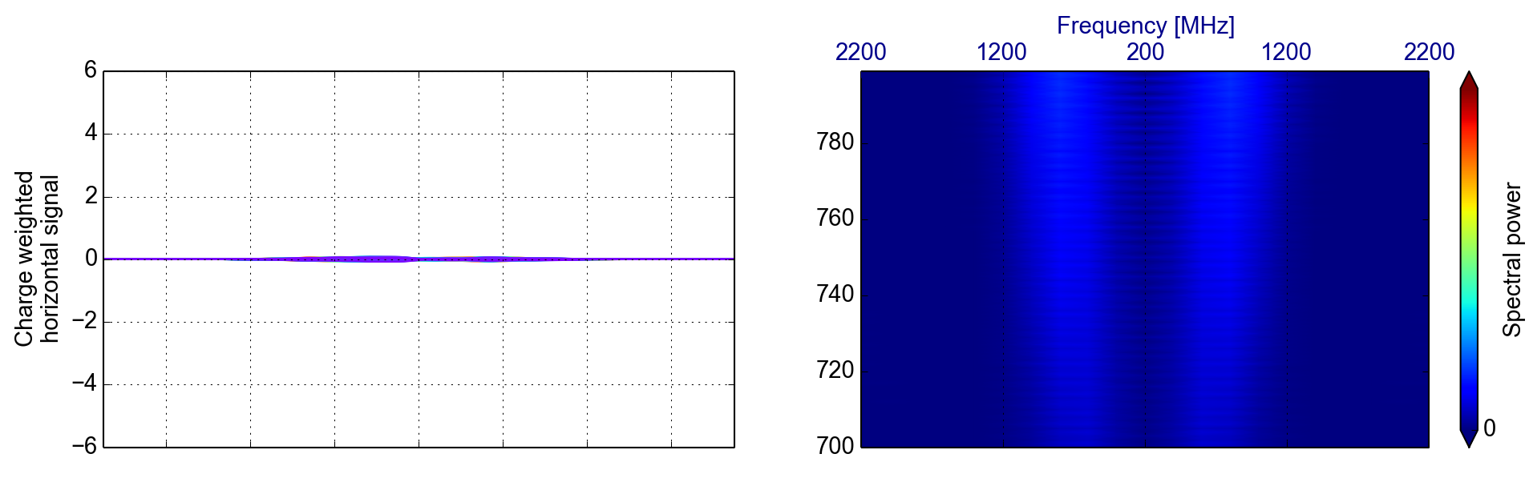
Horizontal instabilities – effect of the damper
EC density 3.8e12
EC dip
EC dip, Chroma
EC dip, Chroma, damper
This type of instability is not observed in the machine because of the strong stabilizing effect of the transverse damper

