Slide 1



Development of a high-efficiency klystron based on the kladistron principle
Antoine Mollard¹, Claude Marchand¹,
Franck Peauger¹, Juliette Plouin¹
Armel Beunas², Rodolphe Marchesin²
¹DRF/Irfu/SACM/Lisah
CEA Saclay
91191 Gif-sur-Yvette Cedex
²Thales Electron Devices
2 Rue Marcel Dassault
78140 Vélizy-Villacoublay
Eucard2 WP12 Annual Meeting 2017| Mollard Antoine antoine.mollard@cea.fr

Slide 2
Development of a high-efficiency klystron based on the kladistron principle
CLIC and the Kladistron project
TH2166 klystron and the kladistron prototype design
TH2166 kladistron cavities development
TH2166 kladistron fabrication and testing

Slide 3
CLIC and the Kladistron project

Slide 4



The high-efficiency klystron project
WP12 : Innovative RF Technologies
2013 - 2017
« In this sub-task, CEA will develop and search for innovative concepts of X band RF power sources and components. The objective is to propose affordable and reliable solutions for future testing capabilities for the CLIC accelerating structures. The task includes the design and the fabrication of prototype RF devices to demonstrate the feasibility of the new concepts proposed. »
Budget available to build a (small) part of the RF power source or component
Collaboration with THALES ELECTRON DEVICES :
PhD funding : 50% CEA/50% Thales (Contrat de Thèse CEA Industrie)
Co-supervisation :
Juliette Plouin/Franck Peauger/Claude Marchand @ CEA
Armel Beunas/Rodolphe Marchesin @ Thales
Collaboration with CERN : Igor Syratchev, Walter Wuensch…
MAGIC bought by CEA with “contribution exceptionnelle de la France au CERN”
☞ Activity fully oriented towards R&D

Slide 5
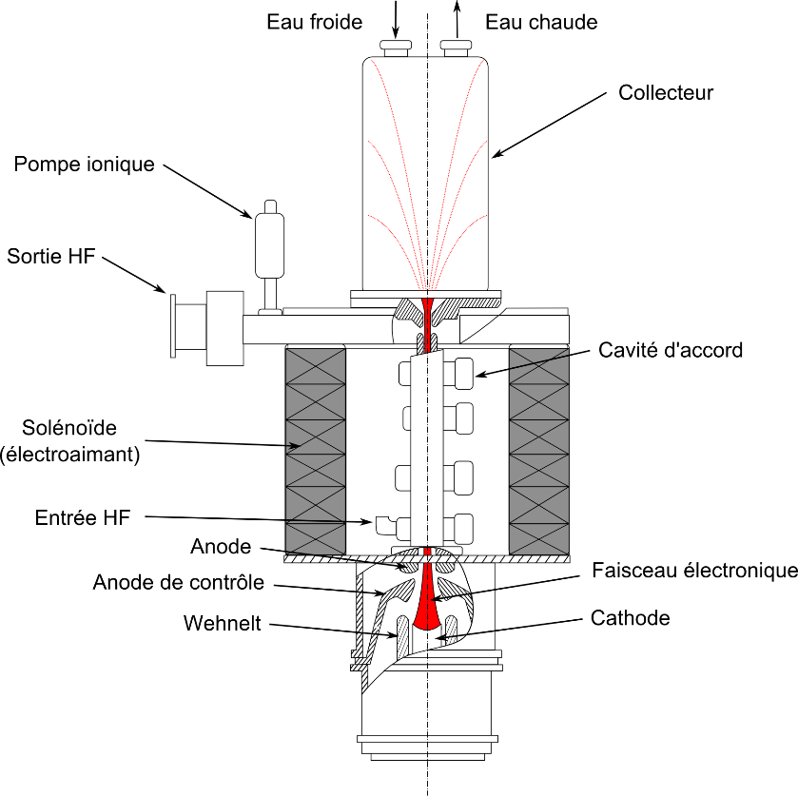
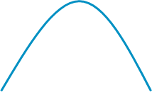

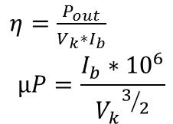
Klystron principle
Cold water
Hot water
Linear-beam vacuum device which is used as a narrow bandwidth amplifier for high radio frequencies (100 MHz-100GHz)
Creation of a stream of electrons by the electron gun (thermionic emission)
Confinement by an external magnetic field
Triggering of the beam modulation by the wave in the input cavity
Modulation of the beam into a set of electron bunches in the gain cavity/ies
Drifting of the electron bunches
Energy transfer between the bunches and the output antenna
Absorption of the lower energy electron beam by the collector
Klystron efficiency is the ratio of the output power to the electron gun supply power.
Collector
Ionic pump
7
RF output
6
Ps
Middle cavity
Solenoid
2
5
4
RF input
3
Pe
Control anode
Electron beam
Vk
Ib
1
$η=\frac{P_{out}}{V_{k}∗I_{b}}$
$$µP=\frac{I_{b}∗{10}^{6}}{{V_{k}}^{3/2}}$$

Slide 6
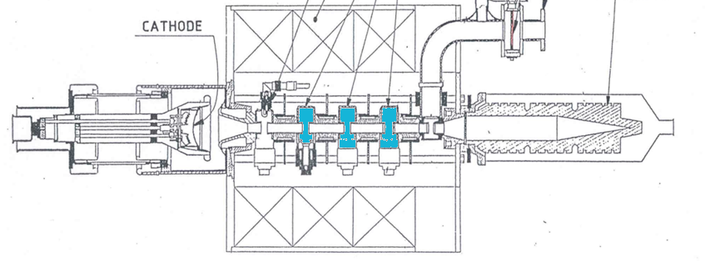
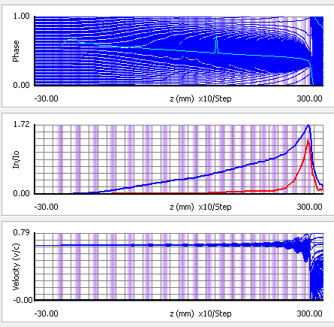
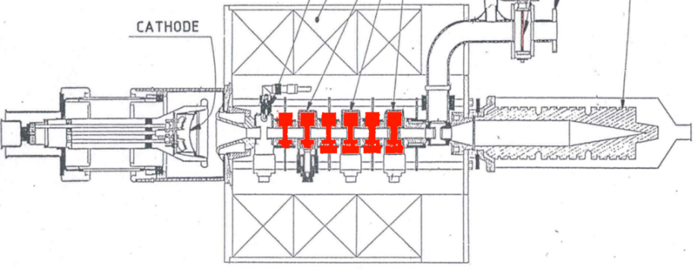



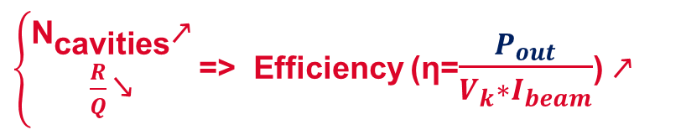


Kladistron principle
A Kladistron (Kl-adi(adiabatic)-stron) is a high-efficiency klystron with a large number of cavities (at least twice as many as in a classical klystron).
$$P_{in}$$
$$P_{out}$$
$$V_{k}$$
$\left\{\begin{aligned}{\text{N}}_{\text{cavities}}\text{↗} \\ \frac{R}{Q}\text{↘}\end{aligned}\right.$ => Efficiency (η=$\frac{P_{out}}{V_{k}∗I_{beam}}$) $\text{↗}$
$$P_{in}$$
$${P′}_{out}$$
$$V_{k}$$
20 cavities – 12GHz
µP = 1.5 A.V^-3/2
Efficiency 78 % (AJDisk simulation)
Length 285 mm
CLIC Project needs a 12GHz-high-efficiency klystron, with a microperveance of 1.5 A.V^-3/2. Our preliminary AJDisk results show a higher efficiency than what we can expect from a klystron with such a high microperveance.

Slide 7
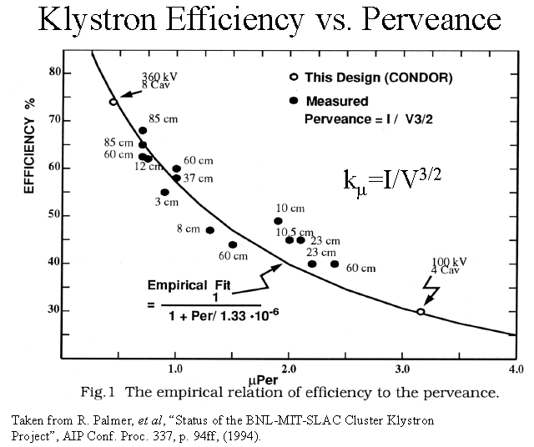
Kladistron and classical klystrons
12GHz
« KLADISTRON »
4.9GHz
« KLADISTRON »
(technical demonstration)

Slide 8
TH2166 klystron and the kladistron prototype

Slide 9


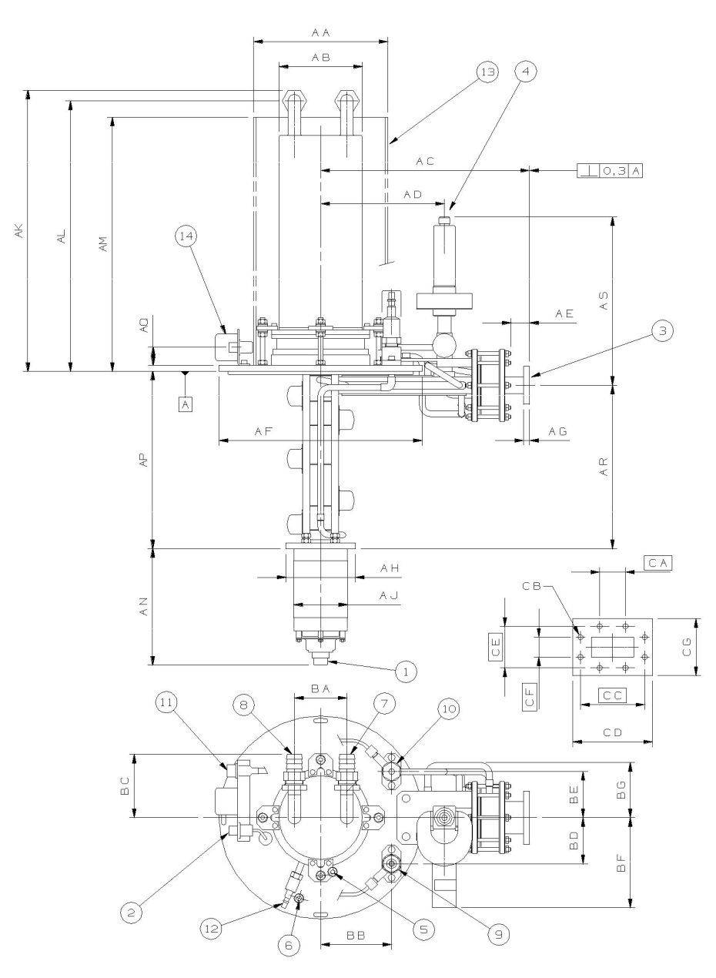
TH2166 Klystron
TH2166 front view
TH2166 klystron was designed by Thales electron devices (TED) for Mainz Microtron.
Features
Frequency | 4.9 GHz
Output power | 56 kW
Efficiency | 50%
Ibeam | 4.3 A
Vk | 26 kV
µP | 1.066
Number of cavities | 6
Interaction line length | 233mm
233mm
This klystron will be modified to verify the kladistron principle.

Slide 10
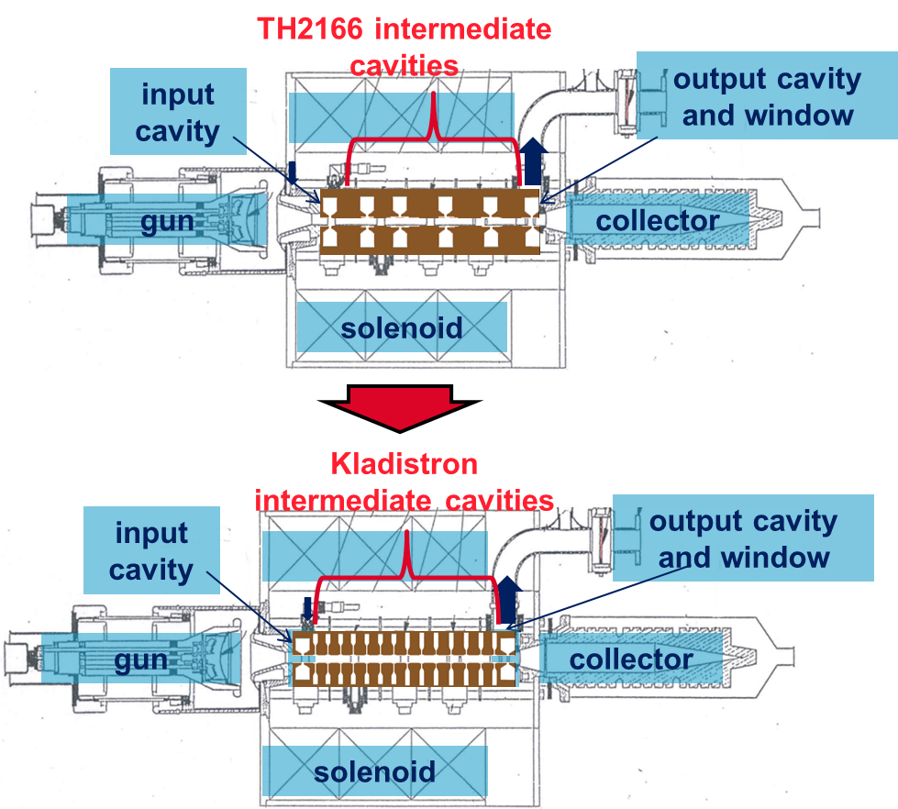
klystron TH2166 enhancement
Cavities preliminary design
The design we are looking for would let us :
Use the TH2166 klystron test and conditioning bench
➔ Total interaction line length of 233mm, same input and output cavities, same solenoid
Use the TH2166 klystron electron gun and collector
➔ Same microperveance of 1µA.V^(-3/2)
Check the kladistron principle
➔ More than 6 cavities
Avoid cavities coupling
➔ Drift space between cavities larger than 9mm
Avoid gain peaks
➔ Low coupling cavities
(low R/Q and Q0 values)
Thales-provided elements

Slide 11
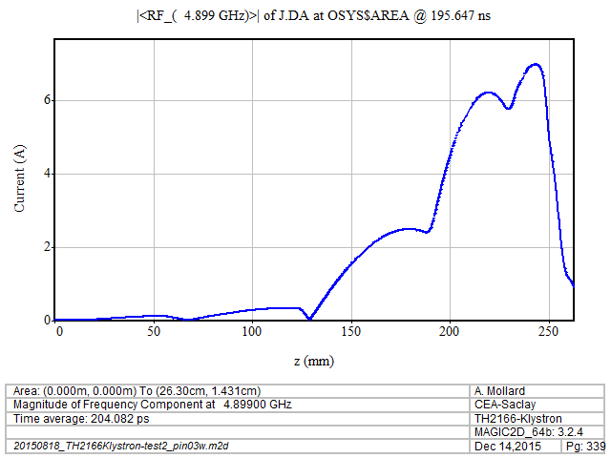
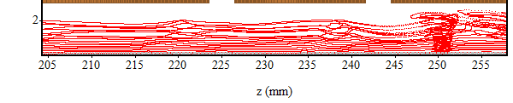
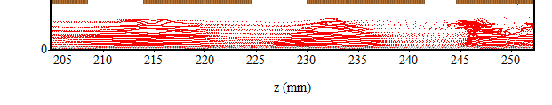
Th2166 Klystron and Kladistron Comparison
MAGIC2D Simulations
Our kladistron simulation results reach an efficiency of six points above TH2166 simulation results.
The electron bunching and the beam current growth are also smoother.
TH2166 beam current along the interaction line
TH2166 electron beam
Kladistron beam current along the interaction line
Kladistron electron beam

Slide 12
TH2166 kladistron cavities development

Slide 13
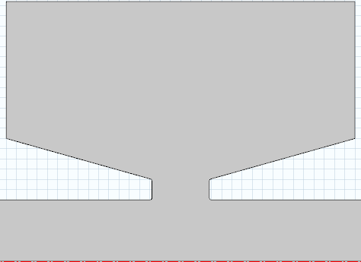
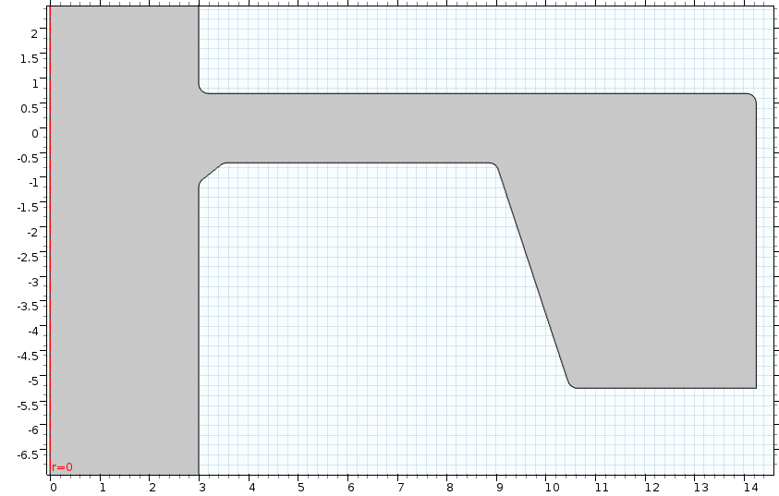
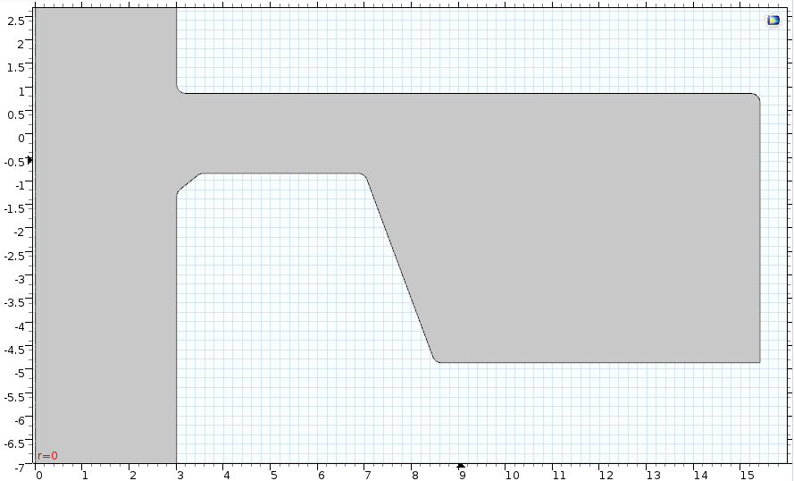
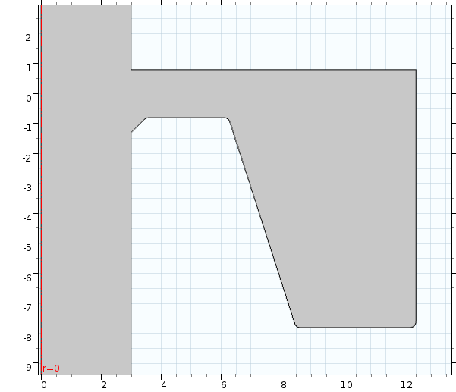
klystron TH2166 enhancement
Cavities preliminary design
Type 2
Type 3
Type 4
Tuning system
Type 1
Type 1
16 cavities interaction line
TH2166 cavity shape
Low-coupling cavity shapes
Type 1
Type 2
Type 3
Type 4
According to our COMSOL simulations, these low-coupling cavities are fit for smooth electron bunching.

Slide 14
Frequency shift : a reliable tuning system is required
The cavities fabrication must also be accurate: a 1-µm error might induce a 2,5MHz frequency-shift (COMSOL).
→Δzgap ≈ -4µm
Zgap
For each computation we shift the frequency of one of the cavities.
Kladistron efficiency is sensitive to its cavities frequency shifts, especially at the end of the interaction line.
Δf/Δzgap ≈ 2.5MHz/µm

Slide 15
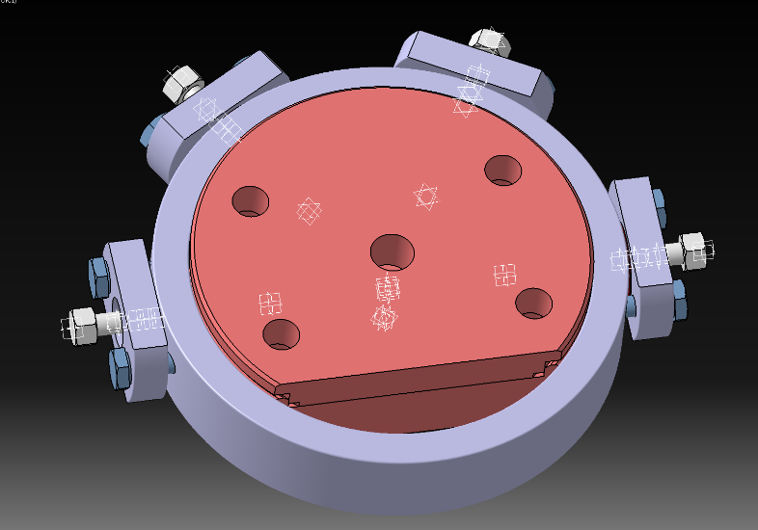
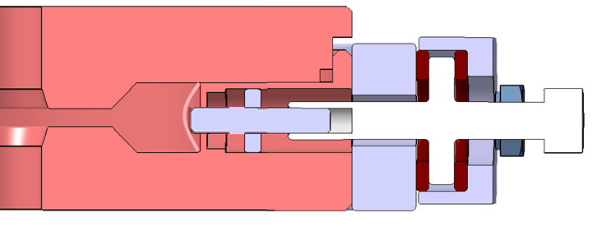
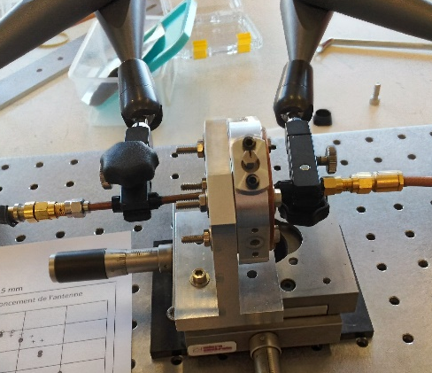
tuning system design and test
Cooling system channels (4)
Threaded Cupronickel pin brazed on the membrane
Beam drift tube
Cavity
Bronze bearing
Copper
Beam drift tube
Misshaped membrane
Screw thread
Pin’s thread broken
Tuning system (x4 at 60°)
4
The tuning system we designed is inspired by CLIC accelerating cavities design; a thigh copper membrane is misshaped to adjust cavities frequencies. This strain is controlled by an accurate screw thread.
Although the airtightness had been preserved during our tests, the pin’s thread had been broken. The tuning system assembling is too rigid and the extra mechanical stress is reported on the screw thread.
3
1
Prototype test bench
2

Slide 16
tuning system design and test
Cooling system channels (4)
Threaded Cupronickel pin brazed on the membrane
Beam drift tube
Cavity
Bronze bearing
Copper
Bronze bearing removed
Beam drift tube
Misshaped membrane
Screw thread
Tuning system (x4 at 60°)
6
We then removed one of the bronze bearing to make the assembling more flexible. We tested our tuning system on two complete cycles (+4/-8 screw revolutions). The overall frequency shift is +3MHz/-1,5MHZ.
Despite the hysteresis induced by the assembling modification, the overall frequency shift after two complete cycles is negligible. We validate our tuning system design.
1
2
3
5
Prototype test bench
4

Slide 17
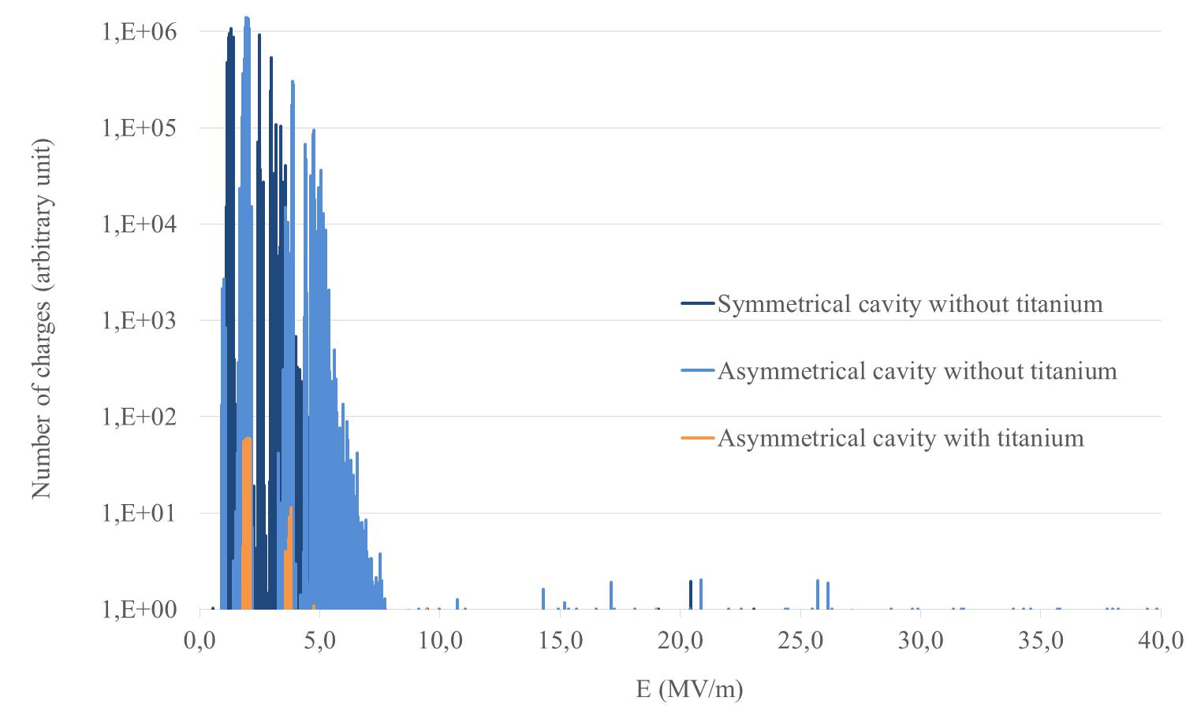
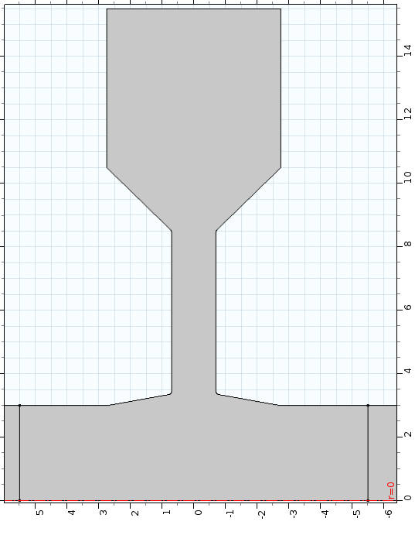
Multipactor and titanium deposition
Musicc3D simulations
Our preliminary Musicc3D (CNRS code) simulations demonstrated that we would face multipactor phenomenon in our cavities’ gaps. We then designed new asymmetrical cavities to apply a titanium layer.
The graph on the left is the number of charges generated in the cavity’s gap, in a Musicc3D simulation: an electron is sent from a chosen area; an electric field with a given phase and amplitude is applied on the charge. The simulation stops after the 20th electron impact, if it has not been absorbed by the material.
Without titanium, a single electron in an electric field of 2MV/m can extract up to 10⁶ charges in the cavity’s gap. With a titanium layer, the maximum number of charges extracted drops to 60.

Slide 18
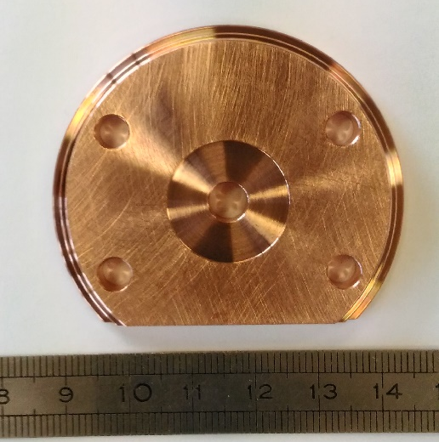
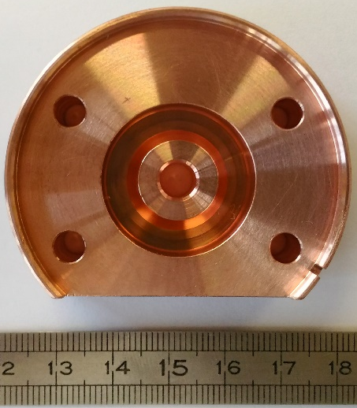
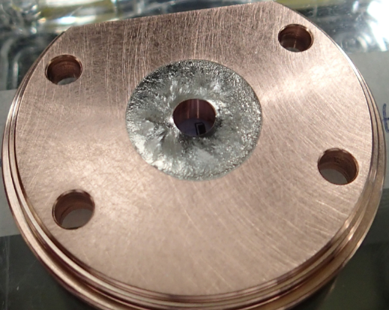
Multipactor and titanium deposition
Prototype tests
Flat part without titanium
Concave part
We designed and ordered 6 prototype cavities to test our titanium deposition method. The “flat” parts (Ti1 to Ti6) have a 0,1mm deflection for the titanium deposition. We cut and brazed titanium discs on these parts. The “flat” and the “concave” parts were assembled to form a cavity to test.
The titanium sheet was misshaped during the brazing process therefore the frequency shift is below our expectations. Although these pieces are being machined to fit the drawings dimensions, we are also working on the improvement of this brazing process to guarantee the adequate cavity geometry.
Flat part with a titanium sheet brazed

Slide 19
TH2166 kladistron fabrication and testing

Slide 20
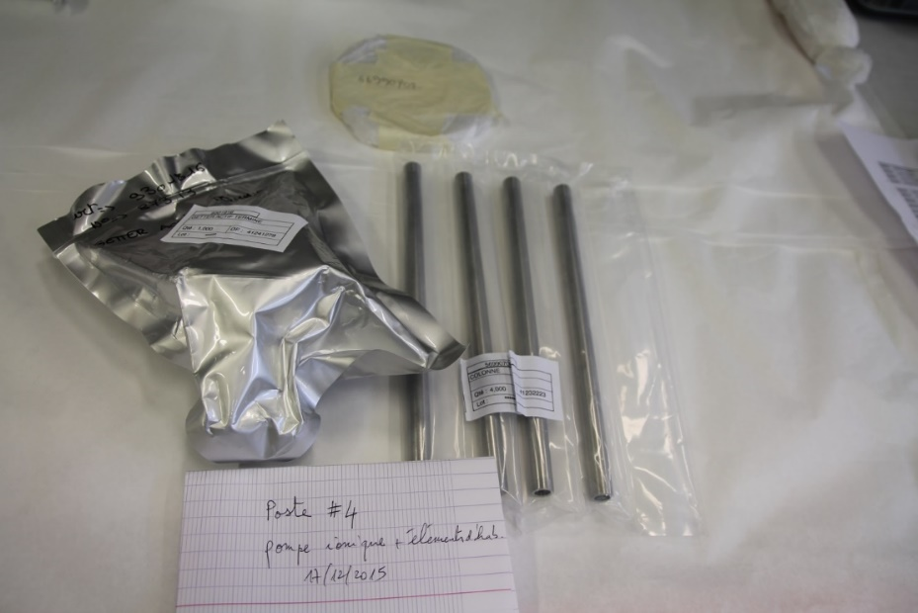
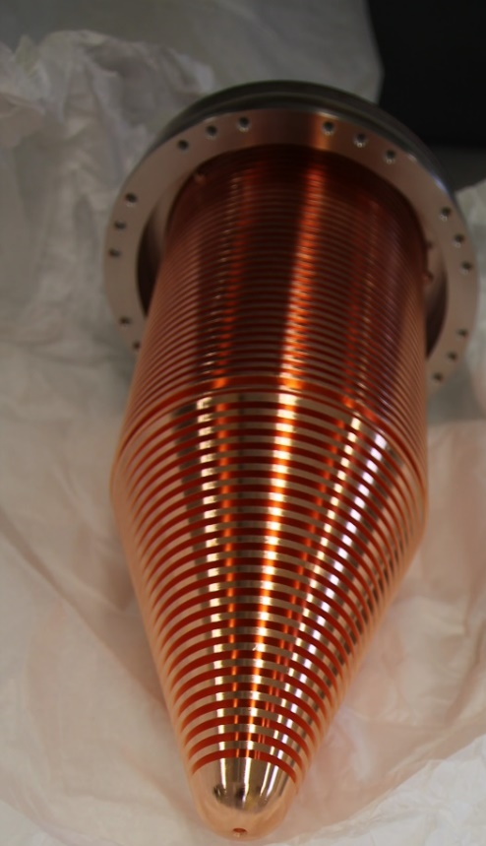
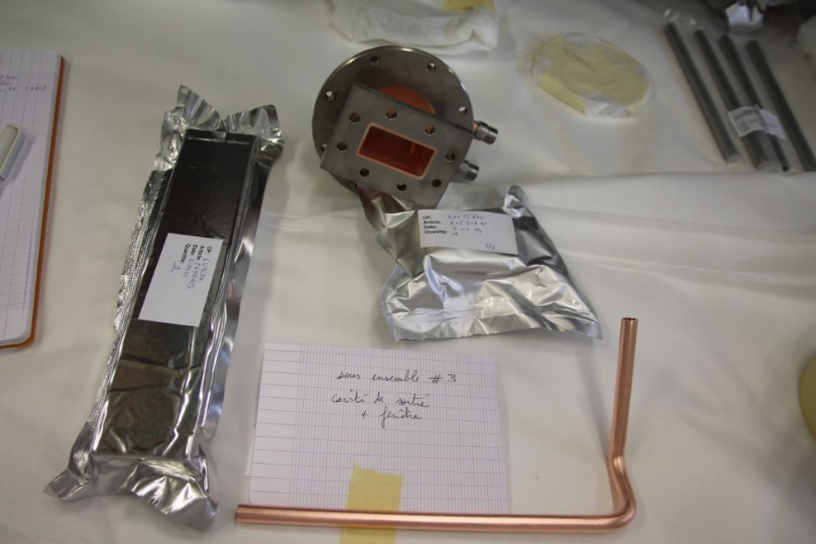
Thales-provided elements
Steel rods and Ionic pump
Wave guide,
Output cavity and
Output antenna
Collector
These elements have already been delivered.

Slide 21
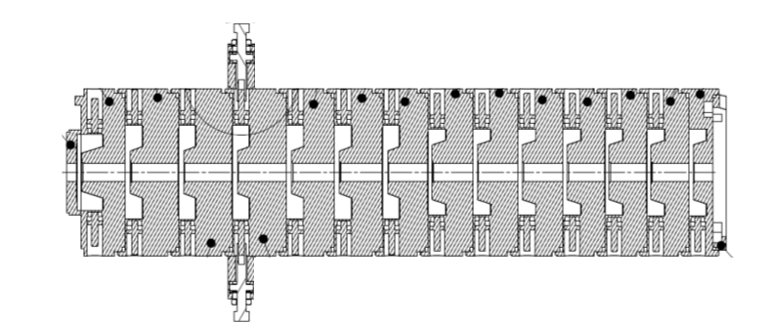

Cavities and tuning system fabrication and assembling
TH2166 kladistron interaction line and tuning system
Pieces provided by VDL
The company VDL (Netherland) won the call for tenders and will machine the pieces of the interaction line and the tuning system. We expect the pieces to be delivered by the end of the month.
Assembling and brazing operations and the kladistron tests will stand at Thales Electron Devices Vélizy.
We are working on the assembling, brazing and test procedure.

Slide 22
Conclusion and outlook
Tuning systems and titanium deposition method tested
TH2166 kladistron’s cavities fabrication almost finished
Assembling, tuning and test procedure validation
TH2166 Kladistron to be assembled and tested in April, May and June.

Slide 23
Thank you for your attention

