Slide 1
Metallic Photocathodes for
Superconducting RF Photo Guns
Jochen Teichert & Rong Xiang
on behalf of the SRF Gun Crew at ELBE
EuCARD2 WP12 Annual Review Meeting NCBJ Swierk

Slide 2

Outline
Introduction
Preparation, laser cleaning and application of Mg cathodes
Laser cleaning and long-term test of Pb/Nb cathodes
Summary

Slide 3
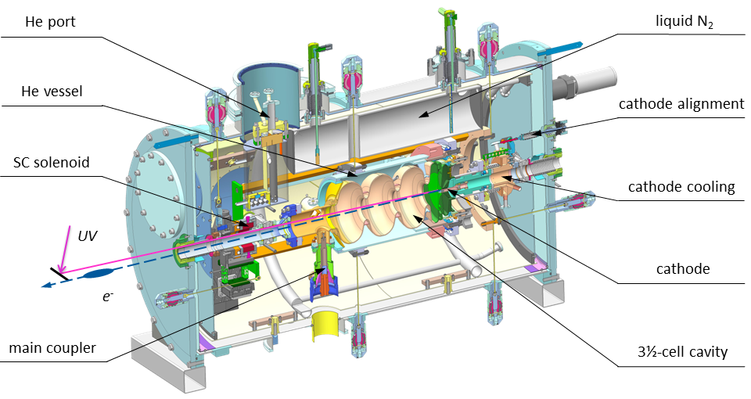
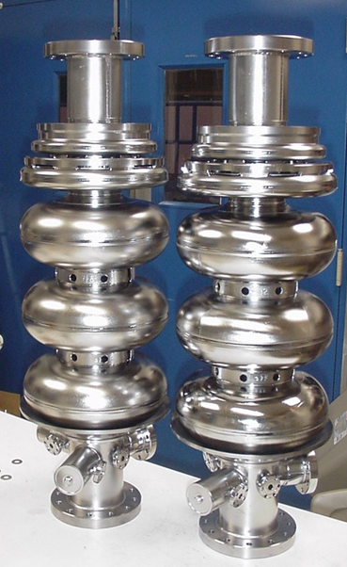
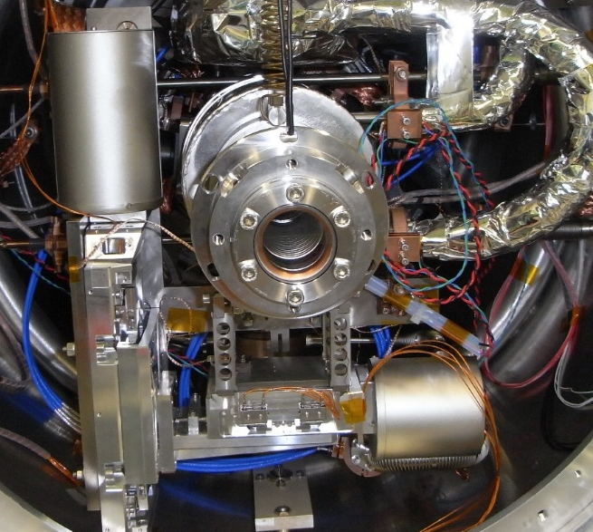
Commissioning of SRF Gun II
ELBE SRF Gun II - Cryomodule
RRR 300
Nb cavity
large grain
Nb cavity
New cavity - fine grain Nb,
produced, treated,
tested at JLab
New cryomodule
10 cm longer, fabricated and assembled at HZDR
Integration of a superconducting solenoid

Slide 4
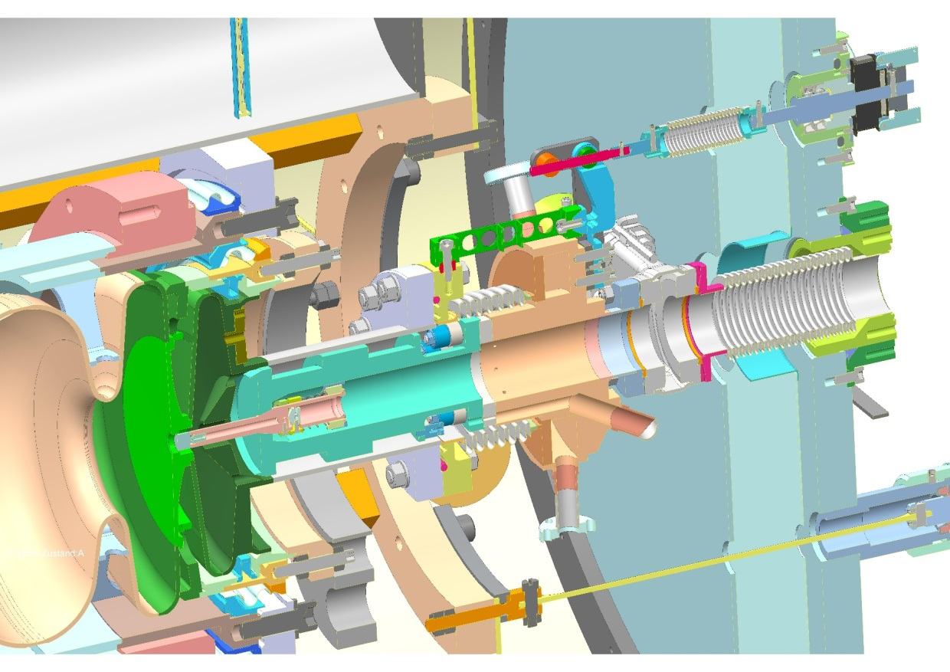
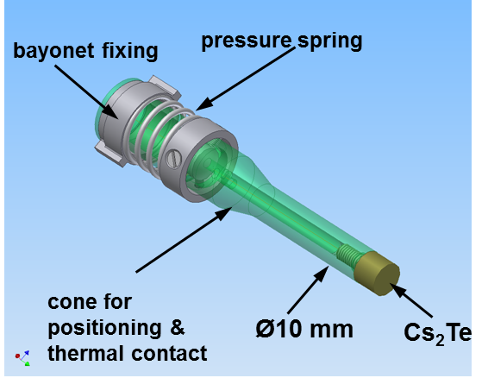
ELBE SRF Gun II – Photocathode
UV laser @ 258 nm
0.5 W CW
100 kHz, ≤ 5 µJ
Gaussian 12 ps FWHM
screw drive
normal conducting - low RF losses on axis
vacuum gap - thermally and electrically isolated
axis alignment (by hand)
remote controlled positioning +- 0.6 mm range
retracted RF focussing
cathode exchange in cold gun

Slide 5
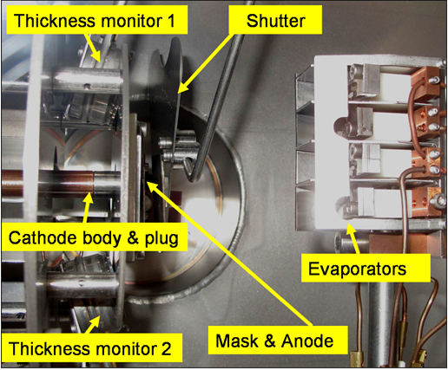
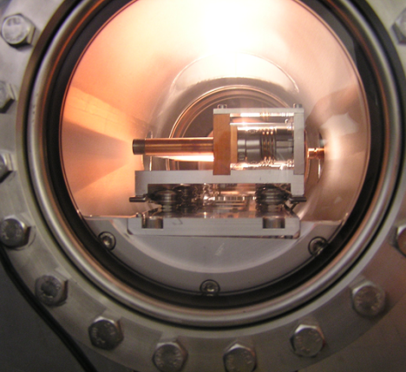
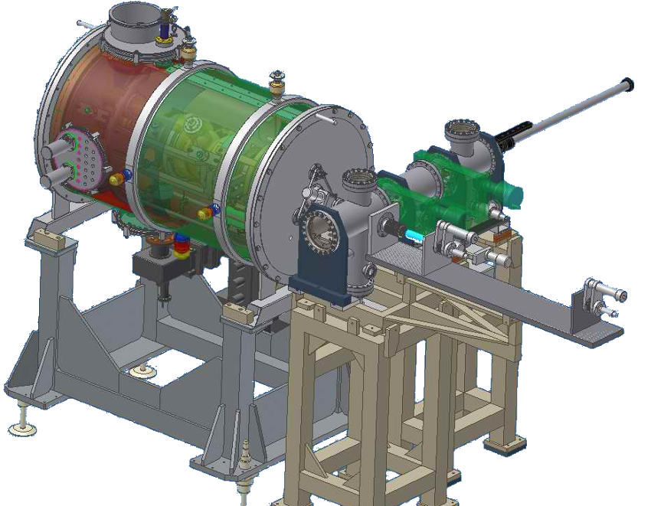
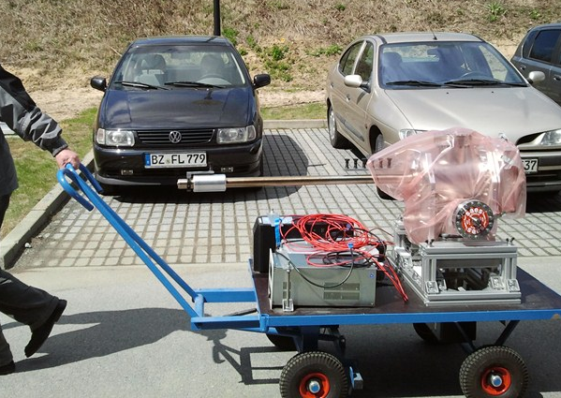
ELBE SRF Gun II – Photocathode
Cs₂Te Cathode Transfer System
Cs₂Te preparation system
refurbished
cathode exchange
system of SRF Gun I
Gun installation finished in May 2014
Photo cathode exchange system ready in January 2015

Slide 6
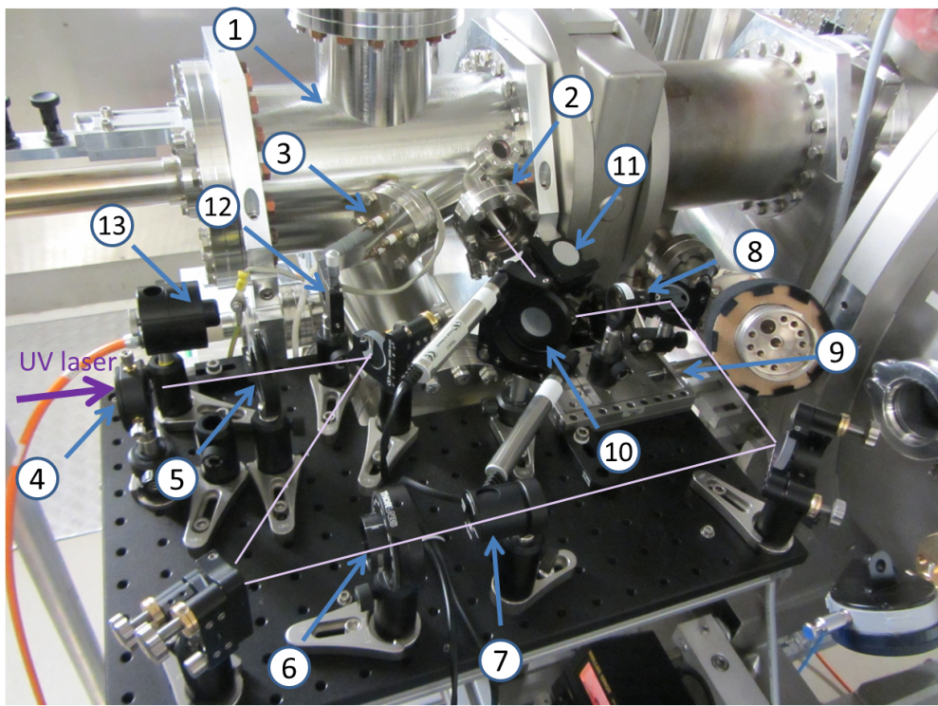
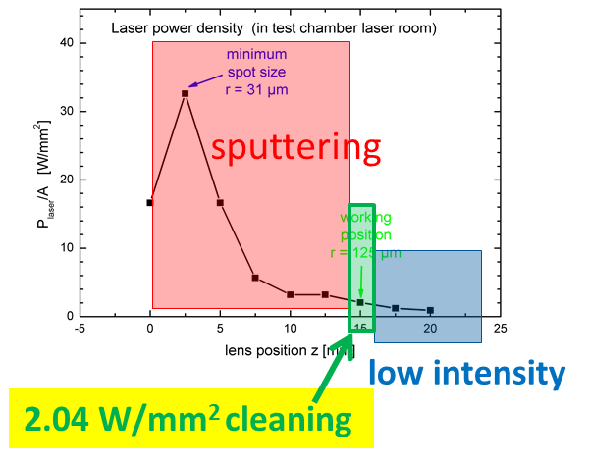
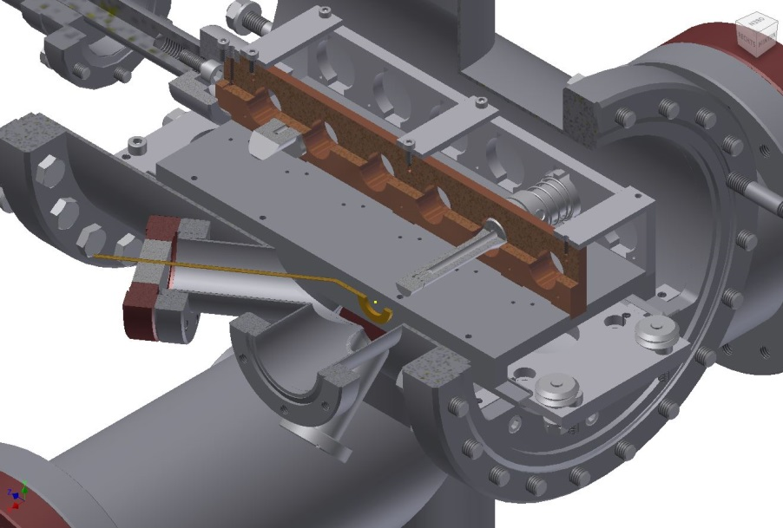
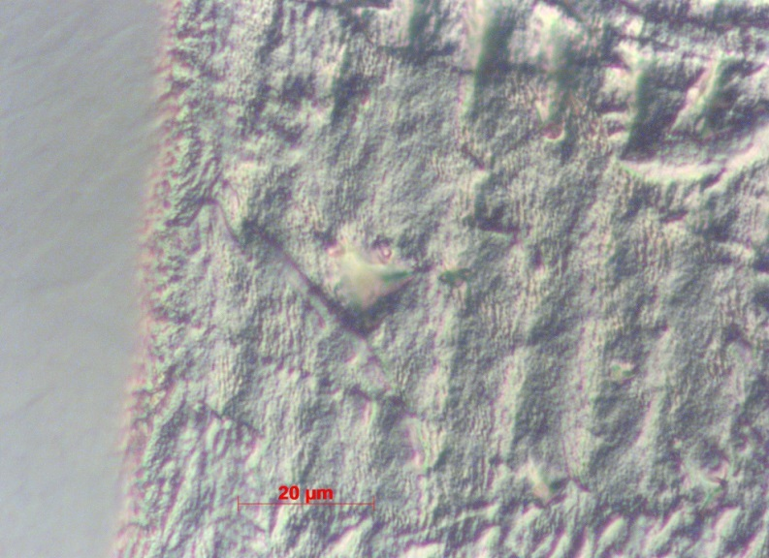
Mg Photocathodes – Laser Cleaning
Laser cleaning set-up at transport chamber at SRF gun
using the UV drive laser (100 mW, 100 kHz CW)
laser ablation
cathode
Anode
virgin
cleaned
window
transport chamber
Notes:
- Transportkammer mit Platz für sechs Photokathoden,
- Quarzglas-Eintrittsfenster für den UV-Laserstrahl,
- HV-Durchführung zur ringförmigen Anode,
- Linse mit f = 250 mm,
- Eintrittsblende,
- Wellenplatte zur einstellbaren Drehung der Polarisationsrichtung,
- Polarisator,
- Fokussierlinse mit f = 200 mm,
- Mikrometertisch zum Positionieren der Fokussierlinse,
- Kippspiegel mit Schrittmotoren,
- Klappspiegel,
- Schneidkanten-Schlitzblende,
- Leistungsmesser

Slide 7
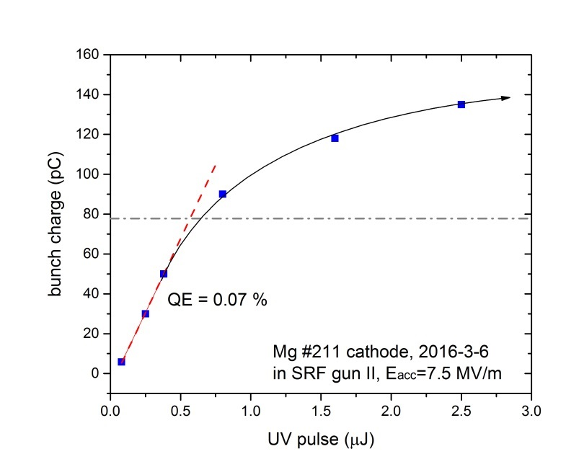
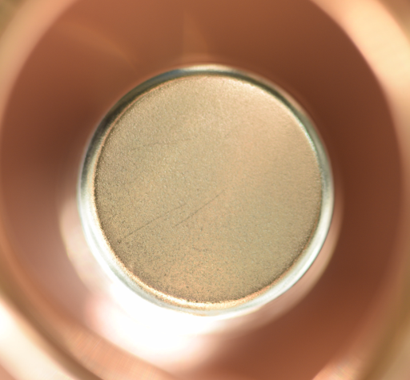
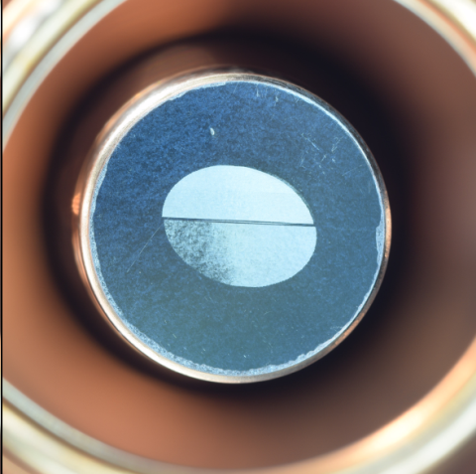
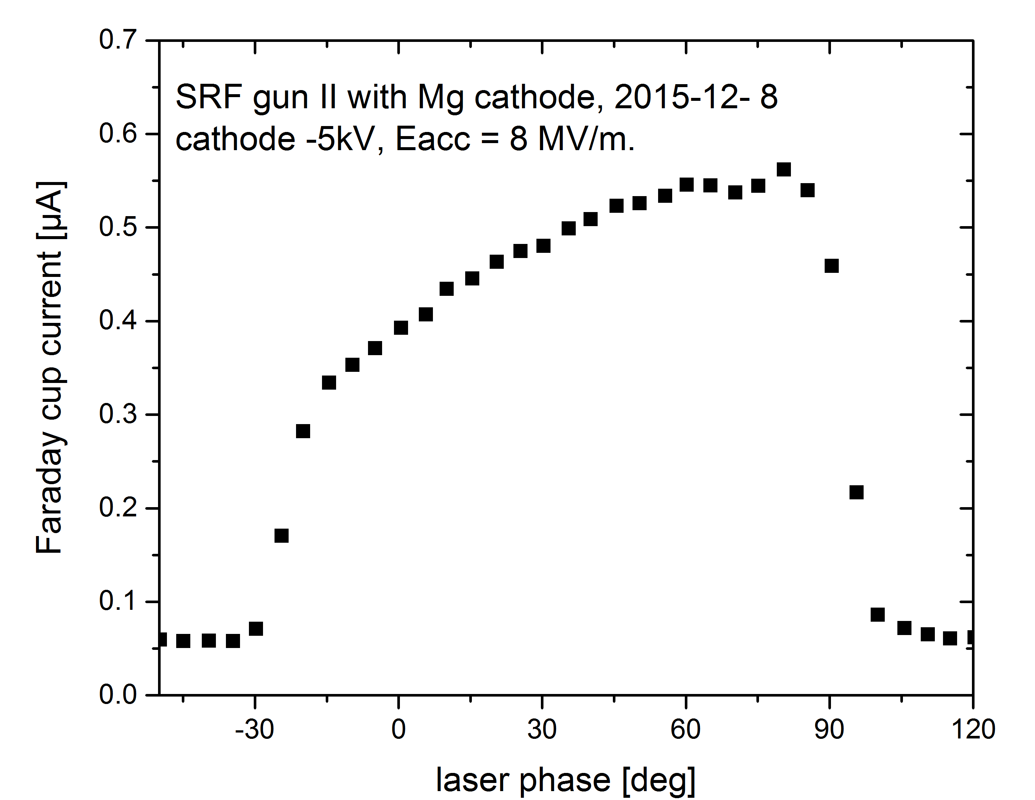
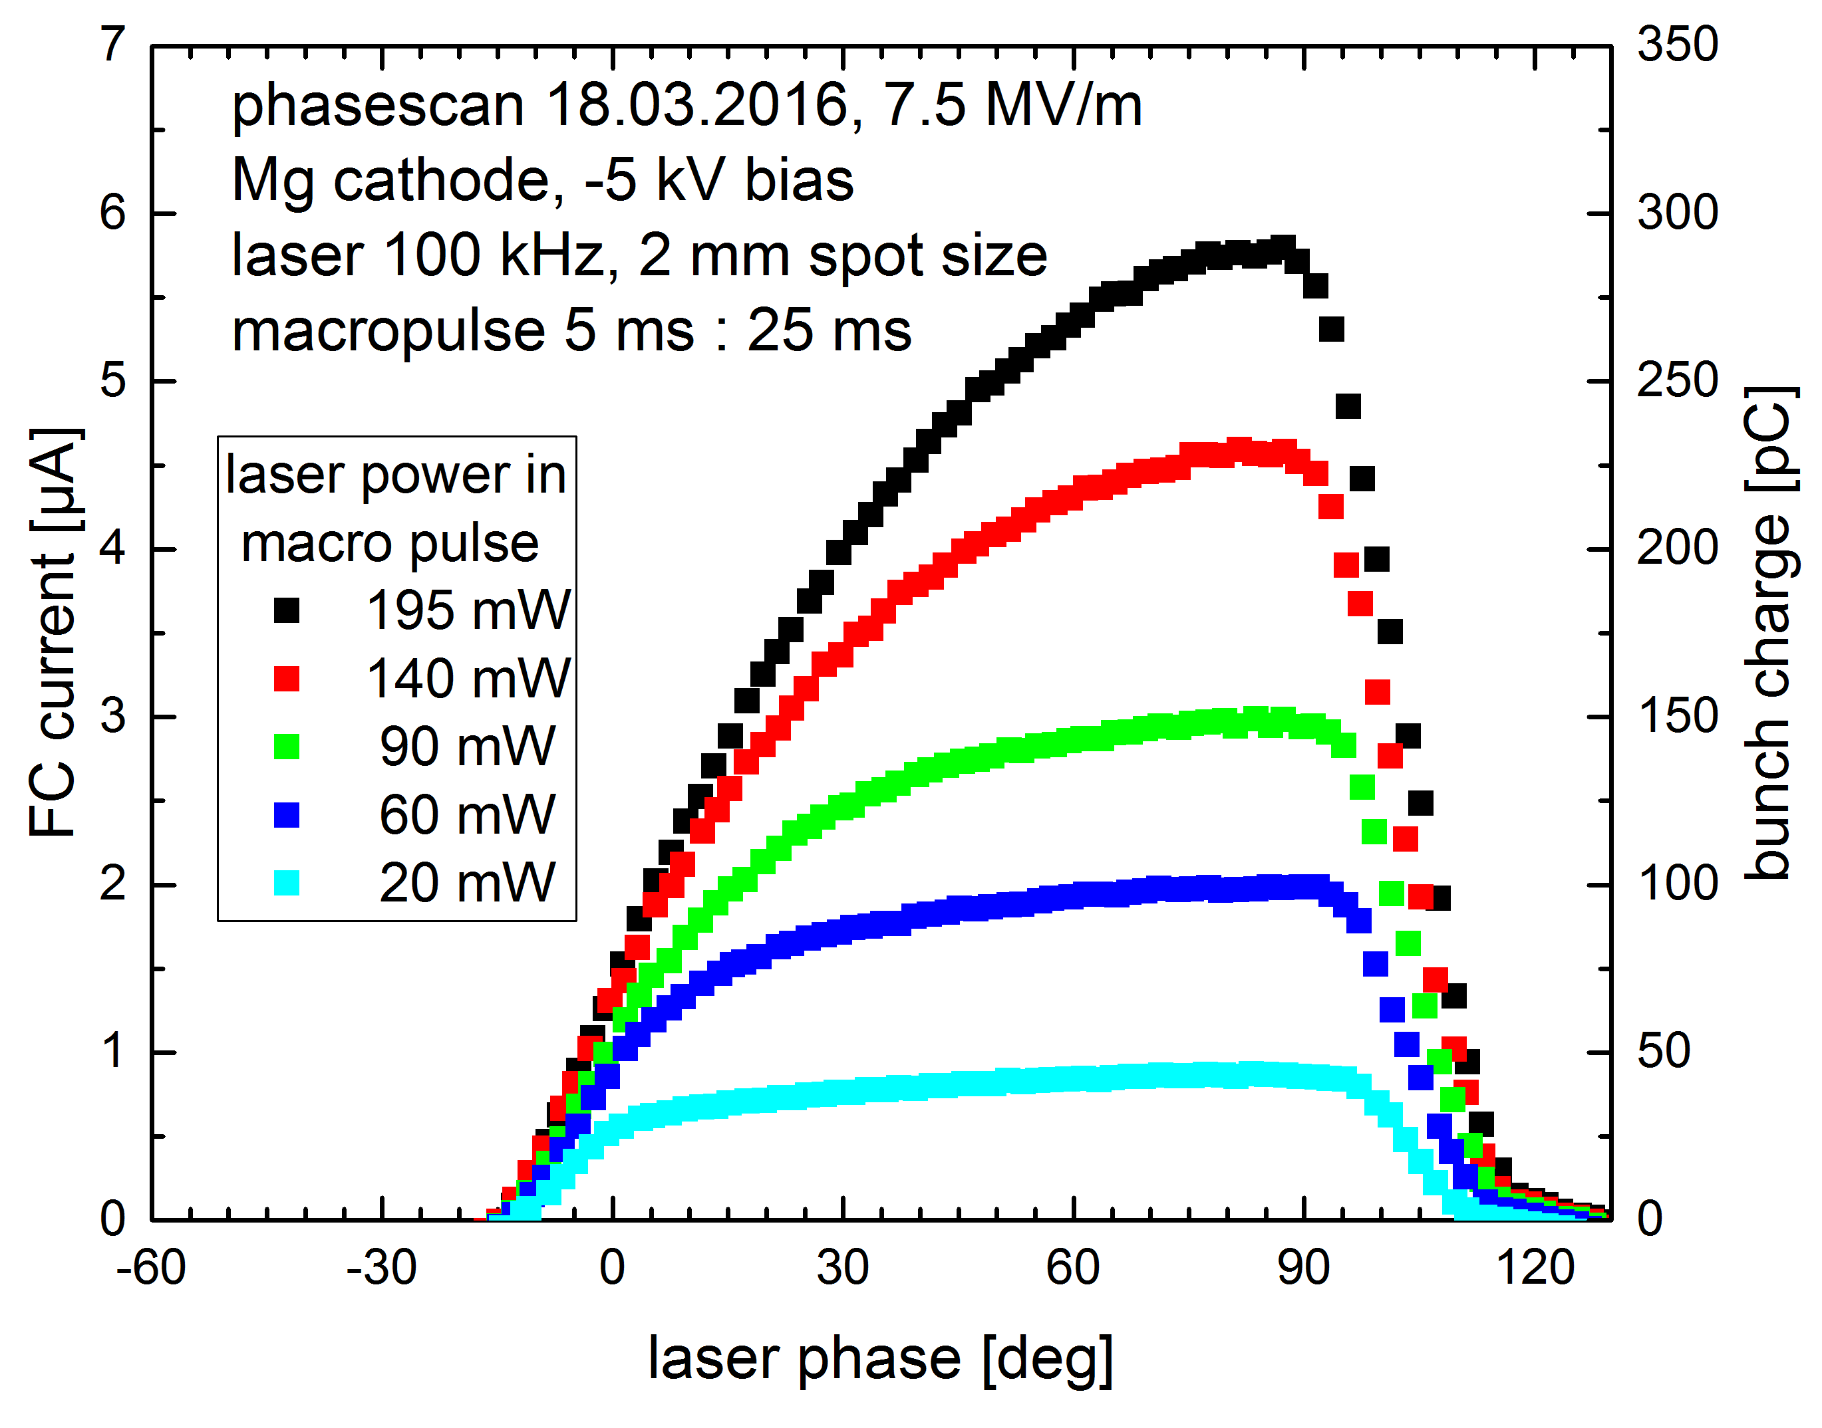
Mg photocathodes - in SRF gun II
Laser phase scan and QE of Mg photo cathode in SRF gun
2015.12.7 Mg ~ 10⁻⁵
2016.03.05 Mg ~ 10⁻³
Schottky effect

Slide 8
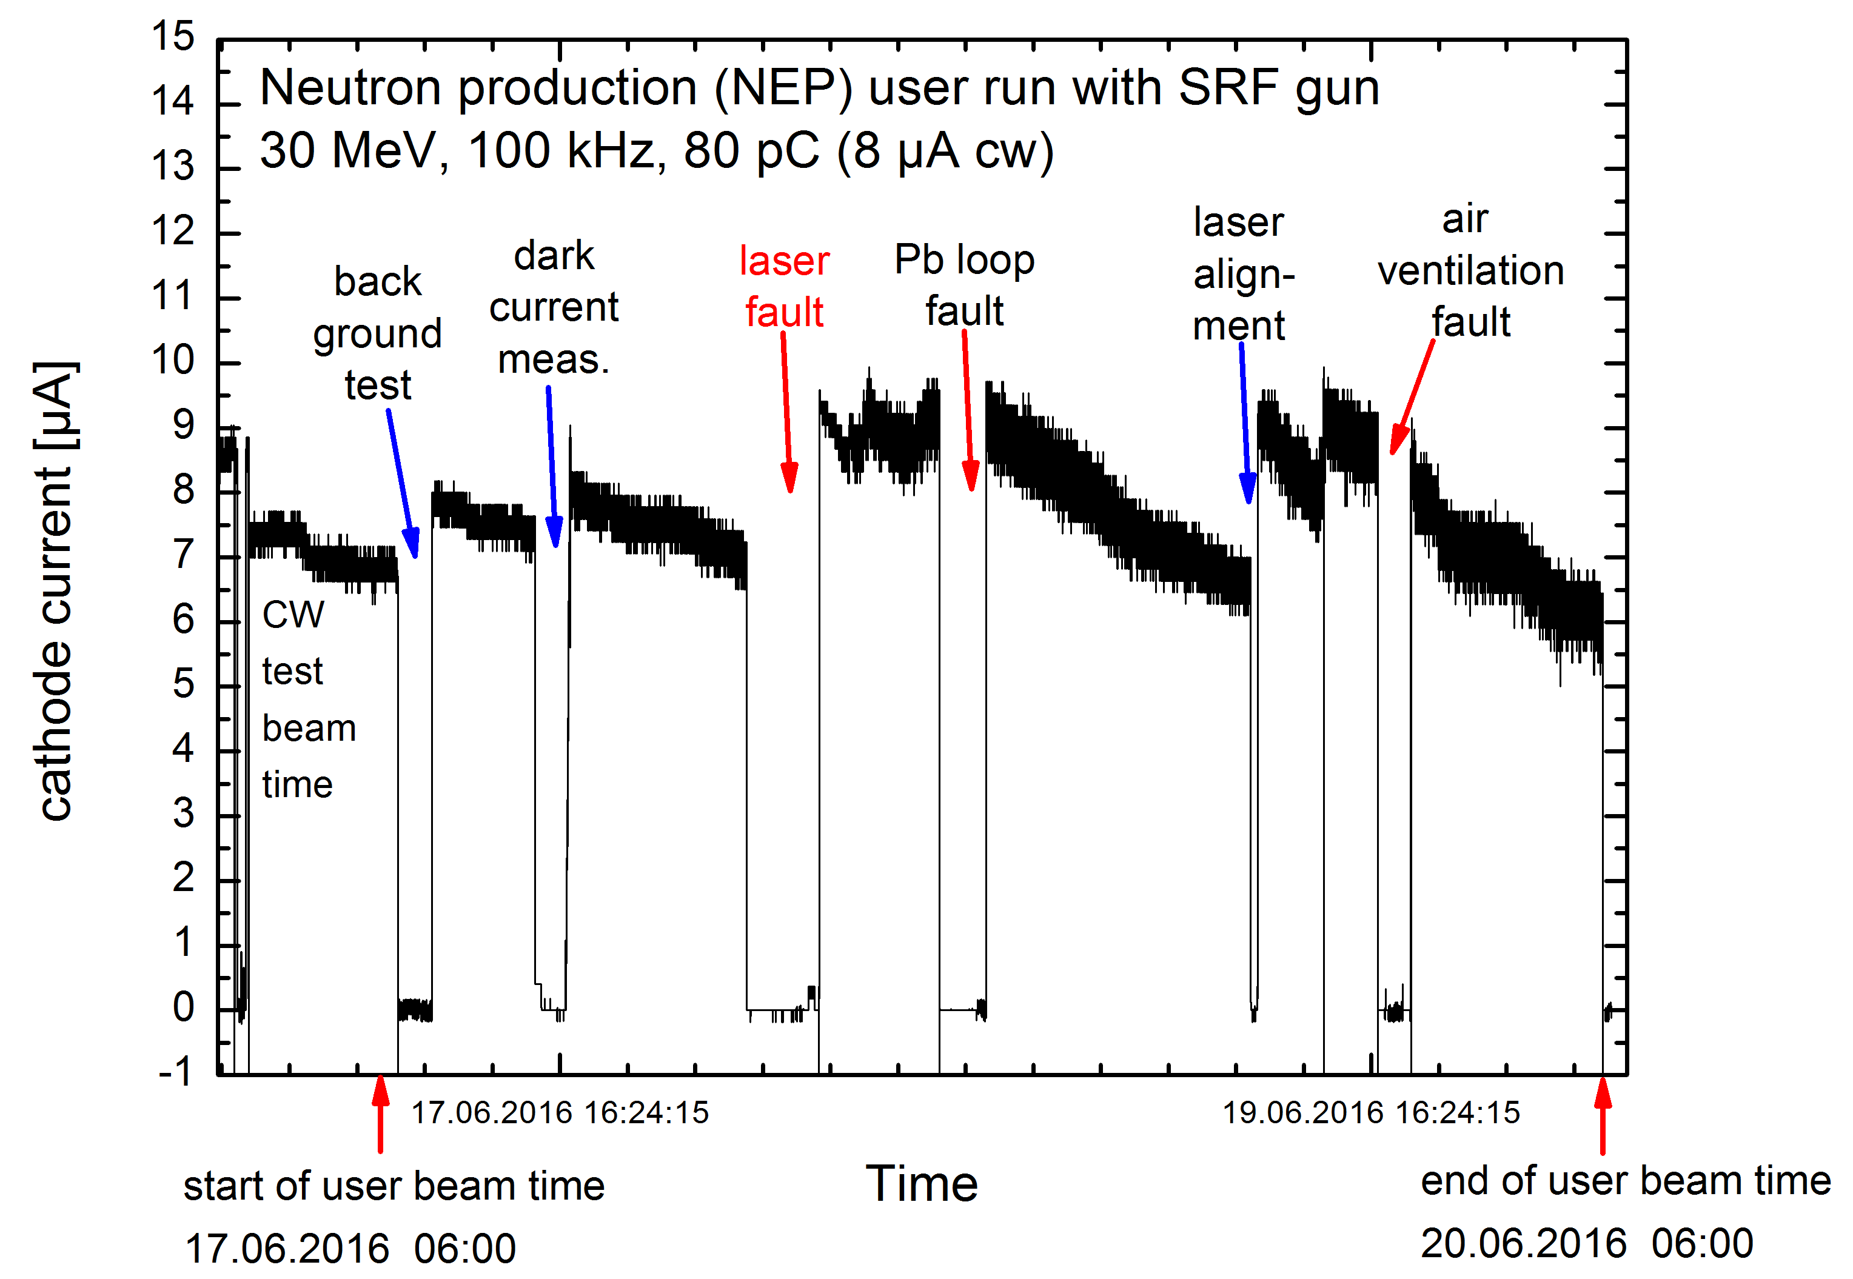
SRF gun for neutron production beam time in ELBE
June 2016: successful 6 x 12 hours user shifts
limited by diagnose mode <10 µA for SRF gun in ELBE

Slide 9
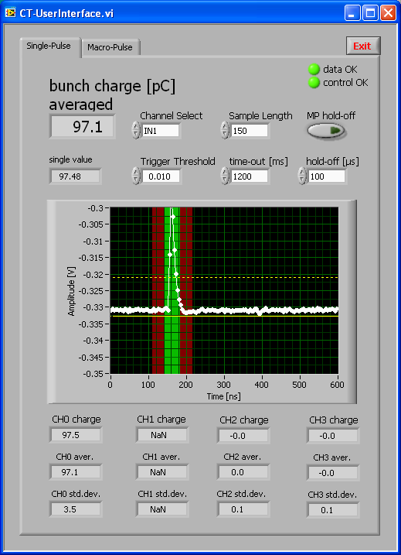
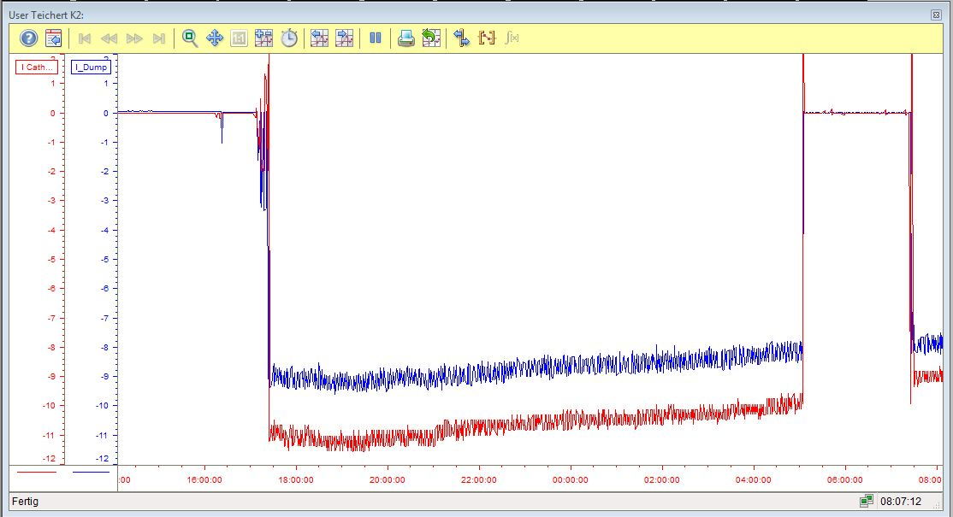
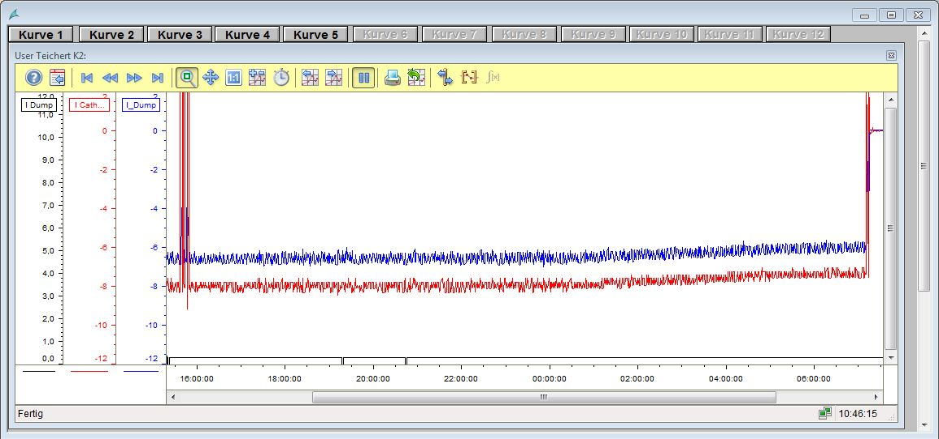
Mg photocathodes - in SRF gun II
Beam for the ELBE accelerator:
several 12h-shifts for user setting preparation, test, and measurement
with 100 kHz CW, 80 -100 pC
ICT in ELBE
w/o laser power stabilization
with laser power stabilization, long-term drifts (< 0.2Hz)
stripe-line BPM -> NI cRIO -> laser polarizer
σ_{rms} = 1.5 %
Mg cathode in gun since March 3rd, 2016, 270 h beam time, no QE decrease

Slide 10
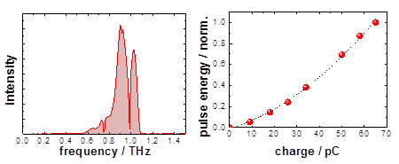
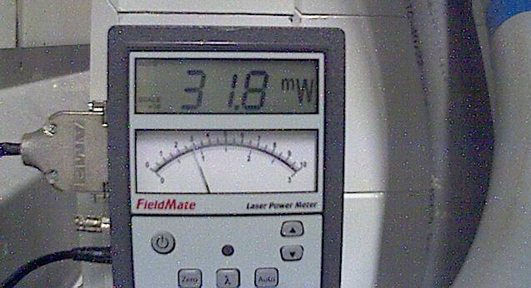
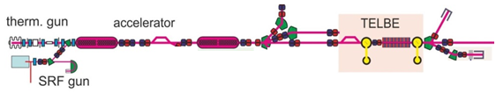
Commissioning of SRF Gun II
4. SRF gun for THz beam time
4 x 12 h user shifts for THz radiation production
80 – 100 pC, E_{kin} = 4 MeV, 100 kHz
10 mW @ 1 THz
32 mW@ 0.5 THz
next: shorter bunches wanted
THz spectrum and charge dependence
first beam 3.12.2016!
ARD-ST3 test facility TELBE
ARD-ST1
MuT /ARD Subtopics ST1 „SRF“ & ST3 „ps-fs“

Slide 11
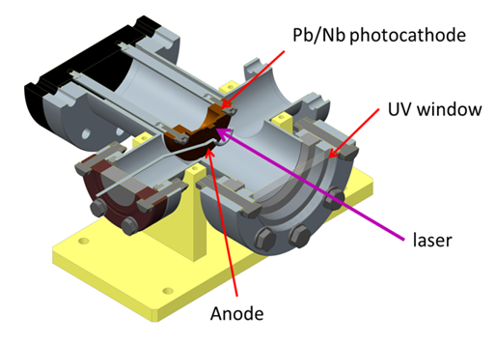
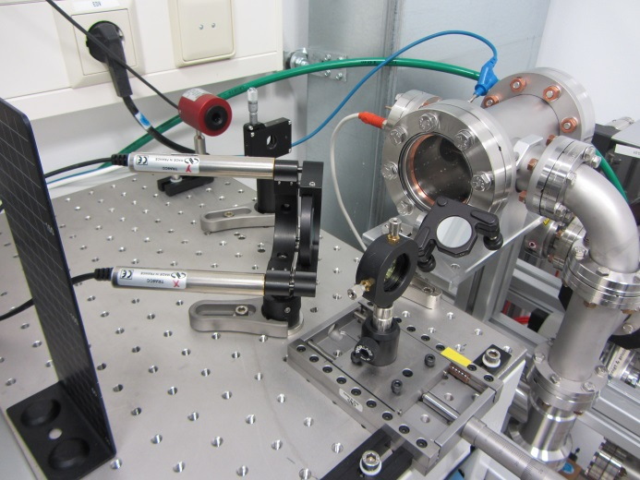
Measurement of Pb/Nb photo cathodes
Test chamber for DESY-type cathodes
Cleaning and irradiation set-up

Slide 12
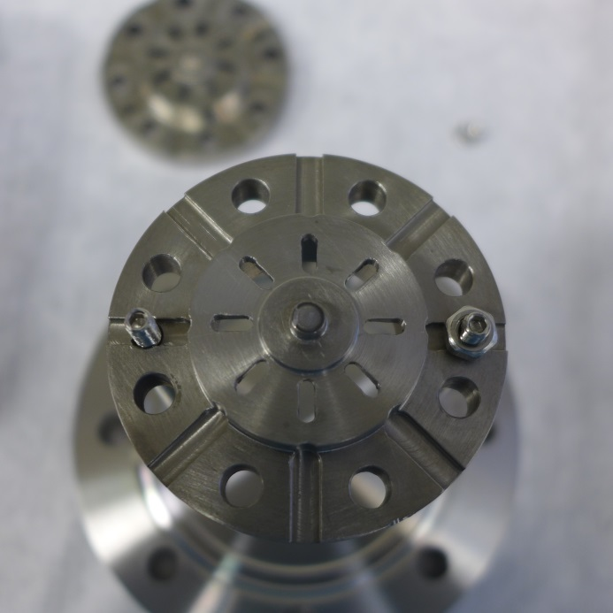
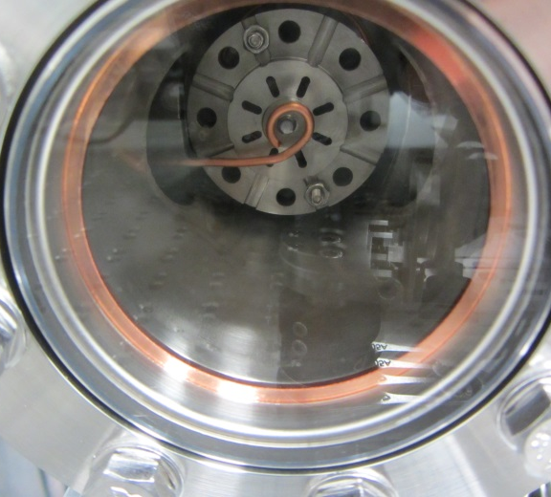
Measurement of Pb/Nb photo cathodes
DESY Pb/Nb photo cathode deposited at NCBJ Swierk

Slide 13
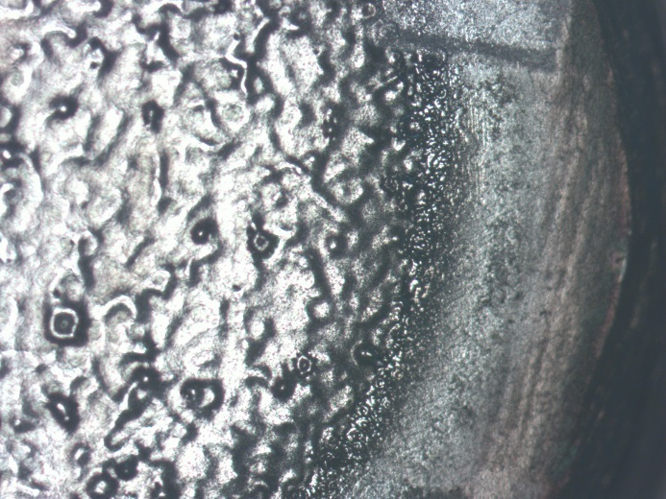
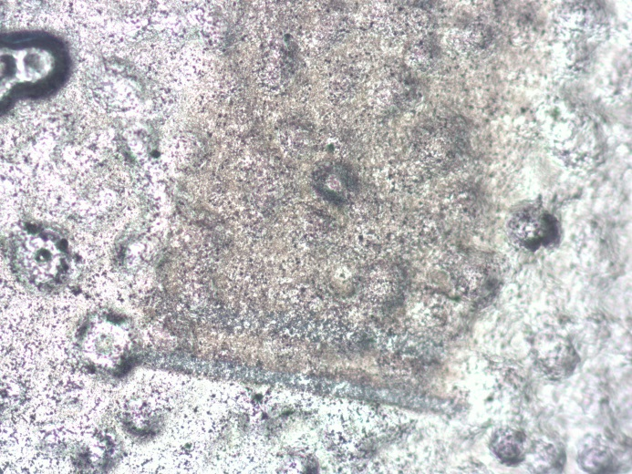
Measurement of Pb/Nb photo cathodes
optical microscope view of
depositedPb layer
laser cleaned test field
parameter | value
Power | 100 mW
Pulse length | 16 ps FWHM
Repetition rate | 100 kHz
Pulse energy | 1 µJ
Spot size (radius) | 125 µm
Power density | 2 W/mm²
Pixel dwell time | 100 ms
Pulse number per pixel | 10 000
Pulse energy density | 20 µJ/mm²
UV laser (263 nm)
parameters for
Pb/Nb cathode
cleaning by scanning
the focused laser spot
across the cathode

Slide 14
Measurement of Pb/Nb photo cathodes
Results for quantum efficiency QE
Sample | Quantum efficiency QE @ 263 nm |  |  | References
 | before cleaning after cleaning
J. Smedley et al. /BNL | - | 3.8 x 10⁻⁴ | [5]
R. Barday et al. /HZB ¹⁾ | 3.6 x 10⁻⁵ | 9.2 x 10⁻⁵ | [11]
HZDR Pb/Nb #1 ²⁾ | 2.0 × 10⁻⁵ | 1.0 x 10⁻⁴ | this report & [17]
HZDR Pb/Nb #2 ²⁾ | 2.7 × 10⁻⁵ | 6.0 × 10⁻⁵ | this report & [17]
DESY Pb/Nb #1 ³⁾ | - | 1.8 x 10⁻⁴ | this report
DESY Pb/Nb #2 ³⁾ | <1 × 10⁻⁵ | 1.7 x 10⁻⁴ | this report
[5] J. Smedley, et al., Physical Review Special Topics - AB 11, 2008, 013502.
[11] R. Barday, et al., Proceedings of IPAC13, Shanghai, China, p. 279
[17] R. Xiang, et al., Proceedings of FEL2014, Basel, Switzerland, p. 836

Slide 15
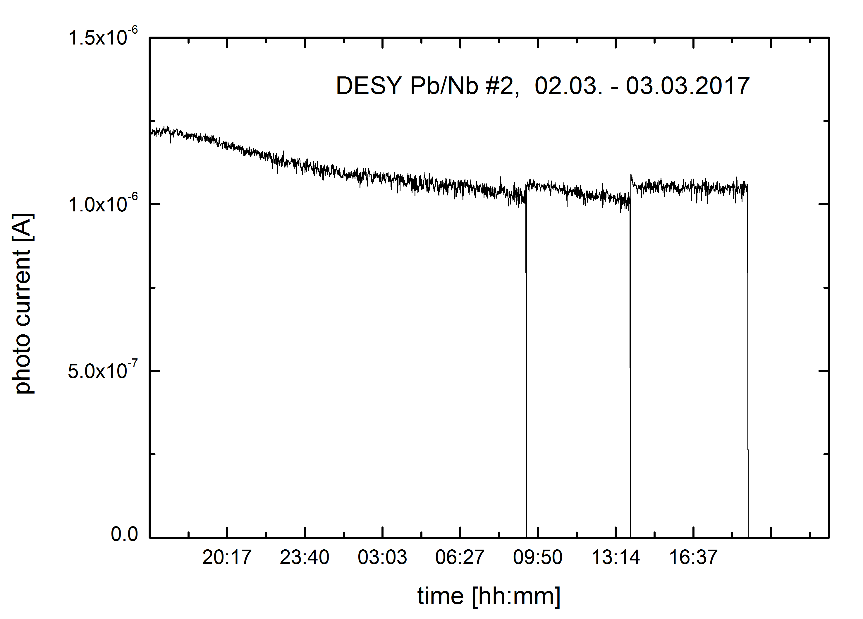
Pb/Nb cathode operational lifetime
long-term testing of Pb/Nb photocathode in test-chamber with UV photo gun laser
laser irradiation
2016: 40 h (report)
2017: 108 h up to now
will be continued

Slide 16
Summary
Normal contacting photo cathodes operate successfully in SC cavities
Photocathode exchange and operation are a high risk for cavity contamination
- careful quality check of cathodes
- improved mechanics to avoid particle production
Metallic photocathodes can easily be used in SC cavity
- Mg can reach high QE of 10⁻³ , suitable for current application < 100 µA
- no multipacting and low dark current ( <10 nA)
- Cs2Te + UV light is still the choice for medium currents (1 mA)
Superconducting Pb/Nb photo cathodes
- SC photo cathodes can be integrated in SC cavity
- successful laser cleaning with standard UV photocathode laser
- long-term operational life-time are ongoing

Slide 17
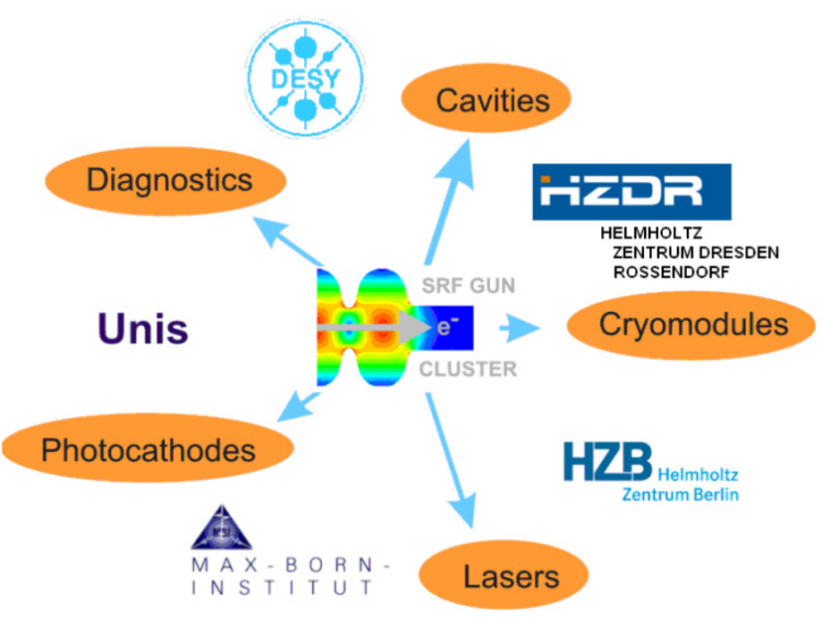



Acknowledgements
Thank you for your attention!
Thanks to the ELBE team
A. Arnold, S. Hartstock, P. Lu, P. Murcek, H. Vennekate, R. Xiang, H. Büttig, M. Freitag, M. Gensch, M. Justus, M. Kuntzsch, U. Lehnert, P. Michel,
C. Schneider, G. Staats, R. Steinbrück,
and our co-workers
P. Kneisel, G. Ciovati JLAB, Newport News, USA
I. Will MBI, Berlin, Germany
T. Kamps, J. Rudolph, M. Schenck, M. Schmeißer, G. Klemz,
J. Voelker, E. Panofski, J. Kühn, HZB, Berlin, Germany
J. Sekutowicz, DESY, Hamburg, Germany
K. Aulenbacher, JGU, Mainz, Germany
R. Nietubyć NCBJ, Świerk/Otwock, Poland
U. van Rienen, Uni Rostock, Germany
We acknowledge the support of the European Community under the FP7 programme since 2009 (EuCARD, EuCARD2, LA3NET) as well as the support of the German Federal Ministry of Education and Research, grants 05 ES4BR1/8 and 05K2012.

Slide 18
ELBE SRF Gun II – Photo cathode history
Type | Time | QE | Q / I_{CW} | Remarks
Cu | June 14 – Feb. 15 | 2x10⁻⁵ | 3 pC / 300 nA | Inserted during clean-room assembly of the gun
Cs₂Te | Feb. 15 | 2 % 0 % |  | strong multipacting & field emission cavity polution
Cu | Mar. 15 – Feb. 16 | 2x10⁻⁵ | 3 pC / 300 nA | high dark current from cavity, no multipacting
Mg (#201) | Mar. 16 – Aug. 16 | 0.2 % | 200 pC / 20 µA | no multipacting, no dark current from Mg, stable (user) operation, no QE decrease
Mg (#207) | Nov. 16 – Dec. 16 | 0.1 % | 80 pC / 8 µA | no multipacting, no dark current from Mg, stable (user) operation, no QE decrease
Cs₂Te | Feb. 17 | 1.7 % | 300 pC / 30 µA | no multipacting, no dark current from cathode, QE drop down
Mg (#207) | Mar. 17 – April 17 | 0.2 % |  | Not yet tested
Cs₂Te | May 17 ->

