Slide 1
WP12 Management Report
& EuCARD-2 Updates
Peter.mcintosh@stfc.ac.uk
Nicoleta.baboi@desy.de
Juliette.plouin@cea.fr
14 - 15th March 2017
WP12 4th (and final) Annual Review Meeting, NCBJ, Poland

Slide 2

Outline
Status of the Project
Milestones and Deliverables
Publications
  Accreditation
Monographs
Accelerating News
3rd Periodic Report
Annual Review Meeting
Other H2020 Activities:
  ARIES and AMICI
Our meeting this week @ NCBJ
#Eucard2

Slide 3

We are now only 49 days to the end of the EuCARD-2 project!

Slide 4
Contractual obligations (required to receive the final funding)
Upload on the EC web portal the remaining deliverables by 30 June 2017 (2 months after end).
  No need to write long reports (10-20 pages is enough), but should keep a good scientific standard.
Complete the 3rd Periodic Report covering the final year – 12 months – by end of M48 (April).
Complete and upload by 30 June 2017 the Final Project Report: a summary of all activities during the project, a summary of what reported in Intermediate Reports 1 (M18), 2 (M36) and 3 (M48).
Complete (by 30 June) all Financial Reports.

Slide 5
WP12 Milestones
Milestone | Title | Beneficiary | Date | Comments
MS87 | Fundamental SRF Thin Film physics report | CEA | M48 | Final Activity Report
MS84 | Deposition test facility designed at CEA. | CEA | M40 | Facility designed and validated (Merge with D12.10)
MS78 | Characterisation test facility implemented at HZB | HZB | M30 | Facility implemented and validated
MS88 | Report summarising the results obtained in characterising the various new thin film technologies developed, which include both multilayer and monolayer techniques | CEA | M48 | Final Activity Report
MS81 | RF design CLIC_DDS_B (Scope change agreed) | UNIMAN | M36 – Delayed to M48 | Activity Report
MS86 | RF design of fully interleaved structure and CLIC SW study. | UNIMAN | M45 | Activity Report
MS76 | 1D-2D Code Benchmarking for a High Efficiency Klystron | CEA | M24 | Activity Report
MS74 | Design concept RF front end | PSI | M12 | Activity Report
MS77 | Phase stabilisation experiment design | ULANC | M24 | Activity Report
MS79 | Crab cavity electromagnetic design | ULANC | M30 | Activity Report
MS82 | Completed coupled cavity simulations of 8-cavity module | UNIMAN | M36 | Activity Report (Merged with D12.7)
MS80 | Demonstrated operation of improved deposition system, Pb layers of 1 μm in thickness. | NCBJ | M30 | Report on sample characterisation
MS73 | Commissioning of the SAPI for operation with metal photocathodes | STFC | M8 | Publication report
MS75 | Investigation of quantum yield and energy spectrum of the electrons, emitted from the metal photocathode surface in SAPI | STFC | M18 | Intermediate scientific report
MS83 | Manufacturing and commissioning of the photocathode transport system | STFC | M36 | Technical design report
MS85 | Investigation of the brightness of different metal photocathodes in a S-band NCRF gun | STFC | M42 – Delayed to M48 | Scientific report
Task 12.2
Task 12.3
Task 12.4
Task 12.5

Slide 6
WP12 Deliverables
Deliverable | Title | Beneficiary | Date | Comments
D12.1 | Deposition test facilities implemented and verified at CERN and INPG. | CERN | M18 | Report
D12.5 | First resonator deposited and qualified at CERN. | CERN | M40 | Report
D12.10 | Cavity deposited and qualified at CEA. | CEA | M48 | Report
D12.2 | Initial progress report of task 12.3. | CERN | M18 | Report
D12.6 | Intermediate progress report of task 12.3. | CERN | M36 | Report
D12.11 | Final report of task 12.3. | CERN | M48 | Report
D12.3 | Design of electronics for XFEL HOM diagnostics. | DESY | M18 | Report
D12.7 | Completed characterisation of HOMs in the 8-cavity XFEL 3HC module. | UNIMAN | M36 | Report
D12.12 | Report on characterisation of HOMs in XFEL coupled 3HC cryomodule. | UNIMAN | M48 | Report
D12.4 | Scientific report on photocathode R&D. | STFC | M18 | Report
D12.8 | Optimised procedure for preparation of flat, clean and adherent Pb/Nb films. (Scope change agreed) | NCBJ | M36 | Report
D12.9 | Pb/Nb plug photocathodes measurements and characterization. | HZDR | M42 | Report
D12.13 | Results of DAC implementation in SRF guns. | HZB | M48 | Report (Under review)
Task 12.2
Task 12.3
Task 12.4
Task 12.5

Slide 7
Publication Accreditation
Still too many papers do not acknowledge EuCARD-2!
Long version:
"The research leading to these results has received funding
from the European Commission under the FP7 Research
Infrastructures project EuCARD-2, grant agreement no.312453"
Short version:
"The work is part of EuCARD-2, partly funded by the European
Commission, GA 312453.“
Important for upcoming conferences:
  IPAC17, Copenhagen, 14 – 19 May 2017
  SRF2017, Lanzhou, 17 – 21 July 2017

Slide 8
WP12 Publications (29)
Task | Author | Title | Publication | Accreditation
12.2 | C.B. Baumier et al | Multilayers Activities at Saclay/Orsay | SRF2013
12.2 | G. Terenziani et al | Nb coating developments with HIPIMS for SRF applications, SRF2013 Proceedings | SRF2013
12.2 | F. Weiss et al | Chemical vapor deposition techniques for the multilayer coating of superconducting RF cavities | SRF2013
12.2 | F. Mercer et al | Niobium Nitride Thin Films deposited by High Temperature Chemical Vapor Deposition, Journal of Surface and Coatings Technology | 10.1016/j.surfcoat.2014.08.084.
12.2 | N. Katzan et al | Characterization of Thin Films Using Local Magneometer | SRF2015
12.2 | S. Kechert et al | Optimizing a Calorimetry Chamber for the RF Characterization of Superconductors | MSc Thesis, Universität Siegen, 2015
12.2 | S. Kechert et al | Design and First Measurements of an Alternative Calorimetry Chamber for the HZB Quadrupole Resonator | SRF2015
12.2 | G. Rosaz et al | Biased HiPIMS technology for superconducting rf accelerating cavities coating | HIPIMS 2015 | EuCARD
12.2 | G. Rosaz et al | Development of Nb3Sn coatings by magnetron sputtering for SRF cavities | SRF2015
12.3 | M Dehler et al | Wake field monitors in a multi purpose X Band accelerating structure | IBIC2013
12.3 | G. Burt et al | Bead-Pull Measurement Method and Tuning of a Prototype CLIC Crab Cavity | Linac14
12.3 | B. Woolley et al | High Gradient Testing of an X-band Crab Cavity at XBox2 | IPAC15
12.4 | L Shi et al | Stability and resolution studies of HOMBPMs for the 1.3 GHz superconducting accelerating cavities at FLASH | La3Net15
12.4 | J Heller et al | Computational benefits using an advanced concatenation scheme based on reduced order models for RF structures | HOMSC14 | Yes, but not correct accreditation
12.4 | T Galek et al | Analysis of Higher Order Modes in Large Superconducting Radio Frequency Accelerating Structures | ICEAA15 | Yes, but not correct accreditation
12.4 | J Heller et al | Uncertainty Quantification for Complex RF-structures Using the State-space Concatenation Approach | PIERS15 | Yes, but not correct accreditation
12.4 | T Flisgen et al | Scattering Parameters of the 3.9 GHz Accelerating Module in a Free-Electron Laser Linac: A Rigorous Comparison Between Simulations and Measurements | Phys. Rev. ST Accel. Beams 17, 022003.
12.4 | T. Flisgen et al | Time-Domain Absorbing Boundary Terminations for Waveguide Ports Based on State-Space Models | IEEE Transactions on Magnetics, 50 (2). | EuCARD
12.4 | N. Baboi et al | Commissioning of the Electronics for HOM-based Beam Diagnostics at the 3.9 GHz Accelerating Module at FLASH | IBIC2014 | ☺
12.4 | L. Shi et al | Stability Study of the Higher Order Mode Beam Position Monitors at the Accelerating Cavities at FLASH | IBIC2014
12.4 | T. Wamsat et al | First Tests of a uTCA-Based Downconverter Electronic for 5GHz Higher Order Modes in Third Harmonic Accelerating Cavities at XFEL | IBIC2014
12.4 | J. Heller et al | Quantification of Geometric Uncertainties in Single Cell Cavities for BESSY VSR Using Polynomial Chaos | IPAC14 | EuCARD
12.4 | T. Flisgen et al | Computation of Eigenmodes in Long and Complex Accelerating Structures by Means of Concatenation strategies | IPAC14
12.4 | T. Flisgen et al | Computation of External Quality Factors for RF Structures by Means of Model Order Reduction and a Perturbation Approach | Conf. Computetion and Mangentic Fields, 2015
12.4 | S. Liangliang et al | Stability and Resolution Studies of HOMBPMs for the 1.3 GHz Superconducting Accelerating Cavities at FLASH | LA3NET 2015
12.5 | R. Barday et al | Characterization of a Superconducting Pb Photocathode in a Superconducting RF Photoinjector Cavity | Phys. Rev. ST Accel. Beams 16, 123402.
12.5 | R. Kleindienst et al | Development of an optimized quadrupole resonator at HZB | SRF2013 | ☺
12.5 | R. Nietubyć et al | Recent development in optimization of superconducting thin film lead photocathodes at NCBJ in Świerk | Proc. SPIE Vol. 8903 89032B | ??
12.5 | J. Lorkiewicz et al | Deposition and optimization of thin lead layers for superconducting accelerator photocathodes | Phys. Scr. 2014 014071 | EuCARD
We are only ~50% successful overall, 80% successful in last year!
Need 100% accreditation of EuCARD-2 in final year!
All publications stored on CERN CDS: http://cds.cern.ch/collection/EuCARD-2

Slide 9




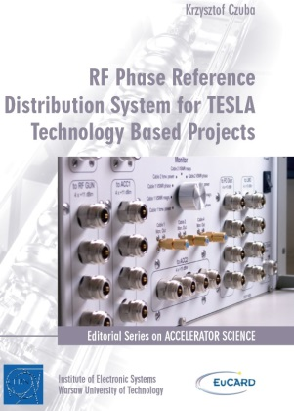
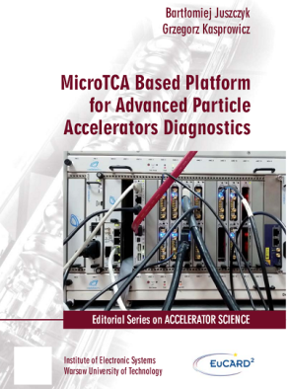





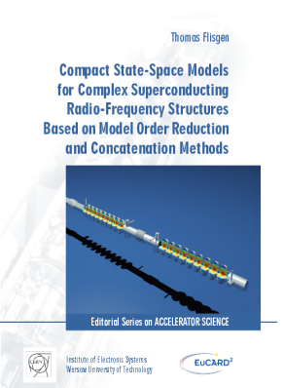
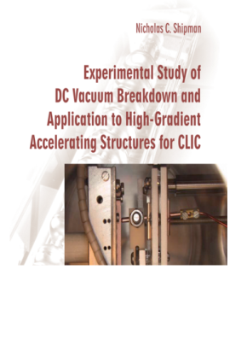
Monographs
11 RF activities published in EuCARD:
11 RF activities published in EuCARD:
We have 2 so far in EuCARD-2, with another 1 - 2 anticipated:
CLIC Crab Cavity
Ben Woolley
SRF Thin Film Characterisation
Sebastian Kechert
Additional WP12 Topics?!?!?
Who else are we expecting to
graduate in the next year?

Slide 10
Schedule for final reporting
Periodic Report 3
February - March 2017: writing (by Task Leaders).
30 March: deadline for sending WP chapters for Periodic Report 3.
15 April : draft of Periodic Report 3 ready for comments.
30 April: final version of PR3 submitted to EC web portal.
Final Report
15 May: deadline for sending contributions for Final Report.
31 May: complete draft of Final Report ready for comments.
30 June: final version of Final Report submitted to EC web portal.

Slide 11
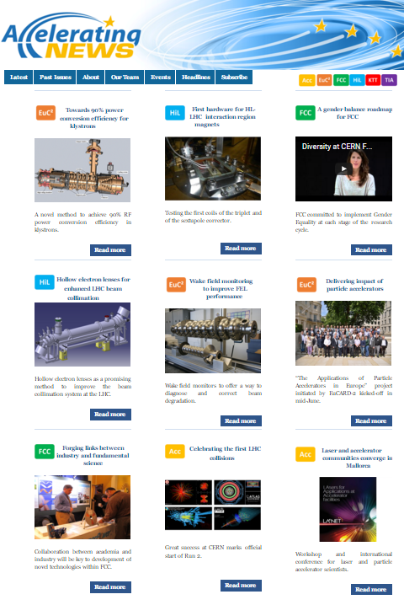
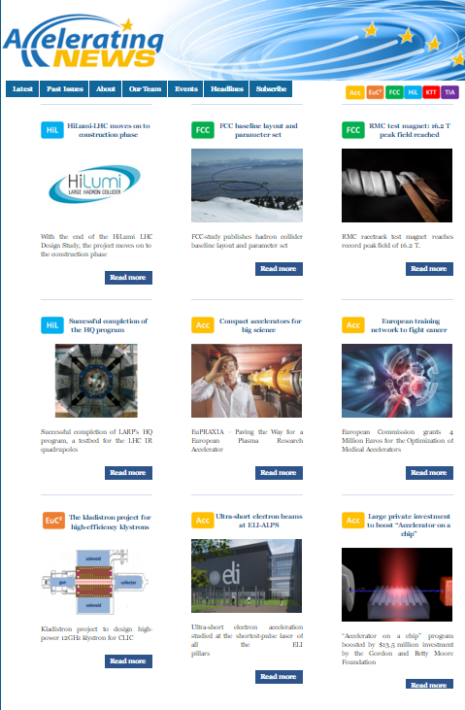
Accelerating News
www.acceleratingnews.eu
Issue 14 published (Jun 15):
  Wake field monitoring to improve FEL performance (WP12 – M Dehler PSI)
Issue 15 published (Nov 15):
  The kladistron project for high-efficiency klystrons (WP12 – J Plouin CEA)
None in 2016!
Future contributions for WP12:
  Final WP12 Annual Meeting, P McIntosh
  WP12 suggestions?
    SRF thin film tests
    Crab cavity tests
    3.9GHz SRF HOM system for XFEL
    Pb photocathodes
    DAC photocathodes
Next issues: March, June, September, even December.
Task 12.2 Performance breakthrough for SRF thin film, utilising multi-layer, high Tc technologies.
Task 12.3 Breakdown free performance capability demonstrated for >100MV/m NC RF structures.
Task 12.4 High performance beam position diagnostic demonstrated for XFEL.
Task 12.5 High performance (intensity, emittance) photocathodes demonstrated for SRF and NC applications.

Slide 12

EuCARD-2 4th Annual Review
28-30 March 2017 @ Strathclyde University, Glasgow
Encourage all WP12 collaborators to attend:
  https://indico.cern.ch/event/489475
On Wednesday 29th March:
  WP12 Report by P McIntosh.
  WP12 Highlight talks on:
    Beyond Niobium SRF materials: thin films and new superconductors, by C Antoine (CEA)
    Numerical Simulations for Complex Superconducting RF Structures, by T Flisgen (UROS)

Slide 13

ARIES Roadmap
ARIES - Accelerator Research and Innovation for European Science and Society
Project start 1st May 2017, duration 4 years.
Budget of 10 M€ (for established communities and advanced topics).
Integrating Activity
To open up key national and regional research infrastructures to all European researchers and to ensure their optimal use and joint development:
  Networking
  Transnational/Virtual Access
  Joint Research Activities for the improvement of RI services
Emphasis on Management Efficiency, Innovation Capacity (technology transfer, participation of SMEs, instrumentation development), international dimension, management of generated data …
Kick-off meeting scheduled for 4 – 5th May 2017 at CERN
https://indico.cern.ch/event/616743/

Slide 14
ARIES Integration
Lepton machines
Hadron machines
Plasmas
Societal applications
Education
NA
RULE
AC-DC
EuroNNAC
Energy
Diagnostics and Instrumentation
Applications
Beam
Plasmas
Materials
TA
RF
Follow-on from
WP12
Magnets
SC thin films
VHG techn.
Materials
JRA
Innovation

Slide 15
ARIES Highlights
Project budget: 23.8 M€, requested EU contribution 10 M€, funding rate 42% (i.e. 58% matching funds from partners). Share of EC contribution: 38% NA, 23% TA, 39.0% JRA.
WP coordinators: 6 from CERN, 4 from UK, 4 from Germany, 3 from France, 1 from Switzerland, 1 from Sweden. 4 female (21%).
Expanded Transnational Access: cluster of 14 Test Facilities in European Laboratories and Universities used for Accelerator R&D where access is provided under the new project (only 3 in EC2).
Portfolio of 22 key accelerator technologies to be developed within the project (after consultation of the community and in agreement with ESGARD). 3 to be developed in industry, 3 in collaboration with industry.
Strong innovation JRA with industries and one industrial association, continued and more focused activity on applications and energy efficiency.
Improved links with synchrotron light sources and ESS.
New task on “sustainability of accelerator research” and new Network on “Education, training and outreach”
Enlarged consortium: 42 beneficiaries from 18 European countries (+ CERN and ESS). In EC2, 40 beneficiaries from 12 countries.
New in accelerator IA’s: Portugal, Hungary, Latvia, Romania, Slovenia, Slovakia.

Slide 16

AMICI, ‘qu’est-ce-que c’est ?’
AMICI, for ‘Accelerator and Magnet Infrastructure for Cooperation and Innovation’, is an H2020 European ‘Coordination and Support Action’ project.
Aims at coordinating and supporting the Technological Infrastructure dedicated to the design, construction and validation of accelerators and large superconducting magnets, in European laboratories and industries.
Propose a model for the long term profitability and sustainability of the Accelerator and Magnet Technological Infrastructure in Europe, based on the engagement of the European Commission, the National Agencies and Industry, serving innovation and scientific research.
2.5 year programme, 2.3M€ secured from EC, started in Jan17.

Slide 17










AMICI Consortium

Slide 18
AMICI Activities
In addition to taking up the construction and ensuring the success of future Research Insfrastructures worldwide, Accelerator and Magnet T-Infrastructure could host the following actions:
  Research and Development of key technology prototypes
  Development of innovative products for society
  Test and verification of industrial products
  Professional training and apprenticeship
  Certification studies and training (e.g. vacuum, cleanliness, welding,…)
  Harmonisation and standardization studies (e.g. cryogenics, material, …)
Together, the assessment of these actions fit in two AMICI Work Packages:
  WP4 : ‘Innovation’, for Industry’s benefit
  WP5 : ‘Industrialization’, for Science’s benefit

Slide 19
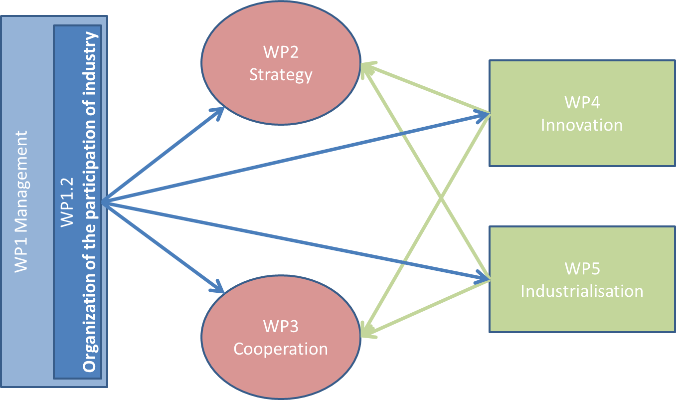
AMICI Framework
To optimize the future impact of these actions, i.e. matched to the needs of Society and Science applications, and their collaborative implementation, AMICI will assess their prevailing strategic elements will explore new and hopefully more efficient modes of cooperation, in the two Work Packages:
  WP2 : ‘Strategy’
  WP3 : ‘Cooperation’
WP1 ‘Management’ will ensure the overall coordination of the project, including the capital question the Industry participation.

Slide 20
WP12 3rd Annual Review
Speakers please ensure all talks are uploaded prior to session starting!

Slide 21
WP12 Annual Review
Organisation:
Review hosted at: https://indico.cern.ch/event/605923/
Group photograph during afternoon coffee break today at 15:15.
Visit to the Neon Muzeum at 17:45 today.
Review dinner this evening at ‘Warszawa Wschodnia Restaurant’ at 19:00 today.
NCBJ facilities tour tomorrow: 11:00 – 12:30.
Celebratory cake tomorrow at 15:00.
Many thanks:
To the NCBJ organising team and in particular Robert Nietubyc and Valerie Brunner (CERN).
To all WP12 task leaders.
Looking forward to a successful 4th (and final) WP12 review!

Slide 22

Follow Meeting on Twitter
#Eucard2
#ASTeC

