Slide 1
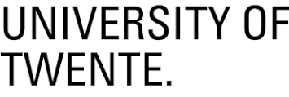



Matthias Mentink
Education / Job experience
Bachelor of Science (2003-2007) and Master of Science (2007-2009) in Applied Physics, University of Twente, Netherlands
PhD research (2009-2014) ‘An Experimental and Computational Study of Strain Sensitivity in Superconducting Nb₃Sn’, degree awarded Cum Laude by University of Twente in collaboration with Lawrence Berkeley National Laboratory and UC Berkeley
Senior research fellow at CERN (2014-2016), mainly working on conceptual designs of detector magnets for FCC-hh
Relevant experience
Supervision of 8 students, including 1 PhD student (joint supervision)
10 first author publications (Accepted + pending)
Presented at about 20 conferences
Participated in SBIR coordination effort at Department of Energy
Technical editor for IEEE Trans. on Appl. Supercond.
Recipient of IEEE CSC award, ESAS award for young researchers, SNF best preprint award

Slide 2
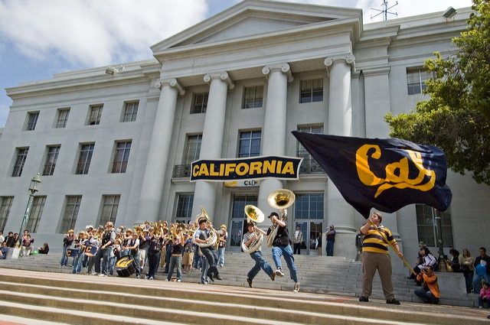
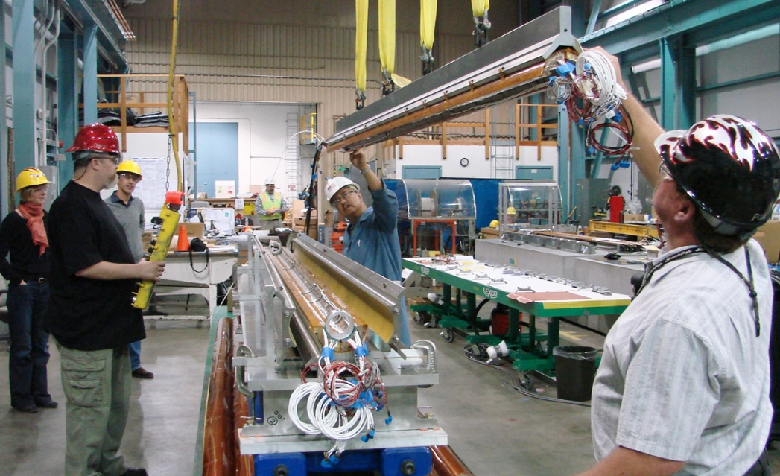
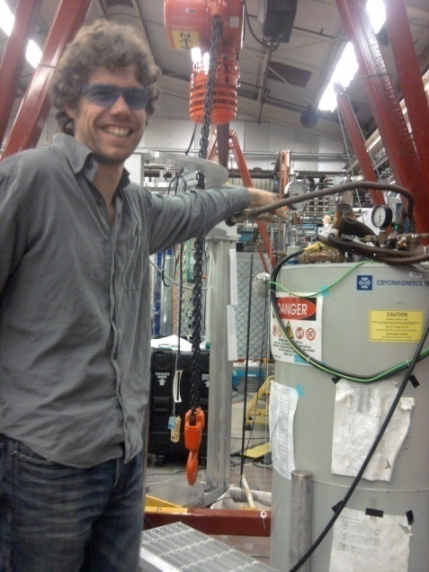
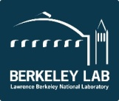
PhD research: Strain sensitivity of superconducting Nb₃Sn
University of California, Berkeley
Lawrence Berkeley National Laboratory
Research at Lawrence Berkeley National Laboratory in Berkeley, California
Collaboration between University of Twente, UC Berkeley, Lawrence Berkeley National Laboratory
Investigation of how strain affects the superconducting properties of Nb₃Sn
Experimental research: Fabrication of Nb₃Sn thin film samples, low-temperature measurements of superconducting properties, characterization using SEM/EDX, XRD, etc
Ab-initio calculations + microscopic theory

Slide 3
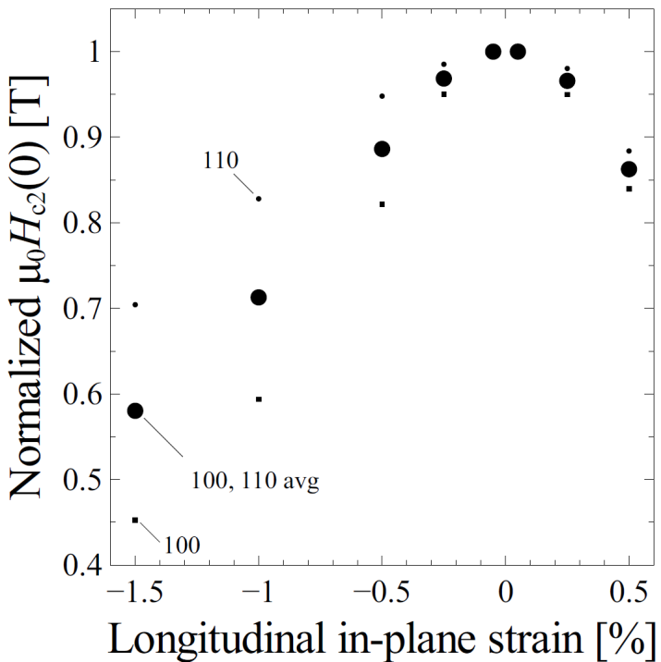
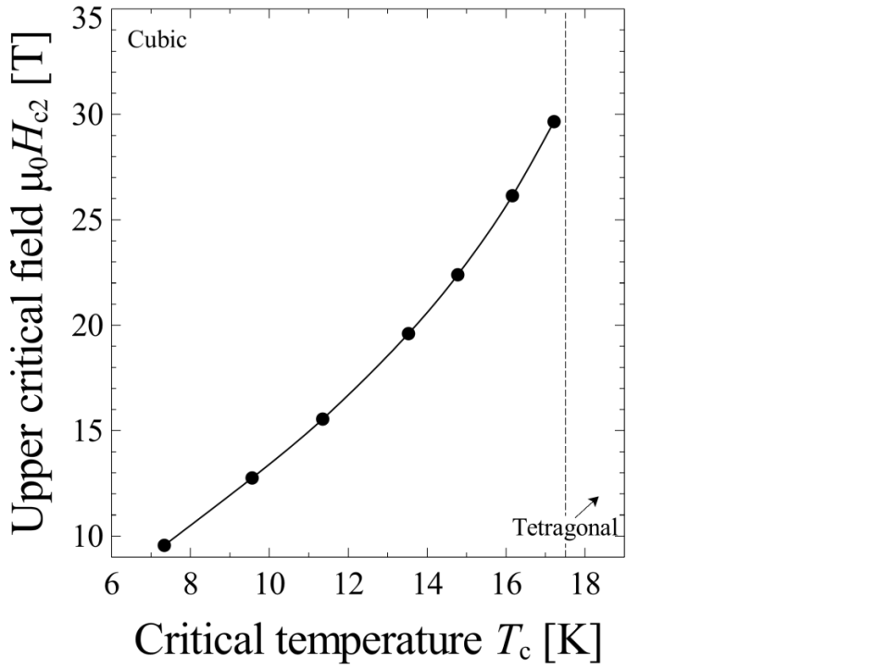
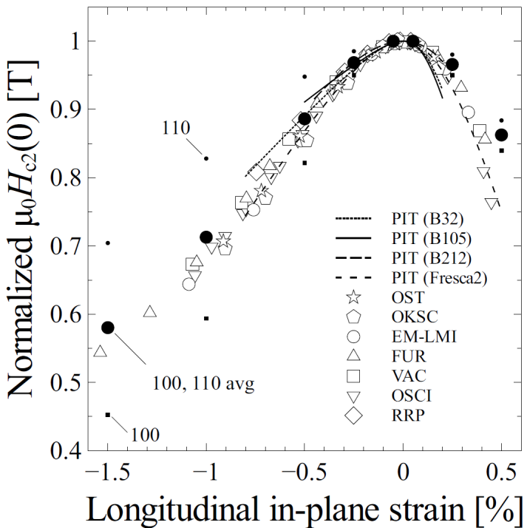
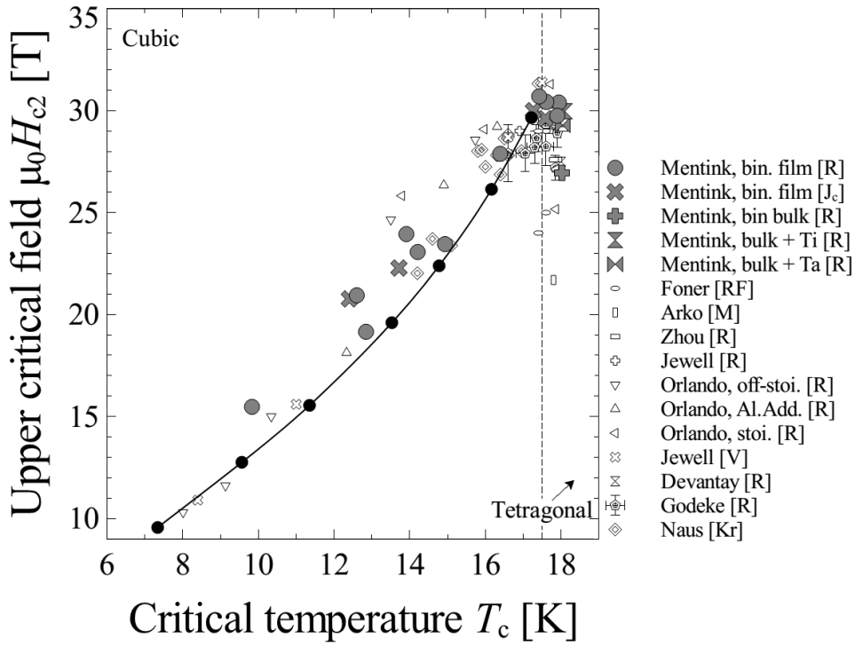
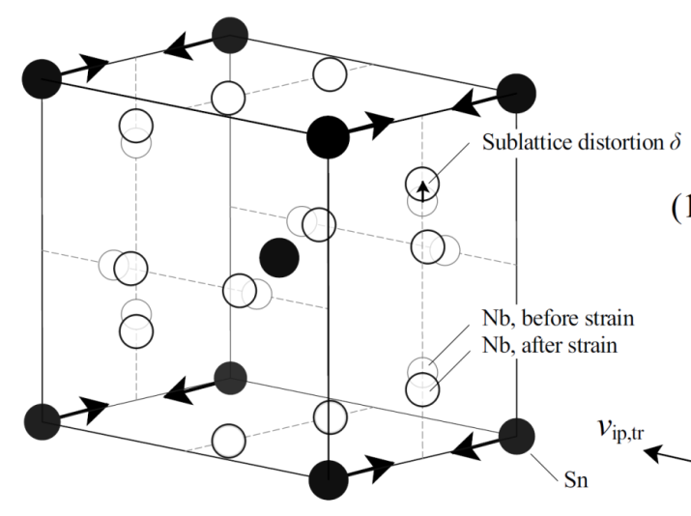
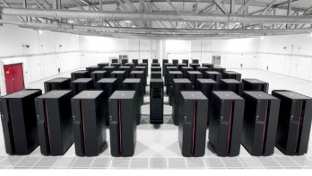
Why do strain and disorder strongly affect superconducting properties of Nb₃Sn?
Experimental validation
Calculation results
Experimental validation
Calculation results
Strained Nb₃Sn
Motivation for research
To get optimal performance from Nb₃Sn-based superconducting magnets, correct amount of disorder is needed
Strain unavoidable in superconducting magnets → Affects Nb₃Sn performance
Results
Ab-initio calculations + microscopic theory
  Disorder disrupts the electronic structure and vibrational properties, thus indirectly lowering critical temperature T_{c} and upper critical field H_{c2,0}
  Strain results in distortion of niobium chains, resulting in reduced T_{c} and H_{c2,0}
Experimental observations consistent with calculation results
National Energy Research Supercomputing Center (NERSC)

Slide 4
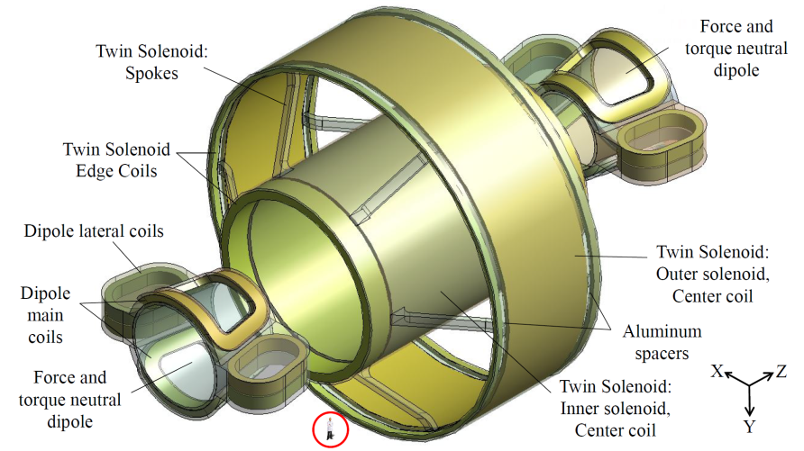
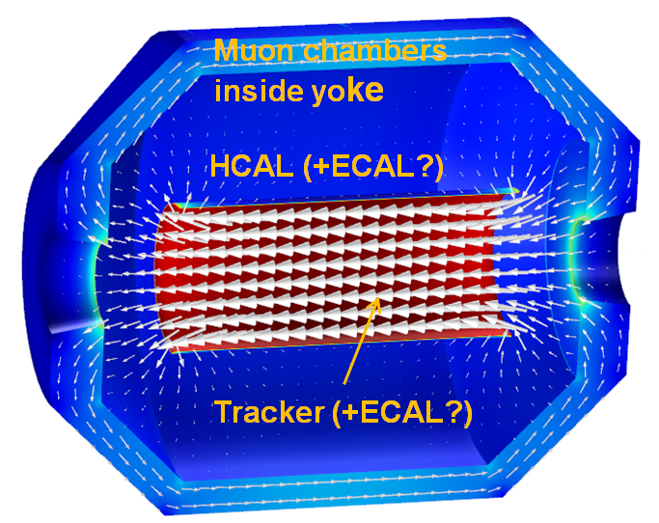
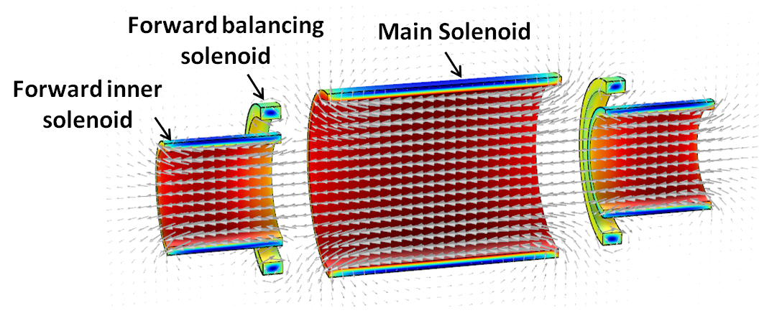
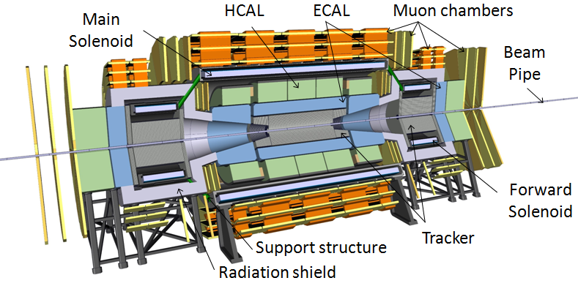
Senior research fellow at CERN: Development of conceptual designs of FCC-hh detector magnets
Senior Research Fellow at CERN
(ATLAS magnet team in EP department)
Development of conceptual detector magnet designs in FCC-hh detector magnet working group
  Magnetic field calculations
  Mechanical aspects
  Quench protection, etc.
Various side projects, such as:
  Development of a superconducting transformer
  Development of HTS-based gas-cooled current leads
  Development of gas heaters for ATLAS
Twin Solenoid & Force-and-Torque-Neutral forward dipoles
High-stress ‘transparent’ solenoid
Unshielded solenoid + balanced forward solenoid
Current FCC-hh baseline design

Slide 5
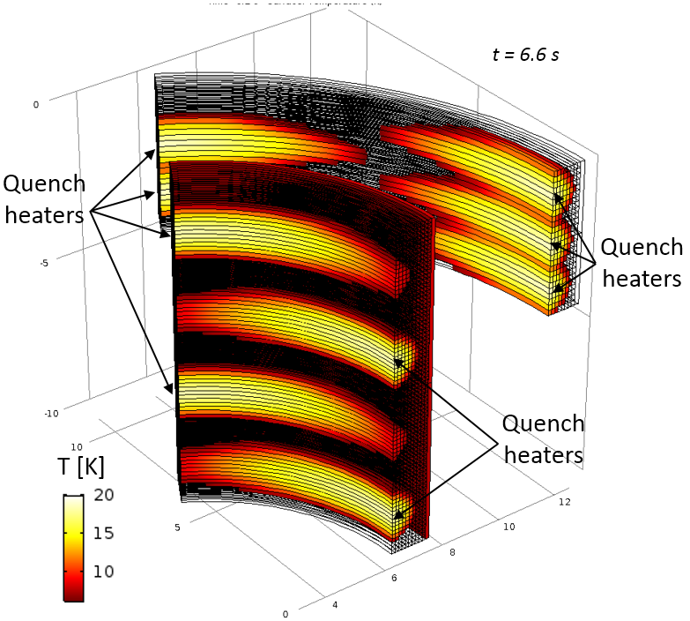
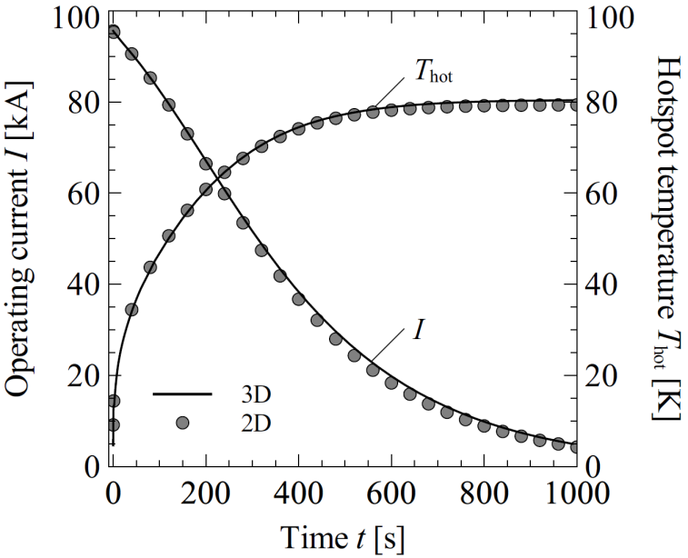
Quench protection calculations of detector magnets for FCC-hh
Quench protection calculations of Twin Solenoid Detector magnet
2D Axi-symmetric calculations with Quench 2.7, originally developed by J. van Nugteren
3D Comsol model (Thermal diffusion + inductive coupling)
  Validation of ‘Quench 2.7’ calculation results
  Allows for modeling of quench heaters
Consistent results demonstrated

Slide 6
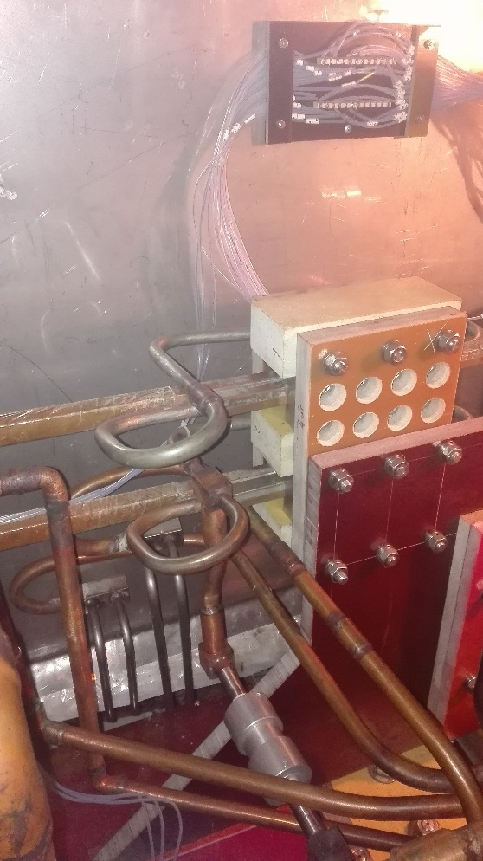
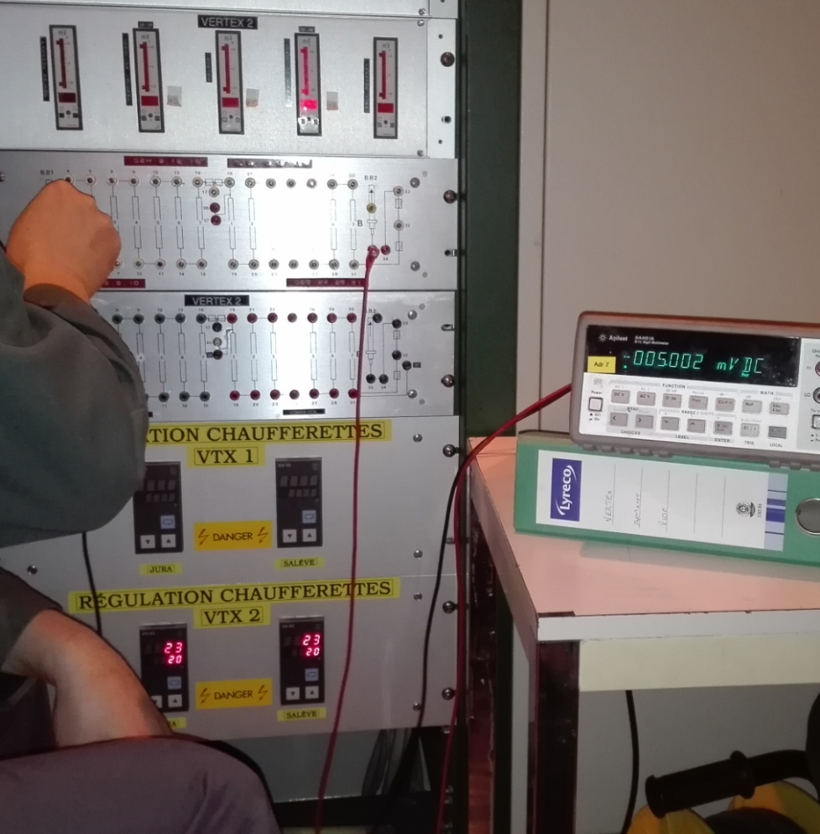
Investigation of malfunctioning detector magnets in NA61 at CERN
Investigation of Vertex superconducting magnets
Cooling failure and quench protection system malfunction observed in Vertex 1
Team activities
  Investigated origin of quench protection failure, debugged voltage taps, determined resistance of superconducting coils + busbars, etc.
  Formulation of improvements to quench protection system
  Assisted in commissioning of new quench protection system
Final result: successful re-commissioning of Vertex magnets

Slide 7
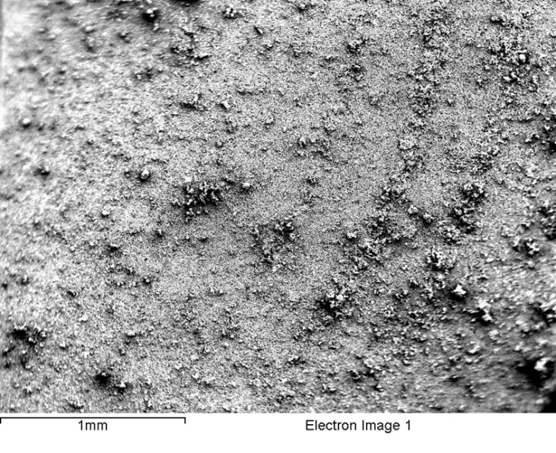
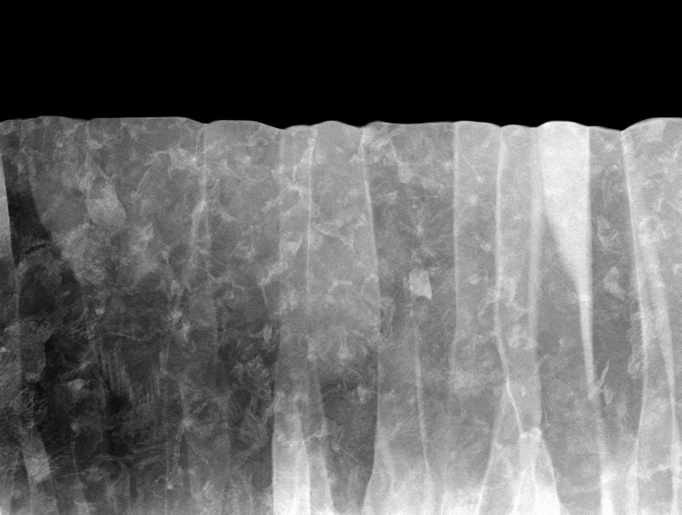

Summary
Career overview
2003 - 2009: Bachelor + Master at University of Twente, Netherlands
2009 – 2014: PhD research at Lawrence Berkeley National Laboratory, collaboration between University of Twente, LBNL, and UC Berkeley
2014 – 2016: Fellow at CERN in the ATLAS magnet team (EP department)
Since start of 2017: Staff (TE-MPE-PE)
  Supervisor: Arjan Verweij
  STEAM (Electro-thermal simulations)
  QP of corrector circuits, NbTi / Nb₃Sn damage studies, MQXF CLIQ test, etc.

