Slide 1
Preparation of post mortem analysis of HiRadMat experiment 31
V. Raginel, K. Kulesz, D. Wollmann

Slide 2
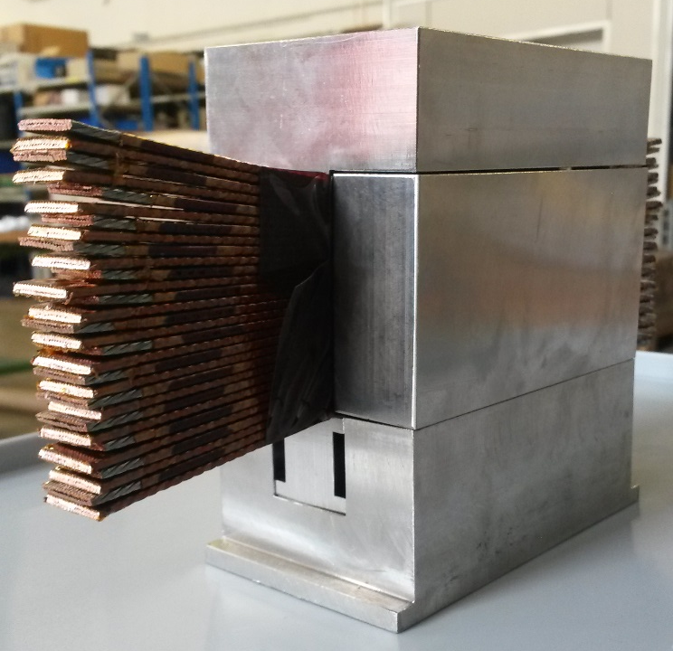
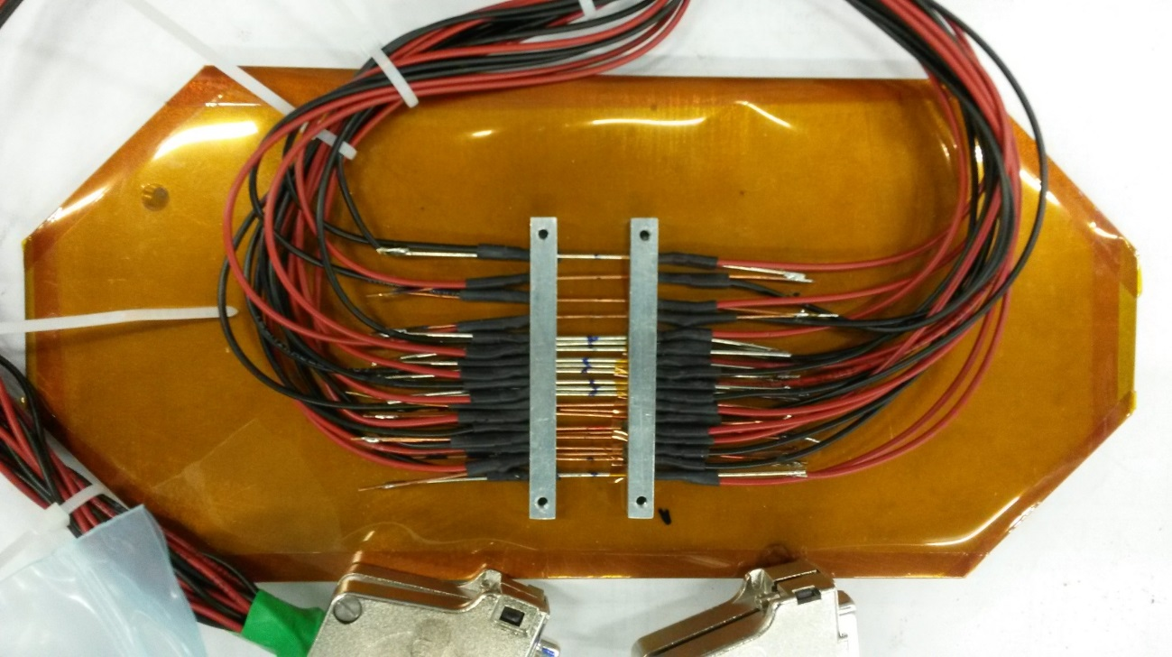
HiRadMat Experiment 31
In the HiRadMat facility shooting 440 GeV protons at:
  LHC Nb-Ti Cable stacks to study degradation of cable insulation
  Nb-Ti and Nb₃Sn strands to study degradation of superconducting properties
  Stainless steel plate to study mechanical stability of steel (input for the design of our next beam experiment at cryogenic temperature)
  Samples were within an inert atmosphere.
Nb-Ti & Nb3Sn strands
~ 15 cm
30 Nb-Ti cables
~ 5 cm
~ 10 cm
Steel plate
~ 7 cm

Slide 3
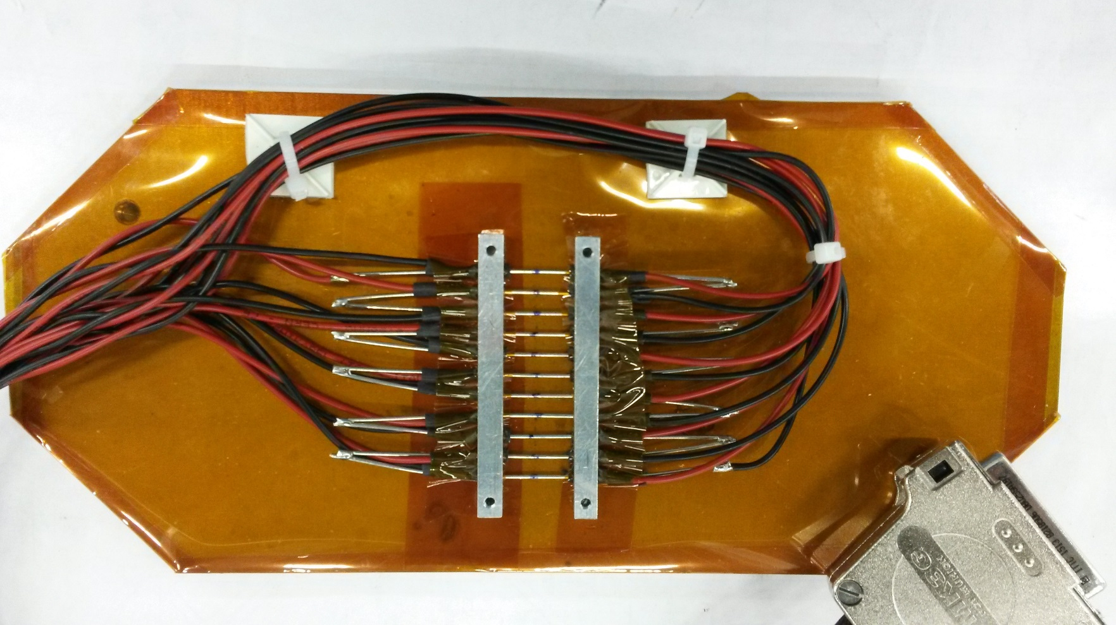
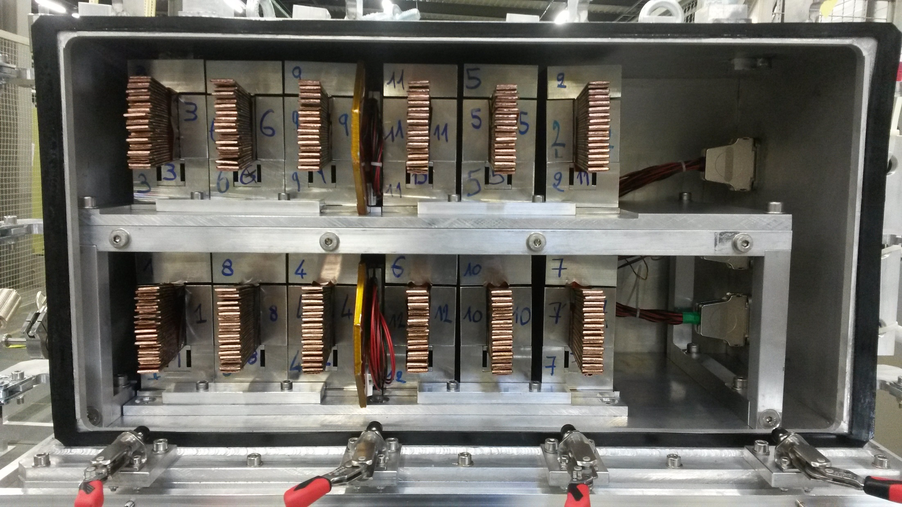

Inside the tank
Nb-Ti strands
Nb-Ti cable stacks
in steels moulds
Second Picture with the tank open
p+
Nb-Ti & Nb3Sn strands
Nb-Ti and Nb3Sn strands fixed on a steel plate

Slide 4
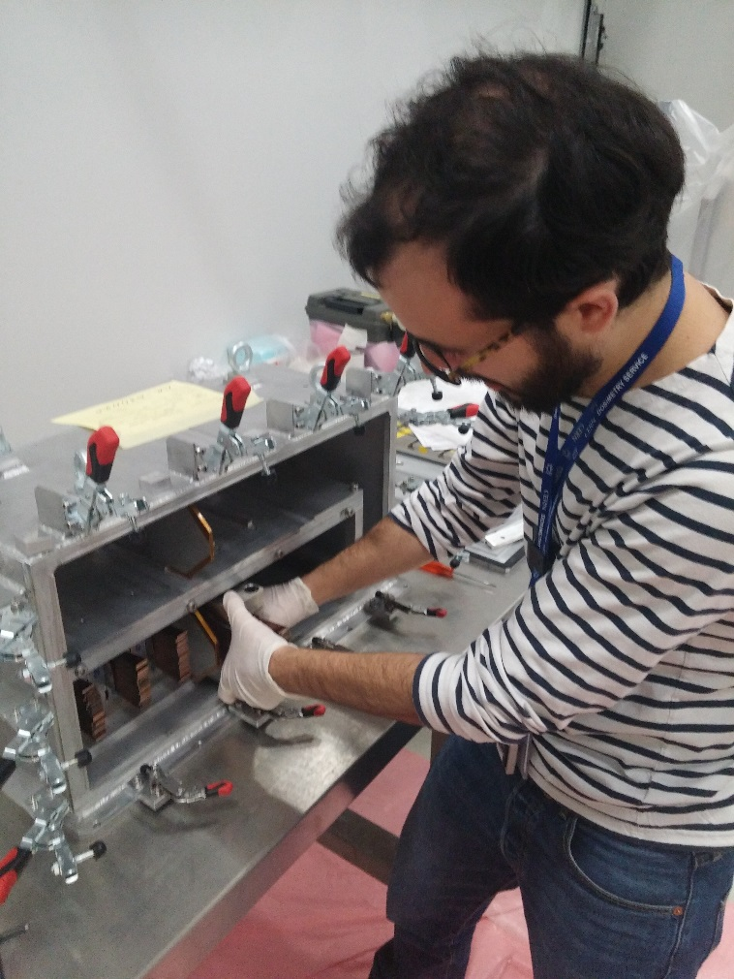
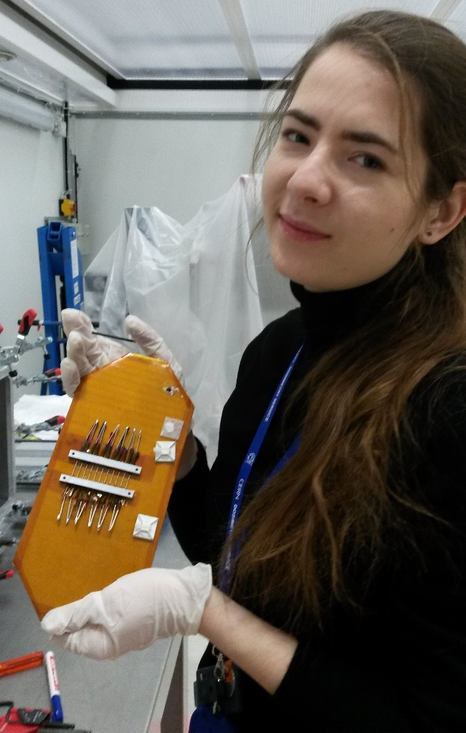
Samples extractions in control area (b 867)

Slide 5
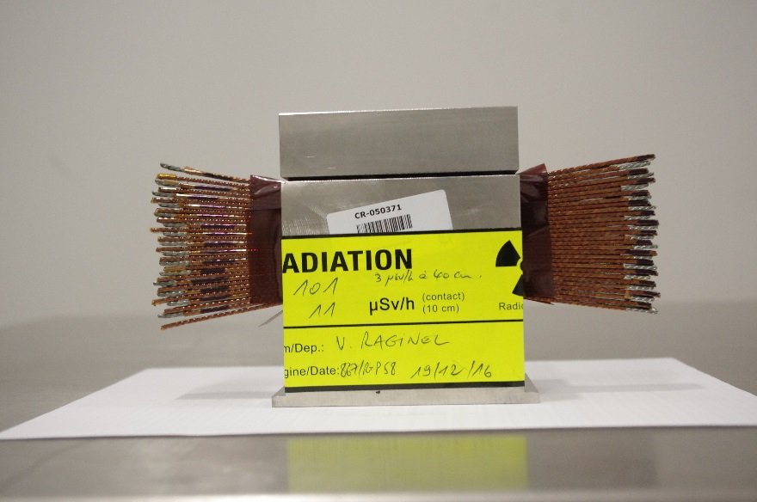
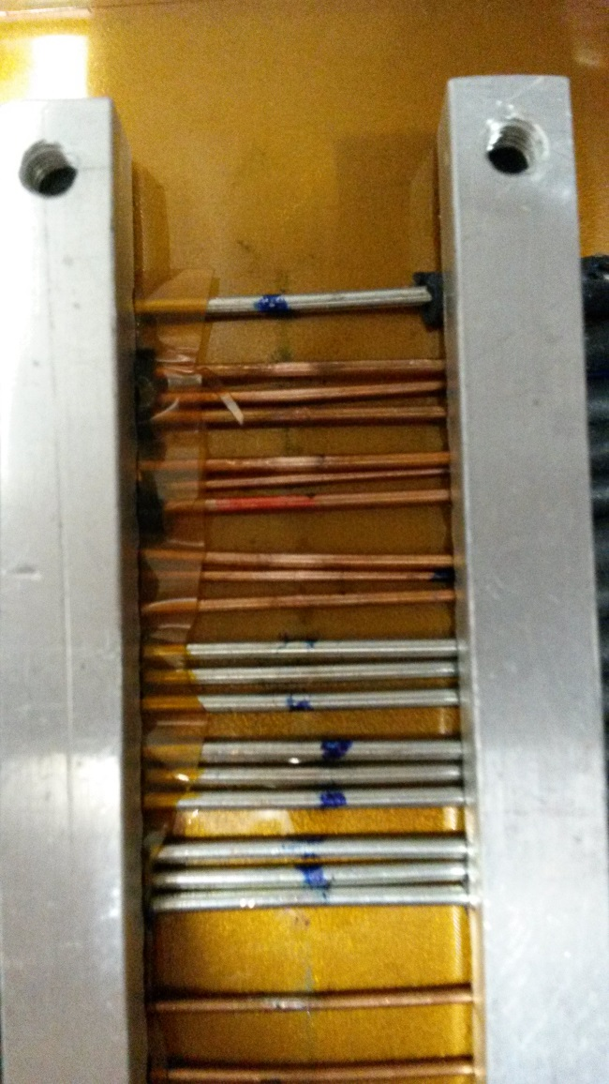
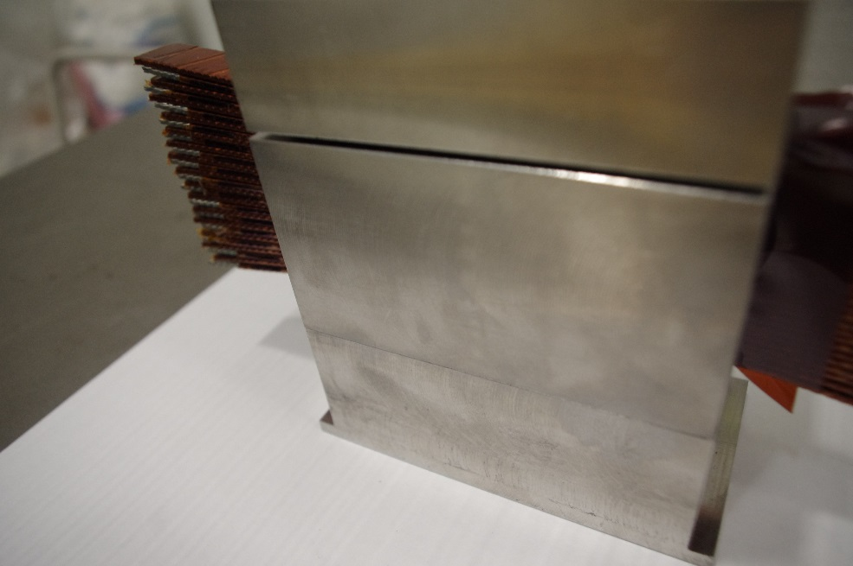
Some samples after beam impact

Slide 6
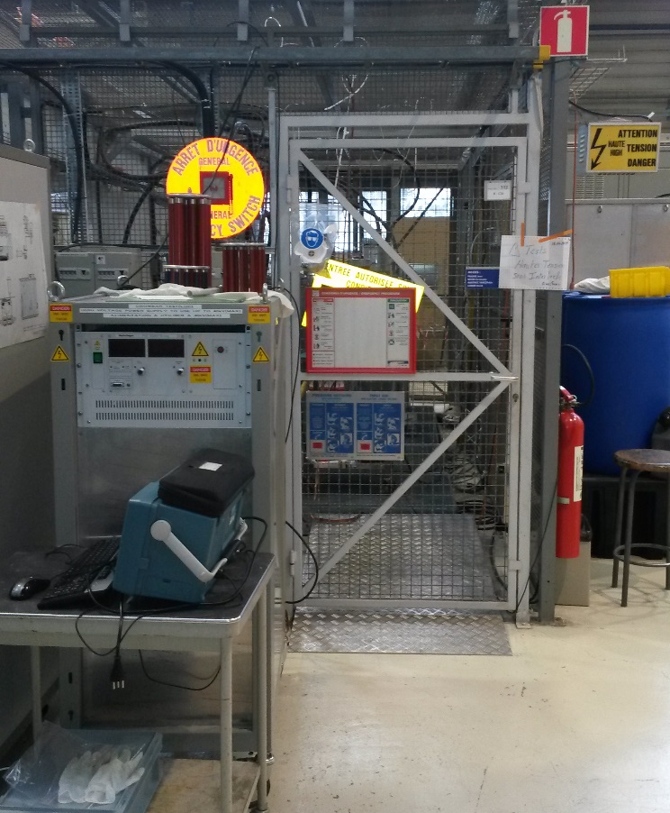
High-voltage measurements
  Aim is to compare the breakthrough voltage cable to cable of our irradiated samples to non irradiated ones and furnace experiment.
  The tests consist of rising the voltage between 2 adjacent cables until breakthrough (electric arc)
  Special precautions have to be taken since the sample are activated (up to 130 μSv/h): limited duration, no destructive test, protection of the sample surrounding,…
HV Power Supply (up to -60 kV)
Faraday cage
Supervised Area
RF Group – Klystron section

Slide 7
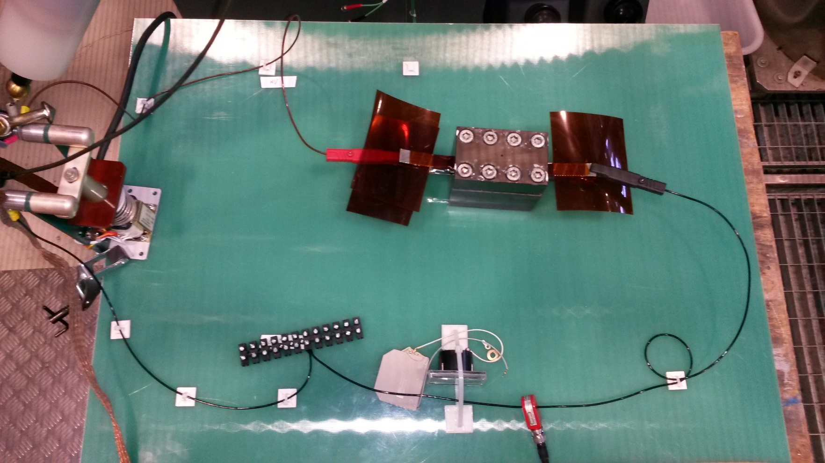
High-voltage measurement setup
HV Probe (voltage readout)
Test Cable 1 to Cable 2
To Power Supply
HV Relay
Current Transformer
(current readout)

Slide 8
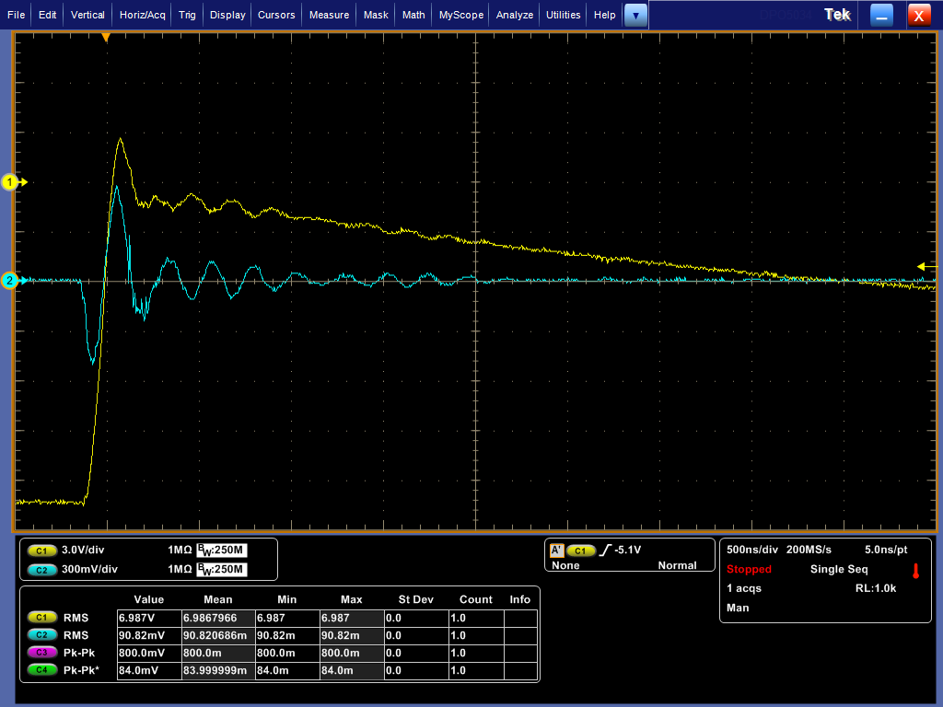
Measurement example
The scope is triggered on the rising flange of the voltage
Voltage divided by 1000
Current divided by 2
Recharge of the system
~ -20 KV
~ 1 A
Electric arc!

Slide 9
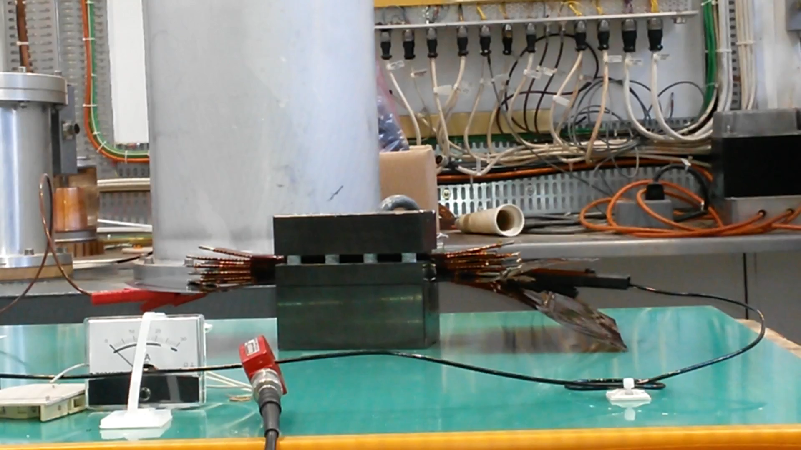
How do a breakthrough look like?

Slide 10
Next steps
The HV tests on the irradiated sample will take place next week (25th to 27thJanuary)
After the tests, the cable stacks will be sent back to radioactive storage
Questions ?

