Slide 2
CLIQ Discharge Experiment Summary
TE-MPE Section Meeting
K. Kulesz, V. Raginel. D. Wollmann

Slide 3
Degradation of critical current I_{c} in superconductor due to pulsed heating
Strands of SC cables (Nb-Ti and in Nb₃-Sn) heated at room temperature in the ms time scale
By means of a capacitive discharge
(CLIQ unit to discharge a current pulse)
Aimed peak temperature in strands: 400°C - 1000°C
Final goal: to measure the magnetization degradation (ΔM ∝ I_{c})

Slide 4
Experiment schedule
Discharge tests (Dec 2016) :
  initial test at low charged voltage (~50V)
  (a test of setup and measurement system)
  experimental tests (V↑ and 3 samples for each V)
Magnetization tests (this/next week at University of Geneva):
  reference samples (not heated)
  samples which have reached the highest temperature (700°C, 900°C, 1000 °C)

Slide 5
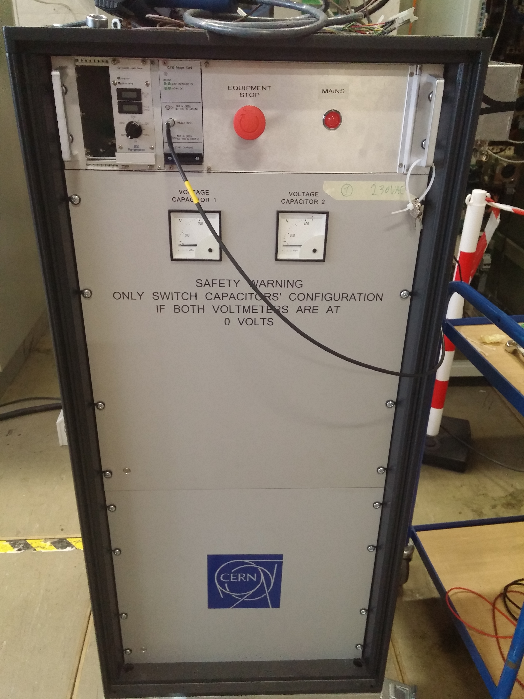
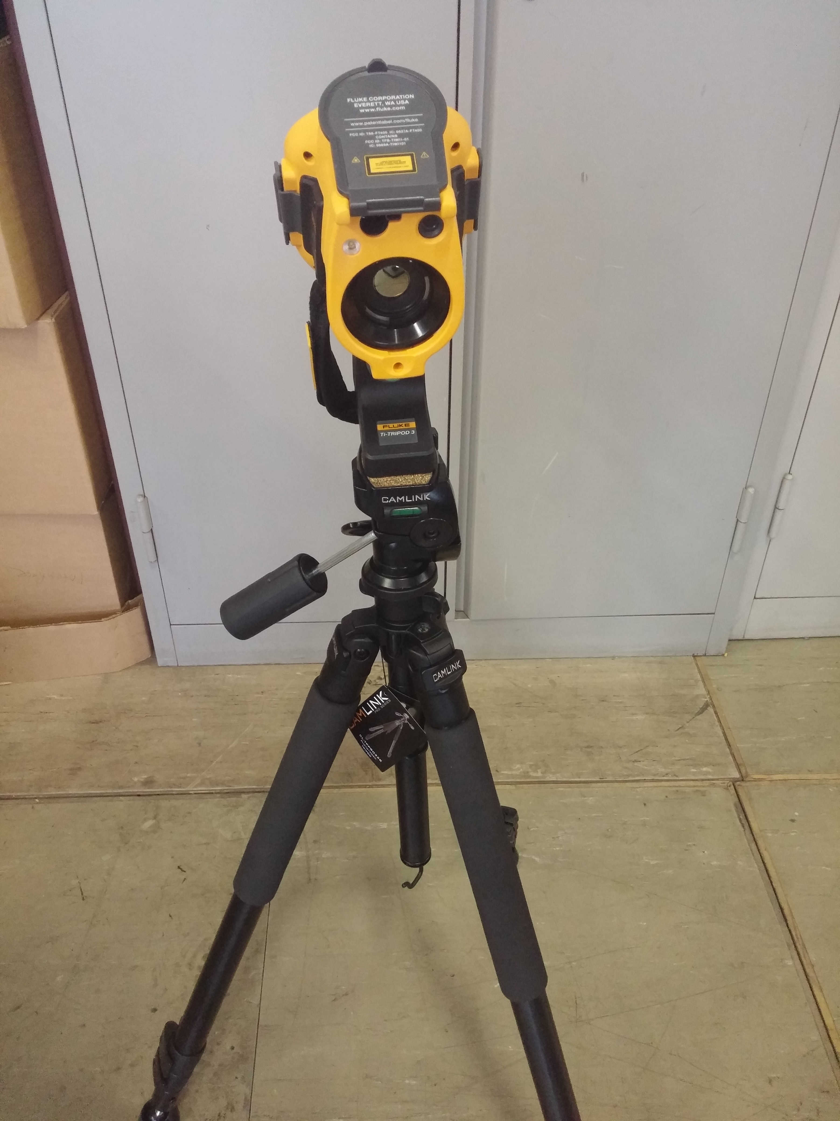
Experiment setup
HV source (CLIQ characteristics):
Capacitor 40mF or 80mF
Charging voltage up to 500 V
Maximum output current 6kA
(limitation of the thyristor)
Resistances in series:
Nb-Ti and Nb₃-Sn sc. strands (10 cm long) ≈ 3mΩ at room temp.
2 x 11 m of 10 mm2 copper cables ≈ 35 mΩ
(limits the CLIC output current; kept in room temp.)
Temperature measurement
Resistance measurement
current (measured with CLIQ unit)
voltage (measured at strand)
Thermal camera
FLUKE Ti400 IR Fusion Technology:
Framerate: 9Hz
Temperature range: -20 - 1200°C
Minimum focus distance: 15 cm
Thermal sensitivity (NETD) ≤ 0.05 °C at 30 °C target
Copper plates
Nb-Ti (Nb₃-Sn) single strand
Copper plates
Fibre glass plate (insulation)
2 x 11 m long cables
-
+
CLIQ Unit
CLIQ
Courtesy: Vivien Raginel
FLUKE thermal camera

Slide 6
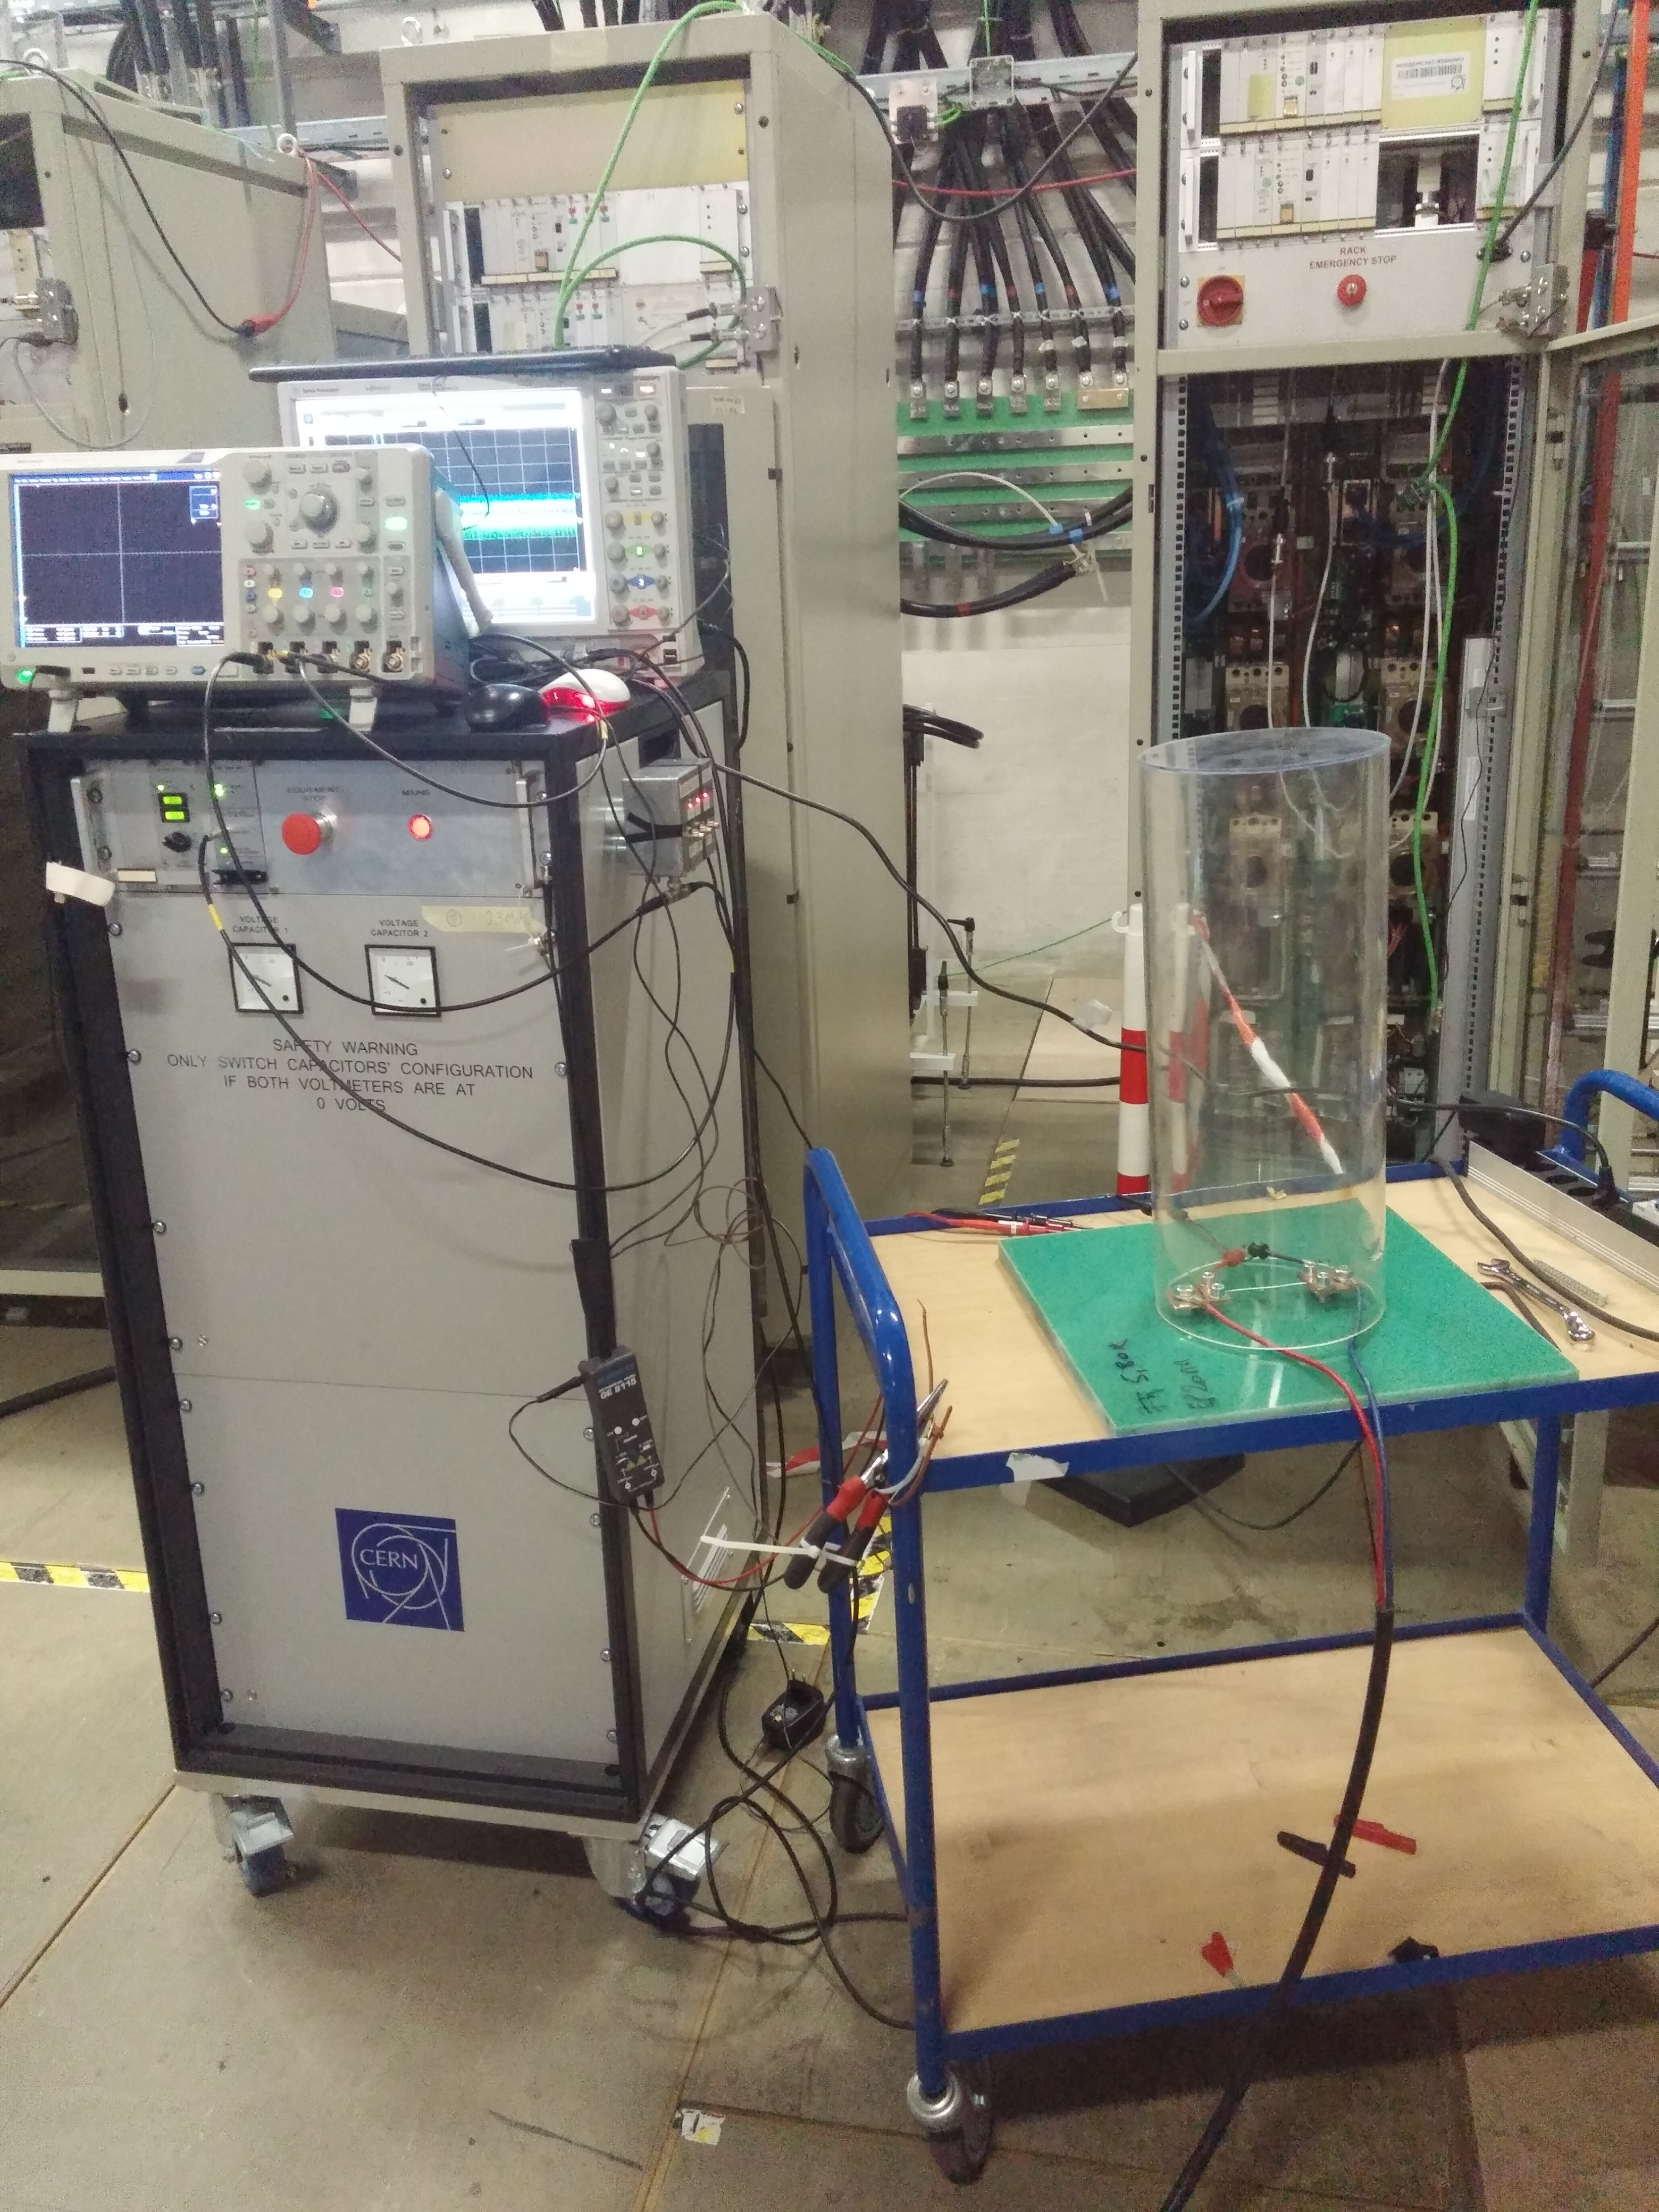
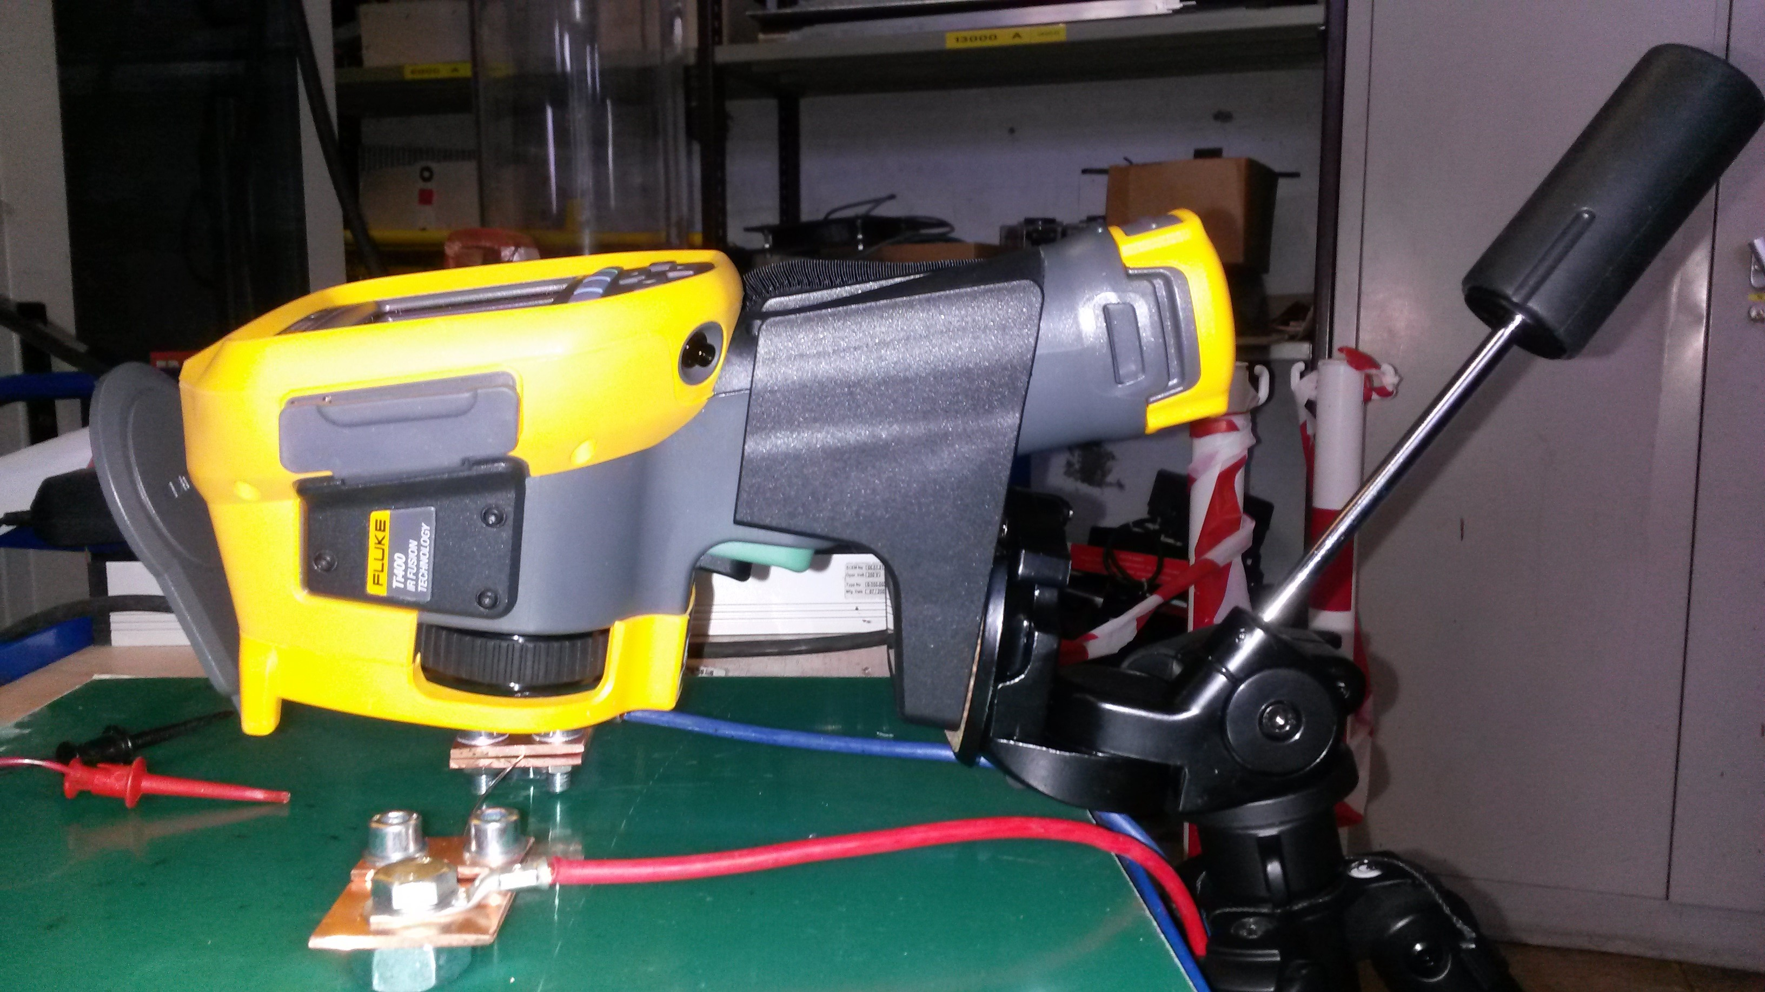
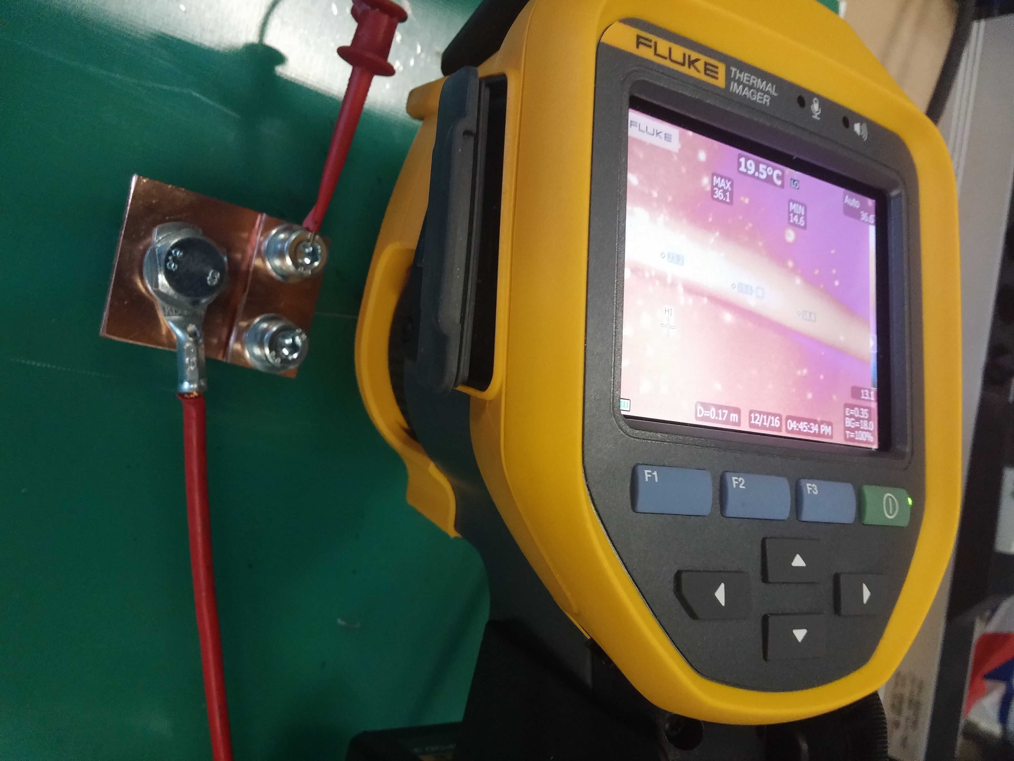
Experiment setup

Slide 7
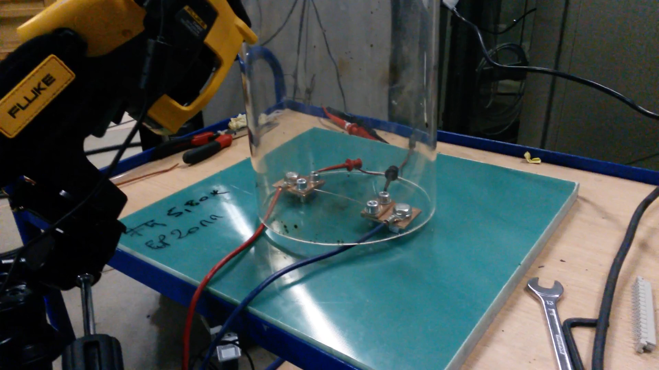
Measurement: Nb-Ti (80mF, 240V)

Slide 8
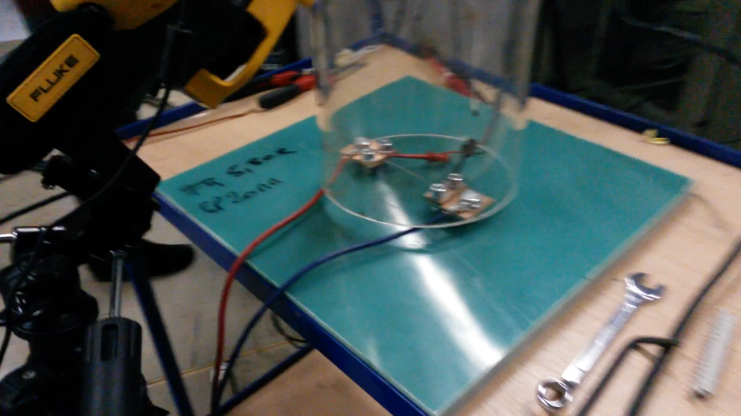
Measurement: Nb-Ti (80mF, 250V)

Slide 9
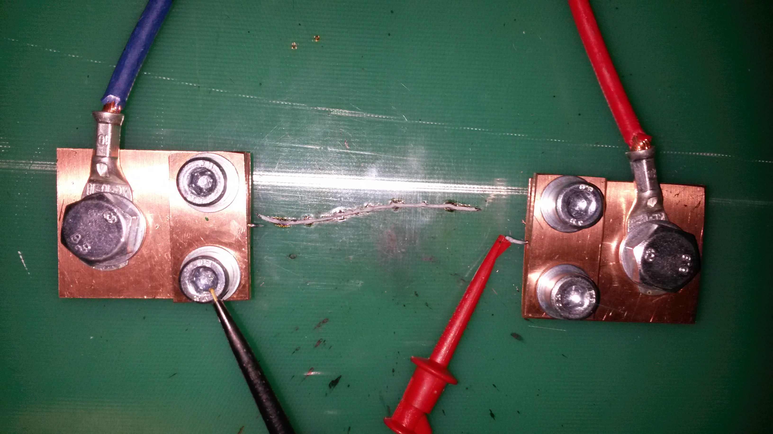
Measurement: Nb-Ti (80mF, 250V)

Slide 10
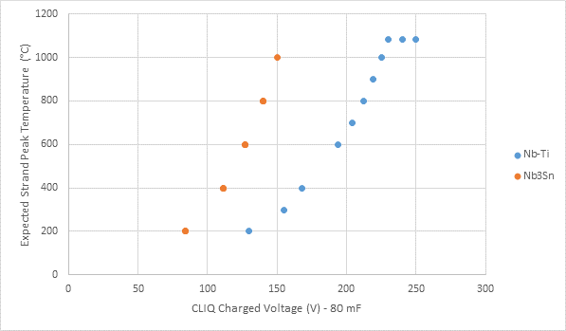
Prestudy: parameters
melted
Discharge time (5 τ) ≈ 15 ms
Cooling time ≈ 2s – 20 s
ΔT in 10 m cable ~ 1- 2 °C
Melting temperature for Cu: 1085 °C

Slide 11
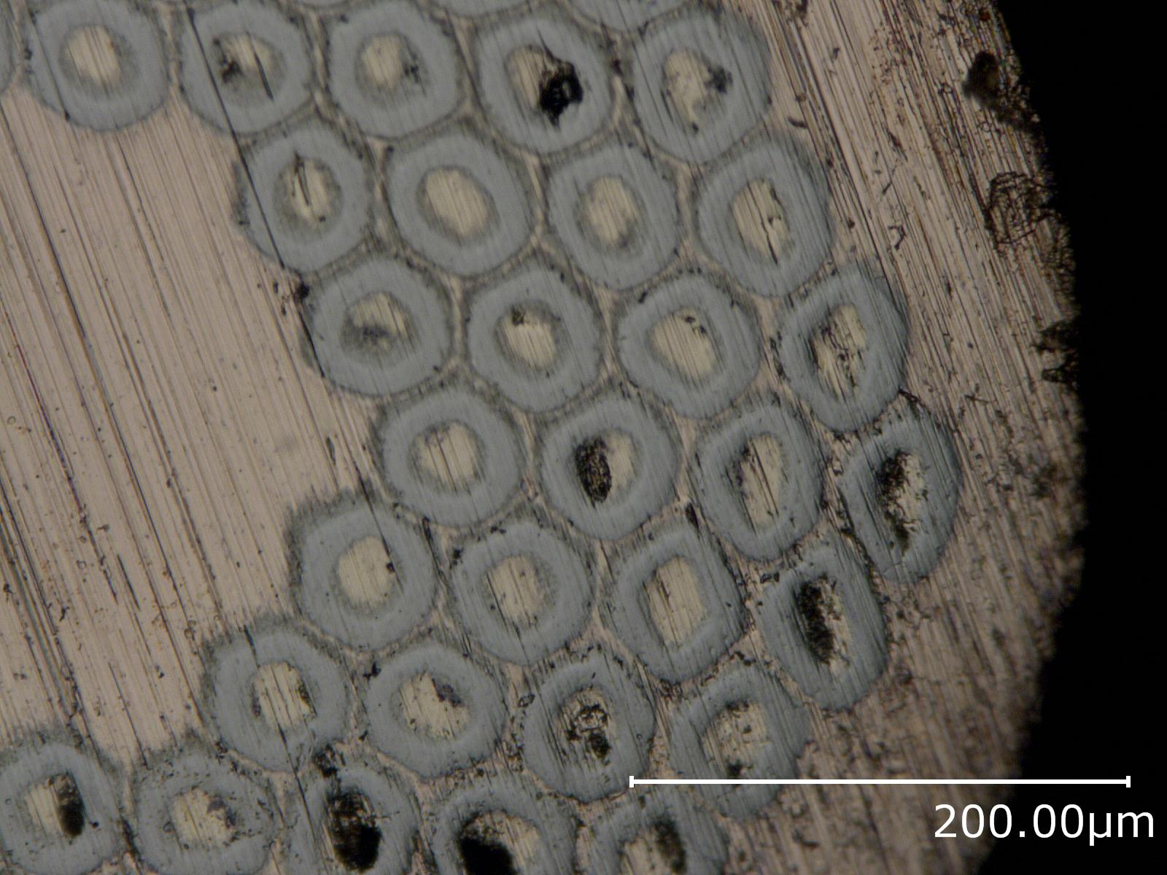
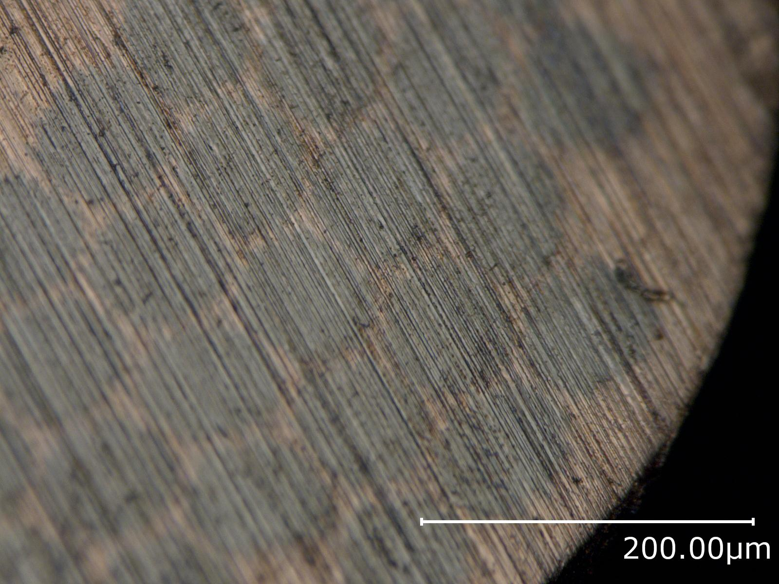
Preparation for magnetization
Nb3-Sn
Nb-Ti

Slide 12
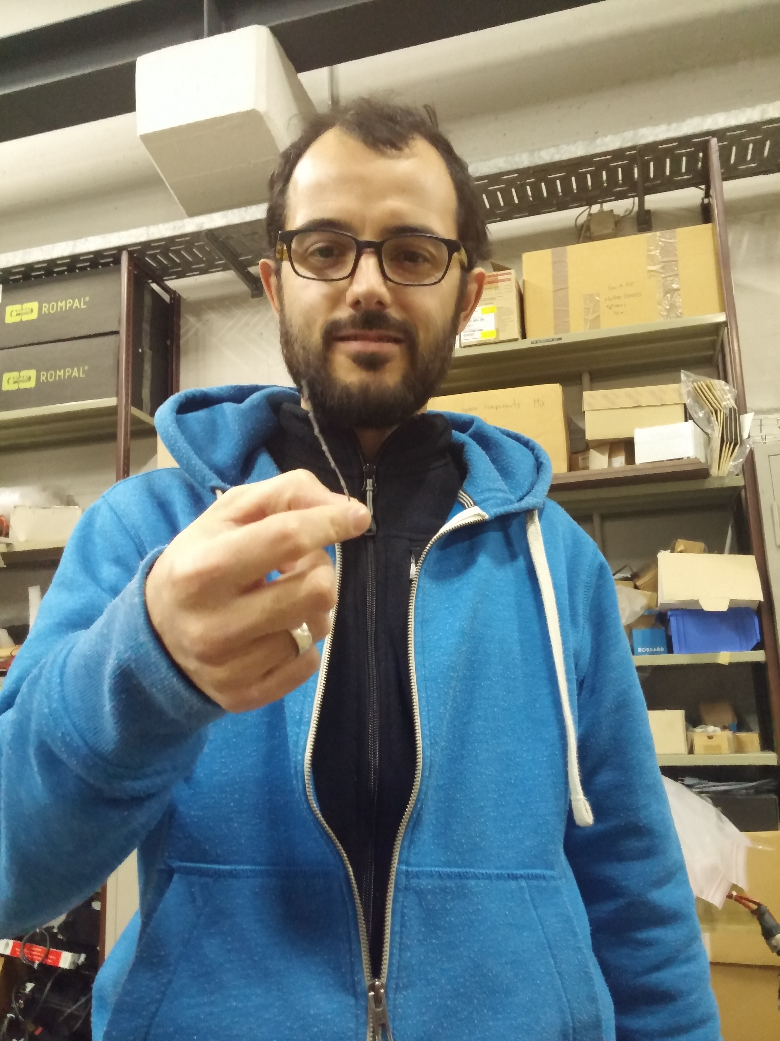
Questions?
CLIQ Discharge Experiment Summary

