Slide 2
How does a klystron work?
TE-MPE Section Meeting
Karolina Kulesz

Slide 3
Why do we need klystrons?
Produce far higher microwave power outputs than solid state microwave devices (e.g. Gunn diode)
From hundreds of MHz (UHF) up through hundreds of GHz (Extended Interaction Klystrons in the CloudSat satellite)
At work with:
  radars and satellites,
  wideband high-power communication (very common in television broadcasting and satellite terminals)
  medicine (radiation oncology)
  high-energy physics (particle accelerators and experimental reactors)

Slide 4
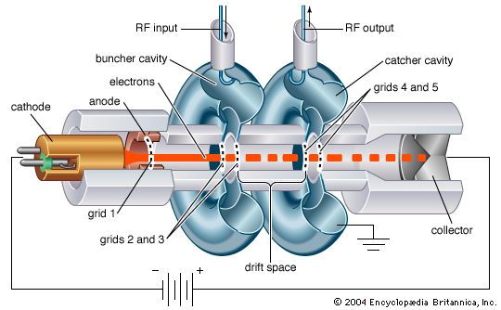
Klystron’s parts and components
Two cavity klystron
Electron gun ( ~54 kV)
Collector (Collector Dissipation Capability ≥ 500 kW)
2(or more) cavities
External electromagnet
RF signal input (AC source)
High power coupler (waveguide/coaxial type)
Water cooling
(collector, body and electromagnet)
Vacuum pump
Power supply, insulation etc.
Reflex klystron (Sutton tube)

Slide 5
Main idea:
How klystron amplifies the HF signal?
Electron gun
Continuous beam
Beam arrives at 1st cavity
Bunched beam
Beam arrives at 2nd cavity
Collector

Slide 6
Zoom in at 1st cavity
transmission of RF signal via coupling:
magnetic (longitudinal slots on waveguides) or electric (coaxial cables/antena)
HF weak wave
is induced in the the cavity
HF weak wave = low amplitude of wave
= low power (100W)
Electrons are accelerated and deaccelerated
Bunched beam

Slide 7
Zoom in at 2nd cavity
Bunched beam induces magnetic field in 2nd cavity
Cavity surface current/electric field
strong HF wave is collected with power coupler
HF wave travels to LHC

Slide 8
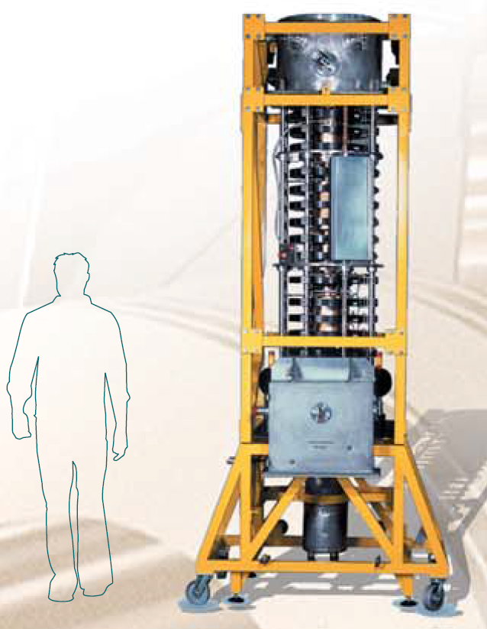
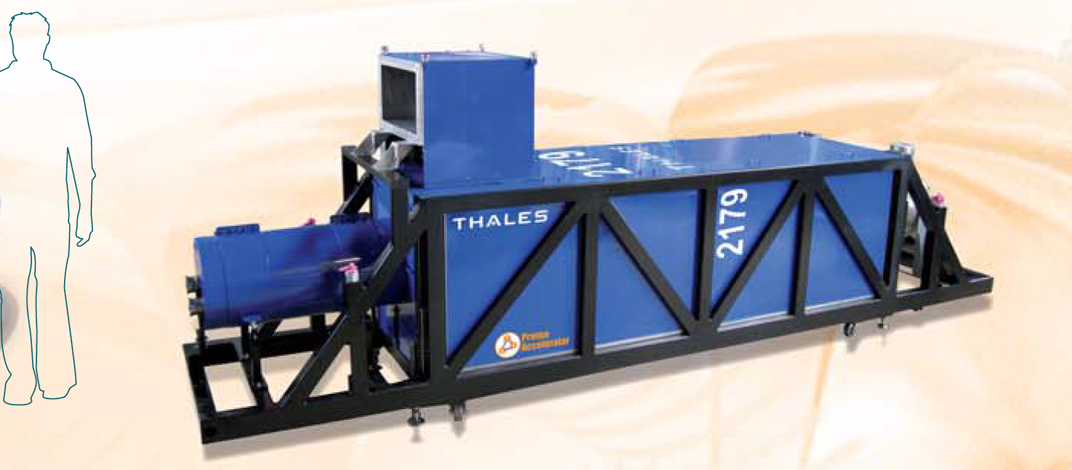
What klystrons do we use in CERN?
TH 2167
300 kW CW at 401 MHz
Continuous-wave
Efficiency 63%
Peak beam voltage: 54kV
16 klystrons constitute two RF systems
(protons accelerated to their final energies of 2 × 7 TeV)
Th 2179
2.8 MW peak up to 210 kW av. at 352 MHz
Pulsed
Efficiency 53%
Peak beam voltage: 107kV
1 mln CHF
LINAC4

Slide 9
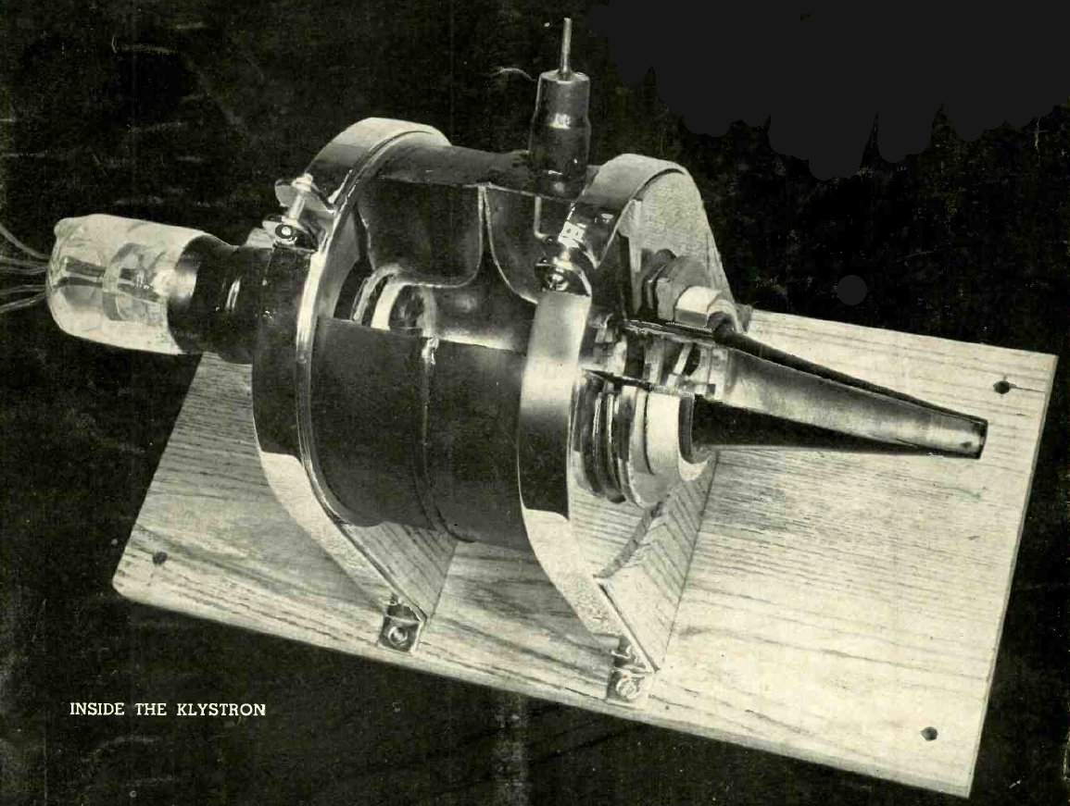
Thank you! Questions?
The first prototype klystron, manufactured by Westinghouse in 1940.
It could generate 200 W of power at 40 cm (750 MHz) with 50% efficiency.

Slide 11
Literature
Article Electron tube, Britannica Encyclopaedia,
website: https://www.britannica.com/technology/electron-tube#ref132618
Article Two-cavity klystron, Britannica Encyclopaedia,
Website: https://www.britannica.com/technology/two-cavity-klystron
Article Microwave tube devices,
website: http://www.daenotes.com/electronics/microwave-radar/microwave-tube-devices
Article High-power klystrons. The benchmark in scientific research., THALES, S.135B/2012.03
https://www.thalesgroup.com/sites/default/files/asset/document/high-power-klystrons.pdf
YouTube lecture How a Klystron amplifier works,
Website: https://www.youtube.com/watch?v=Fvud81pYGOg&t=498s
Coupling types: https://cas.web.cern.ch/cas/Denmark-2010/Lectures/Alesini.pdf

Slide 12
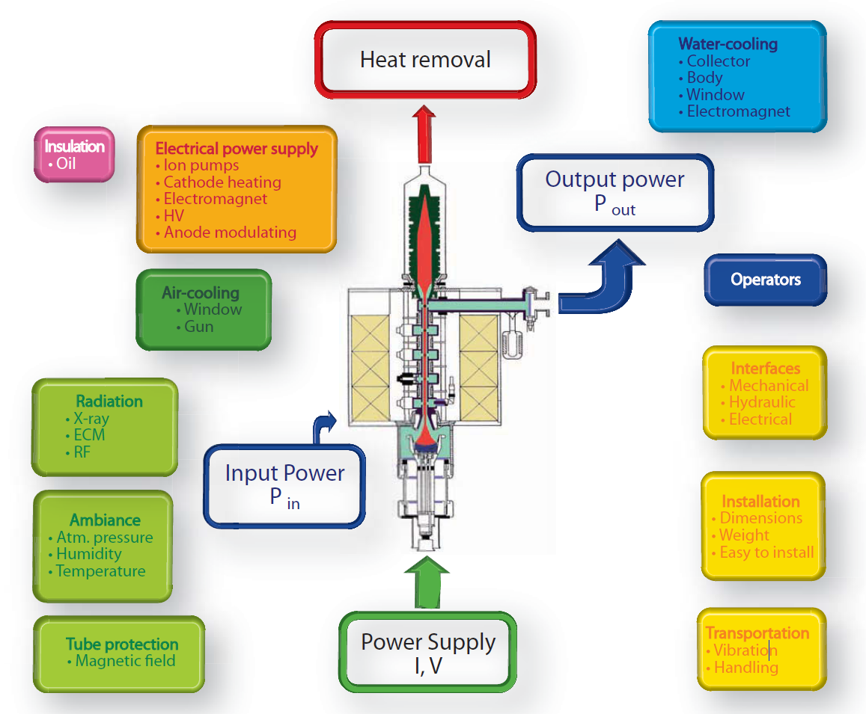
Klystrons are high-efficiency linear beam amplifiers, with high gain and narrow bandwidth, designed to operate at frequencies from UHF to millimetric bandwidth. To ensure efficiency, klystrons have to be integrated in a very specific environment, demanding expertise in high-voltage operation, cooling, RF and electromagnetic radiation (X-rays).

Slide 13
Zoom in at 1st cavity
1ST CAVITY:
coaxial cable conducts electrical signal using an inner conductor → transmission line for radio frequency signals
HF weak wave is provided to the cavity (HF weak wave = low amplitude of wave = low power (100W)
Maxwell’s laws → It excites electrons in the walls of metal cavity (aluminium cavities would not work)
Maxwell’s laws → Electrons in the cavity walls generate electromagnetic field.
Generated electromagnetic waves with a range of frequencies
Resonance frequency of the cavity depend on its shape and impedance.
Electrons are accelerated and deaccelerated (photo) → they get bunched.
Bunched electrons travel towards collector → They induce EM field in following cavities
LAST CAVITY (or 2ST)
strong HF wave is collected (power coupler, antenna)
Example: in SC cavities of LHC accelerates bunches to its highest energies
Some of them are equal to resonating frequencies. These are amplified in the cavity.

Slide 14
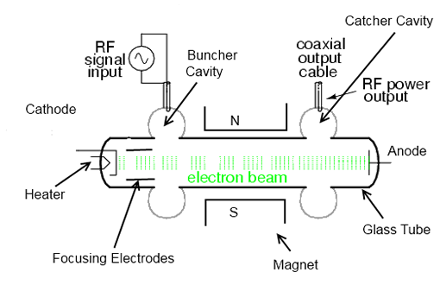
Examples

