Slide 1
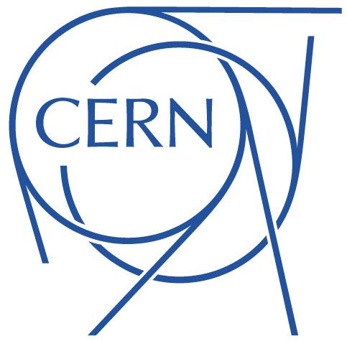
Crab Cavities test in the SPS
- Failure Scenarios and Machine Protection Aspects
Björn Lindström - TE-MPE-PE
Acknowledgements: D.Wollmann, M.Valette, K.Sjobaek, A.Garcia
TE-MPE-PE section meeting 1st March 2017

Slide 2
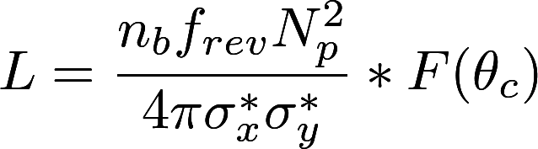


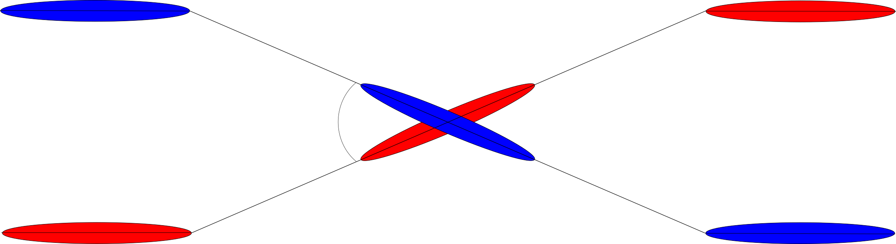

Crab Cavities - what are they?
In HiLumi LHC, due to smaller β* and to limit beam-beam effects the crossing angle will be increased
⇾ Lower luminosity:
Piwinski Reduction (Geometric) Factor
 | 2012 LHC | 2015 LHC | HL-LHC
 | 313 | 290 | 590
 | 0.88 | 0.85 | 0.31
Geometric Factor

Slide 3
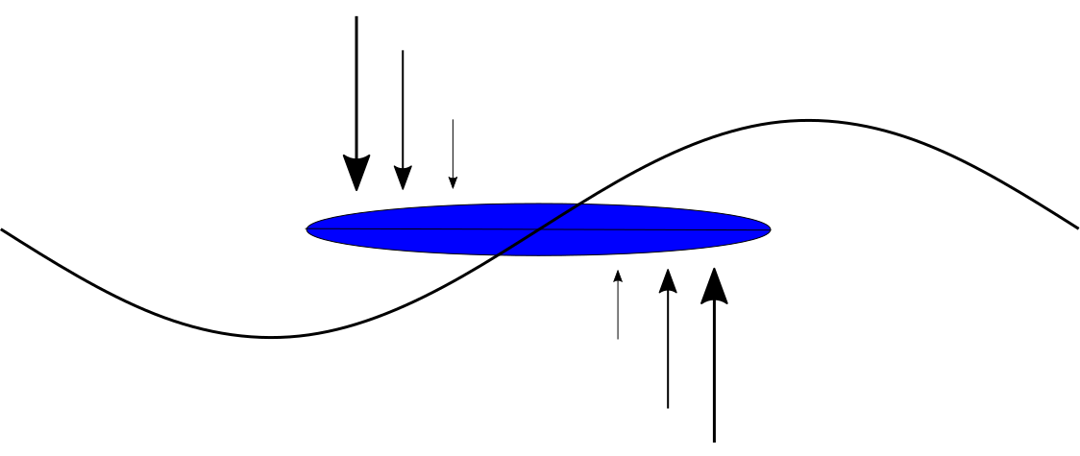
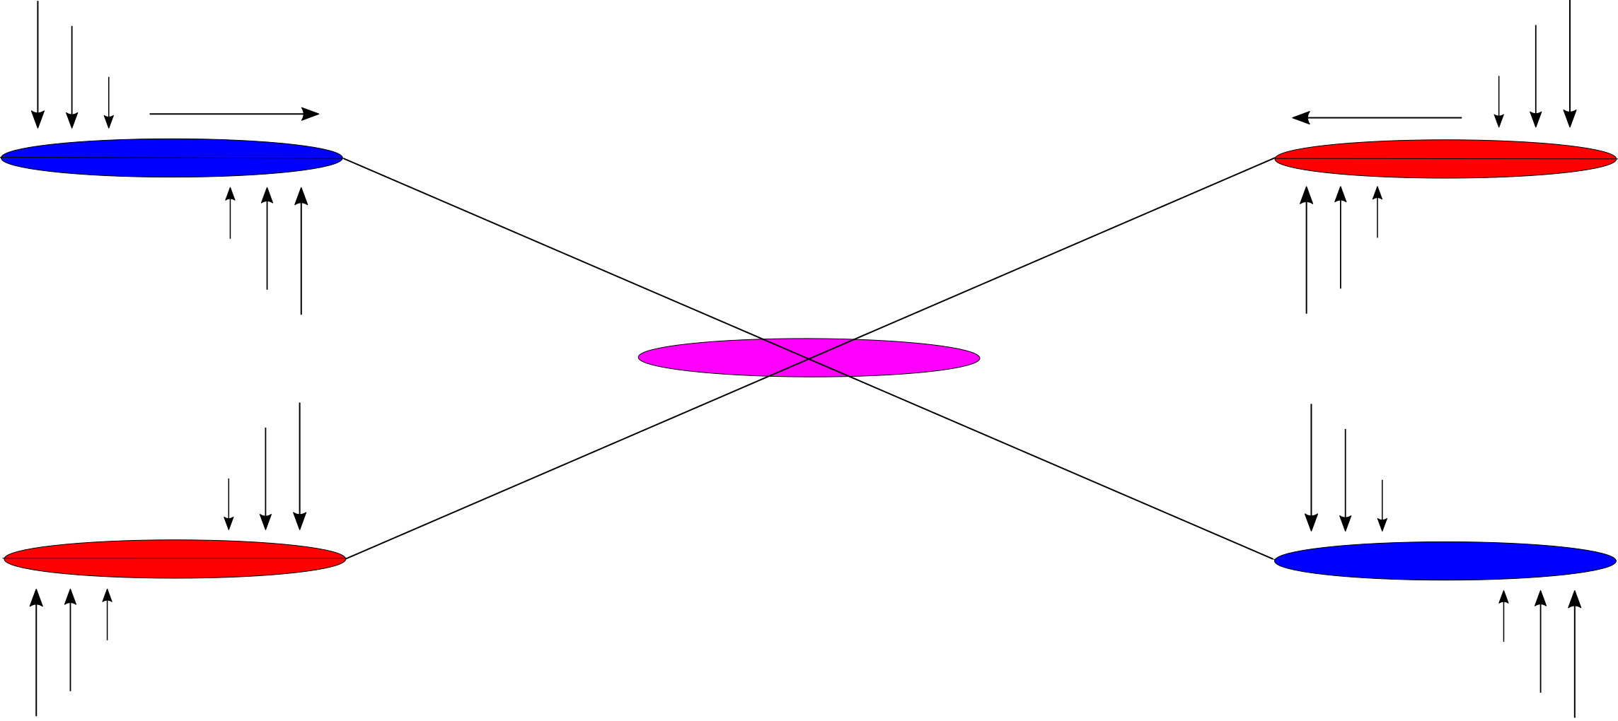
Crab Cavities - what are they?
Cavity with sinusoidal transverse kick - bunch is tilted - better overlap at crossing point
E
180° - x’ set to 0 with same voltage
0° - kick in x’
90° - max offset in x
Phase advance:

Slide 4
Why important to study for MPE?
CCs give strong transverse kick, short time constant - can potentially lead to large fast losses
Untested technology - SPS tests for validation
SPS BIS must be defined for the CCs
  What failures can occur?
  What are their consequences?
  How to detect them? future topic
  How probable are they? future topic
  How can they be mitigated? future topic

Slide 5
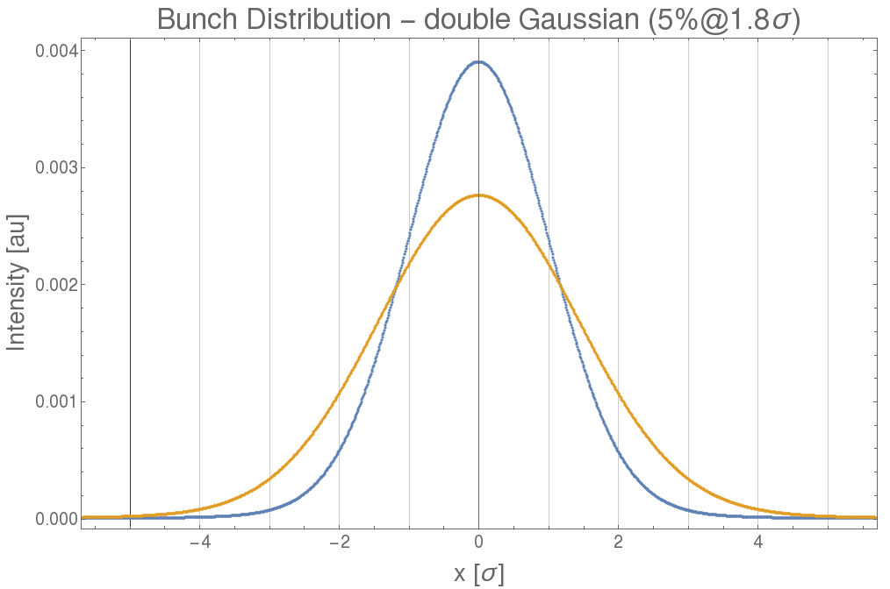
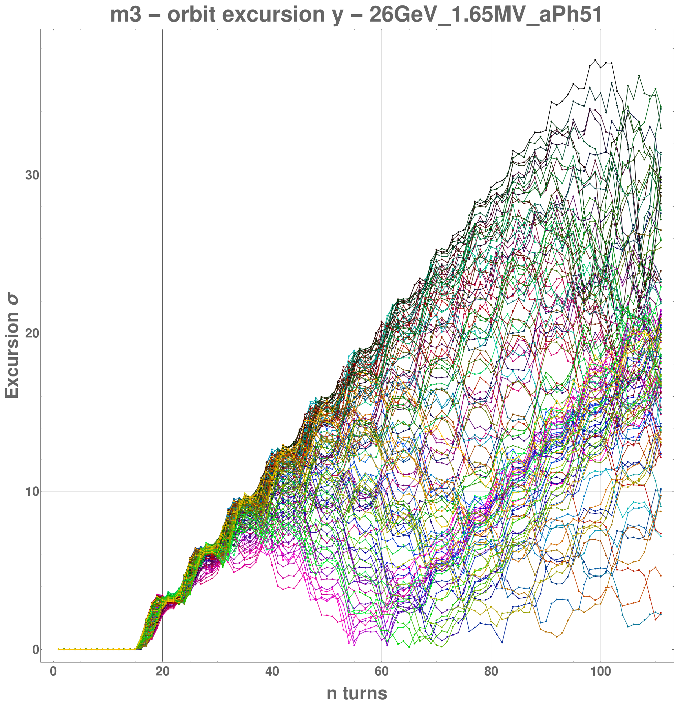
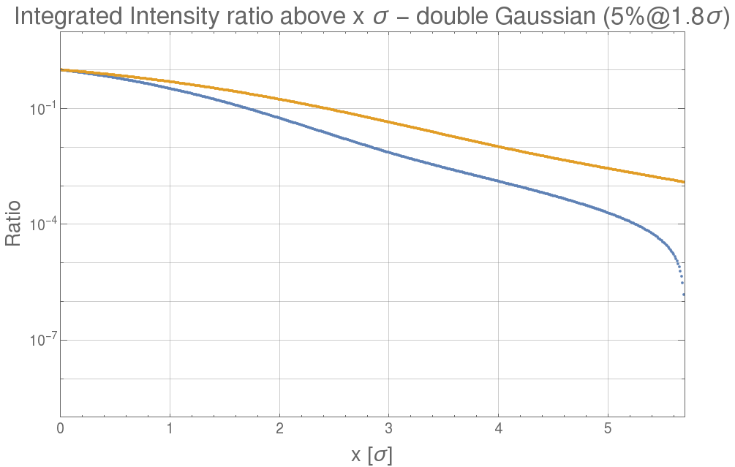
Why important to study for MPE?
If crabbing not compensated (e.g. voltage drop), transverse beam distribution wider - increases consequences of other failures
Phase shift causes beam core to be transversally kicked - can give fast beam loss
Nominal
180 µrad tilt

Slide 6
Considered Failure Scenarios
Voltage Drop
  Assumed linear drop in four turns
Phase Change
  Max phase change per turn limited by RF power and cavity voltage
  Assumed worst case of LLRF driving max change possible
    One slip
    Consecutive slips for multiple turns
Combination (quench)

Slide 7
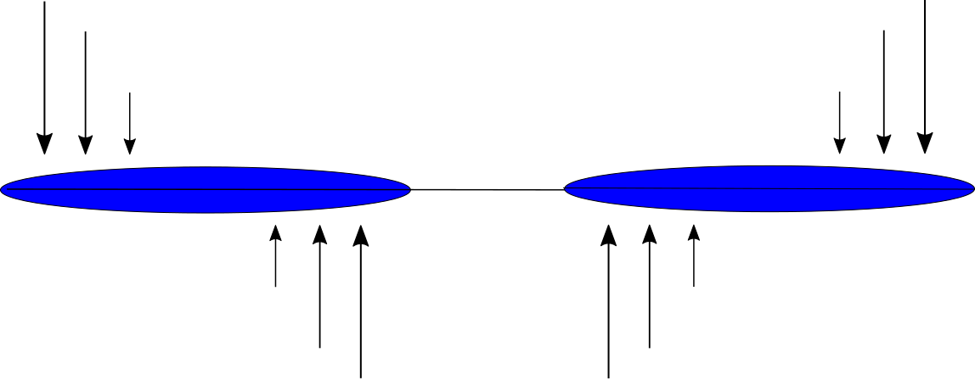
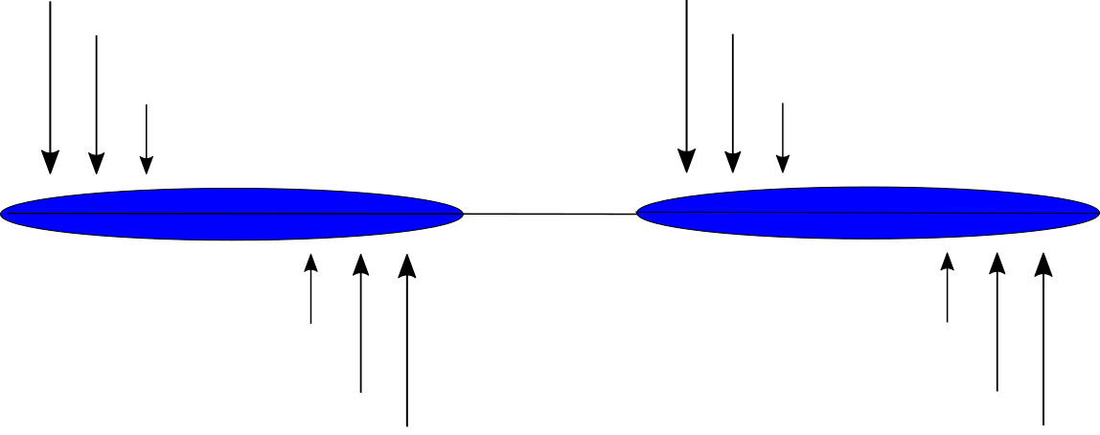
SPS Tests
CCs to be validated in SPS before LHC installation
  Two vertical CCs in 2018
  Two horizontal CCs after LS2
Operational Modes:
  Anti-phased (Transparent)
  Phased (CCs ‘cooperating’)
Points to consider:
  Lower energy than LHC
    Less damage for beam impact
    Less beam rigidity
  Lower maximum intensity
  SPS Aperture much larger than LHC
  SPS has a plenitude of operational modes - can CC tests be done parasitically?
Phase advance < 2°

Slide 8
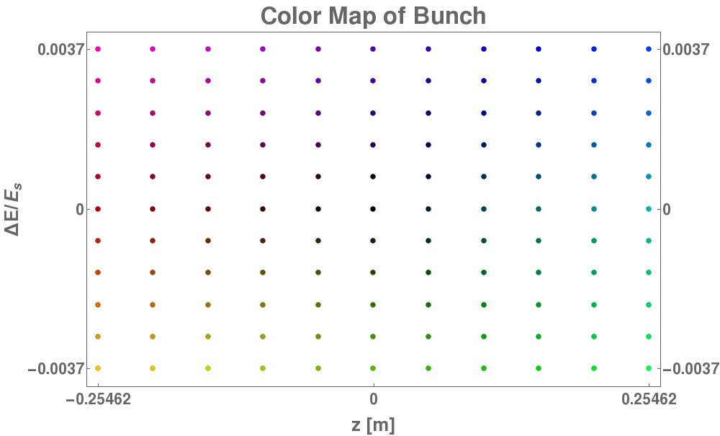
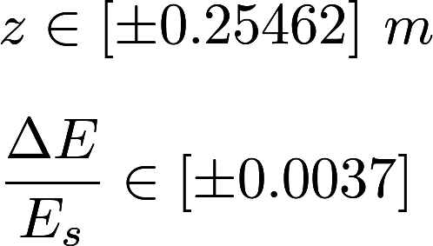
Procedure
Tools: MAD-X, Mathematica
Sample particles spread across the bunch are tracked to see how bunch is affected
  Weight can be assigned to each sample to determine actual beam losses
Main focus on injection energy 26 GeV (least rigid beam), but also top energy 450 GeV, and coasting energies (55, 120, 270, 400)
Tradeoff between precision and time consumption; 11x11 sample particles tracked with initial conditions

Slide 9
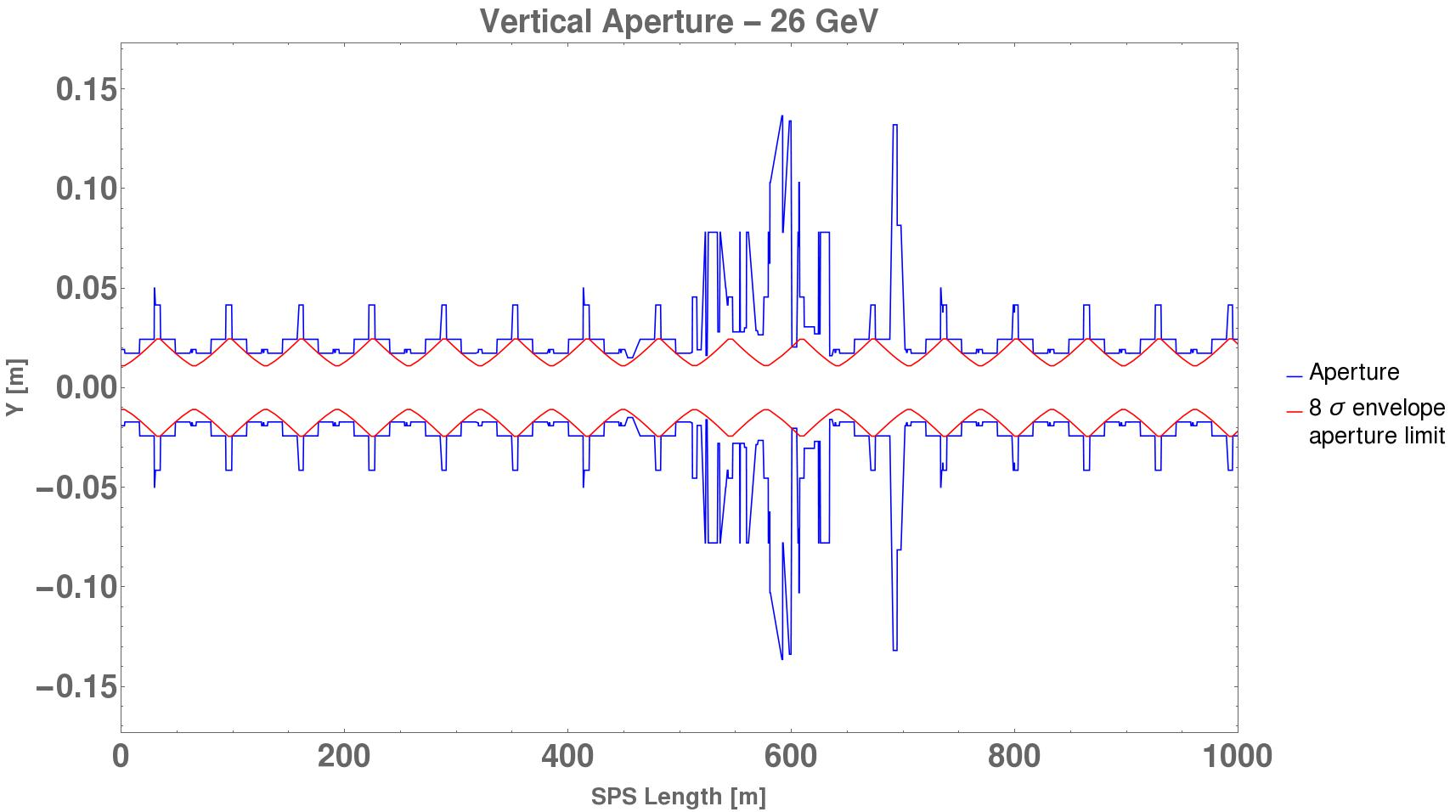
SPS Aperture - where will losses occur?
Bottleneck at 8σ for injection energy, 26 GeV
TIDV.11892 (internal beam dump)

Slide 10
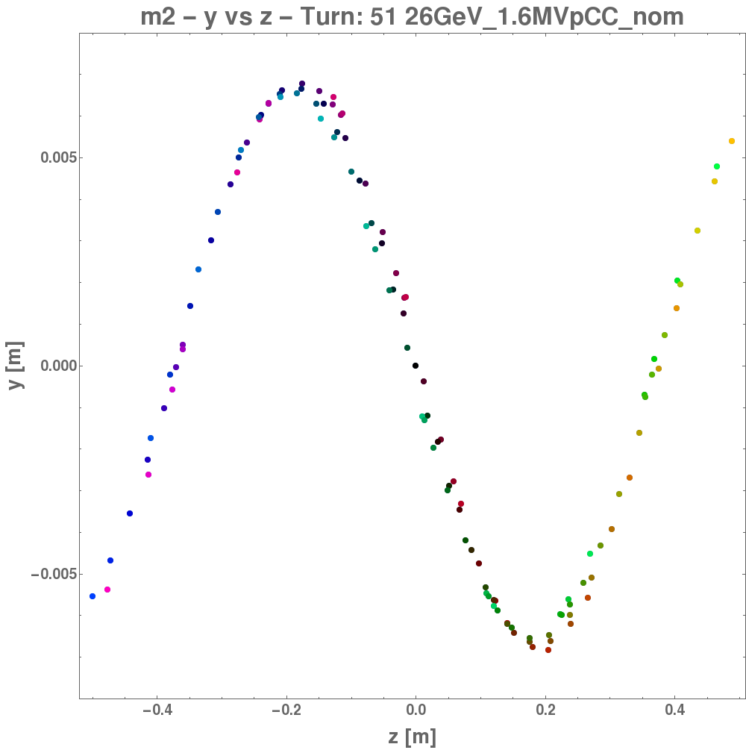
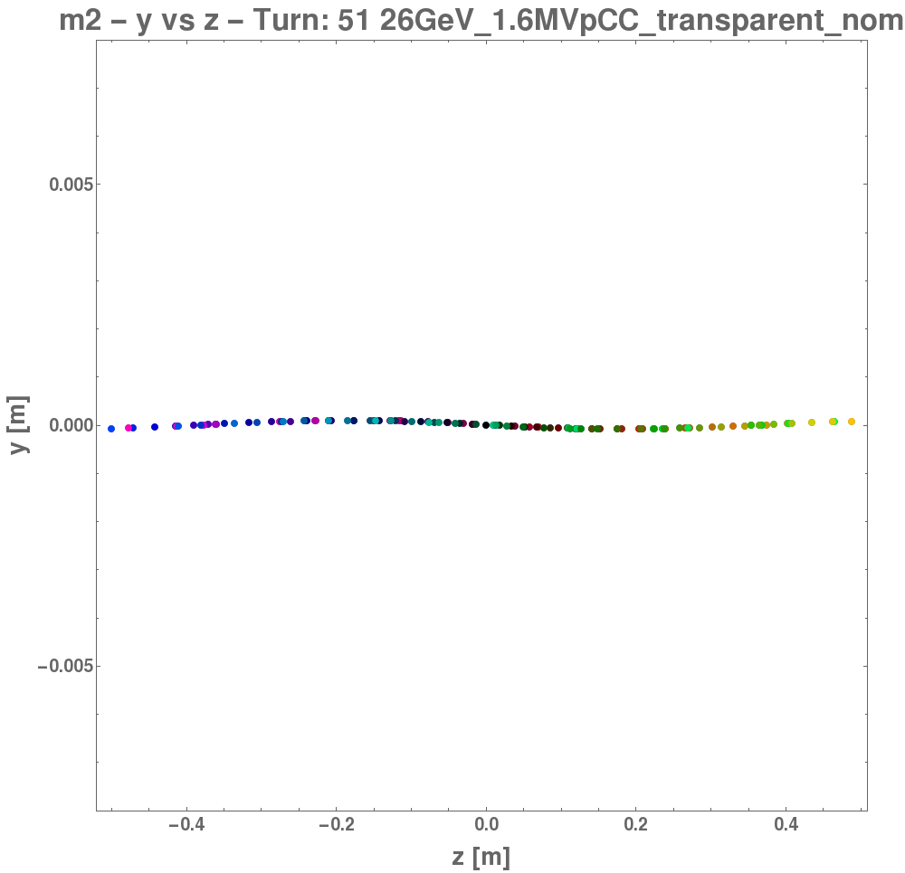
Crabbed Bunch Shape
Bunch shape after one turn of crabbing (26 GeV, 3.2 MV)
Transparent mode ~60 times smaller y offset
Non-transparent Mode
Transparent Mode

Slide 11
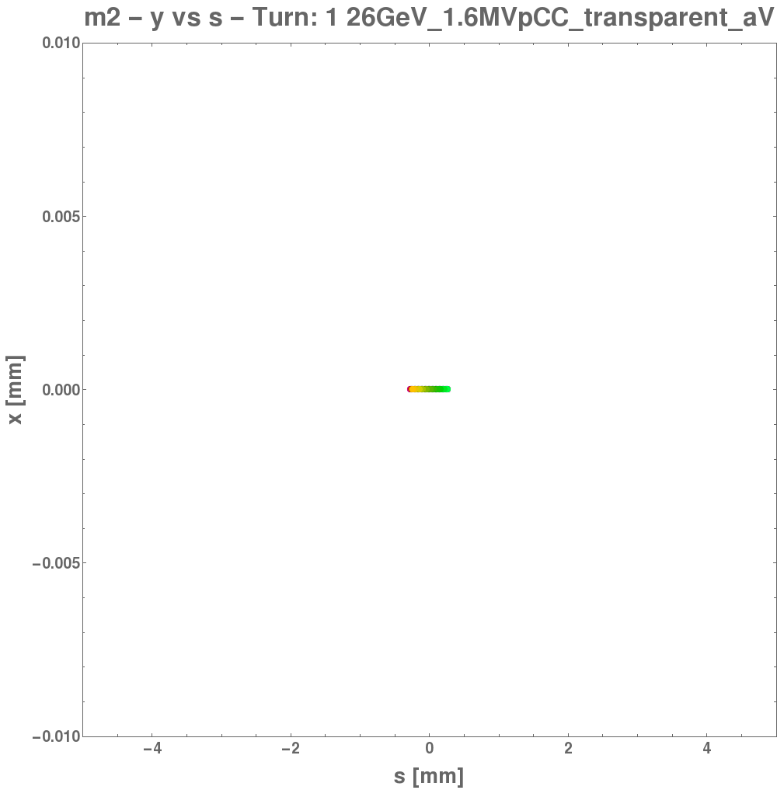
Crabbed Bunch Shape
Time-evolution of y vs Δs between CCs in transparent mode
  CCs on turn 50
  Voltage drop in one CC from turn 55

Slide 12
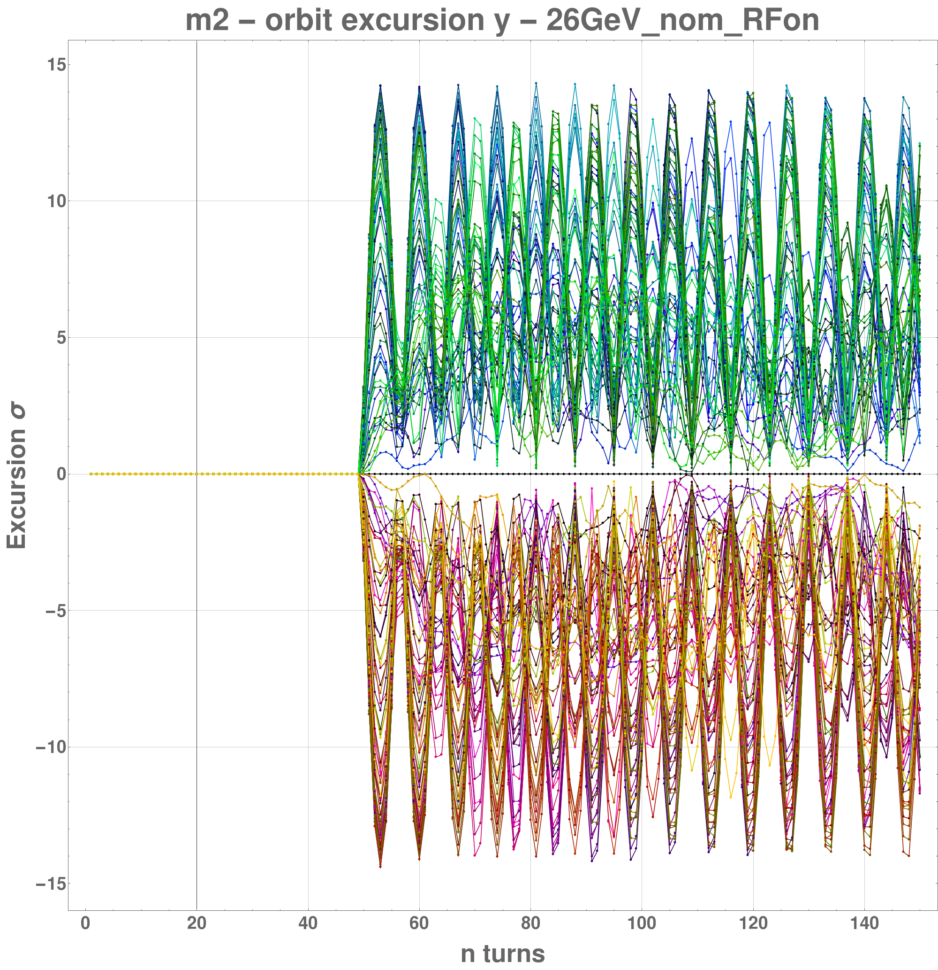
Phased Mode - no failure
Beam impacts aperture. Total voltage must be limited < 3.2 MV
Kick amplitude ∝ 1/E
Normalization ∝ √E
⇾ Norm. kick ∝ 1/√E
Aperture limit ∝ √E
  ⇾ Max voltage ∝ E
Orbit Excursion - 26 GeV - 6 MV total kick
SPS Aperture
Energy [GeV] | Max Voltage [MV] | Aperture Limit [σ]
26 | 3.2 | 8
55 | 6.4 | 11
120 | 14.8 | 16
270 | 33.2 | 24
400 | 49.2 | 31
450 | 55.4 | 33
SPS Aperture

Slide 13
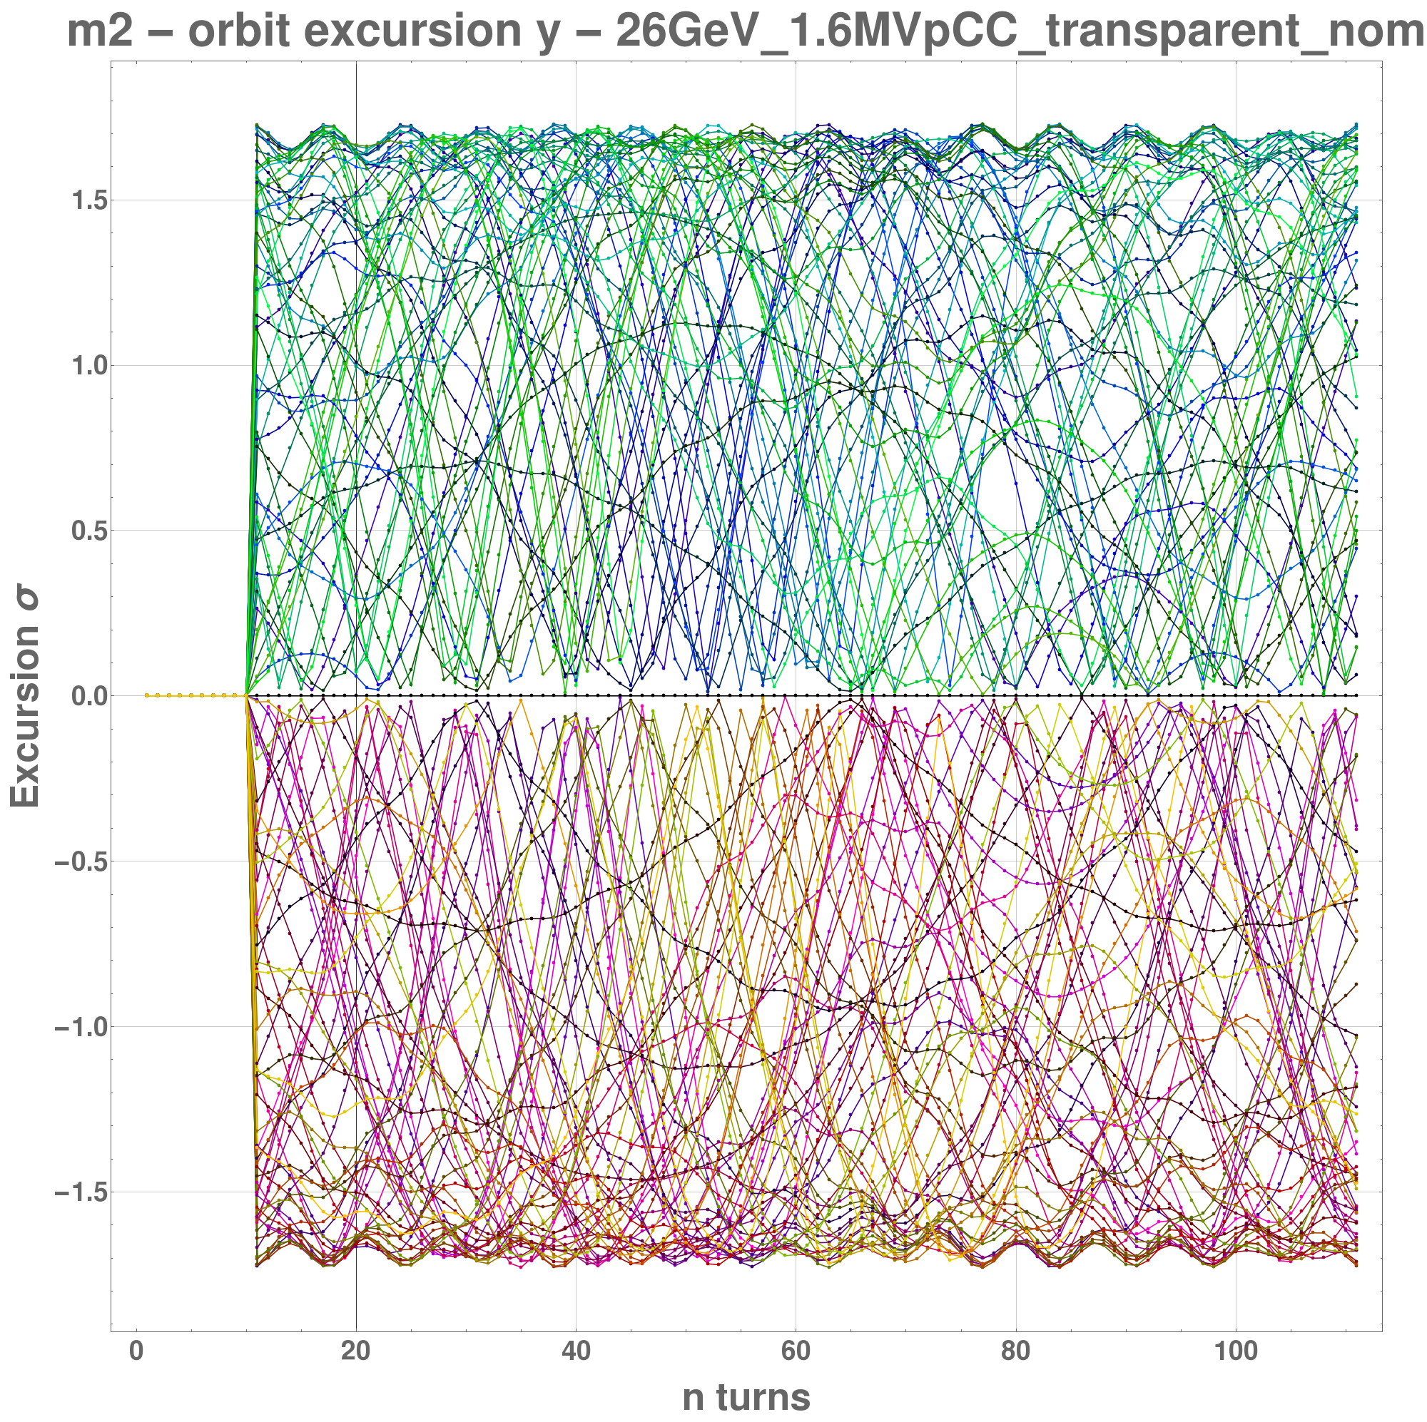
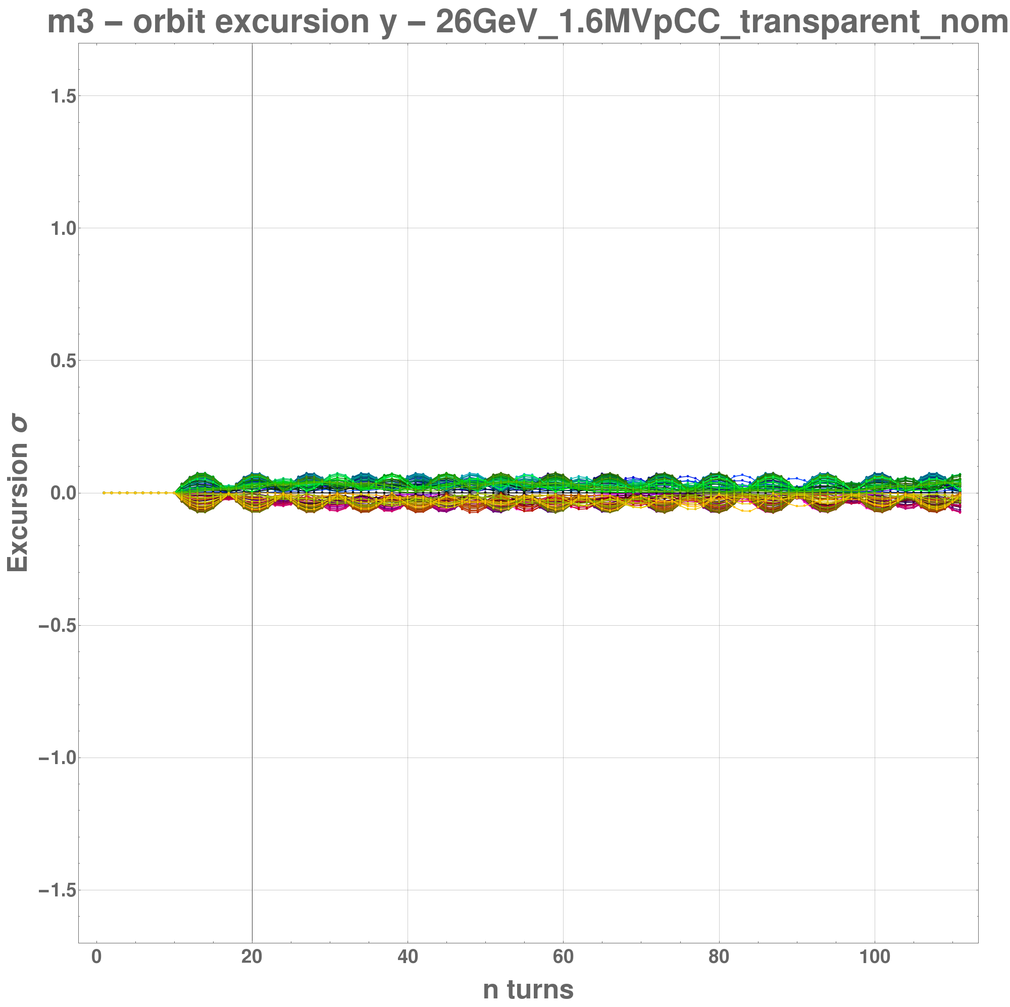
Transparent Mode - no failure
Residual crabbing outside CC region < 0.08 σ
Orbit Excursion between CCs
Orbit Excursion outside CC region

Slide 14
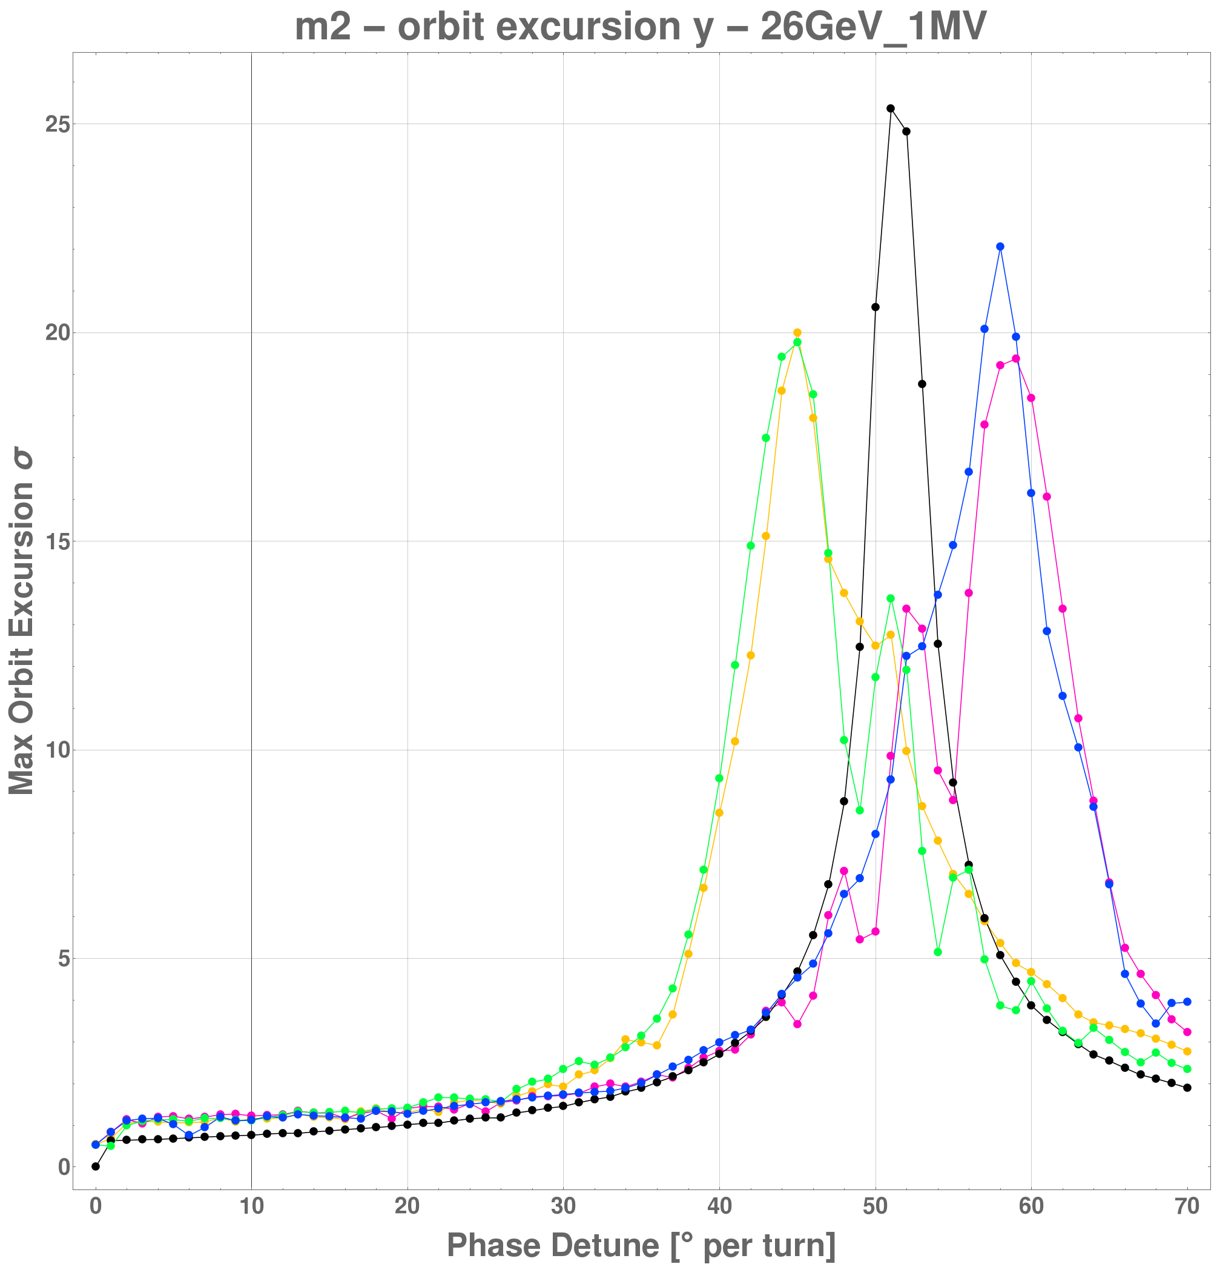
Transparent Mode - phase shift
Voltage kept constant at 1 MV
100 turns from failure tracked
Five particles:
Resonance around the fractional tune of optics
Plot can be scaled to appropriate voltage to determine dependence of orbit excursion vs voltage
Maximum orbit excursion vs Phase detune

Slide 15
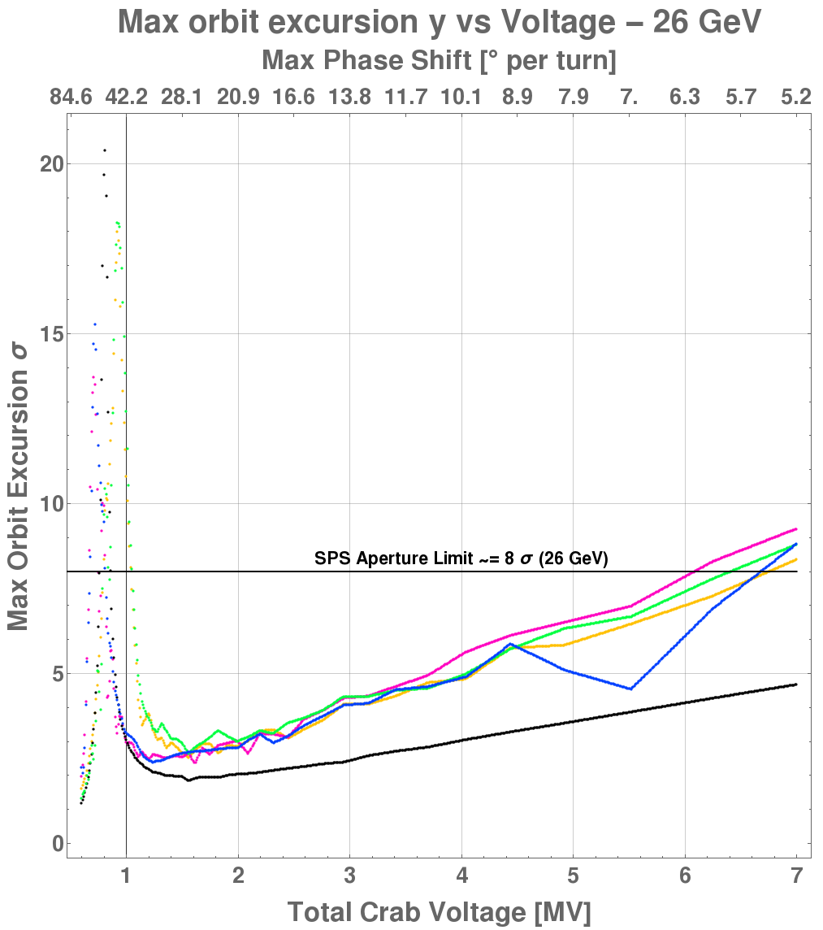
Transparent Mode - Phase Shift
Max possible phase shift per turn is used to determine max orbit excursion vs voltage
For low voltage, there is risk of resonance, while for high voltage the kick amplitude can be too large
  ⇾A “valley” of safer voltages

Slide 16
Transparent Mode - Phase Shift
Low voltage resonance
Despite the lower kick amplitude of low voltage, the whole beam can impact aperture in < 20 turns at resonance (26 GeV, 1.65 MV)
SPS Aperture

Slide 17
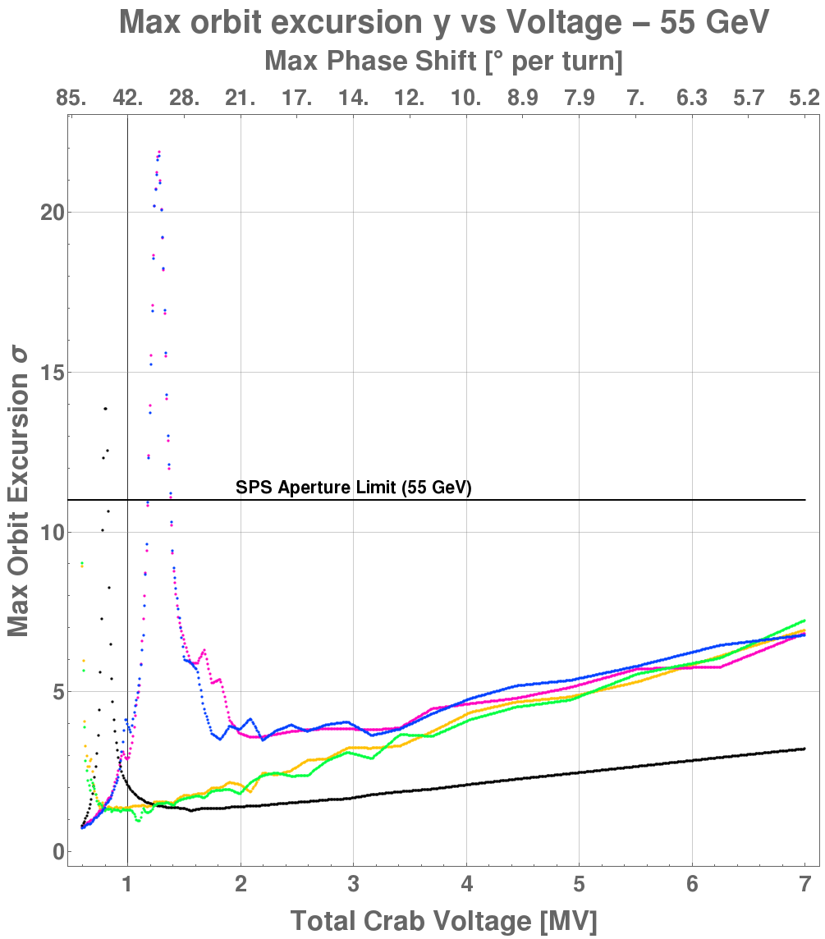
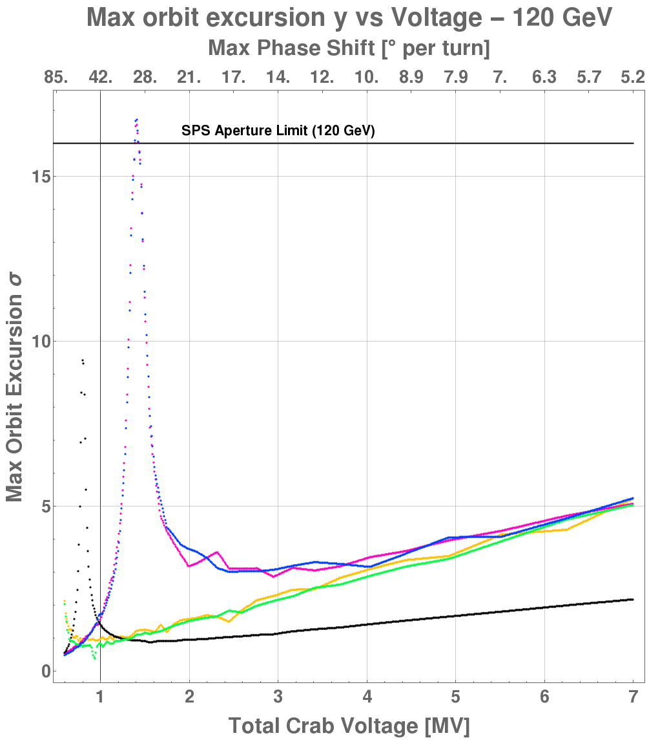
Transparent Mode - Phase Shift
With higher energy the voltage limits can potentially be relaxed
(note: vertical scale different)

Slide 18
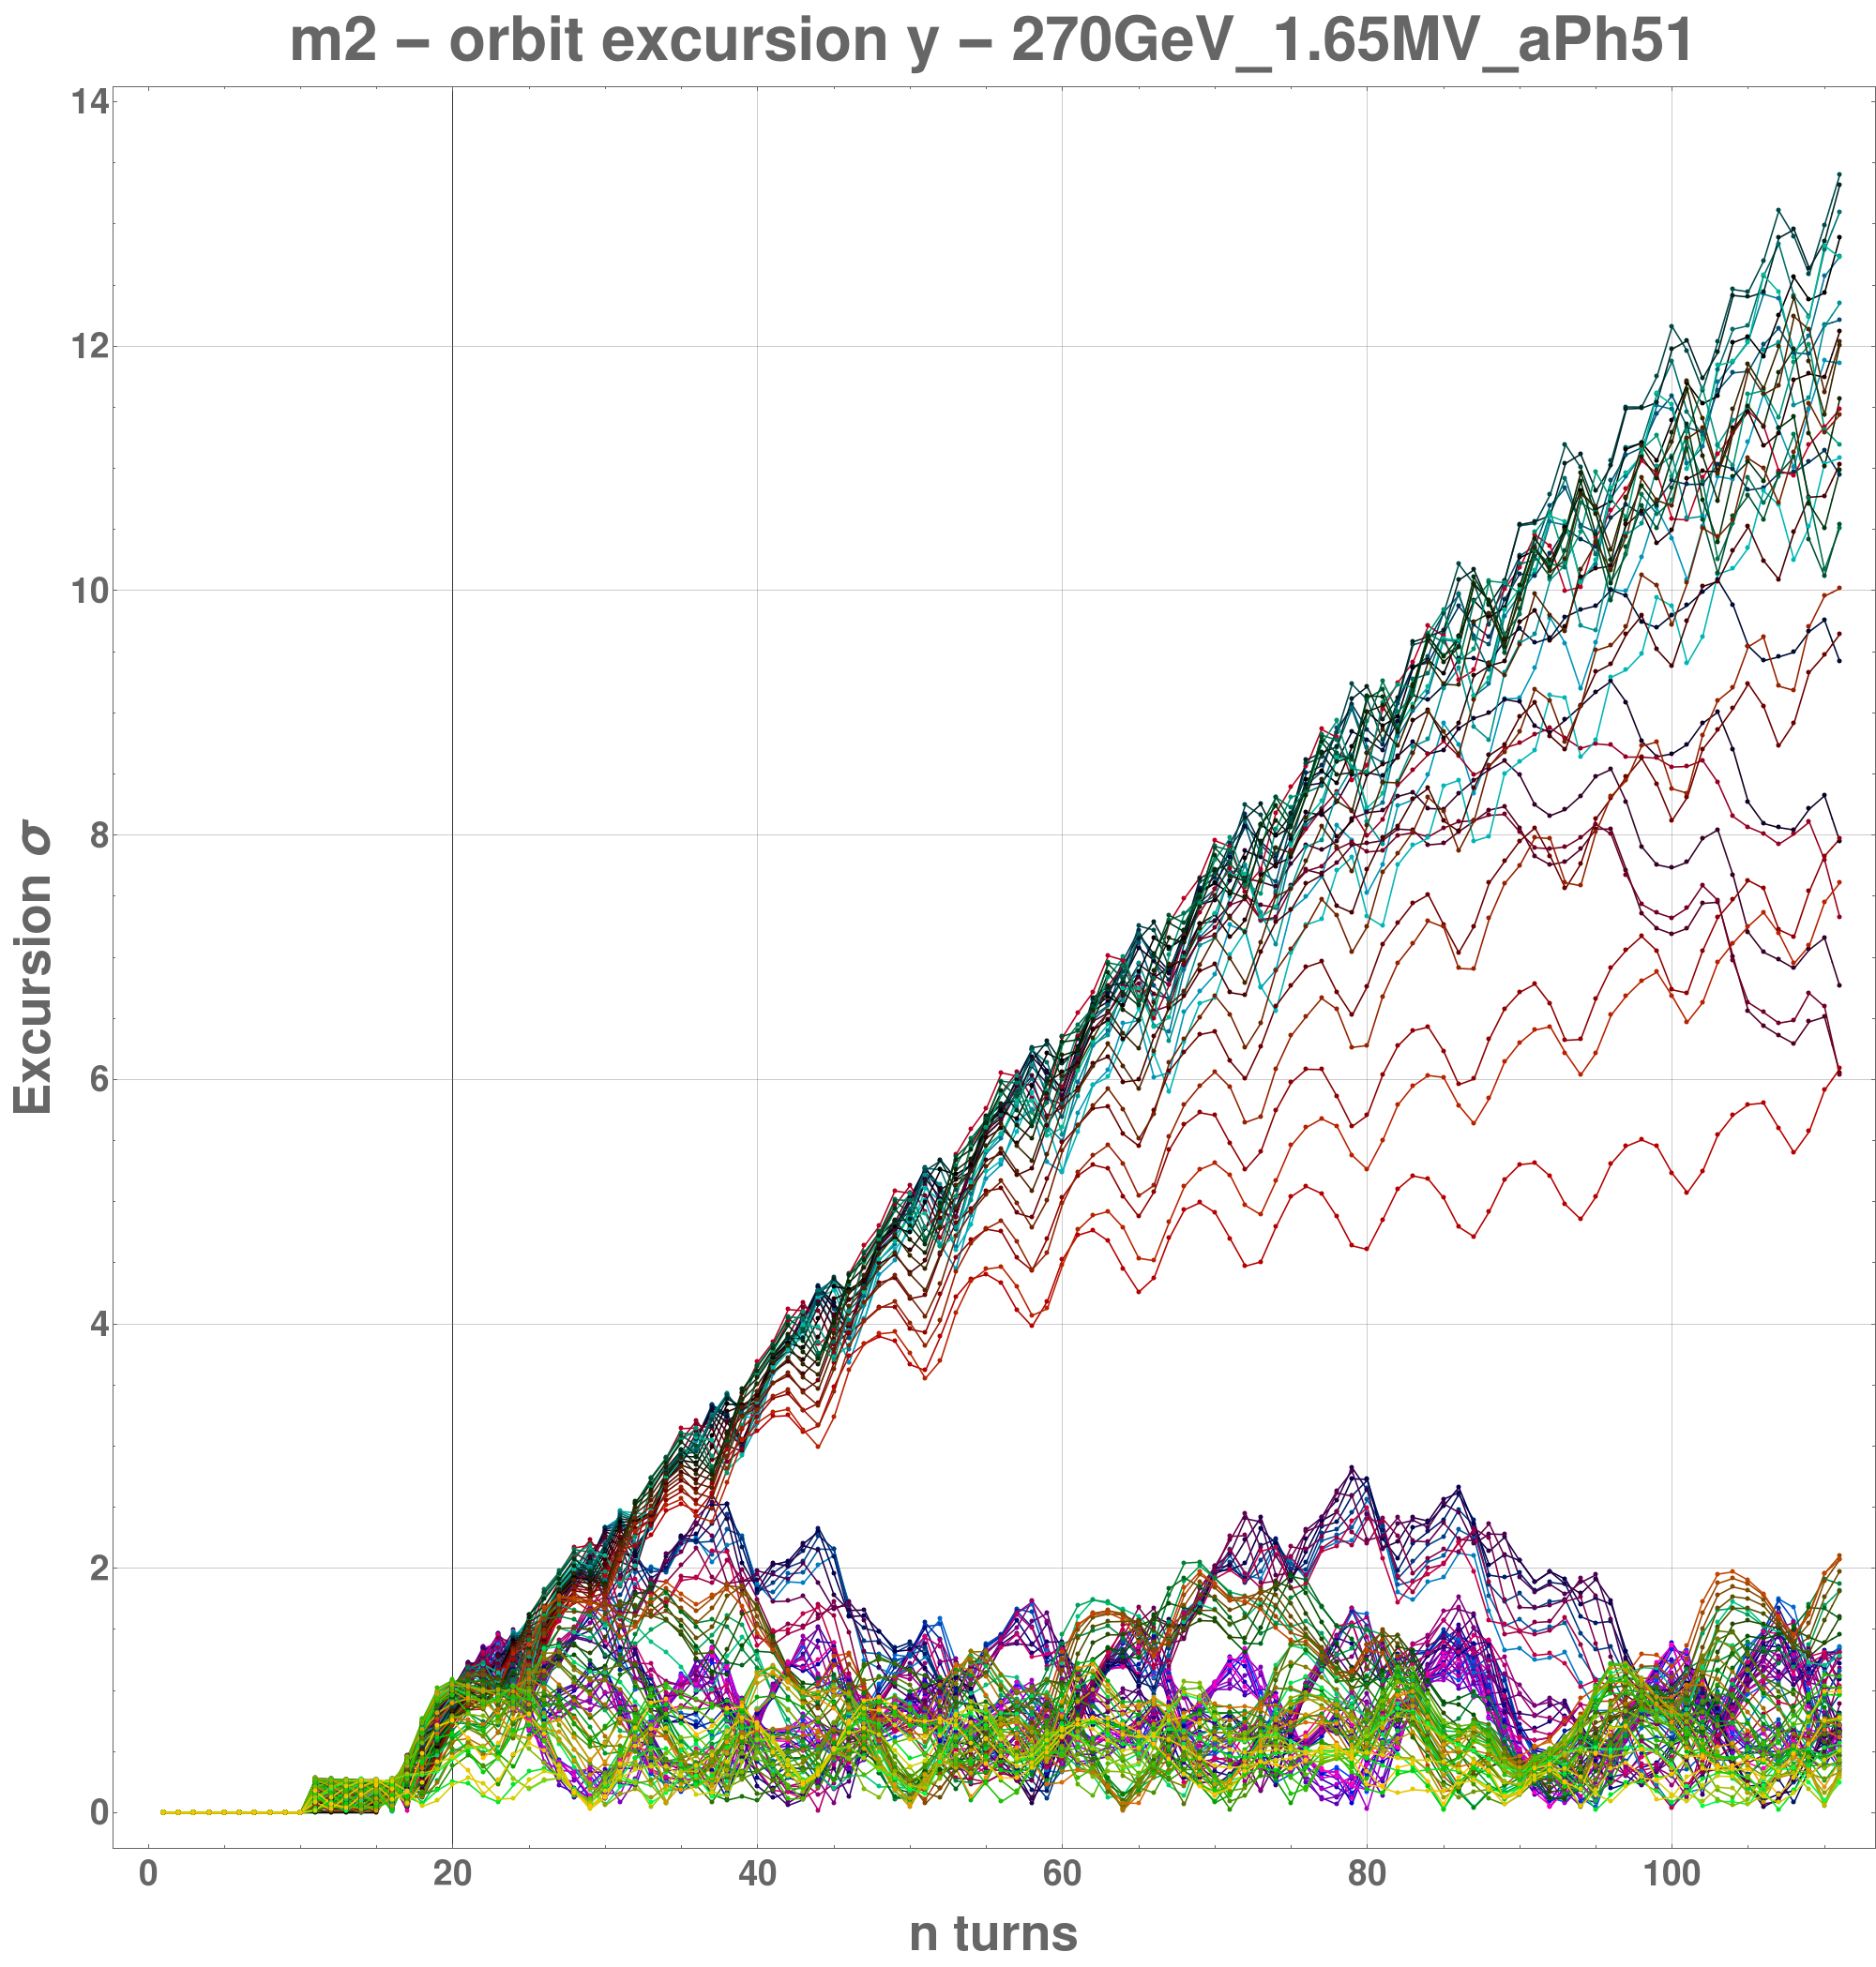
Transparent Mode - resonance for higher energies
For higher energies, the resonant failure is slow
(270 GeV, 1.65 MV)
SPS Aperture 24 σ

Slide 19
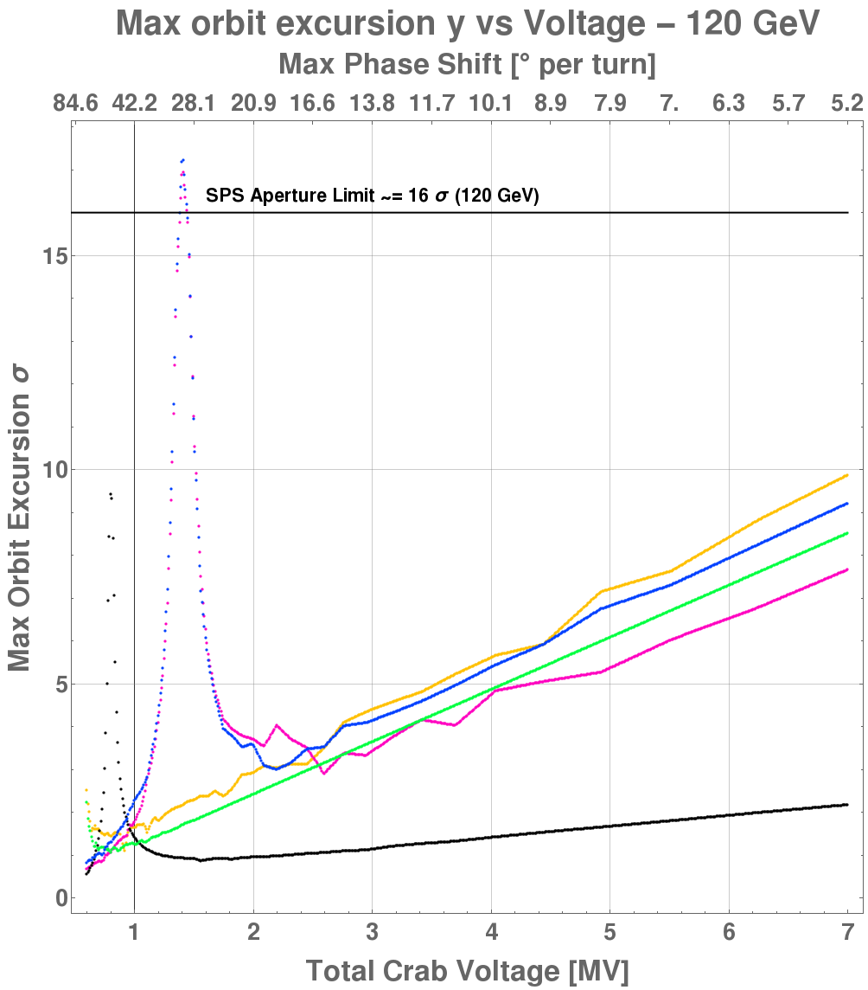
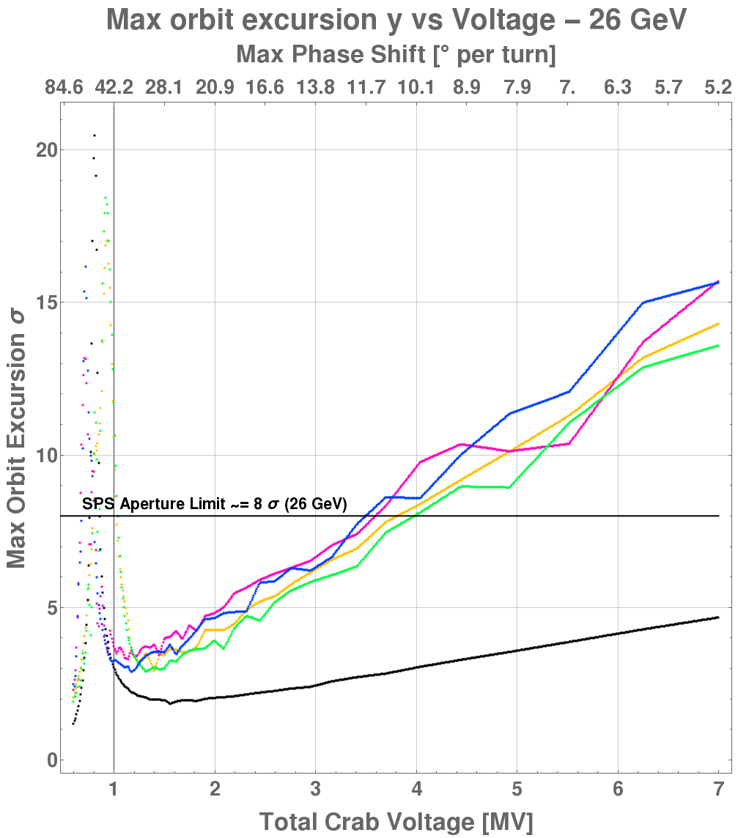
Non-transparent Mode - Phase Shift
For the non-transparent mode, the orbit excursion is larger for a given failure/phase

Slide 20
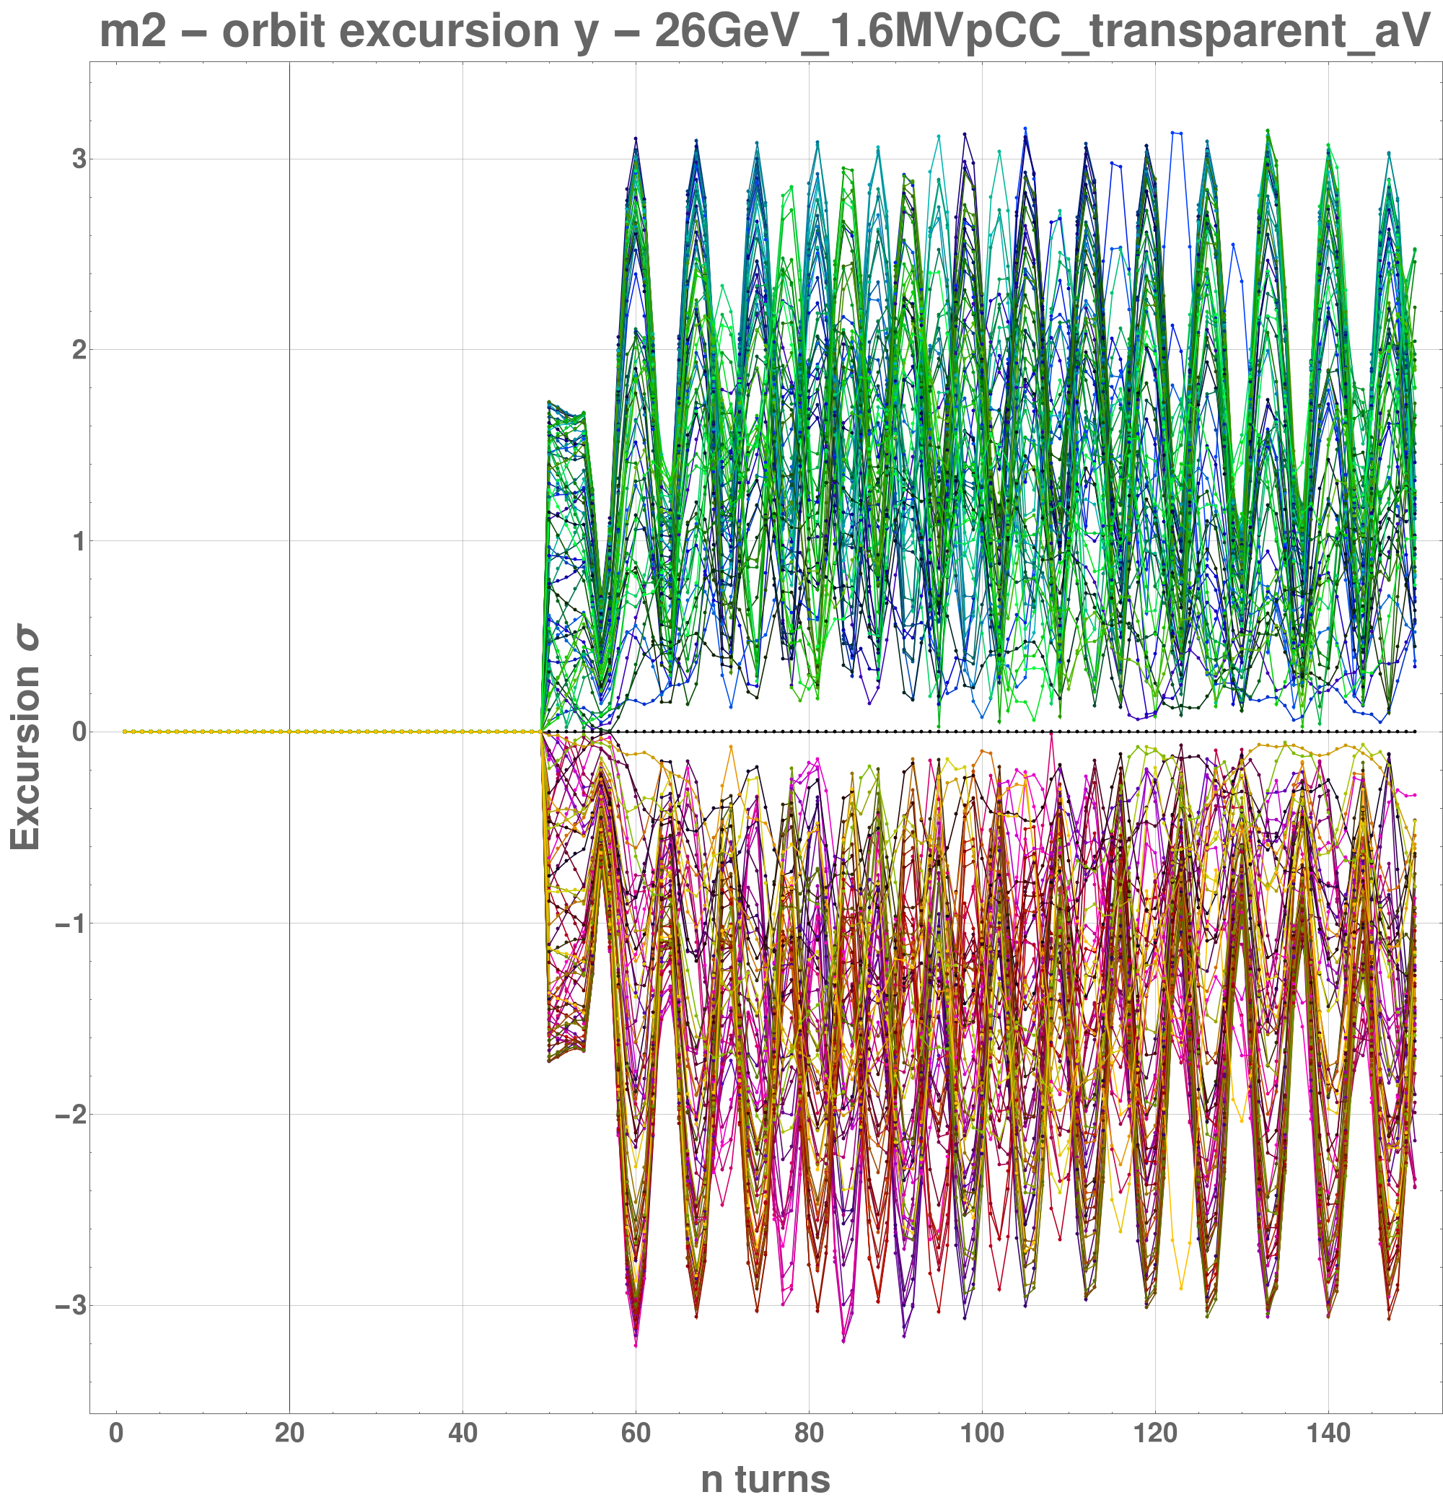
Voltage Drop
Only a potential concern for transparent mode
Can not be worse than nominal non-transparent mode of half the voltage
Region between CCs
26 GeV, 3 MV total - one cavity drops voltage over 4 turns

Slide 21
Summary
Due to risk of resonance, a lower bound on voltage might be required
Upper bound on voltage for lower beam energies required, even if no failure occurs
Phase failures can be critical for lower energies
  -- fast loss of whole beam
Resonance highly dependent on optics
  -- higher fractional tune could relax lower voltage limit and vice versa
Non-transparent mode is more dangerous in all cases

Slide 22
Outlook
Results in these slides impose conservative restrictions
  Actual beam loss studies to be done
Alignment errors can be large (< 2 mm) and need be considered
If used with slow extraction to North Area, risk of uncontrolled kick of beam into extraction channel due to local orbit bump and strong x-y coupling in the SPS
MDs will be conducted to test the various failure scenarios and benchmark the simulation models
  to be used for further studies for HL-LHC CCs

Slide 23
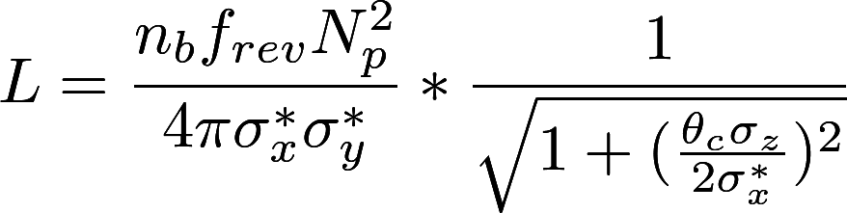
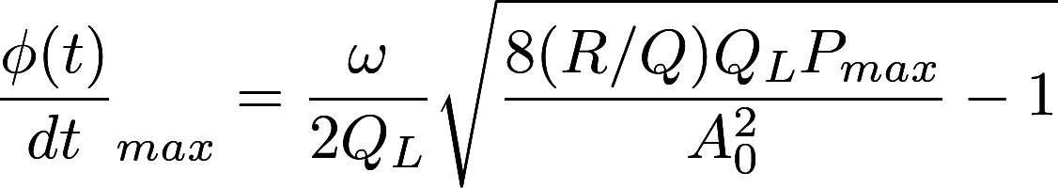
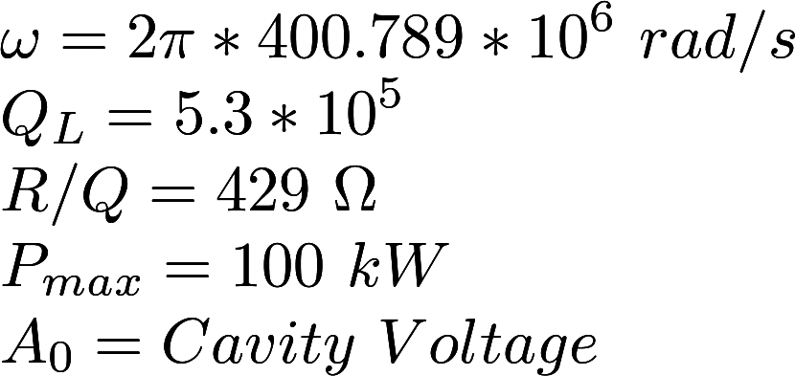
Extras

