Slide 1

Update on Crab Cavities failures in the HL-LHC:
Criticality of Crab Cavity failure as a function of phase advance
Matthieu Valette
CERN/TE-MPE-PE
Acknowledgements:
B. Lindstrom, D. Wollmann, A. Santamaria, K Sjobaek
PE section meeting – 01 March 2017

Slide 2
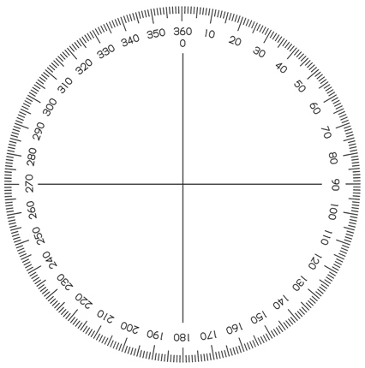
Different failures for different IPs/Beams
Until recently, only failures of the Cavities from IP1 Beam 1 were studied, the other cases were assumed to be similar.
There are in fact two orders of magnitude in terms of losses from one case to the next, this is due to the different phase advances:
  IP/Beam Phase advance Beam lost after 50 turns (5ms) Energy (MJ)
  ATLAS B1: 30° 0.85% 5.7
  ATLAS B2: 16° 0.09% 0.6
  CMS B1: -134° 5.88% 39.8
  CMS B2: 45° 2.23% 15.1
x’
x
Beam 1
Collimation
IP1

Slide 3
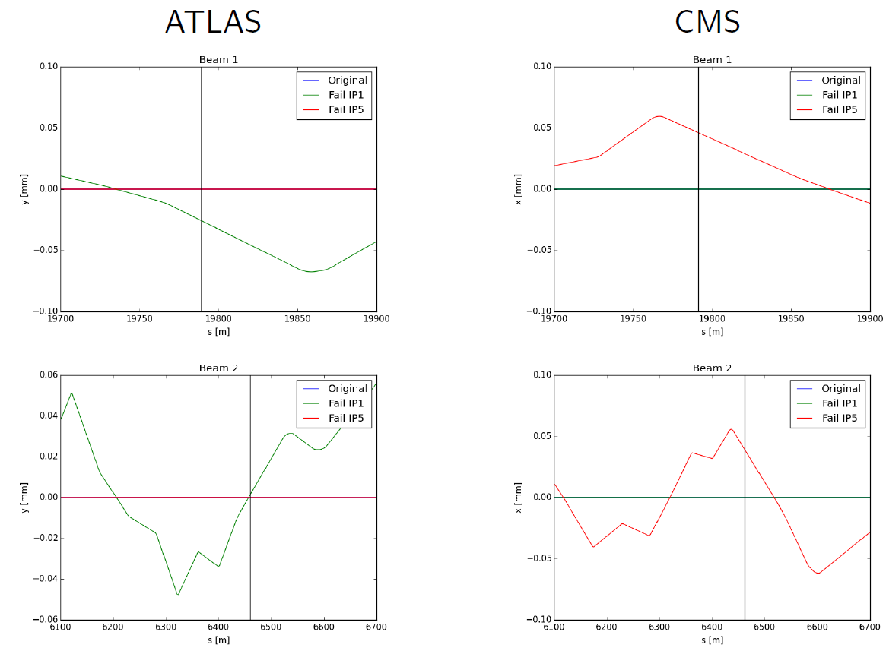
Different failures for different IPs/Beams
Courtesy K. Sjobaek

Slide 4
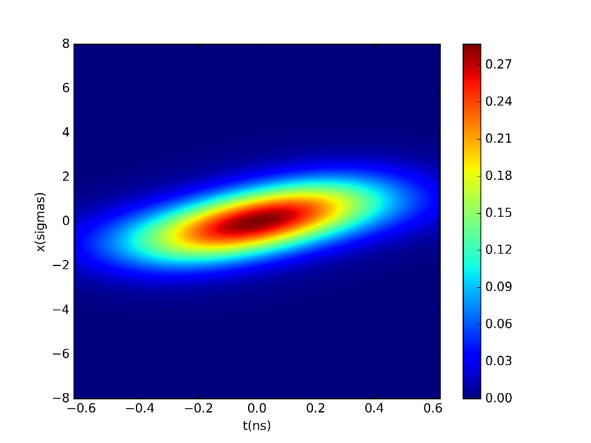
Linear Optics model (1)
The LHC optics are simulated using transport matrices, which only requires the phase advances from one point to the next but doesn’t take into account non-linear optical effects.
Three particles are tracked and the beam distribution is reconstructed from them.
φ_{CC->TCP}
Beam distribution
Beam 1
Collimation
φ_{IP}
Q_{x}/Q_{y}

Slide 5
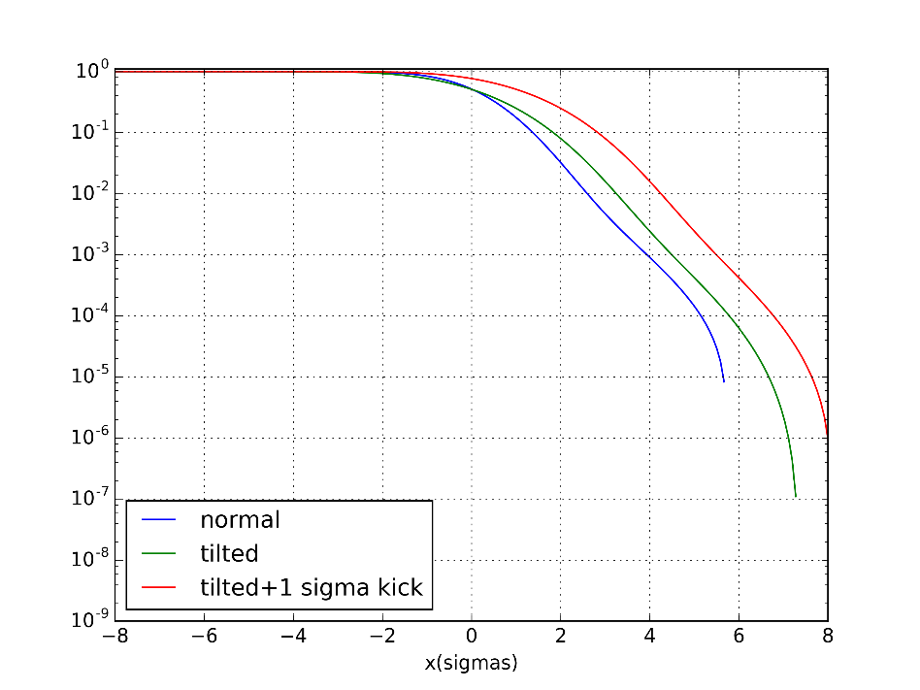
Linear Optics model (2)
The tilted/shifted beam distribution is then integrated from the collimation limit to infinity.
This proportion of the beam is then lost.
Beam distribution
Distribution integrals
5.7σ
5.7σ
Due to the tune being close to 1/3, the losses can be overestimated from turn 4

Slide 6
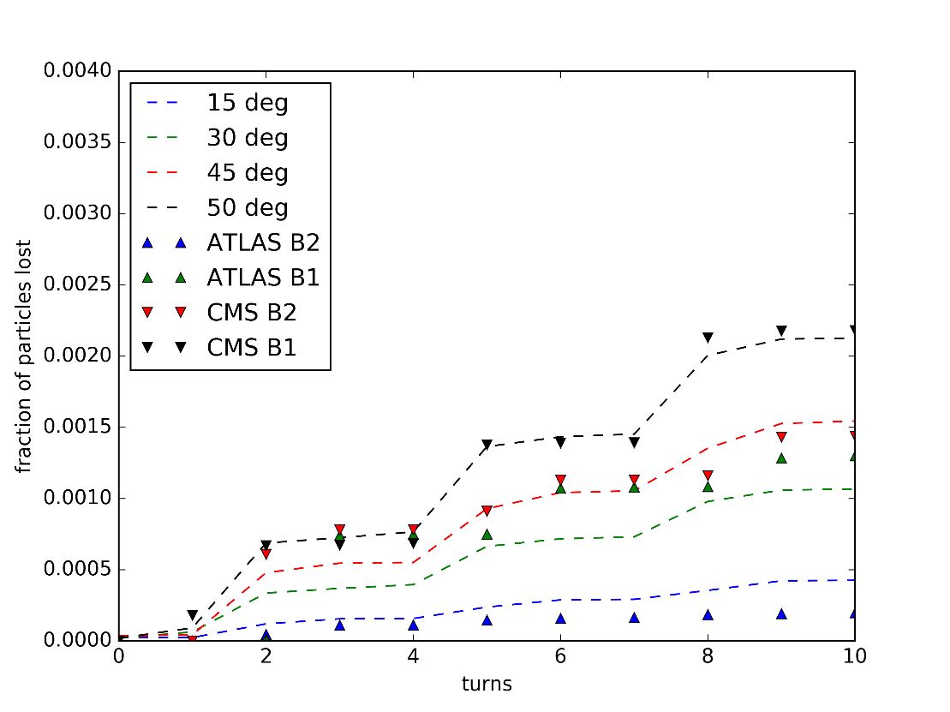
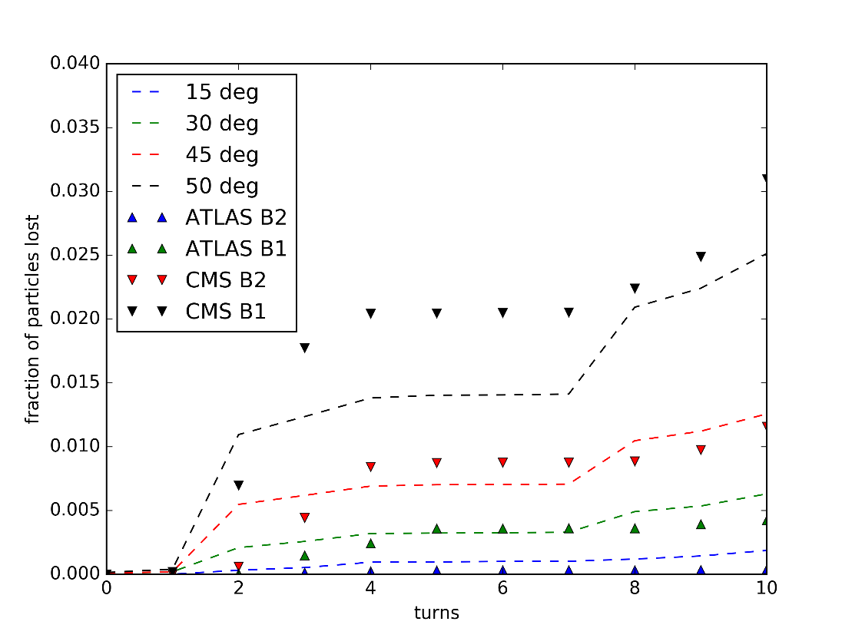
Benchmark of the model
The results from these calculations are here compared with SixTrack simulations done for the 4 sets of Crab Cavities (ATLAS/CMS, B1, B2) for two reference failure cases:
  60 degrees phase jump (the phase reference is changed in the control room)
  60 degrees per turn detuning (the LLRF/feedback loop goes crazy)
Very important losses are underestimated
Losses for low phase advances are overestimated

Slide 7
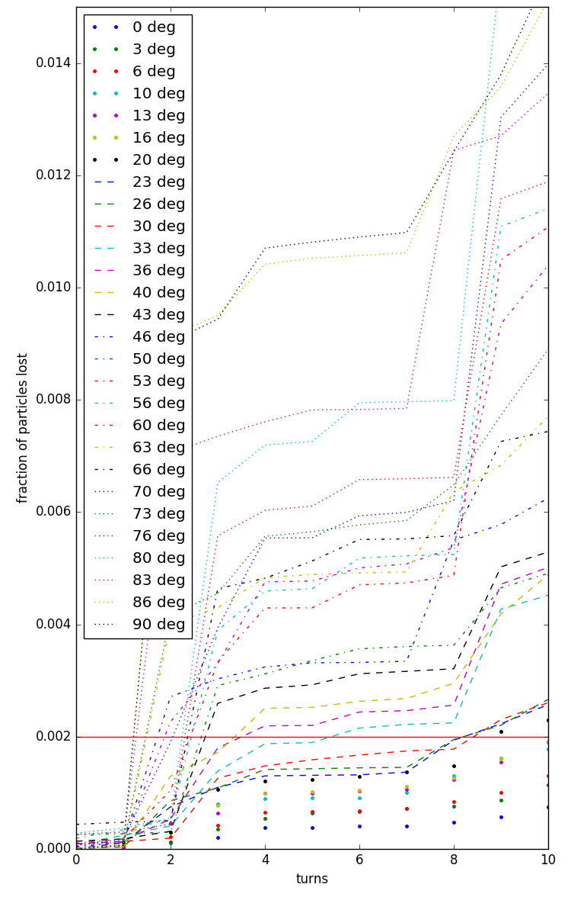
Preliminary limit on phase advances
The phase advance from the CCs to the collimators was then scanned to derive the losses in the first few turns.
The damage limit of the LHC collimation system is around 1 MJ, which corresponds to 0.2% of the beam.
A phase advance below 16 degrees allows staying below the damage limit after 10 turns with this model.
Damage limit
Current lectronic of the BLMs

Slide 8
Summary
A phase advance below 16 degrees allows staying below the damage limit after 10 turns with this model. This can be used as a preliminary limit.
This has to be confirmed by SixTrack simulations and by using more realistic beam distributions.
The possibility of relying only on a passive protection with phase advance has then to be reviewed:
  The losses in the Primary collimators would rise more slowly
  -> can they be detected by the BLM system in time ?
  The particles could then be lost elsewhere
  -> the loss patterns have to be studied
  The retraction of the secondary collimators would be fixed -> limits the reach in β*
  It also adds constraints on the optics -> which are already numerous

Slide 9
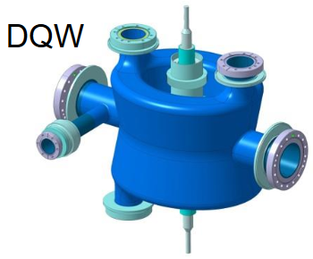
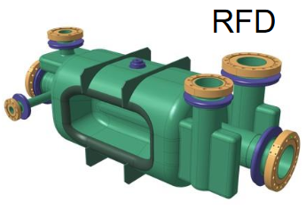
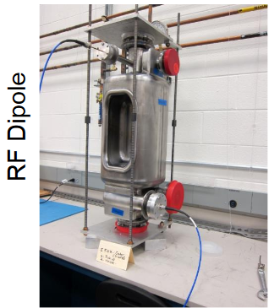
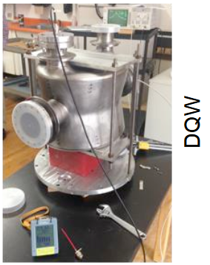
Bonus pictures

