Slide 1

Update on Crab Cavities failures in the HL-LHC:
Crab Cavities, availability and integrated luminosity – update with flat optics
Matthieu Valette
CERN/TE-MPE-PE
Acknowledgements:
A. Apollonio, D. Wollmann, J. Uythoven
PE section meeting – 01 March 2017

Slide 2
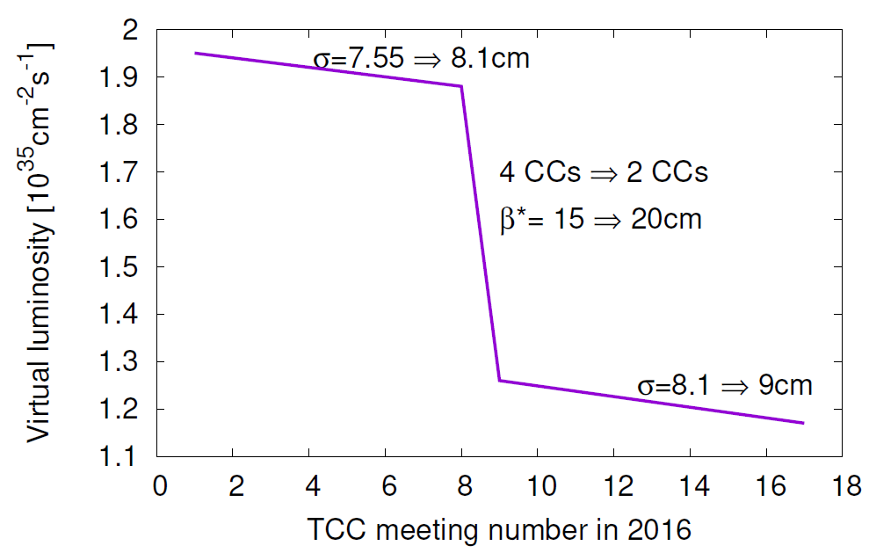
Recent re-baselining of the HL-LHC
Due to increased costs for civil engineering the budget of some work packages was cut and a new baseline was established:
  Number of Crab Cavities halved (32 -> 16)
  More realistic considerations on cold bore protection in the IP quadrupoles:
    β* increased from 15 cm to 20 cm
    Q4 & Q5 will operate at 1.9K, Q6 at 4.5K and moved 10 meters towards the IP
  Bunch length increased to 1.2 ns in two steps for stability and to account for bunch by bunch variation
See presentation from R. Tomas in the 2016 HiLumi meeting

Slide 3
New prospects on optics
The number of bunches could be increased from 2736 to 2800 using 80b trains
The bunch length could be reduced from 9 to 8.1 cm and the crossing angle could be lowered from 12.5 to 10 σ during the fill thanks to the intensity decreasing.
  The leveling would be done via β*
    lowering to stay below maximum allowed by experiment
  Anti-leveling with x-ing and bunch length
    increasing to level for a longer time
Flat optics: using different β* in x and y would allow compensating the geometric factor
  Requires larger aperture in Q4
See presentation from R. Tomas in the 2016 HiLumi meeting

Slide 4
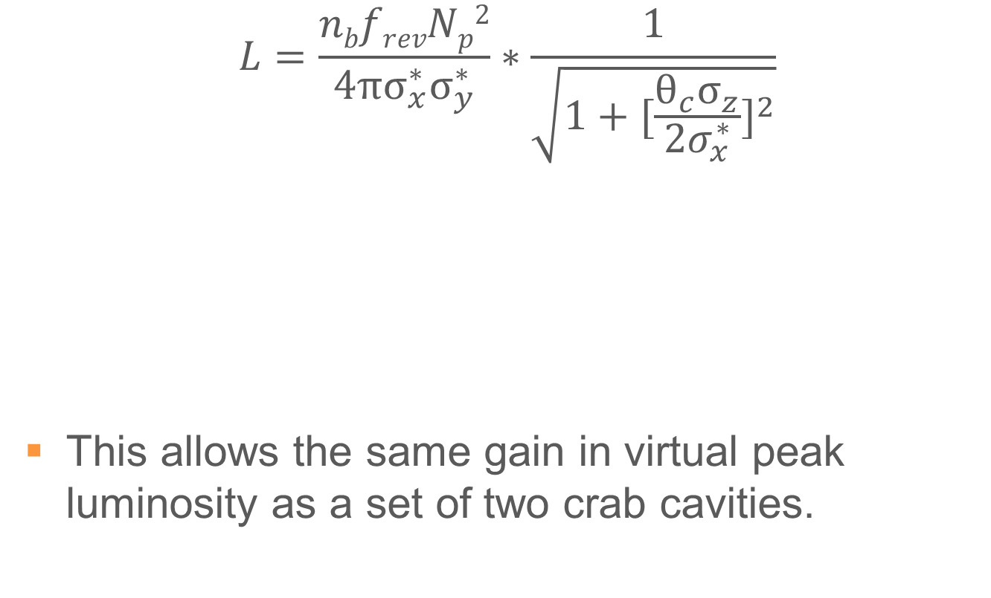
Luminosity considerations (1)
$$L=\frac{nbfrevNp2}{4πσ_{x}^{∗}σ_{y}^{∗}}∗\frac{1}{\sqrt{1+{[\frac{θ_{c}σ_{z}}{{2σ}_{x}^{∗}}]}^{2}}}$$
This allows the same gain in virtual peak luminosity as a set of two crab cavities.
One can gain in luminosity by increasing this ….
While keeping this constant

Slide 5
Luminosity considerations (2)
Beam 1
Beam 2
This is a 2D phenomenon
Flat optics
Round optics

Slide 6
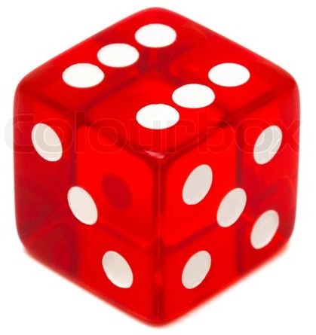
Monte Carlo model - schematic
Luminosity
Fill start
Fill start
Fill dumped
EoF dump
Dump time
Optimal Fill length
Exp distribution
Turnaround time
Lognormal distribution
Time
Fault time
Turnaround time
Exp distribution
Lognormal distribution
The distributions are taken to fit the availability data.
E.g. The turnaround time is a lognormal because most durations are centred around a non-zero value.

Slide 7
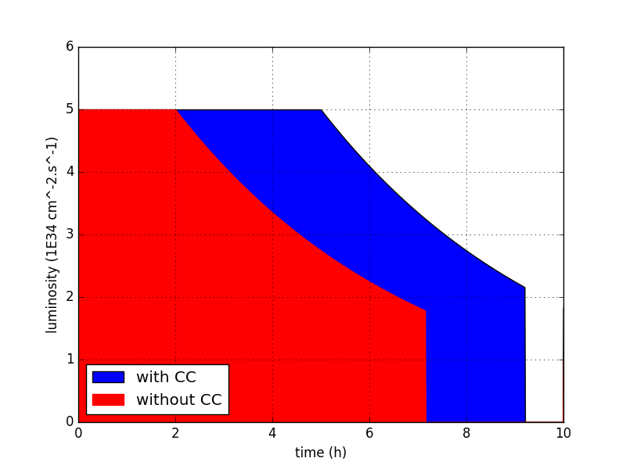
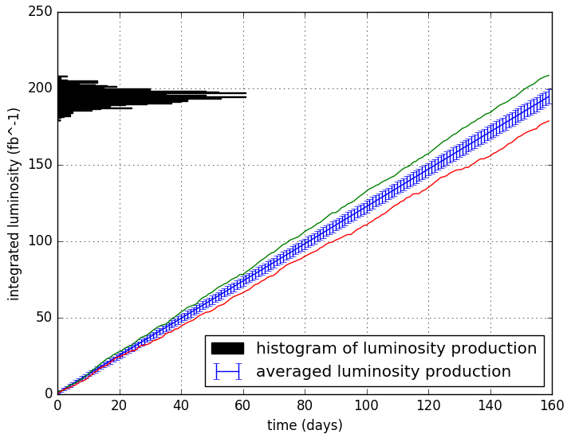
Luminosity production with perfect CCs
levelling
yearly luminosity production without CC
dump
Parameter | Round CC | Round no CC | Flat CC | Flat no CC
Virtual Luminosity (10³⁴cm⁻².s⁻¹) | 11.7 | 5.95 | 16.3 | 8.3
Levelling time | 5.2 h | 1.25 h | 6.75 h | 3.4 h
Optimal Fill length | 8.9 h | 6.9 h | 10 h | 7.75 h
Yearly Luminosity | 272 fb⁻¹ | 195 fb⁻¹ | 295 fb⁻¹ | 245 fb⁻¹
Physics efficiency | 48 % | 40 % | 50 % | 43 %
LHC Availability | 69 % | 65 % | 72 % | 67 %
This data doesn’t include CC failures

Slide 8
Monte Carlo model – introducing CC failures
CC failure
Exp distribution
Luminosity
Fill start
Fill start
Fill dumped
EoF dump
Dump time
Optimal Fill length
Exp distribution
Turnaround time
Lognormal distribution
Time
Fault time
Turnaround time
Exp distribution
Lognormal distribution
A CC failure can happen randomly at any time during a fill, even successful.
CC failures are kept as a separate type of failure to keep tack of their number.
The data on CC failures is limited, which availability parameter space to explore ?

Slide 9
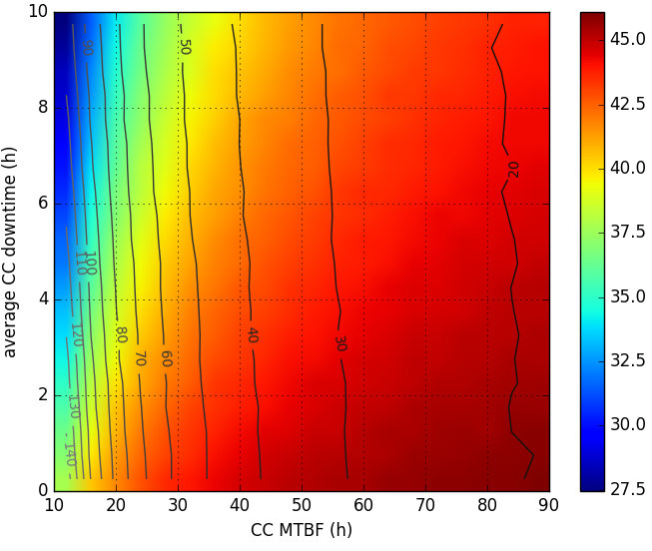
CC failures’ impact on availability – flat optics
Number of dumps due to CC
Physics efficiency (%)
Quench of a dipole magnet
(hours of physics)
KEKB CC
LHC AC

Slide 10
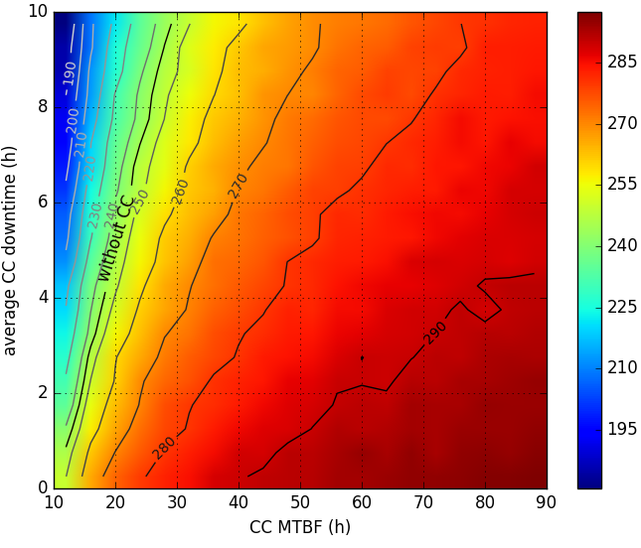
CC failures’ impact on luminosity – flat optics
Integrated luminosity (fb⁻¹)
Quench of a dipole magnet
In case a failure happens every other day and result in a quench.
Breakeven line
(hours of physics)
KEKB CC
LHC AC

Slide 11
Summary
A Monte Carlo model simulating effects of crab cavities on HL-LHC availability shows, that crab cavity faults:
  strongly impact HL-LHC physics efficiency.
  A fault every second day, causing magnet quenches, is not acceptable → gain in integrated luminosity due to crab cavities would be absorbed.
  A fault every 10h of operation without extra downtime, would also be unacceptable.
Failure modes (time scales, kick strength, … ) have to be fully understood to allow for mitigations, avoiding quenches (and damage) of superconducting magnets and the collimation system.
Experience with crab cavities in SM18, the SPS and Uppsala University will provide important input to extrapolate to HL-LHC physics efficiency.

Slide 12
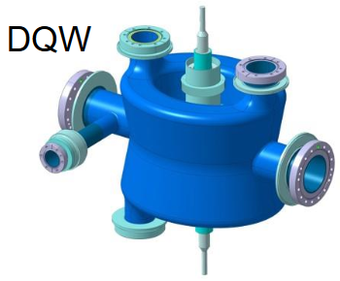
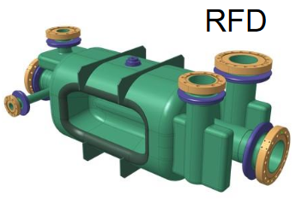
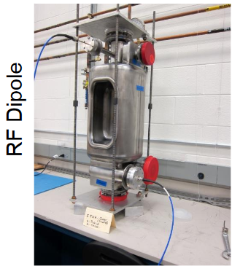
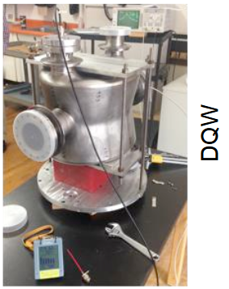
Bonus pictures

