Slide 1
UFO (simulations) updated
Objectives
Use Bernhard's and Scott's work, and continue to add additional physics
Extend the calculations to FCC parameters
Activities on UFOs:
Laura Grob –experimental
Martyna Dziadosz –data analysis
Yuancun Nie –FLUKA calculations
Rüdiger Schmidt -simulations

Slide 2
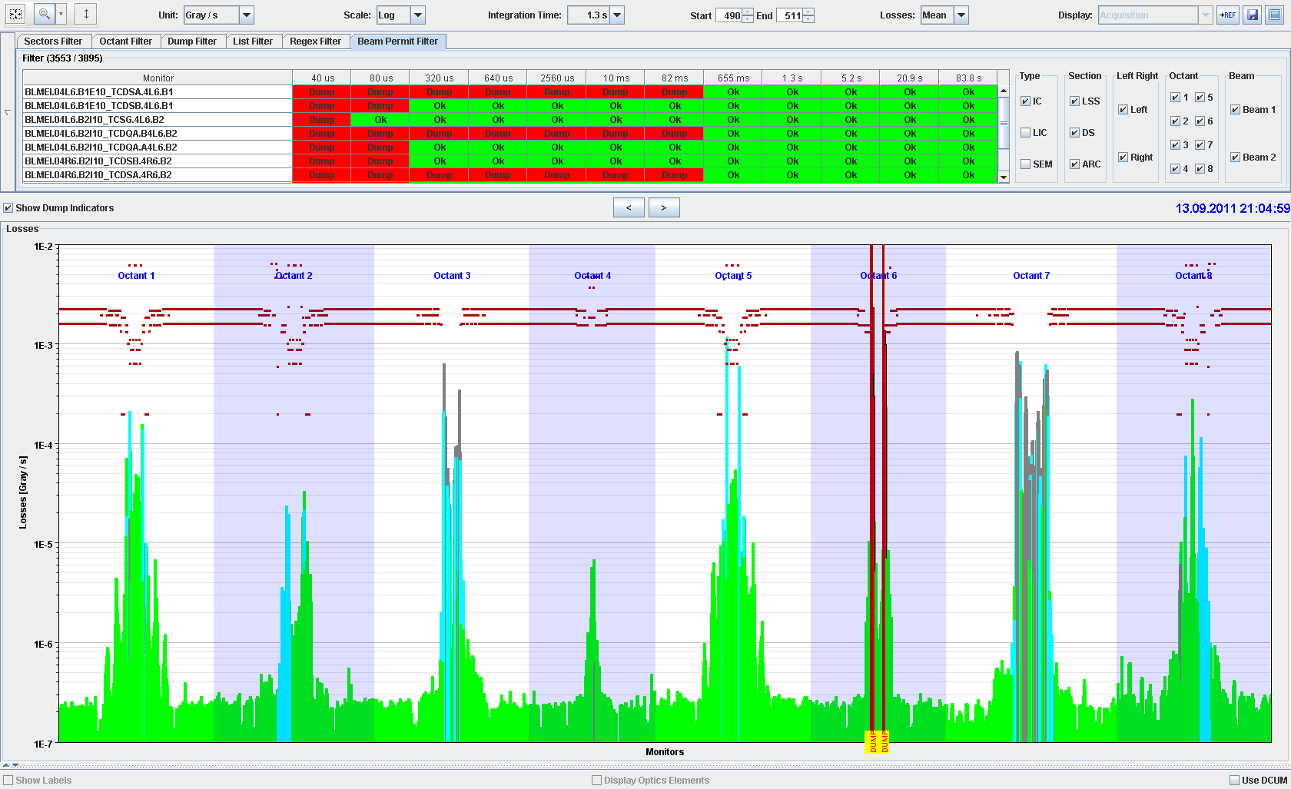
Continuous beam losses during collisions
ATLAS Experiment
ALICE Experiment
MomentumCleaning
RF and
BI
CMS Experiment
Beam
dump
Betatron Cleaning
LHCb Experiment

Slide 3
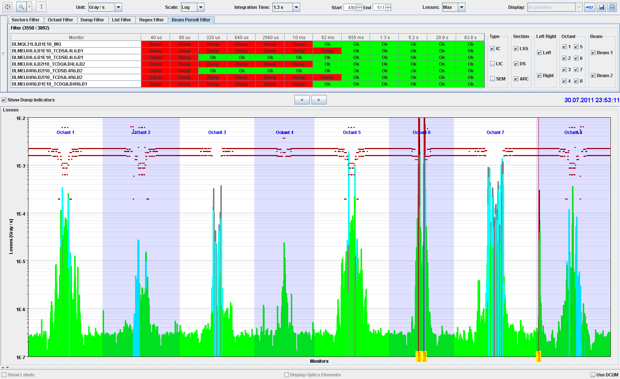
Accidental beam losses during collisions
ATLAS Experiment
ALICE Experiment
MomentumCleaning
RF and
BI
CMS Experiment
Beam
dump
Betatron Cleaning
LHCb Experiment

Slide 4
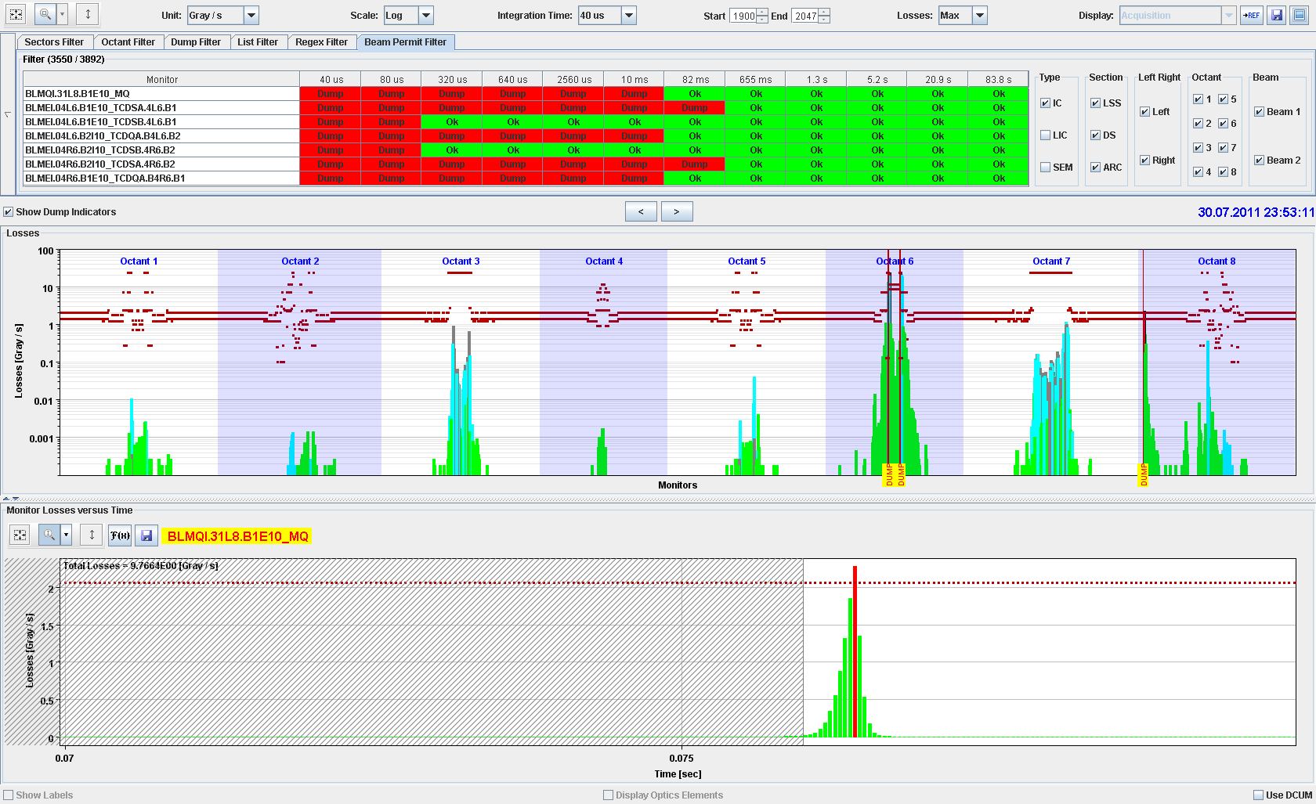
Accidental beam losses during collisions

Slide 5
Reminder: UFOs at LHC
Sudden “localised” beam losses are observed around LHC when operating with high intensity beams
The beam losses are large enough to quench magnets, when operating at high energy (6.5 TeV)
There was a significant conditioning of UFOs: the number of UFOs decreased over the years
A numerical model for UFOs was developed by Bernhard and Scott
  UFOs are falling by gravitation from the beam screen towards the beam
  There is an interaction between UFOs and the beam
  The signature of beam losses is predicted by the model

Slide 6
Poor mans beam screen drawing with falling dust
+- 1mm
14.5mm
y
46mm
x
1cm LHC = 3cm picture
Beam size 0.38mm, 0.13mm

Slide 7
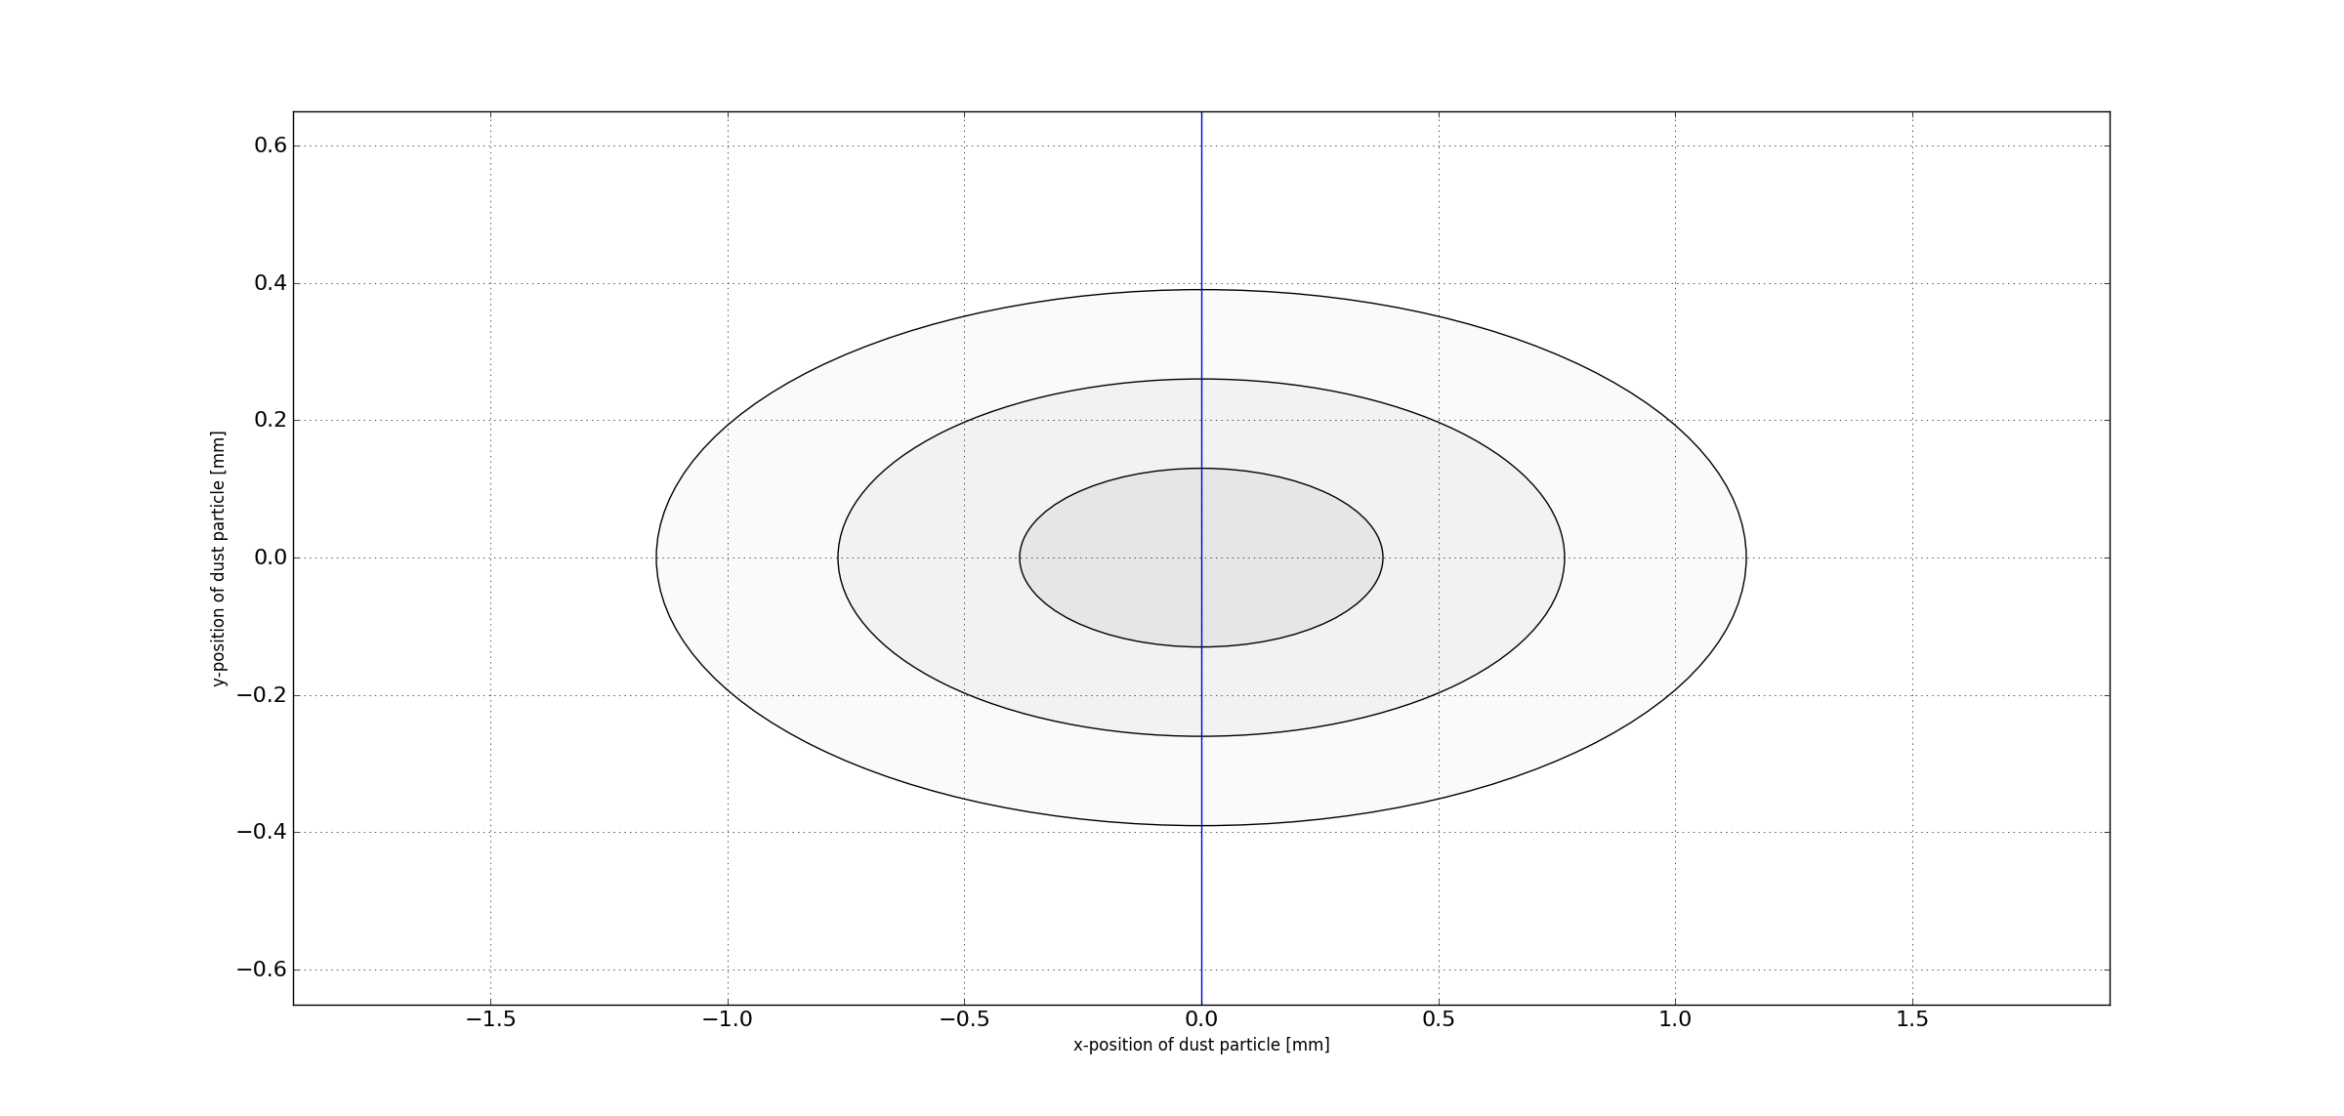
Looking towards the beam, 1E13 protons, about 100 bunches

Slide 8
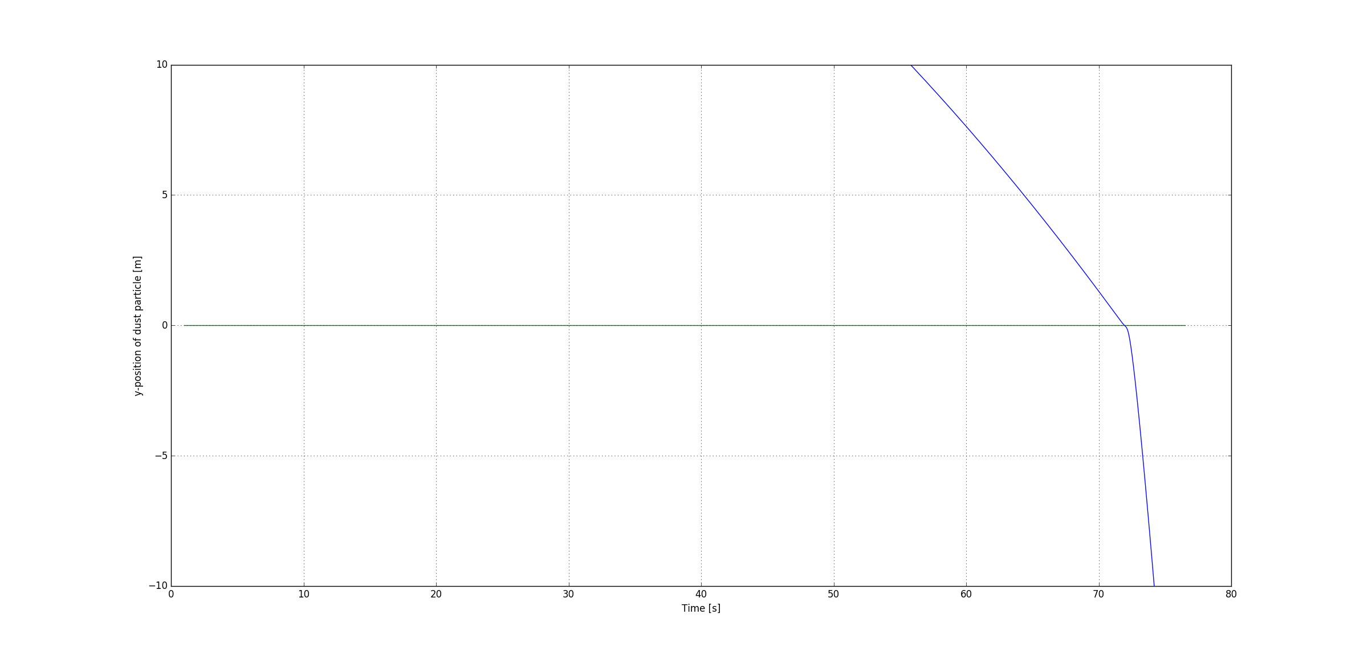
Position of dust particle versus time

Slide 9
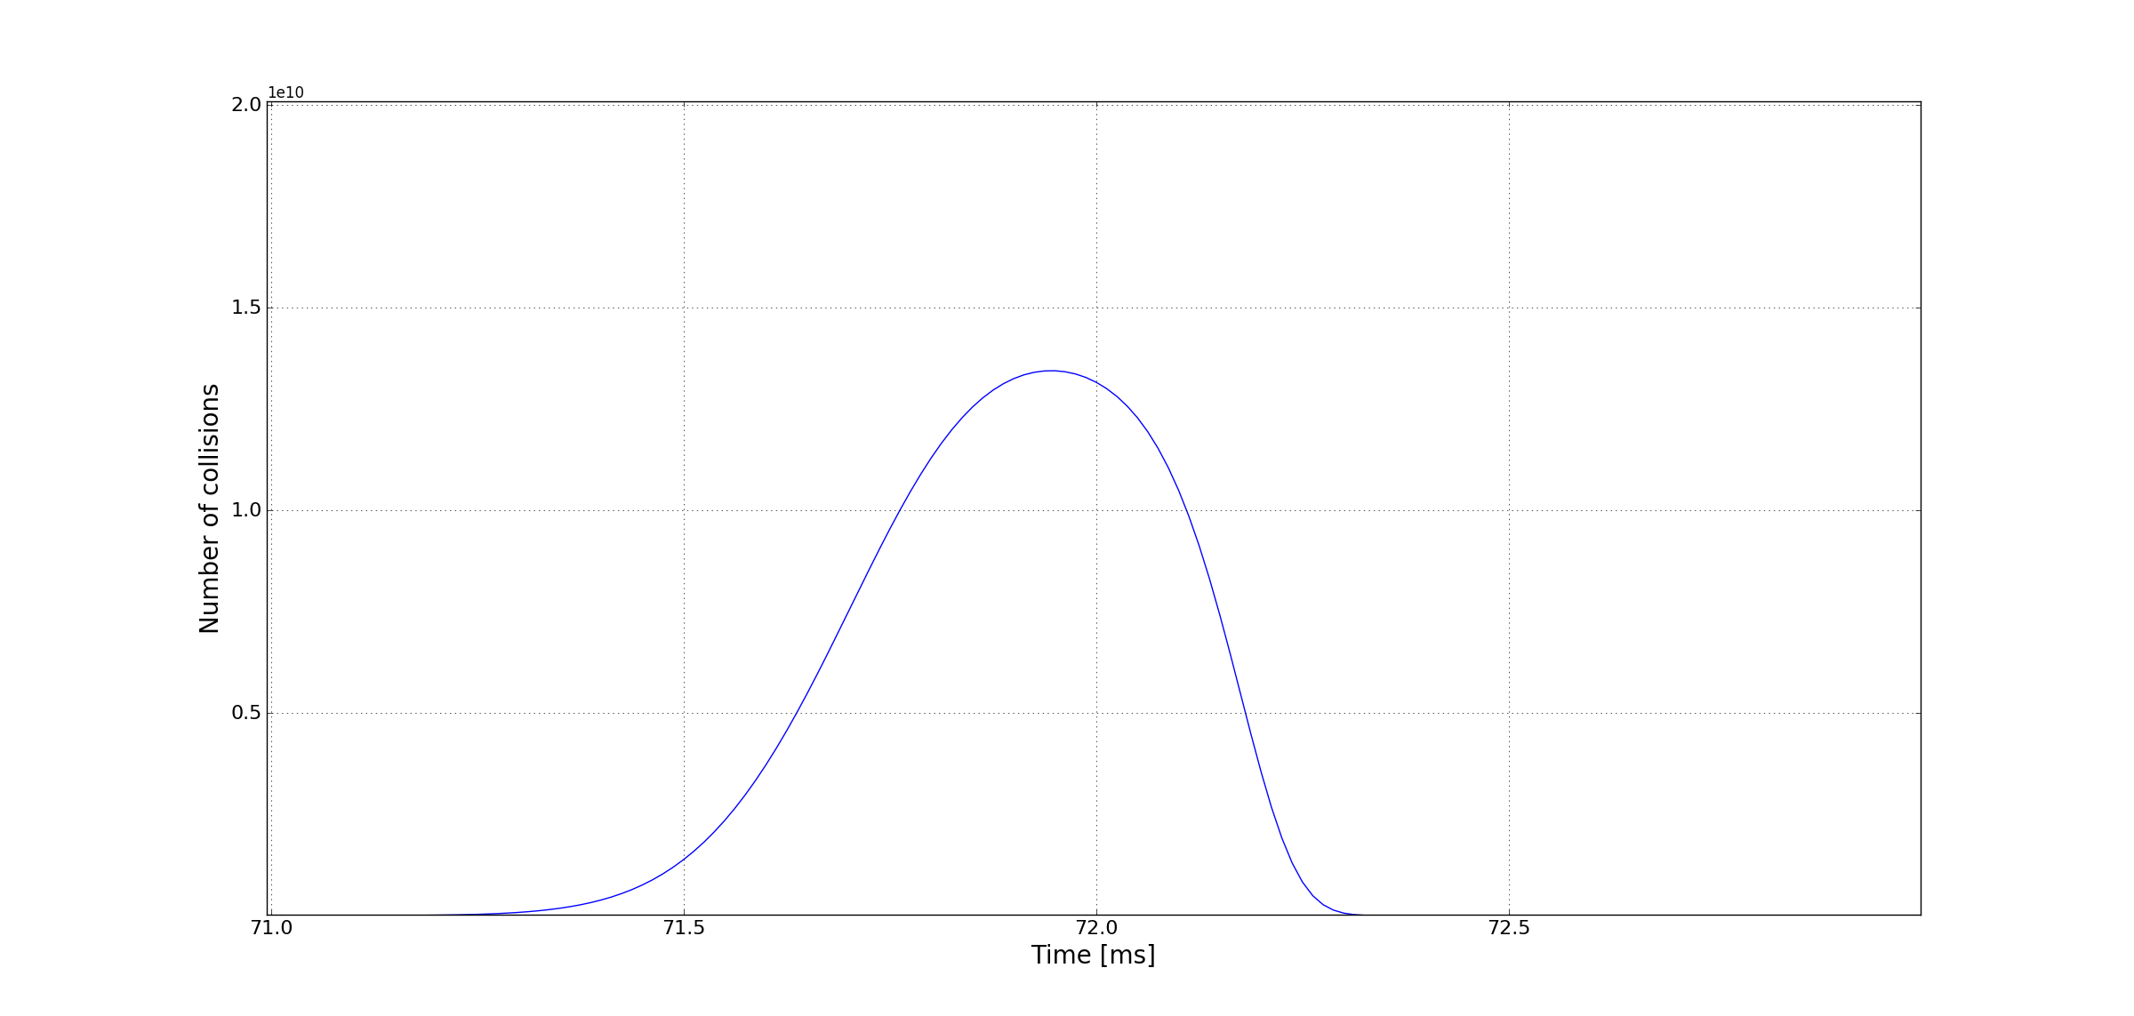
Signal in adjacent BLM

Slide 10
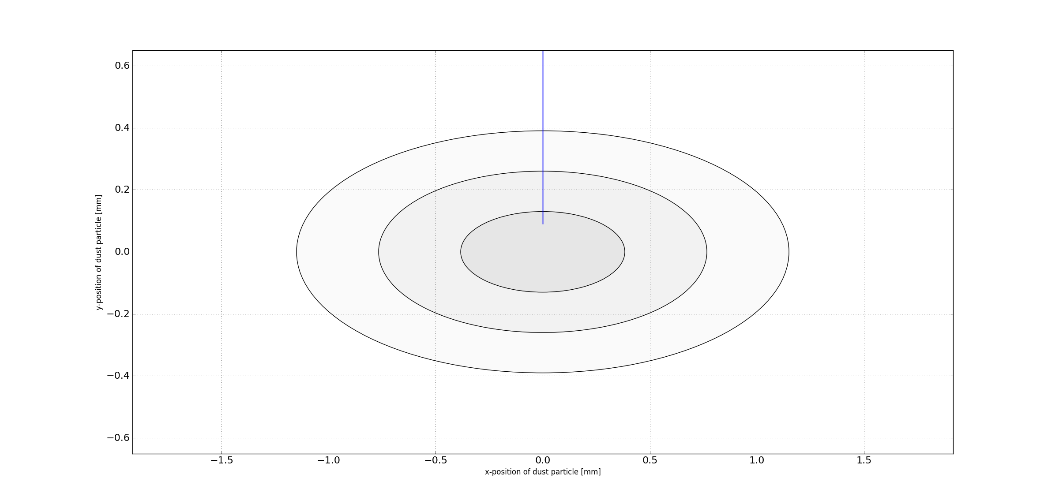
Looking towards the beam, 2E13 protons, about 200 bunches

Slide 11
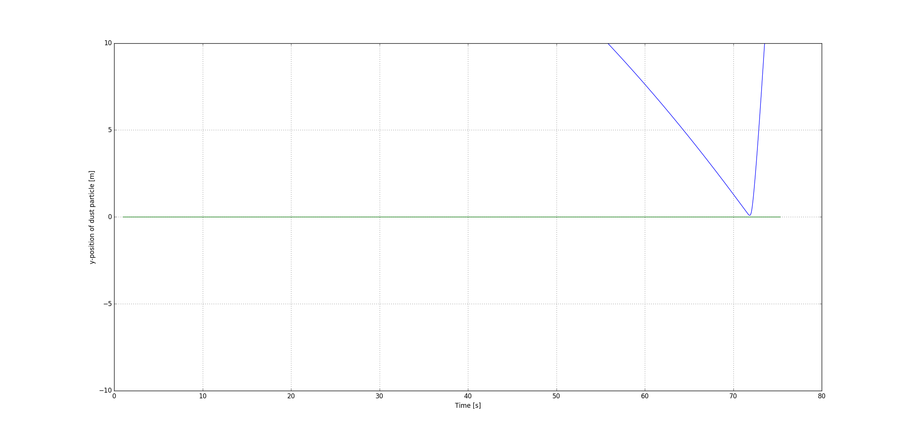
Position of dust particle versus time

Slide 12
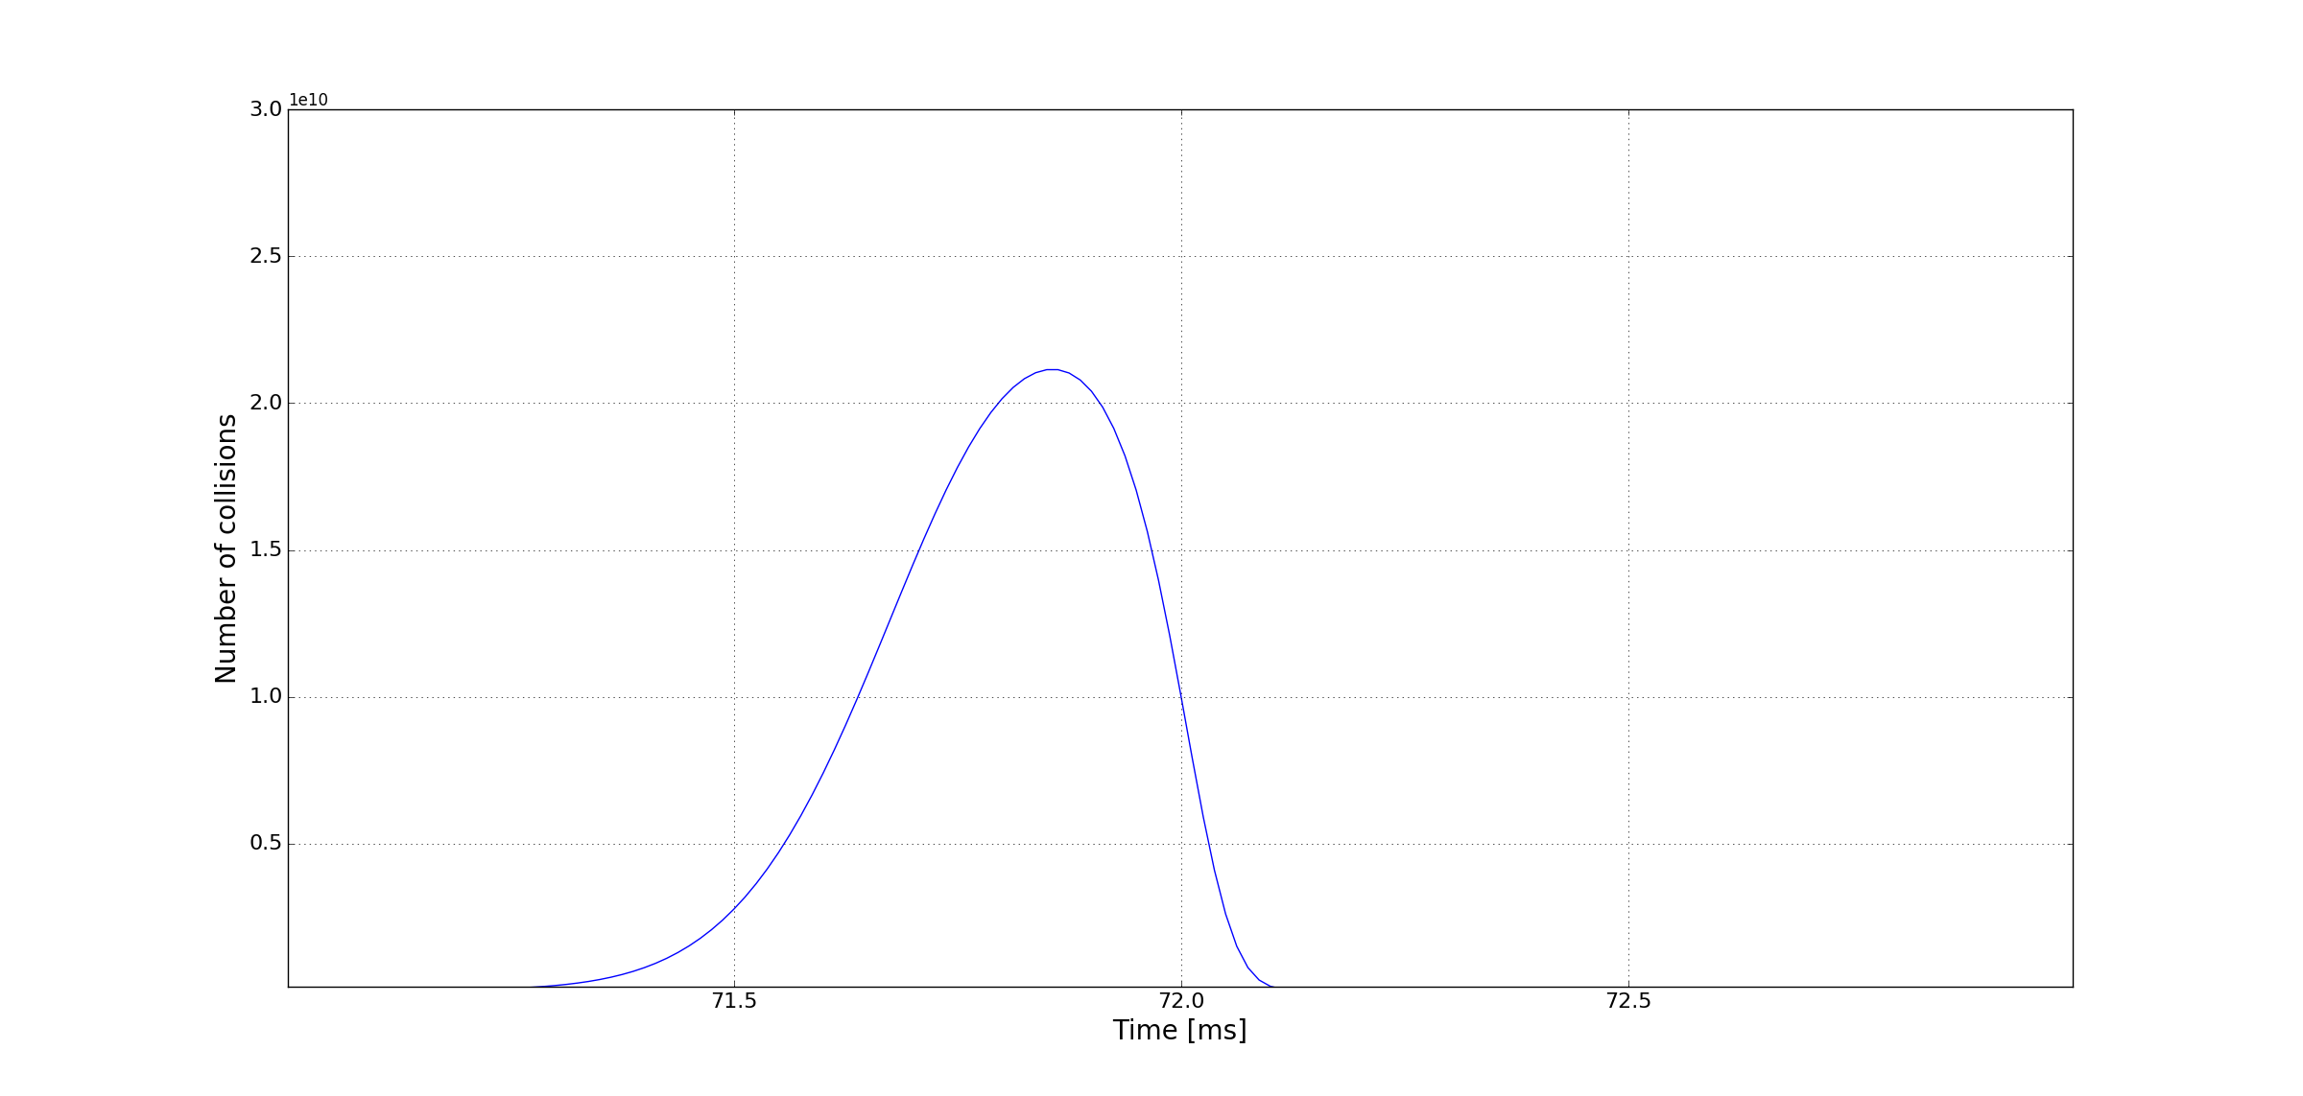
Signal in adjacent BLM

Slide 13
Illustration: dust starting at x=0, and 1-3 sigma
x
Beam direction towards us

Slide 14
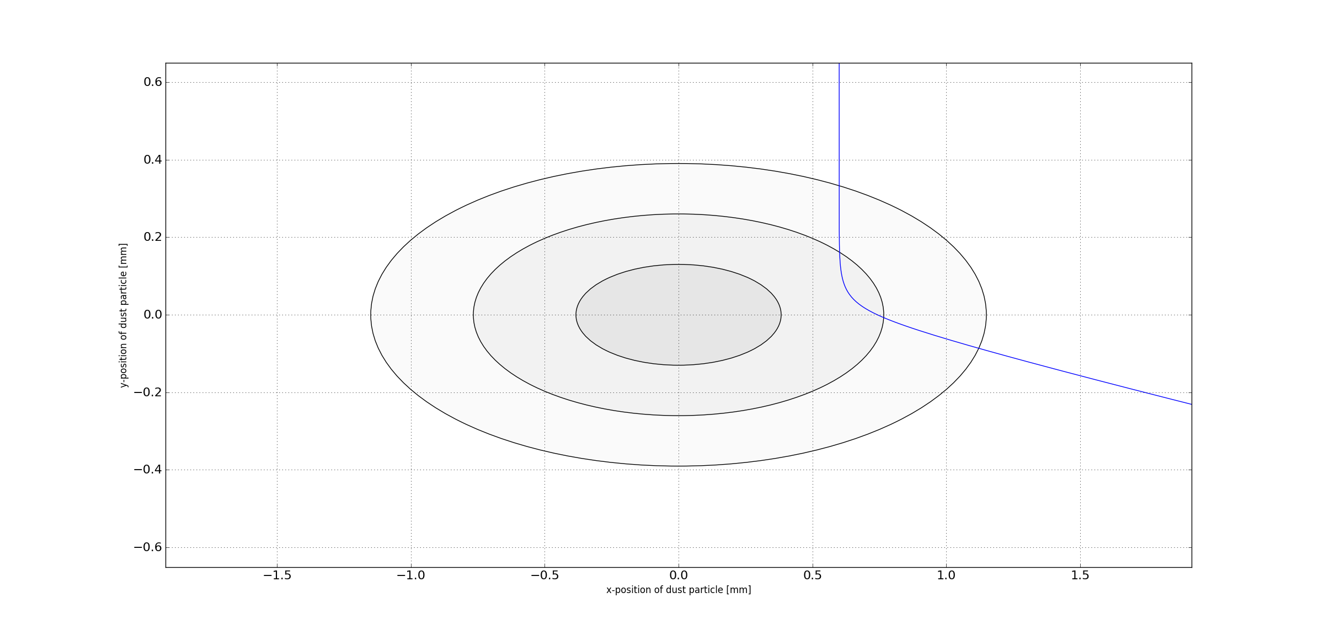
Dust particle with offset to beam center

Slide 15
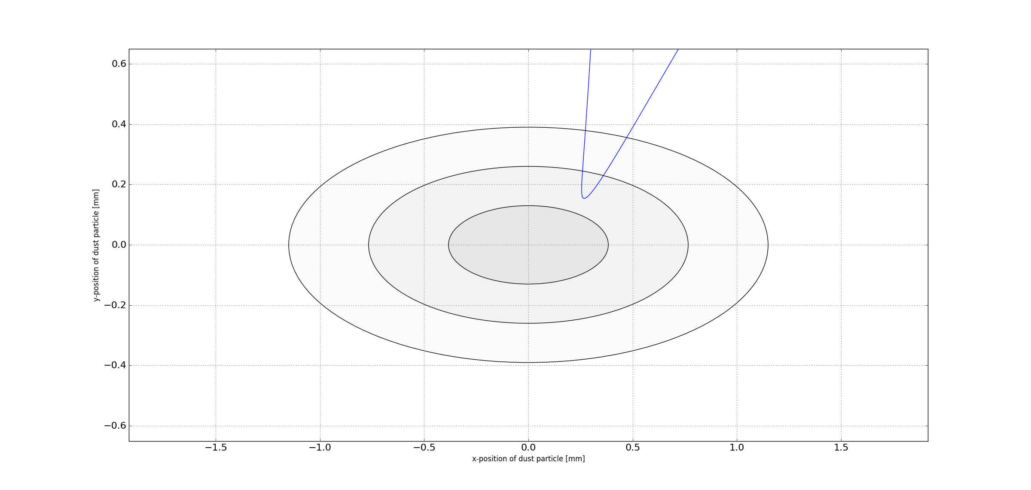
Dust particle with offset to beam center and charge

Slide 16
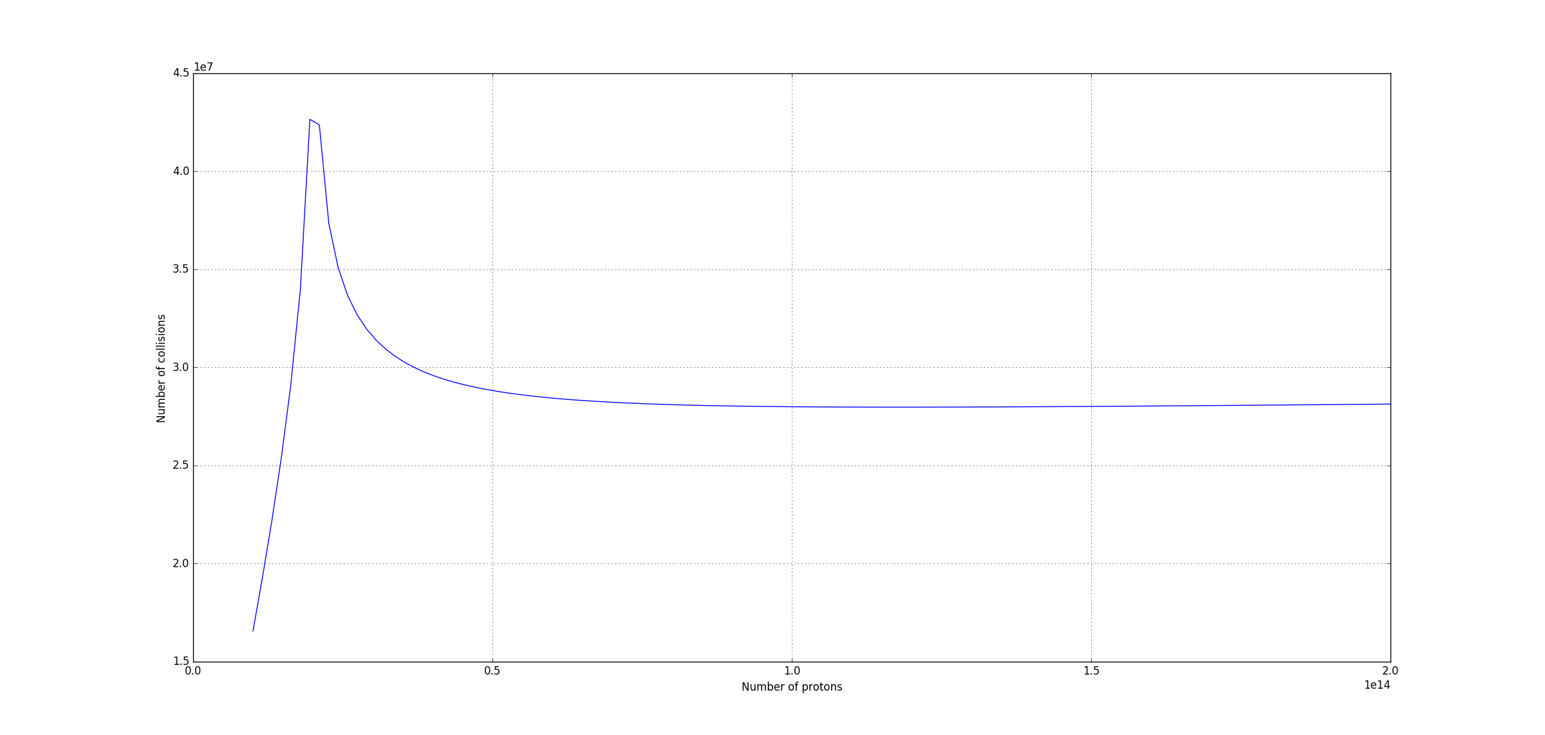
Integral number of collisions as function of proton intensity (dust particle falling from center)
Copper
Radius of dust = 15 um
Nominal LHC beam emittance
Energy of 6.5 TeV
No-charged dust particle
0E14
2E14

Slide 17
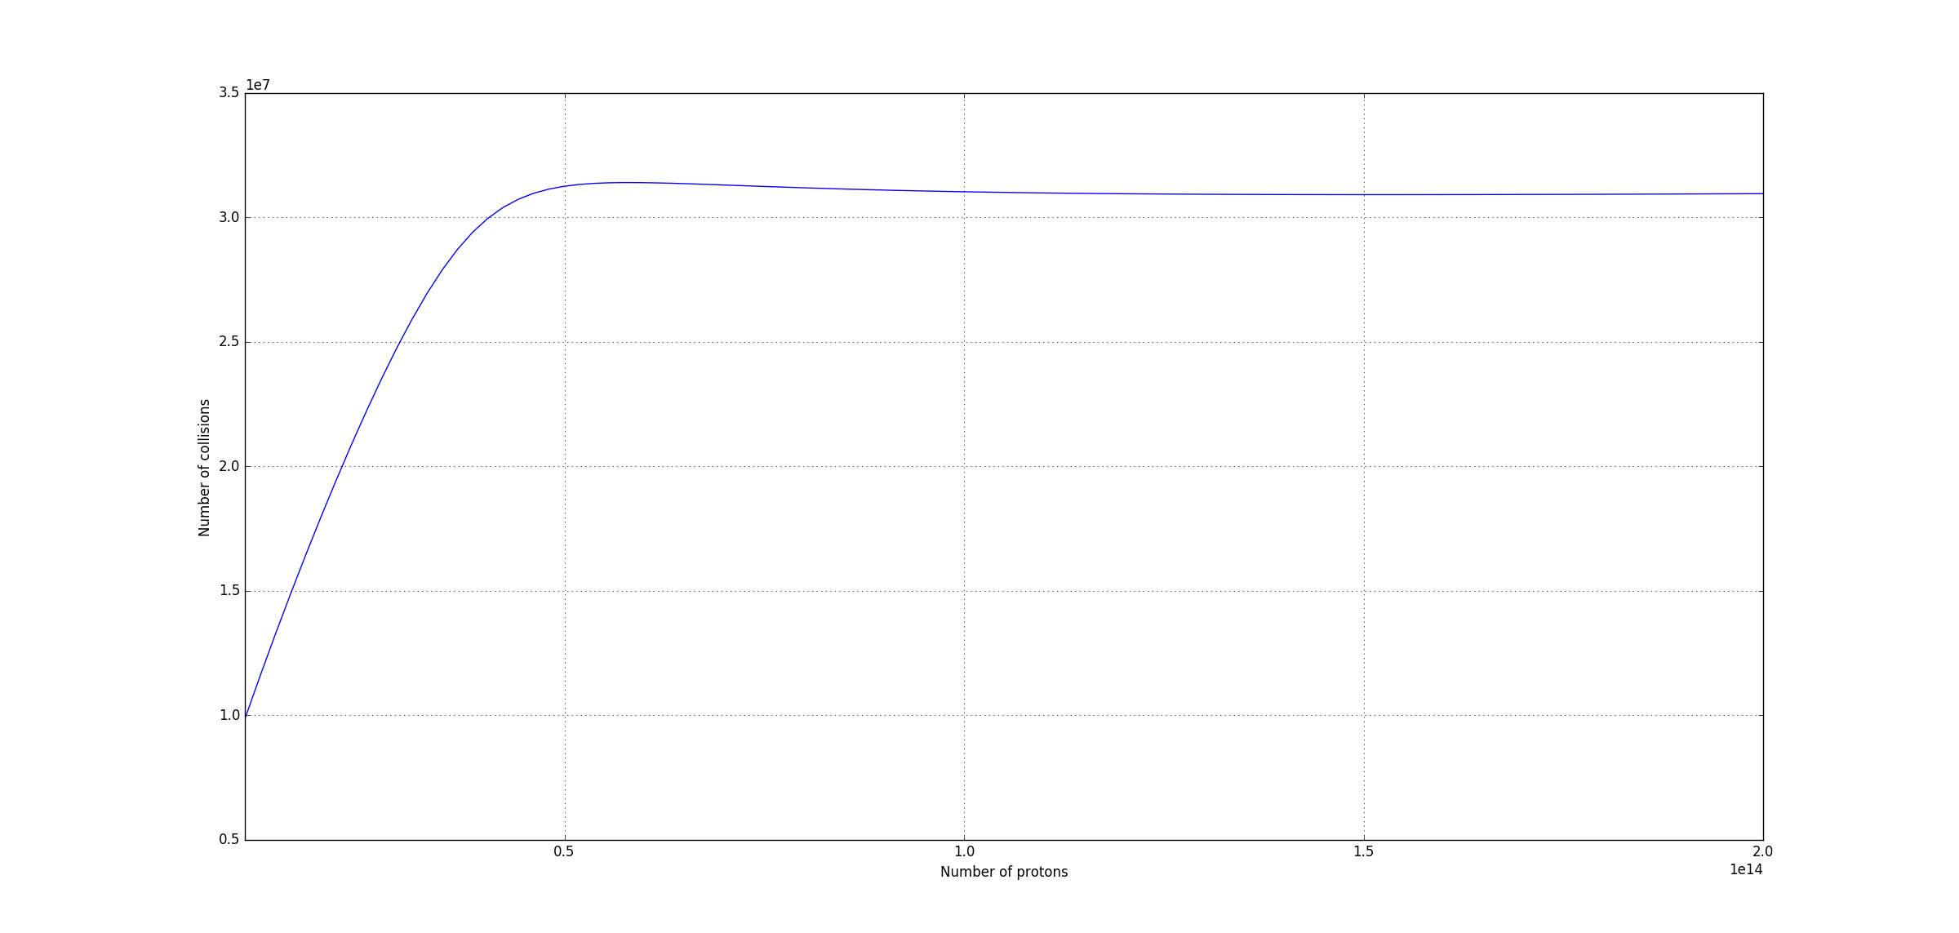
Integral number of collisions as function of proton intensity (dust particle falling from a position of one sigma)

Slide 18
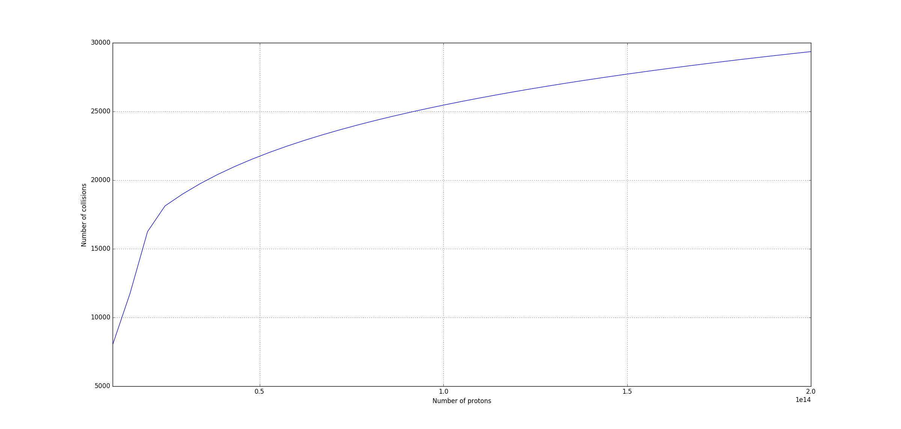
2-dimensional scan- dust no charge-QF, dust falling randomly through beam
30000

Slide 19
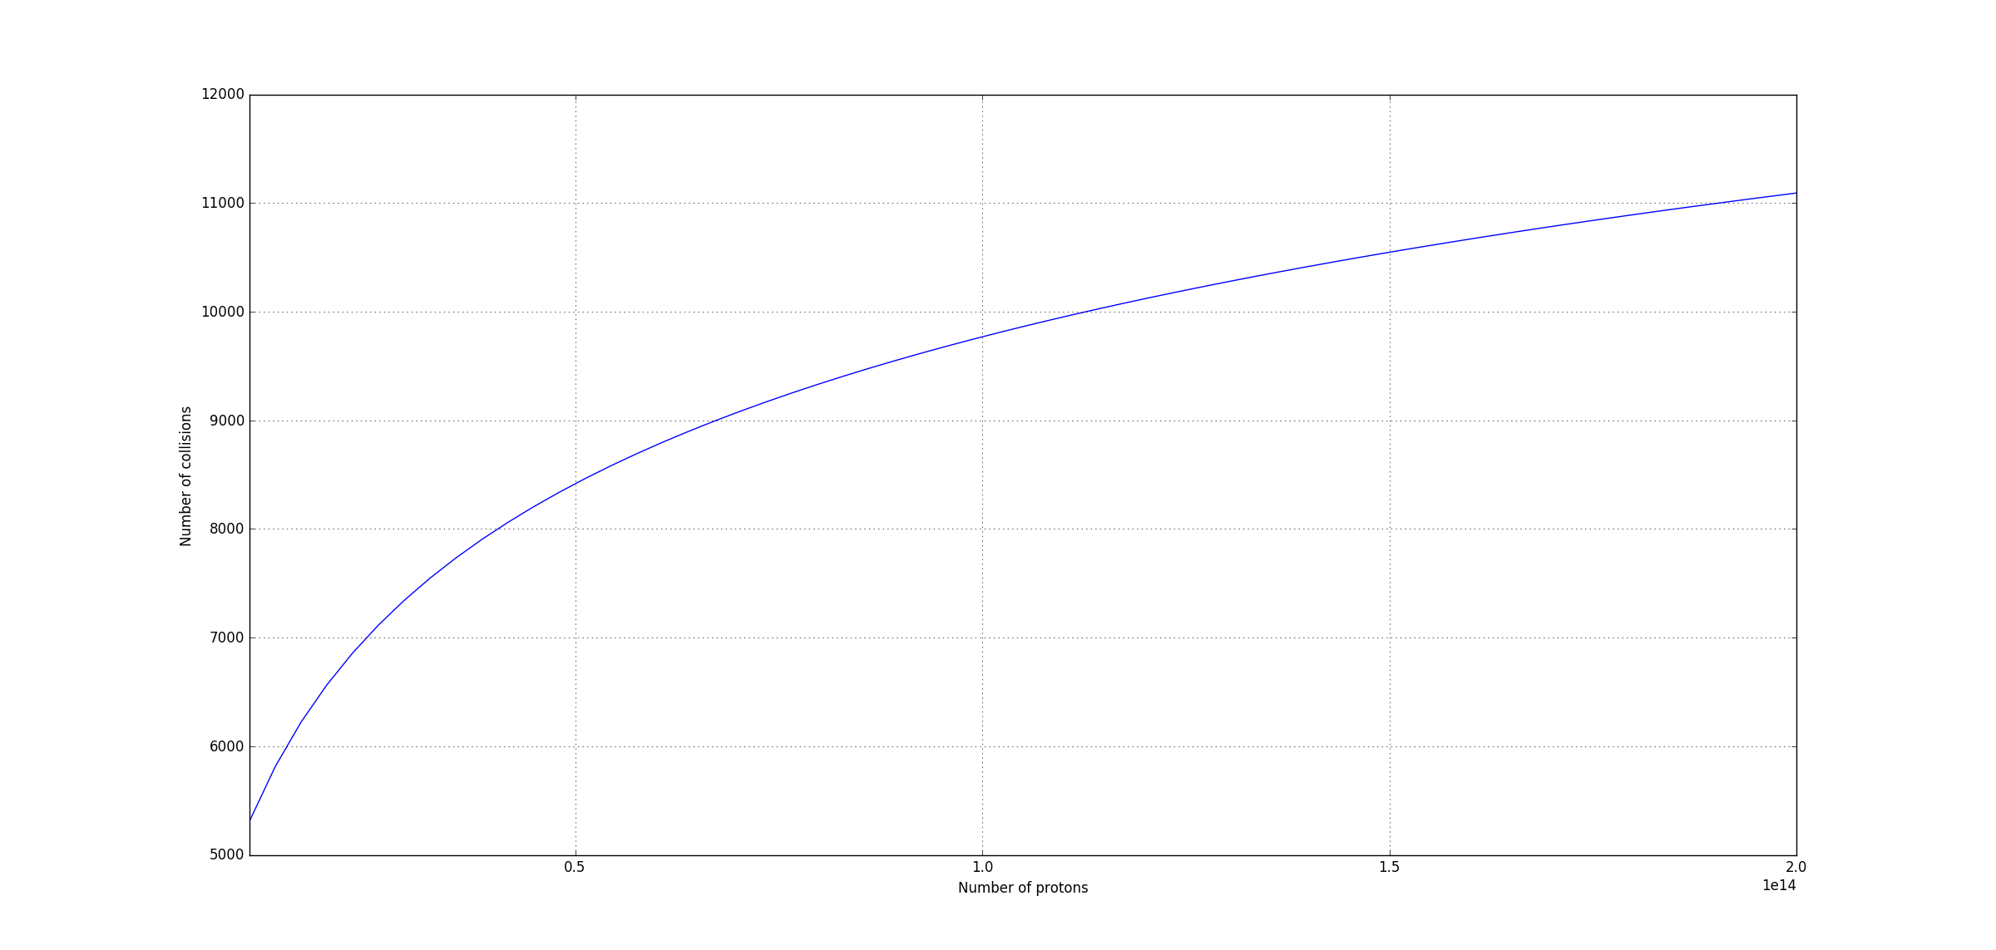
2-dimensional scan- dust no charge-QD, dust falling randomly through beam
12000

Slide 20
Step 6– 1-dimensional scan in x with fixed Np=2e14
Fix parameters
  E = 6.5TeV, dust R=15mu and copper, initial charge=0
  sigma_x: 0.38330340 mm , sigma_y: 0.13010546 mm
Initial Position of dust particle x0_position changing from 0.0mm to 0.1150mm (3 sigma) in 100 steps
Beam of 2E14

Slide 21
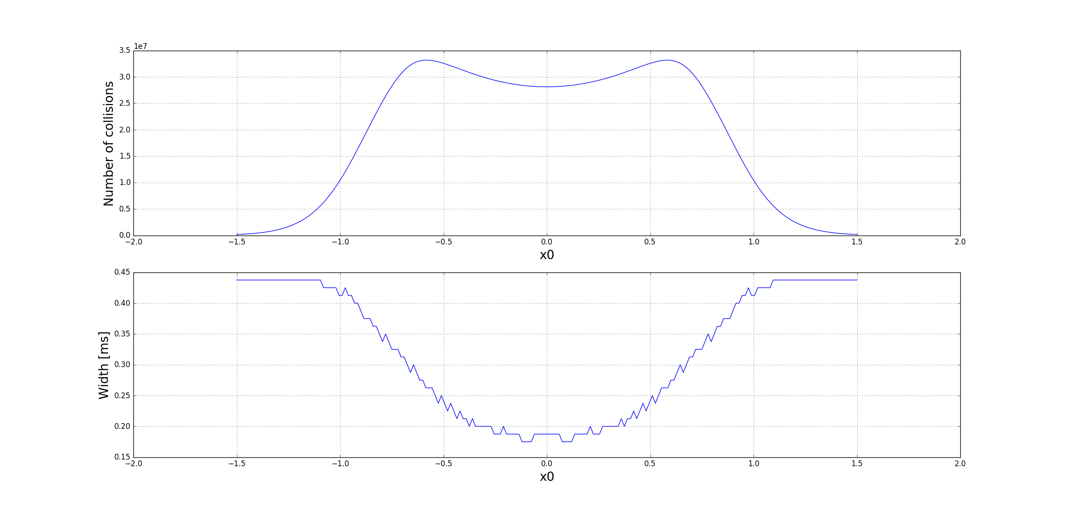
Nr of collisions and width versus x

Slide 22
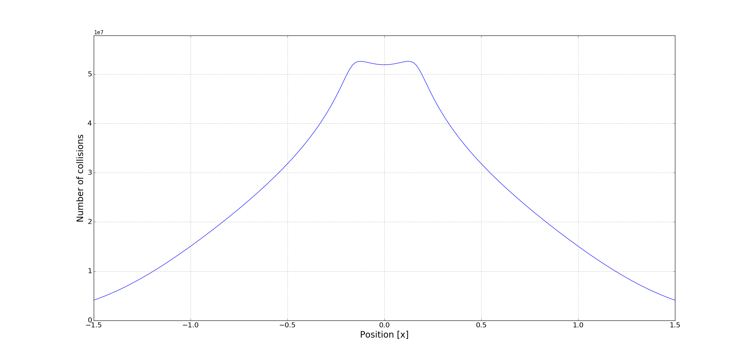
Step 8– 1-dimensional scan in x with fixed Np=4e13 – charge = -2e12

Slide 23
Remarks
Assuming randomly falling dust from the top into the beam
Expect more UFOs above a given threshold around horizontally focusing magnets (beams are larger)
Expect an increase of UFO rate above a given threshold with beam intensity
Assuming charged dust
The signal from the dust particles will increase, since the dust enters further into the beam
Dust particles from a larger area can get into the beam

Slide 24
Why does a dust particle fall into the beam?
Dust entering the beam is well known for negatively charged beams, where ionised dust is attracted by the beam
If dust particles fall from the top of the beam screen, there must have been a force that attached them to the beam screen
They fall since either another force is stronger, or because the force attaching them to the beam screen becomes weaker
If the dust particle enters the beam from the bottom or from the side, there must be a force attracting the particle towards the beam

Slide 25
Randomly falling non-charged dust?
Random process, e.g. dust particles fall randomly from the top to the bottom, and sometimes will fall into the beam. It is expected that dust particles have an equal probability to start falling as a function of x
If it not charged, only a small fraction will interact with the beam, most dust particles will miss the beam

Slide 26
Charged dust?
Assume that dust particles have a negative charge when they are detached from the surface.
  They will move towards the beam with an increased speed when falling from the top, due to gravitation plus electric forces
  For dust at the bottom: if the charge is large enough, the particles might be lifted up by the beam. This could lead to the dust particle that enters the beam with slower speed since gravitation and electrical force are opposite
Parameters
  Initial position of dust particle (horizontal x0 and longitudinal)
  Initial Charge of dust particle
  Material (copper or carbon)
  Dust size (radius R, assuming round particle)
  Beam current and time structure
  Beam size H and V (depends on the position in the cell)
  Energy (6.5 TeV)

Slide 27
Charged dust?
What is the force that glues the particle to the beam screen?
  Van der Waals
Why does it get charged?
  If it gets charged, it is most likely due to the beam, but how?
  Is it possible that it gets charged by e- bombardment? E-clouds?
  Typical e- energies are between a few eV and 1 keV. Can such electrons charge a dust particle? Dust particles would then have to be insulators
  What is the maximum charge? Is it limited by voltage breakthrough due to the distance to the metal of the beam screen?
  When the dust charges up negatively, it will repel electrons that are approaching. This could prevent further charging. What is the limit?
  There is a electrostatic force attaching the charged dust particle to the beam screen that seems to be rather strong

Slide 28
Metal
+
+
+
+
+
+
+
+
+
+
+
+
-
+
30 micron
-
-
Dust particle with negative charge
-
-
-
-
-
-
-
-

Slide 29
Forces on dust particles – preliminary non-checked-
Typical force values for Carbon, r = 15 mu, 6.2e10 elementary charges
  Gravitational force on dust particle = 3e-10 N
  Van-der-Waals force on dust particle = 6e-8 N
  Beam force on dust particle = 1.3e-9 N
  Force between charged dust particle and beam screen = 10e-5 N
Image current circulating in the beam screen: what happens to force between dust particle and wall?

Slide 30
Consequences for observations
If dust particle are falling from the top randomly, we expect more particles at location with wider beam (close to horizontally focusing quadrupole magnets)
If the dust particles are charged, their speed entering into the beam should be higher leading to a shorter BLM rising signal

Slide 31
Observation and statistical analysis
Longitudinal position of UFO (including “hot spots”) along the cell
In some areas there are more UFOs, where and when?
During some periods, UFO frequency increased – statistical fluctuation?
Dependence of UFO rate as a function of beam intensity?
  Data from intensity ramp-up of particular interest
Probability for UFOs as function of beam current, of time in the cycle and of time during the run / over several years
  Effect of scrubbing
  Effect of beam screen temperature
Dependence on rise and fall time on beam intensity: get statistics, to compare with simulations
Signature of the ULOs, similar to UFOs or different?
Using diamond detectors for bunch resolved observation of UFOs
Signal in adjacent BLMs, and in BLMs close to collimator limiting the aperture (see slide)

Slide 32
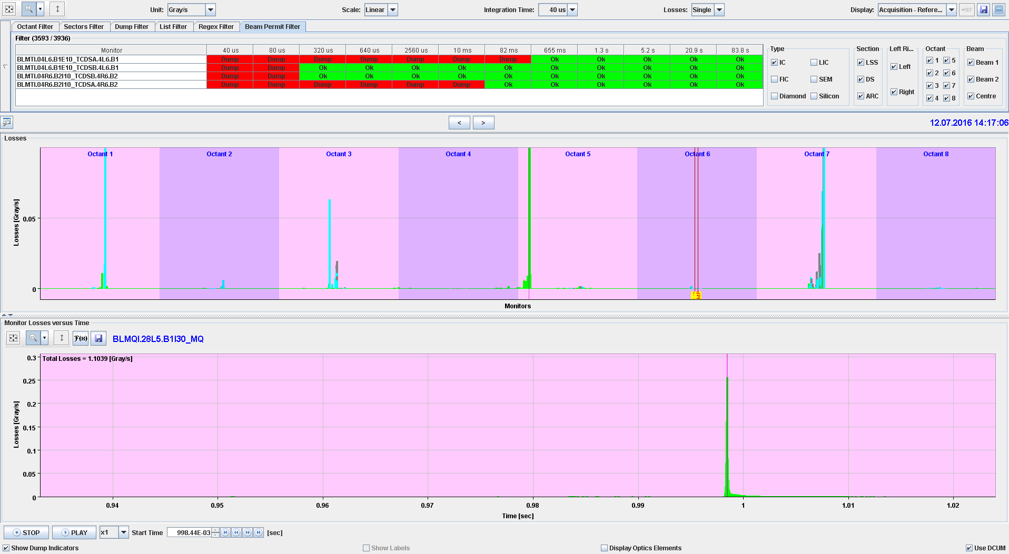
TCLA.7L3.B2
TCTPV.R1.B2
28L5.B2I10_MQ
TCP.C6R7.B2
TCTPV.4R2.B2
TCSM.A5L3.B2
TCTPV.4R5.B2
TCDQA.A4L6.B2
Difference of beam losses, just before the UFO, and in the centre of the UFO.
Note that the maximum of the BLMs does not appear always at the same time as the maximum of the UFO at the UFO location
Signal in adjacent BLMs, and in BLMs close to collimator limiting the aperture

Slide 33
Remarks and questions
Questions
UFO bursts (several UFOs within one second) …..where and when? Why?
Sometimes we observe long tails in the BLM signal - why?
Can we detect if a dust particle comes from the bottom / top? Ideas?
Why do we see a strong conditioning effect?
  Dust particle are falling from the top, and then are gone?
  Dust particles are heated up, vaporising and therefore destroyed?
  Other mechanisms?
  Very interesting to see sector 1-2 after restart (vacuum system was opened)
Charging of UFOs from electrons, and image current in the beam screen – effect on force between UFO and beam screen?
Ongoing studies
Parameters of dust particles in LHC vacuum system (experimental investigation)
Heating up and vaporising of UFO
If a dust particle moves, what are the forces from the B-field? => small

Slide 34
Main focus of future work
Activities (short + medium term)
Understanding of dust from analysis of dust samples (magnet exchange in sector 1-2)
Improving statistical analysis – develop new analysis tools
Adding ‘physics’ into UFO model, e.g. heating of dust particle
Observations in LHC operation in 2017 and 2018
Extending UFO-Beam interaction simulatio
Using diamond detectors for observing UFOs
Simulation of particle dynamics of protons that are deflected at a small angle by a UFO
Ideas for beam tests
Beam test: run one sector with horizontal orbit away from the normal orbit? Will this have an effect on the UFO rate?

