Slide 2

About pbelange ( )
3rd year bachelor student in physical engineering
Previous internships :
  Optical fiber laboratory (Polytechnique Montréal)
  MDA satellite system
Interests :
  Rock climbing
  Sailing
  Any kind of sport
  Any geeky stuff

Slide 3
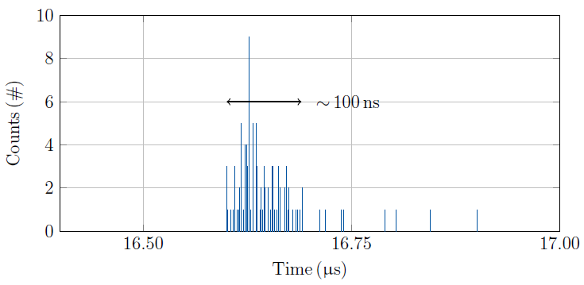
Subject of my work
Initially : Better understanding of MD456 results (from O. Stein)
    Low counts
    Time jitter
Updated : Support dBLMs work
    ROSY acquisition
    Understanding of UFO dynamics and UFO detection

Slide 4
First three weeks summary
Learning about LHC and accelerator physics
Jumped in to help for ADT-AC dipole MD
  Script for online data visualisation
  Data acquisition during the MD in itself
Preparing for next MD : UFO dynamics studies and UFO fast detection
  Ensuring that we record the dBLM data from the ROSY box
  New script for online waveform data visualisation
  Post analysis of the data?

Slide 5
www.cern.ch

