Slide 1
UFO UPDATE 2017
Why do we still worry about UFOs?

Slide 2
Motivation for continued UFO studies
UFO impact on LHC availability significantly reduced over the last years
Optimizing the BLM threshold actively prevents unnecessary dumps
A conditioning effect reduced the UFO rates from 60 to 2 UFOs/h
The conditioning of the UFOs remains one of the big UNKNOWN. To fully understand the UFO phenomenon the release mechanism needs to be understood.
Only then a reliable and efficient operation of LHC (and its upgrades) can be guaranteed

Slide 3
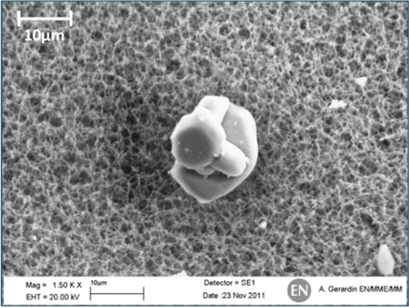
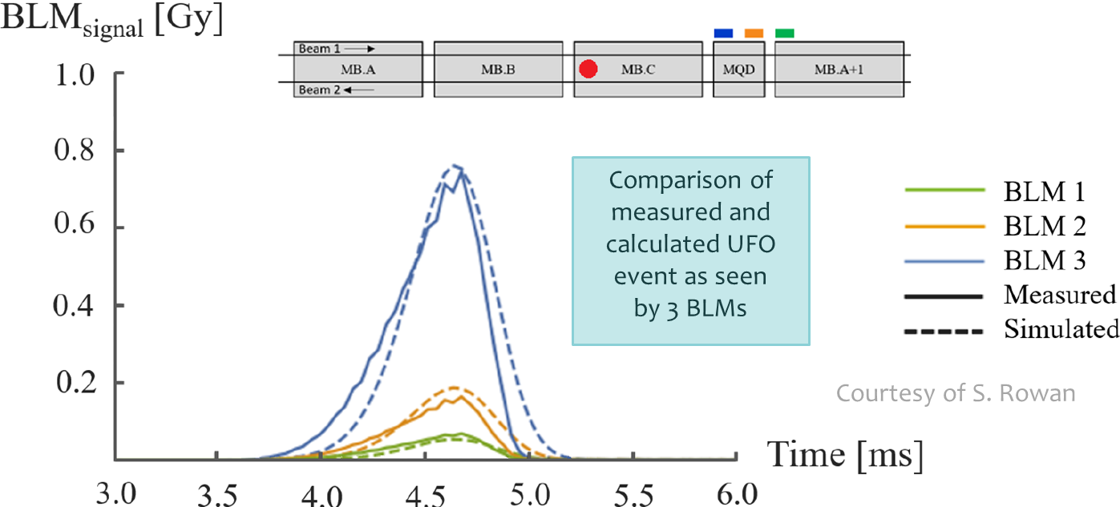
UFO Knowledge
UFO events are caused by macroparticle-beam-interactions:
confirmed by MKI intervention (indications that high E-field during kicker operation lead to release of Al2O3 particles)
Confirmed by analytical model simulating a spherical particle falling into the LHC proton beam (proposed mechanism: ionization until repulsion)

Slide 4
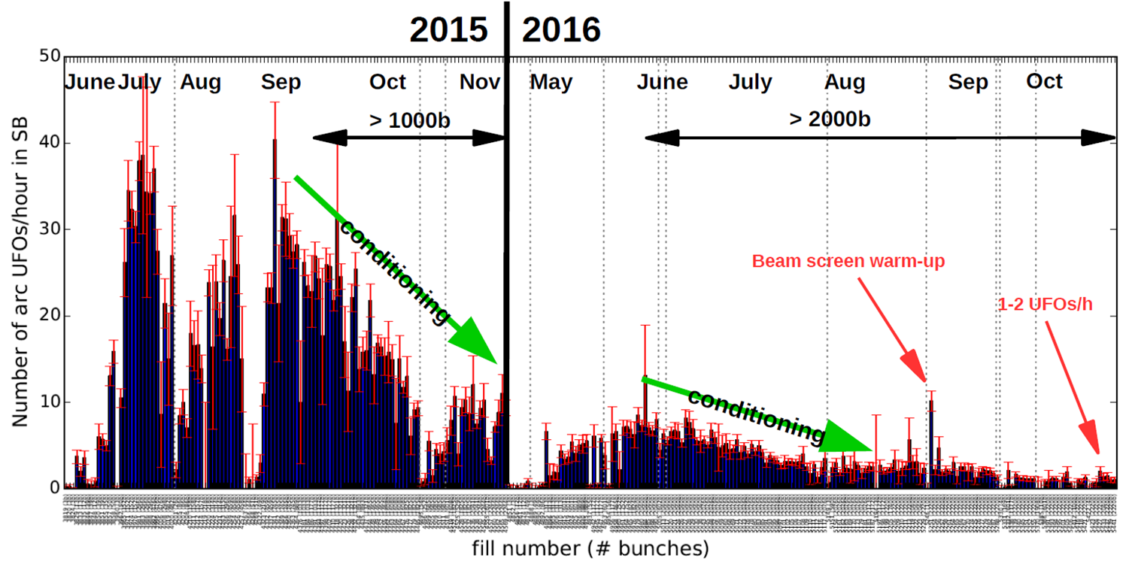
UFO Knowledge
There is a conditioning of the UFO rate over time: still mysterious
Could be caused by electron bombardement
Could imply that all dust fell to the bottom and cannot be levitated
Could mean dust „disappears“ over time (evaporation or break-down?)
Other ideas?

Slide 5
UFO Knowledge
UFO events are caused by macroparticle-beam-interactions:
confirmed by MKI intervention (indications that high E-field during kicker operation lead to release of Al2O3 particles)
Confirmed by analytical model simulating a spherical particle falling into the LHC proton beam (proposed mechanism: ionization until repulsion)
There is a conditioning of the UFO rate over time: completely mysterious
Could be caused by electron bombardement
Could imply that all dust fell to the bottom and cannot be levitated
Could mean dust „disappears“ over time (evaporation or break-down?)

Slide 6
Remaining „UFO Mysteries“
Difference between LHC UFOs (e.g. roman pots, 16L2, arc UFOs)
Distribution along LHC (Why are there hot spots? Related to cleanliness?)
Impact of warm-up (e.g. LS2, LS3)
Correlation to beam parameters and magnet/machine parameters (LHC, HL/HE-LHC, FCC)
  Improved statistical data analysis of existing LHC Data (see Introduction of UFO-Buster analysis tool)
Initial conditions (Floating or attached? Adhesion forces?)
Release mechanism
Mitigation (We need understanding of conditioning & more information on UFO properties and physics behind)
Possibly particle control in new components? (Reduce amount of dust in vacuum system)
Real macroparticle properties (size & material, origin)
  UFO dust analysis + update of UFO simulations (see Update on UFO dust sampling campaign)
Also check slide xx in appendix

Slide 7
Ongoing activities linked to UFOs
LHC dust sampling (UFO sizes and chemical composition for enhanced simulations and model extension)
Improved analysis (UFO-Buster analysis tool for high quality data selection and analysis)
Advanced diagnostics (Diamond BLMs with < 10 ns time resolution for bunch-by-bunch losses)
UFO MD (Wire scanners to mimick UFO dynamics)
Revision of UFO Model:
(16L2 UFOs indicate missing physics, investigation of evaporation probability
Validation of „Falling“-Hypothesis
Initial conditions including adhesion, charging, location for estimation of binding force to be overcome
Mechanism behind multiple UFOs)
Examination of new surface treatments (Particle production in coating processes, e.g. LESS and a-C)

Slide 8
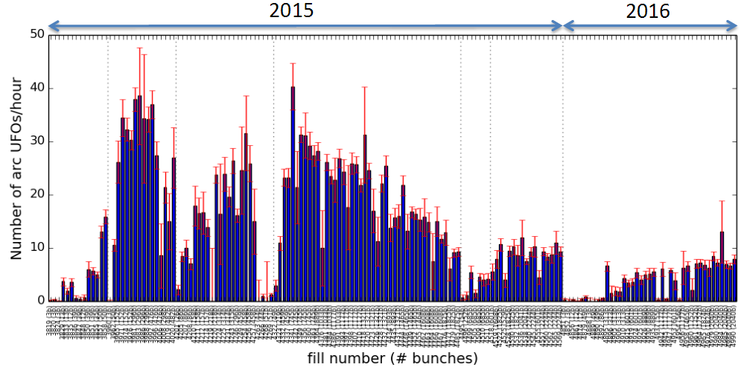
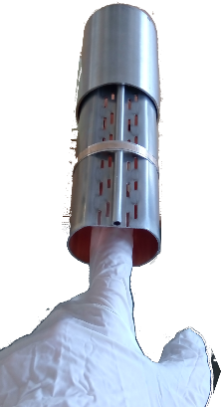
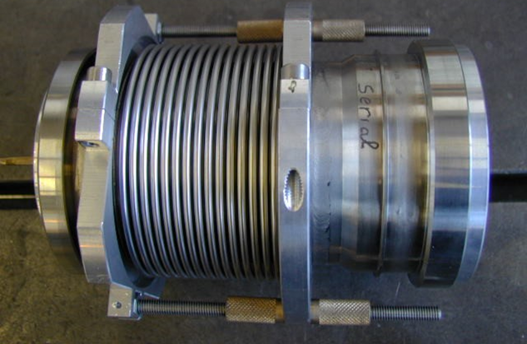
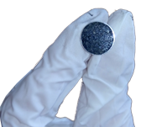

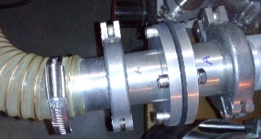
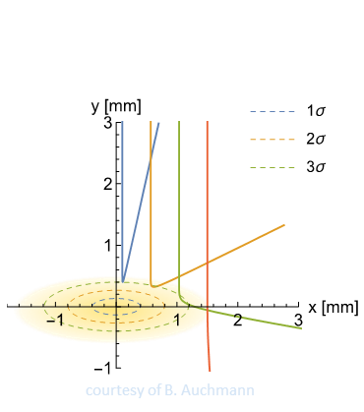
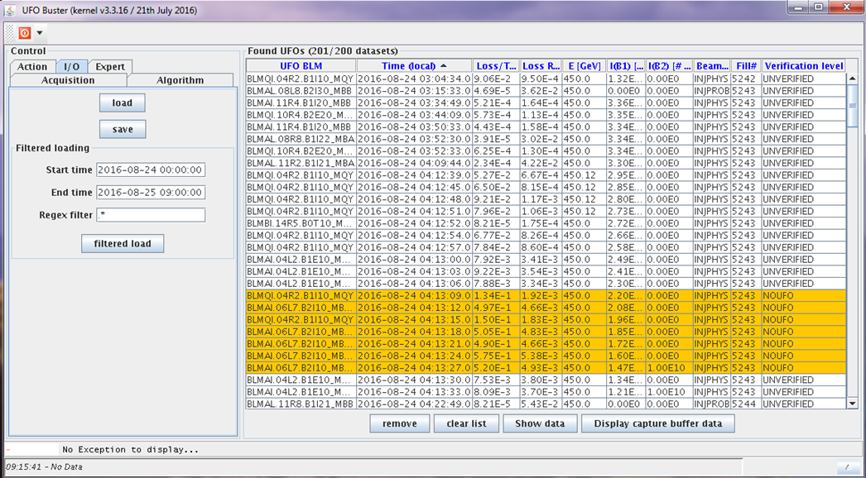
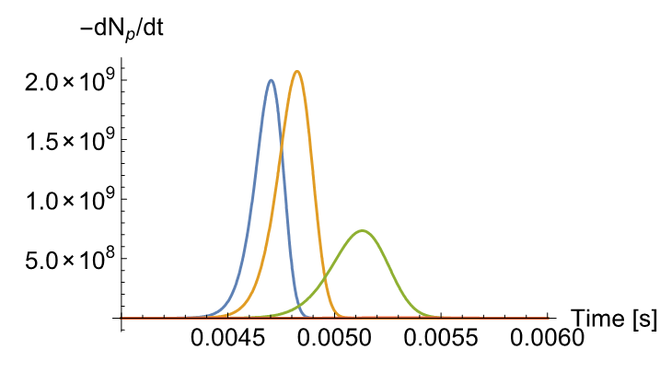
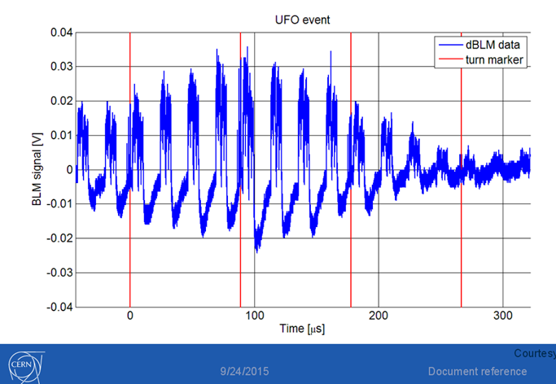
Reminder: multi-directional approach to UFO problem
Statistical
Analysis
UFO rates
Experimental Studies
Dust collection and analysis
Simulation &
Modell
Analytic UFO model
Detection &
Analysis
BLMs & UFO Buster
dBLMs
Monte-Carlo simulation

Slide 9

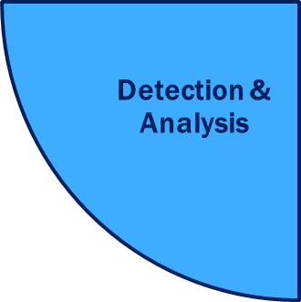
Following presentations focus on:
“Current status of UFO dust sampling” L. Grob
“Introduction of the UFO Buster Analysis Tool” M. Dziadosz

Slide 10

UFO News Part I:
Status of dust sampling & future steps

Slide 11
Outline
List of available dust from LHC components
Dust removal techniques for the respective sample (and status)
Sample preparation for SEM (preliminary)

Slide 12
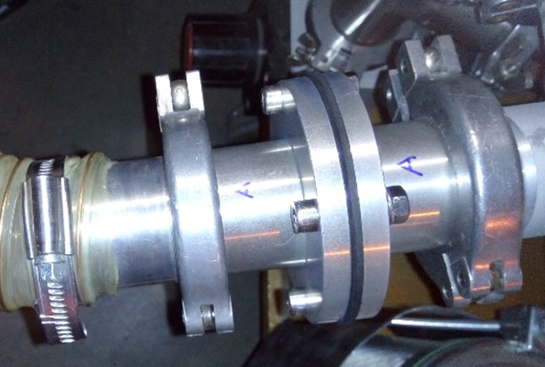
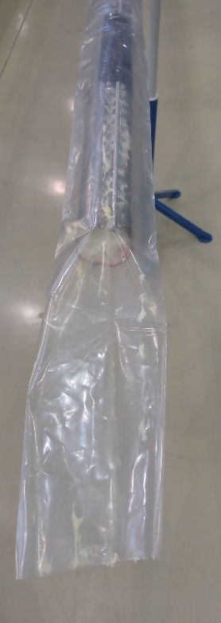
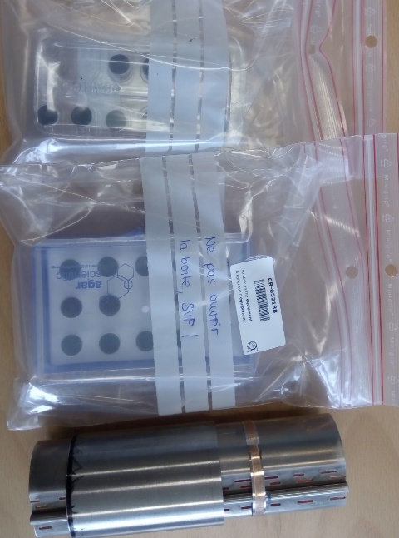
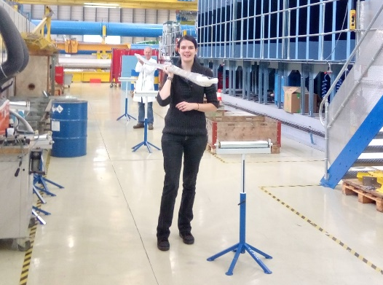
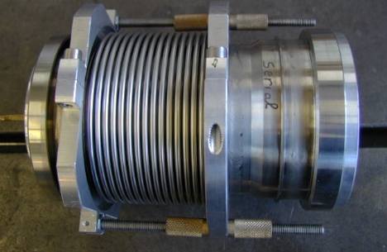
I. Available parts with LHC dust
  Filter unit from RF ball test before warm up
  Dusters with cold bore dust
  Wipe test near interconnects of A31L2 (carbon stickers)
  3 sealed plug-in modules
  (2 with RF fingers, untouched)
  Beam screen parts of A31L2
  (special cutting applied, sealed)

Slide 13
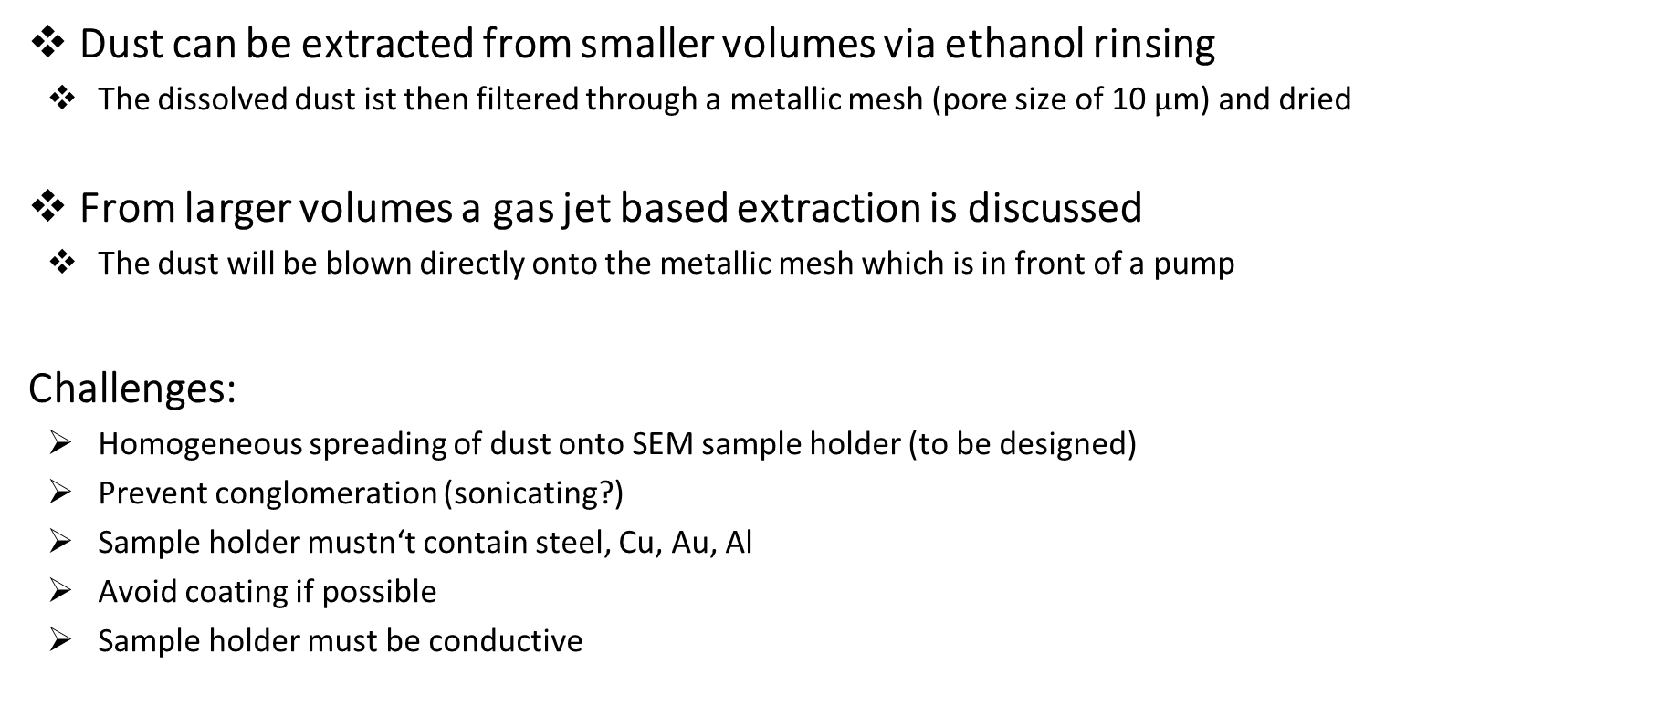
II. Dust extraction from LHC components
Dust can be extracted from smaller volumes via ethanol rinsing
  The dissolved dust ist then filtered through a metallic mesh (pore size of 10 $µ$m) and dried
From larger volumes a gas jet based extraction is discussed
  The dust will be blown directly onto the metallic mesh which is in front of a pump
Challenges:
  Homogeneous spreading of dust onto SEM sample holder (to be designed)
  Prevent conglomeration (sonicating?)
  Sample holder mustn‘t contain steel, Cu, Au, Al
  Avoid coating if possible
  Sample holder must be conductive

Slide 14
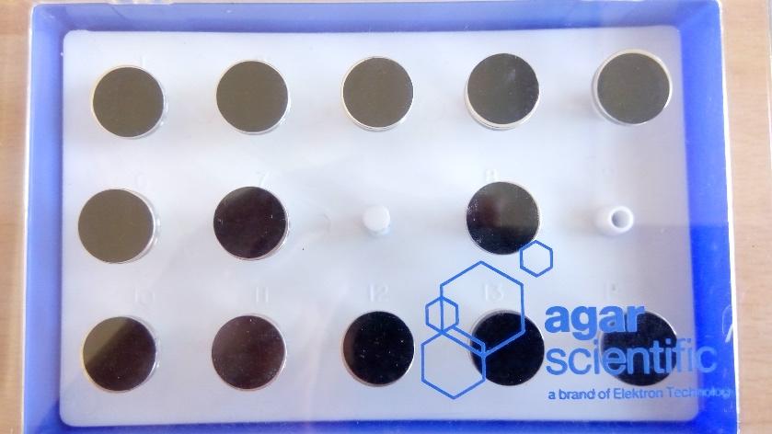
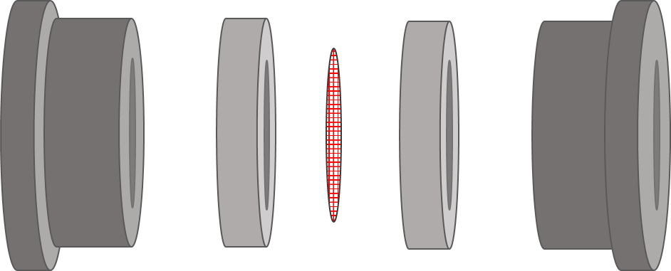
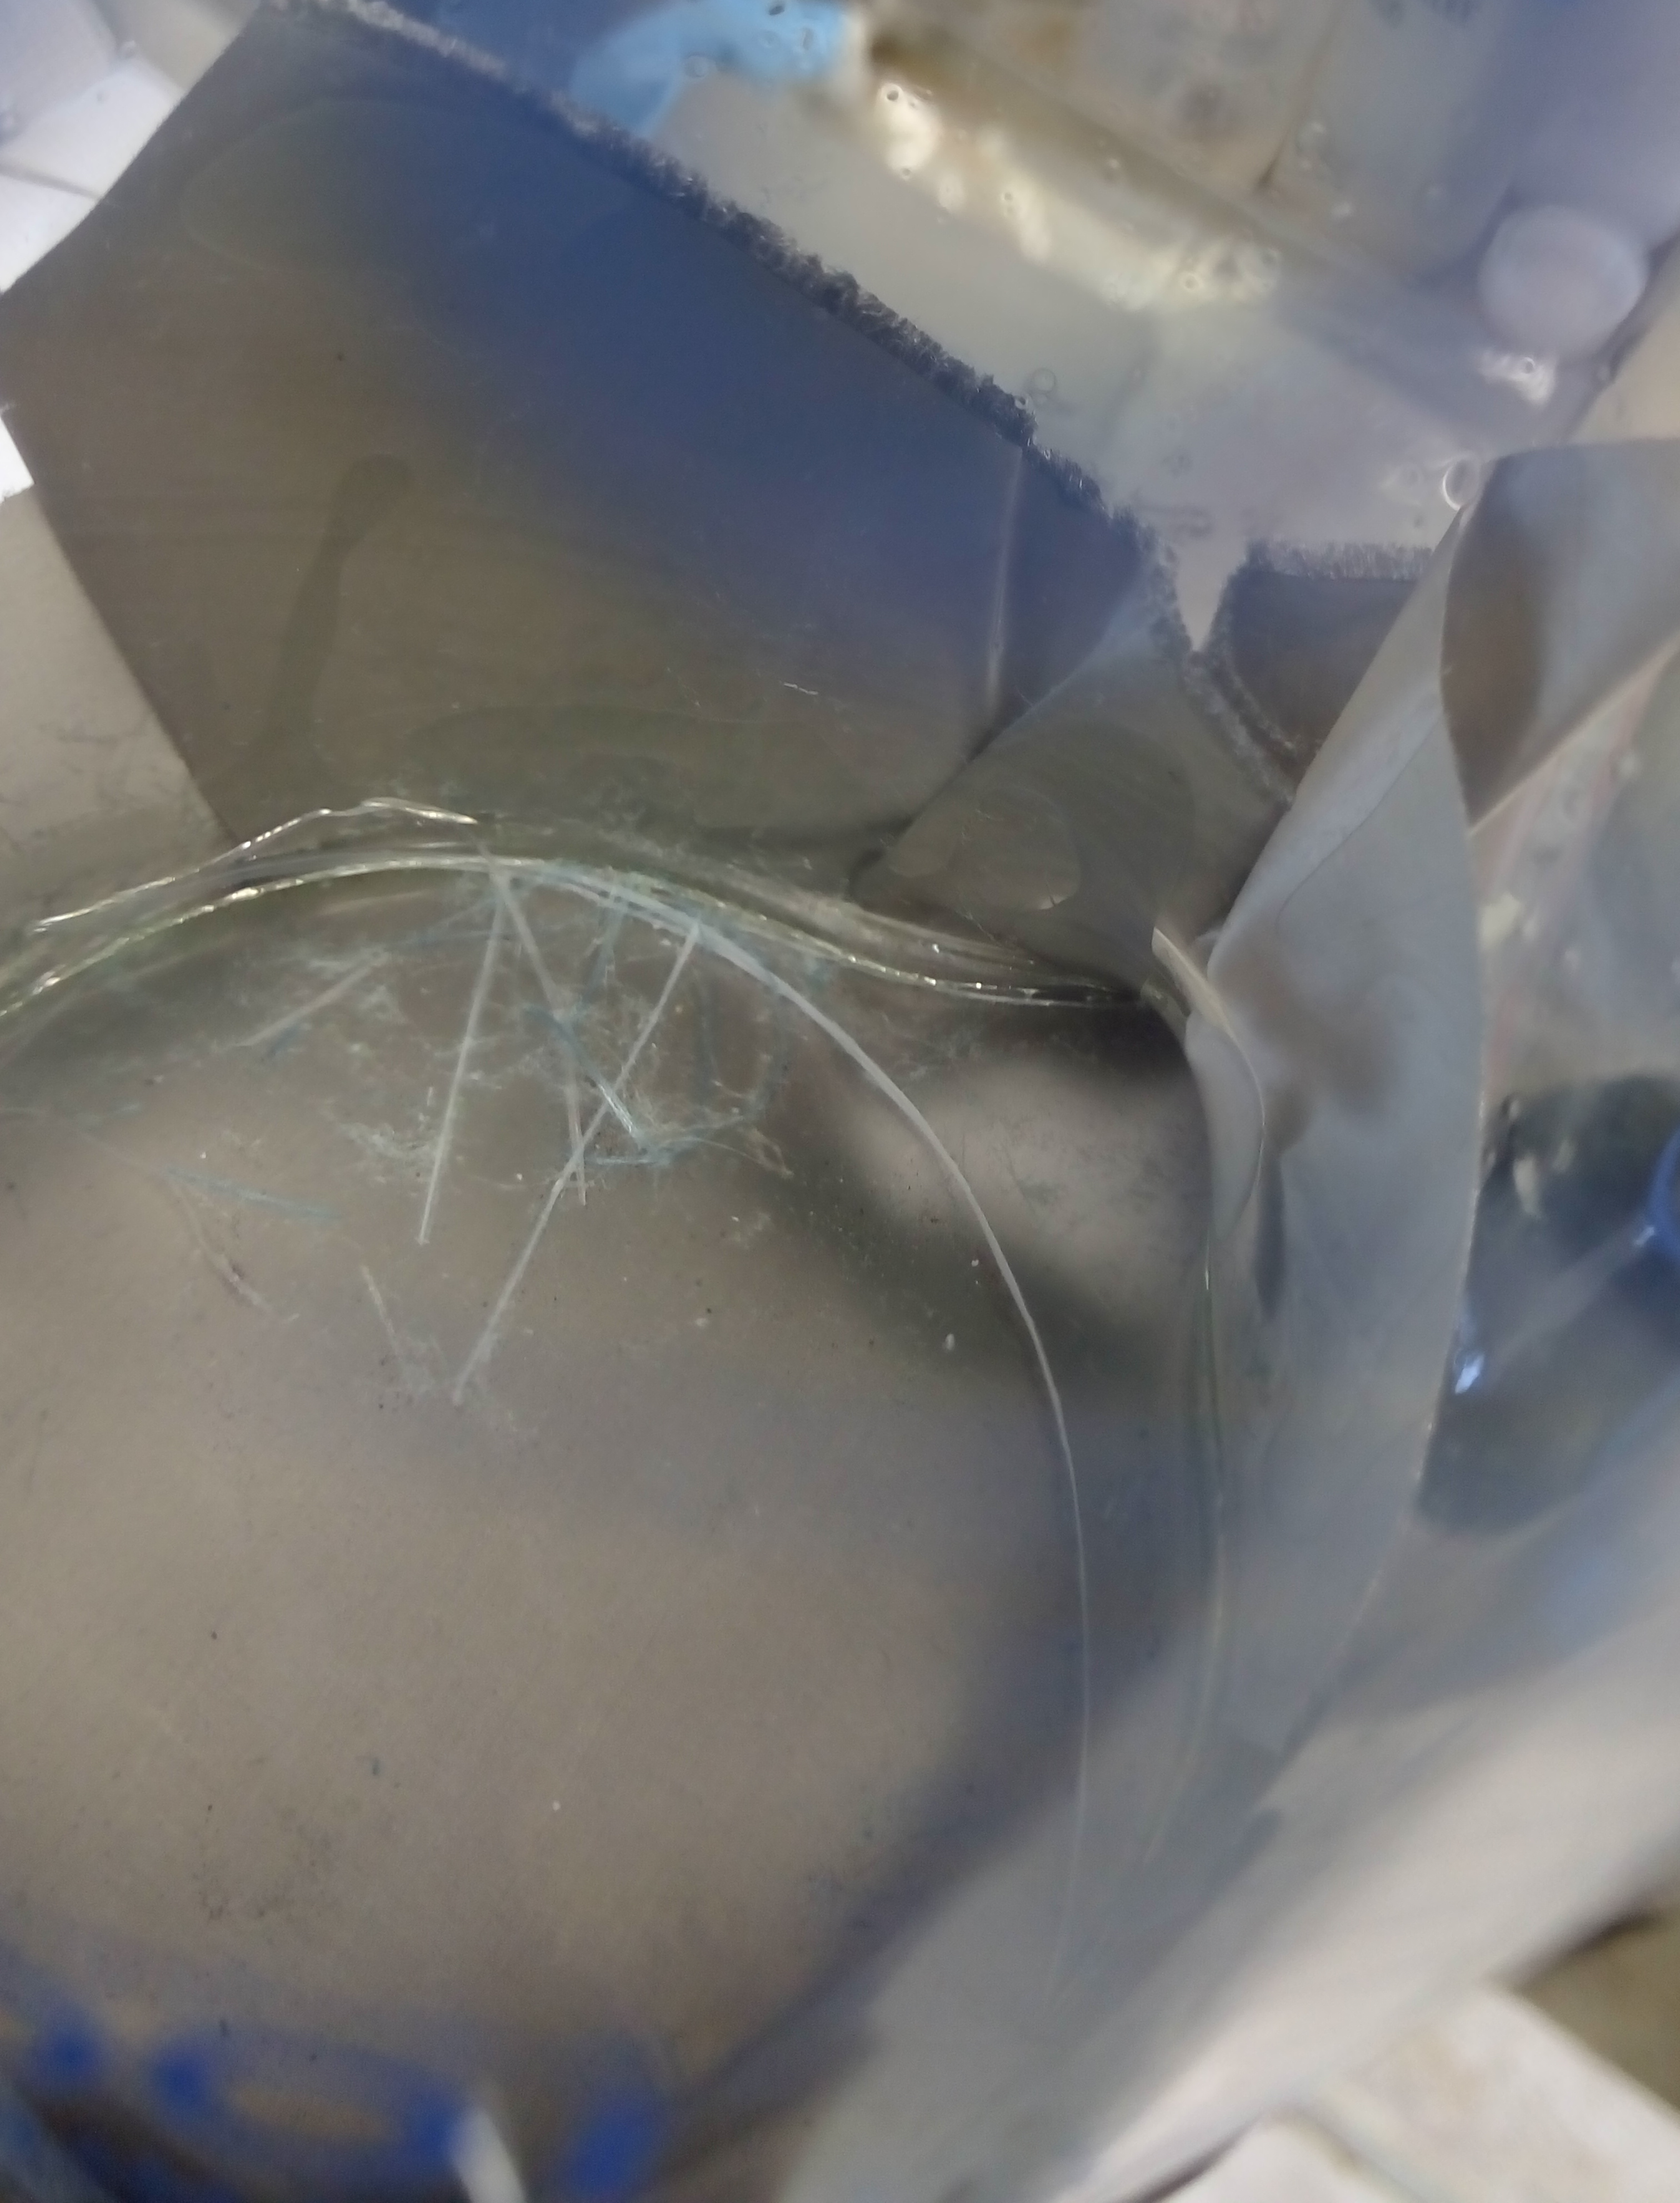

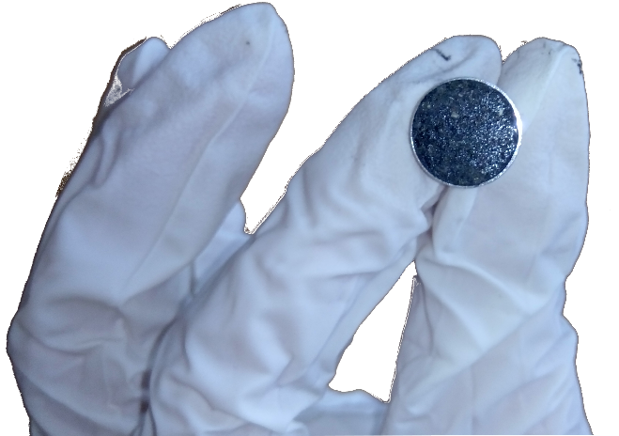
Filter unit and solvent based dust extraction
So far the dust was stamped off the metallic mesh or the glove used for the wipe test.
With the stamping method the following parameters cannot be controlled:
Amount of particles, homogeneous monolayer, particle separation, representatice subset of dust materials/sizes
Which are the alternatives???

Slide 15
III. SEM requirements: sample holder& treatment
The sample holder can carry a standardized membrane filter (as used by M. Barnes for previous MKI UFO sampling)
The dust of one LHC component would be dissolved in ethanol and sonicated
A fraction of the liquid will be dropped on the membrane (small dust amount, homogeneous sample, good particle separation)
After evaporation it needs a conductive coating (choice: carbon because of membrane background)
Side view
First draft
Top view
Agglomeration?
Place of preparation (clean room?)?
Marterial: Al (known detection limitation in SEM due to Al chamber)

Slide 16
Discussion of a hot topic
16L2 beam losses – contribution from Rüdiger

Slide 17
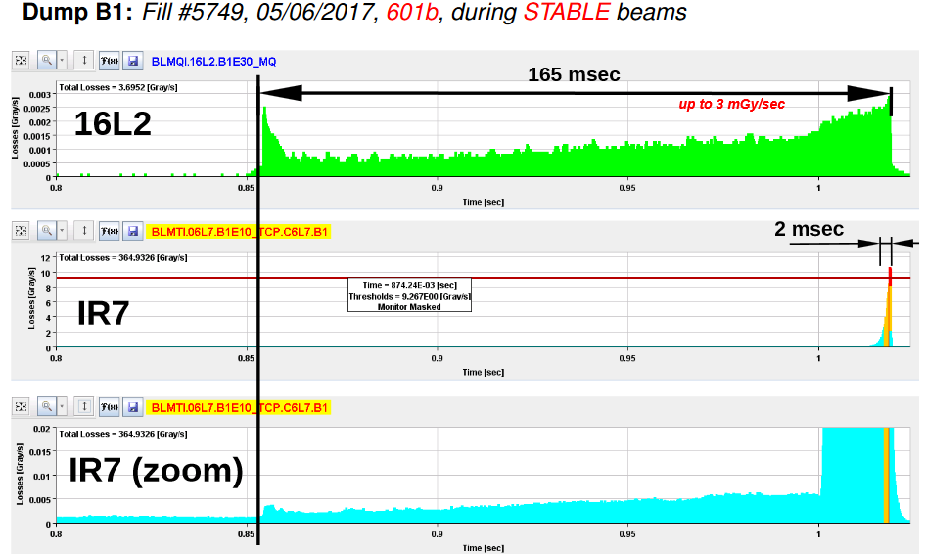
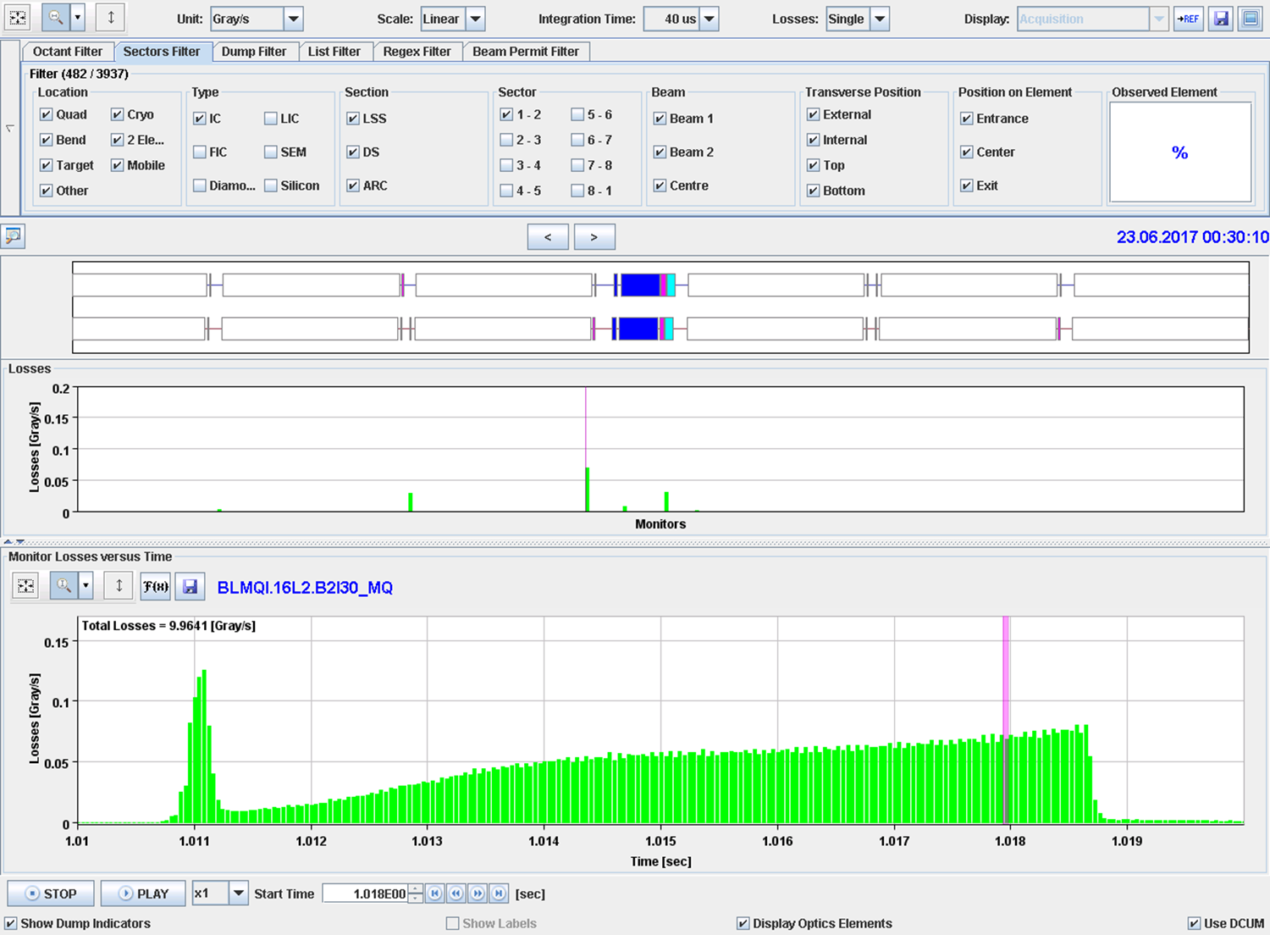
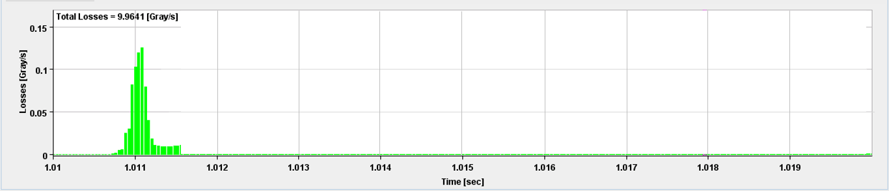
16L2 events | Could they be UFOs?
From Anton Lechner's LMC contribution:
From discussion with Rüdiger:

Slide 18
Idea to explain the 16L2 events
The initial signature of several 16L2 beam loss events is very similar to the well-known UFOs
At a later stage, massive beam losses occur in the collimation insertion, and lead to a beam dump
The closed-orbit of the beam does not change
There is no aperture limitation in 16L2
The losses in 16L2 can only be explained by matter getting into the beam
12.07.2017 | MPE-PE Meeting | Laura Grob + Rüdiger Schmidt

Slide 19
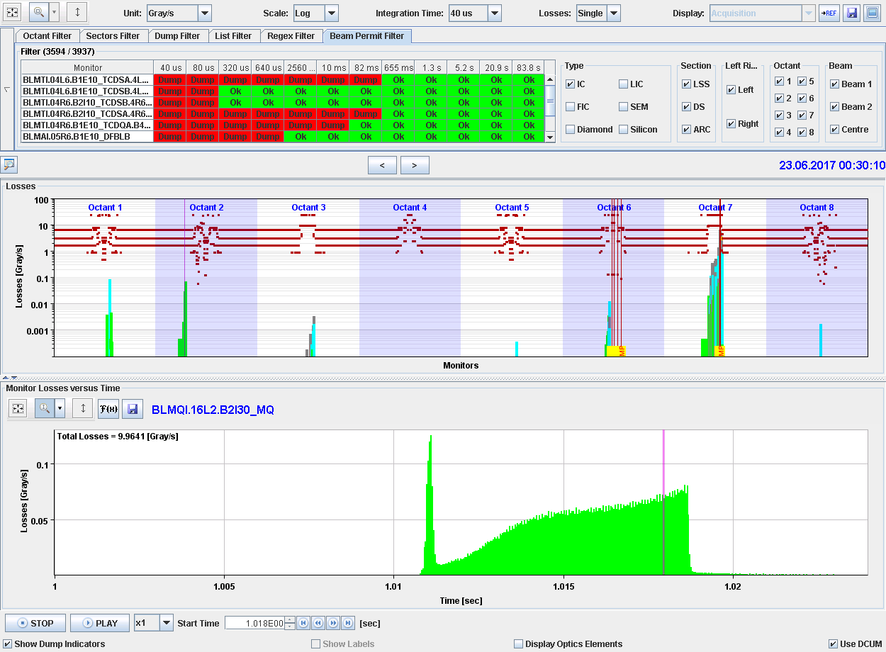

Slide 20
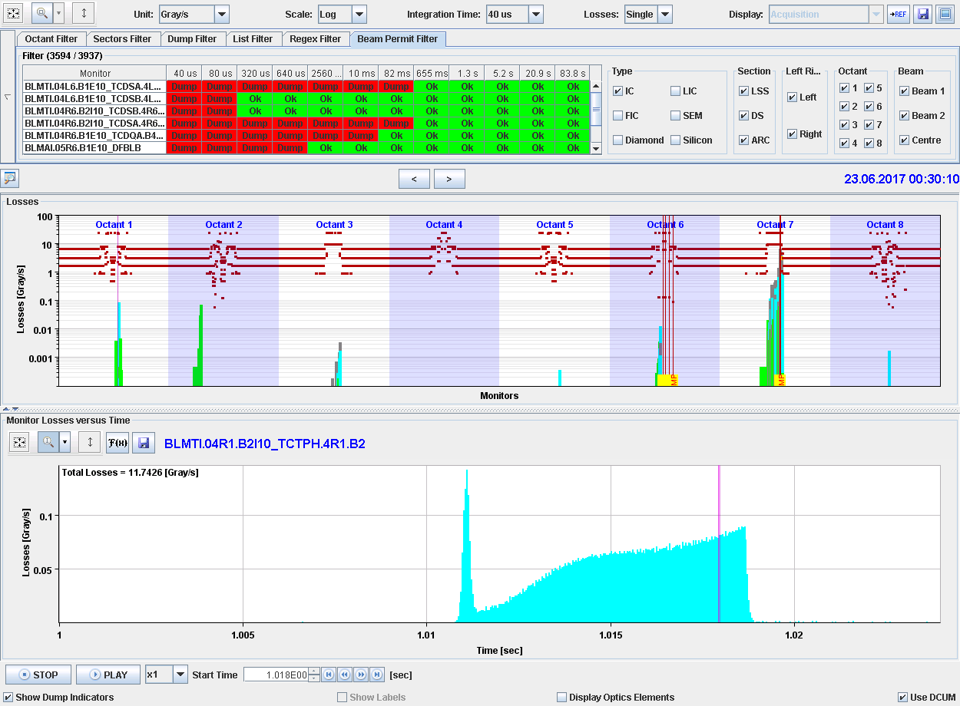

Slide 21
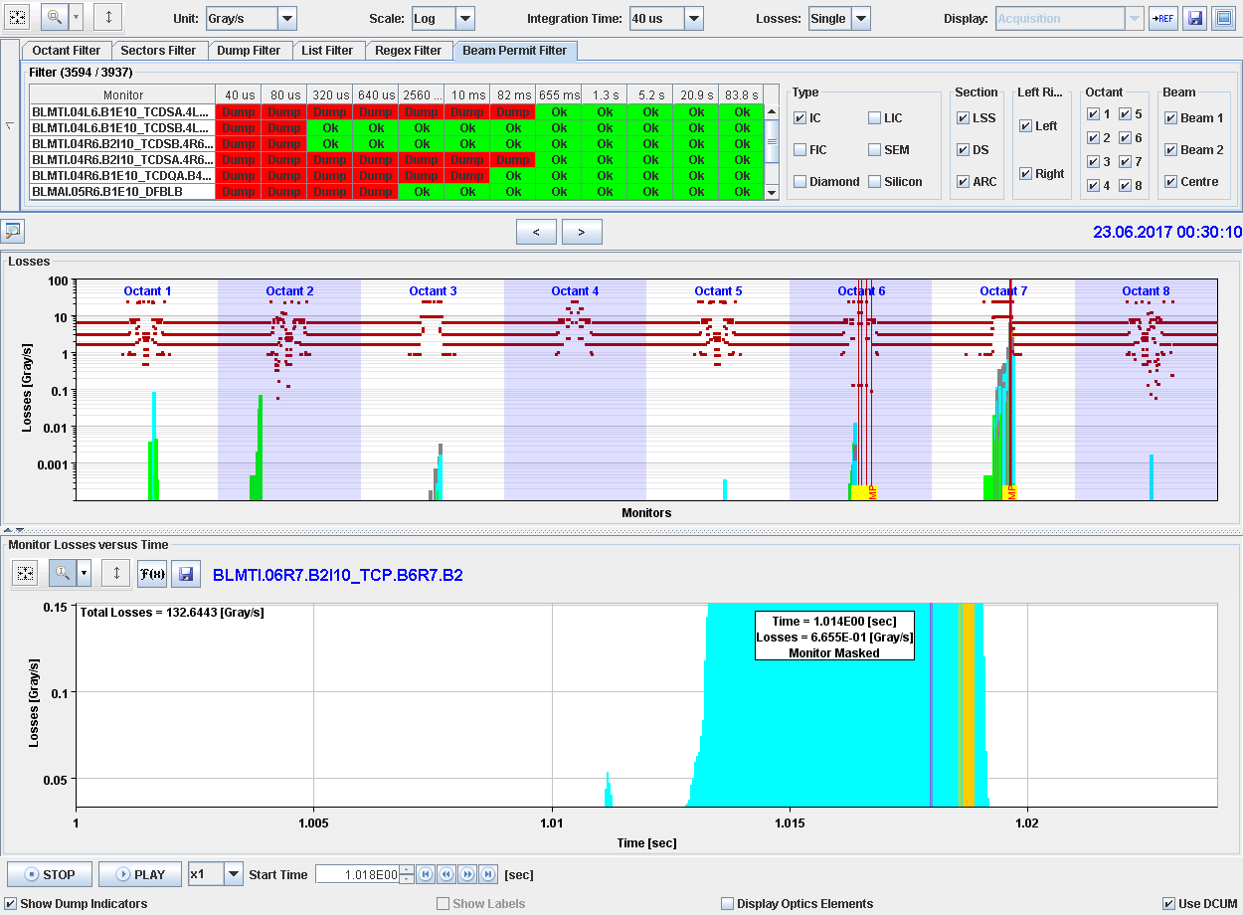
TCP same scale

Slide 22
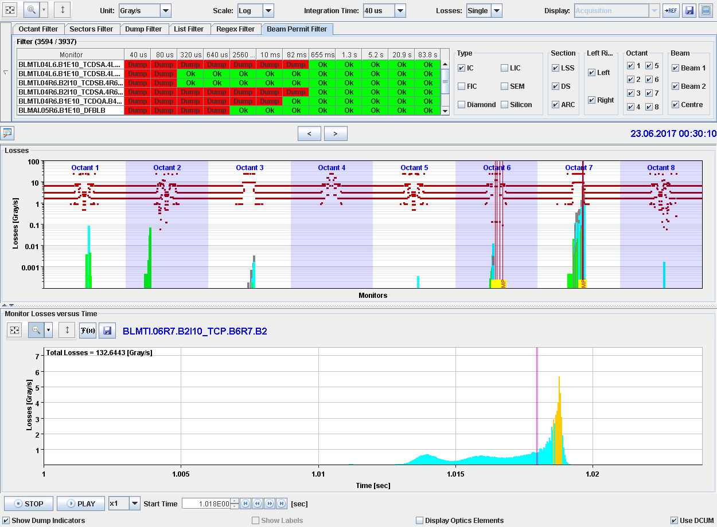
Scale times 50

Slide 23
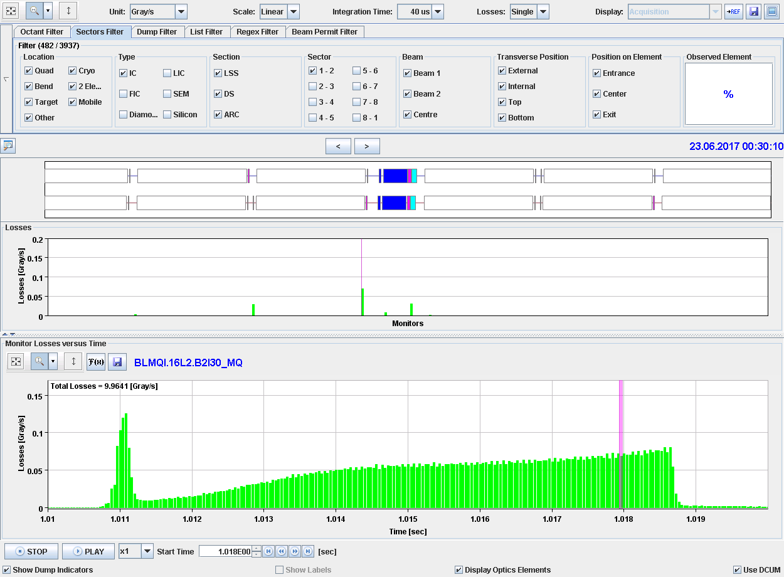

Slide 25
Regular UFOS
A dust particulate enters the beam tail
The protons interact with the atoms, and this lead to ionisation of atoms
By the ionisation electrons are created
In general, electrons remain in the dust particulate
If the electrons have an energy of several 10 keV (for a dust particulate of 30 um diameter), the electrons can escape
The dust particulate gets charged due to the loss of electrons
The dust particulate is expelled due to its positive charge

Slide 26
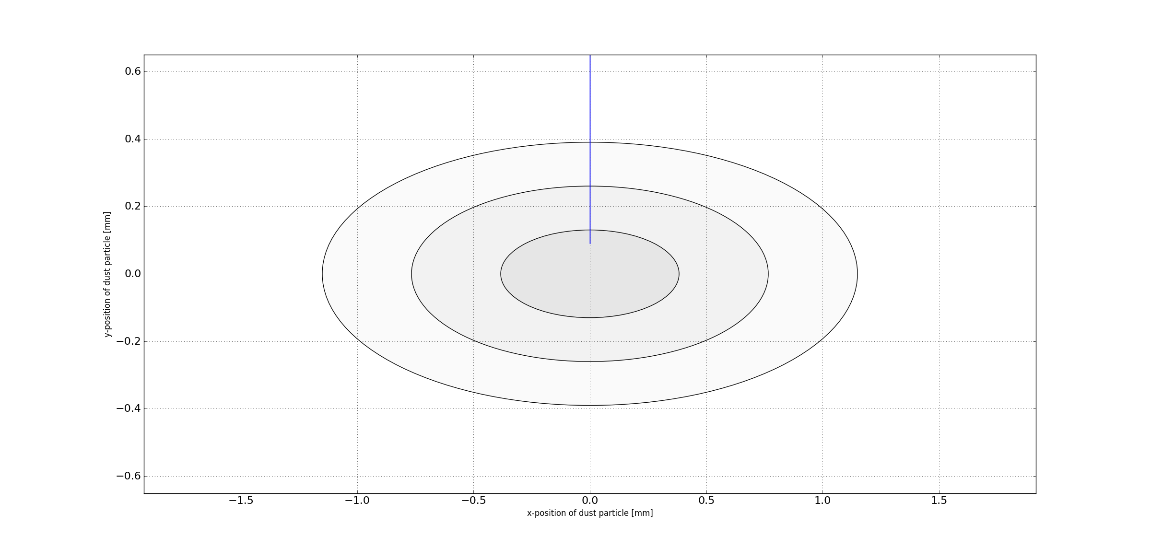
Looking towards the beam, 2E13 protons, about 200 bunches

Slide 27
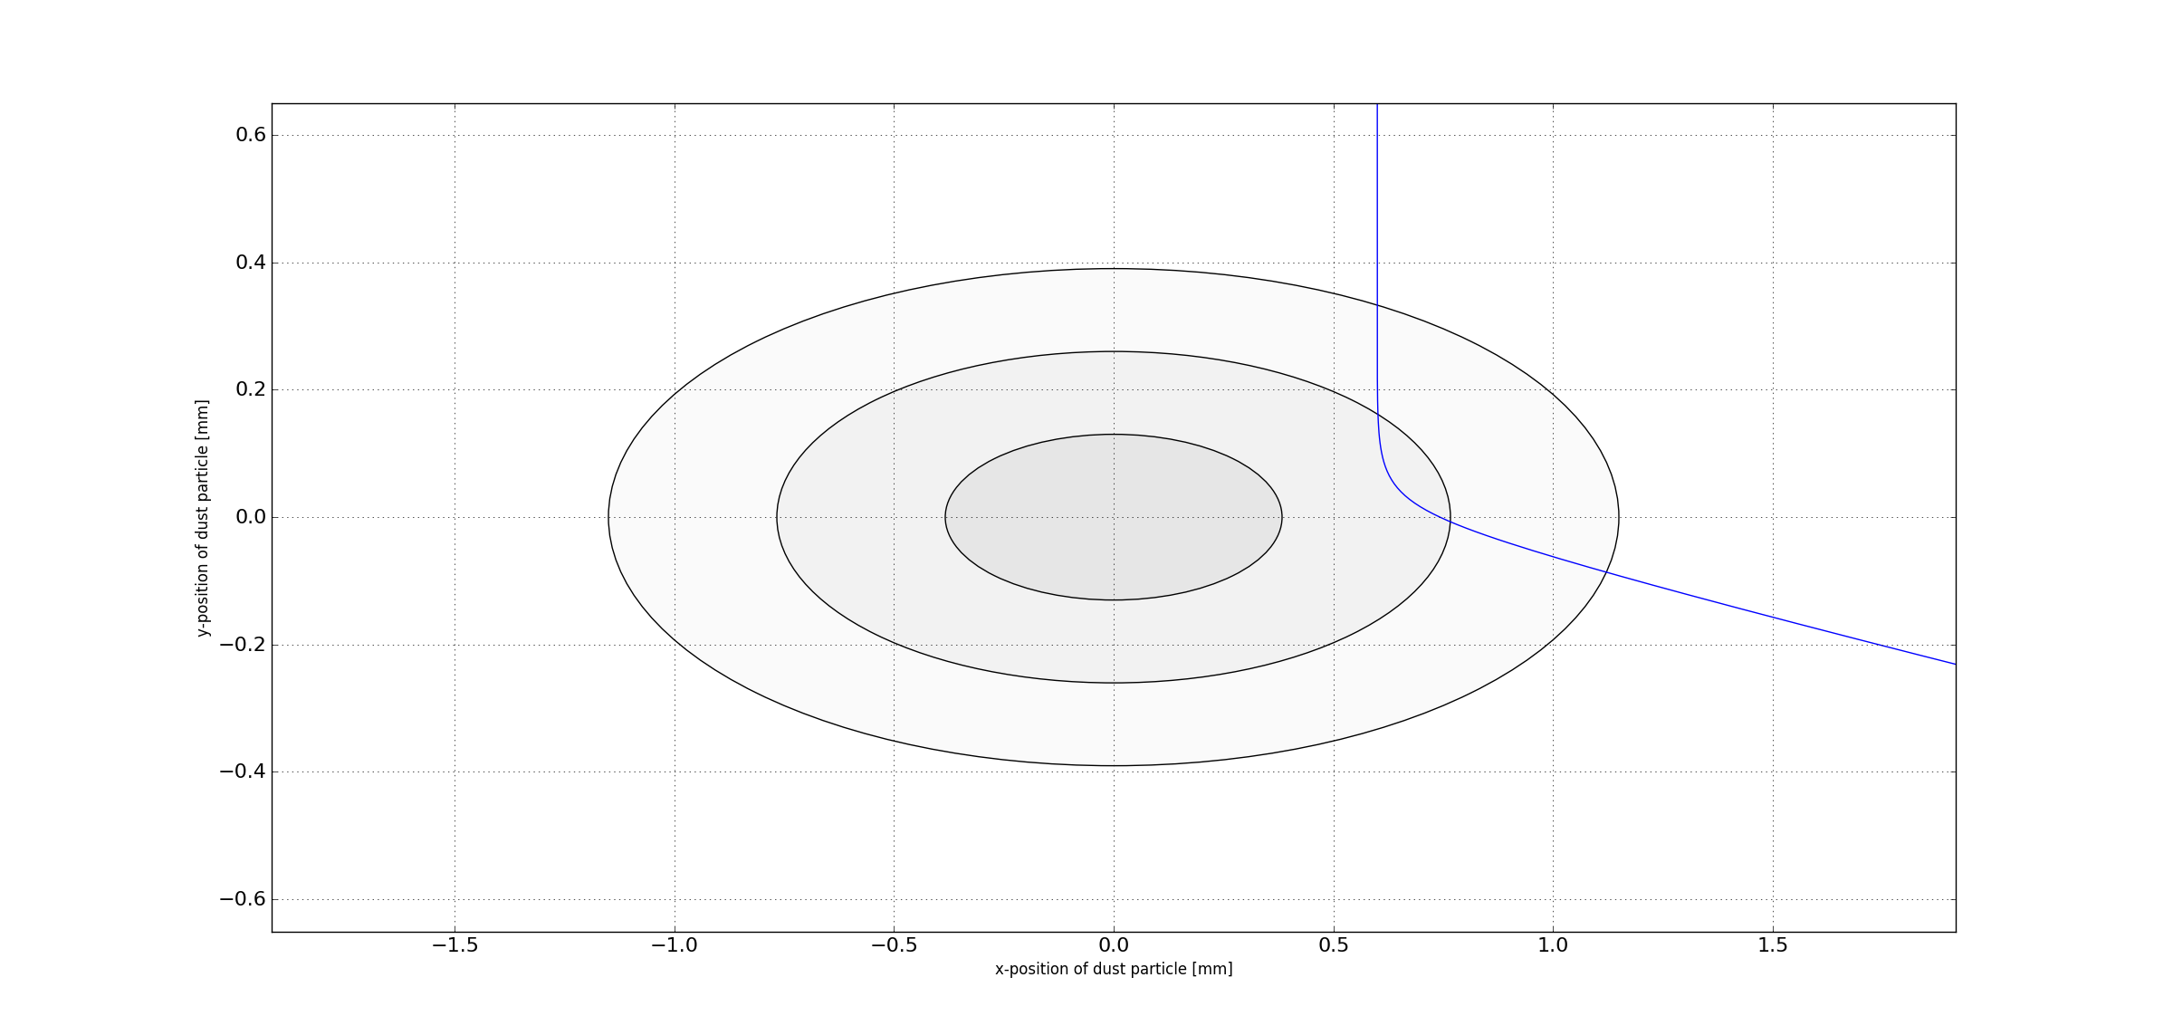
Dust particle with offset to beam centre

Slide 28
Regular UFOS
Type 2 UFOS ?
A dust particulate enters the beam tail
The protons interact with the atoms, and this lead to ionisation of atoms
By the ionisation electrons are created
In general, electrons remain in the dust particulate
If the electrons have an energy of several 10 keV (for a dust particulate of 30 um diameter), the electrons can escape
The dust particulate gets charged due to the loss of electrons
The dust particulate is expelled due to its positive charge
A dust particulate enters the beam tail
The protons interact with the atoms, and lead to ionisation of atoms
By the ionisation electrons are created
In general, electrons remain in the dust particulate
If the electrons have an energy of several 10 keV (for a dust particulate of 30 um diameter), the electrons can escape
At the same time, energy is deposited in the dust particulate that heats it up. Depending on the material, the dust particulate might be (partially) vaporised or sublimated
There is a free cloud of atoms
The atoms get ionised by the beam

Slide 29
Regular UFOS
Type 2 UFOS ?
The cross section of ionisation of atoms is very high since it needs only little energy to ionise an atom
Electrons with a low energy (order of 10 eV) are created
The electrons are captured in the beam potential
The electrons create an instability, similar to the well known electron cloud instability

Slide 30
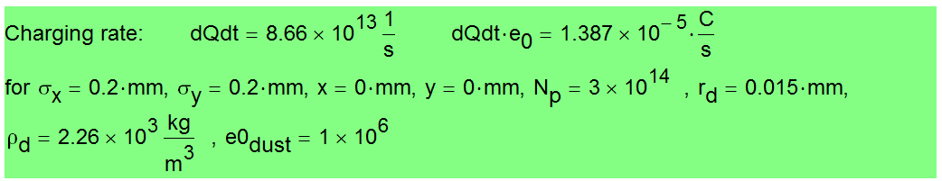
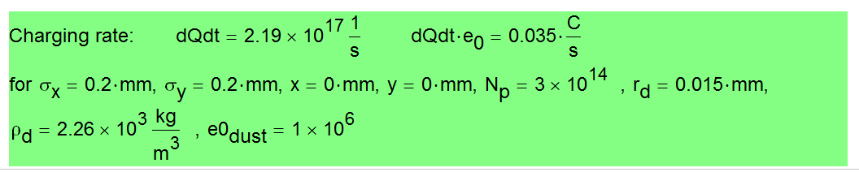
Some numbers (…..hot of the press, not verified)
The charging rate of a dust particle (Ecut at 38 keV)
The charging rate of atoms (Ecut at 15 eV)

Slide 31

THANK YOU FOR YOUR ATTENTION!
I would like to thank the numerous co-workers from TE-MPE, TE-VSC and TE-MSC for their continuous support and advice on that project!

Slide 33
Sample preparation
PRE-REQUIREMENT: CLEAN ROOM ACCESS!
Extract samples from metallic mesh via small quantity of ethanol and sonicate the solution to break conglomerates
Mix the solution well and use a pipette to drop a defined quantity onto the filter
Use ClearLine MCE gridded membranes (order @Milian #175067, d=47mm,p=0.2um)

Slide 34
Open Questions: Brainstorming with Rüdiger
From kickers: particulates
Our understanding of UFOs is very limited
The model of falling dust particle and then expelled from the top is not complete (demonstrated dramatically by the recent 16L2 event)
  is our UFO modelling correct??
We do not fully understand (not all in our camp)
  what material
  what size
  Release mechanism
  Mitigation strategies?
  Origin of dust particles
  We do not understand the distribution around the ring
  Are all UFOs the same? Roman pots, 16L2 ?
  How does it scale with beam and magnet parameters (HL-LHC, HE-LHC, FCC)
  What about new types of surfaces? Laser treated…..
  Can we prepare vacuum components such that UFOs are minimised?
  What about UFOs after a warm-up? E.g. after LS2, LS3, ….
  What about UFOs after installation of new components? E.g. after LS2, LS3, ….
Activities
Dust investigation
Data analysis and interpretation (incl. improved statistical analysis)
Better diagnostics (diamonds)
Understanding of dynamics (MD planned)
Model improvement (melting and vaporisation?, adhesion, …), with input from dust analysis

Slide 35
https://www.americanelements.com/meltingpoint.html

