Slide 2
UFO Buster analysis tool
A brief introduction
Martyna Dziadosz
TE-MPE-PE | martyna.dziadosz@cern.ch
Notes:
Hi, Today I would like to give you a brief introduction to the project I’m working on – the UFO Buster analysis tool

Slide 3
Motivation
We want an analysis tool which is:
Fast
Easy
Reliable & reproducible
Enables advanced analysis
Focus on real UFO data
All in one place + manual/readme
One module for frequent analyses
Search for correlations
Notes:
Let’s start with familiarizing you a little bit more with the project itself by presenting it’s motivations.
Hence, what are do we await from the tool ?
The aim is to develop the analysis tool for the UFO Buster data from LHC, that will allows fast and easy advanced analysis
focused on UFO events independently from UFO Buster software. Which has to be reliable and reproducible.
Obtaining mentioned requirements throught the application of certain conditions (that I’ll present on one of the consecutive slides) the tool will be focused on real UFO data
All necessary data are stored in one place and do not interfere with UFO Buster original data itself
The tool consist of several, independent from each other moduls, which allow for quick analysis and provide/ensure rreproducibility.
thanks mentioned moduls inependence, the tool allows for repeatablility of steps, which are of our interest without need to reapeat all if them
What is more it provide searching for the correlations in UFO events

Slide 4
Structure of the UFO Buster analysis tool
Data Extraction
Raw Data Analysis
Collimator Losses
Advanced Analysis
Select only real UFO events
Reduce data volume
Plot UFO event
Analysis signal shape
Correlation with elastic losses (IP7/IP3/IP6)
Statistical analysis (UFO rates etc.)
Correlations to LHC parameters
Determination of UFO location
Discard empty and fishy files
Group like events
Notes:
Giving the big picture of the toolkit the structure of the UFO Buster analysis tool is presented at the following slide.
As I’ve mentioned before it contains, several modules, that can be grouped as followed: data extraction, raw data analysis, collimator losses and advanced analysis.
Data extraction is aimed at selection real UFO events, reducing data volume and discard of empty and fishy files
Next step is focused on analysis the signal shape and consequently creating the group like events
It is followed by looking for the correlations in collimator losses and execution the advanced analysis

Slide 5
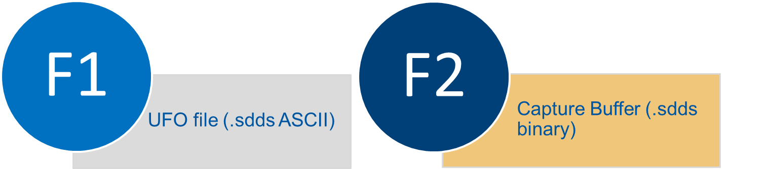
  DATA EXTRACTION
Step 1
Retrieve original UFO Buster data
Merge only relevant info into one file F3
Notes:
1 step is to extract data from UFO Buster files F1 (UFO file, which contains max losses for all BLMs for 12 RS together with important prameters, such as verification level, beam mode, UFO BLM names, fillnumber) and F2 (capture buffer file with recorded losses for all BLMs registered with RS2 for 4369 points with timestamp of 80 us) and merge information into one file - F3 (extract/ …).
To give you the feeling of data extraction step the following slide presents the scheme visualizing code structure

Slide 6
INPUT
F1 with the corresponding F2
~2000
CONDITION 1:
Beam_mode: STABLE
VerificationLevel: UFO_verified
CONDITION 2:
F2 for which max loss for UFO BLM match the value for RS2 in the corresponding F1
CONDITION 3:
losses > threshold (5 * 10⁻³)
CONDITION 4:
At least 2 point nearby each other for which condition 3 is fulfilled
~60

Slide 7


  DATA EXTRACTION
Step 1
Basic info (timestamp, fill number, machine parameters)
UFO BLM + neighbours (losses + DCUM)
Time-resolved data (capture buffer)
Notes:
Presented at the previous slides consecutive steps and applied conditions for F1 and F2 yield in a result to creating file F3, which contains necessary for the further steps
-> basic informations, such as timestamp, fill number and machine parameters
-> registered by BLMs losses for UFO BLM + it’s neighbours and selected BLMs localized in the collimators area

Slide 8
  DATA EXTRACTION
Step 1
ü
Reduces data volume for quick analysis
Notes:
As F3 is created only for event fulfilling certain conditions,
Data volume has been reduced, what allows for quick analysis

Slide 9
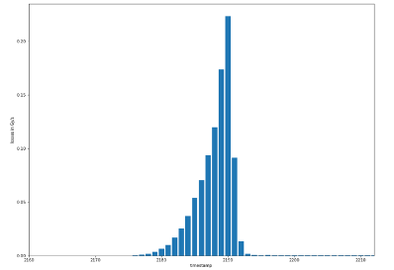
  RAW DATA ANALYSIS
Step 2
Plot UFO event from F3
Compare with UFO Buster output for confirmation
Losses in Gy/s
Time (here in 80 µs bits)
Notes:
After extracting the interesting data we can move to the next step – analysis of the raw data
Initially our attention was focus on creating the plot of losses [Gy/s] of/for the UFO event in a timescale (which at the presented photo is given in bits – 80us)
And them compare achieved results with the UFO Buster output in order to confirm the corectness of conducted analysis

Slide 10
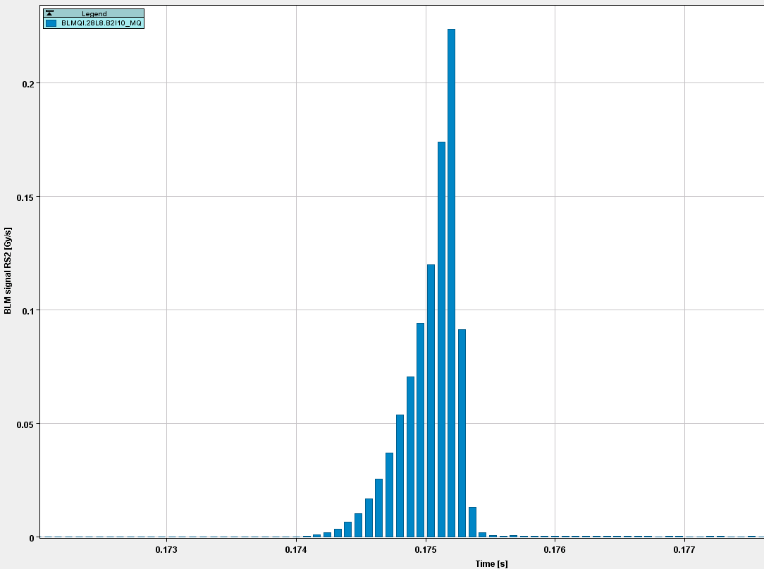
  RAW DATA ANALYSIS
Step 2
UFO Buster from capture buffer
Losses in Gy/s
Time (here in 80 µs bits)
ü
Plot time-resolved UFO event
Notes:
Here is present results achieved using the develop tool and the corresponding plot from UFO Buster software

Slide 11
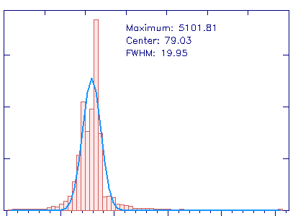
  RAW DATA ANALYSIS
Step 2
Analyse and group UFO events
Losses in Gy/s
Time (here in 80 µs bits)
Notes:
subsequently we’re going to make the analysis of the UFO events in terms of signal changes

Slide 12
  RAW DATA ANALYSIS
Step 2
ONGOING
Losses in Gy/s
Time (here in 80 µs bits)
✗
Analyse signal shape & group (FWHM, max, symmetry)
Notes:
This is the ongoing step, which will includes signal shape analysis and then consectively storing into the group by
Certain conditions such as the value max losses and symmetry

Slide 13
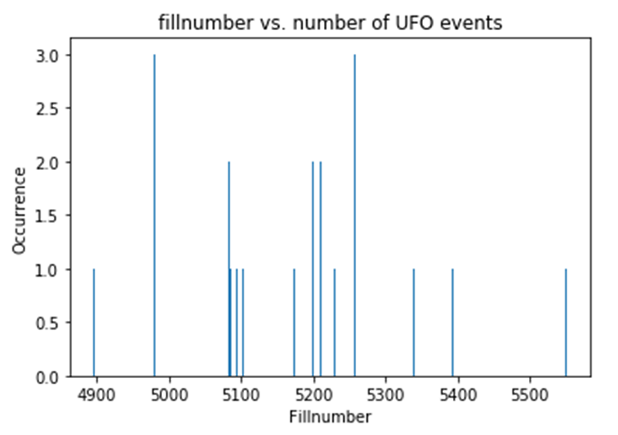
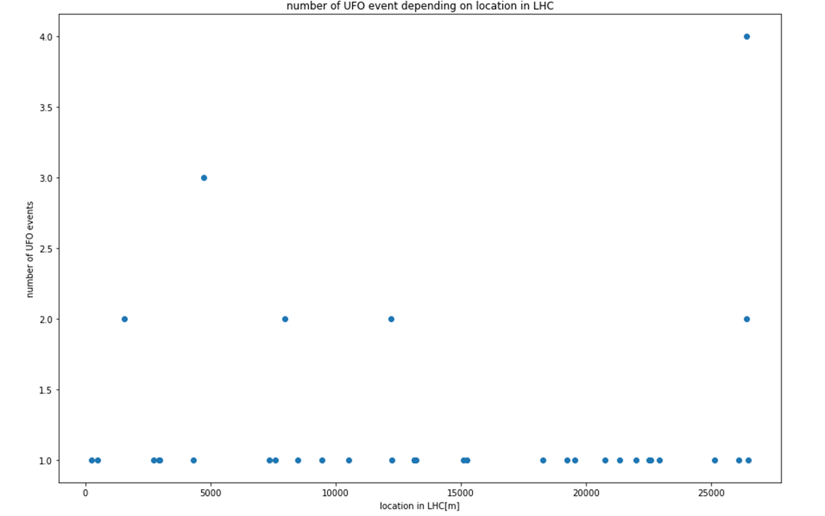
  STATISTICAL ANALYSIS
on reduced sample size
Step 3
UFO rate vs. time or location
number of UFOs
number of UFOs
Location in LHC [m]
Notes:
The next step are statistical analysis, which are partialy made. So far on a very reduced sample size, which will be changed by the applicatin of slightly different analysis conditions.
On this slide the UFO rate vs time and location has been presented.
The location of the UFO events might tell us a little bit more about area, which are more pronounced to the UFO occurnece
It may give us a bit more information about the regions where UFO evety more often

Slide 14
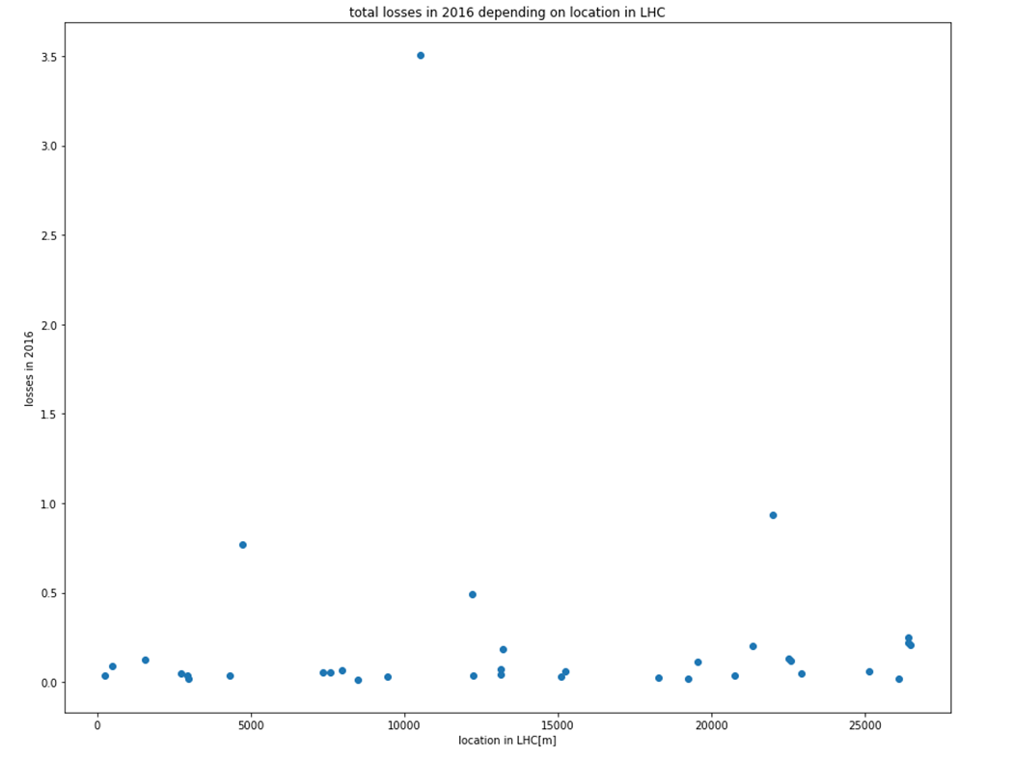
  STATISTICAL ANALYSIS
on reduced sample size
Step 3
Total UFO losses vs. Location (2016)
2016
Integrated losses[Gy/s]
Location in LHC [m]
ü
Plot of loss distribution along LHC

Slide 15
Integrated losses of all UFOs per BLM
ROMAN POT AREA
Notes:
Hot spots, where more than one UFO event occured during 2016 LHC-working time
Those are mainly the roman pots area, where we can expect such an behaviour

Slide 16
Summary of Achievements
ü
Reduced data volume → faster analysis
ü
BLM losses vs time
→ UFO event visualization
ü
UFO rate plots (vs time, location or BLM name)
ü
Plot of loss distribution along LHC
07/12/2017 | Schematic overview of UFO Buster analysis tool
Notes:
Summarizing, until know it has been reached :
-> that allow
Versus/in reference

Slide 17
Conclusion
Data extraction and visualization working
Basic functionality validated with reduced data set
Extension for big data needed
Statistical analysis available
UFO shape analysis still to be implemented
… to be continued!
Notes:
To conclude now we have principally working tool created within usage of Python software.
With working data extraction and visualzation. Furthermore, basic functionality was validated on the reduced sets of data.
It worth to mentioned that’s so far we are workig with the skretch/test version to get the feeling of the data in order to
Apply the precise conditions for the final software layout.
What is more, some of the modules still recquires to be applied and will be shown on one of the consective presentations

Slide 18
Thank you for your attention. ☺

Slide 19
www.cern.ch

Slide 20
APPENDIX

Slide 21
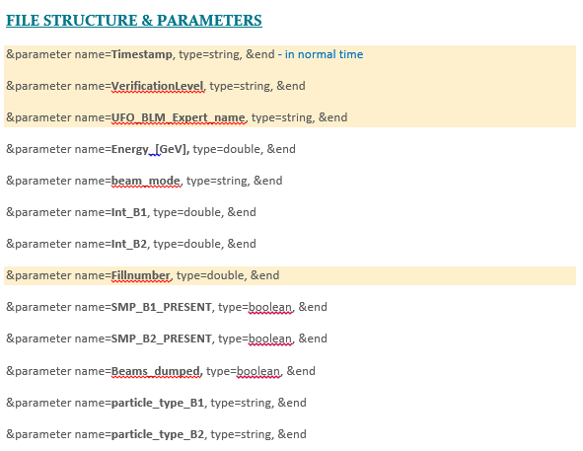
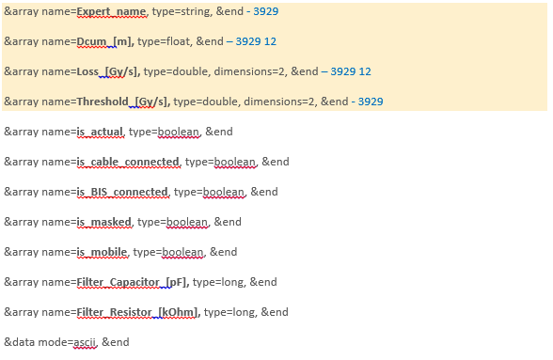
Appendix – F1 structure

Slide 22
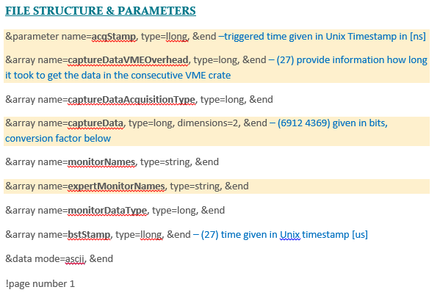
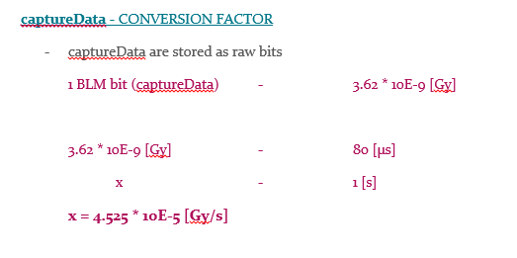
Appendix – F2 structure

Slide 23
  DATA EXTRACTION
Step 1
F1
find the corresponding file type 2
F2
look for F2 with the same timestamp and fillnumber
EXTRACT
DECONVERSION -> JAVA
Java objects:
String[] header
(1D matrix with BLMs names)
Int[][] value
(2D matrix with BLMs signal losses)
Fillnumber, Timestamp, UFO_BLM_Expert_name, Dcum, VerificationLevel, beam_mode, Expert Name
List of files type F1 for which the exist the corresponding file type F2
Notes:
Initially we have 2 files
the 1 step is to extract data from retrieved from UFO Buster files F1 and F2 and merge information of our interest in F3 (extract/ …).
To give you a broader impression of that step the following slide presents the diagram visualizing code structure

Slide 25

  DATA EXTRACTION
Step 1
Retrieve original UFO Buster data
ONGOING
Merge only relevant info into one file F3
Basic info (timestamp, fill number, machine parameters)
UFO BLM + neighbours (losses + DCUM)
Time-resolved data (capture buffer)

Slide 26
INPUT FILES
F1
F2
F2
UFO file (.sdds ASCII)
Capture Buffer (.sdds binary)
max losses [Gy/s] for
12 RS for 3929 BLMs
losses [bits] recorded for every 6912 BLM
important parameters:
VERIFICATION LEVEL
BEAM MODE
UFO BLM name
FILLNUMBER
data registered with RS2 time resolution for 4369 timestamps

Slide 27
Diagram visualizing code structure

Slide 28
F1
find the corresponding file type 2
F2
2 WAYS
.sdds ASCII file
.sdds binary file
EXTRACT
DECONVERSION !!!
JAVA
1) looking for F2 with the same timestamp and fillnumber
2) go to an appropriate path using fillnumber. Then look for the corresponding F2 using naming convention
Fillnumber
Timestamp
UFO_BLM_Expert_name
Dcum []
VerificationLevel
beam_mode
Expert Name
Java objects:
String[] header (1D matrix with BLMs names)
Int[][] value (2D matrix with all BLMs signal losses)
OUTPUT:
List of files type F1 for which the exist the corresponding file type F2

Slide 29
INPUT
F1 with the corresponding F2
CONDITION 1:
Beam_mode: STABLE
VerificationLevel: UFO_verified
CONDITION 2:
F2 for which max loss for UFO BLM match the value for RS2 in the corresponding F1
CONDITION 3:
losses > threshold (5 * 10⁻³)
CONDITION 4:
At least 2 point nearby each other for which condition 3 is fulfilled

Slide 30
F3
excel file (.csv)
F3
excel file (.csv)
Basic info
(timestamp, fill number, machine parameters)
UFO BLM + neighbours (losses + DCUM)
Time-resolved data (capture buffer)

Slide 31
OUTPUT FILES
+
F3
F4
F4
excel file (.csv)
excel file (.csv)
losses over time for:
UFO BLM
20 neighboring BLMs
selected list of BLMs in collimator’s area
parameters for filtered in UFO BLMs:
  UFO BLM
  fillnumber

Slide 32
Analysis results

Slide 33
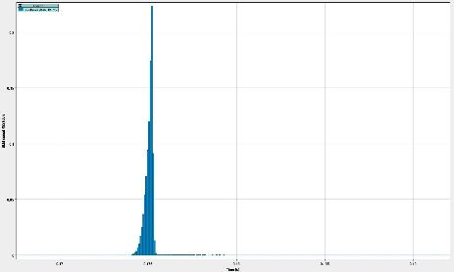

STEP 2 – plot comparison (UFO Buster vs achieved plots)
Ufo_2016_05-09_01-49-42.0_BLMQI.28L8.B2I10_MQ

Slide 34
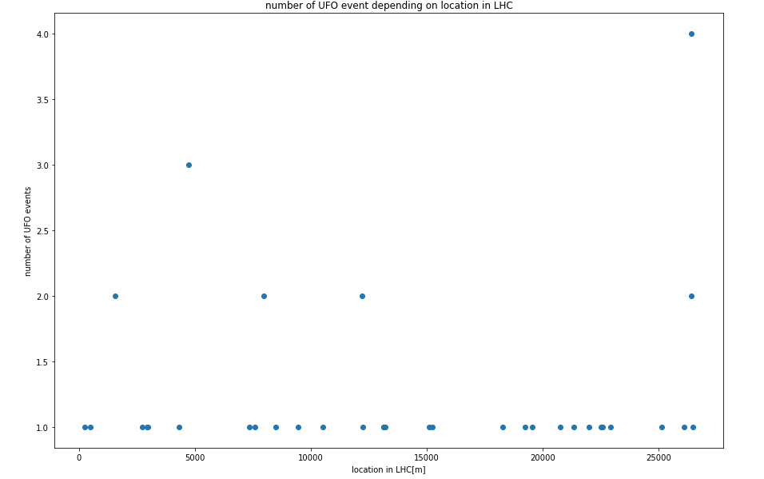
LHC location vs number of UFO events

Slide 35
LHC location (in terms of BLMs names) vs (integrated) losses in 2016
ROMAN POT AREA

Slide 36
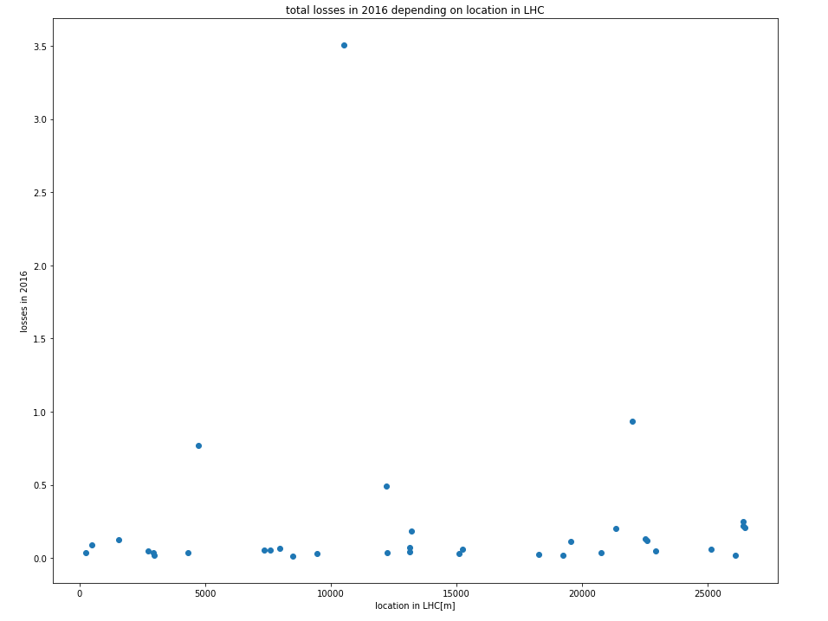
LHC location vs total losses in 2016

Slide 37

Fill number vs number of UFO events

Slide 38
Conclusions & outlock
Now we have principally working tool created mainly in Python (plus Java in order to decode F2). Currently we are working with an initial version (sketch) which gives us the first feeling of the data being still under development.
Future steps:
playing around with data making further analysis with changed parameters & conditions
precise the conditions for the final software layout

