Slide 1



Summer Student programme
Michał Wilczek
June-August 2017

Slide 2


My studies
Lodz University of Technology, (2013-15,2016-17)
specialisation : Mechanical Engineering and Applied Computer Science
General Engineering, (2015-16) specialisation : Mechanical Engineering

Slide 3


Academic projects
Bachelor thesis : Design of a modular apparatus for the production of nitric acid in electric discharge phenomena
Research student at Institute of Materials Science and Engineering, Lodz Univ. of Technology

Slide 4

Project at Cern
Simulation of a mechanical response to unbalanced currents in the 11T magnet protected by the CLIQ system.
The project consists of:
Preparation of a mechanical model of 11T magnet in Ansys
    Pre-stress analysis
    Cooling-down (shrinking phenomena)
    Application of Lorentz forces
    Change of temperature of the magnet due to quench
Mesh-based interpolation and one-way coupling the Ansys model together with the Comsol models via MpCCI software
Continuation of the Tina Griesemer’s work (proof of concept)

Slide 5
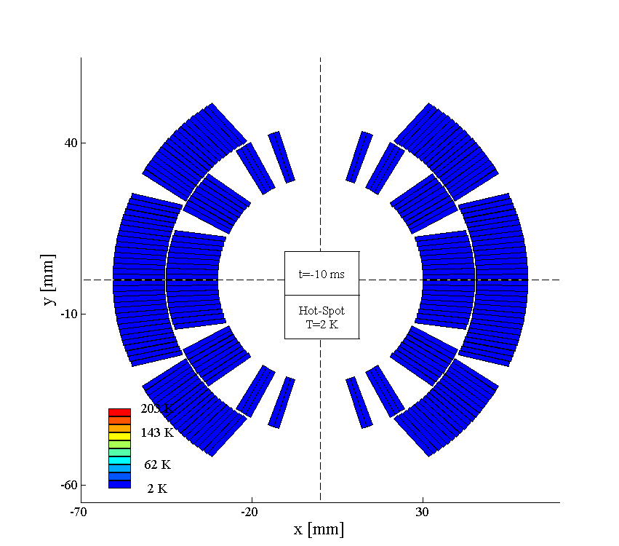
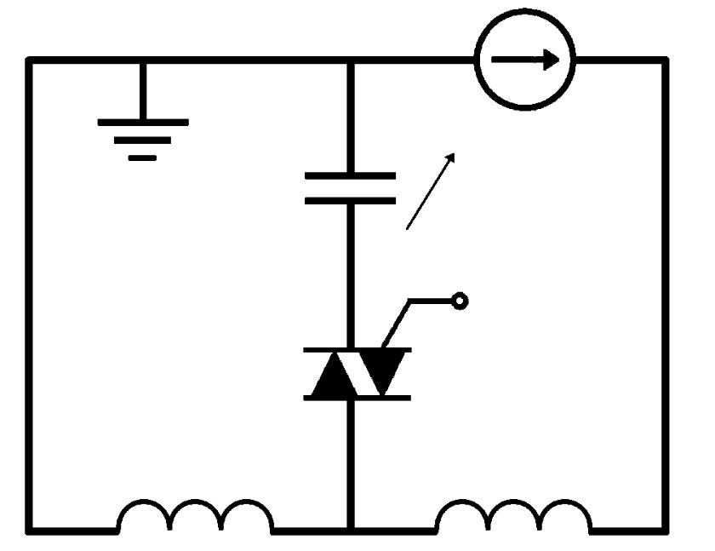
CLIQ in a NUTSHELL
Current
Change
Magnetic Field
Change
I_{C}
Coupling-Losses
(Heat)
Temperature
Rise
I₁
I₂
QUENCH

Slide 6
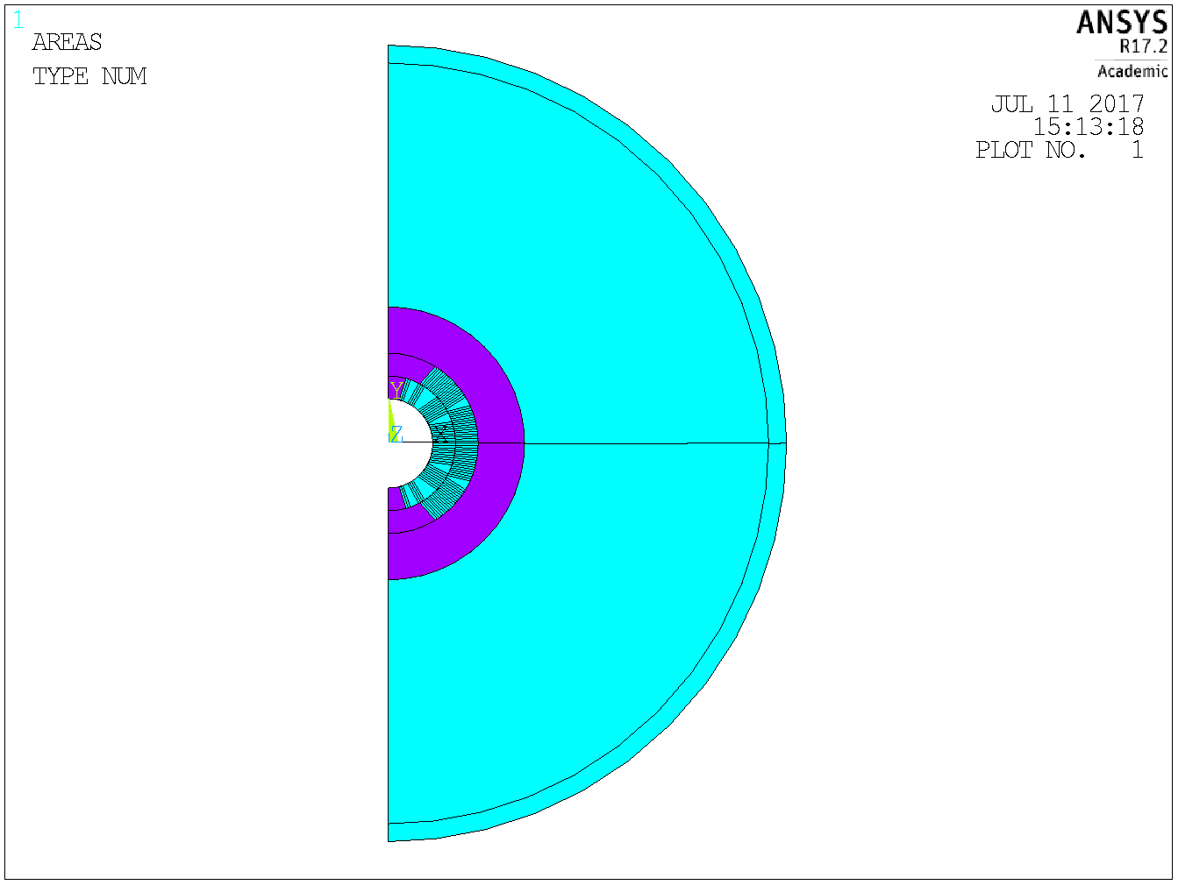
Preparation of 11T magnet model
Shell
Yoke
Shims for
Pre-stress
Collar
Coil

Slide 7
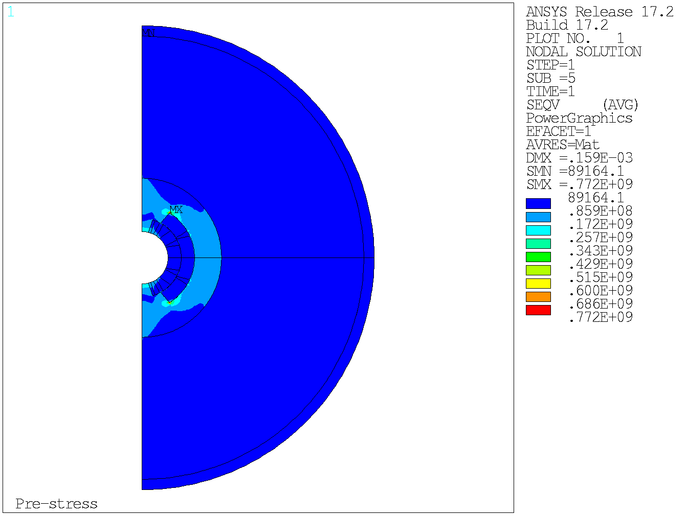
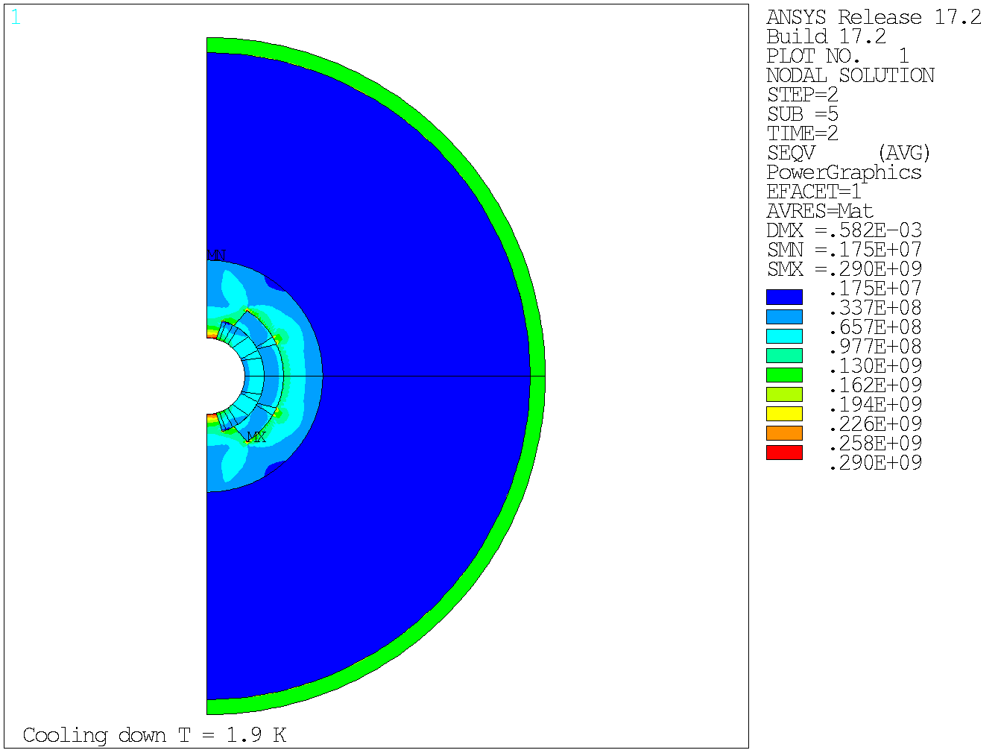
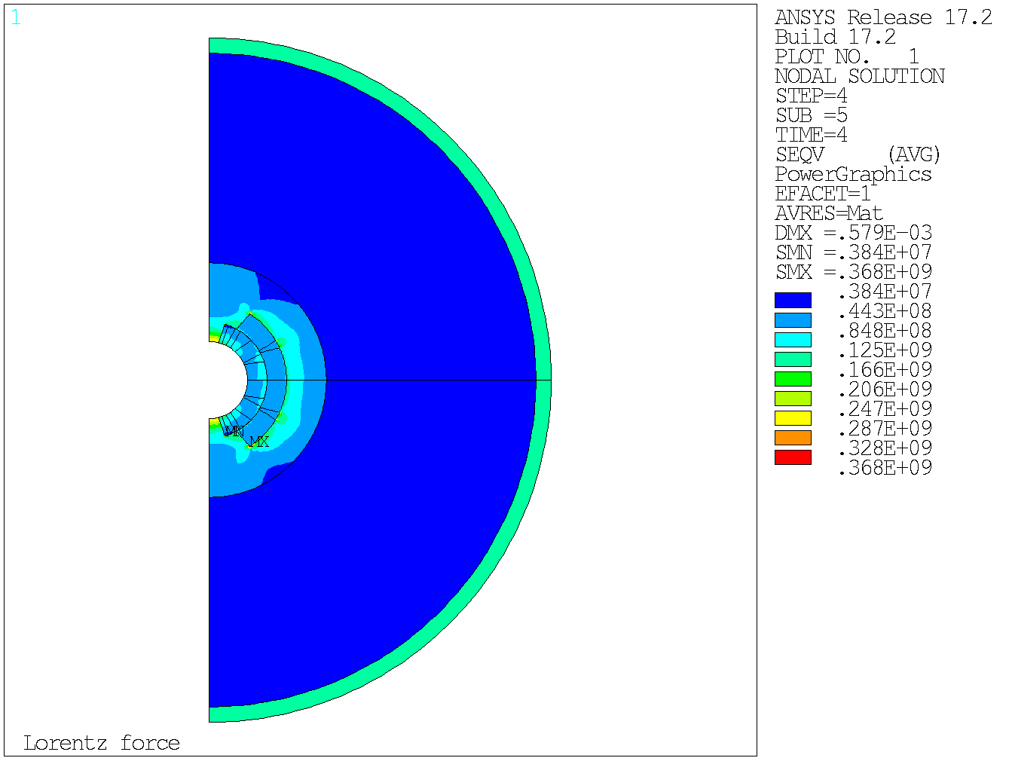

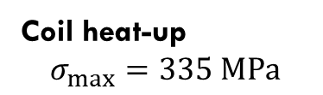
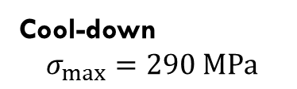
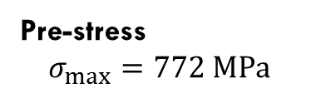
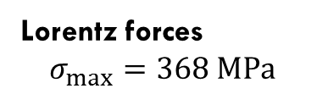
Pre-stress
Cool-down, T=1.9 K
Coil heat-up
Lorentz forces
11T magnet - Eqv Stress Analysis
1.
2.
Pre-stress
$$σ_{max}=772 MPa$$
Cool-down
$$σ_{max}=290 MPa$$
4.
3.
Lorentz forces
$$σ_{max}=368 MPa$$
Coil heat-up
$$σ_{max}=335 MPa$$

Slide 8
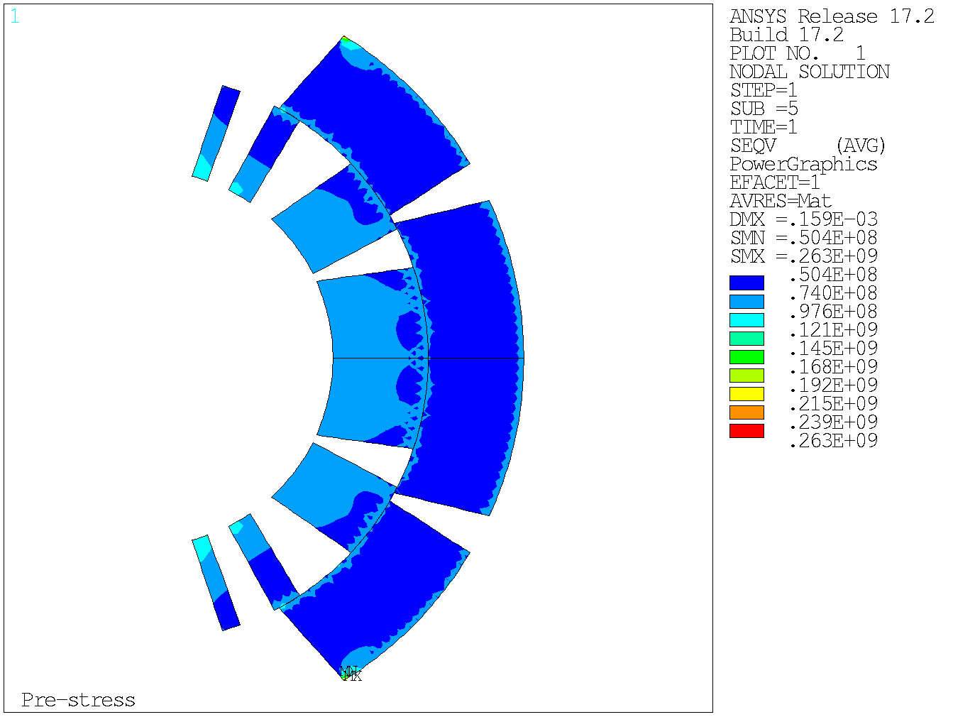
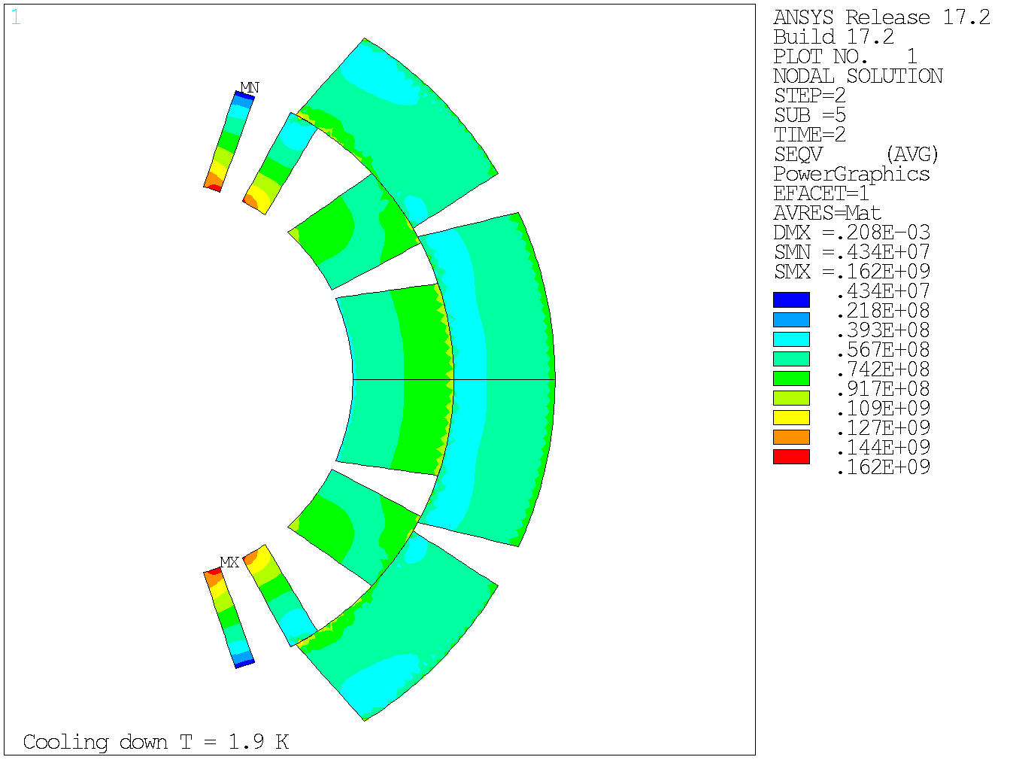
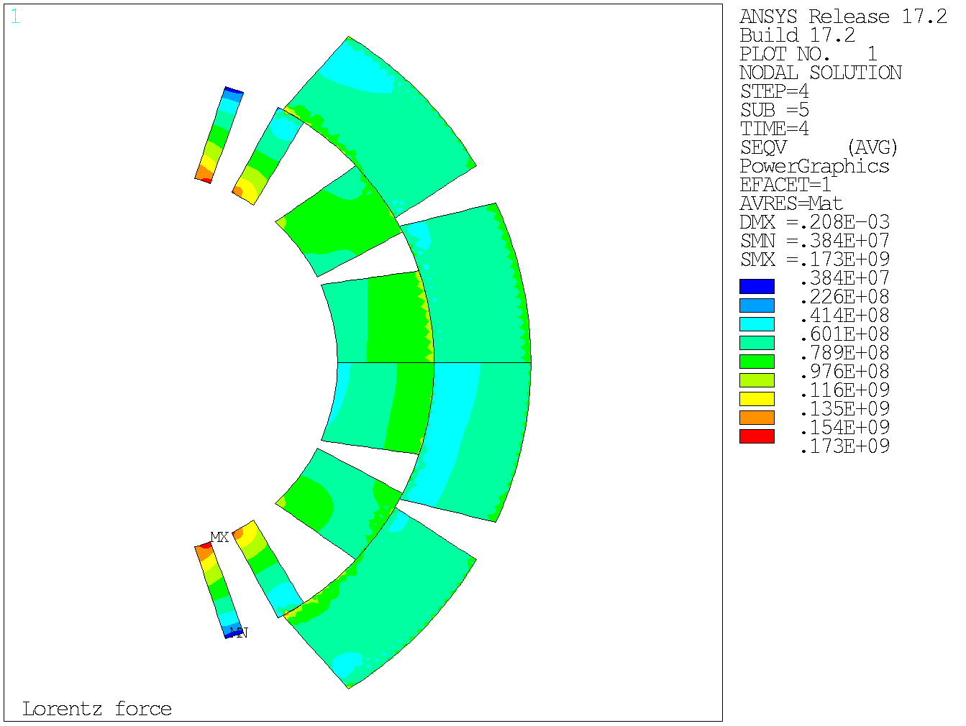
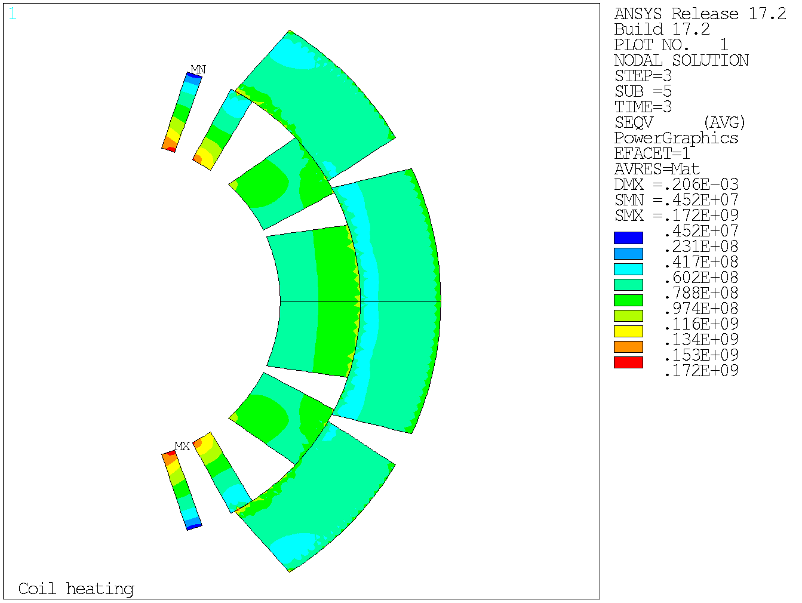
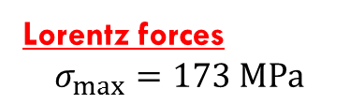
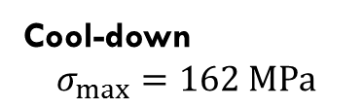
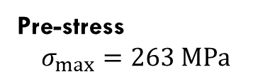
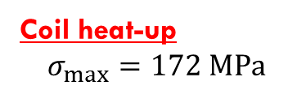
Coil - Eqv Stress Analysis
Pre-stress
Cool-down, T=1.9 K
Coil heat-up
Lorentz forces
1.
2.
Pre-stress
$$σ_{max}=263 MPa$$
Cool-down
$$σ_{max}=162 MPa$$
4.
3.
Lorentz forces
$$σ_{max}=173 MPa$$
Coil heat-up
$$σ_{max}=172 MPa$$

Slide 9
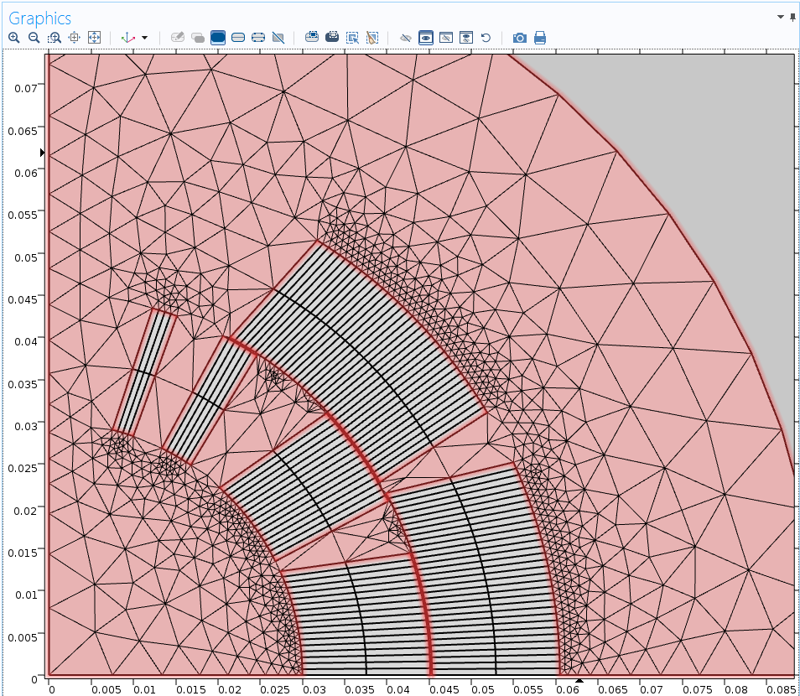
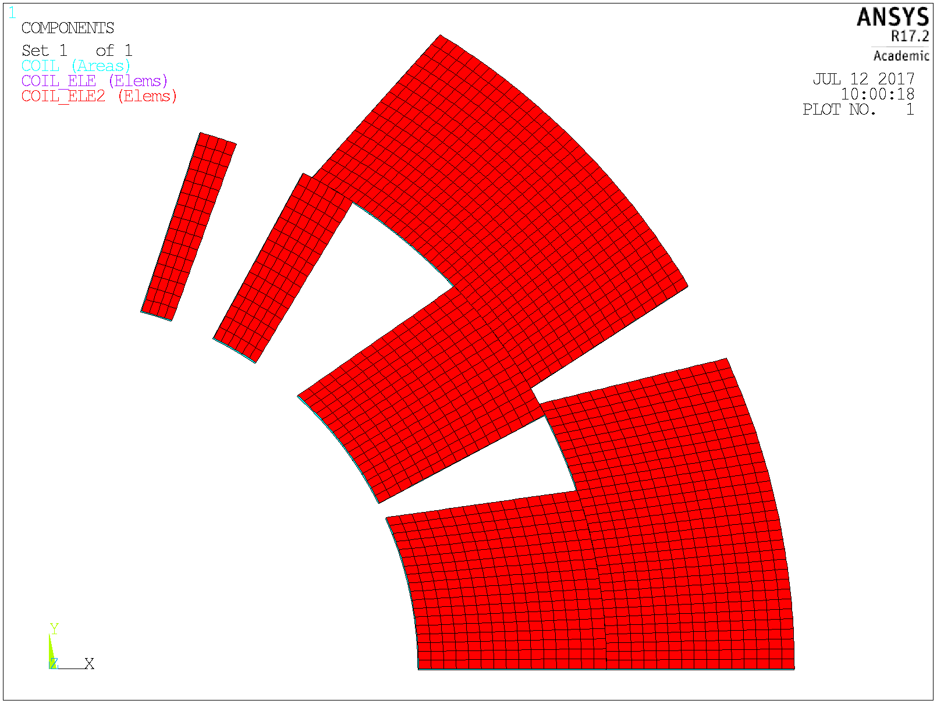




Next steps of the project
COMSOLCodeAdapter
$$T, {\vec{F}}_{L}$$
$$\hat{T}, \hat{{\vec{F}}_{L}}$$
Mesh-based
interpolation
The coupling method performed by the MpCCI software (change of mesh between Comsol and Ansys)
Verification whether the coupled Ansys – Comsol analysis with the data received from the MpCCI gives the same results like in a monolythic Ansys simulation
Strength analysis of the obtained results (possible mesh refinement, more accurate simulation of heat exchange phenomena in Ansys software)

