Slide 2
Availability estimation methods
based on systems complexity
Odei Rey Orozco
July 2017, MPE-PE Section meeting
Acknowledgments: Andrea Apollonio, Jan Uythoven

Slide 3
Outline
Introduction
Procedure to allocate Complexity
Applications
Conclusions and Outlook

Slide 4
Introduction

Slide 5
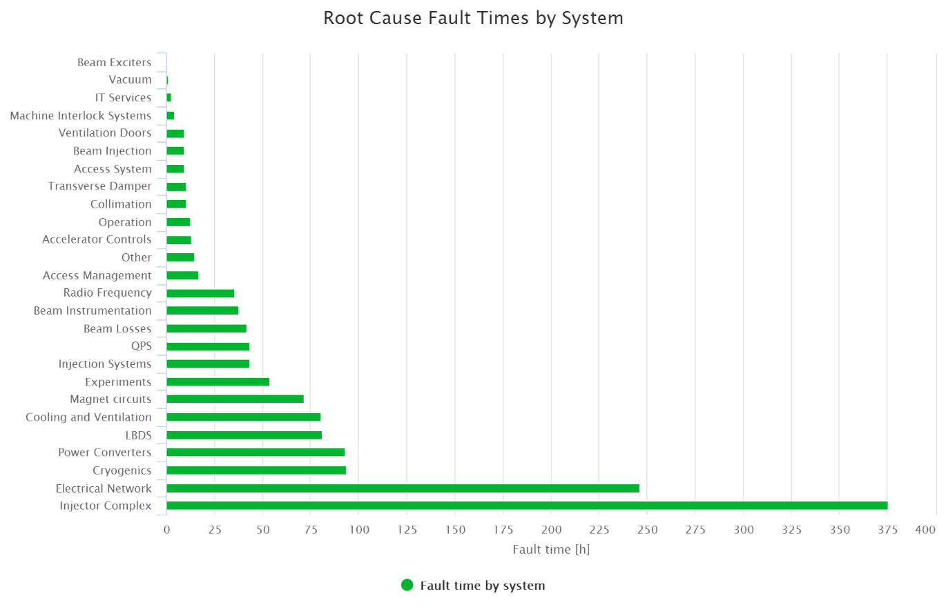
Introduction
LHC Root Cause Fault time by system 2016
-Chamonix Workshop-
How to make fault time data comparable?

Slide 6
Introduction
Literature review: Reliability/ Availability allocation methods
Methods combine several criteria for obtaining an allocation weight
Idea:
  Apply the methods to evaluate “complexity” of each system
  Compute “expected fault time” according to the complexity weight
  Compare “expected” and achieved/real fault time for each system
High complexity allocated
Performed better
Expected
according to complexity
Real fault time of subsystem i

Slide 7
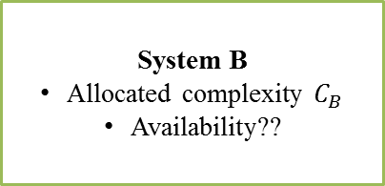
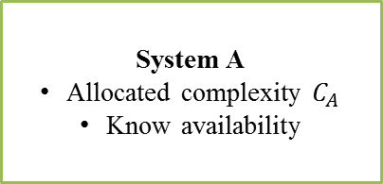
Introduction
Other applications:
System under design
Target availability -> Allocate availability requirements for each subsystem
LOWER availability requirements
Higher complexity
TARGET AVAILABILITY
HIGHER availability requirements
Lower complexity
Estimate future machine performance from similar operating technologies
System A
Allocated complexity $C_{A}$
Know availability
System B
Allocated complexity $C_{B}$
Availability??

Slide 8
Procedure to allocate complexity

Slide 9
Procedure to allocate complexity
Step 1: List the structure of system and subsystems
Step 2: Determine the scales for the selected factors
Perform the DEMATEL procedure
Step 3: Computation of complexity index
( Next: Applications)

Slide 10

Factors
$$A_{ij}≔rating of factor j for system i$$
j | Factor | Scoring scale
1 | Repair time | Scale from 1 to 10 10: highest repair time 1: lowest repair time
2 | Criticality | Logarithmic scale: 10 (1) 100 (4) 1000 (7) 10000 (10)
3 | Intricacy | Scale from 1 to 10 10: highly intricate system 1: less intricate system
4 | State of art | 1: Innovative 0.67: existing 0.33: established
5 | Performance time | 1: whole mission time 0.67: Continuous and long times 0.33: instantaneous
6 | Environment | 1: highly radioactive 0.67: average radioactive 0.33: low radioactive

Slide 11
Computation methods
FOO technique – ISPE factors – Factors product
  Intricacy, State of Art, Performance Time, Environment
Average weighting allocation method
  Factors product (Karmiol method, Geometric)
  Factors sum (Karmiol method, Arithmetic)
  Bracha Method (State of Art higher importance)
  + + + DEMATEL procedure
  An expert evaluates the relationship between subsystems of paired alternatives
  The pair wise comparison scale is designated into 10 levels
  Higher indirect relationship, higher complexity weight allocation

Slide 12
Applications
Expected availability based on complexity
Use case: LHC 2016

Slide 13
LHC Root Cause Fault time 2016

Slide 14
Step 1: List the LHC systems
i | System
1 | Accelerator controls
2 | Access System
3 | Beam Exciters
4 | Beam Instrumentation
5 | Collimation
6 | Cooling and Ventilation
7 | Cryogenics
8 | Electrical Network
9 | Experiments
10 | Injection Systems
11 | Injector Complex
12 | IT Services
13 | LBDS
14 | Machine Interlocks System
15 | Magnet circuits
16 | Power Converters
17 | QPS
18 | Radio Frequency
19 | Transverse Damper
20 | Vacuum
21 | Ventilation Doors

Slide 15
Step 2: Determine scales

Slide 16
Step 2: DEMATEL procedure

Slide 17
Step 3:
Computation of complexity index
Four different methods + DEMATEL

Slide 18

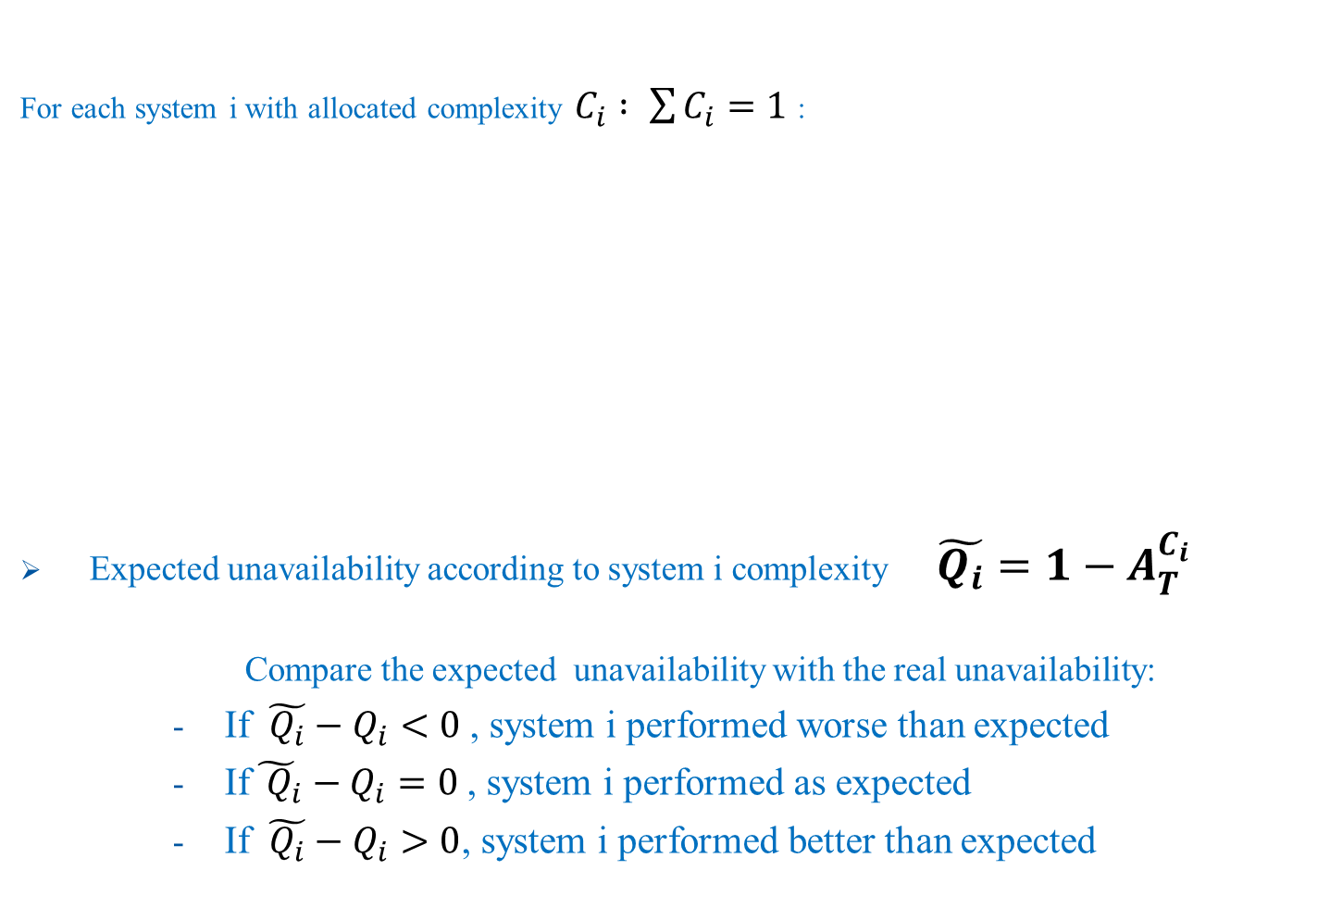

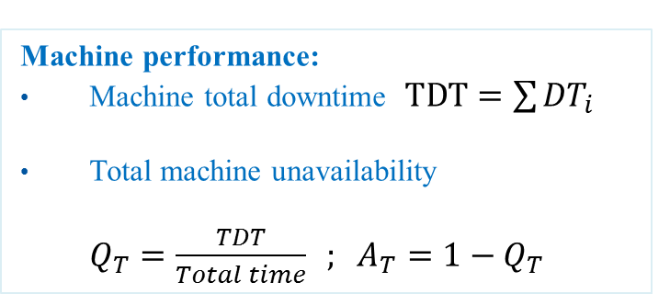
Application: Computation of expected unavailability
For each system i with allocated complexity $C_{i} : \sum{C_{i}}=1$ :
Expected unavailability according to system i complexity $\tilde{Q_{i}}=1−A_{T}^{C_{i}}$
  Compare the expected unavailability with the real unavailability:
      If ${\tilde{Q_{i}}−Q}_{i}<0$, system i performed worse than expected
      If${\tilde{{ Q}_{i}}−Q}_{i}=0$, system i performed as expected
      If ${\tilde{Q_{i}}−Q}_{i}>0$, system i performed better than expected
System i performance:
From AFT → Downtime ${DT}_{i}$
Unavailability
$Q_{i}=\frac{{DT}_{i}}{Total time} ; { A}_{i}=1−Q_{i}$
Machine performance:
Machine total downtime $TDT=\sum{{DT}_{i}}$
Total machine unavailability
$Q_{T}=\frac{TDT}{Total time} ; A_{T}=1−Q_{T}$
Note that $\prod{A_{i}}=A_{T}=\prod{{\tilde{A}}_{i}}$

Slide 19
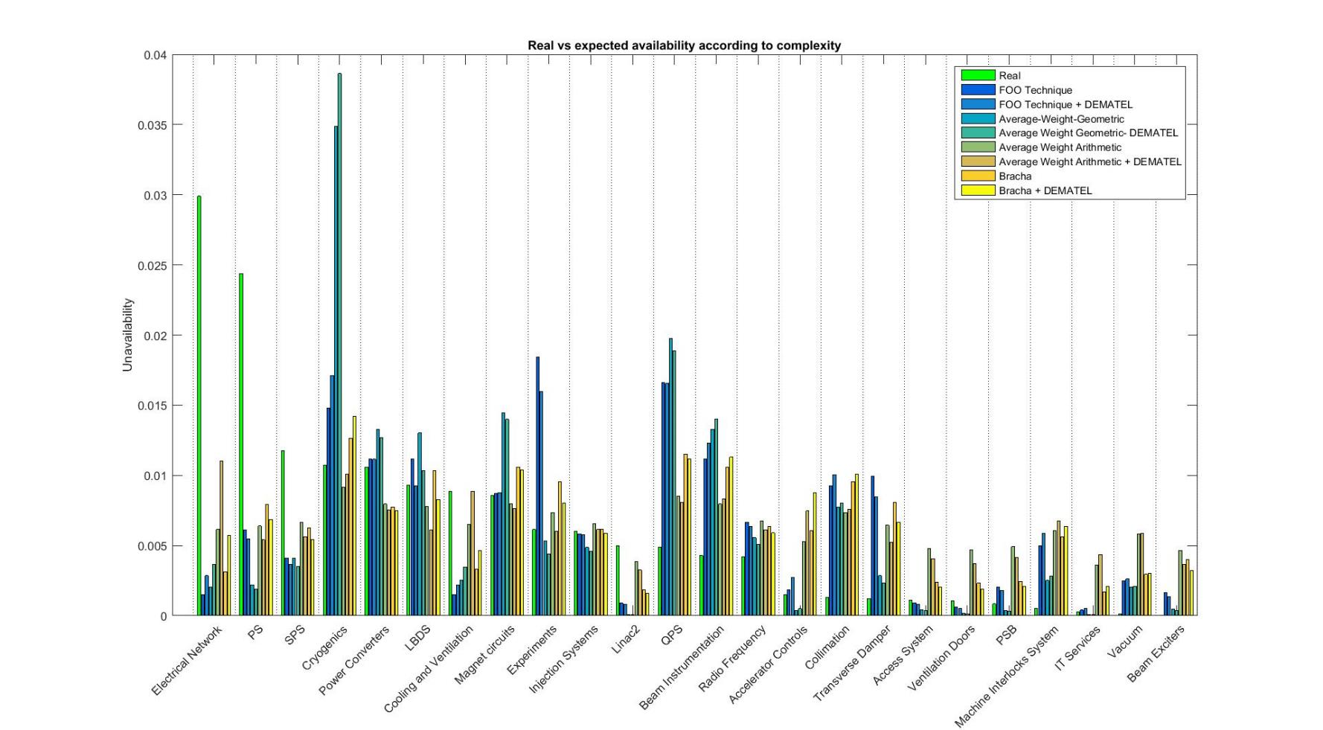
Real vs Expected Unavailability 2016

Slide 20
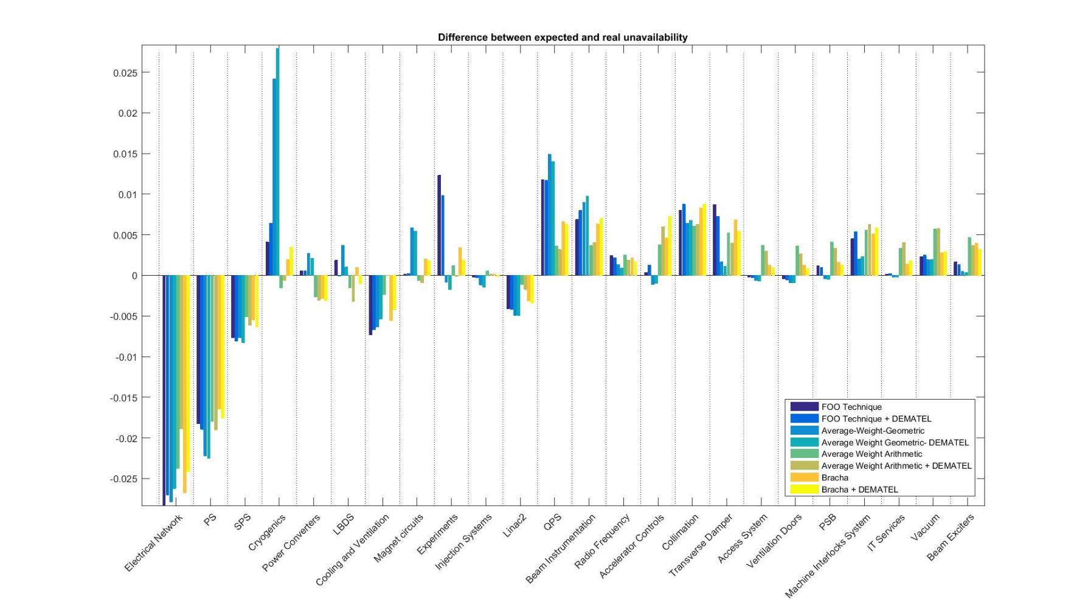
Unavailability Difference Real –Expected 2016
Better performance than expected
Worse performance than expected

Slide 21
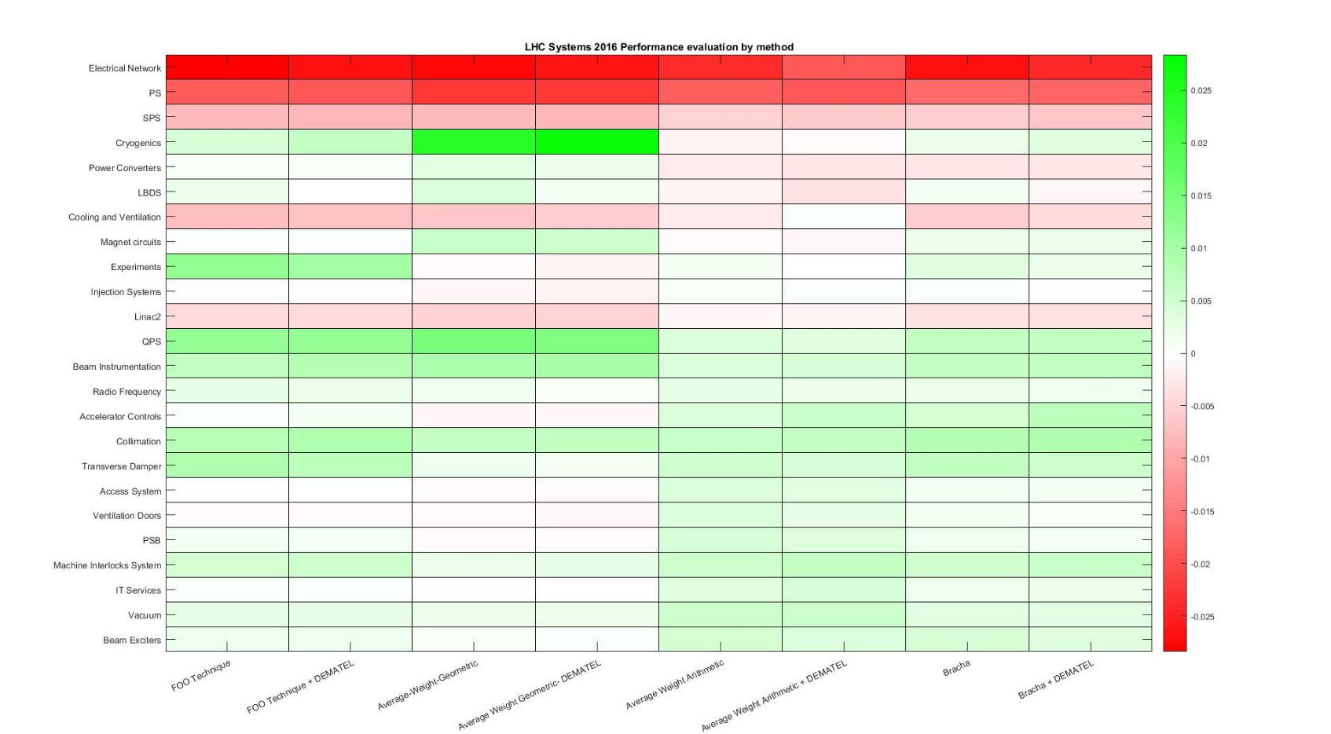

Slide 22
Applications
Allocate availability based on complexity
Use case: Linac4

Slide 23
Complexity allocation
Step 2. Determine scales and DEMATEL procedure
Step 1. List the Linac4 systems
Step 3. Computation of complexity index

Slide 24
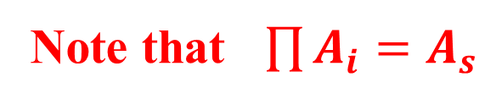

Application: Availability allocation
For each system i with allocated complexity $C_{i} : \sum{C_{i}}=1$ :
Target availability $A_{S}$
Allocated availability for system i : $A_{i}=A_{T}^{C_{i}}$
Note that $\prod{A_{i}}=A_{s}$

Slide 25
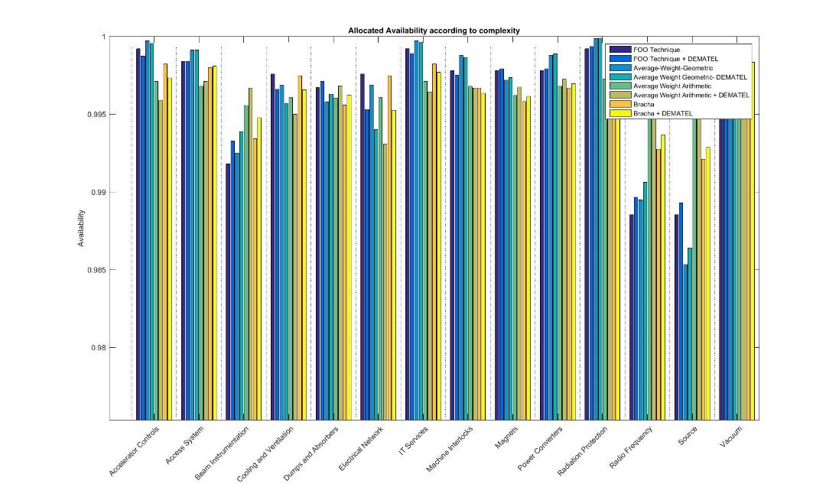
Allocated availability I – Target: 95%

Slide 26
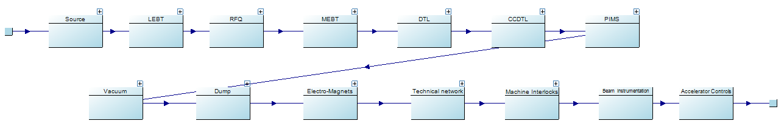
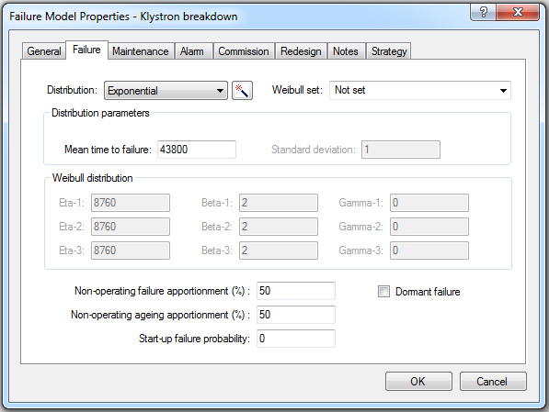
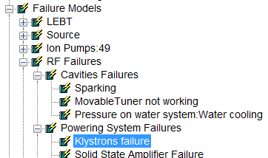
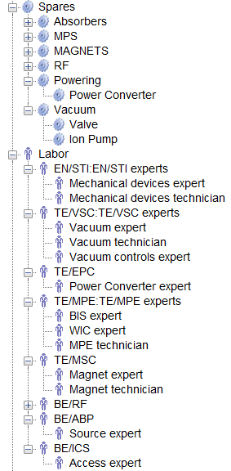
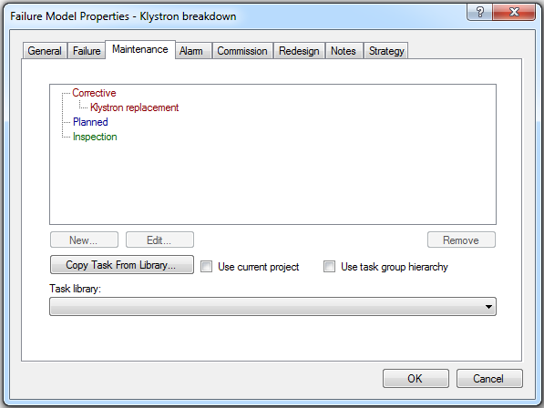
LINAC4 Availability model
Linac4 failure behaviour modelled by Reliability Block diagrams in Isograph®
Each block can be assigned a failure mode…
  Failure distribution
  MTTF
  Consequences
…and a maintenance strategy

Slide 27
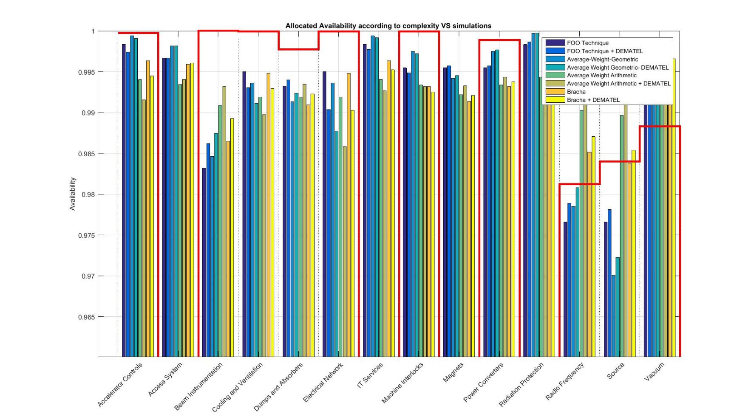
Allocated availability I – Target: 95%
From simulations

Slide 28
Applications
Availability estimation based on complexity
Use case: Linac4

Slide 29
Predict Linac4 availability
from Linac2 performance data
based on complexity

Slide 30
Complexity allocation Linac2 and Linac4
LINAC4 complexity index
LINAC2 complexity index

Slide 31
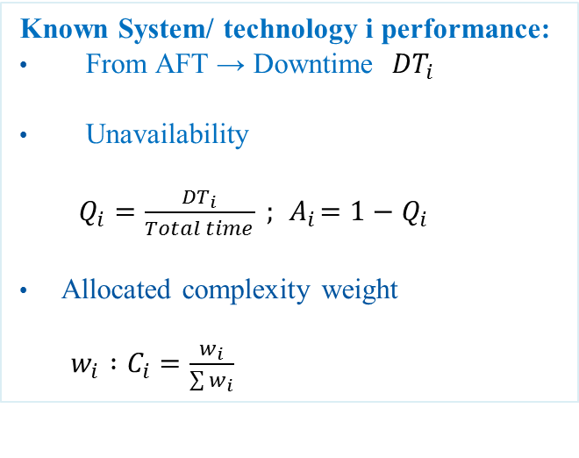
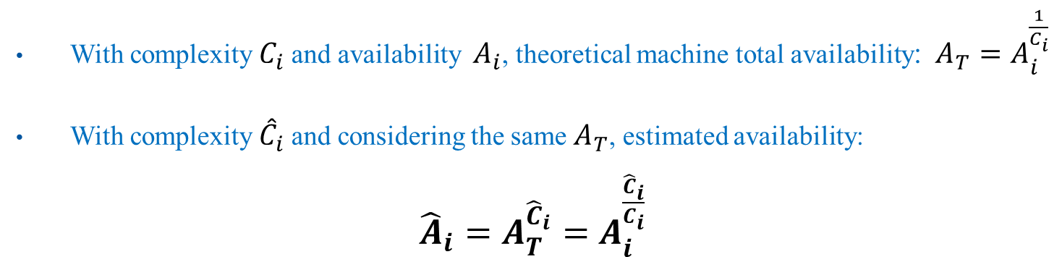

Application: Availability estimation
Known System/ technology i performance:
From AFT → Downtime ${DT}_{i}$
Unavailability
$Q_{i}=\frac{{DT}_{i}}{Total time} ; { A}_{i}=1−Q_{i}$
Allocated complexity weight
$w_{i} :C_{i}=\frac{w_{i}}{\sum{w_{i}}}$
Future technology i :
Allocated complexity weight
$${\hat{w}}_{i} :{\hat{C}}_{i}=\frac{{\hat{w}}_{i}}{\sum{{\hat{w}}_{i}}}$$
With complexity $C_{i}$ and availability ${ A}_{i}$, theoretical machine total availability: $A_{T}=A_{i}^{\frac{1}{C_{i}}}$
With complexity ${\hat{C}}_{i}$ and considering the same $A_{T}$, estimated availability:
${\hat{A}}_{i}=A_{T}^{{\hat{C}}_{i}}=$ $A_{i}^{\frac{{\hat{C}}_{i}}{C_{i}}}$

Slide 32
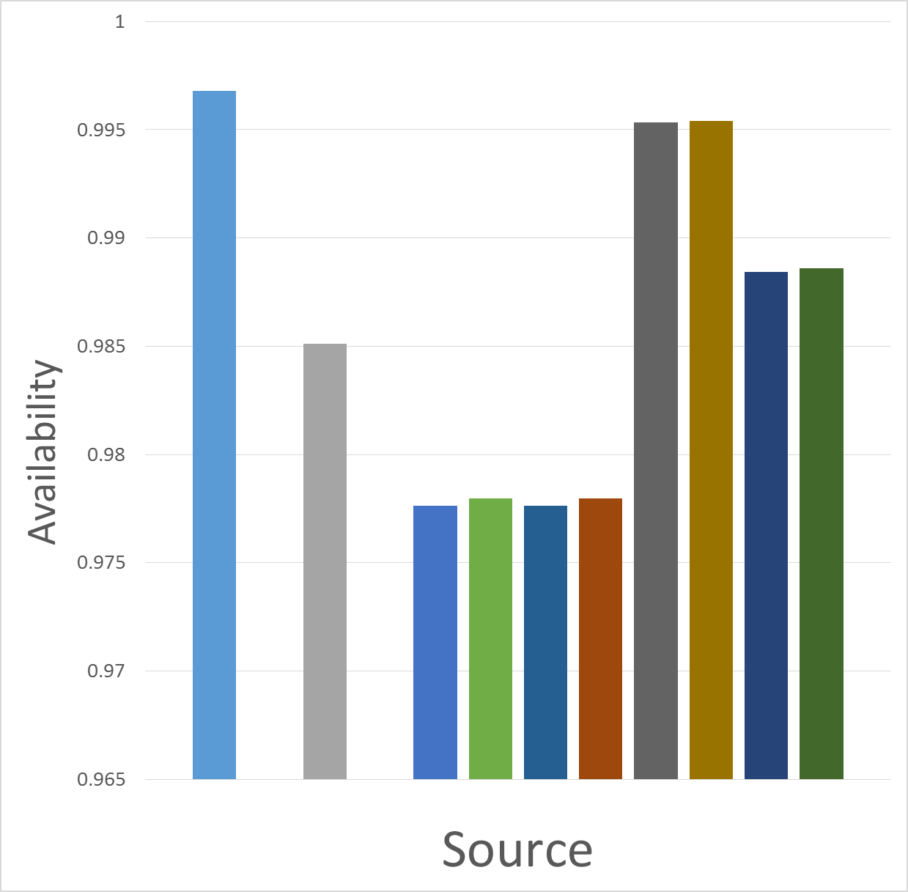
LINAC2
Estimated Availability based on complexity
LINAC4
ESTIMATIONS
SIMULATIONS
SOURCE | Availability
LINAC2 | 0.997
LINAC4 Simulations | 0.985
LINAC4 Estimations | min = 0.978 max = 0.995 Average = 0.985

Slide 33
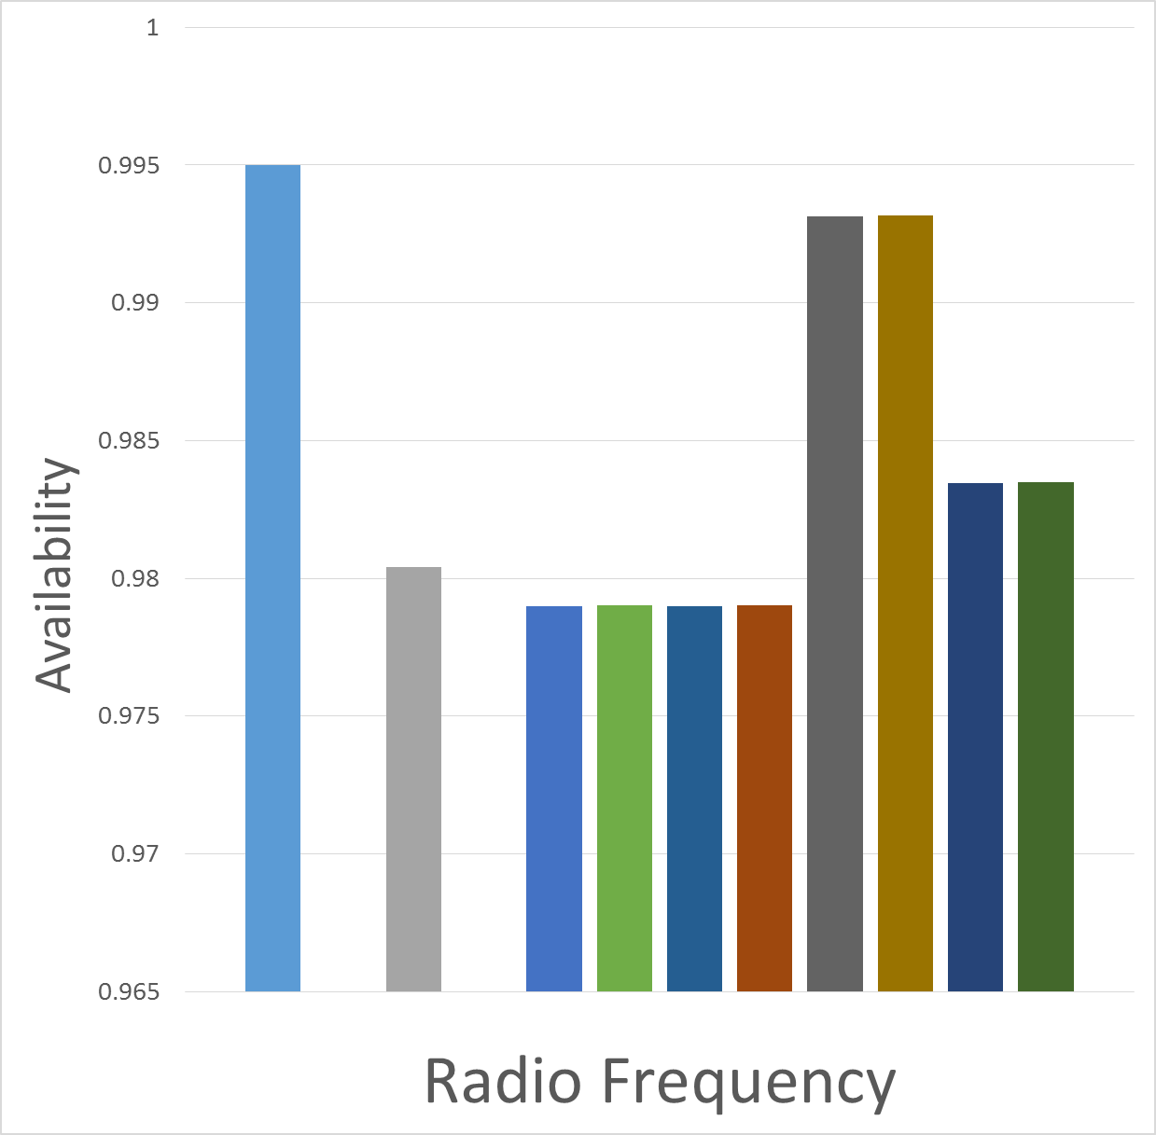
LINAC2
Estimated Availability based on complexity
LINAC4
ESTIMATIONS
SIMULATIONS
RADIO FREQUENCY | Availability
LINAC2 | 0.995
LINAC4 Simulations | 0.98
LINAC4 Estimations | min = 0.979 max = 0.993 Average = 0.984

Slide 34
Conclusions
Procedure to allocate complexity
→ In general, factors product and Bracha methods give the most intuitive results
→ More than one expert should evaluate the factors to avoid “subjective” results
Applications based on complexity:
  Compute expected availability and compare, good performance?
  → Results match expectations
  → Good method to evaluate systems performance
  Allocate availability requirements
  → LINAC4 simulation results suggest that the system will operate above required availability
  Estimate availability from existing fault data
  → Estimated availability results go inline with results from simulations

Slide 35
Outlook
More than one expert will evaluate complexity factors
Evaluate the impact of the complexity factors on the results
LINAC4 – Estimate availability
Validate proposed procedure and model with the Reliability Run data
LHC – Performance evaluation
Validate complexity rating together with system experts
CLIC
Allocate availability requirements to CLIC systems
Estimate future machine performance from similar operating technologies (e.g. Linac4, LHC)

Slide 36
Thanks for your attention!
Questions?
Remarks?

