Slide 2
Coupling simulation of the HiRadMat-12 experiment to study impact of high energy proton beam on copper (work in progress)
Yuancun NIE
TE-MPE-PE
Acknowledgments:
R. Schmidt, N. Tahir, F. Burkart, D. Wollmann,
L. Mettler, C. Fichera, F. Carra, A. Bertarelli, etc

Slide 3
Outline
Introduction
A new simulation approach
Progress
Outlooks

Slide 4
I. Introduction: the worst-case failure mode
At high energy proton accelerator complex, one of the worst-case failure scenarios is that the entire beam (a bunch train) is lost at the same point:
  In the accelerator
    wrong deflecting angle of the extraction kickers
      energy-tracking system failures
      part of the kicker magnets are firing
  In the extraction/beam dump transfer line
    wrong deflecting angle of the septum magnets
      energy-tracking system failures
      septum magnets failures (such as inter-turn short)
  On the beam dump blocks
    dilution kicker failures
The probability is rather low, but the consequences are serious (hydrodynamic tunneling).
Once it happens, we highly rely on passive protections (beam absorbers).

Slide 5
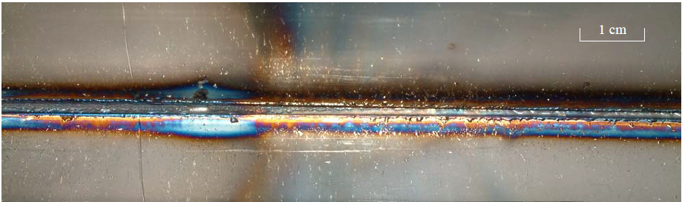
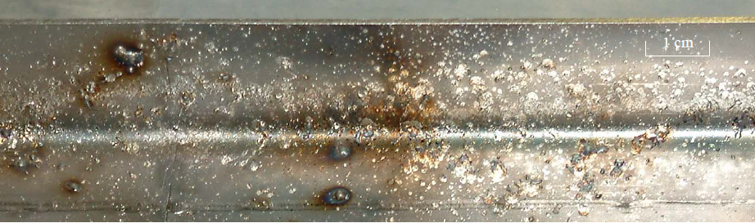
I. Introduction: the worst-case failure mode (did happen!)
In 2004, the full SPS beam (288 bunches, 3.4×10¹³ protons, 450 GeV) was once extracted with wrong angle due to switch-off of the septum. Vacuum chamber (stainless steel) of one magnet in the transfer line was severely damaged. Both the vacuum chamber and the magnet had to be replaced. [B. Goddard, et al, AB-Note-2005-014 BT]
  Outside of the vacuum chamber
  Inside, beam impact side
  Inside, opposite to the beam impact

Slide 6
I. Introduction: hydrodynamic tunneling
What is hydrodynamic tunneling → “simplified picture”:
5 4 3 2 1
8 7 6 5 4
Energy deposition (density-dependent) → temperature/pressure increase → phase transition (solid, liquid, gas, plasma), density reduce (radial shock wave) → new spatial distribution of energy deposition

Slide 7
I. Introduction: coupling FLUKA with BIG2
FLUKA, a Monte Carlo simulation package, provides energy deposition distributions of protons in target.
BIG2, a two-dimension hydrocode, simulates thermodynamic and hydrodynamic response of the target material using semiempirical equation-of-state (EOS, relations between pressure, density and temperature) models.
The two codes are applied iteratively until the entire beam has been delivered.
updated energy deposition
FLUKA
BIG2
target
physical state
iterative run till the end of beam impact
modified density map once the density changes by 10-15%

Slide 8
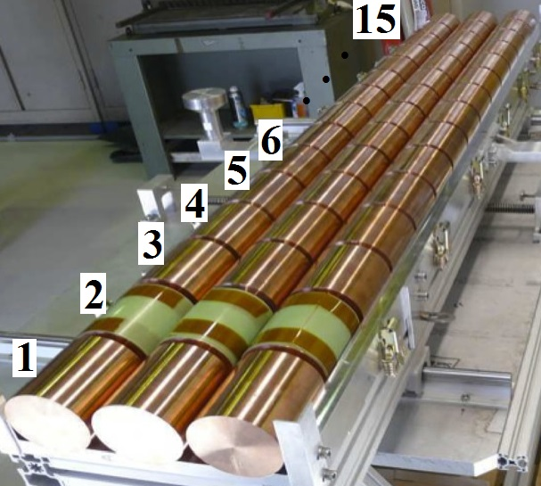
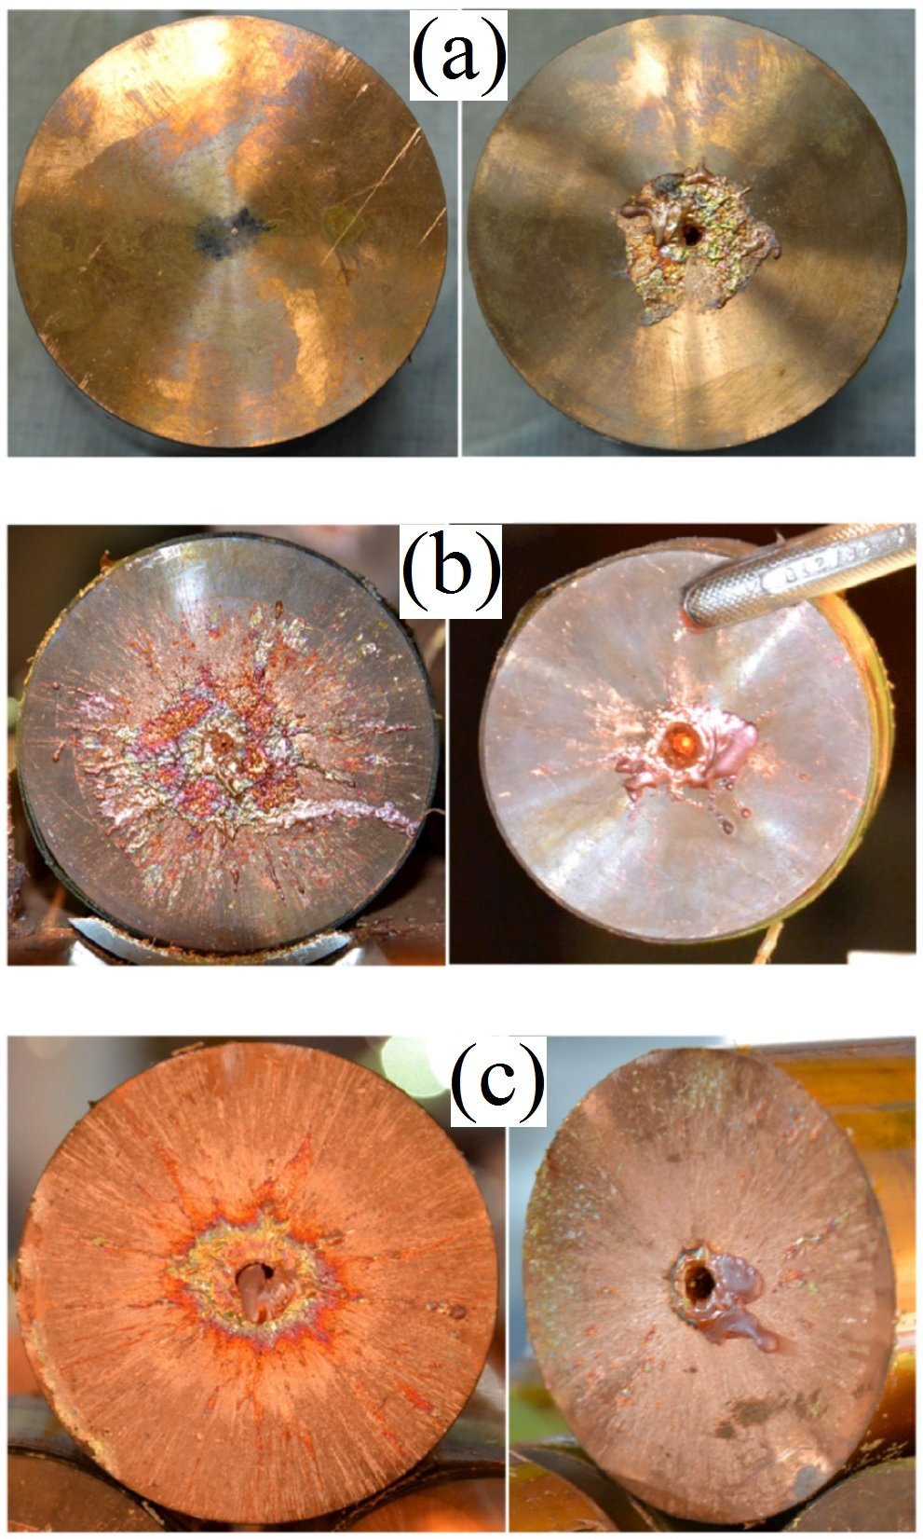
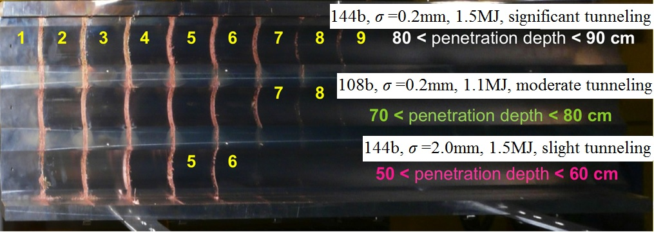
I. Introduction: HiRadMat experiment in 2012
Upper left: three Cu (density 8.93 g/cm³) targets (each with 15 cylinders, every cylinder has R=4 cm, L=10 cm, and the gap is 1 cm which is ignored in the simulation)
Upper right: front and back faces of cylinders 1-3 (a-c) of target 3
Lower: top cover of the three targets (up to down: target 3, 2, 1)
R. Schmidt, et al., Phys. Plasmas 2014
http://dx.doi.org/10.1063/1.4892960
N.A. Tahir, et al., PRE 2014
https://doi.org/10.1103/PhysRevE.90.063112
F. Burkart, et al., J. Appl. Phys. 2015
http://dx.doi.org/10.1063/1.4927721

Slide 9
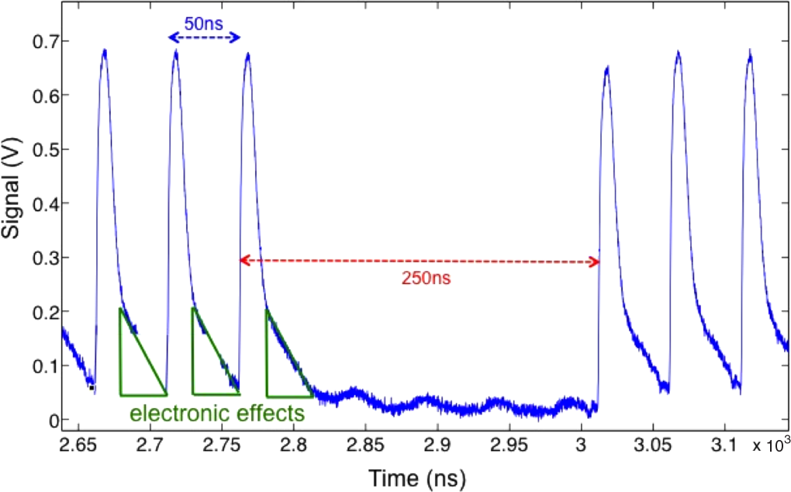
I. Introduction: HiRadMat experiment in 2012
Proton energy: 440 GeV
Bunch intensity: 1.5×10¹¹
Bunch length: 0.5 ns
Bunch spacing: 50 ns
The protons were delivered in sets of 36 bunches each, separation between two neighboring bunch packets was 250 ns, total (36×4=144 bunches) beam length ~7750.5 ns

Slide 10
I. Introduction: existing hydrodynamic tunneling studies
Accelerator | Proton energy | Bunch number | Bunch intensity | Bunch separation | RMS beam size | Target material | Tunneling range | Source
SPS | 440 GeV | 108 | 1.5×10¹¹ | 50 ns | 0.2 mm | copper | 0.8 m | Simulation [1]
SPS | 440 GeV | 108 | 1.5×10¹¹ | 50 ns | 0.2 mm | copper | 0.795 m | Experiment [2,3]
SPS | 440 GeV | 144 | 1.5×10¹¹ | 50 ns | 0.2 mm | copper | 0.9 m | Simulation [1]
SPS | 440 GeV | 144 | 1.5×10¹¹ | 50 ns | 0.2 mm | copper | 0.85 m | Experiment [2,3]
SPS | 450 GeV | 288 | 1.1×10¹¹ | 25 ns | 0.088 mm | copper | 1.3 m | Simulation [4]
SPS | 440 GeV | 288 | 1.15×10¹¹ | 25 ns | 0.2 mm | copper | 1.1 m | Simulation [5]
SPS | 440 GeV | 288 | 1.15×10¹¹ | 25 ns | 0.5 mm | copper | 0.85 m | Simulation [5,6]
LHC | 7 TeV | 2808 | 1.15×10¹¹ | 25 ns | 0.2 mm | copper | 35 m | Simulation [7,8]
LHC | 7 TeV | 2808 | 1.15×10¹¹ | 25 ns | 0.5 mm | graphite | 25 m | Simulation [6]
FCC | 40 TeV | 10600 | 1.0×10¹¹ | 25 ns | 0.2 mm | copper | 290 m | Simulation [9]
FCC | 50 TeV | 10600 | 1.0×10¹¹ | 25 ns | 0.2 mm | copper | 350 m | Simulation [9]
FCC | 50 TeV | 10600 | 1.0×10¹¹ | 25 ns | 0.4 mm | water | 1300 m | Simulation [10]
Many other beam parameters need to be studied, but scaling is not obvious.
[1] N.A. Tahir, et al, PRE 2014.
[2] R. Schmidt, et al., Phys. Plasmas 2014.
[3] F. Burkart, et al., J. Appl. Phys. 2015.
[4] N.A. Tahir, et al, NIM A 2009.
[5] N.A. Tahir, et al, High Energy Density Physics 2013.
[6] N.A. Tahir, et al, PRST:AB 2012.
[7] N.A. Tahir, et al, Contrib. Plasma Phys. 2011.
[8] N.A. Tahir, et al, PRE 2009.
[9] N.A. Tahir, et al, PRAB 2016.
[10] N.A. Tahir, FCC Week 2017.

Slide 11
I. Introduction: why FLUKA & other hydrocodes?
BIG2 is not commercially available, only limited resources can be used.
It is always good to compare different codes when dedicated experiment is impossible/too expensive.
Therefore, we decided to ‘re-simulate’ the HiRadMat-12 experiment (targets 2&3) coupling FLUKA and ANSYS-Autodyn (commercially available) as a benchmarking study (with EN-MME), so as to develop an alternative solution for other case studies.
Hydrocode | EOS | Mesh
BIG2 | semiempirical | Eulerian
Autodyn | SESAME | Lagrangian

Slide 12
II. A new simulation approach: workflow
First FLUKA simulation using nominal density (8.93g/cm³) of the (copper) target
Predict beam heated area composed of fine regions (cylinders) that are supposed to undergo density changes
Autodyn: dynamic response of material to certain number of bunches
physical state of the target
modified density map once the density changes by 10-15%
Construction of new FLUKA model (possible extension of fine regions, assign densities to regions, merge/split regions to assure the total number of regions <20000 and density gradient within a few percent.)
Predefine ~100 density levels (materials) from 0.1 g/cm³ to 10.0 g/cm³. (in maximum 700 materials can be handled by FLUKA)
New FLUKA simulation for the following bunch/bunches
updated energy deposition distribution
iterative run till the end of beam impact

Slide 13
II. A new simulation approach: innovations
Compared to previous coupling between FLUKA and BIG2, the basic principle is similar, but the implementation is quite different. Except for different geometry modelling and data conversion, our method has two main features as follows:
  We don’t define discrete density levels in each iteration. From the accuracy point of view, 100-200 predefined (fixed) densities are sufficient.
    Data analysis and FLUKA modelling are hence significantly simplified, since for each density, different kinds of material & compound have to be defined.
  Previous scripts assign one material to only one region, so the total number of regions is limited to be less than 700. We are able to assign one material to different regions, so that the region number could be up to 20000.
    Regions with the same density may be merged (Boolean Calculation) to save certain simulation time, but we are more flexible (merging regions takes time as well, there is a trade-off).

Slide 14
III. Progress: static approximation from initial FLUKA map
Linear scaling from one proton (GeV/g/p) to 144 bunches (kJ/g)
Two black curves, upper: melting contour line; down: boiling contour line

Slide 15
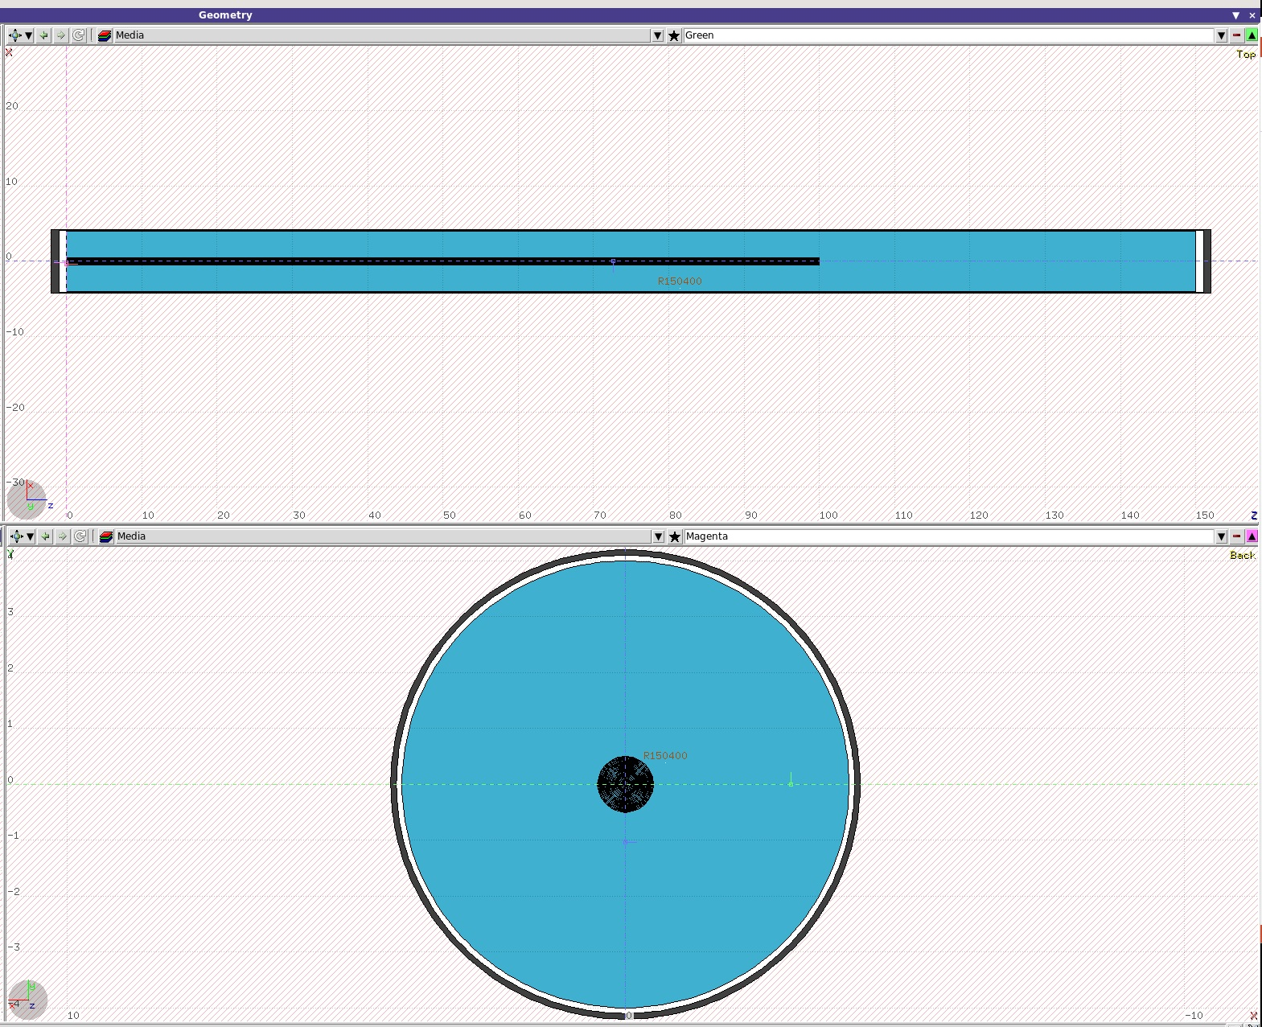
III. Progress: target modelling in FLUKA
Cylindrical target: R=4 cm, L=150 cm
Fine regions (beam heated area):
r=0-0.5 cm, z=0-100 cm
(predicted from linear scaling, may need to be extended according to modified density distributions from Autodyn)
Proton beam
×
Proton beam

Slide 16
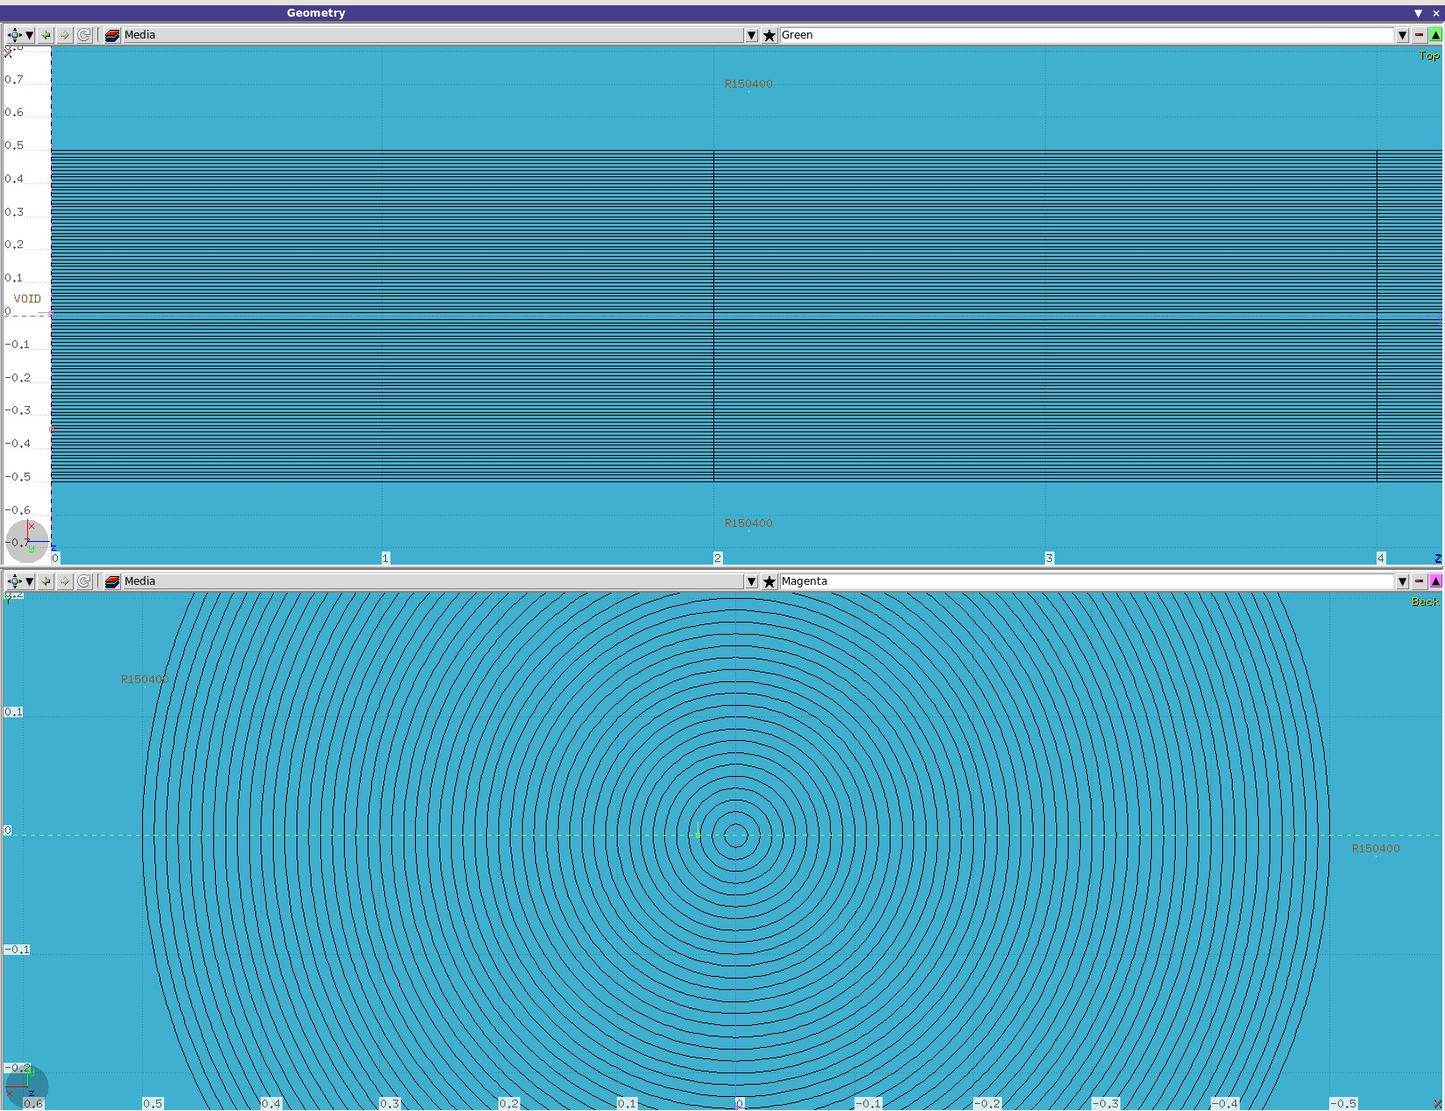
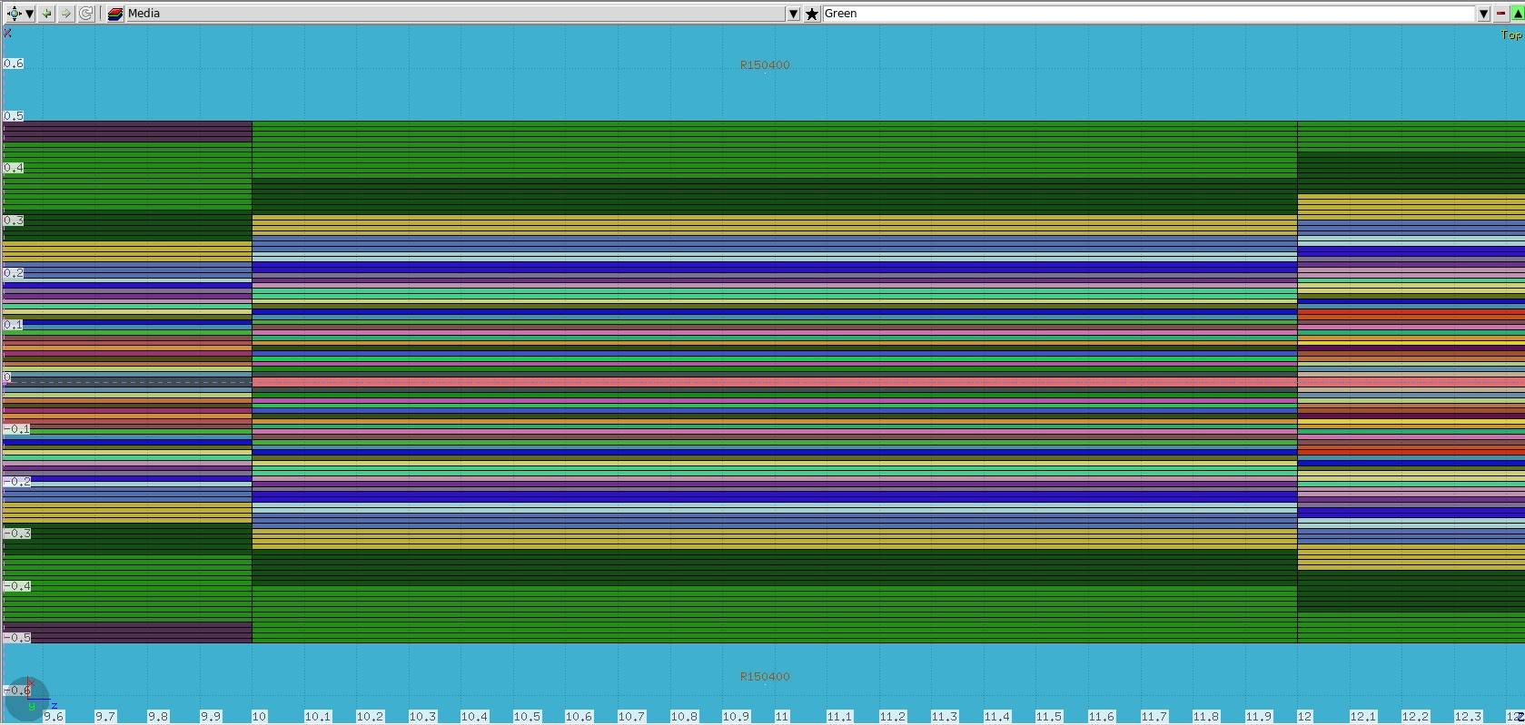
III. Progress: target modelling in FLUKA
Fine regions (beam heated area): Δr=0.01 cm ($σ_{x,y}/2$), Δz=2 cm
→2500 fine regions supposed to have modified densities!
(Maximum number of regions can be handled in FLUKA is 20000)

Slide 17
III. Progress: iteration steps
Proton beam moving to the target
36 bunches, bunch spacing 50 ns
Bunch packet separation 250 ns
Iteration 1 Bunches 1-12
0-600 ns
Iteration 2 Bunches 13-24
600-1200 ns
Iteration 3 Bunches 25-36
1200-2000 ns
Iteration 4 Bunches 37-48
2000-2600 ns
Iteration 5 Bunches 49-60
2600-3200 ns
Iteration 6 Bunches 61-72
3200-4000 ns
Iteration 7 Bunches 73-84
4000-4600 ns
Iteration 8 Bunches 85-96
4600-5200 ns
Iteration 9 Bunches 97-108
5200-6000 ns
Iteration 10 Bunches 109-120
6000-6600 ns
Iteration 11 Bunches 121-132
6600-7200 ns
Iteration 12 Bunches 133-144
7200-7800 ns
t=0 ns
t=7800 ns
Bunch length 0.5 ns is not shown in the picture
In total, 4 packets, each consists of 36 bunches
The beam pulse length is 35*50*4+250*3=7750 ns for 144 bunches (target 3)
The density drops 13% in max. after the first 12 bunches → 12*12 bunches

Slide 18
III. Progress: FLUKA maps [GeV/(g p)]
2D dose distribution for bunches 1-12

Slide 19
III. Progress: FLUKA maps [GeV/(g p)]
2D dose distribution for bunches 25-36

Slide 20
III. Progress: FLUKA maps [GeV/(g p)]
2D dose distribution for bunches 49-60

Slide 21
III. Progress: FLUKA maps [GeV/(g p)]
Dose vs. target axis for different bunches

Slide 22
III. Progress: temperature (K)
2D temperature distribution after 12 bunches

Slide 23
III. Progress: temperature (K)
2D temperature distribution after 24 bunches

Slide 24
III. Progress: temperature (K)
2D temperature distribution after 36 bunches

Slide 25
III. Progress: temperature (K)
2D temperature distribution after 48 bunches

Slide 26
III. Progress: temperature (K)
Temperature vs. target axis at different times

Slide 27
III. Progress: pressure (GPa)
2D pressure distribution after 12 bunches

Slide 28
III. Progress: pressure (GPa)
2D pressure distribution after 24 bunches

Slide 29
III. Progress: pressure (GPa)
2D pressure distribution after 36 bunches

Slide 30
III. Progress: pressure (GPa)
2D pressure distribution after 48 bunches

Slide 31
III. Progress: pressure (GPa)
Pressure vs. target axis at different times

Slide 32
III. Progress: density (g/cm³)
2D density distribution after 12 bunches

Slide 33
III. Progress: density (g/cm³)
2D density distribution after 24 bunches

Slide 34
III. Progress: density (g/cm³)
2D density distribution after 36 bunches

Slide 35
III. Progress: density (g/cm³)
2D density distribution after 48 bunches

Slide 36
III. Progress: density (g/cm³)
Density vs. target axis at different times

Slide 37
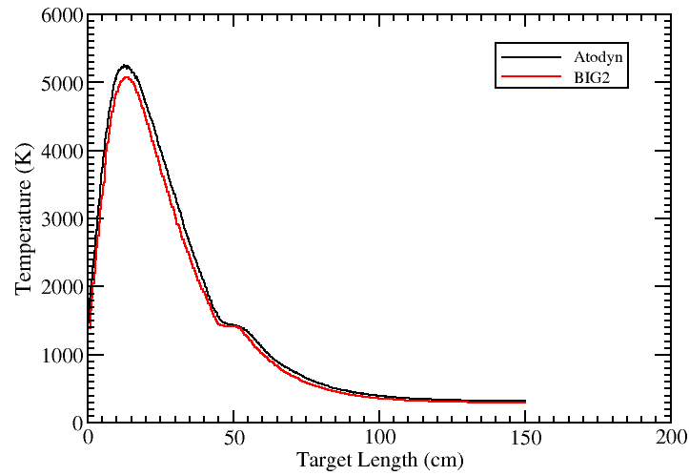
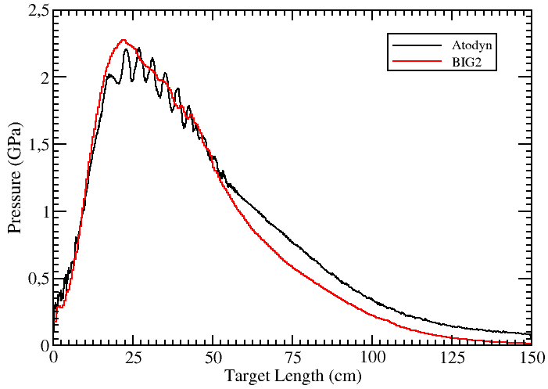
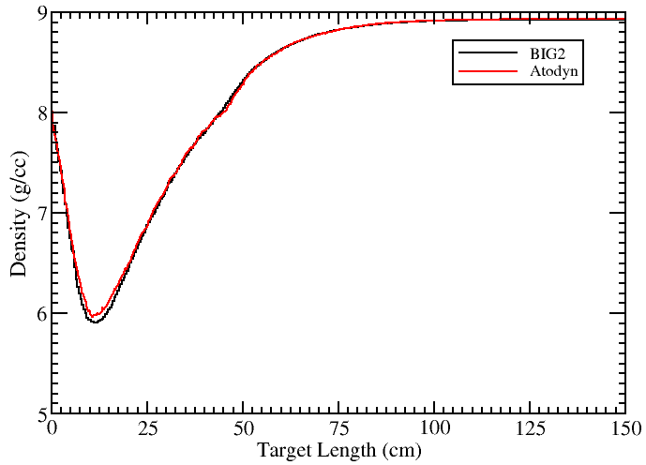
III. Progress: comparison of melting depth
Bunch number | FLUKA (static) | Measurement | Coupling BIG2 | Coupling Autodyn
108 | 63.5 | 79.5 | 80 | ?
144 | 68 | 85 | 90 | ?
Comparison between BIG2 and Autodyn after 36 bunches have been delivered (Thanks to Naeem)

Slide 38
IV. Outlooks
In collaboration with EN-MME group, a new approach has been developed to simulate the hydrodynamic tunnelling effect, by coupling FLUKA and Autodyn, instead of BIG2.
Compared to the existing method (FLUKA&BIG2), data analysis and target modelling are simplified by predefining a certain number of density levels without influencing the accuracy. Time-consuming ‘region merging’ becomes more flexible since we can assign one material to various regions.
The benchmarking case study validates the approach. Other practical case studies are foreseen, especially for the FCC beam (water dump…).

