Slide 1
Coupling of Mechanical and Magneto-Thermal Models of Superconducting Magnet by Means of Mesh‑Based Interpolation
Magnet Technology Conference 2017
M. Maciejewski, P. Bayrasy, K. Wolf, M. Wilczek, T. Griesemer, B. Auchmann, L. Bortot, M. Prioli,
A.M. Fernandez Navarro, M. Mentink, S. Schöps, I. Cortes Garcia, and A.P. Verweij
Notes:
The Finite Element Method (FEM) is used to perform accurate modelling of superconducting magnets for magnetic field design, mechanical design, and calculations of the peak temperature and voltages to ground in the magnet during a quench.
Each design step solves a set of partial differential equations with appropriate boundary conditions, nonlinear material properties, and problem-adapted meshes. For as long as possible, physical problems are dealt with independently and solved with appropriate FEM programs. The study of multiphysics phenomena, however, requires to solve coupled systems of equations, and a monolithic solution using a single tool might not always be desirable. Another approach treats the coupled models independently by means of input and output relations. In this setting, the interpolation of the results obtained with two different mesh definitions has to be carefully addressed. As a result, each model is treated with an optimal tool. Models created for independent studies can be reused for multiphysics analyses, and the overall development time is reduced.
We study the mechanical impact of temperature gradients and Lorentz-force evolution during a quench and subsequent current discharge in a superconducting magnet. The magneto-thermal study is performed with COMSOL Multiphysics and the mechanical analysis is carried out with an ANSYS APDL. Both models are created through the STEAM (Simulation of Transient Effects in Accelerator Magnets) coupling environment developed at CERN. We use the MpCCI (Multi-physics Code Coupling Interface), which allows for a generic mesh-based interpolation of results obtained with a variety of FEM tools. Integrating MpCCI in STEAM workflows increases in important way the flexibility and reliability of STEAM coupling workflows. The coupling method is illustrated with a simulation of an 11‑T dipole magnet for the High-Luminosity upgrade of the Large Hadron Collider. In the study the magnet is protected on a test bench with the CLIQ (Coupling-Loss Induced Quench) technology.

Slide 2
Coupling of Magneto-Thermal and Mechanical Models - Motivation
Full exploitation of existing accelerator circuits as well as design of new protection methods and magnets (in particular Nb₃Sn) calls for more accurate numerical analysis.
2D finite element model in COMSOL developed within the STEAM framework provides consistent representation of magneto-thermal transients.
Mechanical models of superconducting magnets are usually developed with ANSYS APDL and used for mechanical analysis.
We study one-way coupling of magneto-thermal and mechanical finite element models during current discharge following triggering of a protection system.

Slide 3
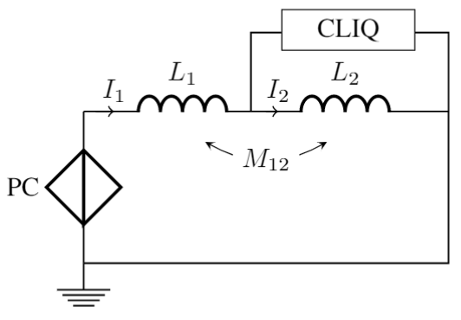
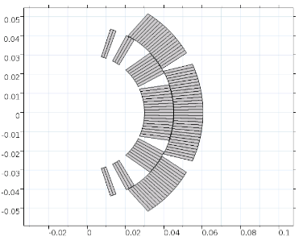
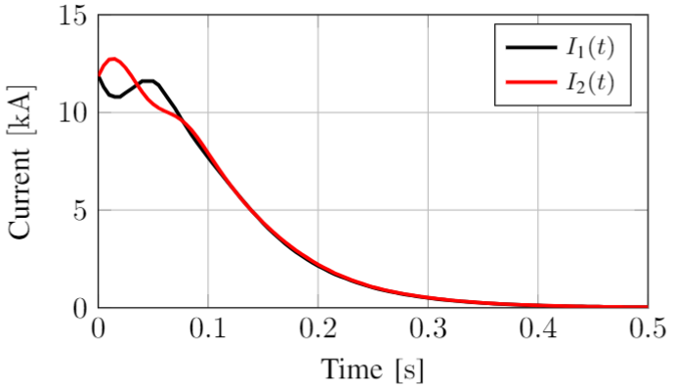
Case Study - Standalone 11-T Magnet Protected by CLIQ
STEAM framework provides a field/circuit coupling algorithm allowing for resolving mutual influence of a finite element
model representing a superconducting circuit and a network model of the circuit powering.
We consider a standalone 11-T magnet on a test bench protected by CLIQ (C = 60 mF and U = 500 V)
at current equal to 11850 A.
field/circuit
coupling
Application of the waveform relaxation technique to the field/circuit coupling ensures consistency of obtained results.
I. Cortes Garcia et al. Optimized Field/Circuit Coupling for the Simulation of Quenches in Superconducting Magnets
IEEE Journal on Multiscale and Multiphysics Computational, Vol 2, pp. 97-104, 2017.

Slide 4
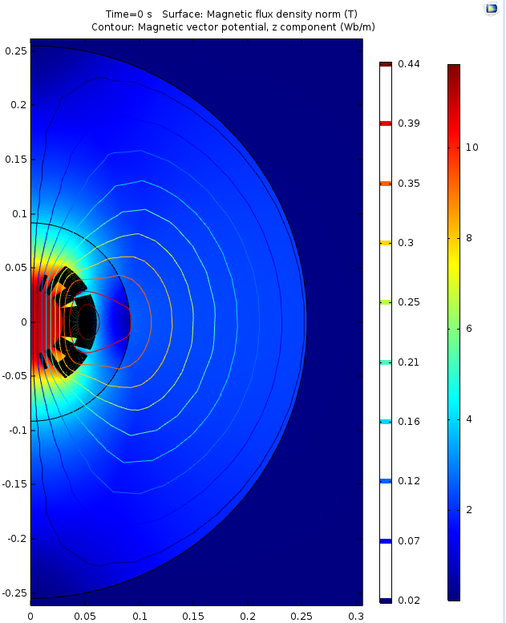


Magneto-Thermal Model in COMSOL
Magnetic model considers dynamic effects occurring in the Rutherford cable, non-linear iron yoke as well as eddy currents in wedges
Thermal model is governed by the heat balance equation
Post-processing of a field solution provides load to the mechanical model
L. Bortot et al. A 2-D Finite-Element Model for Electro-Thermal Transients in Accelerator Magnets
IEEE Transactions of Magnetics, under review, 2017

Slide 5
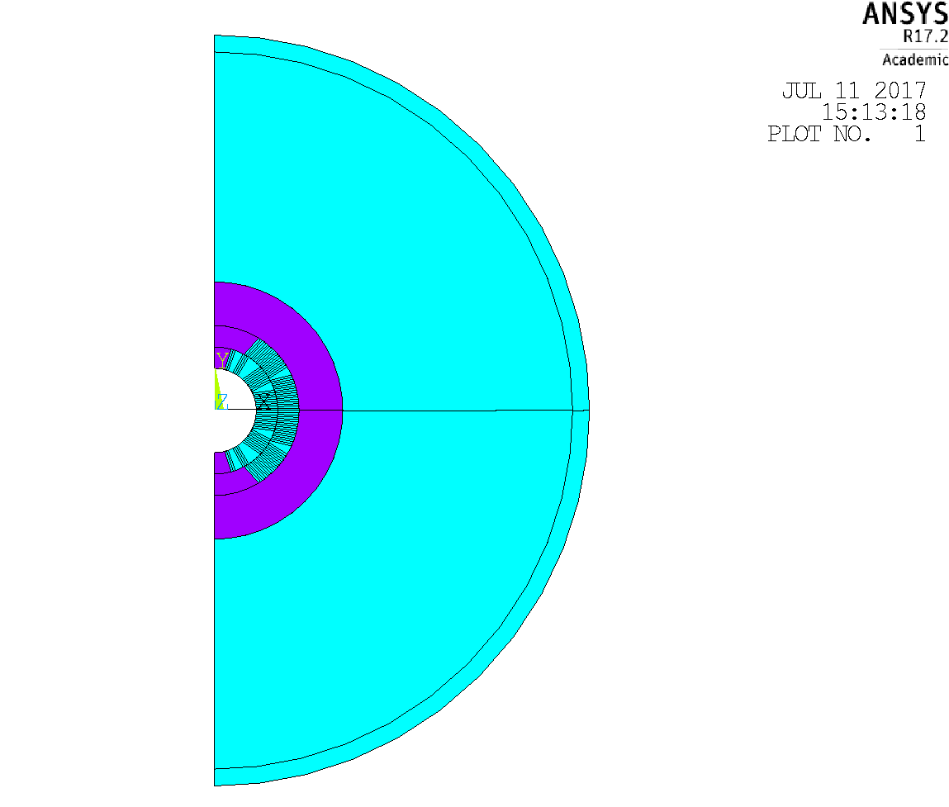
Mechanical Model in ANSYS APDL
Electromagnetic and thermal stress acts on a mechanical model composed of
Steel shell
Iron yoke
Steel collar
Nb₃Sn coil
with appropriate elements contact and boundary conditions.
Shell
Yoke
Shims for
Pre-stress
Collar
Coil
Pre-stress
Cool-down, T=1.9 K
Coupling

Slide 6


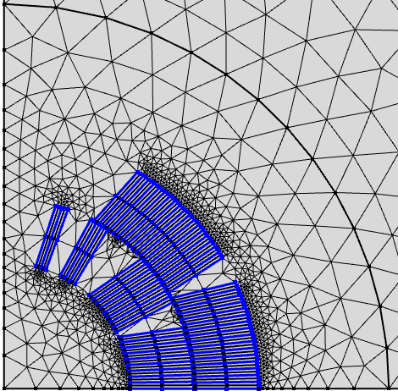

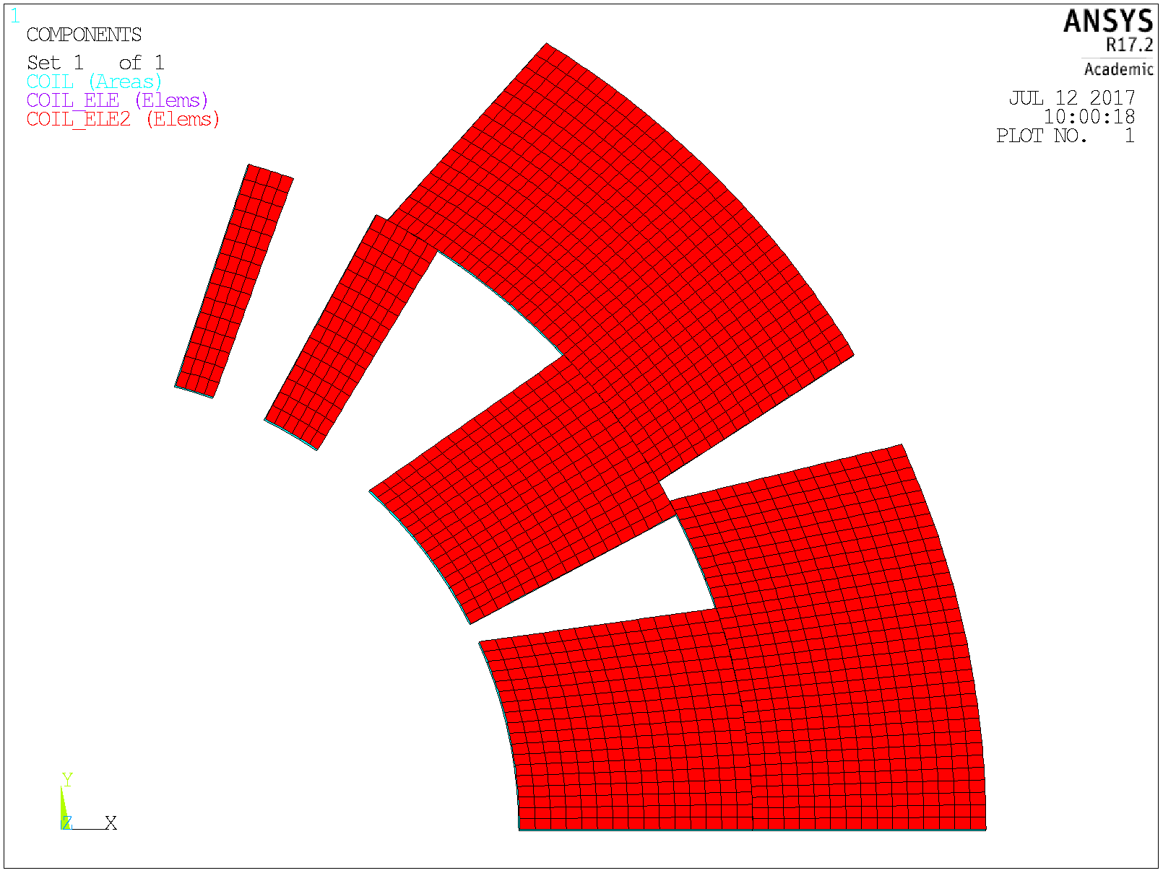


Mesh-based Interpolation
In this contribution we consider electromagnetic and thermal stresses occurring during the current discharge of
a superconducting Nb3Sn magnet protected by CLIQ technology.
Magneto-Thermal Model
Coupling Environment
Mechanical Model
$$T$$
$${\vec{F}}_{L}$$
$$\hat{T}$$
$$\hat{{\vec{F}}_{L}}$$
Mesh-based
interpolation

Slide 7
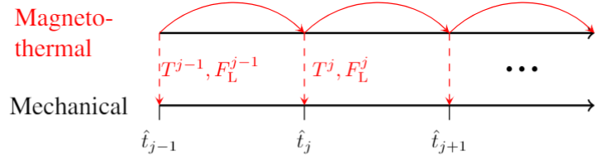
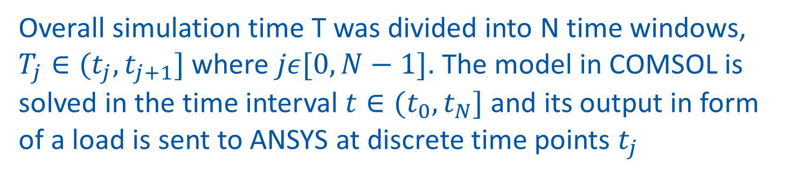
Mesh-Based Interpolation - Algorithm
Overall simulation time T was divided into N time windows, $T_{j}∈(t_{j},t_{j+1}]$ where $jε[0,N−1]$. The model in COMSOL is solved in the time interval $t∈(t_{0},t_{N}]$ and its output in form of a load is sent to ANSYS at discrete time points $t_{j}$

Slide 8

Implementation of One-way coupling with MpCCI
MpCCI server already supports ANSYS APDL models.
For COMSOL it was necessary to develop a dedicated code adapter
cml.runTransientStudy();
adapter.init();
for (int j = 0; j < timeIndices.length; j++)
{
adapter.setCurrentIteration(j);
adapter.setTimeIndex(timeIndices[j]);
adapter.exchange();
}
adapter.exit();
!Perform pre-stress study
!Perform cool-down study
~mpcci,settag,-1,0
~mpcci,init,2D
*DO,j,1,steps
~mpcci, receive
ALLSEL
SOLVE
FINISH
~mpcci,settag,-1,j
*ENDDO
~mpcci,quit
Four MpCCI server commands are required for establishing connection, exchange of quantities and synchronization.

Slide 9
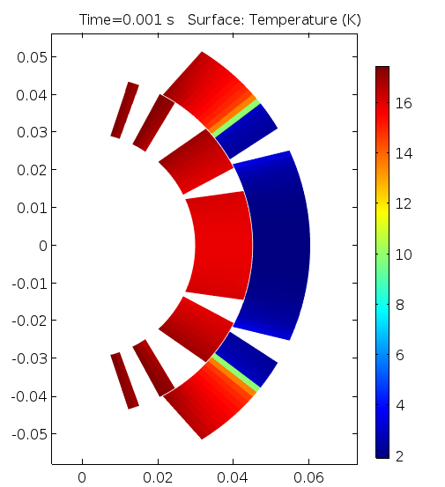
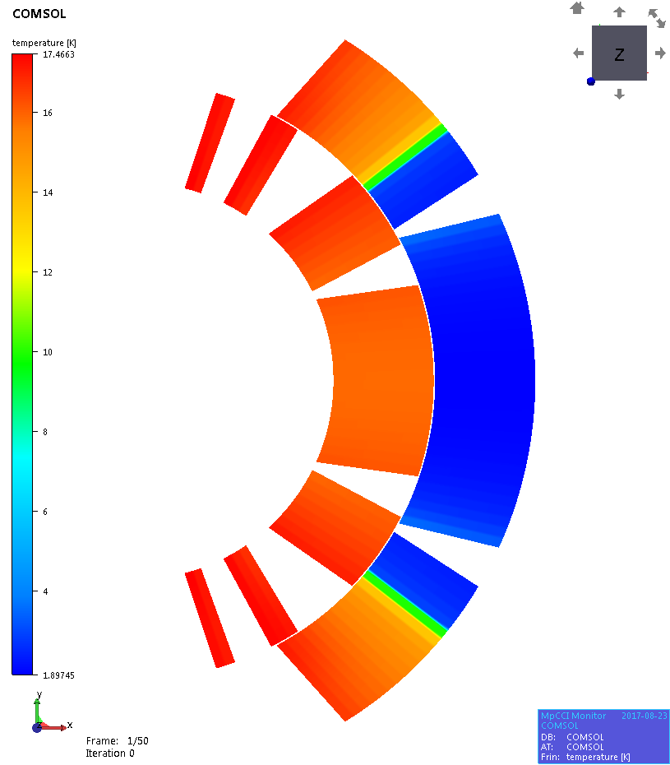
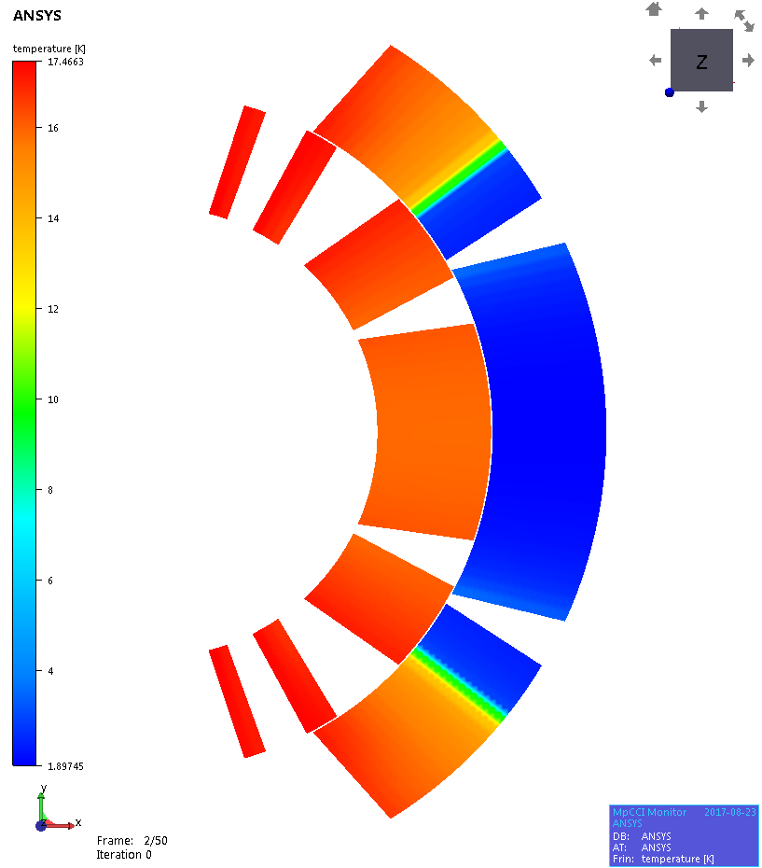
Temperature – Node to Node Interpolation - t = 1 ms
Element Type : QUAD
Element Type: PLANE183
Interpolation from one element nodes to another

Slide 10
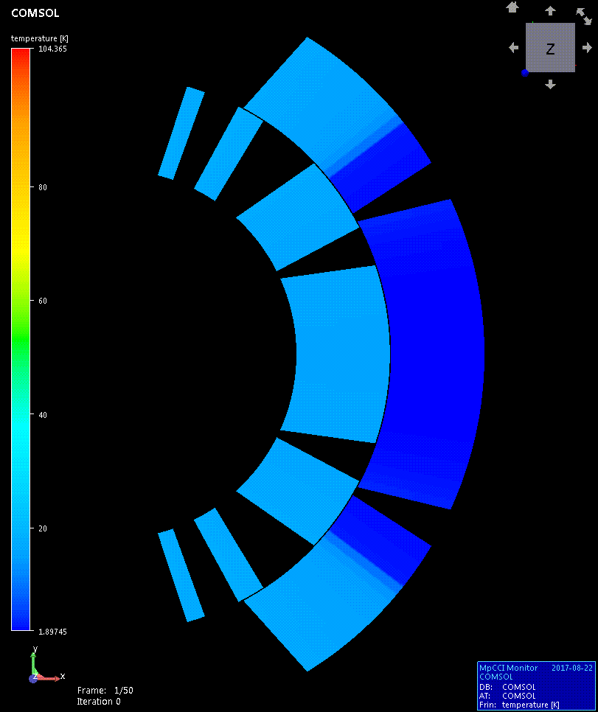
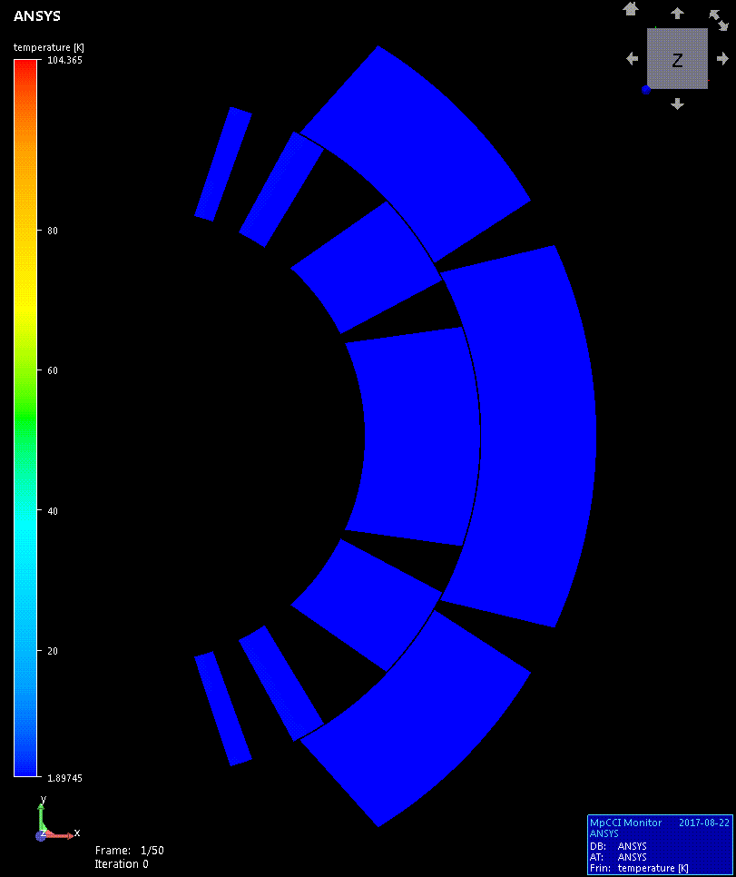
Temperature Transfer – 0 < t < 250 ms

Slide 11
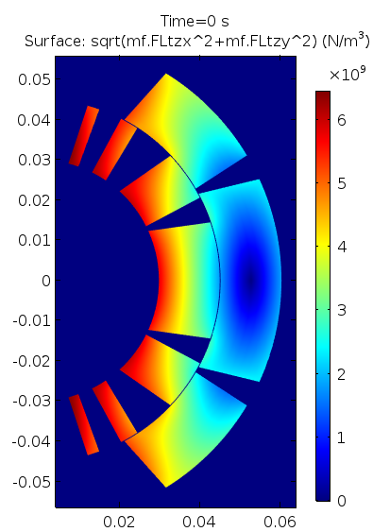
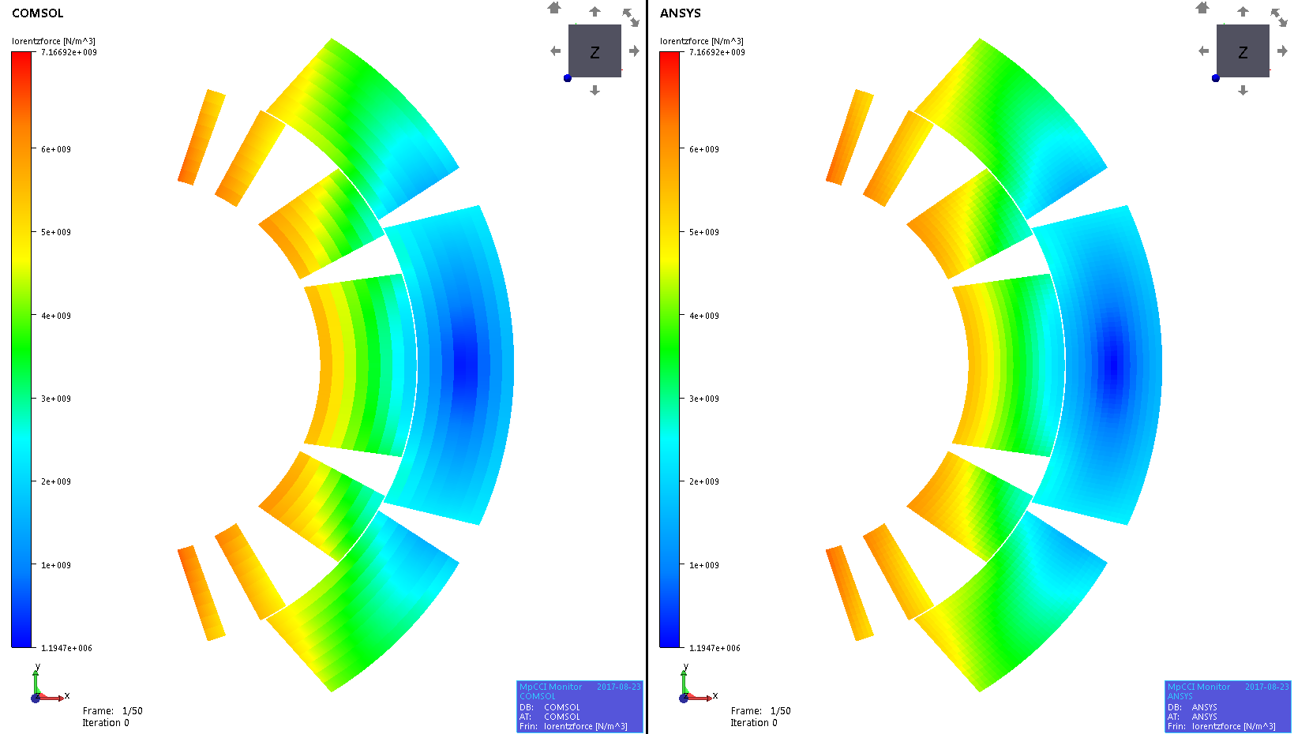
Lorentz Force – Element to element interpolation - t = 1 ms
Element Type: QUAD
Element Type: PLANE183
Interpolation from one element centre to another
Distribution from element centre to nodes

Slide 12
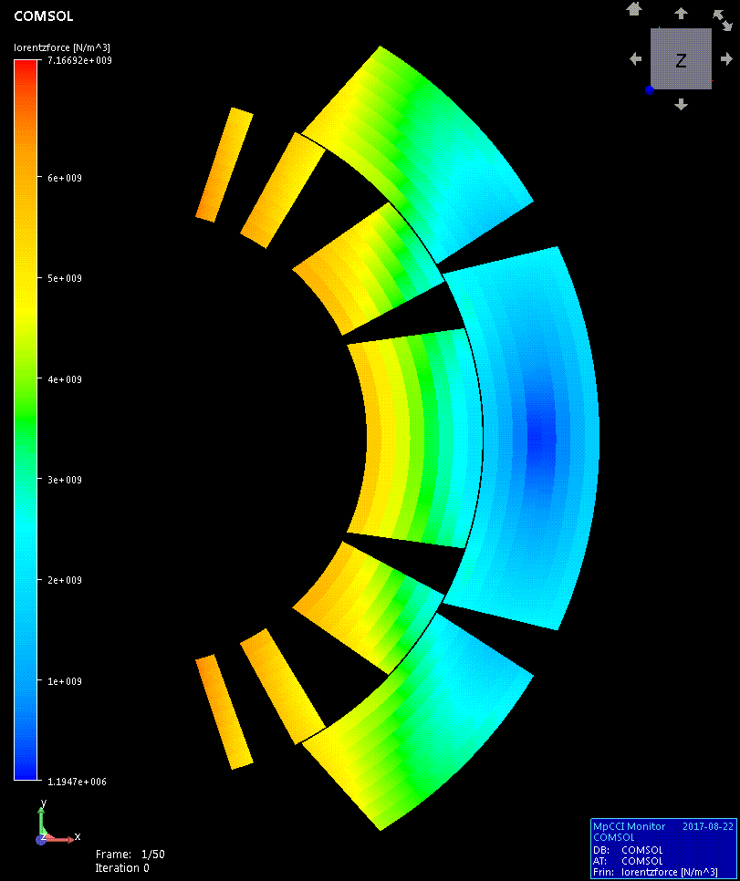

Lorentz Force Transfer – 0 < t < 250 ms

Slide 13
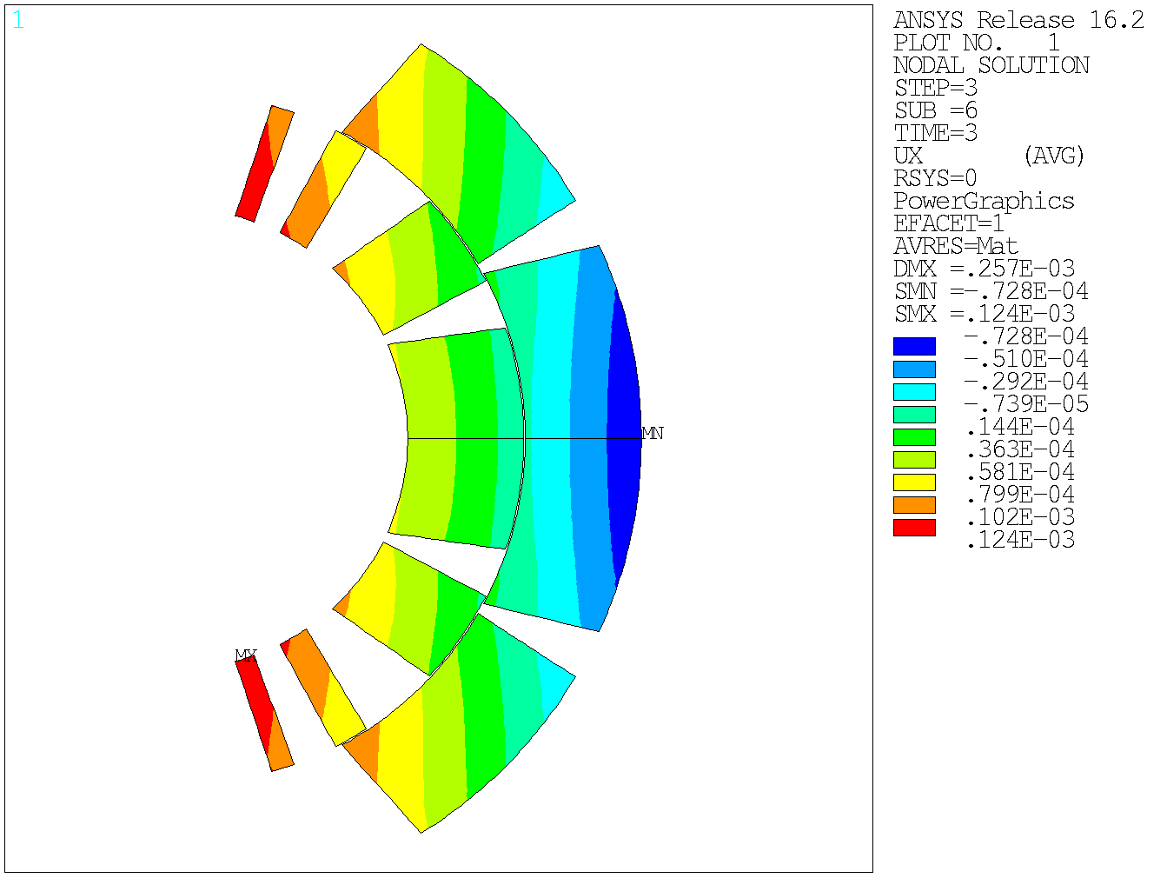
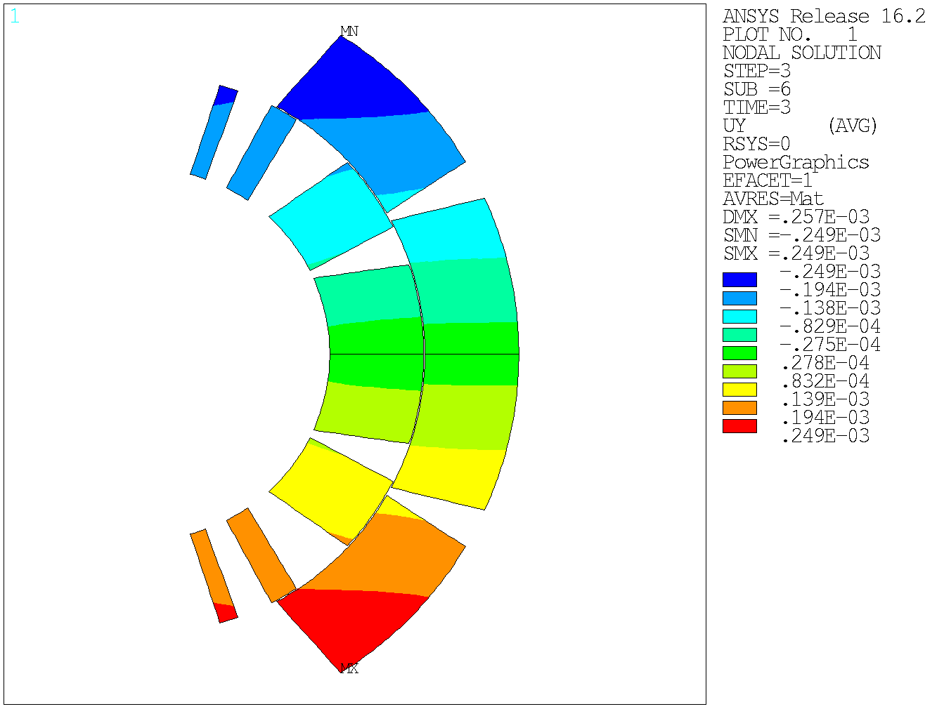
Coil Displacement

Slide 14
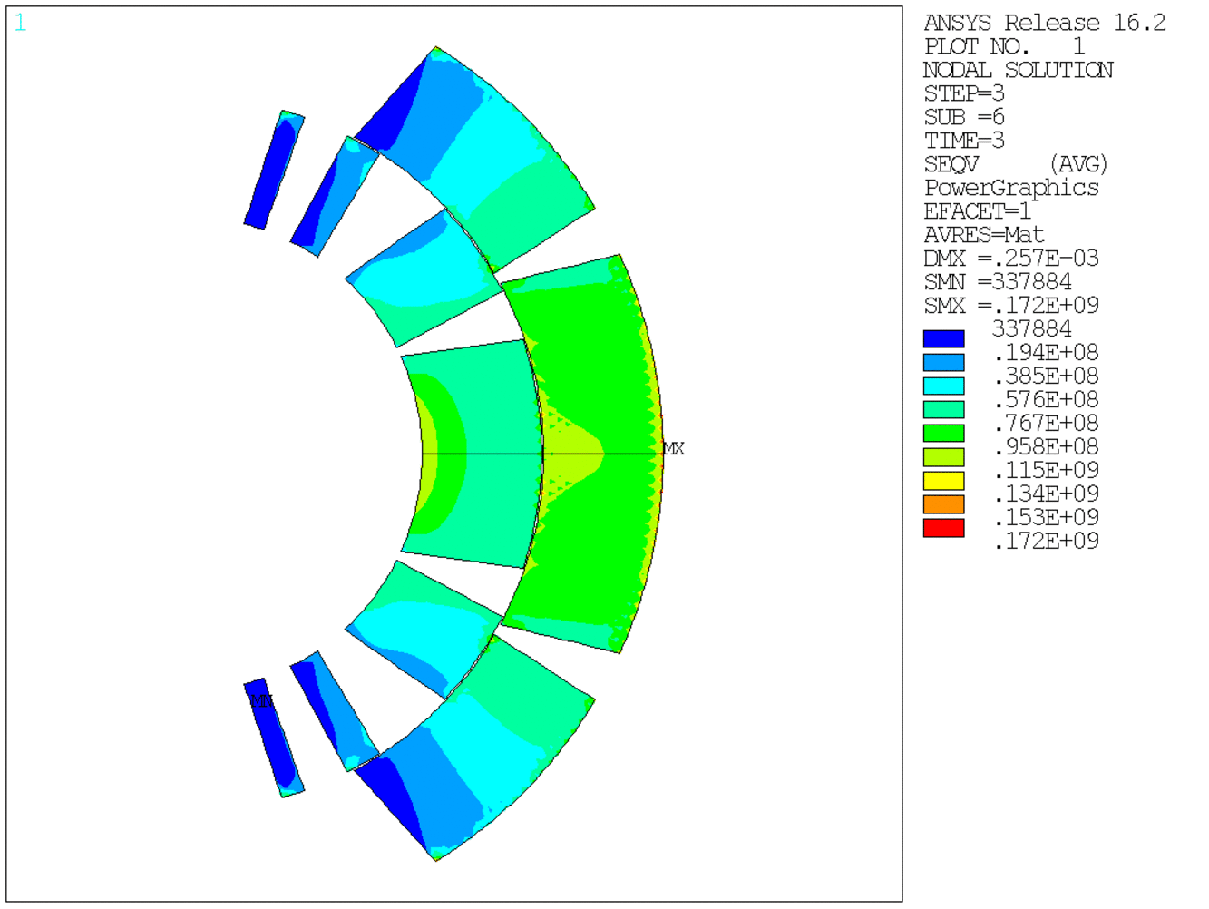
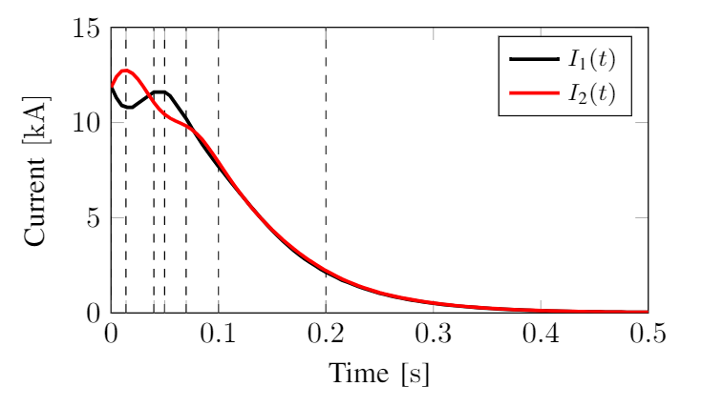


Equivalent Stress
Time step [ms] | Max temperature K] | Position inside the coil | Max eqv stress [MPa] | Location
0 | 2.1 | Block 6, turn 2 (upper) | 135 | Block 5, turn 1 (symmetric)
14 | 36.8 | Block 6, turn 2 (upper) | 141 | Block 5, turn 2/3 (upper)
40 | 56.2 | Block 6, turn 2 (upper) | 136 | Block 5 (symmetric)
50 | 61.8 | Block 6, turn 2 (upper) | 140 | Block 5 (symmetric)
70 | 72.1 | Block 6, turn 2 (upper) | 123 | Block 5 (symmetric)
100 | 86.3 | Block 6, turn 2 (upper) | 104 | Block 5, turns 1-5 (symm)
200 | 103.7 | Block 6, turn 2 (upper) | 83 | Block 1,4 (symmetric)
For $t∈(0;0.03]$s, time step equals 0.001 s
For $t∈(0.03;0.25]$ s, time step 0.01 s

Slide 15
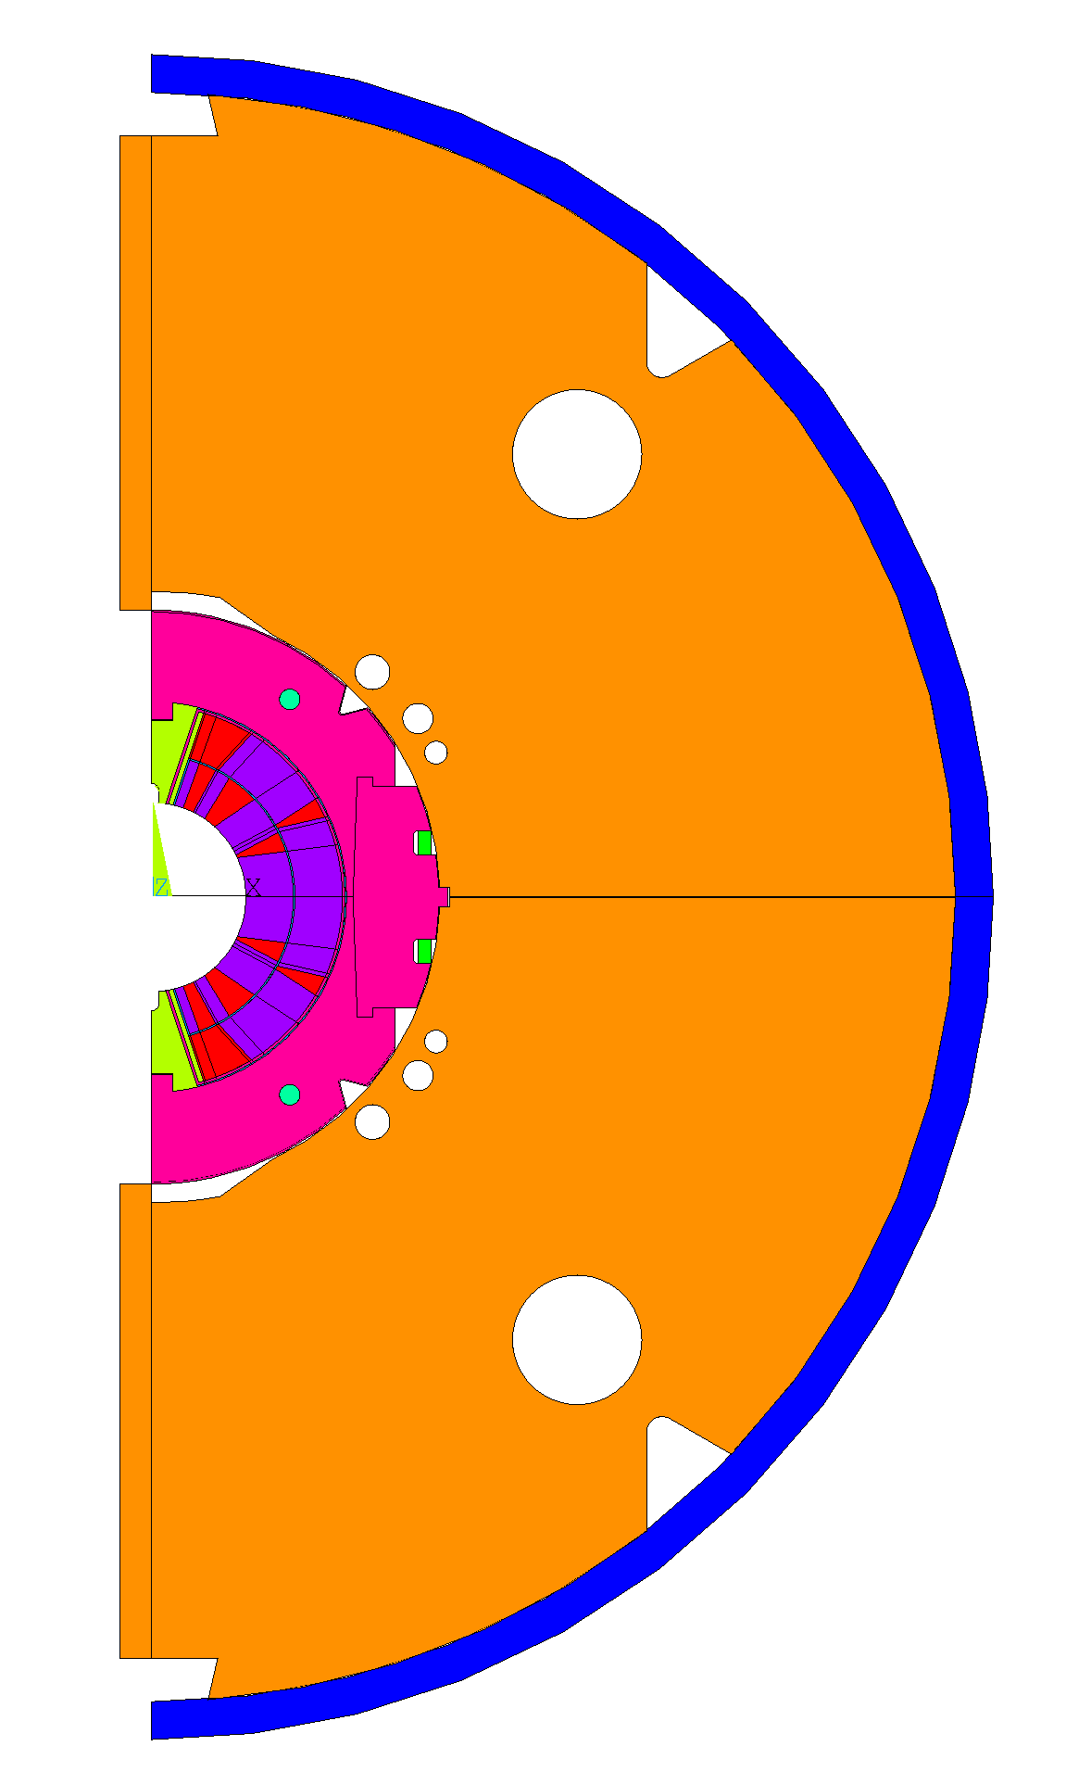
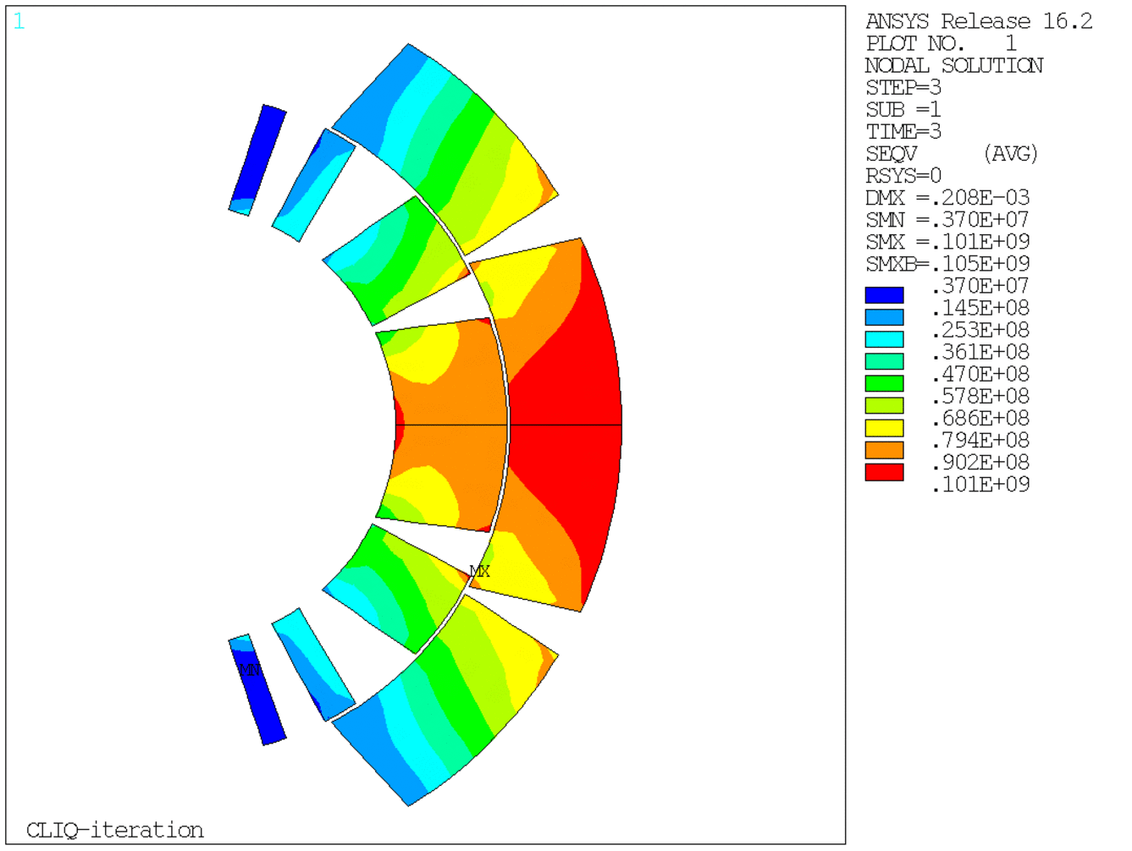
Coupling in realistic 11T models

Slide 16
Conclusions and Future Work
One-way coupling of magneto-thermal and mechanical models was developed and applied to the case of a standalone 11-T magnet protected by CLIQ system
MpCCI coupling environment was employed to perform mesh-based interpolation of exchange of temperature (over nodes) and Lorentz force (over elements)
Superimposed effects of electromagnetic and thermal stresses play a relevant role during magnet protection and should be carefully studied
Developed algorithm is generic and can be applied to analysis of more accurate mechanical models of 11-T magnet as well as other magnets.
MpCCI is a generic coupling environment supporting over 10 FEM tools allowing for time transient studies and coupling of multiple models

