Slide 1


MT25 The 25th International
Conference on Magnet Technology
Addressing all aspects of magnet research, development, construction, testing, and operation, and some associated technologies.
electro-magnetic magnets
permanent magnets
coils for power, energy, transport and other applications.
The objective of the conference is:
- to provide a forum for the exchange of magnet related technology as well as design and analysis techniques,
- to diffuse in the scientific community new applications for magnets,
- to provide an exchange between research activities and industrial applications,
- to encourage professional scientists and engineers to follow careers in magnet technology and its applications.
A. Verweij, MPE-PE section meeting, 14/9/2017

Slide 2

Key figures
1201 Abstracts
930 participants of which 20% students
49 Exhibitors
More than 550 manuscripts
NEW: Most of the contributions (posters and orals) in Indico
( https://indico.cern.ch/event/445667/ )
NEW: “Young scientist” plenary
NEW: 4 Best Poster Awards
A. Verweij, MPE-PE section meeting, 14/9/2017

Slide 3
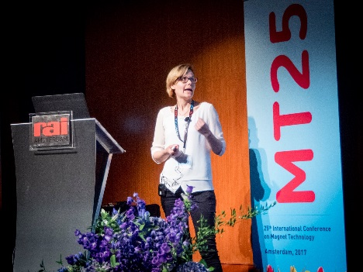
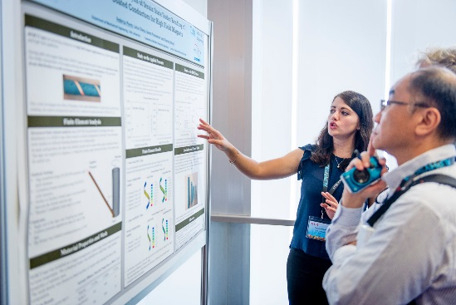
The global picture
1201
Abstracts
SPC meeting April 2017
1157
Approved abstracts
44
Rejections
218
Withdrawals
200
Oral
contributions
739
Poster
contributions
A. Verweij, MPE-PE section meeting, 14/9/2017
3
No shows
136
No shows
197 orals
603 posters

Slide 4
Distribution of the presentations over the 8 categories
 |  | Abstracts | In the program | Actually presented
A | Magnets for Particle and Nuclear Physics | 185 | 140 | 136 (17%)
B | Magnets for Fusion | 75 | 65 | 62 (8%)
C | Magnets for High-Field Facilities | 62 | 48 | 43 (5%)
D | Magnets for Medical, Biological, and Analytical Applications | 58 | 52 | 47 (6%)
E | Coils for Power, Energy, Transport, and other Applications | 404 | 274 | 191 (24%)
F | Conductors and Materials for Magnets | 146 | 126 | 109 (14%)
G | Magnet Test, Analysis and Design Tools | 208 | 174 | 159 (20%)
H | Associated Technologies for Magnets | 63 | 60 | 53 (7%)
 | Total | 1201 | 937 | 800
A. Verweij, MPE-PE section meeting, 14/9/2017

Slide 5
Distribution of the presentations over the 8 categories
 |  | Total
A1 | Superconducting Accelerator Magnets | 83
A2 | Resistive Accelerator Magnets | 23
A3 | Wigglers and Undulators | 11
A4 | Fast cycling Accelerator Magnets | 7
A5 | Particle Detector Magnets | 16
A | Total | 140
B1 | Superconducting Magnets for Fusion | 63
B2 | Resistive Magnets for Fusion | 2
B | Total | 65
 |  | Total
C1 | Superconducting and Hybrid High-Field Magnets | 10
C2 | Resistive and Pulsed High-Field Magnets | 15
C3 | HTS Insert and Model Magnets | 23
C | Total | 48
D1 | Magnets for NMR | 14
D2 | Magnets for MRI | 20
D3 | Magnets for other Medical and Biological Applications | 18
D | Total | 52
A. Verweij, MPE-PE section meeting, 14/9/2017

Slide 6
Distribution of the presentations over the 8 categories
 |  | Total
E1 | Motors | 128
E2 | Generators | 14
E3 | Wind, Wave, and Tidal Generators | 19
E4 | Levitation and Magnetic Bearings | 24
E5 | Energy Storage / SMES | 11
E6 | Transformers and Fault Current Limiters | 27
E7 | Magnetic Separation | 2
E8 | Space Applications | 2
E9 | Novel and Other Applications | 47
E | Total | 274
 |  | Total
F1/2 | Low/High Tc Wires and Cables | 33
F3 | MgB2 and Iron-based Wires and Cables | 7
F4 | ReBCO Wires and Cables | 36
F5 | Cable-in-Conduit Conductors and other Internally-Cooled Conductors | 6
F6 | Joints between Superconductors | 14
F7 | Current Leads, Links, and Busbars | 9
F8 | Structural Materials for Magnets | 11
F9 | Electrical Insulation for Magnets | 6
F10 | Other Magnet Components | 4
F | Total | 126
A. Verweij, MPE-PE section meeting, 14/9/2017

Slide 7
Distribution of the presentations over the 8 categories
 |  | Total
G1 | Quench Detection and Protection Systems | 30
G2 | Quench and Normal-Zone Behaviour | 22
G3 | Stability of Conductors and Coils | 22
G4 | Losses in Conductors and Coils | 20
G5 | Magnetisation and Field Quality | 25
G6 | Mechanical Behaviour, Stress and Strain | 22
G7 | Multiphysics Design and Analysis | 19
G8 | Novel Diagnostics and other Techniques | 14
G | Total | 174
 |  | Total
H1 | Cryostats and Cryogenics | 16
H2 | Power Supplies and Flux Pumps | 30
H3 | Other Associated Technologies | 14
H | Total | 60
A. Verweij, MPE-PE section meeting, 14/9/2017

Slide 8
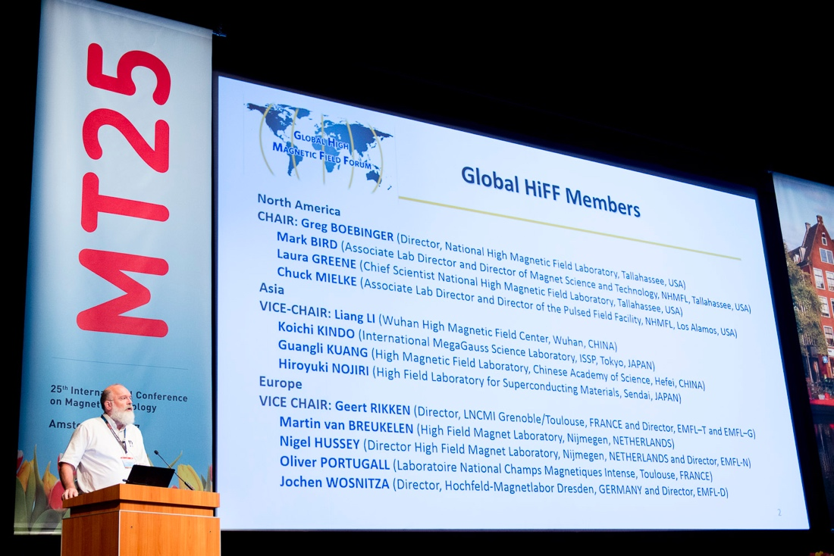
Plenaries
Key applications:
  Bernard Bigot (ITER) ITER
  Yoshiyuki Iwata (NIRS) Radio therapy
  Greg Boebinger (NHMFL) High field facilities
  Jurgen Kellers (ECO5) Wind turbines
  Luca Bottura (CERN) Accelerators
Special 4-in-1 Plenary on conductors:
  Amalia Ballarino (CERN) Customer needs & requirements
  Jianwei Liu (WST)
  Hisaki Sakamoto (Furukawa) Producer perspective and outlook to the future
  Burkhard Prause (Bruker)
A. Verweij, MPE-PE section meeting, 14/9/2017

Slide 9
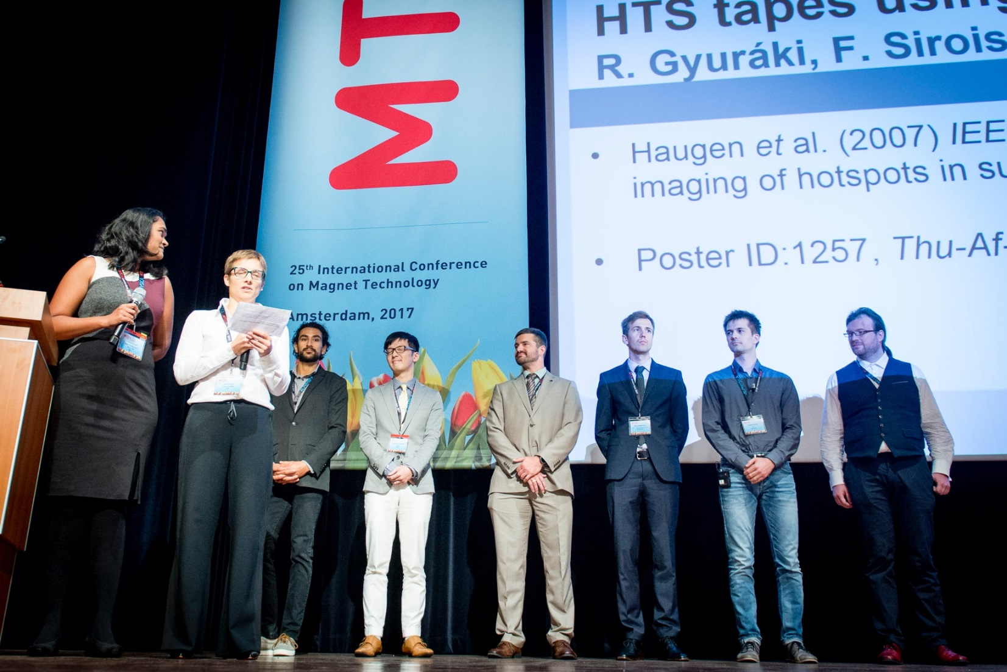
Enthusiastic “Young scientist” plenary
5 min per person, focussing on new idea.
Great feedback from the audience!
Roland Gyuraki | KIT, Germany
Yoshinori Yanagisawa | RIKEN, Japan
Charlie Sanabria | FSU, USA
Nikolay Bykovsky | PSI, Switzerland
Trey Holik | FNAL, USA
Jeroen van Nugteren | CERN, Switzerland
A. Verweij, MPE-PE section meeting, 14/9/2017

Slide 10
Contributions (total=939) per country
Country | Total | %
China | 279 | 29.7%
South Korea | 155 | 16.5%
Japan | 109 | 11.6%
USA | 107 | 11.4%
Switzerland/CERN | 69 | 7.3%
France/ITER | 48 | 5.1%
Germany | 30 | 3.2%
UK | 30 | 3.2%
Netherlands | 24 | 2.6%
Italy | 23 | 2.4%
Russia | 23 | 2.4%
Spain | 8 | 0.9%
Taiwan | 8 | 0.9%
Finland | 5 | 0.5%
New Zealand | 5 | 0.5%
Country | Total | %
Czech Republic | 3 | 0.3%
Poland | 3 | 0.3%
Greece | 2 | 0.2%
Mexico | 2 | 0.2%
Slovakia | 2 | 0.2%
Brazil | 1 | 0.1%
Canada | 1 | 0.1%
India | 1 | 0.1%
Morocco | 1 | 0.1%
A. Verweij, MPE-PE section meeting, 14/9/2017
Region | Total | %
Asia | 552 | 59%
Europe | 270 | 29%
America | 111 | 12%
Australia & NZ | 5 | 1%
Africa | 1 | 0%

