Slide 2

Short overview of MT-25
Wednesday and Thursday
Zinour Charifoulline
Indico Link to all presentations

Slide 3
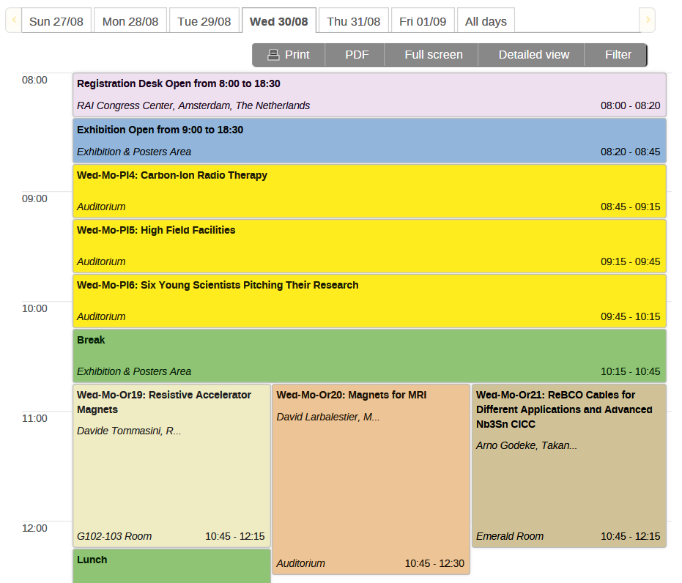
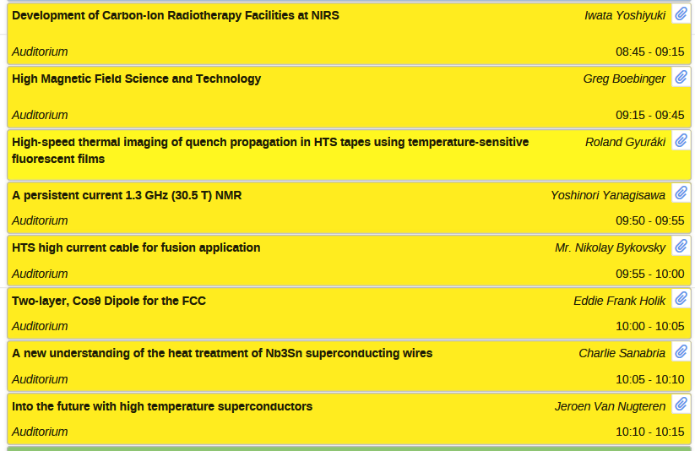
Indico Link

Slide 4
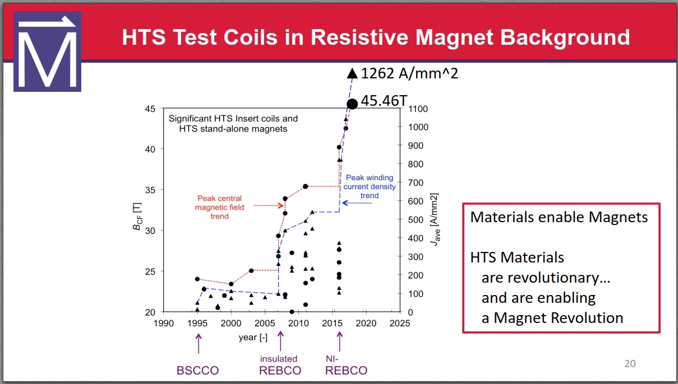
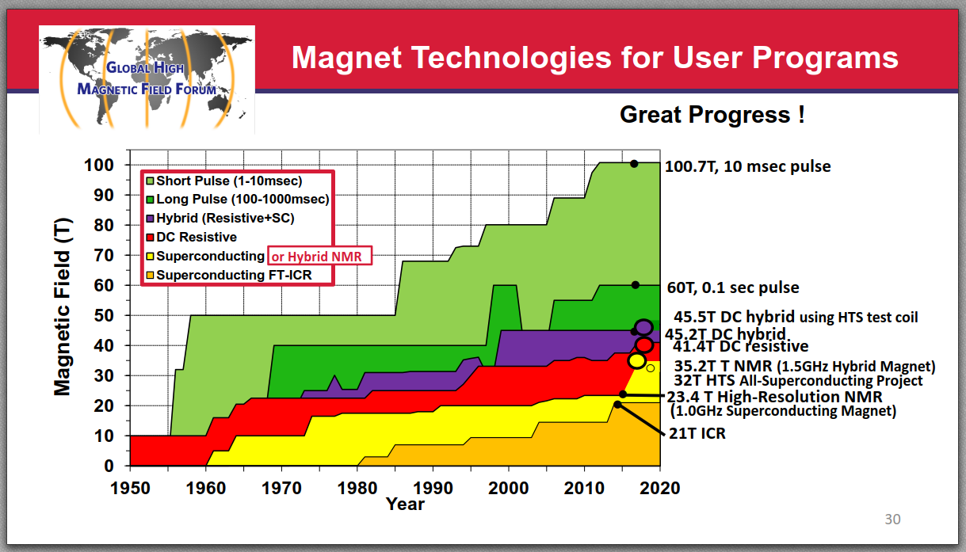
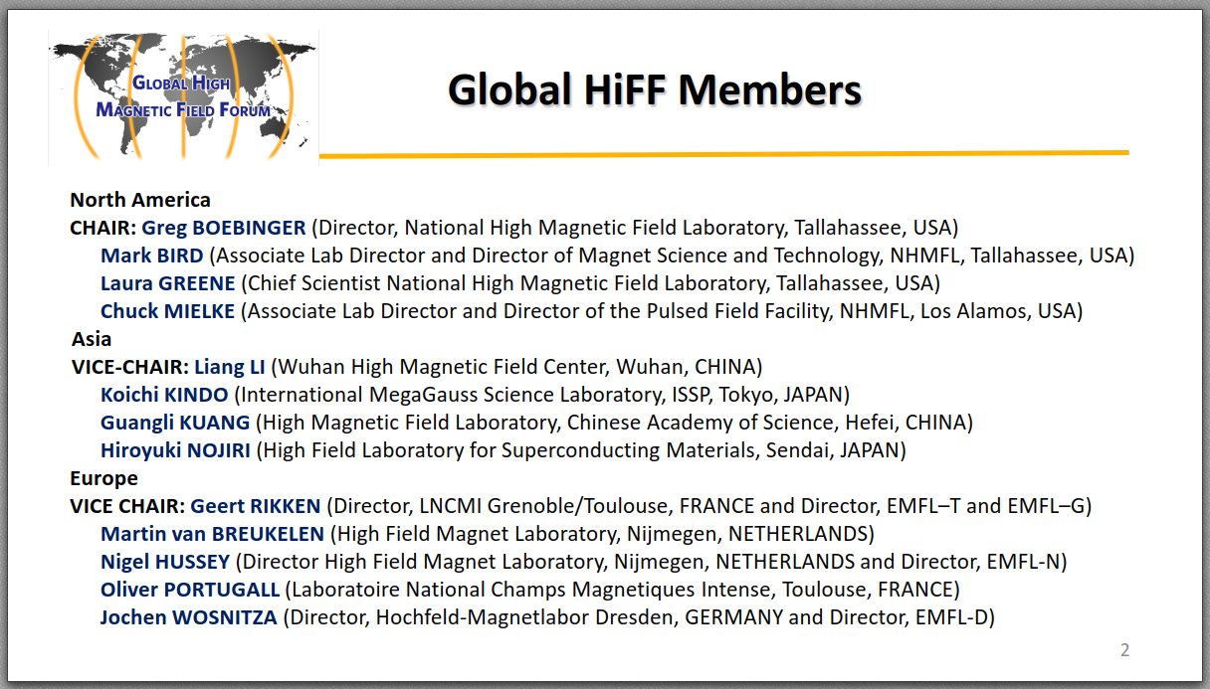
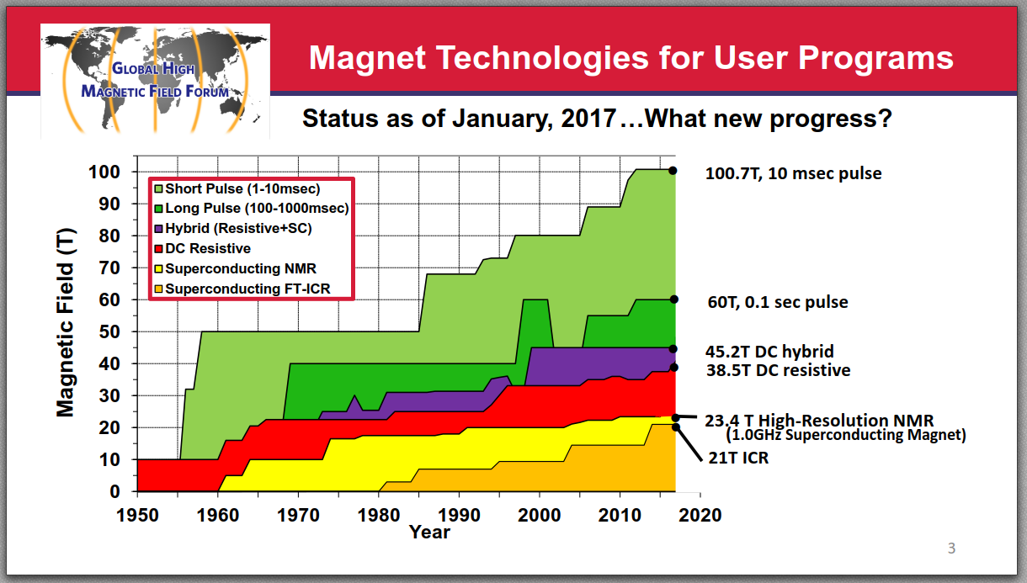

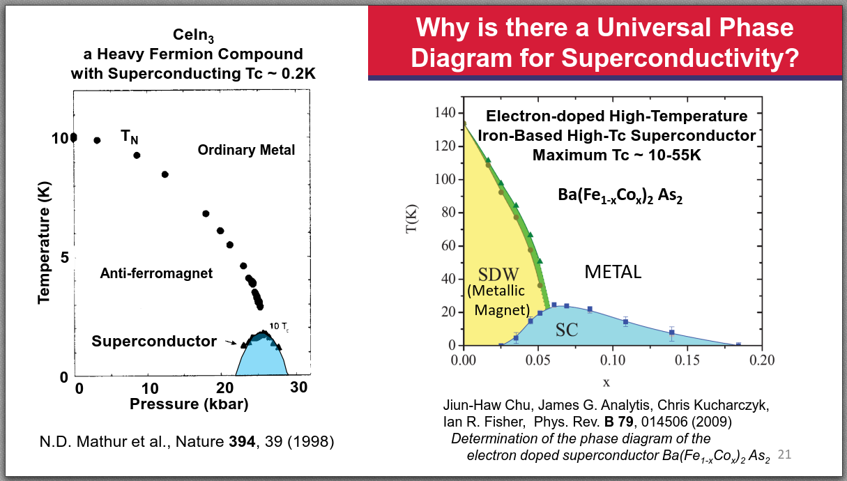

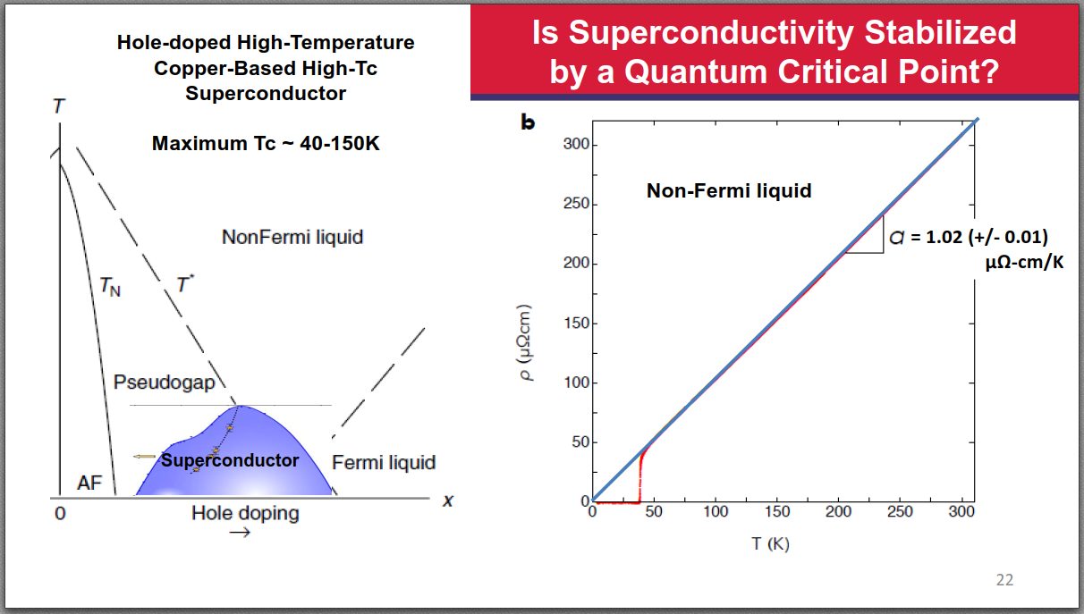
Plenary Session 5: High Field Facilities
CERN is not in the list!
Indico Link

Slide 5

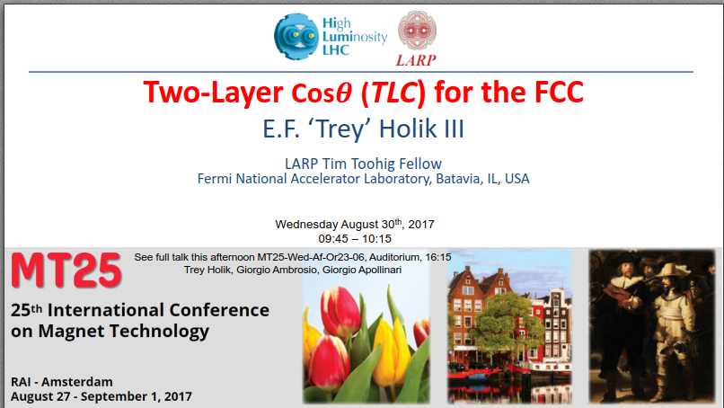
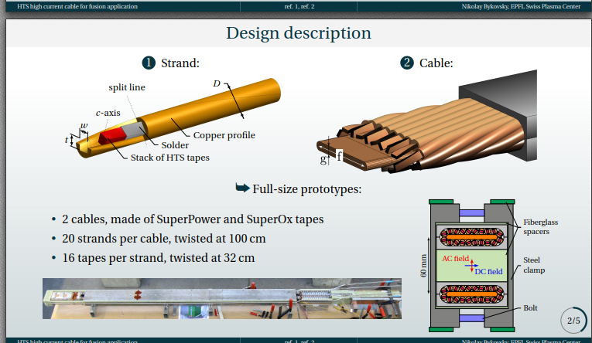
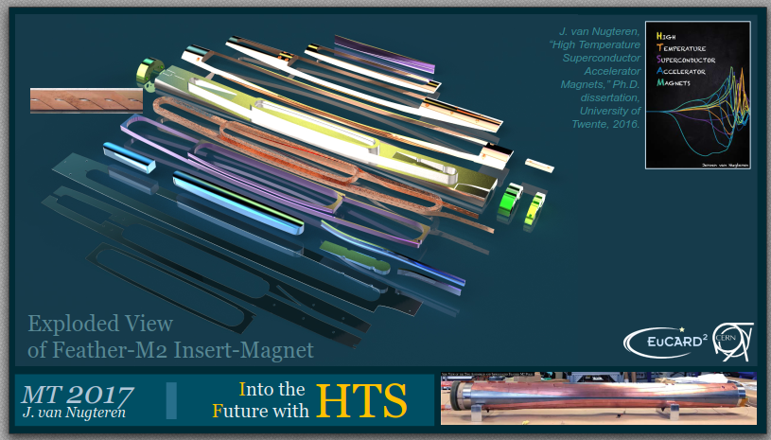
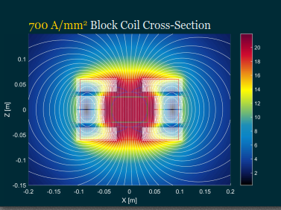
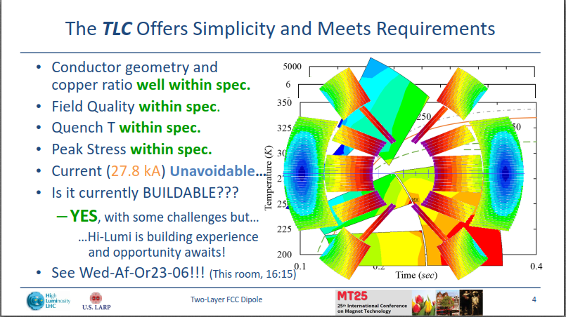
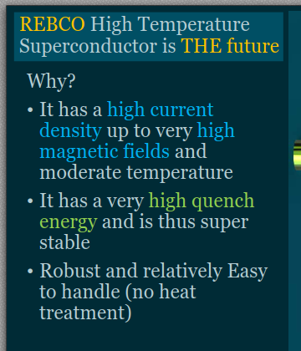
Plenary Session 6: Six Young Scientists Pitching Their Research
Indico Link

Slide 6
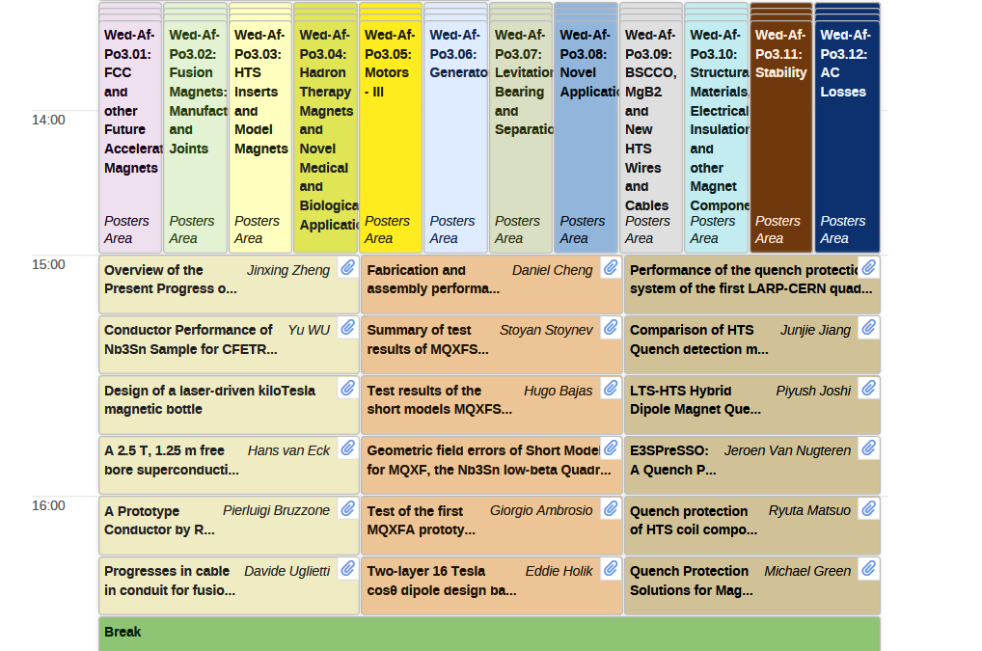
Wednesday Poster Session
Indico Link

Slide 7
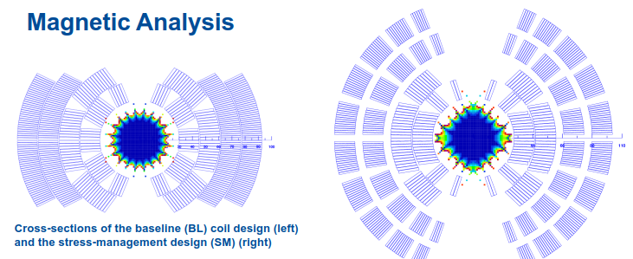
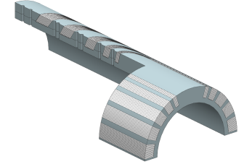
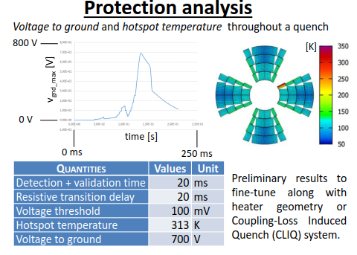
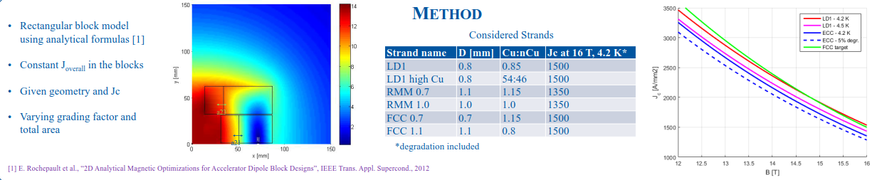
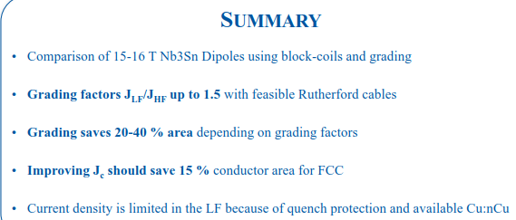
Poster Session 3.01: FCC and other Future Accelerator Magnets
“60-mm aperture High-Field Nb₃Sn Cos-theta Dipole with Stress Management”, Igor Novitski, Fermilab
“Design of a Nb₃Sn 400 T/m quadrupole for the FCC”, Clement Lorin, CEA
“Parametric Study of Block-Coil Dipoles Using Graded Conductors”, E. Rochepault, CERN
Indico Link

Slide 8
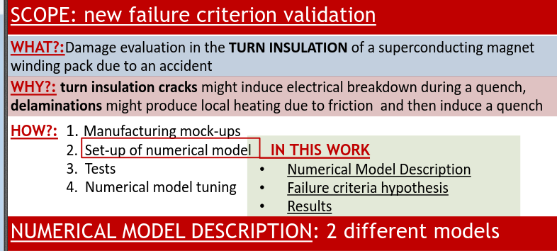
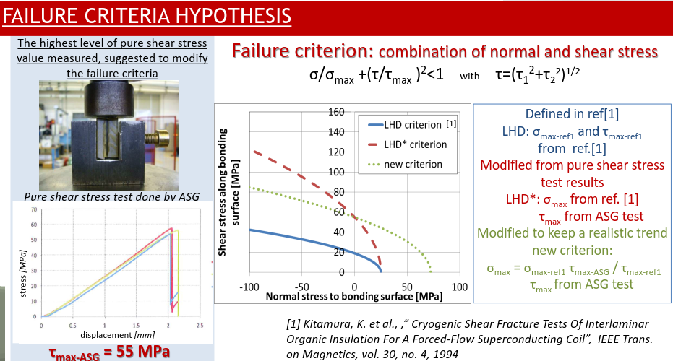
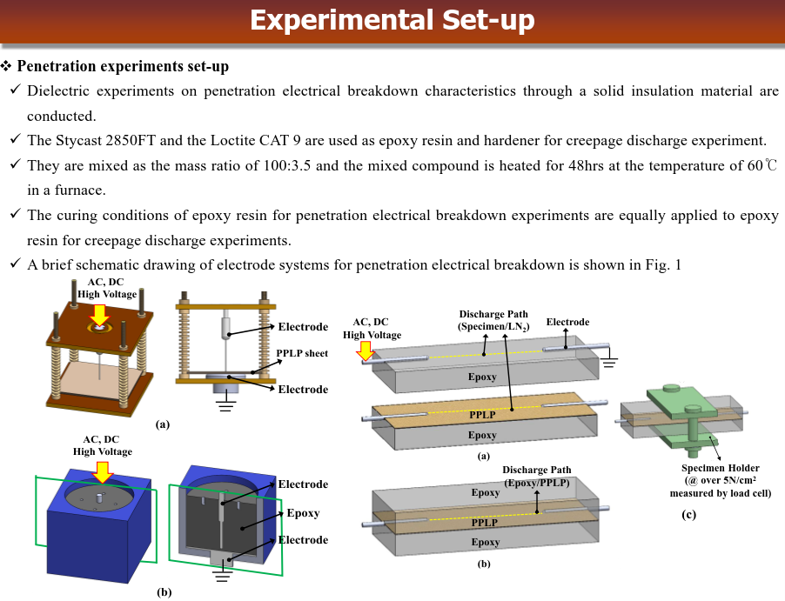
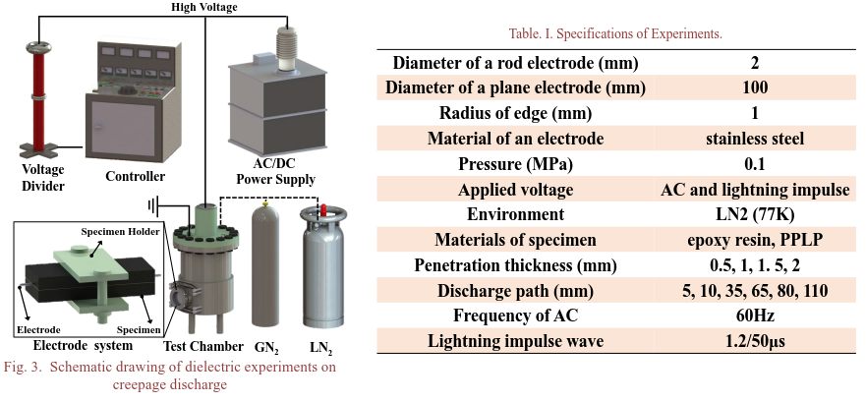
Poster Session 3.10: Structural Materials, Electrical Insulation
and other Magnet Components
“Damage evaluation in a superconducting magnet winding pack due to an accident”, S. Roccella, Frascatti, Italy
“Creepage Discharge Characteristics of Solid Insulation Materials under Cryogenic Temperature for a Superconducting Apparatus”, O. Lee, Korea
Indico Link

Slide 9
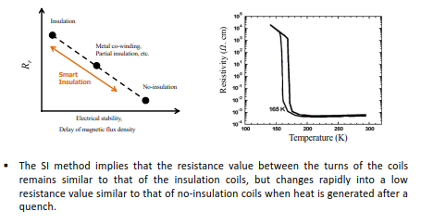
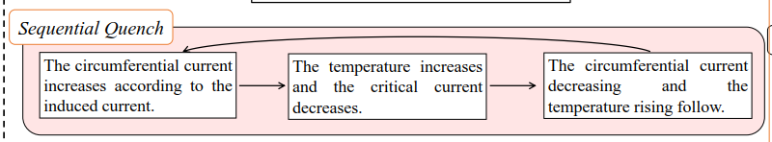
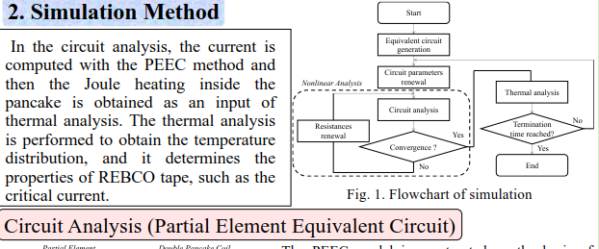
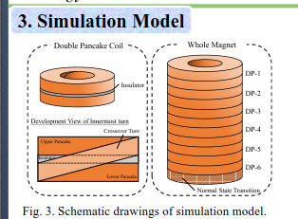
Poster Session 3.11: Stability
“HTS Magnet with Smart Insulation Method”, Y.-S. Jo, KERI
“Thermal and Electromagnetic Simulation of Multi-stacked No-Insulation REBCO Pancake Coils on Normal-state Transition by PEEC method”, R. Miyao, Japan
Not all posters are loaded to Indico ☹
Indico Link

Slide 10
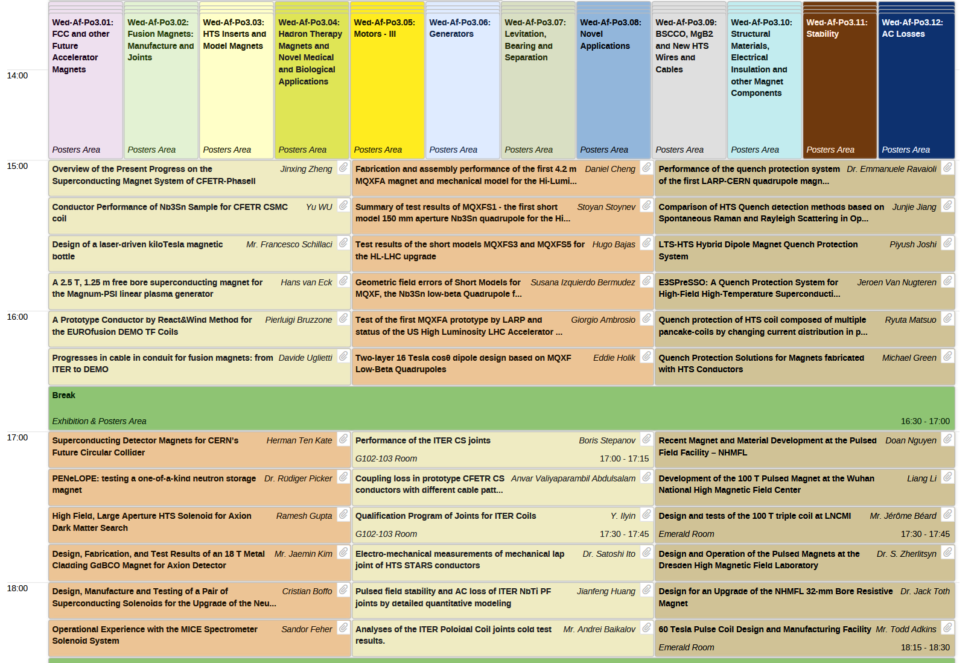
Wednesday Afternoon Oral Sessions
Indico Link

Slide 11

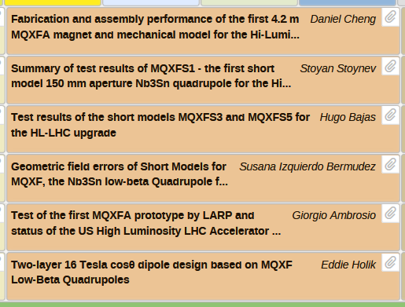
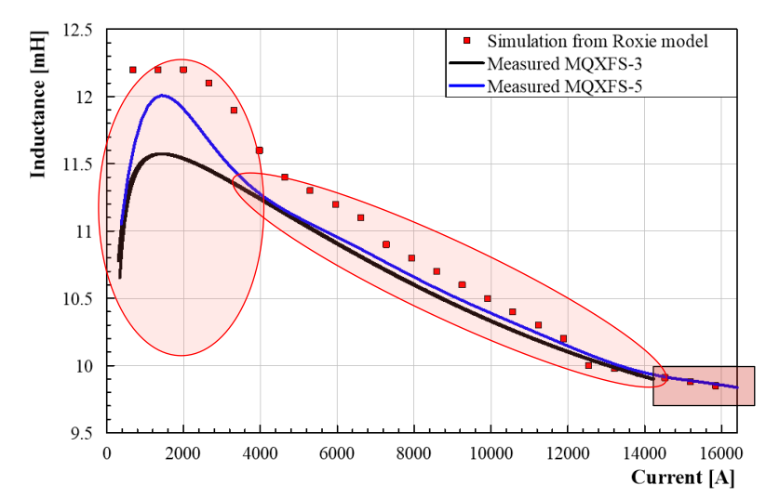
Oral Session 23: Nb₃Sn Quadrupole Magnets for Accelerators
(CERN)
Magnets load-line, critical surface and short sample limit;
Magnets instrumentation;
Performance measurements and training;
Quench location;
Flux jump measurement;
Voltage disturbance measurement;
Splice resistance measurement;
Inductance measurement;
Magnetic measurement;
Magnet protection study;
Mechanical measurements;
Indico Link

Slide 12



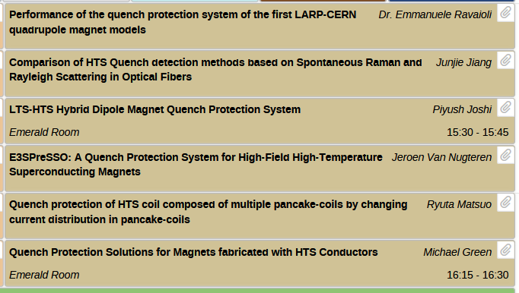
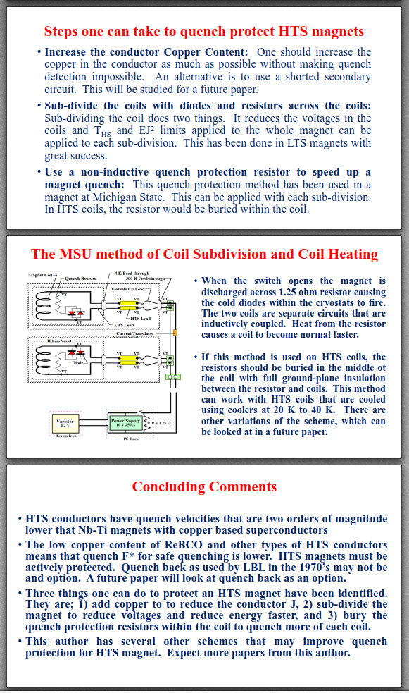
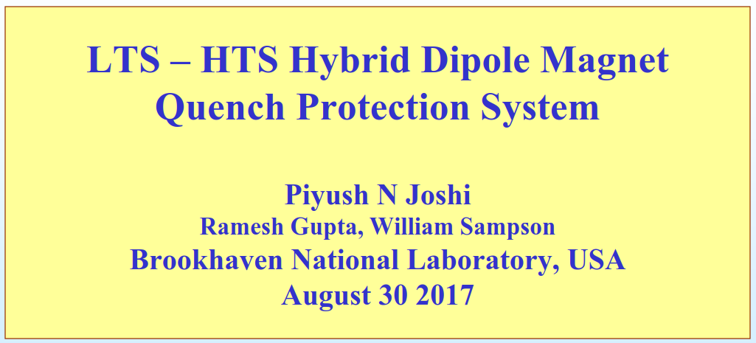
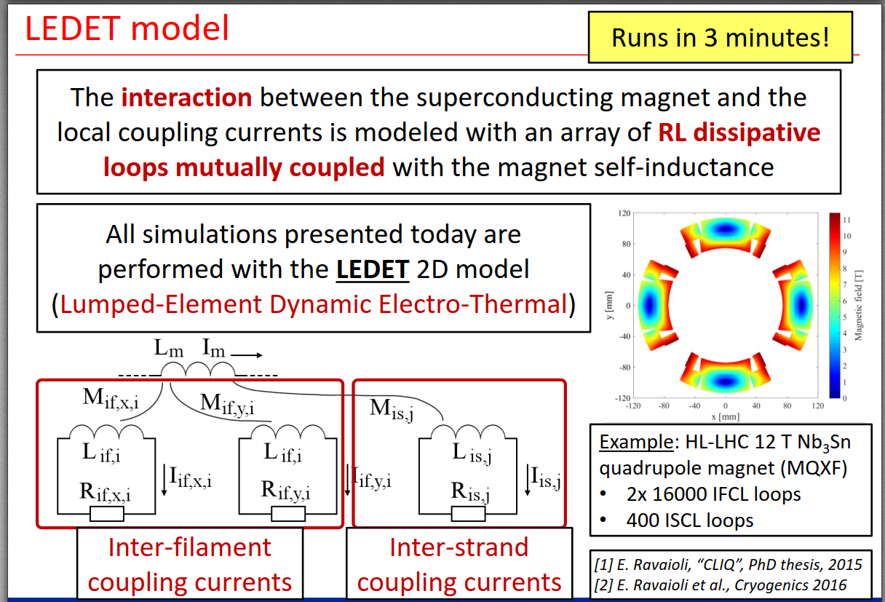
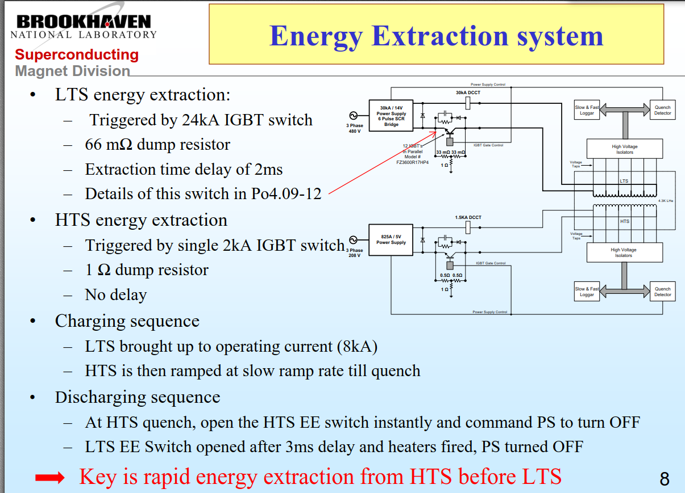
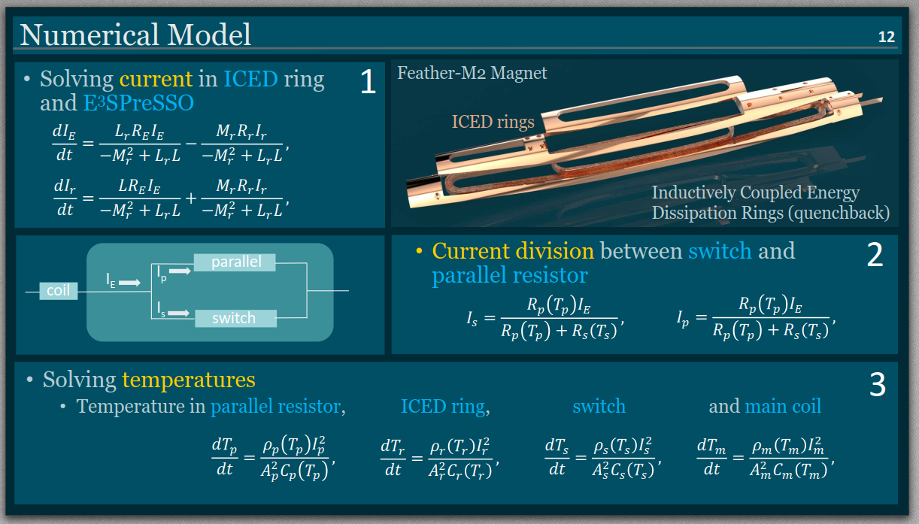
Oral Session 24: Quench Detection and Protection Ssytems - II
Indico Link

Slide 13
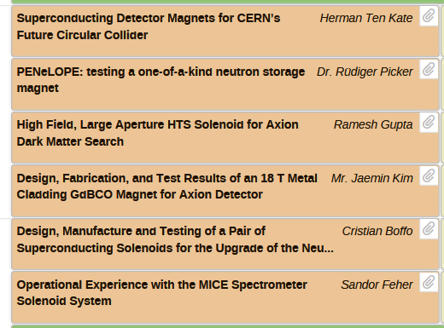
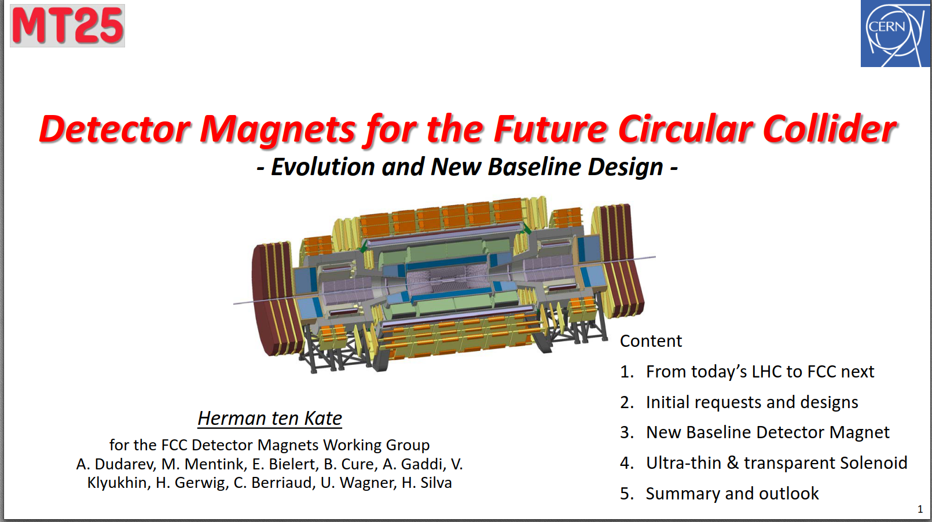
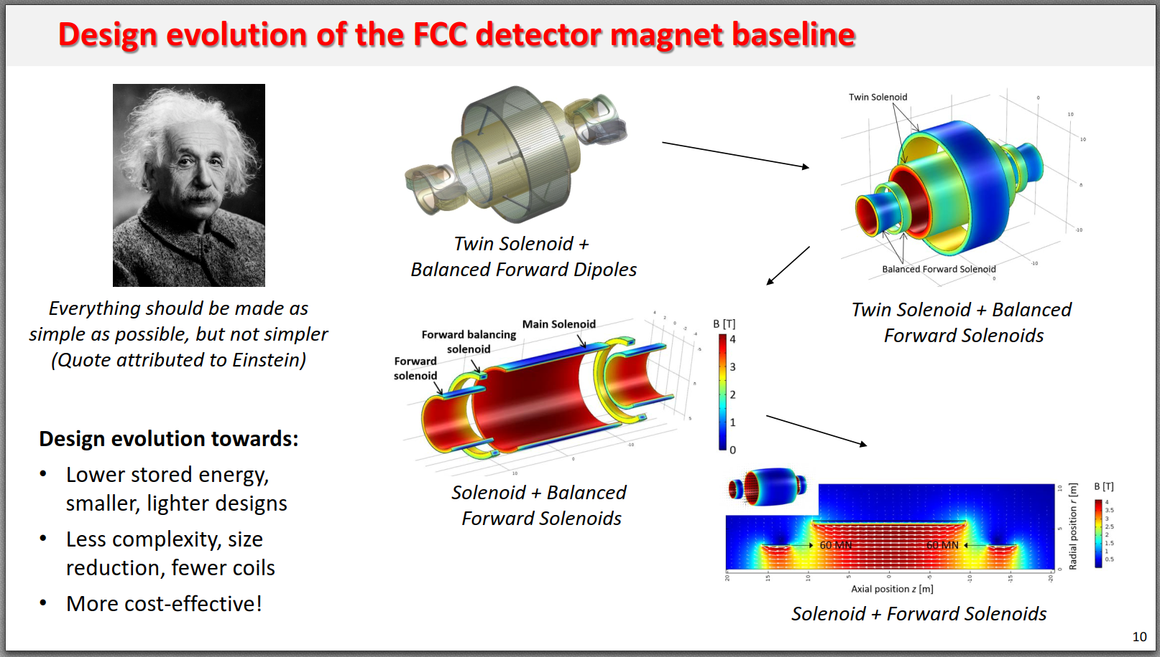
Oral Session 25: Particle Detector Magnets
Indico Link

Slide 14
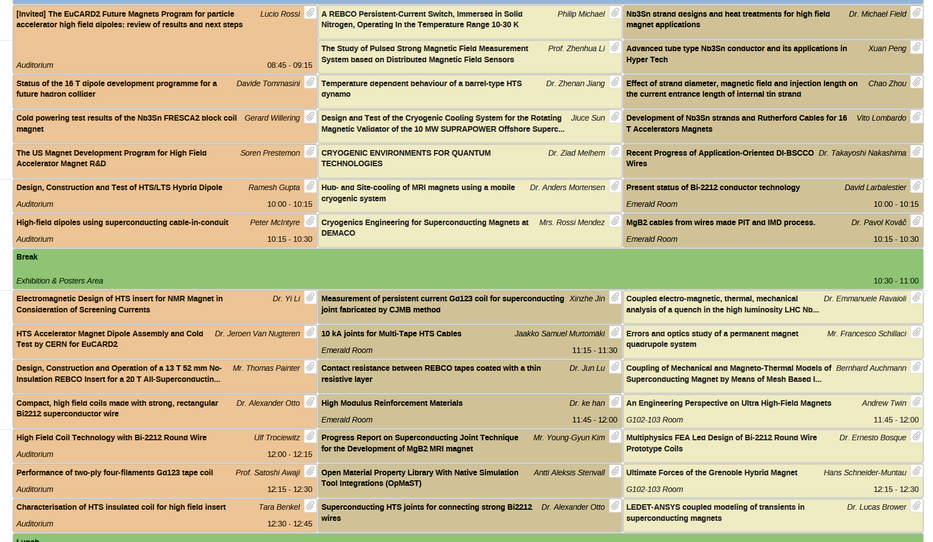
Thursday Morning Oral Sessions
Indico Link

Slide 15

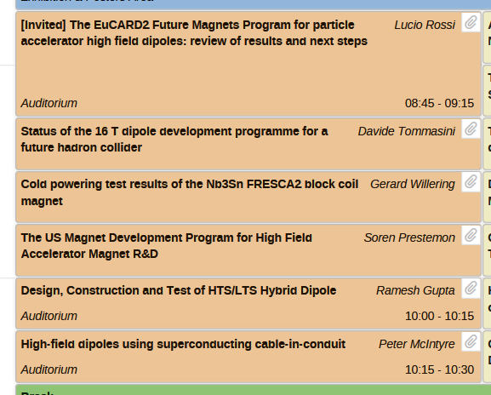
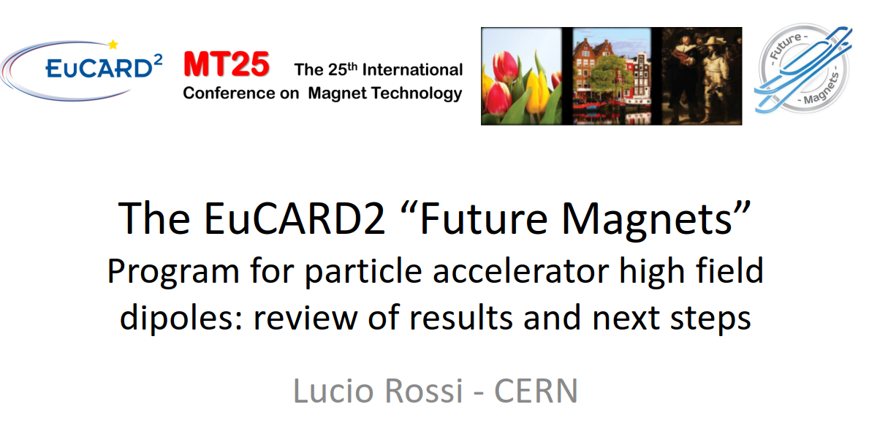
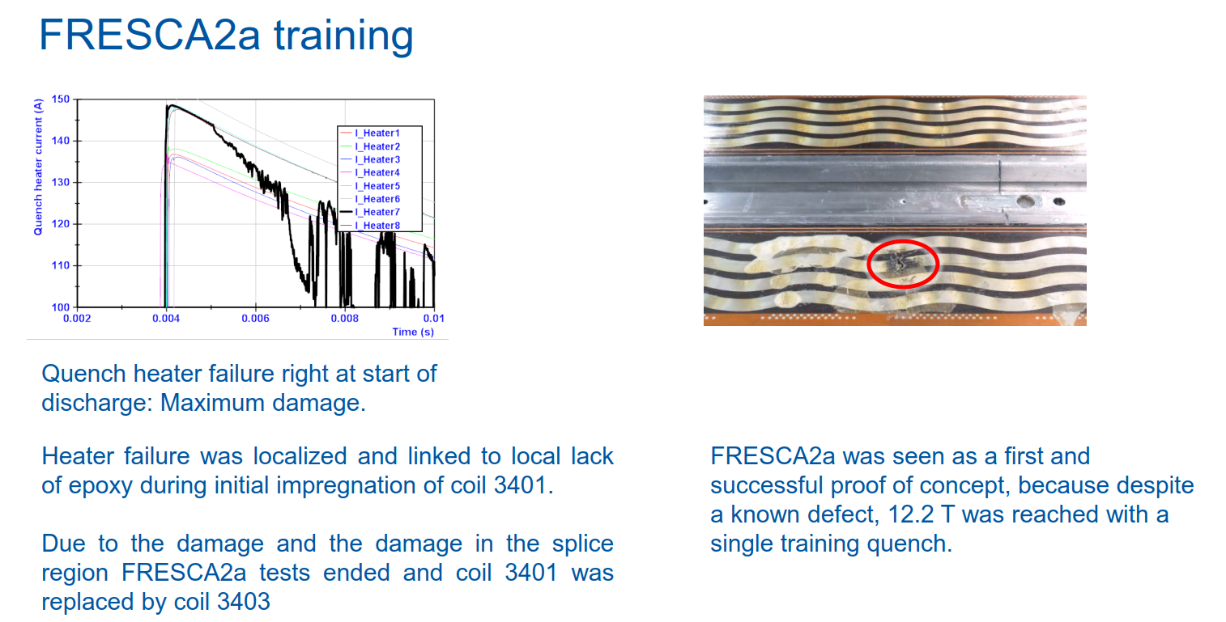
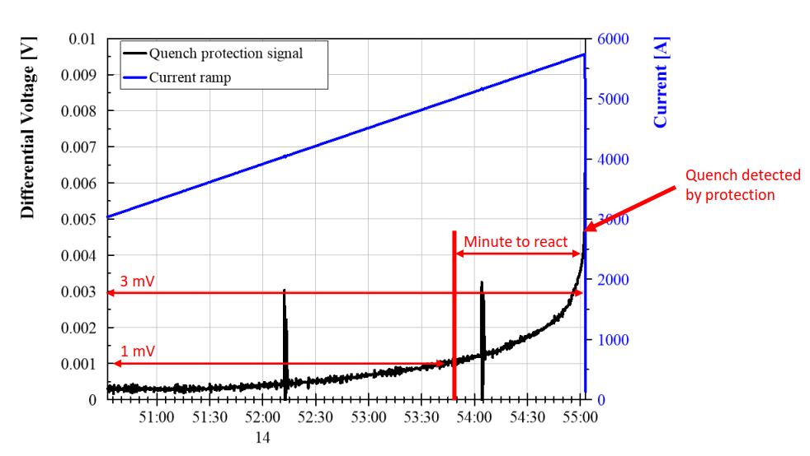
Oral Session 28: Magnets for Future Accelerators
(45 slides)
Indico Link

Slide 16

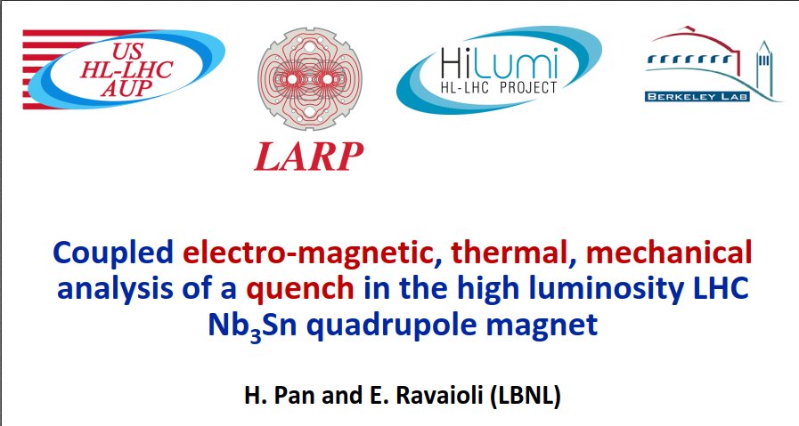
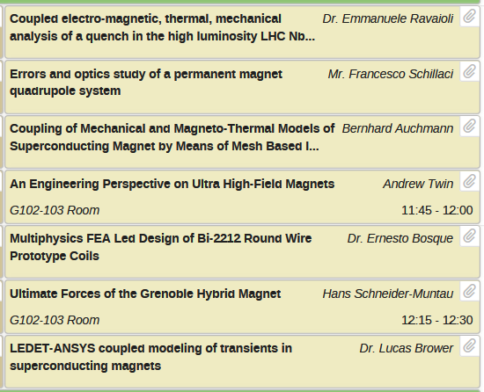
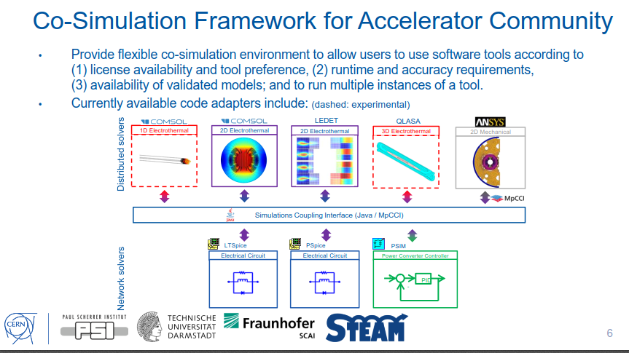
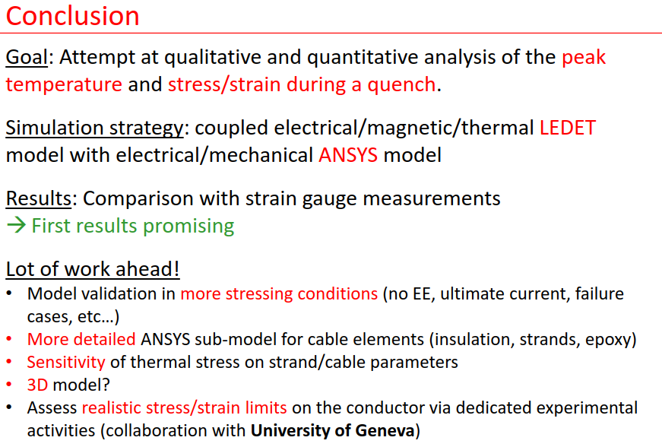
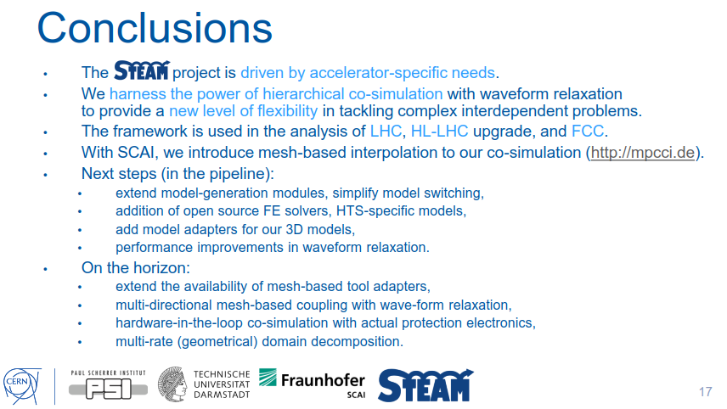
Oral Session 33: Multiphysics Design and Analysis for Different
Magnet Applications
Indico Link

Slide 17

Thursday Poster Session
Indico Link

Slide 18


Poster Session 4.09: Quench Detection and Protection Systems
Indico Link

Slide 19



Poster Session 4.11: Novel Diagnostics
Indico Link

Slide 20



Thursday Afternoon Oral Session
Indico Link

Slide 21





Thanks to Organisers!

Slide 22
Hi Zinur and Matthias,
For next week Andrea has put “report from MT25” on the agenda (see below).
I suggest that I give a short overview of the conference (which categories/magnet types are presented at MT, etc) and that you both briefly show some slides with orals/posters with interesting content for our section (so mainly in the field of magnet protection, CLIQ, quench heaters, simulation, HiLumi, damage tests, etc). 10-15 min max per person. PS: Lorenzo is on holiday
Everything is available on Indico. Maybe you can split (Matthias: Mon+Tue, Zinur: Wed+Thu)
Cheers,
Arjan

