Slide 1
Who am I?
(An introduction by the new guy in 30-05-007)

Slide 2

The basics
Name: Mikael Motyka
Age: 25
Hometown: Lund, Sweden
Contract: Technical Student
Duration: 10 months

Slide 3

Background
University: Blekinge Institute of Technology
Program: Master in Software Engineering

Slide 4

How did I end up here?
Thesis at the European Spallation Source
  Development of a software simulation tool for
  Availability analysis (Availsim3)
  Current group showed interest in the tool

Slide 5
Availsim 1
Tom Hiemel and his team, developed for SLAC
Written in MATLAB
Includes complexities not possible in commercial tools such as:
  Smart repairs
  Scheduled maintenance shutdown
  Recovery
  ”Kludge repairs”

Slide 6
Availsim 2
Tailor made for IFMIF RAMI analysis
Availsim 1 features +
  Different failure modes for components
  Individual component threatment
  Flexible (maintenance offset/component locations/redundancies)
  Better corresponds to reality

Slide 7
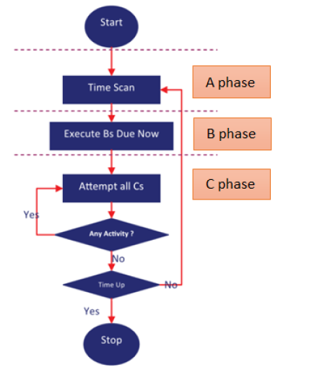
Availsim 3
Developed from scratch in Python 3
Consists of ”Modules” to add/remove functionality more easily
A simulation in discrete time that uses a so called ”three-phased”
approach (Pidd. 1998)
Under continuous development and testing

Slide 8
What will I do? (In a nutshell)
Continue developing Availsim
Maintenance of an existing translator tool to translate availability models
Extend the translator to generate input files for Availsim

Slide 9
Thank You!
Questions?

