Slide 1

Diamond BLM analysis of 16L2 events – current status
Björn Lindström
CERN
Acknowledgements: D. Wollmann, M. Valette, P. Bélanger, C. Xu
MPE PE section meeting – 26 October 2017

Slide 2
Outline
Introduction
  16L2
  Diamond BLMs
Goals
  Current hypothesis
  Observables
Current Understanding of the data
Foreseen MD

Slide 3
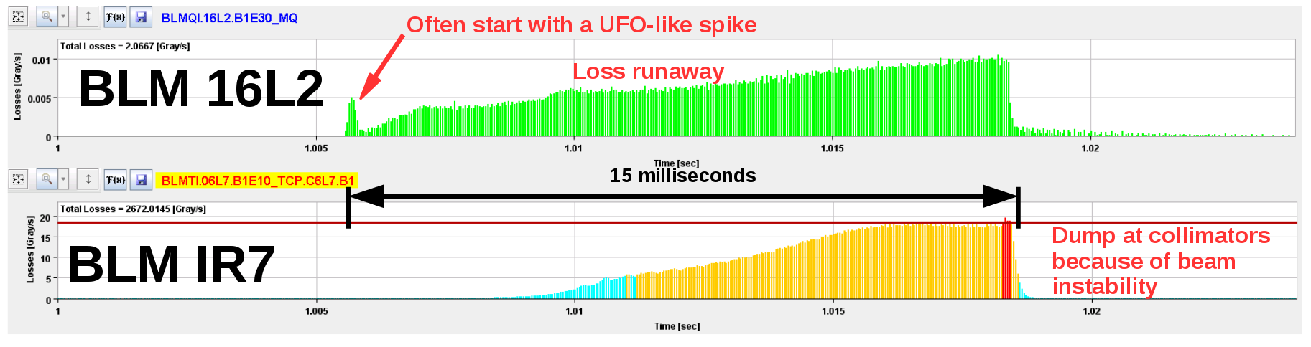
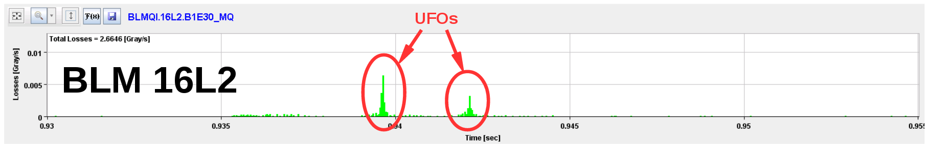
Introduction
16L2 refers to loss events in an interconnection in LHC sector 16L2
Three types:
  Steady state losses (resolved)
  UFO-like losses causing beam instability (fast loss rise, beam dump, quench)
  UFO-like losses not causing instabilities (do not dump)
Courtesy of A.Lechner

Slide 4
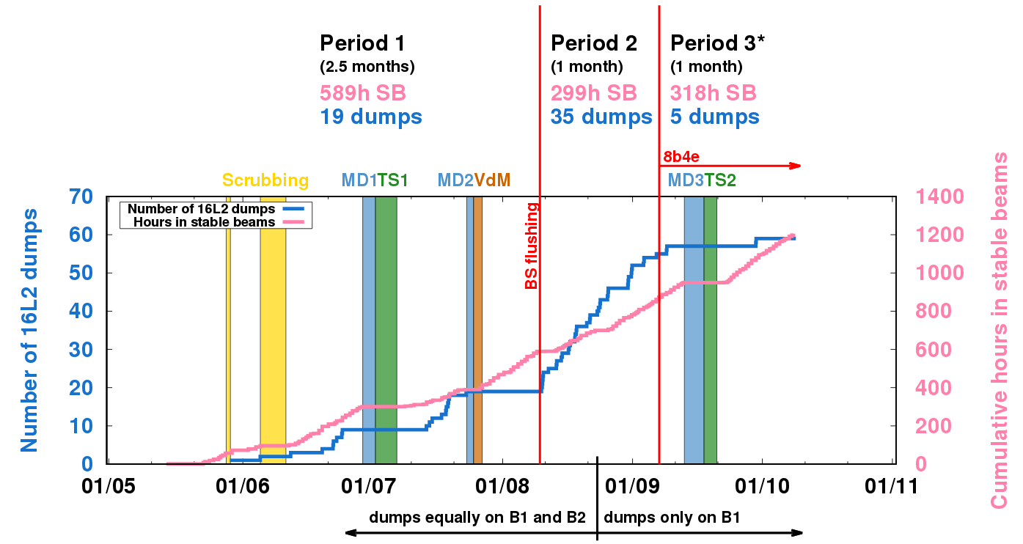
Introduction
61 dumps since May until 25th Oct
  294 dumps due to faults, 64 due to beam losses (incl 16L2)
Courtesy of A.Lechner

Slide 5
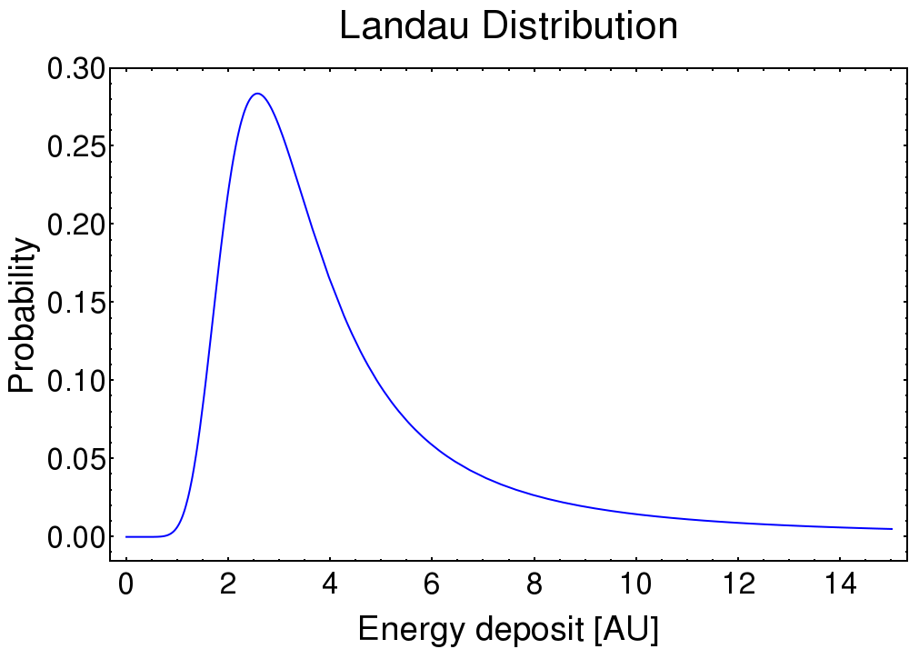
Diamond BLMs
dBLMs installed in IRs 2, 4, 6, 7, 8 and since TS2 locally in 16L2
IR7 dBLMs (at primary collimators) and 16L2 dBLMs are used for analysis
dBLMs are a thin diamond sheet, gold plated on both sides for bias voltage
  Excellent response time (rise time < 1 ns and charge collection quick enough for bunch-by-bunch resolution)
  Very high dynamic range (over 11 orders of magnitude, using appropriate amplification)
  Single particle energy resolution
  Radiation hard and low thermal stress

Slide 6
Observables and Goals
Hypothesis:
  Solid macro-particle enters beam -> gives UFO-like losses
  Macro-particle evaporates -> charged particle cloud -> beam instability -> losses in TCPs
Local dBLM: direct losses from 16L2 interaction (relatively low signal)
IR7 dBLM: losses due to build-up of instabilities
From local data, study the UFO dynamics
  Bunch blow-up in H or V
  Displacement of bunches in H,V or diagonally
    -> Tells us which direction the UFO is coming from (see MD on UFO dynamics with wirescanner)
From IR7 data, study how the instability develops
Fastest losses observed in the LHC

Slide 7
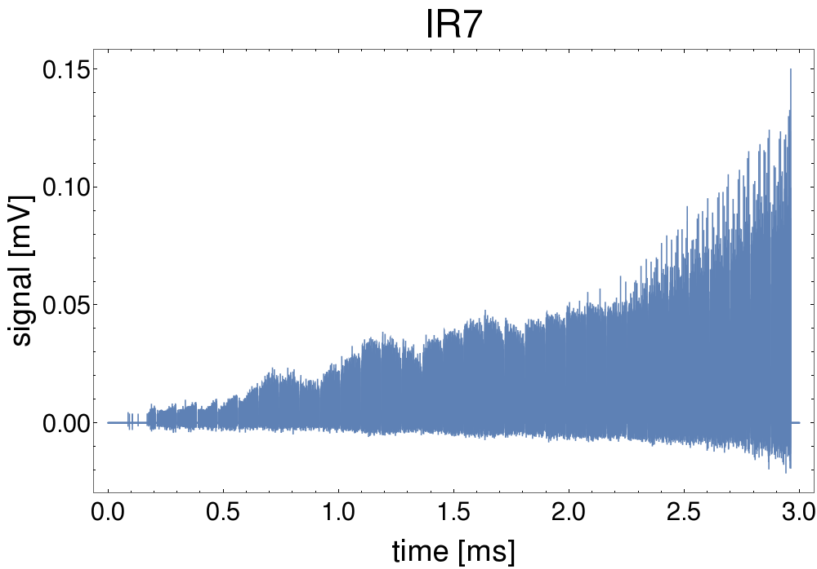
Raw signal – Full Event
Fill 6256

Slide 8
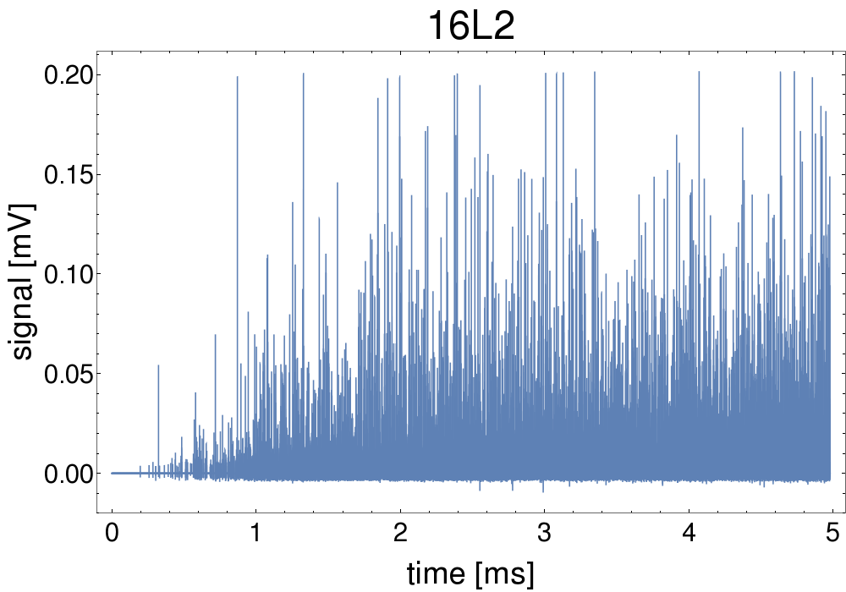
Raw signal – Full event
Fill 6256

Slide 9
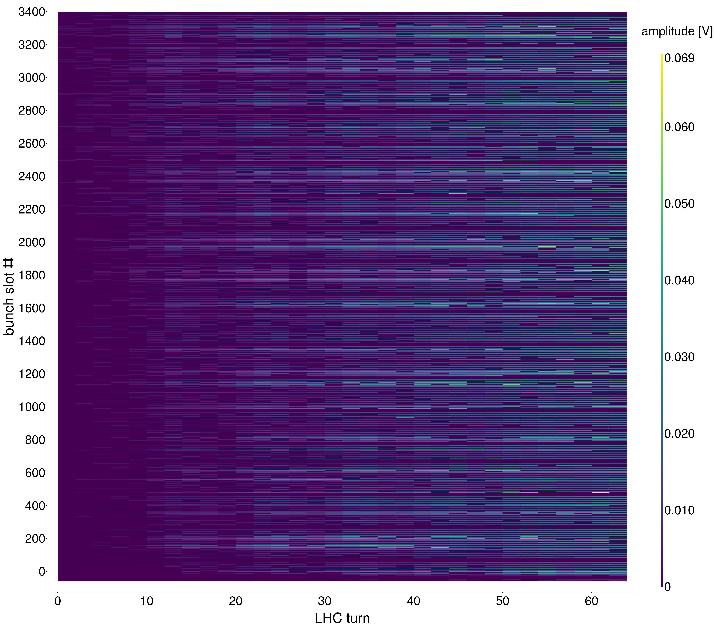
Time evolution of signal – IR7
Overall increase
Periodic oscillations
Fill 6256

Slide 10
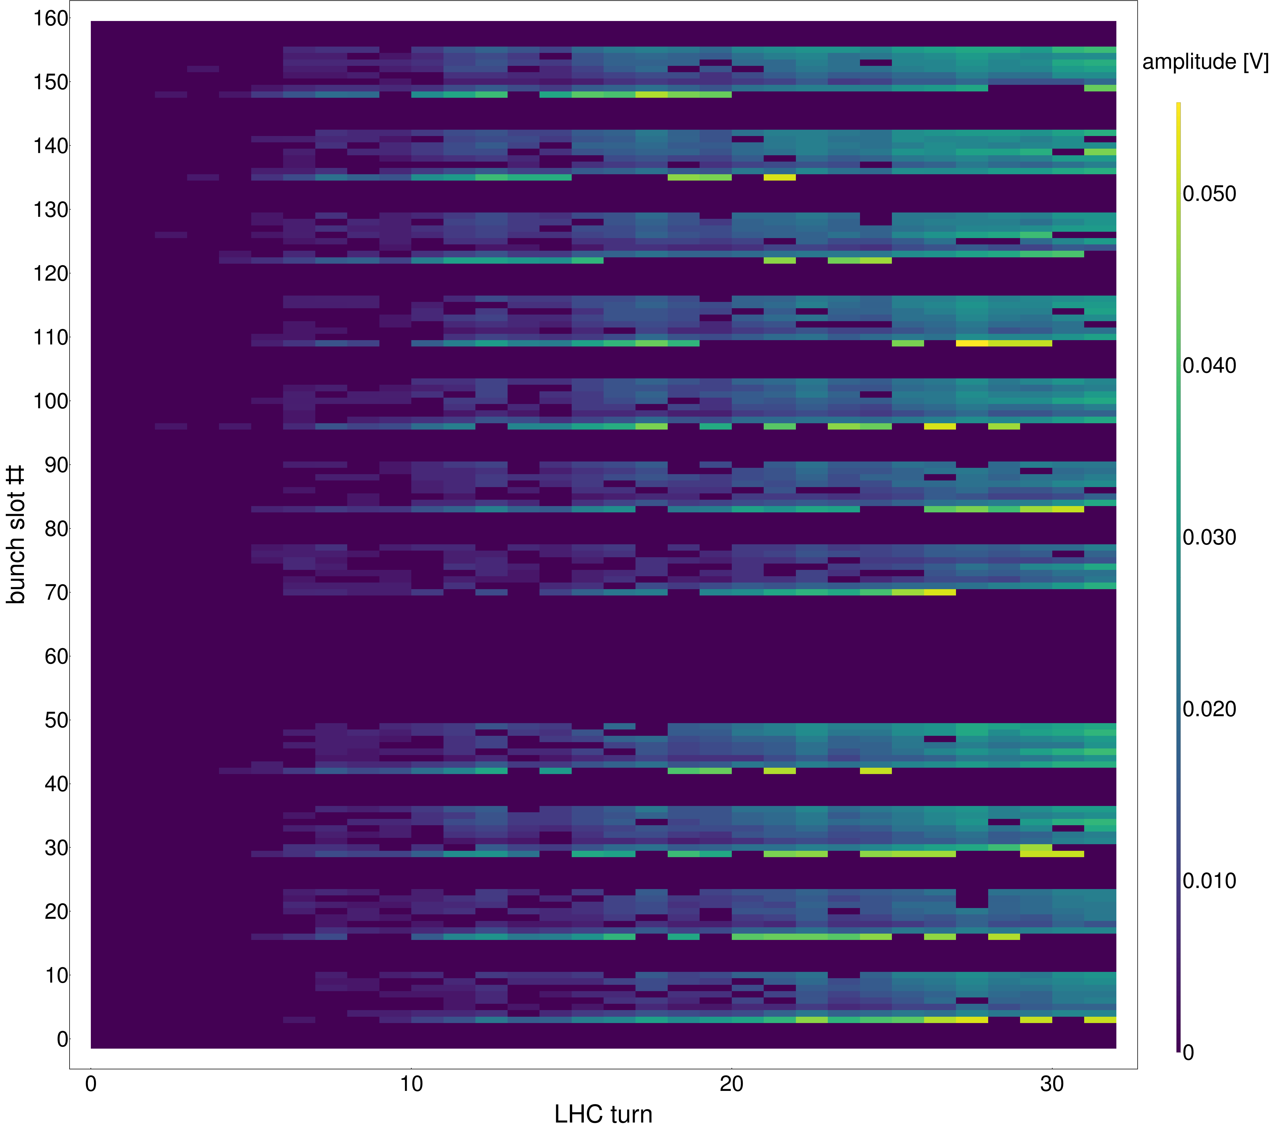
Time evolution of signal – IR7 zoom
Filling pattern clearly visible (8 bunches, 4 empty slots)
Fill 6256

Slide 11
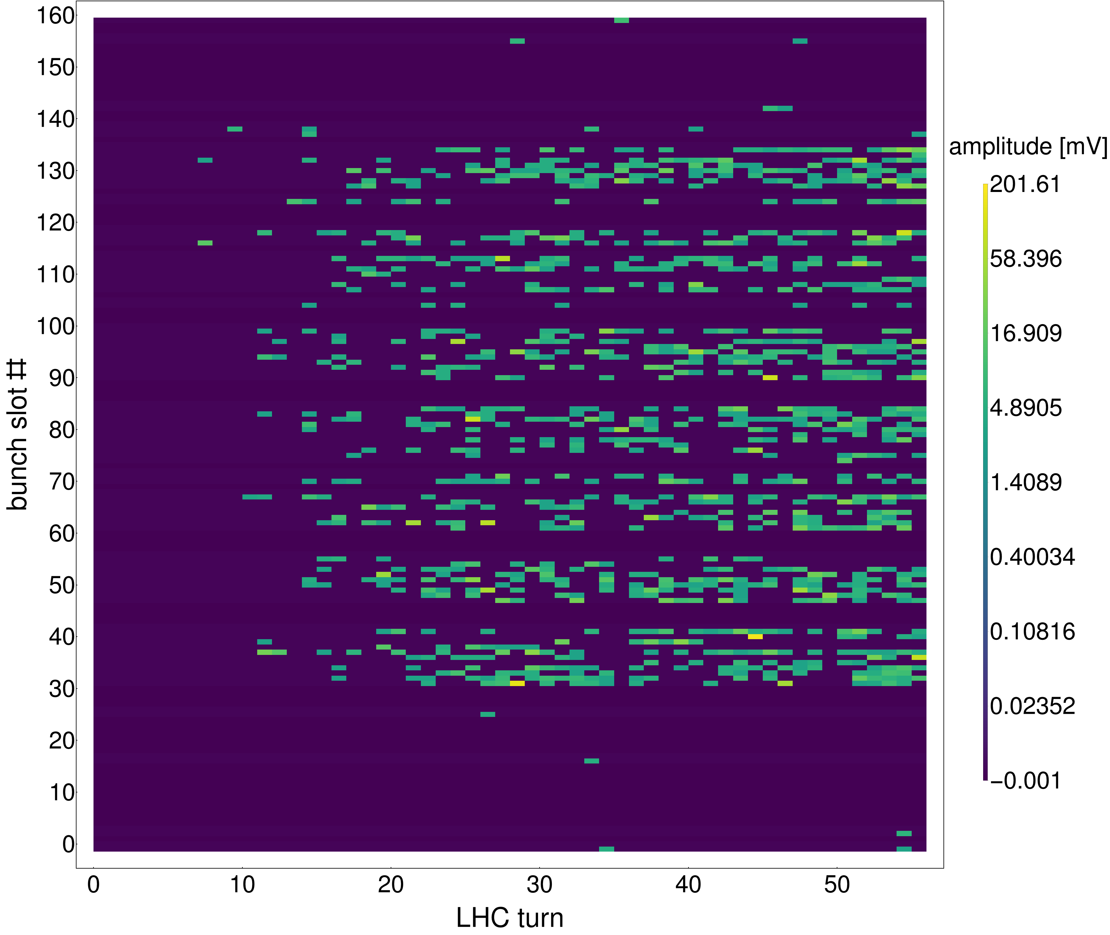
Time evolution of signal – 16L2
Very sporadic signal
No clear filling pattern
Very little increase over time, BUT more bunches show signal
Fill 6256

Slide 12
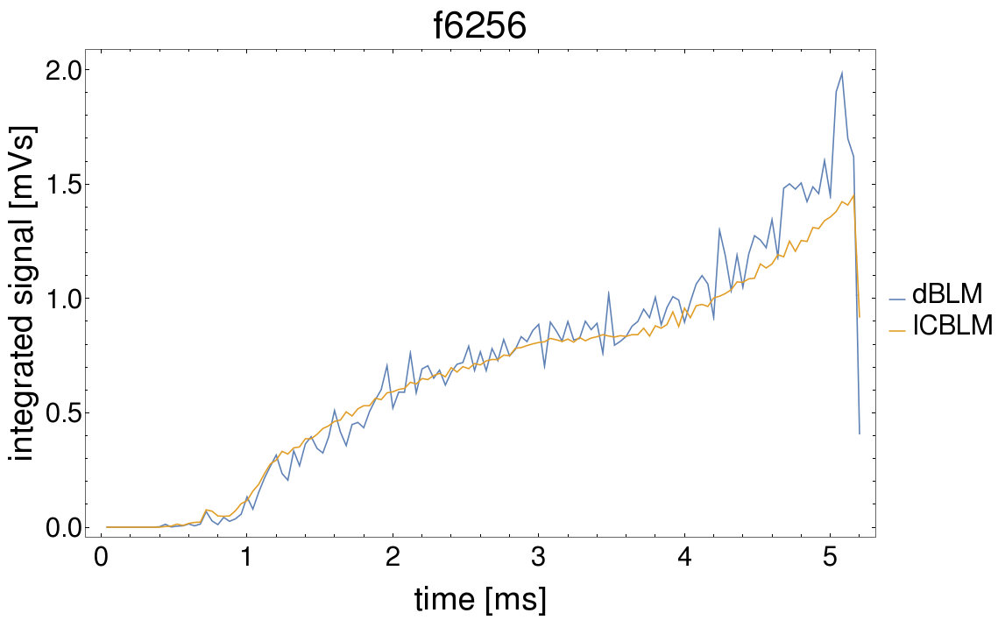
ICBLM comparison
Overlaying dBLM signal integrated in 40 µs buckets with ICBLM signal show good correlation
Can be used to estimate efficiency of dBLM

Slide 13
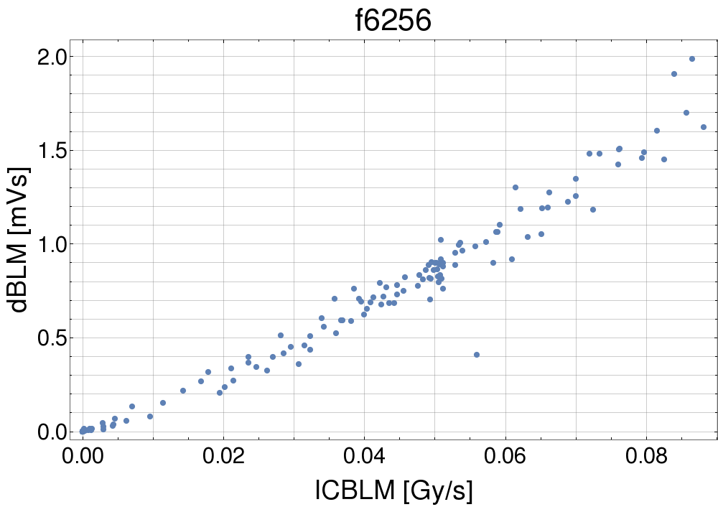
ICBLM comparison
Overlaying dBLM signal integrated in 40 µs buckets with ICBLM signal show good correlation
Can be used to estimate efficiency of dBLM

Slide 14
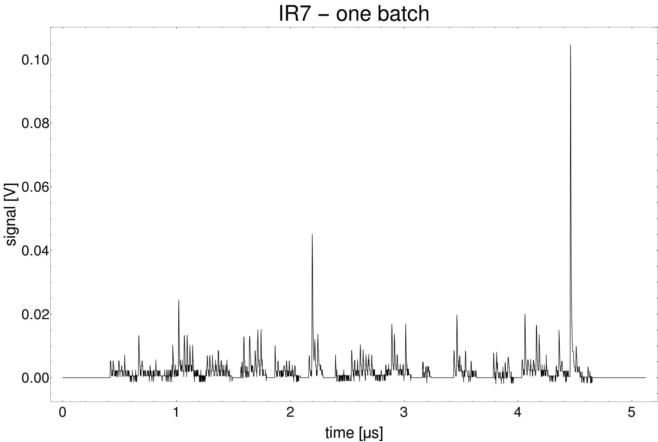
16L2 signal sporadicity
<20 % of bunch-16L2 interactions are detected due to small angular acceptance
  -> Statistical fluctuations become significant
16L2 one batch
Several ”missing” bunches,
Should be 14 trains of 8 bunches

Slide 15
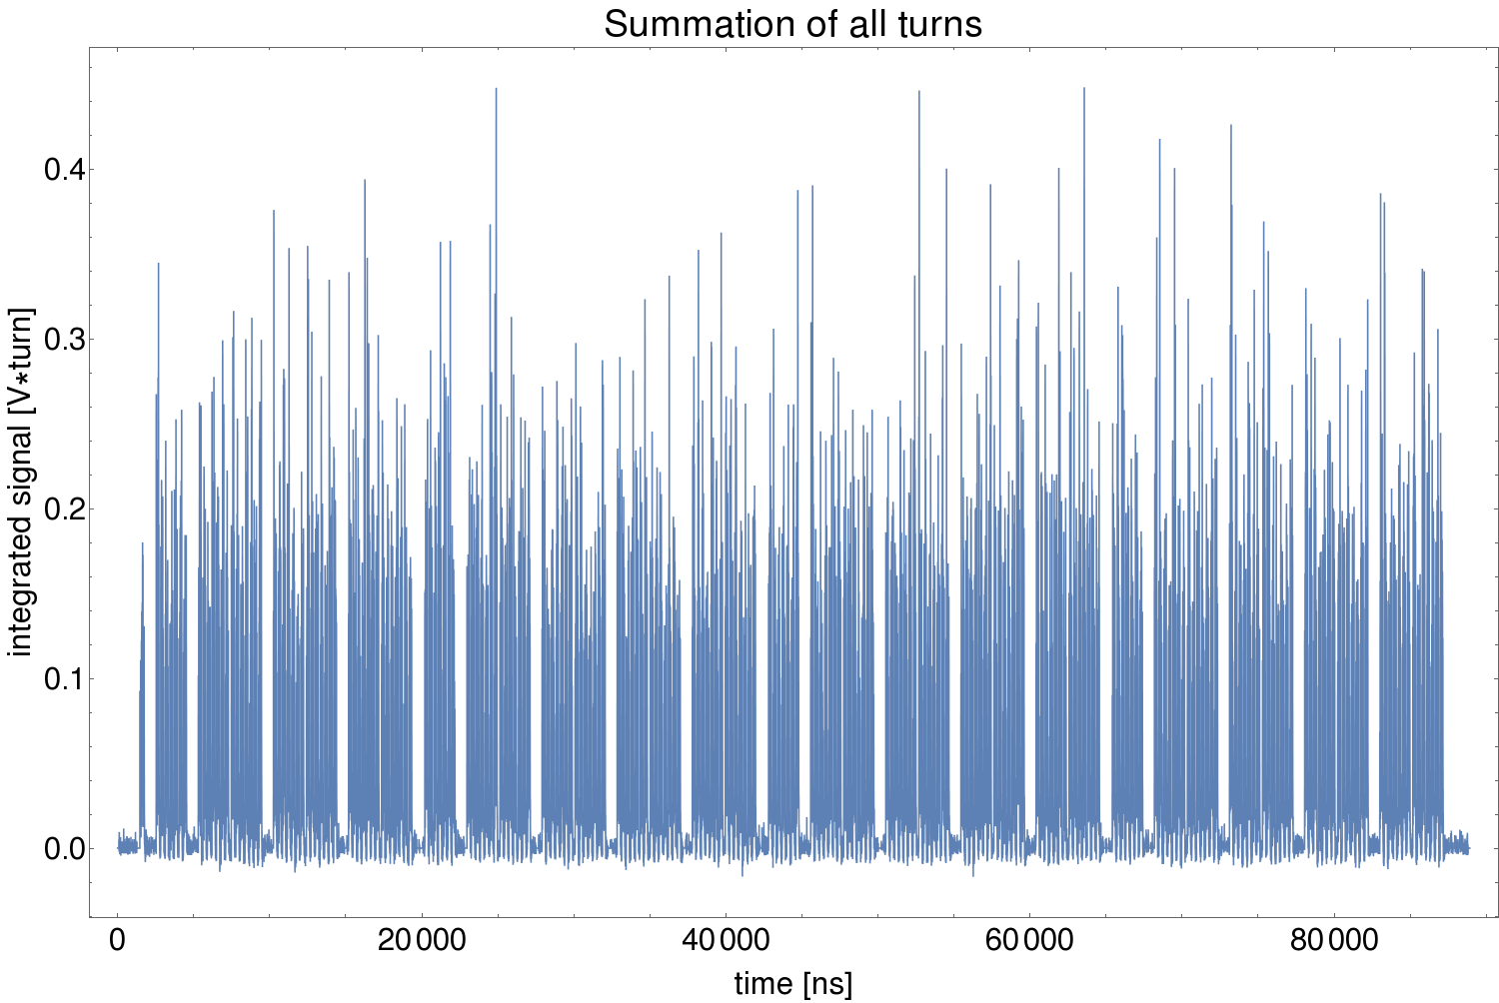
16L2 signal sporadicity
<20 % of bunch-16L2 interactions are detected due to small angular acceptance
  -> Statistical fluctuations become significant
  Summing all turns together reveals filling pattern (minimum 7 turns):

Slide 16
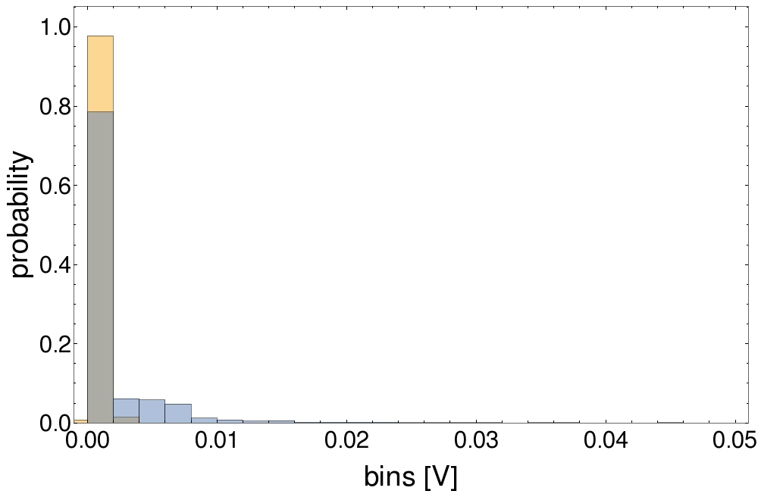
16L2 Histogram
Amplitude of every single bunch for all turns at 16L2, fill 6256
~20 % probability a bunch will be detected
Yellow, noise floor
Blue, all bunches
Gray, frequency of bunch passing 16L2 without being detected

Slide 17
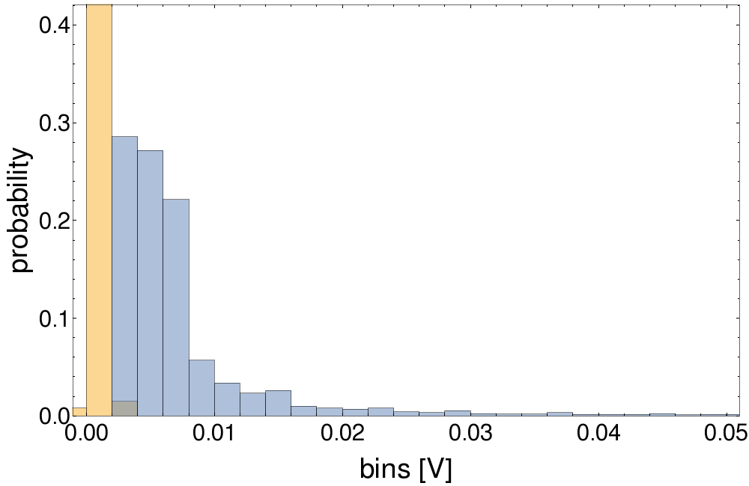
16L2 Histogram
Amplitude of every single bunch for all turns at 16L2, fill 6256
~20 % probability a bunch will be detected
Signal believed to from few particles
  => Several Landau energy distributions overlapped with shifted positions
  Could explain the small ”bumps”
No clear peak in histogram, possible that some signal is hidden in the noise
Zoom, with zeros removed
Yellow, noise floor
Blue, all bunches

Slide 18
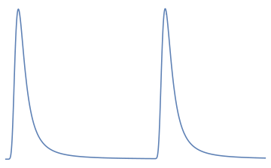
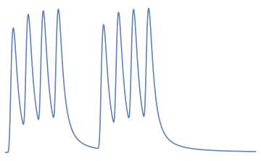
Overcoming signal sporadicity
Different combinations of signal summing are tested:
  1. Keeping the turn-by-turn evolution:
    Integrating over 8 bunch trains
    Adding the signal of bunches at equivalent places in the filling pattern before integrating
    Assuming bunches added together behave the same
    Potential signal structure due to filling pattern lost
  2. Keeping the filling pattern:
    Overlaying several turns (~7 turns must be added to reconstruct filling pattern)
    7 turns lower limit, and signal is still sporadic
    Potential turn-by-turn changes of signal is lost
integrate
Add bunches depending on position

Slide 19
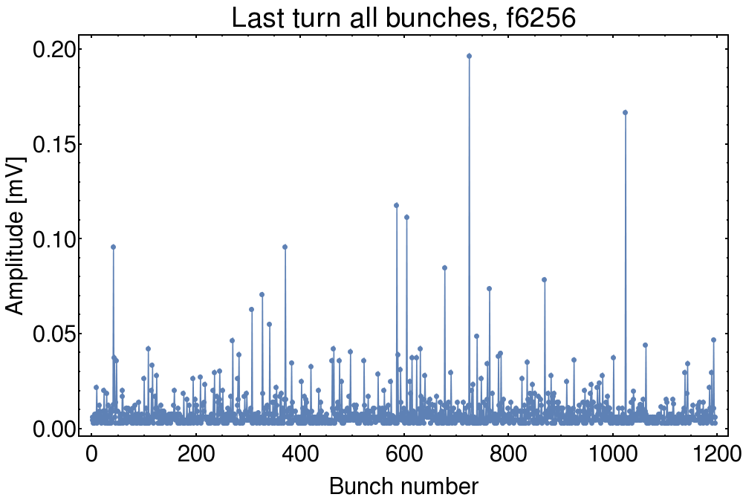
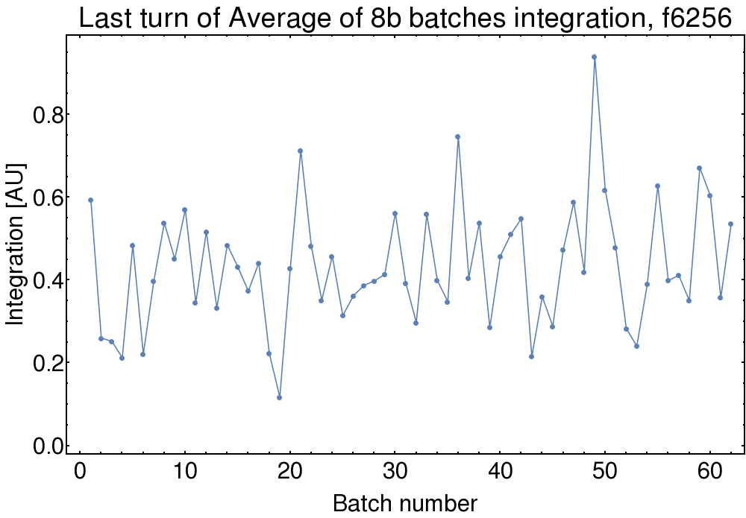
Overcoming signal sporadicity
Signal variation much smaller
  Standard deviation in one turn 140 % vs 60 %

Slide 20
16L2 Machine Development test (MD)
Unique opportunity with UFOs on demand
  High bunch intensity, many bunches and high energy seems to trigger them
Foreseen to conduct MD before end of this run
  Various combinations of blown up and displaced bunches
  -> study UFO dynamics as shown by previous MD2036 using wirescanner
  -> understand 16L2 in case it reoccurs
Challenges for dBLM part:
  Optimize signal
  Use many bunches with set properties for better statistics
    How many bunches required will be an outcome of current analysis
      From understanding the histogram
    How to combine signals from the different bunches to draw conclusions
      Increasing statistics without destroying relevant data

Slide 21
Conclusions
Signal is detected for all 16L2 events both locally and in IR7
IR7 signal is good
16L2 signal is very sporadic due to low angular acceptance
  Various methods of integrating the signal are being investigated
  => Good agreement between dBLM and ICBLM
  => Variance of signal lower when integrating e.g. over 8 bunch trains
  16L2 signal could possibly be optimized by lowering acquisition voltage range
How many bunches with a certain beam parameter required to see a correlation to beam parameters must be determined
  Required for MD preparation
MD foreseen for end of run
Inconclusive correlation to beam parameters so far
  Work in progress to limit the statistical fluctuations

Slide 22
Extras

Slide 23
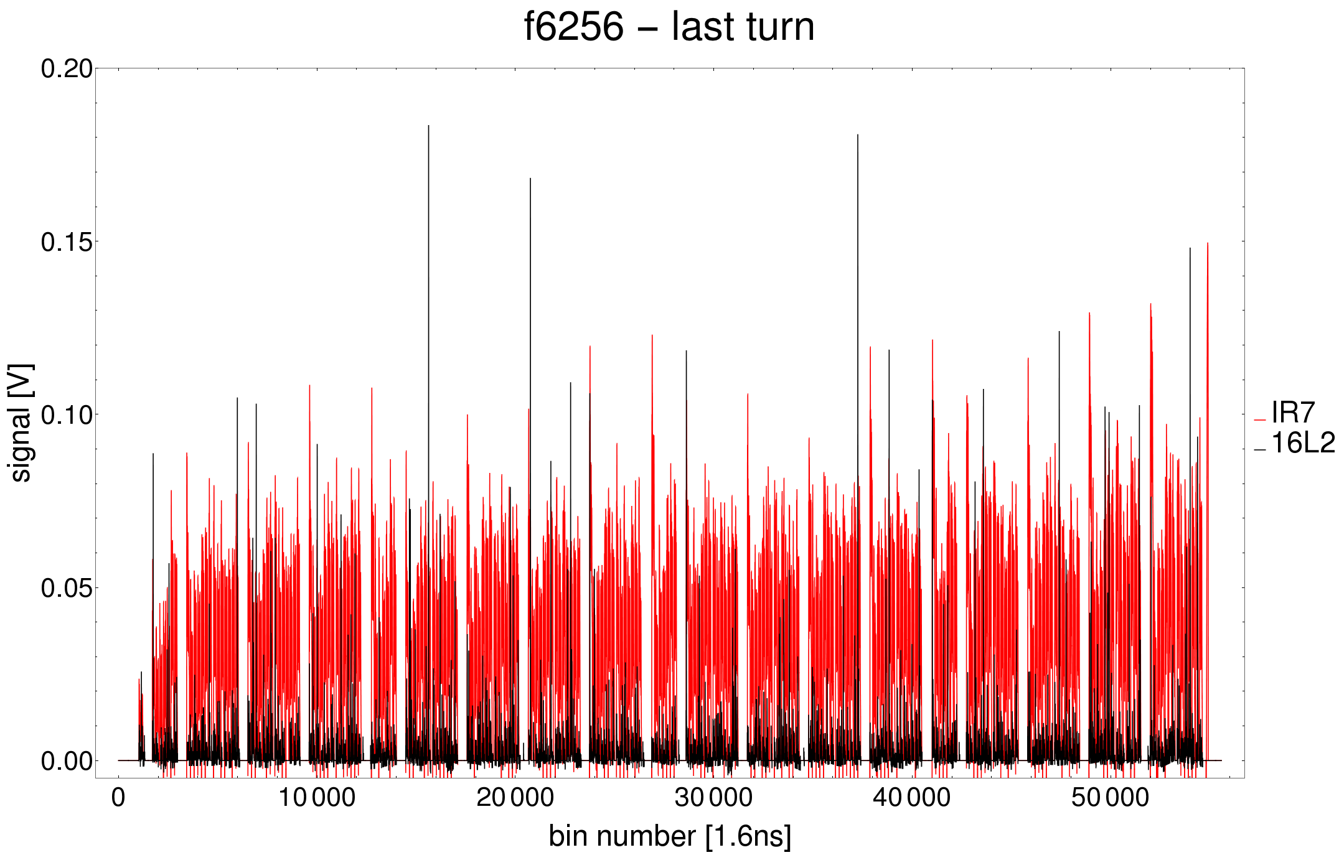
Raw signal

