Slide 2
UFO Buster analysis tool
Software layout status update
Martyna Dziadosz
TE-MPE-PE | martyna.dziadosz@cern.ch

Slide 3
Presentation plan
Unidentified Falling Objects problem
Motivations
UFO Buster Analysis Tool
  layout diagram
  functionalities
UFO Buster vs. UFO Buster Analysis Tool
Future/development ideas
Summary
Notes:
Today I will start with a short reminder about UFOs and project motivations, which will be followed by the presentation of
UFO Buster Analysis Tool layout and functionalities.
Consequitively, I will move to the tool comparison with the UFO Buster.
At the end I will sum up achieved tasks and present our goal for future together with ideas for improvement.

Slide 4
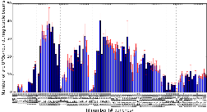
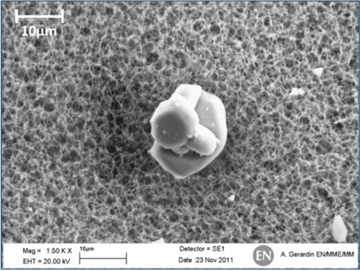
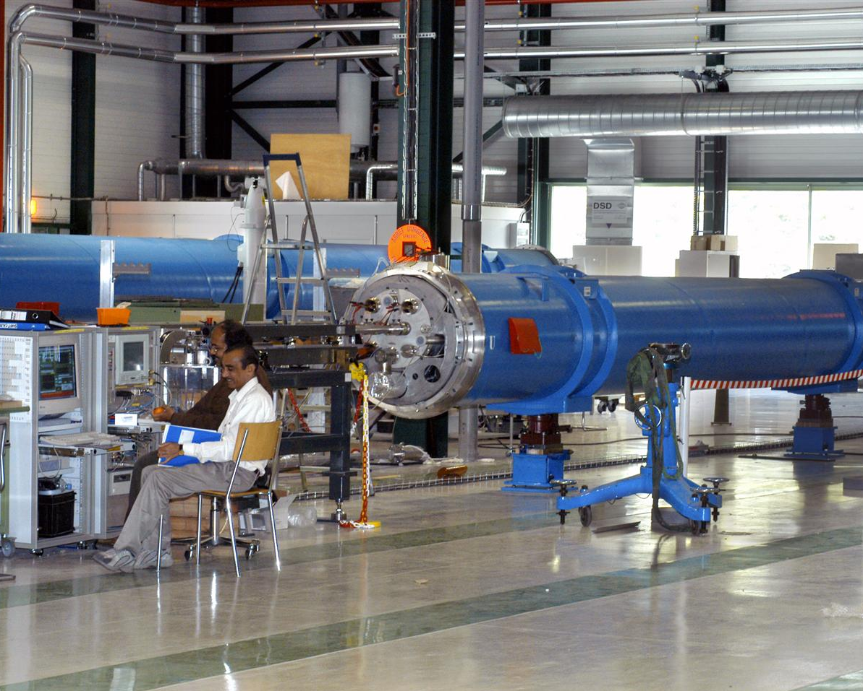


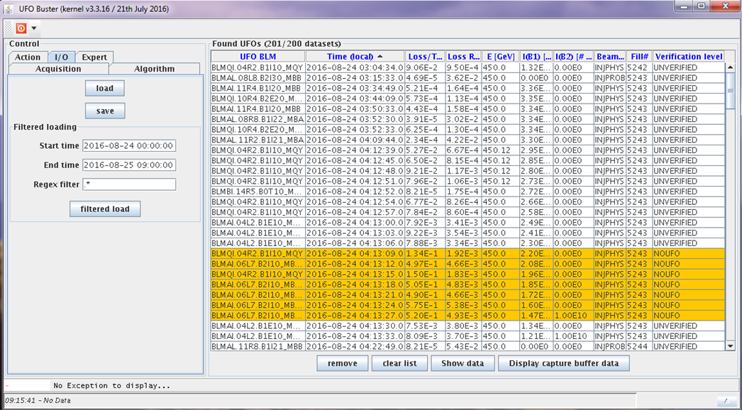

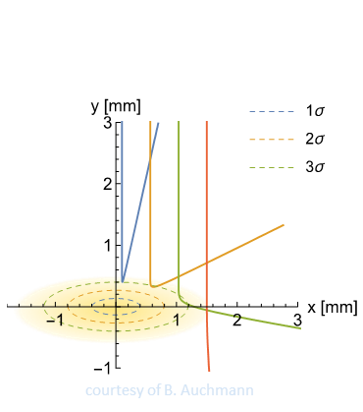
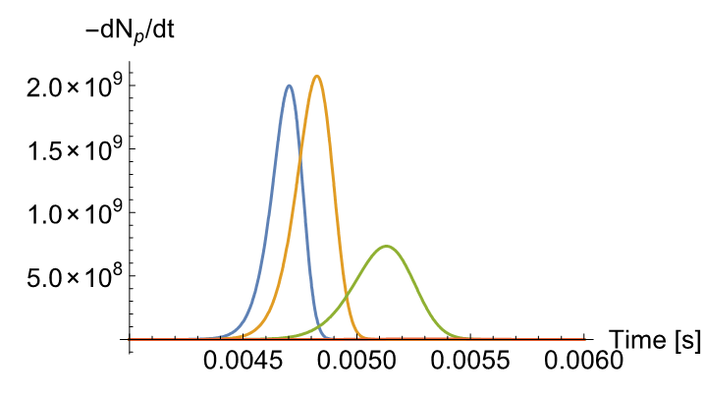


Reminder: multi-directional approach to UFO problem
Numbers of arc UFO events per hour
Statistical
Analysis
Experimental Studies
Detection &
Analysis
Simulation &
model
2/11/2017 | UFO Buster analysis tool – software status update
Notes:
Just as a short reminder we’re dealing with the so called Unidentified Falling Objects, that are most likely micrometer-size
Particles, which lead to very fast beam losses caused by its interactions with the beam.
In order to better understand this phenomena they’re studing in a multi-directional approach that covers:
Experimnetal Studies, Simulation and modeling, Statistical analysis as well as detection and analysis.

Slide 5
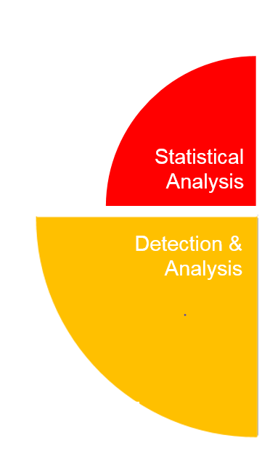

Focus of this presentation is:
“UFO Buster Analysis Tool status update”
2/11/2017 | UFO Buster analysis tool – software status update
5
Notes:
UFO Buster Analysis tool I am working on is on te intersection of Detection and Analysis
And Statistical Analysis

Slide 6
Motivation
We want an analysis tool which is:
Fast
Easy
Reliable & reproducible
Enables advanced analysis
Focus on real UFO data
All in one place + manual/readme
One module for frequent analyses
Search for correlations
Notes:
Accoring to what I have presented in on of the past presentations this project is aimed for the creation of data analysis tool.
Here comes the question: what do we await from the tool and what will be its outcome?
My task is to develop a dedicated analysis software for the UFO events which is based on the already existing UFO-Buster software providing signals losses acquired with the beam loss monitors (BLMs). Thus the tool, that will allow fast and easy advanced analysis of UFO events independently from UFO Buster software.
Furthremore it has to be characterized by highly reliablility and reproducibility .
Consist of individual moduls from each is designed for dedicated analysis of real UFO events

Slide 7
Structure of the UFO Buster analysis tool
Data Extraction
Raw Data Analysis
Collimator Losses
Advanced Analysis
plot UFO event
correlation with elastic losses (e.g. IP3/IP6/IP7/IR1/IR5)
statistic (UFO rates etc.)
correlations to beam parameters
determination of UFO location
signal shape
group similar events
access data
select only real UFO events (reduce data volume)
discard empty files
Notes:
The folowing slide presents the structure of UFO Buster Analysis tool, which is consist of 4 independent modules (Data Extraction, Raw Data Analysis, ...)
Each of which is dedicated for different task.
Briethly,
1st we need to access data, improve their queality and select once of our interest. -> the goal is to obtain a good data set to work on
(at selection real UFO events, reducing data volume and discard of empty and fishy files )
2nd make signal losses analysis (by which we understand ploting events, grouping events like ..)
3rd investigate within losses in the specific area and their correlations, such as IP3, IP6, etc
The last module is intended for statistical analysis of UFO events rate, beam param correlations, ...

Slide 8

  DATA EXTRACTION
Step 1
Access and retrieve data
UFO Buster data
without beam dump
PM data
after a beam dump
.sdds decoding with JAVA
REST API
using Python
ü
standard year analysis
ü
16L2 area analysis
ü
analysis via locations
ü
IR7 & 16L2 correlations analysis
Notes:
Let’s start with the Dataextraction module dedicated to access and retrive the data.
Depending on the analysis purpose we can deal with data without beam dump (provided by UFO Buster) either one recorded after the beam was dumped (PM data).
Hence UFO buster data are accessed with Java software, enabling
Standard year analysis
Analysis via location
While PM data access through REST API using Python enables:
16L2 area analysis
16L2 & IR7 correlations analysis

Slide 9
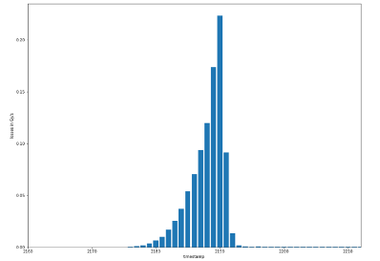
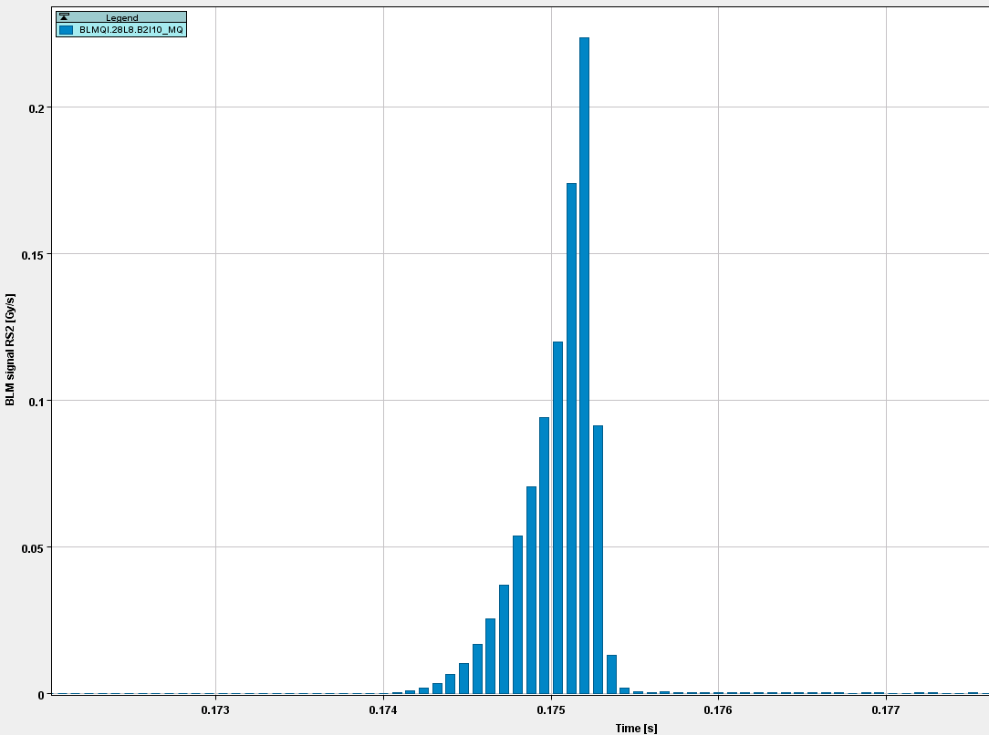
  DATA EXTRACTION
from UFO Buster
Step 1
Plot UFO event & compare with UFO Buster output
UFO Buster Analysis Tool
UFO Buster from capture buffer
Losses in Gy/s
Time (here in 80 µs bits)
ü
Plot time-resolved UFO event
Notes:
As a result of the 1st step we obtained signal losses data which corectness was validated with the output of the UFO Buster.
Presented on the right hand site chart, while the left plot presents retreived using develped UFO Buster analysis tool data.
As you can see from attached plots both charts presents the same data, so retrived data are correct
Corectness of retrieved data was confirmed

Slide 10
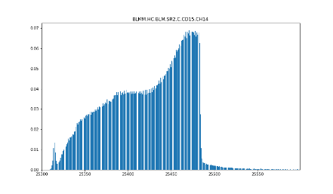
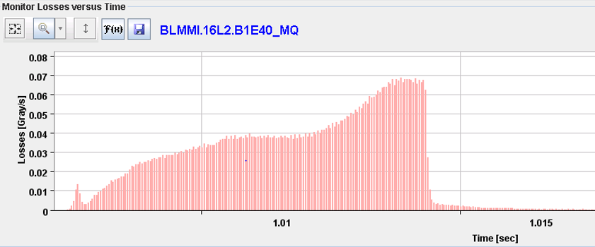
  DATA EXTRACTION
from PM
REST API
Step 1
plot UFO event & compare with PM Playback plots
UFO Buster Analysis Tool
PM PLAYBACK
Losses in Gy/s
Time (here in 40 µs bits)
6/09/2017 20:19:55
ü
Plot time-resolved UFO event from PM data
Notes:
On the following slide the same comparison, but with the Post Mortem Playback plots
for data from obtained from PM REST API.
Same as for UFO Buster data UFO event time-resolved have been made and validate

Slide 11
  DATA EXTRACTION
Step 1
ü
extract data from .sdds file (F1)
extract data from CaptureBuffer file (F2)
store data for the subset (F3) of BLMs (F4)
→ reduction of data volume
access dumped data via PM REST API
from UFO Buster
ü
ü
ü
from PM
REST API
ü
Plot time-resolved UFO event
Notes:
Quickly Summing up achievements of the 1st step
Data from .sdds file and CaptureBuffer file have been extract
which volume was reduced and informations of our interest have been stored consecutivelly in F3 and F4
Dumped datahave been accessed via PM rest API
The result were plot as a time-resolved UFO events

Slide 12
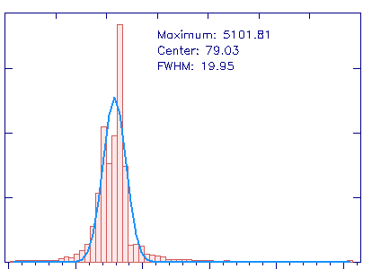
  RAW DATA ANALYSIS
from UFO Buster
Step 2
Analyse and group UFO events
UFO Buster Analysis Tool
Losses in Gy/s
UFO Buster from capture buffer
ONGOING
Time (here in 80 µs bits)
ü
✗
Gaussian fitting
signal shape analysis
Group events by FWHD, max, symmetry
Notes:
Data extraction was followed by raw data analysis.
For UFO buster data obtained data were analyzed in terms of the losses signal changes, ramp & tail duration,
max value of losses signal.
The main purpose of this step is the capability of analyzing losses signal shapes by fitting Gaussian function. This have been already done.
However here it’s worth mention that most of the UFO’s events doesn’t have Gaussian shape, hence we’re investigating with different functions
For the better understanding of the singnal losses evolution to group them into similar events. This is one of the currently ongoing steps

Slide 13
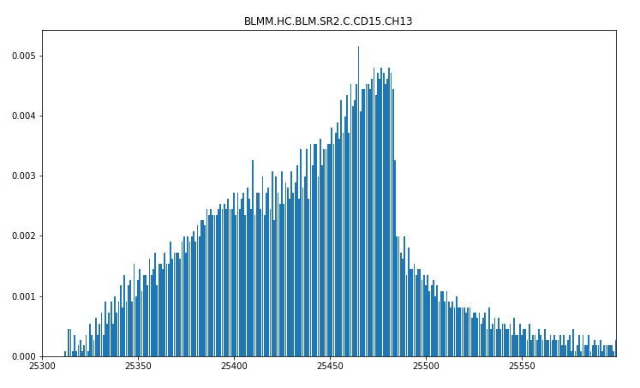
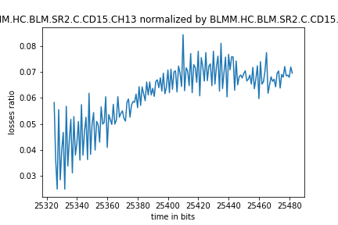
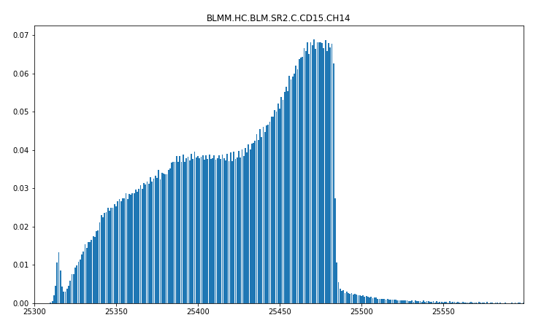
  RAW DATA ANALYSIS
from PM
REST API
Step 2
16L2 BLMs normalization to the 16L2 BLM with the highest signal
16L2 BLM
6/09/2017 20:19:55
Losses in Gy/s
16L2 BLM with highest losses
Losses in Gy/s
ü
Plot UFO losses ratio/normalization
Time (here in 40 µs bits)
Notes:
Moving to the dumped data, the main focus was put at the analysis of the 16L2 area.
Analysis were intended to better understanding the cause of frequently requstered beam dumps in this sector.
Hence the signal normalization by the BLM giving the highest losses signal was done.

Slide 14
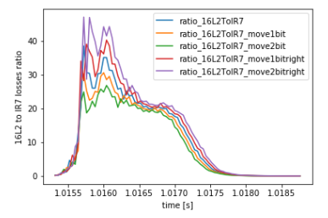
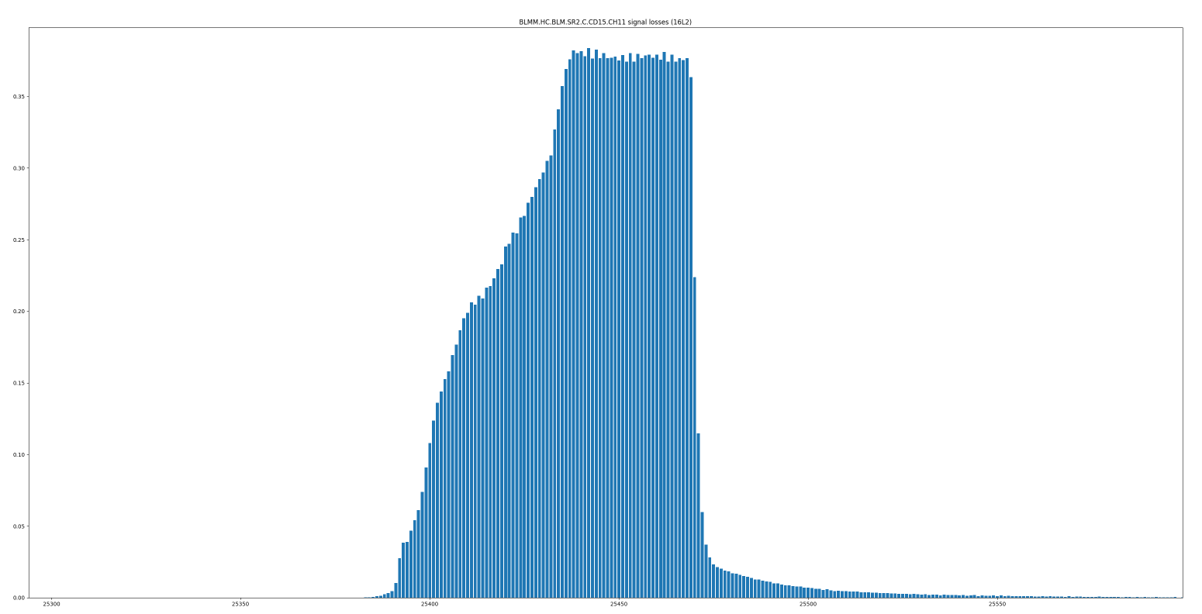
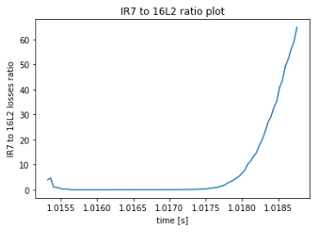
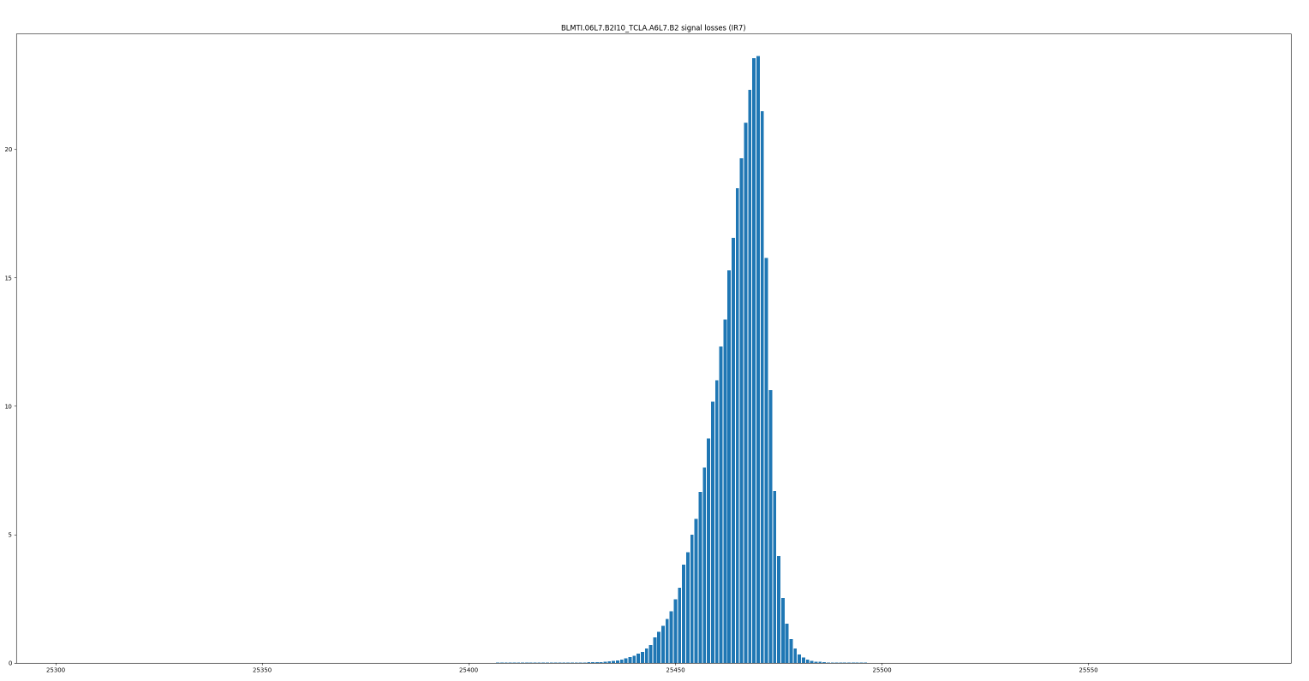
  RAW DATA ANALYSIS
from PM
REST API
Step 2
16L2 and IR7 area losses correlations
30/09/2017 4:55:97
16L2 BLM with highest losses
Losses in Gy/s
Time (here in 40 µs bits)
IR7 BLM with highest losses
ü
Plot 16L2 to IR7 losses ratio for BLMs with highest signal
Losses in Gy/s
ü
Plot IR7 to 16L2 losses ratio for BLMs with highest signal
Time (here in 40 µs bits)
Notes:
Apart from 16L2 the interest were put into the 16L2 and IR7 correlations.
Thus the algorithm is lookoing for the BLM with the fighest losses in both 16L2 and IR7 region, to then
Calculate the ratio of 16L2/IR7 losses and reverse meaning IR7/16L2 (presented on the right plots)

Slide 15
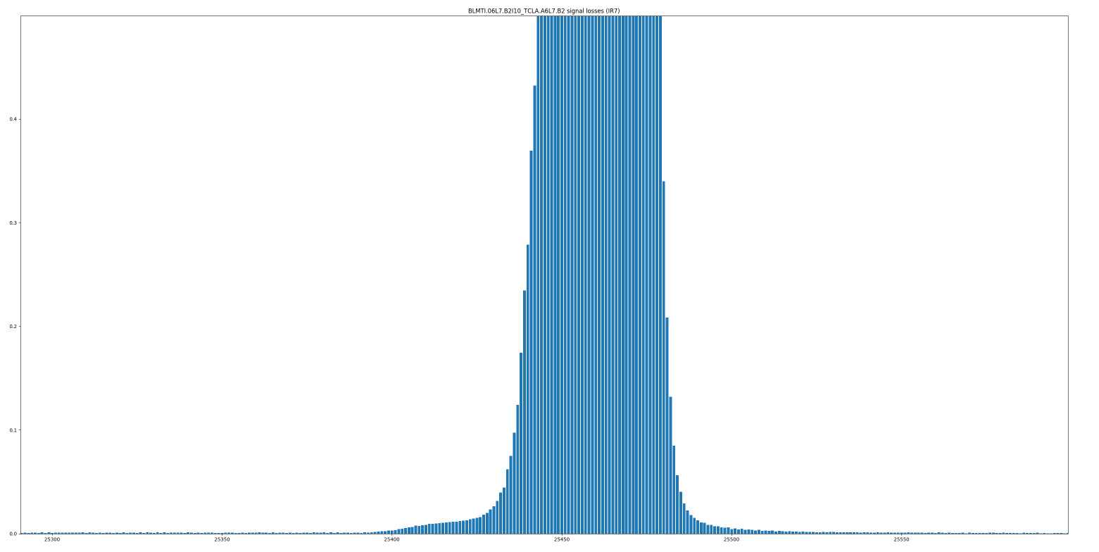
  RAW DATA ANALYSIS
from PM
REST API
Step 2
16L2 and IR7 area losses correlations
30/09/2017 4:55:97
16L2 BLM with highest losses
Losses in Gy/s
Time (here in 40 µs bits)
IR7 BLM with highest losses
ü
Plot 16L2 to IR7 losses ratio for BLMs with highest signal
Losses in Gy/s
ü
Plot IR7 to 16L2 losses ratio for BLMs with highest signal
Time (here in 40 µs bits)
Notes:
Here the same plots just with the one diff – the y axis, that present signal losses has been change to the same range
In order to show you that the order of magnitute of losses registered in IR7 is higher than one for 16L2
(that would also explain the shape of the ratio presented on the right hand side)
Here you might ask why do we have multiple plots at the 16L2 to IR7 plot -> the reason is that we do have

Slide 16
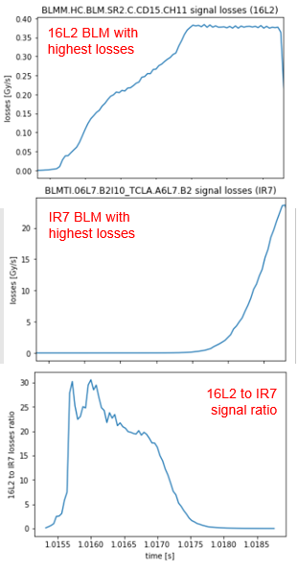
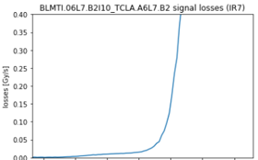
IR7 BLM with highest losses
IR7 to 16L2
signal ratio
Notes:
The following slide presents the short sum up of collected 16L2 and IR7 data and the
Ratio plots presented in the same time scale to show the evolution signal and its ratio

Slide 17
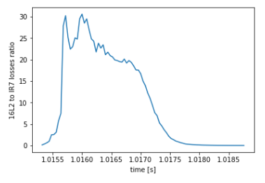
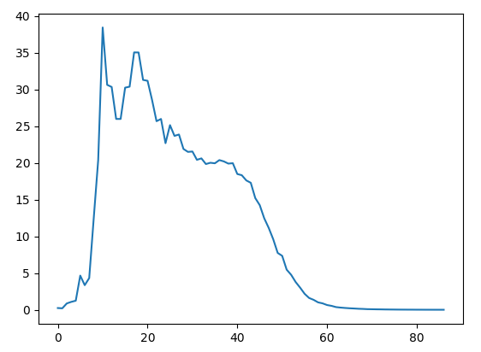
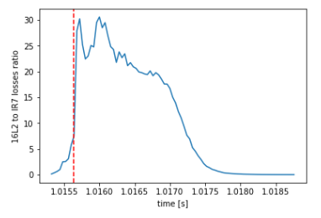
  RAW DATA ANALYSIS
from PM
REST API
Step 2
Investigating the beam instability
ONGOING
Losses ratio
Time (here in 40 µs bits)
Time (here in 40 µs bits)
16L2 to IR7 losses ratio
✗
begining of the beam instability
FUTURE : correlate statistic with beam parameters:
Ongoing: investigation within the beam instability
Evaluation of the events list I got from Rudiger
-> why, what do we wanna to achieve from it
Notes:
Right now the work is ongoing with the instability. So basically what we want is to automate the process
Of looking for the point in time where the beam instability starts. We truthly believe that’s the point where
Presented on plot 16L2 to IR7 ratio drastically rise.
So far it has been done for the separate plots.. However the aim is to make it automate, which apparently is not so staightforward as
Different events ratio plots varies between each other a lot.

Slide 18
  RAW DATA ANALYSIS
Step 2
ü
plot time-resolved UFO events from UFO Buster and PM REST API
UFO signal shape analysis
normalization plots for 16L2 area
plot 16L2 to IR7 losses ratio
group UFO events
find the beginning of the beam instabilities
ü
ü
ü
✗
ONGOING
✗
2/11/2017 | UFO Buster analysis tool – software status update
Notes:
To quickly sum up the achievements of 2nd step...
-
-
-
Have been made, but we’re still working on..
-
-

Slide 19
  COLLIMATORS LOSSES
Step 3
ü
identify highest loss signal in IR7
(to be done in IR3, IR6)
investigate within the coinciding elastic losses in collimation regions
plots from all UFO event presenting a UFO like signature
✗
✗
✗
2/11/2017 | UFO Buster analysis tool – software status update
Notes:
Within the investigatin with the collimators losses,
The highest signal losses in IR7 area have been found (still have to be done for other regions,
But code can be easily adapt to other regions)
While we are still missing:
-
-

Slide 20
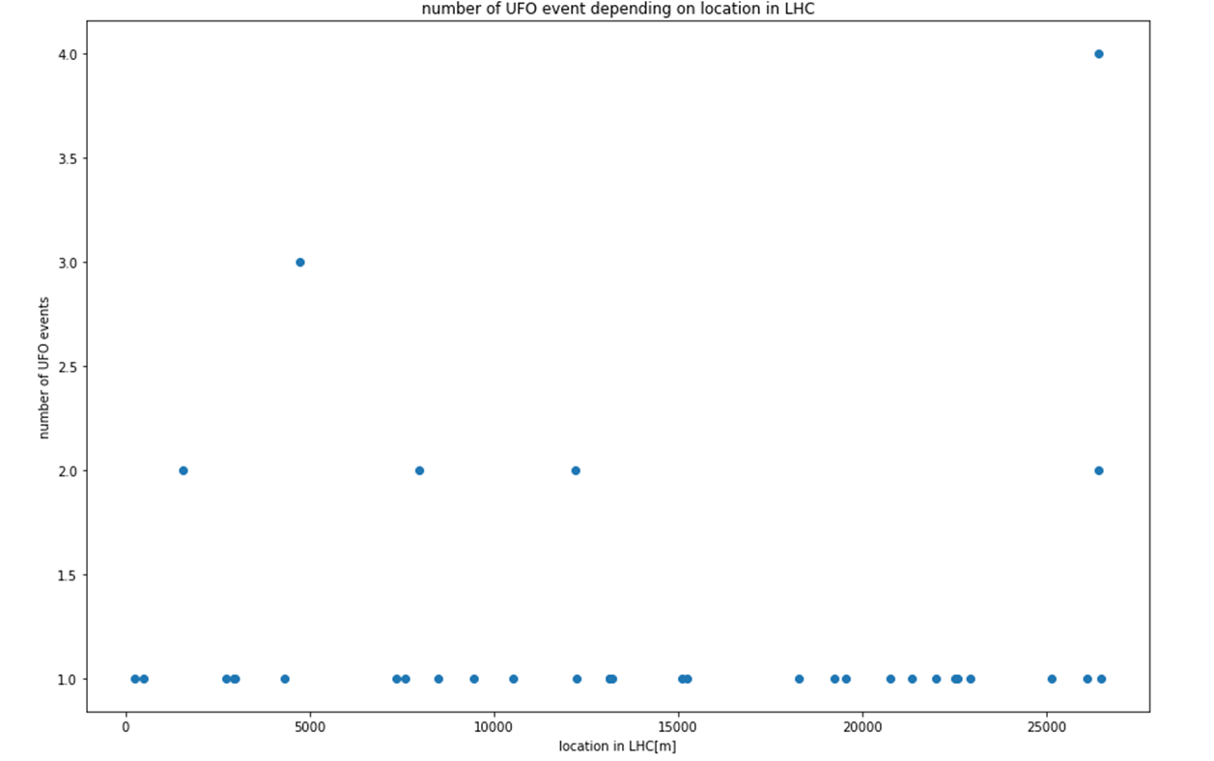
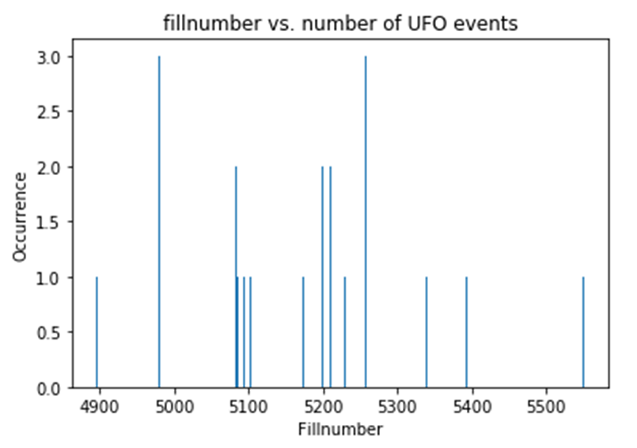
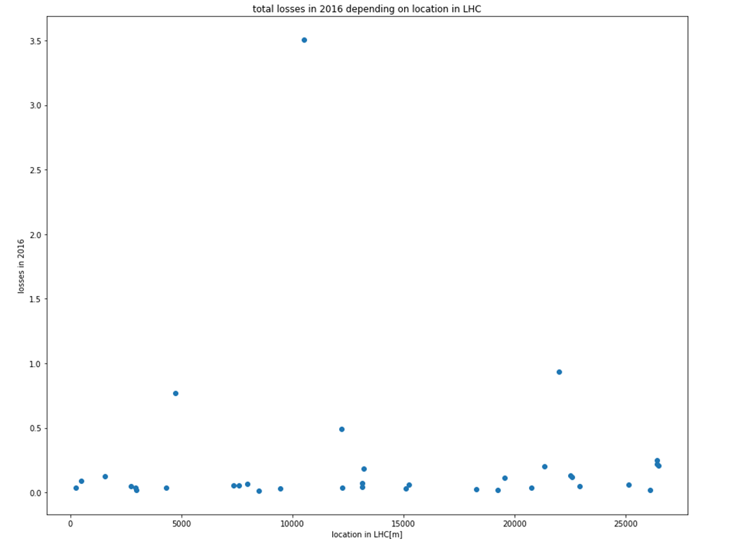
  STATISTICAL ANALYSIS
on reduced sample size
Step 4
UFO rate vs. time and location
number of UFOs
number of UFOs
Location in LHC [m]
ü
Integrated losses [Gy/s]
Plot of loss distribution along LHC
Notes:
Lat step are statistical analysis – partial made on a reduced sets of data.
That will be changed by the applicatin of slightly different analysis conditions.
This slide presents the UFO rate vs time and location. Those information might tell us a bit more
About the area that are more pronounced to the UFO event occurence. So we can then
Determine where the hot spots area are.

Slide 21
  STATISTICAL ANALYSIS
Step 4
ü
plot of loss distribution around LHC
correlations with beam parameters
(bunches, B1/B2 intensity, magnet current)
Hot spot areas analysis
✗
✗
Notes:
Loss distribution plots around LHC have done
Next steps are:
- Investigation with the beam parameters, such as n

Slide 22

UFO Buster Analysis Tool
UFO Buster
vs.
access to CaptureBuffer data display
- manual UFO event verification (by eye)
possibility to look into different BLMs, sectors, running sums (RS)
nice GUI
analysis part of the software works relatively slow
access to CaptureBuffer & PM data
- automated verification of real UFO events
- plot loss data
possibility to look into different BLMs, sectors, RS
advantages for future users
- easy, user friendly
- independent modules for frequent analysis
- .json file to set interesting parameters
- fast analysis
- python scripts, that enables dedicated analysis
depending on needs
- documented in a GitLab repository
dataset reduction
searching for correlation plots
enable fast analysis
Detection threshold – rather wide which yields to the record an occasional false detect of non-UFO event
Event detection - software, more functionalities
Notes:
Detection threshold – rather wide which yields to the record an occasional false detect of non-UFO event
-> respository is very nice/usefull as all ppl working with UFOs can easily access it in order to make analysis
And it’s easily extendable

Slide 23

Summary of Achievements
ü
Reduced data volume
→ faster analysis
ü
BLM losses vs time
→ UFO event visualization
ü
UFO rate plots
→ vs time, location or BLM name
ü
Plot of loss distribution along LHC
ü
Gaussian fitting & signal shape analysis
2/11/2017 | UFO Buster analysis tool – software status update
Notes:
Summarizing, until know it has been reached :
-> that allow
Versus/in reference

Slide 24
Conclusion – future needs
Functionality validation with big sets of data needed
UFO events grouping
Advanced, dedicated statistical analysis
UFO shape analysis
Extension to look at long straight section
Analysis for collimators area
Eventual analysis of Unidentified Lying Objects
Creation of user-friendly GUI
… to be continued!
Notes:
To conclude now we have principally working tool created within usage of Python software.
With working data extraction and visualzation. Furthermore, basic functionality was validated on the reduced sets of data.
It worth to mentioned that’s so far we are workig with the skretch/test version to get the feeling of the data in order to
Apply the precise conditions for the final software layout.
What is more, some of the modules still recquires to be applied and will be shown on one of the consective presentations

Slide 25
Thank you for your attention. ☺
2/11/2017 | UFO Buster analysis tool – software status update

Slide 26
www.cern.ch

Slide 27
Questions/problems
-> begining of the beam instability
-> signal losses distribution shape
2/11/2017 | UFO Buster analysis tool – software status update

Slide 28
Storage in the UFO folder in TE-MPE-PE directory
UFOBusterAnalysisTool
AnalysisScripts
2016
2015
[…] ->consecutive years
Python and java scripts from GitLab
F4 - folder contains all the files
STEP1 - DataExtraction
RawData_thr_5E-3
[…]
Files fulfilling cond1
Files fulfilling cond2
STEP2 - RawDataAnalysis
Analysis_thr_5E-3
Files fulfilling cond3
Files fulfilling cond4
STEP3 - Collimator Losses
RawData_thr_1E-4
Plots and analysis results
STEP4 -AdvancedAnalysis
Analysis_thr_1E-4

Slide 29
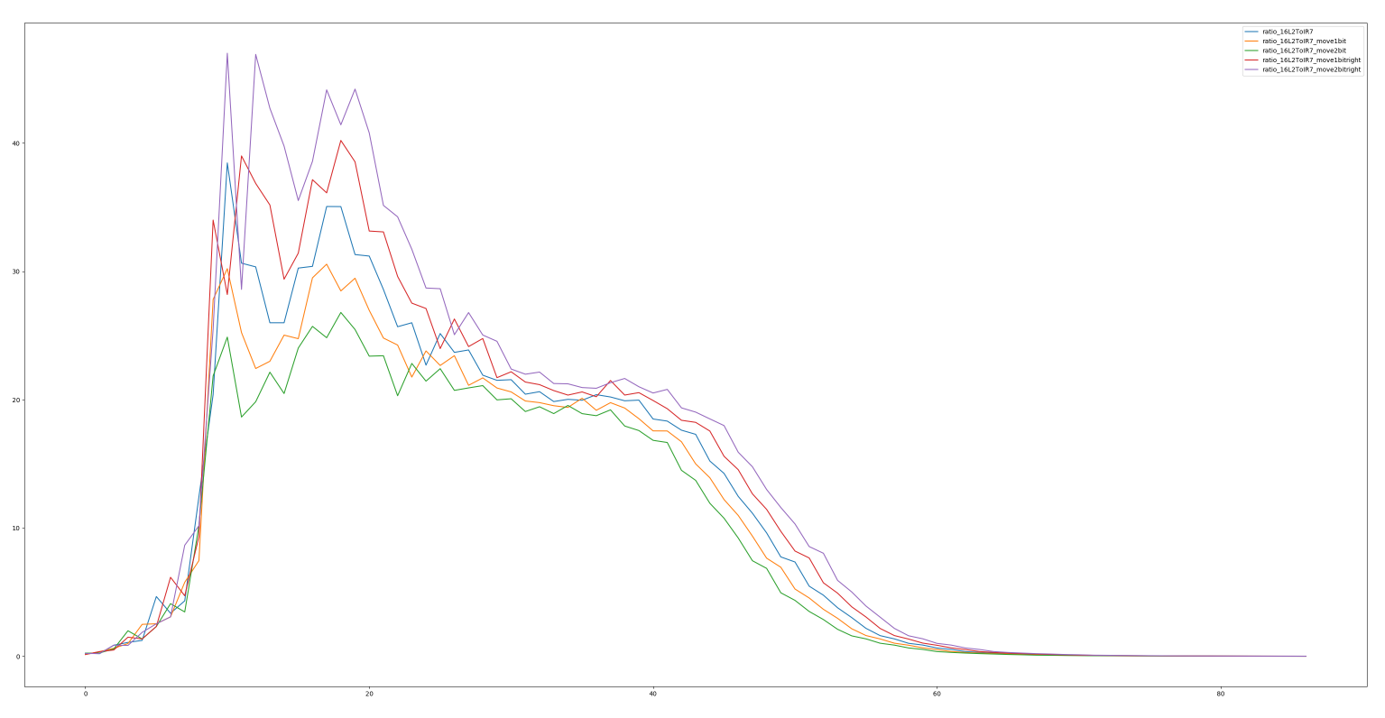
  RAW DATA ANALYSIS
from PM
REST API
Step 2
16L2 and IR7 area losses correlations
30/09/2017 4:55:97
16L2 BLM with highest losses
Might be better to plot IR7/16L2
Losses in Gy/s
Losses ratio
Time (here in 40 µs bits)
Time (here in 40 µs bits)
IR7 BLM with highest losses
ü
Plot 16L2 to IR7 losses ratio for BLMs with highest signal
Losses in Gy/s
Time (here in 40 µs bits)
Notes:
The next step are statistical analysis, which are partialy made. So far on a very reduced sample size, which will be changed by the applicatin of slightly different analysis conditions.
On this slide the UFO rate vs time and location has been presented.
The location of the UFO events might tell us a little bit more about area, which are more pronounced to the UFO occurnece
It may give us a bit more information about the regions where UFO evety more often

Slide 30
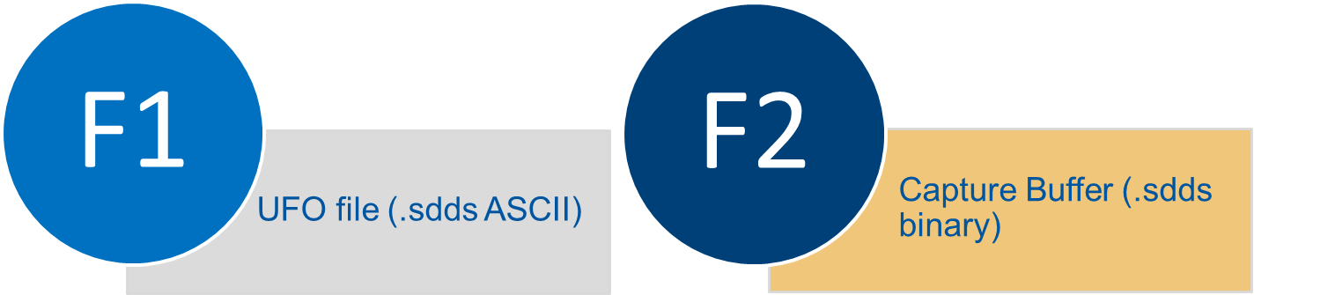

  DATA EXTRACTION – (UFO Buster)
Step 1
Merge only relevant info into one file F3 & F4
Basic info (timestamp, fill number, machine parameters)
UFO BLM + neighbours (losses + DCUM)
Time-resolved data (capture buffer)
F4
excel file (.csv)
Notes:
Presented at the previous slides consecutive steps and applied conditions for F1 and F2 yield in a result to creating file F3, which contains necessary for the further steps
-> basic informations, such as timestamp, fill number and machine parameters
-> registered by BLMs losses for UFO BLM + it’s neighbours and selected BLMs localized in the collimators area

Slide 31
INPUT
F1
F2
Condition 1
STABLE beam mode
verified UFO
F2 for which matching F1 exist
Condition 2
F2
Condition 3
losses > threshold (5 * 10⁻³)
Condition 4
2 consecutive points fullfill cond3

Slide 32
  DATA EXTRACTION
Step 1
F4
excel file (.csv)
ü
Reduces data volume for quick analysis
Notes:
As F3 is created only for event fulfilling certain conditions,
Data volume has been reduced, what allows for quick analysis

Slide 33
F1
find the corresponding file type 2
F2
2 WAYS
.sdds ASCII file
.sdds binary file
EXTRACT
DECONVERSION !!!
JAVA
1) looking for F2 with the same timestamp and fillnumber
2) go to an appropriate path using fillnumber. Then look for the corresponding F2 using naming convention
Fillnumber
Timestamp
UFO_BLM_Expert_name
Dcum []
VerificationLevel
beam_mode
Expert Name
Java objects:
String[] header (1D matrix with BLMs names)
Int[][] value (2D matrix with all BLMs signal losses)
OUTPUT:
List of files type F1 for which the exist the corresponding file type F2

Slide 34
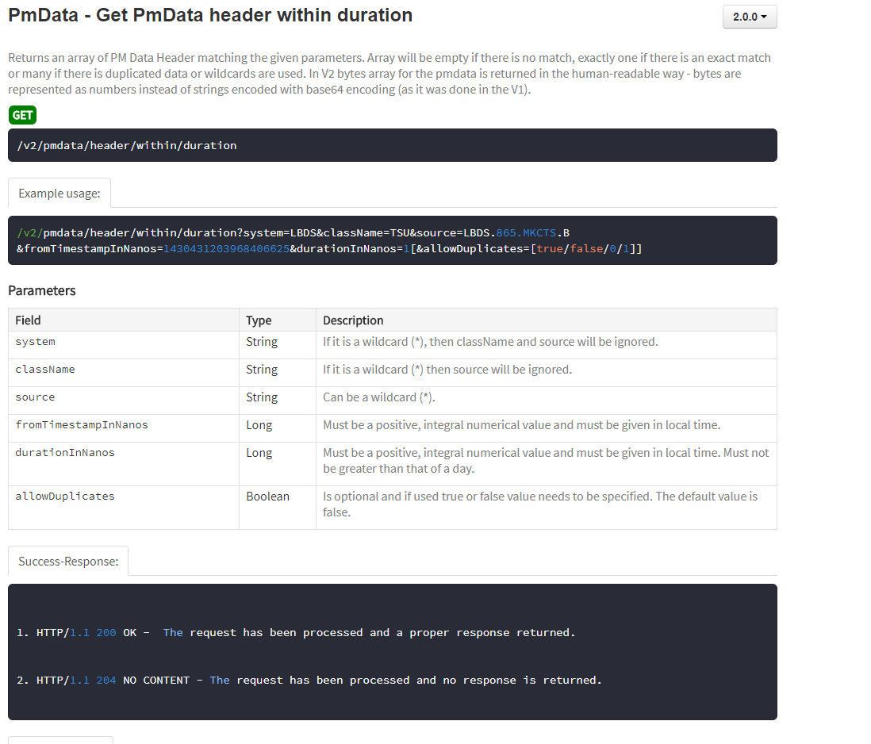
  DATA EXTRACTION – (PM REST API)
Step 1
Notes:
Presented at the previous slides consecutive steps and applied conditions for F1 and F2 yield in a result to creating file F3, which contains necessary for the further steps
-> basic informations, such as timestamp, fill number and machine parameters
-> registered by BLMs losses for UFO BLM + it’s neighbours and selected BLMs localized in the collimators area

Slide 35
Integrated losses of all UFOs per BLM
ROMAN POT AREA
Notes:
Hot spots, where more than one UFO event occured during 2016 LHC-working time
Those are mainly the roman pots area, where we can expect such an behaviour

Slide 36
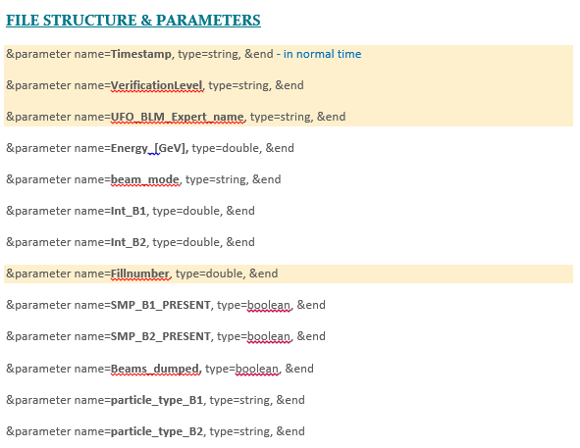
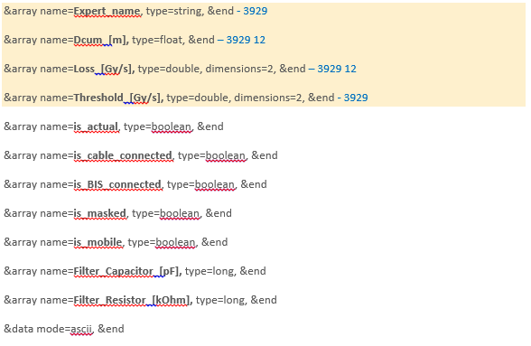
Appendix – F1 structure

Slide 37
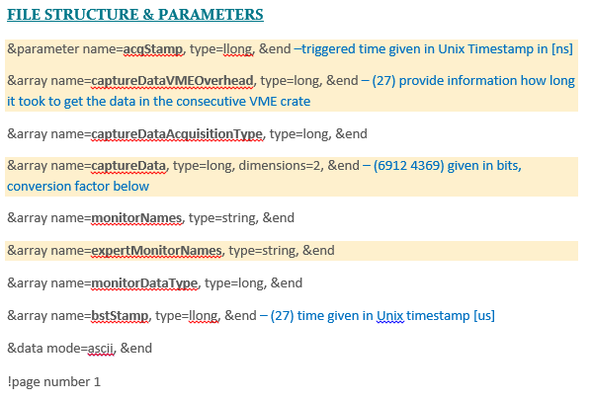
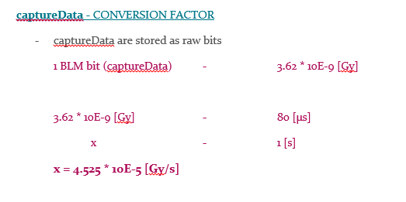
Appendix – F2 structure

Slide 38
TIMESCALE plot
That’s an idea to work on
Merging it together with the coming slide
Step 1
18 days
Jul 20 - Aug 14
Step 2
18 days
Aug 15 - Sep 7
Step 2
24 days
Aug 15 - Sep 17
Step 3
16 days
Sep 8 - Sep 30
Step 3
25 days
Oct 4 - Nov 7
Step 4
21 days
Nov 11 - Dec 11
Milestone 2
Milestone 5
Milestone 1
Jun 7
Milestone 3
Milestone 4
Oct 30
Milestone 6
May 10
Aug 12
Sep 25
Nov 15
Nov 2016
May
Jun
Jul
Aug
Sep
Oct
Nov
Dec
2017
Today
Dec 2017
END

Slide 39
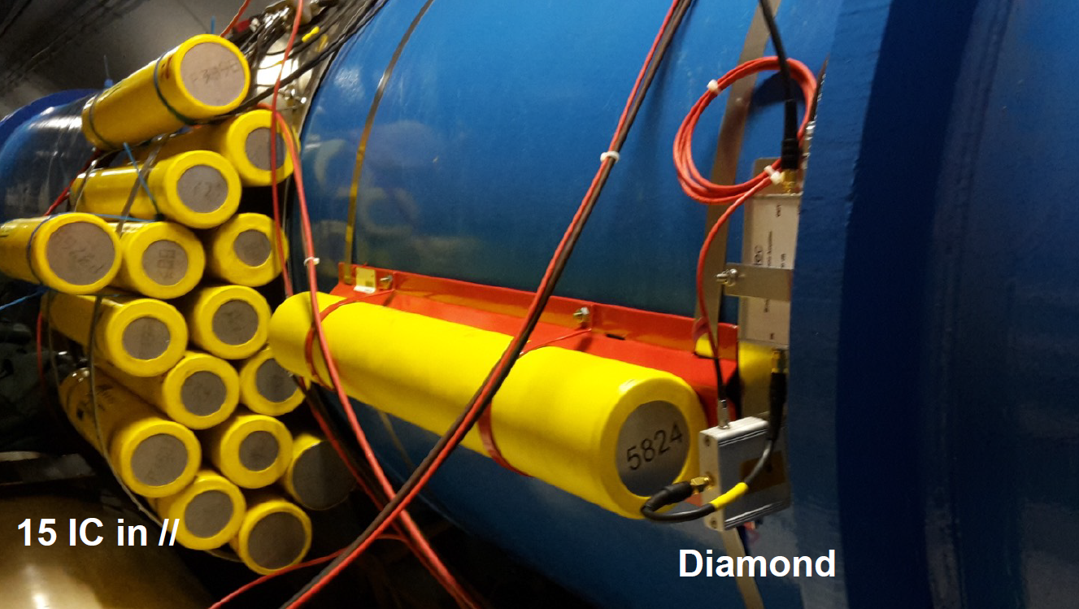
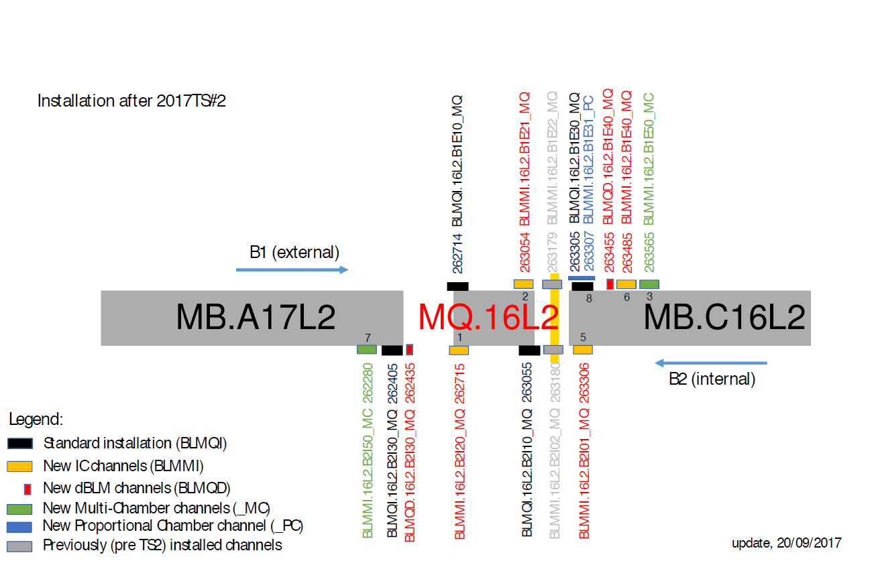
2/11/2017 | UFO Buster analysis tool – software status update

