Slide 1

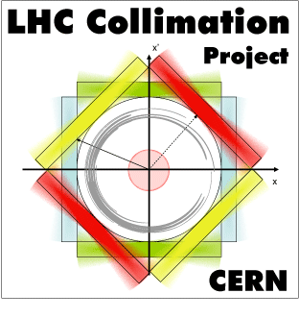
EuCARD2-WP11 Annual Meeting
Collimator Materials for Fast High Density Energy Deposition
EuCARD-2 WP11 Annual Meeting, CERN, 31 Jan – 1 Feb
Adriana Rossi on behalf of

Slide 2
WP11 Milestones and deliveries
… the final length!
Milestones :
  MS69 Irradiation of first samples M12
  MS70 Present results on material damage from irradiation M24
  MS71 Show new material development status M24
  MS72 Present results on material damage from simulation and
  compare to experiments M45
Deliverables :
  11.1 Result on simulations of new materials and composites M36
  11.2 Report on comparative assessment of beam simulation codes M40
  11.3 Irradiation test results M46
  11.4 Results on characterisation of new materials and composites M46

Slide 3
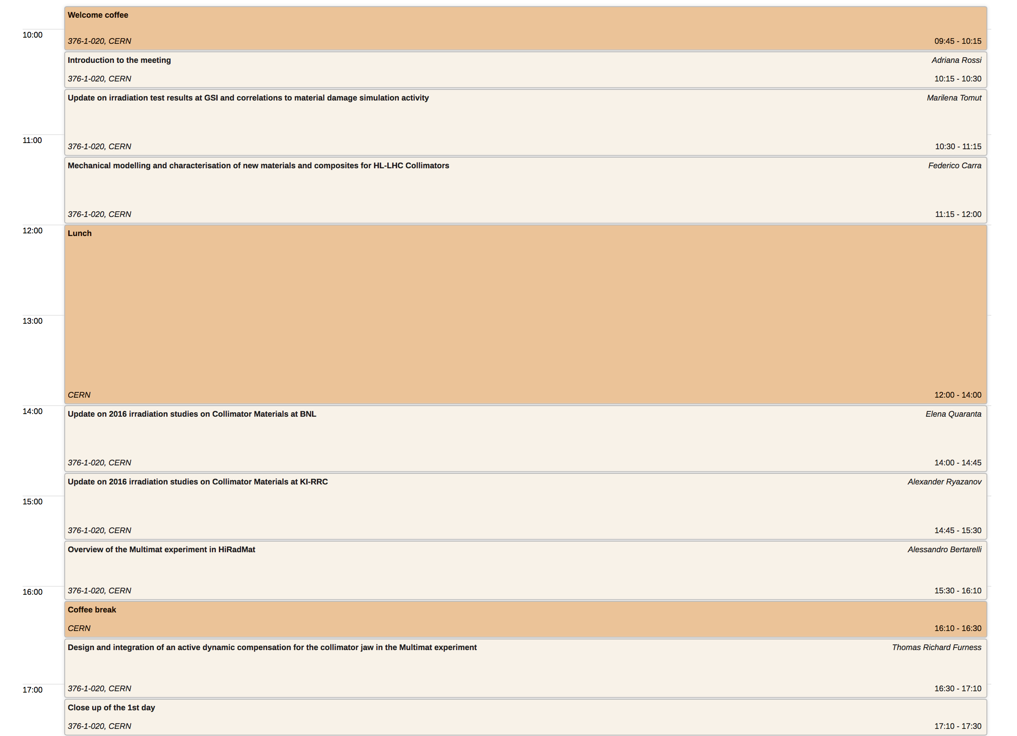

Slide 4
