Slide 1
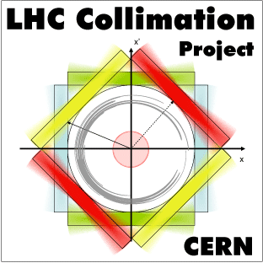
Update on irradiation test results at GSI and correlations to material damage simulation activity
M. Tomut

Slide 2
Team
Micromechanical and resistivity measurements:
Ph. Bolz, TU Darmstadt/GSI
C. Porth, TU Darmstadt / GSI
Microstructural & morphological characterization:
K Bunk, Frankfurt University/GSI
                F. Kopietz, TU Darmstadt/GSI
                W. Bolse & group, U. Stuttgart
DPA calculations-FLUKA: E. Skordis, CERN
MD simulations: K. Kupka, TU Darmstadt / GSI
A. A. Leino, W. Ren, E. H.Ahlgren,K. Nordlund, F. Djurabekova University of Helsinki

Slide 3
Summary
Micromechanical characterization of pristine MoGR samples
  contribution to D11.4 “Results on characterisation of new materials and composites” M46
Update on characterization of MoGr samples irradiated at GSI
  contribution to D11.3 “Irradiation test results” M46
FLUKA DPA calculations for irradiations at GSI and integration with experimental results
  contribution to MS72 “Present results on material damage from simulation and compare to experiments” due by M45 (delayed to after this meeting)

Slide 4
Microindentation depth controlled: 5 µm
20-30 indents
Berkovich indenter
Pristine MoGR characterization-
micromechanical properties

Slide 5
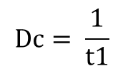
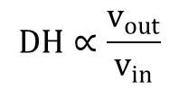
Single impact nanoindentation characterization
Indenter accelerated 2 µm towards
the surface with 15 mN
‘Bouncing` on the surface measured
20 repeats
Damping constant (Dc):
$$Dc= \frac{1}{t1}$$
Dynamic hardness (DH):
$$DH∝\frac{v_{out}}{v_{in}}$$

Slide 6
Pristine MoGR characterization-
dynamic mechanical response

Slide 7
Characterization of MoGr samples irradiated at GSI

Slide 8
Overview of irradiation tests on MoGr
BNL (p⁺, n)
GSI (²³⁸U, ²⁰⁹Bi, ¹⁹⁷Au, ¹⁵²Sm, Ca, C ions)
BNL (p⁺, n)
mid 2013
Feb. 2014
July 2014
mid 2015
2016
3th generation
MG 1110-E
(3.7 g/cm³)
NOT fully molten
20%v Mo
40%v C-fibers
(long+short)
4th generation
MG 3110-P
(2.67 g/cm³)
Fully molten
20%v Mo
40%v C-fibers
(long+short)
5th generation
MG 5200-S
(2.65 g/cm³)
Fully molten
7.2%v Mo
46.4%v C-fibers
(long+short)
2 annealing cycles:
1150°C
1300°C
6th generation
MG 6400-U
(2.63 g/cm³)
Fully molten
4.5%v Mo
NO C-fibers
Annealing 1800˚C
MG 6530-Aa
(2.5 g/cm³)
Fully molten
4.5%v Mo
5%v C-fibers (long only)
Annealing 1900°C
MG 6541-Aa
(2.5 g/cm³)
Fully molten
4.5%v Mo
0. %v Ti
5%v C-fibers
(short only)
Annealing 1900°C
E. Quaranta, CERN
7th generation
MG 6403-Aa
(g/cm³)
Fully molten
4.5%v Mo
%v Ti
NO C-fibers
Notes:
MG 6400U was also irradiated with high-energy Sm beam, however (at date of WP11 meeting in Dec 2014) samples were still to radioactive…

Slide 9
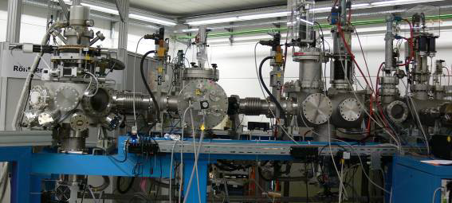
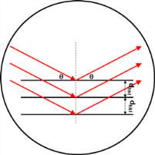
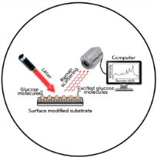
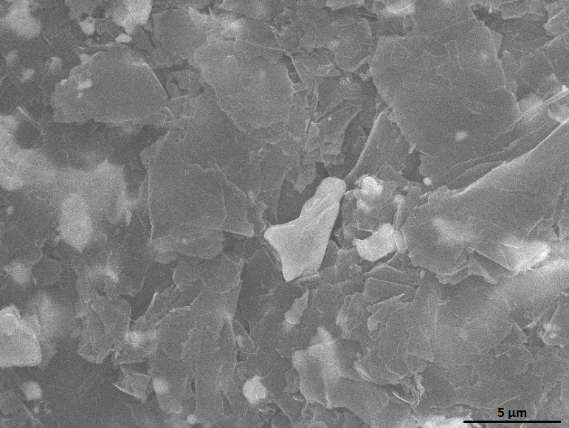
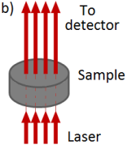
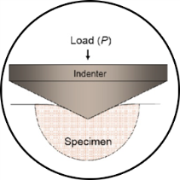
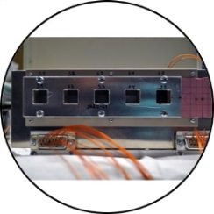
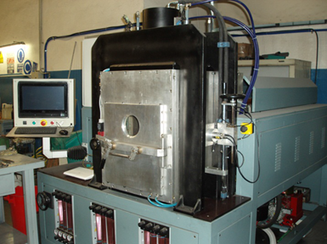
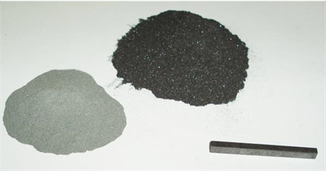
Irradiation of novel composites at GSI
Ion irradiation: C – U
Energies: 70 MeV – 1 GeV
Fluence: up to 1x10¹⁴ i/cm2
Structural characterization:
XRD, Raman spectroscopy, SEM
Functional properties degradation:
thermal ,mechanical, electrical
Material optimization

Slide 10
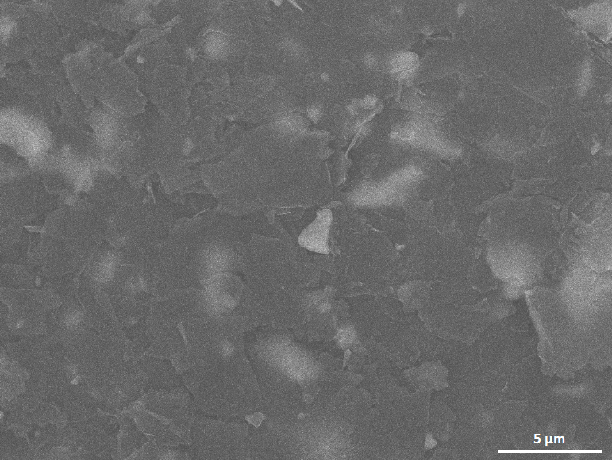
Beam induced structural changes in Mo-Gr
Structural characterization:
In-plane crystallite size reduction – SEM, Raman spectroscopy:
pristine
1e12 Au ions/cm²
Swelling → Stress → Deformation → Cracks in the matrix
In situ SEM during irradiation
pristine
3e113 Au ions/cm²

Slide 11
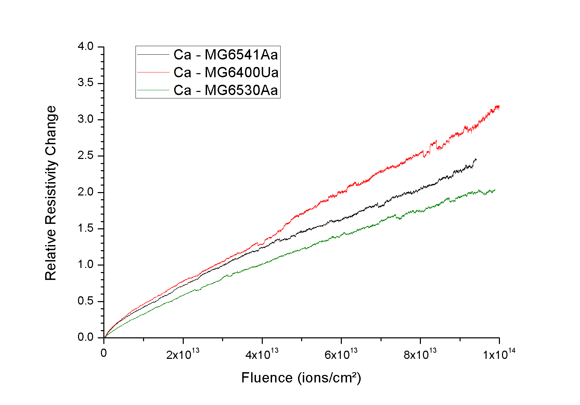
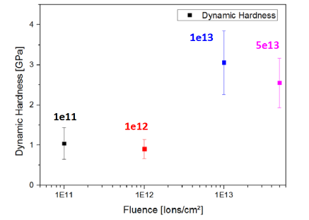
Radiation damage effect on properties degradation
Irradiation induced hardening
– dynamic harness:
Increase of electrical resistivity
- online measurements during irradiation
Hardness and Young’s modulus increased with accumulated dose.
Samples annealed at higher temperatures show less degradation
Defect accumulation results in gradual resistivity increase
Presence of carbon fibers reduce material’s resistivity degradation

Slide 12
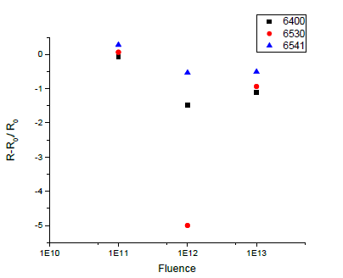
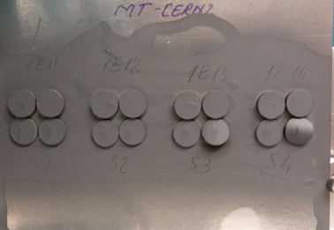
Irradiation induced deformation and mitigation
Macroscopic bending was observed around 5×10¹² Au ions/cm²
Optimization of the material to avoid swelling and deformation

Slide 13
Irradiation induced hardening- latest measurements
MoGr - less hardening than isotropic graphite and CFC

Slide 14
Irradiation induced hardening- latest measurements
MoGr - less increase of elastic modulus than isotropic graphite and CFC

Slide 15
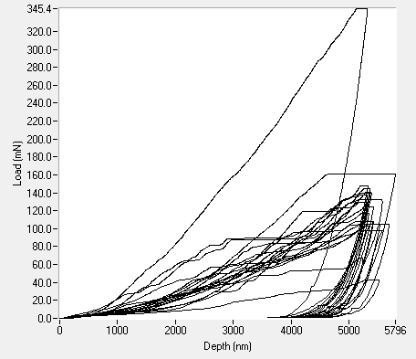
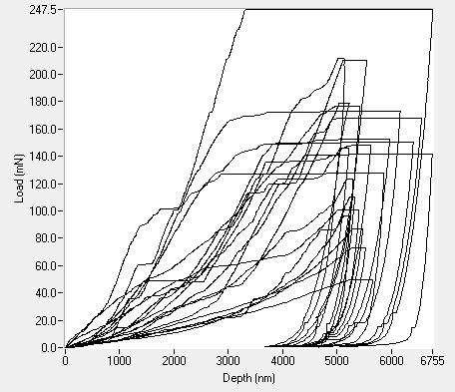
Irradiation induced hardening-
MoGr-long fibers- MG6530
Many pop-ins - Amount increasing with fluence
pristine:
1e13:

Slide 16
Dynamic hardness- impact nanoindentation
Irradiated MoGr - less increase of dynamic hardness than isotropic graphite and CFC

Slide 17
Damping constant of irradiated MoGr- impact nanoindentation
MoGr - less decrease of damping constant than isotropic graphite and CFC

Slide 18

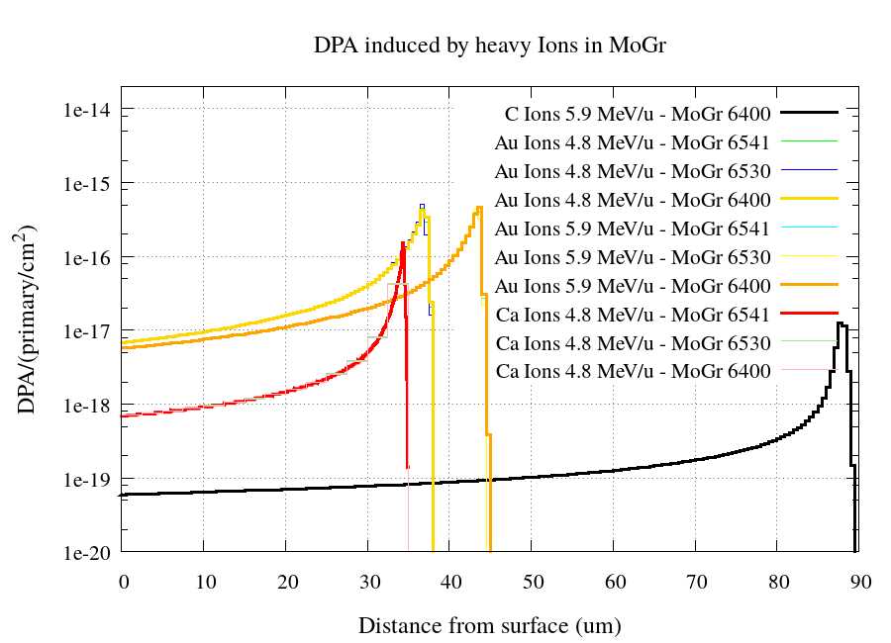
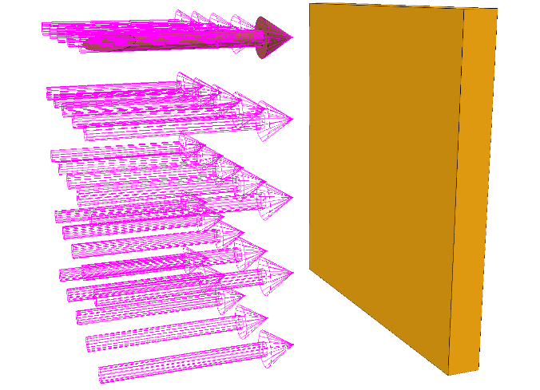
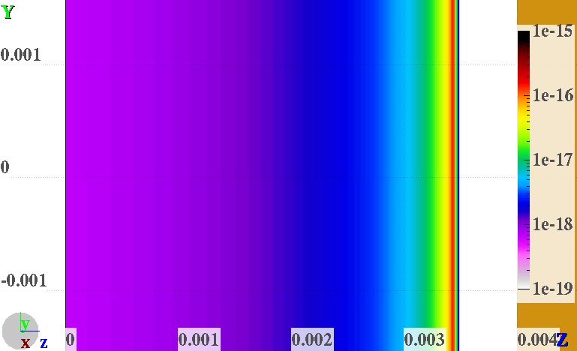
FLUKA for GSI
FLUKA: General purpose particle physics MonteCarlo code used for machine protection, design studies, R2E, activation, collimation -> simulates particle interaction with matter
3 different heavy Ions,
2 different energies and
3 different MoGr grades simulated
1cm^2 beam size impacting on 1 cm^2 target
No significant differences between grades
Beam

Slide 19
Irradiation induced hardening hardness and elastic modulus for Au 4.8 MeV/u
DPA dependence

Slide 20
Irradiation induced hardening impact response for Au 4.8 MeV/u
DPA dependence

Slide 21
Beam-induced bending of MG6400Ua transversal comparison Au 4,8 MeV/u Ca4,8 MeV/u

Slide 22
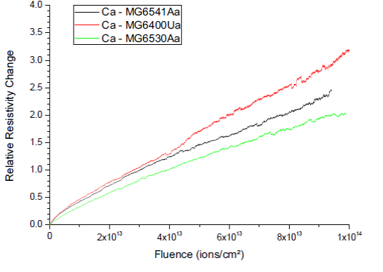
Online study of electrical resistivity degradation for isotropic graphite –light ions
Ca ions to simulate damage induced by secondary particles and recoil atoms in collimator jaw
DPA: 10-4
Degradation of electrical resistivity and thermal conductivity due to beam-induced in-plane size reduction of crystallites
relative change of average resistivity for the whole ion range ~ 35 µm)
MG6530 (long fibers, no Ti) < MG6541 (short fibers, Ti) < MG6400 (no fibers, no Ti)
Notes:
Graphite resistivity decreases with temperature up to ~600 C.
Experiments with lighter ions are also aiming at determining the dependence of property degradation on the ion stopping power. This dependence is necessary for scaling of ion induced defects for lower stopping powers at high energy and for determining the energy-loss threshold for property degradation.

Slide 23
Conclusions
Synergistic activity on optimization of MoGr composition as respect to radiation hardness: CERN, GSI, Brevetti Bizz, BNL
  Outcome:
        MoGr with better radiation hardness
        less deformation in GSI experiments
        no failure in BNL irradiation
        Ti addition leads to more stable carbide phases
        Higher temperature treatment- helps
          My personal favorite MG6541
DPA calculations combined with experimental investigations- swift lighter ions (C-Xe) can be used to acquire accelerated damage for radiation hardness characterization
Transmutations effects not addressed by experiments at GSI and simulations at CERN- to be developed in ARIES

Slide 24
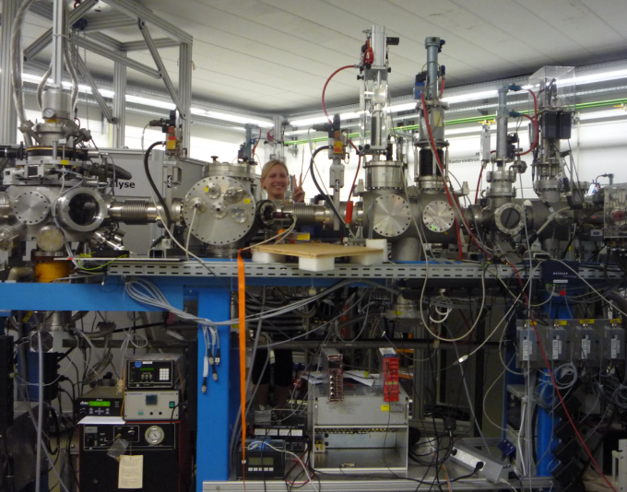
Thank you!
Questions ?

