Slide 1
University of Huddersfield
Centre for Precision Technologies
HI-LHC-UK, WP1, Task 2
STFC/CERN/UoH
Design and integration of an active dynamic compensation for the collimator jaw in the Multimat experiment
Thomas Furness / Simon Fletcher

Slide 2
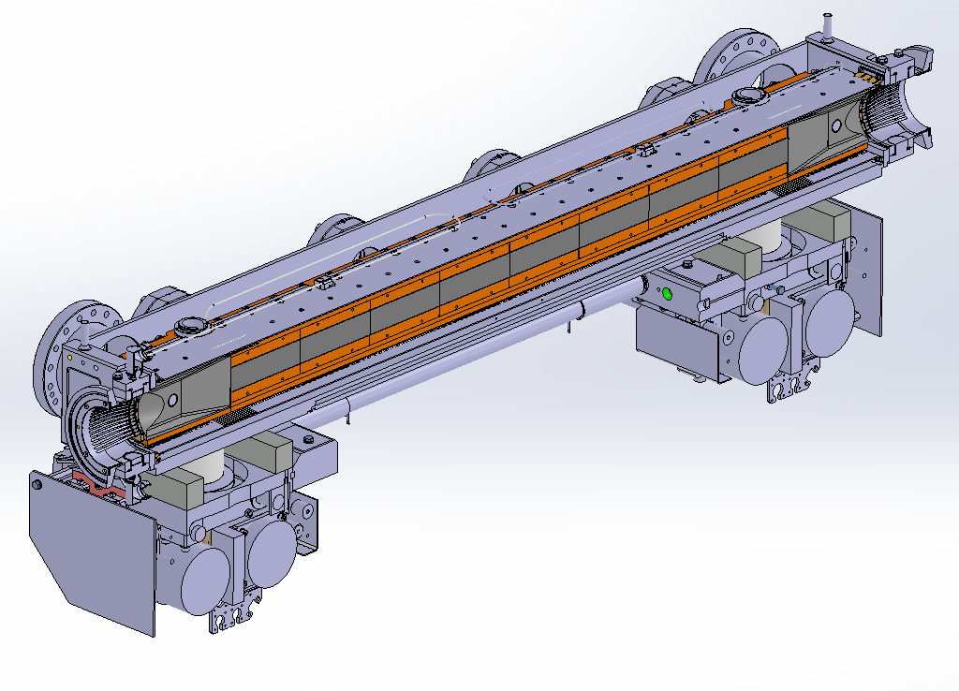
Context: Adaptive Collimation System (ACS)
Aim: to dynamically correct distortions in the collimator jaws, caused by in-operation events, namely thermal deformation.
Travel: ±100µm in varying shapes
ACS to be incorporated upon TCSPM collimator design currently being tested here at CERN.
ACS consists of two areas of interest:
ACS
Actuation
Measurement

Slide 3
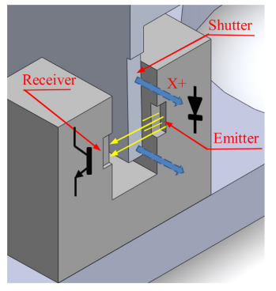
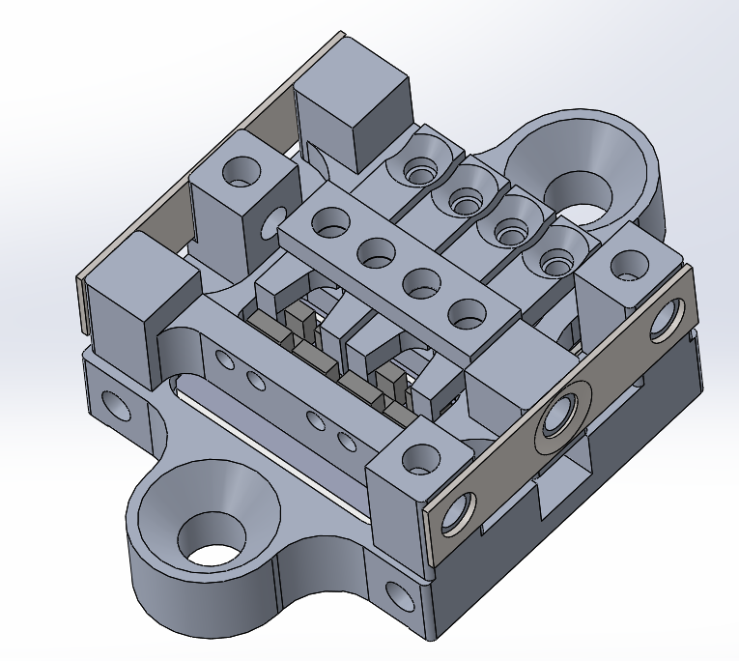
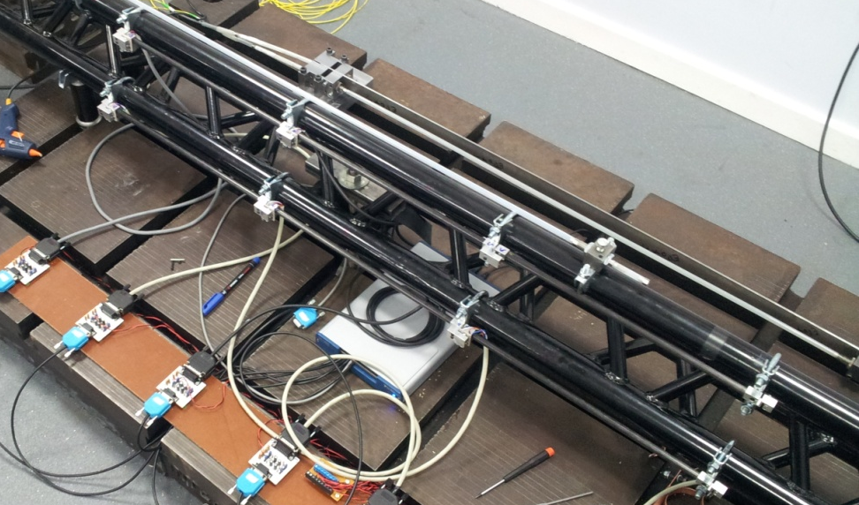
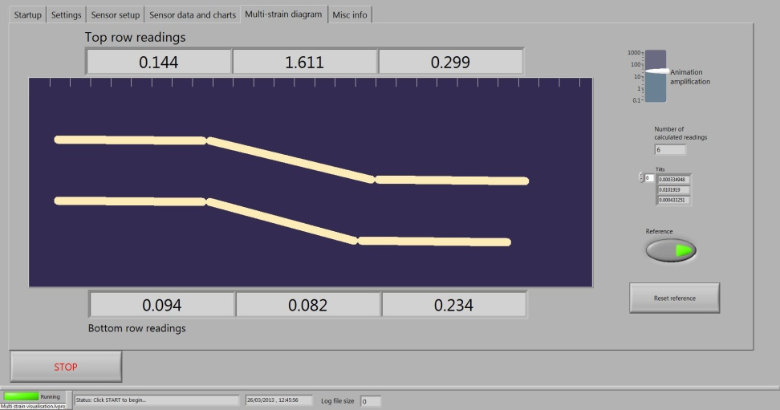
ACS Measurement - SPM
Preliminary Sensor – slotted photo-mircosensor (SPM)
Attributes:
  High resolution (21nm)
  Low cost
  Custom in CPT design
  High success rate with other projects.
Cons:
  Not designed to withstand out gassing temperatures.
  Increases installation difficulty
  SPM susceptible to radiation damage.

Slide 4
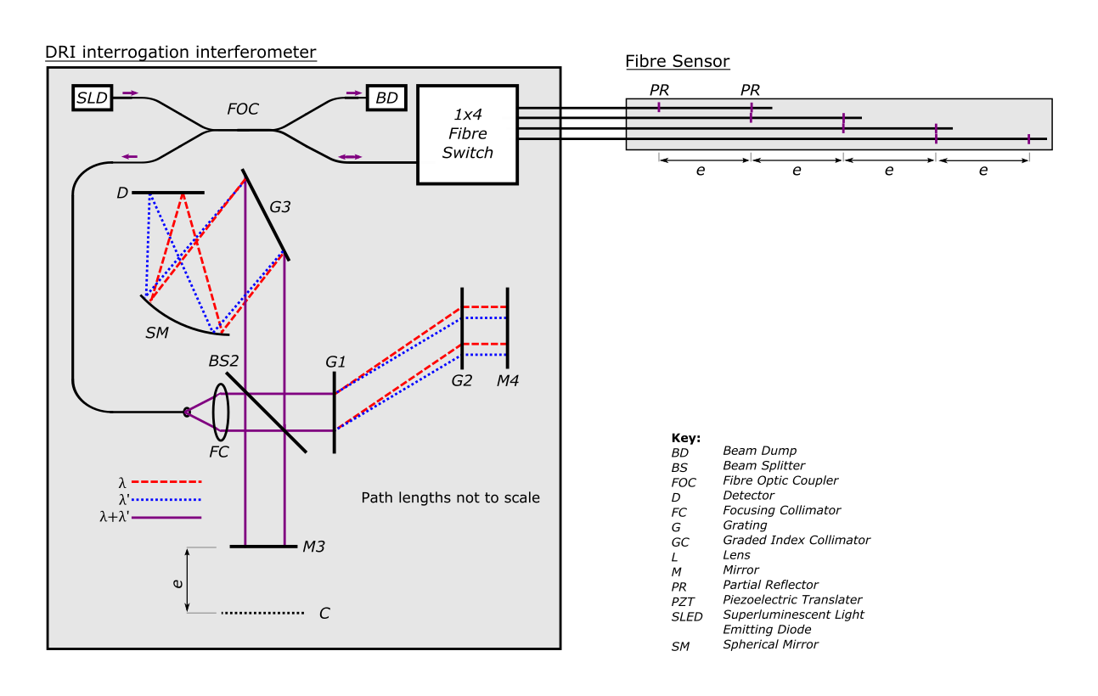
ACS Measurement – DRI
Current Measurement Solution: DRI (Dispersed Reference Interferometry) Strain measurement

Slide 5
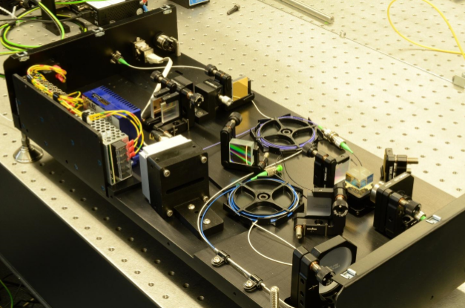
ACS Measurement - DRI
Current Measurement Solution: DRI Strain measurement
  Attributes:
    Easy to install
    Versatile
    Fibres design to withstand high temperatures.
    Major components located outside of vacuum tank
    Absolute measurement system
  Cons:
    Higher start up cost
    Fibres susceptible to spectral absorption (darkening).
    Bonding Issues

Slide 6
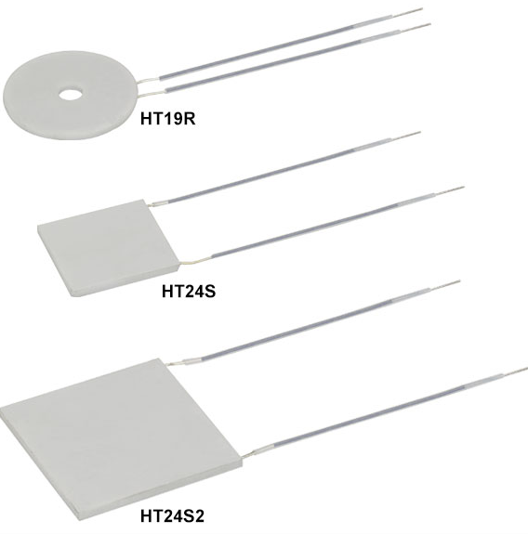
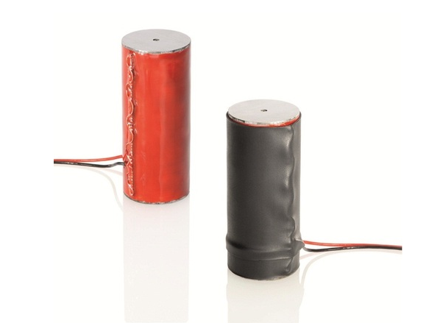
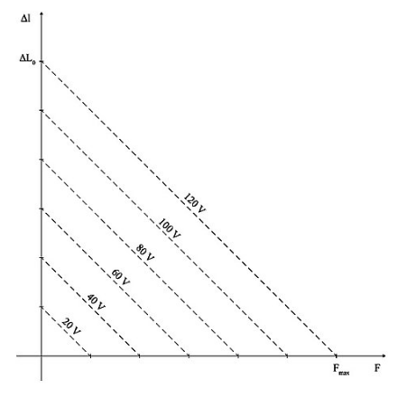
ACS Actuation
Potential actuation solutions:
  Metal ceramic patches
    Cheap, low risk, small power requirements
    However, Long rise times.
  Piezo Actuators
    High force generation
    Multiple options in the market.
    Extremely fast rise times.
    Displacement is inversely correlated to force generation.
    Critical damage induced though high temps, over preloading, excess voltage, shock loading.
    Require high voltages

Slide 7
ACS Actuation
Rise times

Slide 8
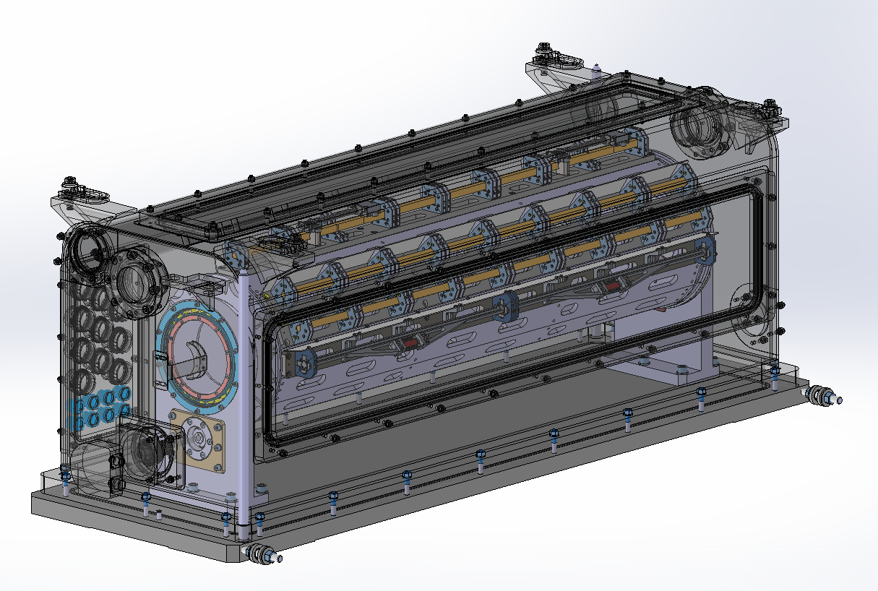
Multi-Mat @ CERN
What is Multi-Mat?
  Material testing experiment
  16 Stations for material samples
  To be assembled summer 2017
  Installed into HiRadMat In SPS At CERN
  Tested end of year 2017
  UoH have been given 1 dedicated station for equipment testing

Slide 9
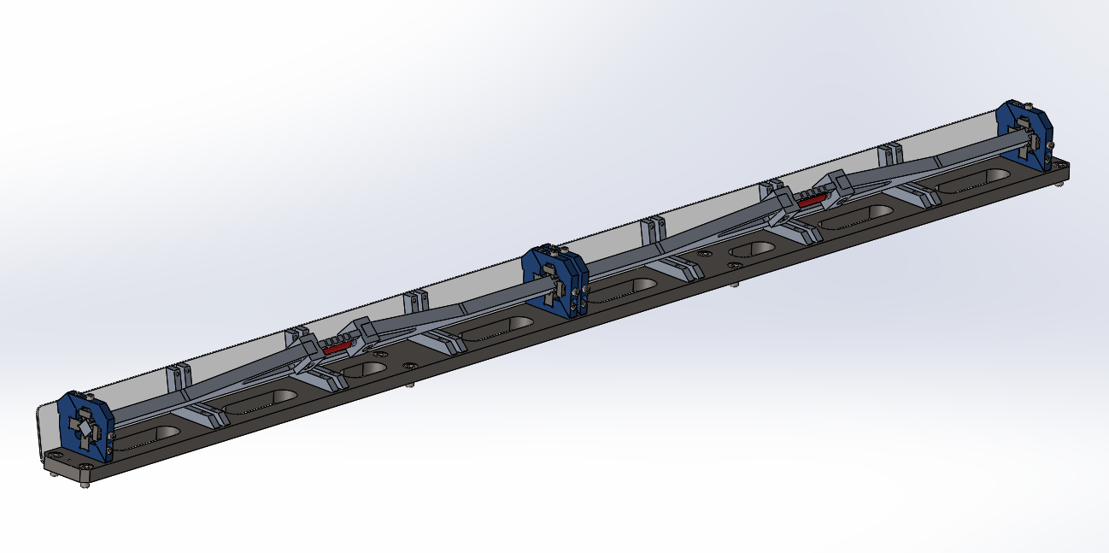
Multi-Mat Adaptive Collimation System V3 (MMACS)
MMACS will allow us to test the measurement/actuation when in close proximity to the beam.
Test Station 2
Beam Direction
Test Piece Clamps
Test Station 1

Slide 10
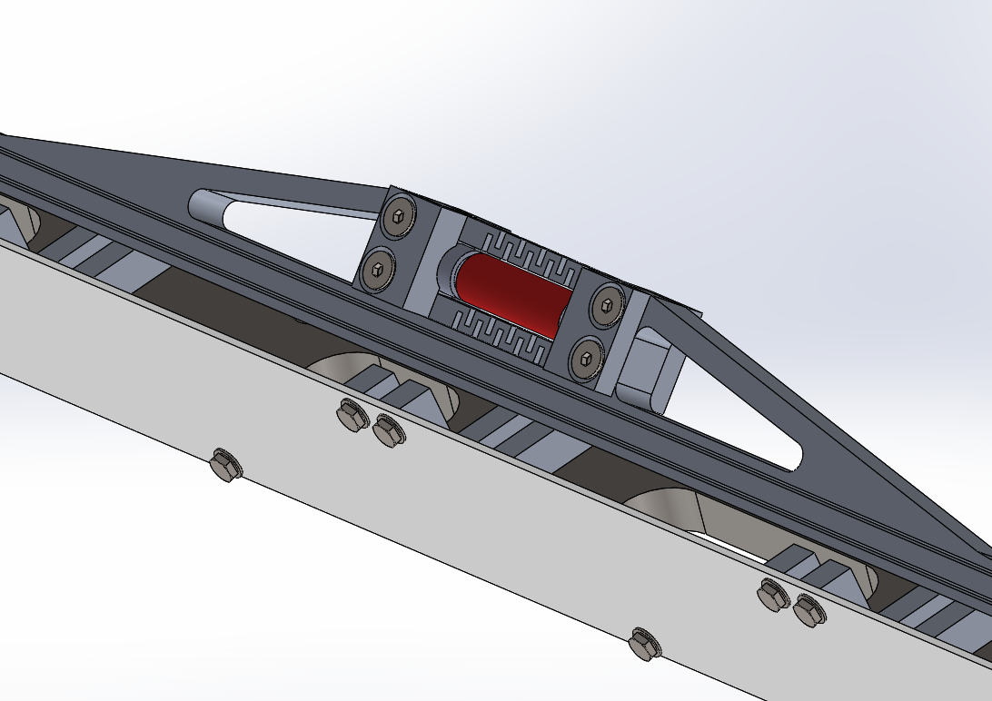
Multi-Mat Adaptive Collimation System (MMACS)
Piezo Actuator
Actuator Housing
Fibre Tracks
Beam Direction offset form centre of test

Slide 11
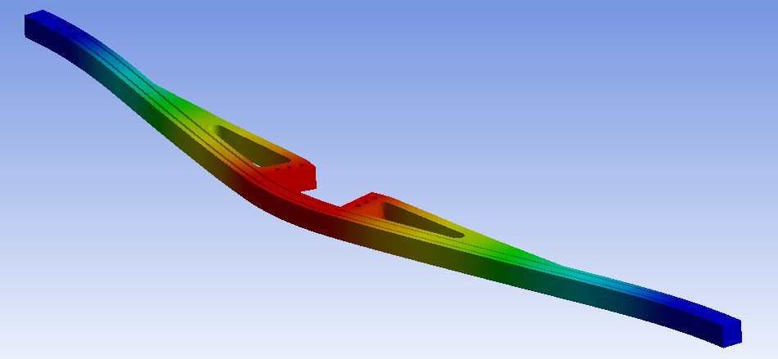
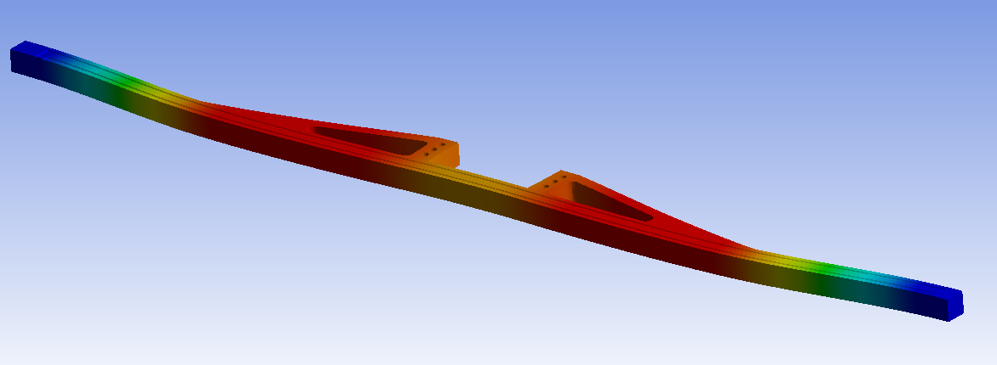
Multi-Mat Adaptive Collimation System (MMACS)
Around 50-60µm
Piezo to induce reversing force
Offset beam to induce thermal distortion
300N Piezo force
Direction Of movement

Slide 12

Multi-Mat Adaptive Collimation System (MMACS)
What Next?
In depth beam simulations of Multi-Mat test rig.
  Manufacture start in UK simulation pending
    Drawings to be released end of Feb
    Manufacture and assembly to be Completed mid April
¼ size (NOT ¼ scale) model of collimator jaw to test actuation and measurement in full – design in progress
Start designs and simulations for final collimator design.

Slide 13







Centre for Precision Technologies
Thank you
Tom Furness, Simon Fletcher, Andrew Longstaff
Email: t.furness@hud.ac.uk/thomas.furness@cern.ch

