Slide 1
WP 17 Materials for Extreme Thermal Management
(PowerMat)
Task 2
(A. Bertarelli – CERN)

Slide 2
Task 2 description
Task 2: Materials development and characterization
  Research, investigation, development, manufacturing, characterization of novel CMC and MMC based on graphitic, carbide or diamond reinforcements. Continuous material optimization will be fostered by the feedbacks provided by tasks 3 and 4.
  Study and development of electrically conductive coatings, resisting the impact of high intensity particle beams.
  Characterization of thermophysical properties measurements, microstructural analyses (SEM, XRD, EDS ...), study of phases and of their change under various environments …
  Participants: CERN, GSI, NIMP, POLIMI, POLITO, UM, Brevetti Bizz, RHP Technology
16 November 2015

Slide 3
Task 2 description
  Research, investigation, development, manufacturing, characterization of novel CMC and MMC based on graphitic, carbide or diamond reinforcements. Continuous material optimization will be fostered by the feedbacks provided by tasks 3 and 4.
    Push forward R&D on advanced materials for HEP, Thermal Management.
    Carbide/graphite composites. Explore new compositions (different carbon types, other carbides …). Strictly related to task 14.3 (specimens needed). Also needs input from task 17.5
    Diamond/metal composites. Improve existing materials (e.g. CuCD) or develop new ones also in view of input/requirements from task 17.5 for broad applications
    Application of Carbon Foams for to High Power Beam Intercepting Devices
16 November 2015

Slide 4
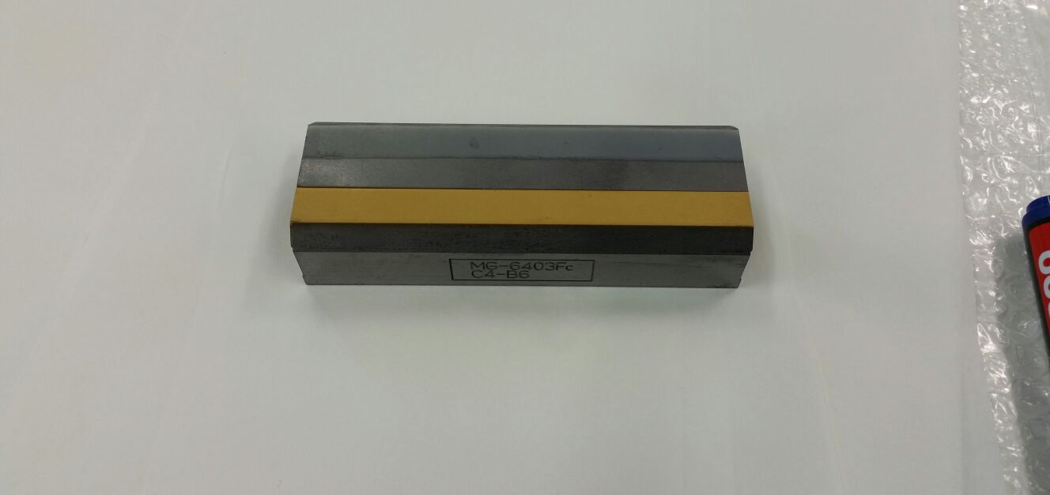
Task 2 description
  Study and development of electrically conductive coatings, resisting the impact of high intensity particle beams.
    Particular focus on development of new coatings for low-impedance collimators, spoilers etc … Materials to be studied include low-density, high conductive, refractory materials/ceramics
16 November 2015

Slide 5
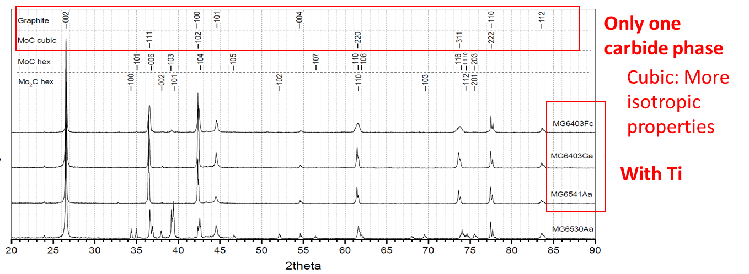
Task 2 description
  Characterization of thermophysical properties measurements, microstructural analyses (SEM, XRD, EDS, FIB, TEM ...), study of phases and of their change under various environments …
    Systematic thermophysical and microstructural characterization of material under study. Close collaboration with task 17.3 for mechanical testing. Optimization of the thermophysical measurement methods.
16 November 2015

Slide 6
Deliverables
Task 17.2) Comparative compendium of the developed materials [month 40]
Task 17.4) Report on simulations on irradiation effects [month 44]
Task 17.3) Irradiation test results: Beam impact on new material and composite [month 48]
Task 1.4) Production of material samples (as large as possible for each industry to demonstrate workability) [month 24]

Slide 7
Milestones
Task 17.1) Organisation of PowerMat kick-off meeting, with publication of talks on Web [month 6]
Task 1.4) Prepare first samples [month 12]
Task 17.2) Material characterisation, with publication of results on Web [month 18-24]
Task 17.3) Irradiation, with publication of report on web[month 27]
Task 17.4) Irradiation effects analysis, with publication of report on web [month 36]
Task 17.5) Report on studies, with publication of report on web, [month 46]

Slide 8
Deliverables and Milestones
Gannt-Chart
Task | Year 1 |  |  |  | Year 2 |  |  |  | Year 3 |  |  |  | Year 4
 | Q1 | Q2 | Q3 | Q4 | Q1 | Q2 | Q3 | Q4 | Q1 | Q2 | Q3 | Q4 | Q1 | Q2 | Q3 | Q4
17.1 |  | M
17.2 |  |  |  |  |  |  | M |  |  |  |  |  | D
17.3 |  |  |  |  |  |  |  |  | M |  |  |  |  |  |  | D
17.4 |  |  |  |  |  |  |  |  |  |  |  | M |  | D
17.5 |  |  |  |  |  |  |  |  |  |  |  |  |  |  |  | M
1.4 |  |  |  | M |  |  |  | D

Slide 9
Budget
TASK | Lab-Ind | Person•month | From EU (k€)
1. Communication & Coordination | GSI | 7 | 15
 | CERN | 7 | 15
2. Materials development and characterization | CERN | 36 | 55 (Meas)
 | GSI | 16 | 70 (PhD +30 subc)
 | POLITO | 5 | 20 (studies - meas)
 | UM | 20 | 50 (studies, part PhD)
3. Dynamic testing and online monitoring | CERN | 4 | -
 | GSI | 16 | 100 (PhD+irradiation)
 | POLITO | 45 | 100 (analysis-meas)
 | POLIMI | 50 | 80 (PhD)
 | ELI-NP | 10 | 30 (laser: target/cons.)
4. Simulation of irradiation effects and mitigation methods | CERN | 30 | 30 (studies)
 | GSI | 1 | 10 (studies)
 | POLIMI | 4 | 10
5. Broader accelerator and societal applications | CERN | 1 | 5
 | GSI | 3 | 20 (subc.)
 |  | 255 | 645

