Slide 1

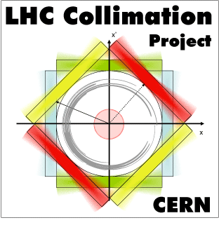


ARIES WP14 – Task 14.4:
Industrial production of materials for extreme thermal management
EuCARD² WP11 Topical Meeting
CERN, Geneva (CH)
1st February 2017
F. Carra^{1,2}
¹CERN – European Organization for Nuclear Research
²Politecnico di Torino

Slide 2
Task description
WP14: Promoting Innovation (PI) – WP leader M. Losasso (CERN). Close relation to industry, final aim to provide society with identified commercial applications of the supported research potential.
Task 14.4: Industrial production of materials for extreme thermal management
  Contribute to material development in collaboration with WP17 (PowerMat)
  Produce at least 10 samples of MgB₂ by Additive Manufacturing on Copper substrate for characterization of the R&D → applications in critical accelerator environments (beam pipes, RF cavities) and other technical domains
  Demonstrate feasibility of production for industrialisation (with large dimensions, small tolerances)
Production objectives:
  30 samples of MgB₂ on metal substrate
  30-50 samples of CuCD
  40 samples of metal-diamond composite for luminescence studies
  50 samples of carbide-graphite or metal-graphite composites
  1 large size block of carbide-graphite or metal-graphite composite with tight mechanical tolerance to proof industrialisation
RHP
CERN with industrial partner (BrevettiBizz)

Slide 3
Deliverable
Deliverable Number | Deliverable Title | Lead beneficiary | Type | Dissemination level | Due Date (in months)
D14.3 | Production of material samples of carbon-based composites and metal-diamond composites | CERN | Demonstrator | Public | 24
D14.3 : Production of material samples of carbon-based composites and metal-diamond composites
Production of: 50 samples of carbon-based composites with different production cycles and 30 samples of metal-diamond composites, 20 for high energy impact studies and 10 for luminescence studies

Slide 4
Thank you.

