Slide 1


Update on Junction Box Design
Edyta Pilorz
(Cracow University of Technology)

Slide 2
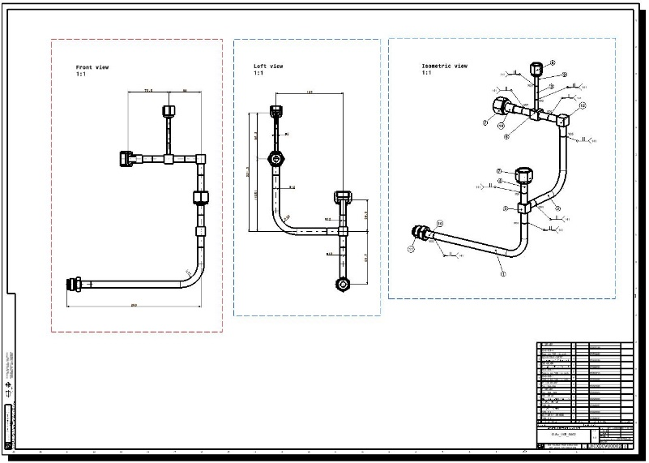
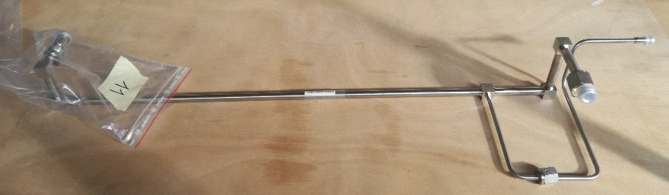
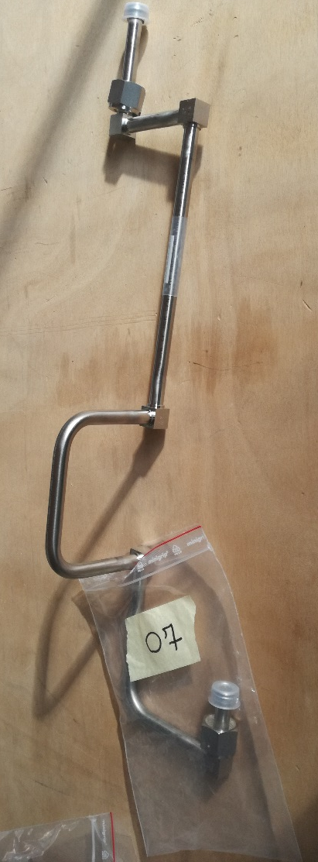
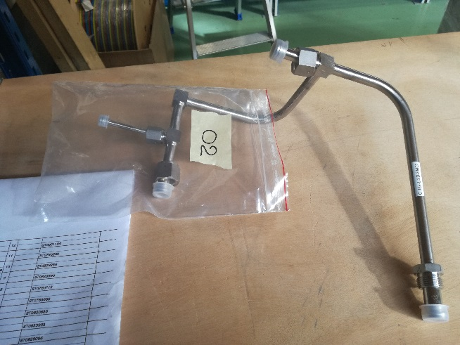
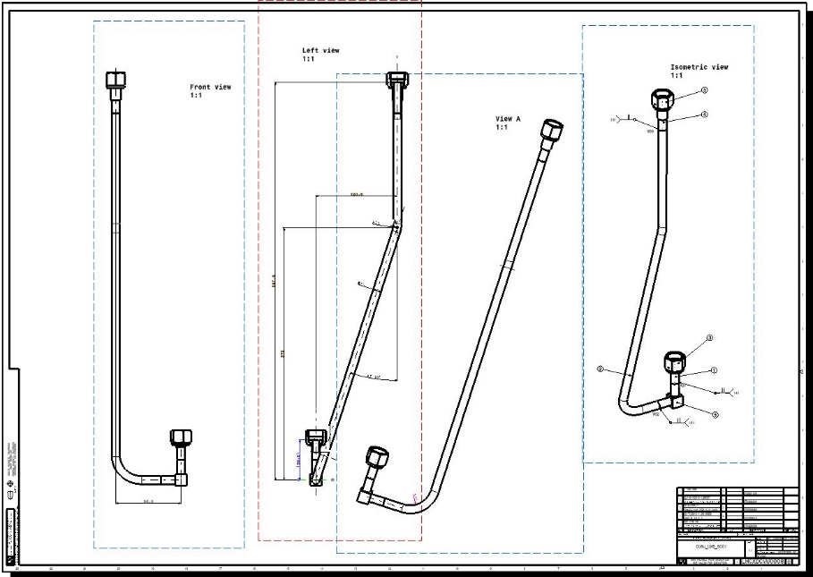
Pipe work
Construction drawings:
Prepared
Checked
Production in progress

Slide 3
Pipe work – quality verification
Quality verification; steps:
Visual inspection in the DT workshop
(66 welds from 210 checked already)
Visual inspection in EN-MME
10% of welds to be checked with X-rays

Slide 4
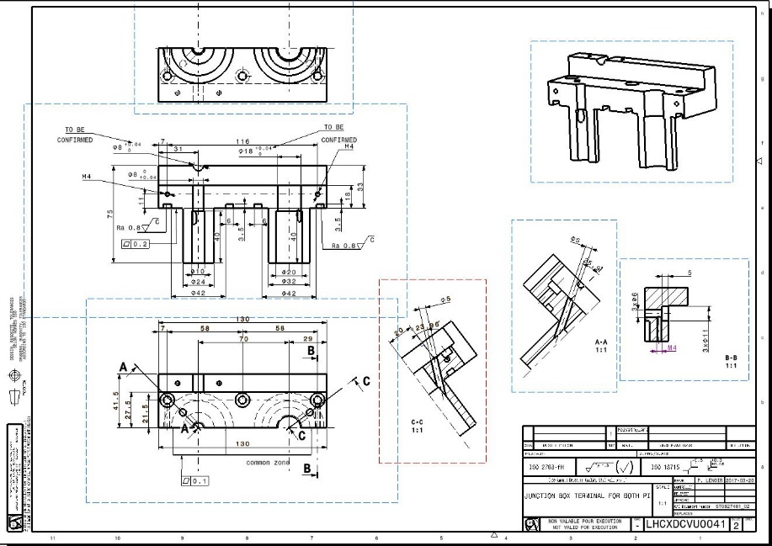
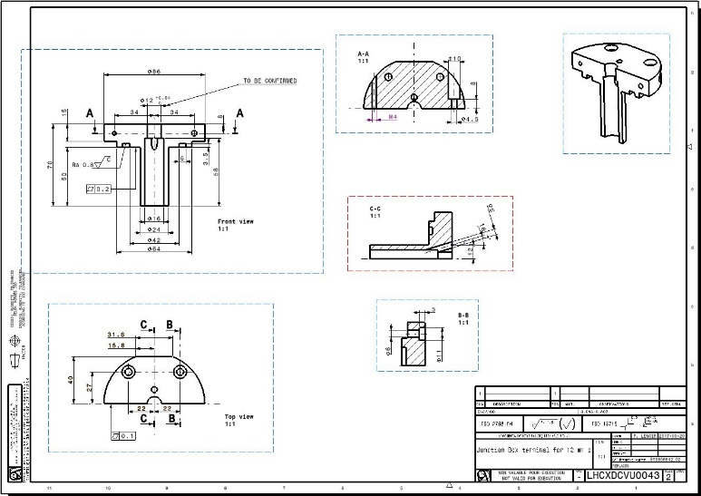
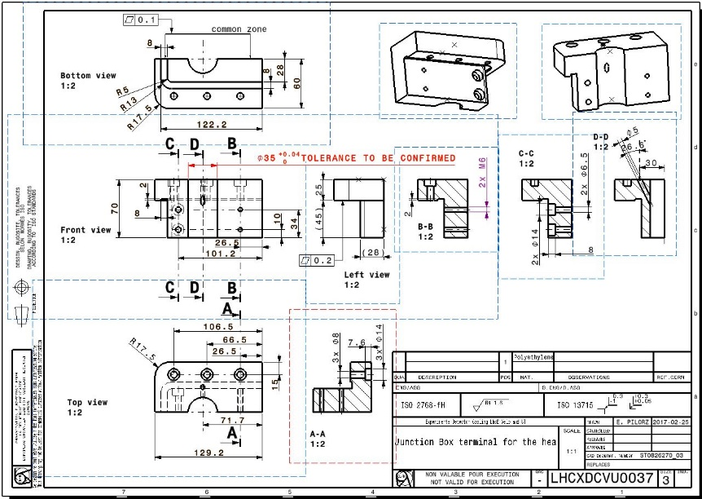
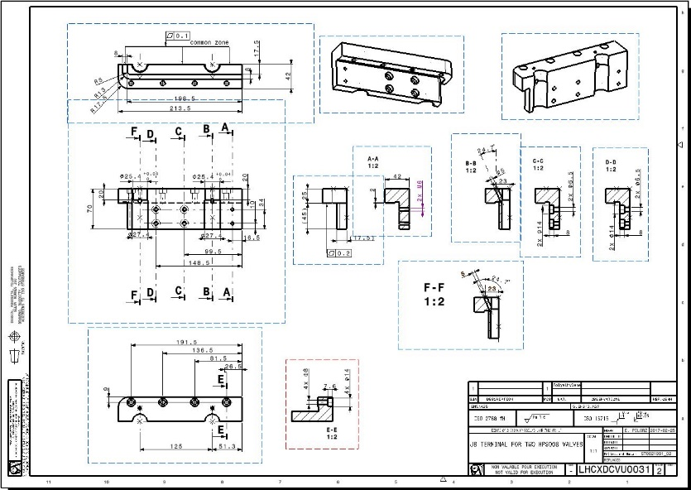
Clamping plastic parts
Construction drawings:
24 drawings prepared
Checking in progress
To be sent to the production after the check (material: polyethylene)

Slide 5
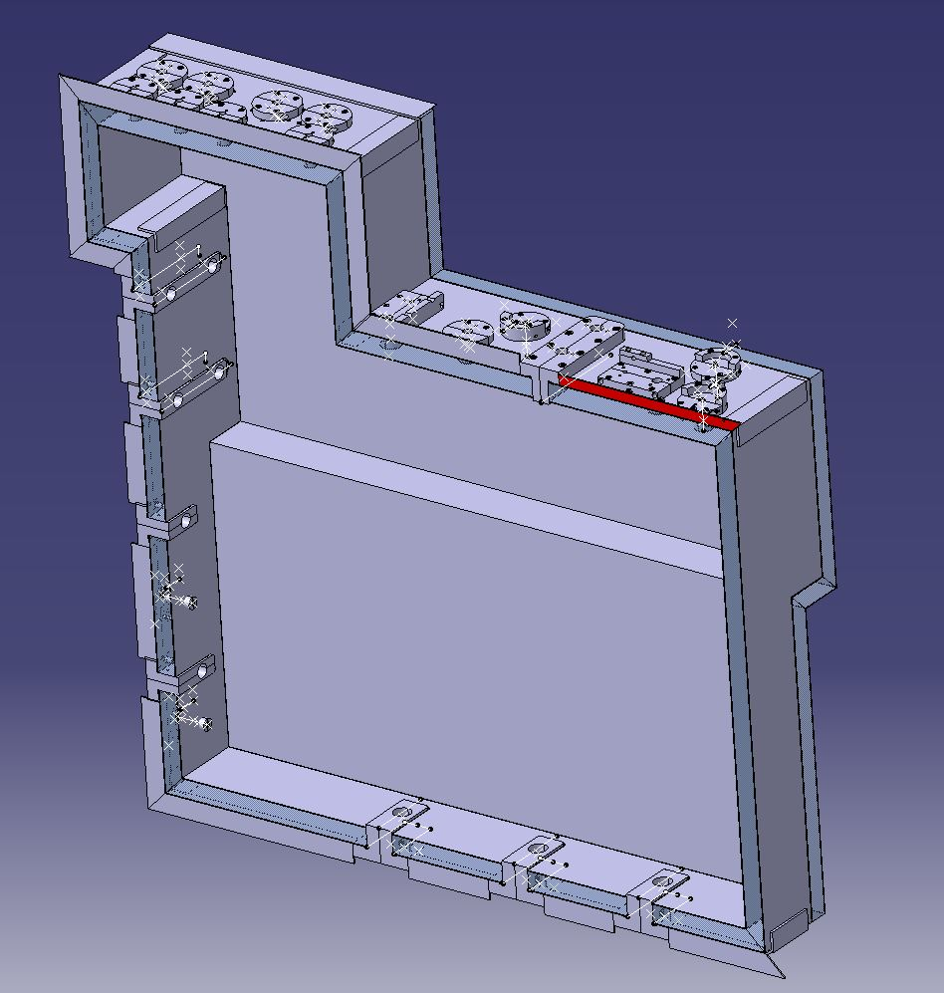
Construction of the box
Construction of the box:
3D model to be finished
Construction drawings to be done

Slide 6
Order status
We are waiting for the delivery of:
Carel valves
Watlow heaters
Material for the box (insulation panels and aluminium profiles)
Some fittings

Slide 7
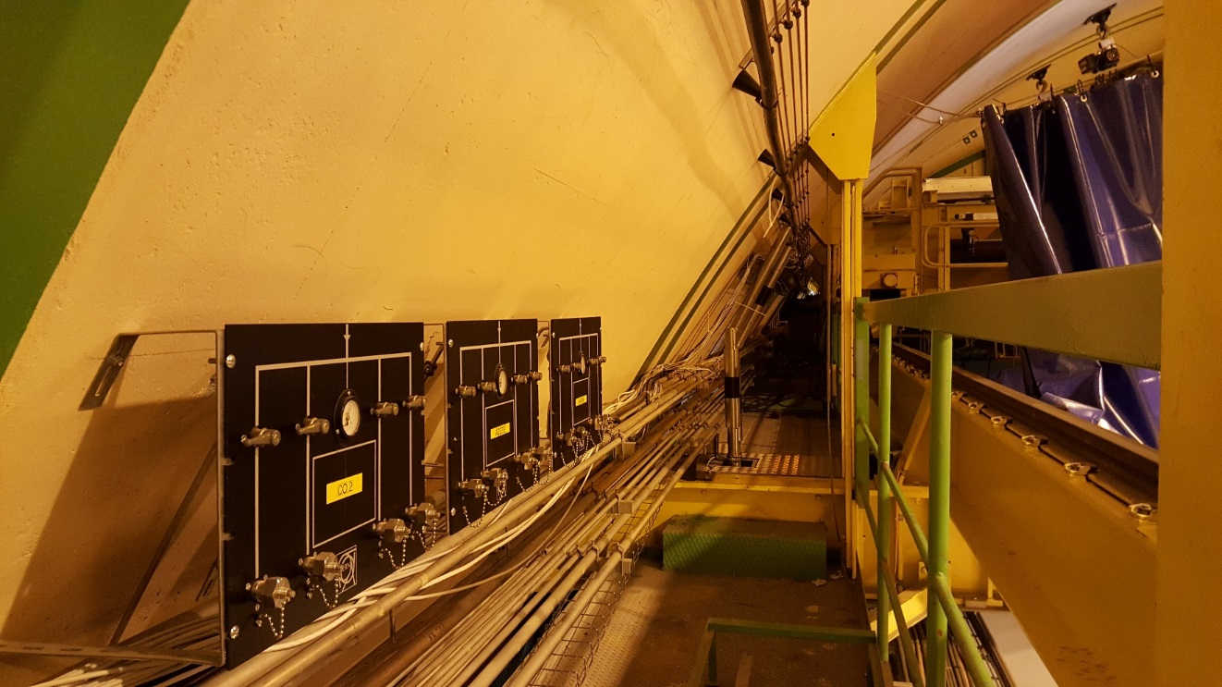
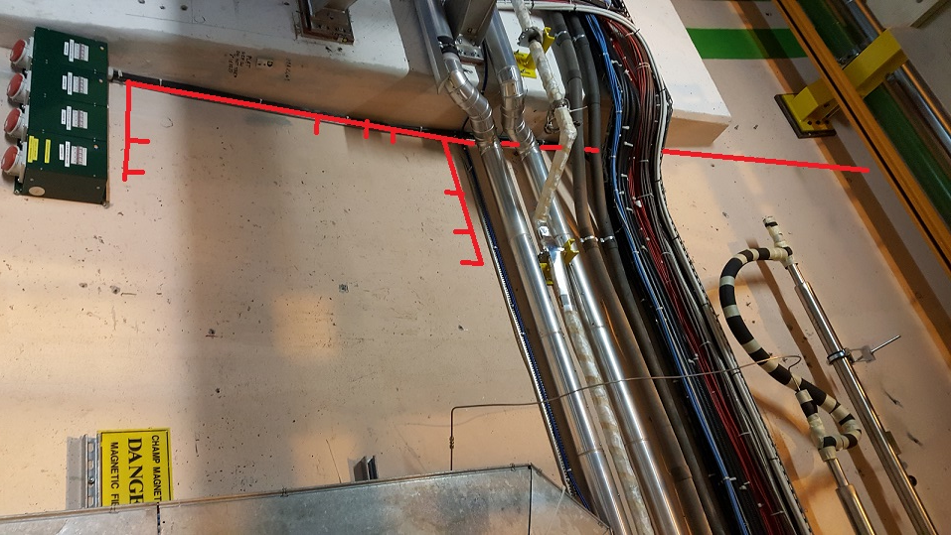
Electrical patch panel location
Main Patch Panel Location
To detector C side
To JB and detector A side

Slide 8
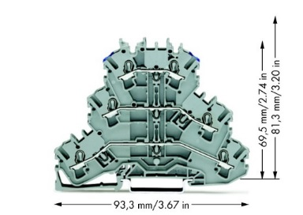
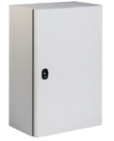
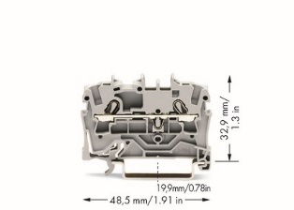
Electrical patch panel
800x400x150 mm
Inputs
NSYS3DB4815
Width | 10.4 mm
End cover width | 1 mm
Length | 46.2 mm
Height NS 35/7,5 | 39.9 mm
Height NS 35/15 | 47.4 mm
Height NS 32 | 44.9 mm
10 cm
GSM cable
0.93x60 cm
~25cm
4.9 cm
4.9 cm
Phoenix MTKD-NICR/NI - 3100062
Outputs
10 cm
60cm
800x600x200 mm
~25cm
NSYS3D8620
10 cm
200
Wago 2002-3203
4.9 cm
0.93x60 cm
Inputs
Door open
Outputs
Gas pipes
4.9 cm
800
90 ˚ turn
600
Wago 2002-1201

Slide 9
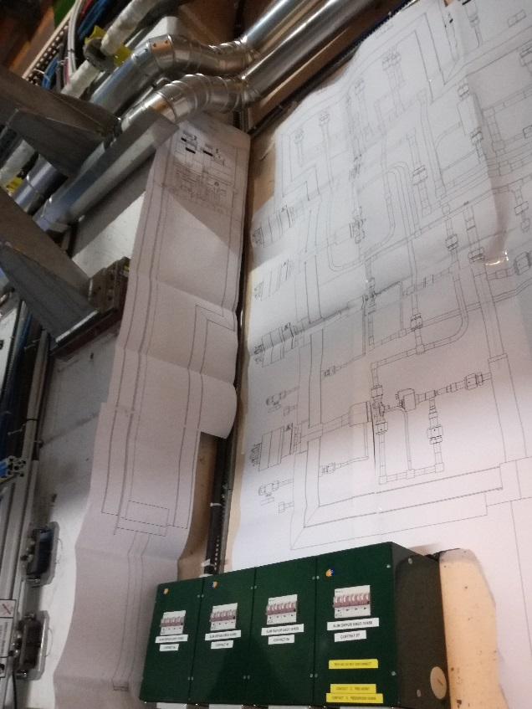
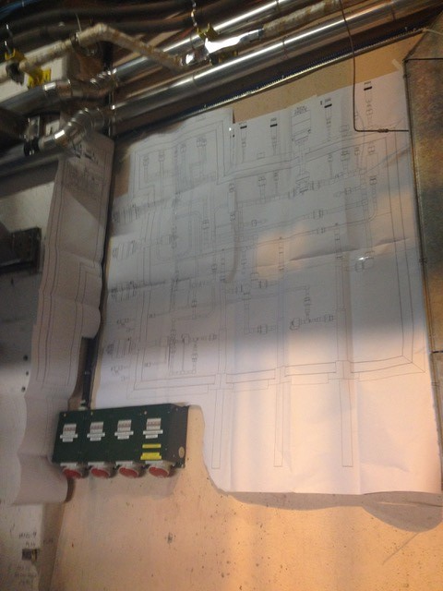
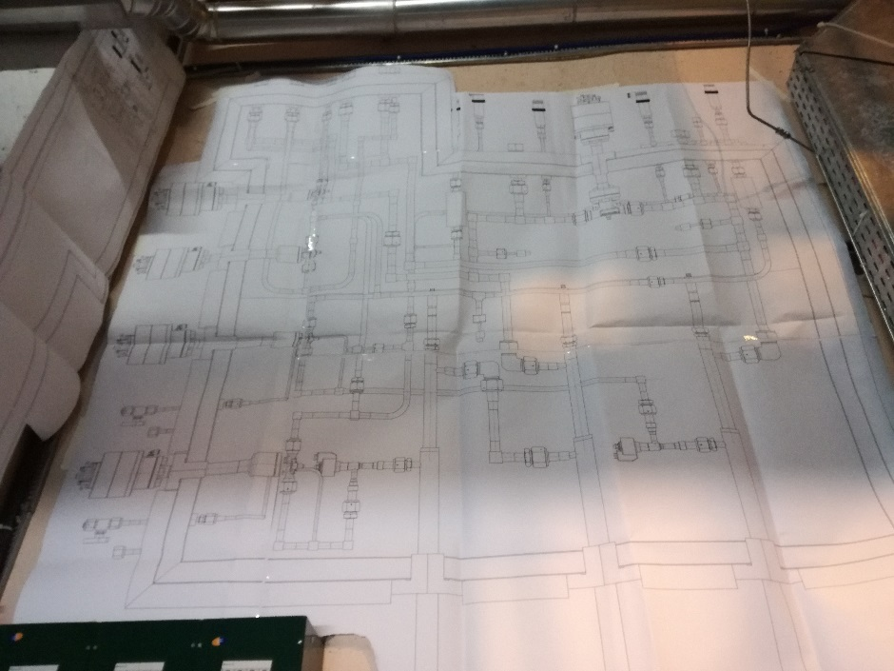
Fitting the “Junction Box” in the alcove - test
Scale: 1:1
This helped us to see how to route the cabling
It is visible where to fix the support for the box

Slide 10
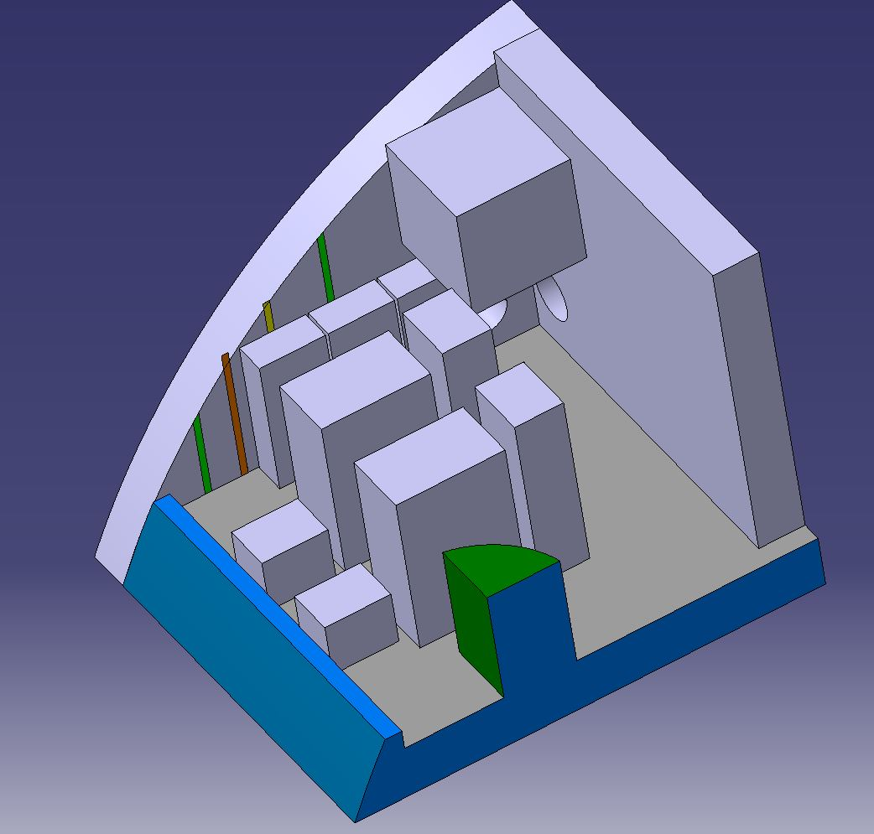
Placing the cooling plants in UX85 alcove - layout
3 electrical cabinets
2nd accumulator
2nd cooling plant
2nd chiller
1st cooling plant
1st accumulator
1st chiller

Slide 11
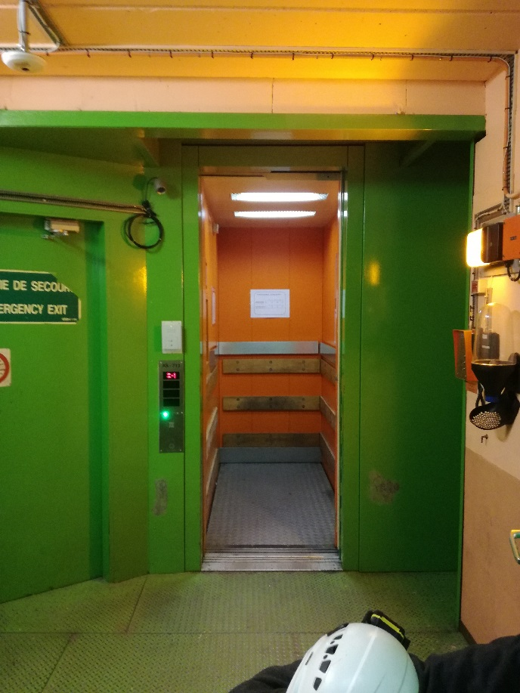
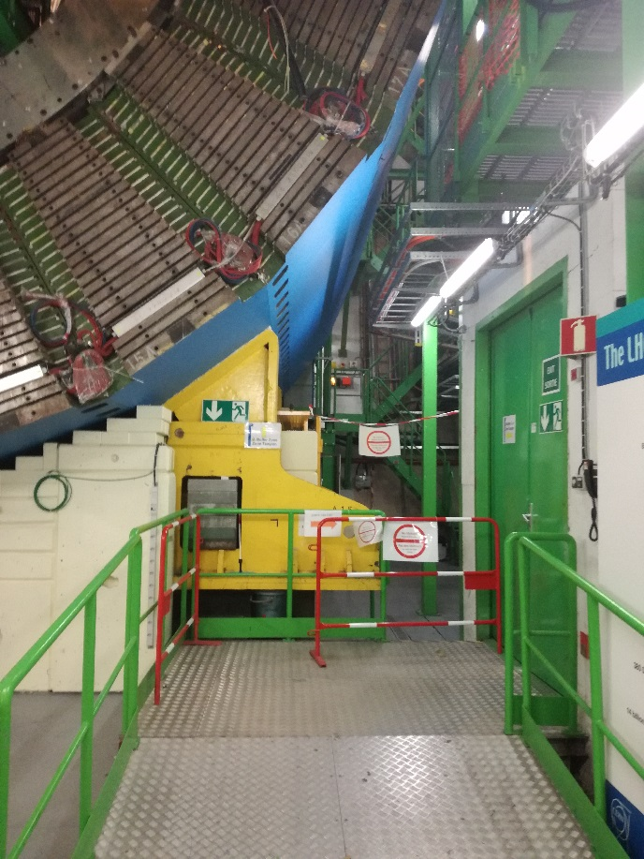
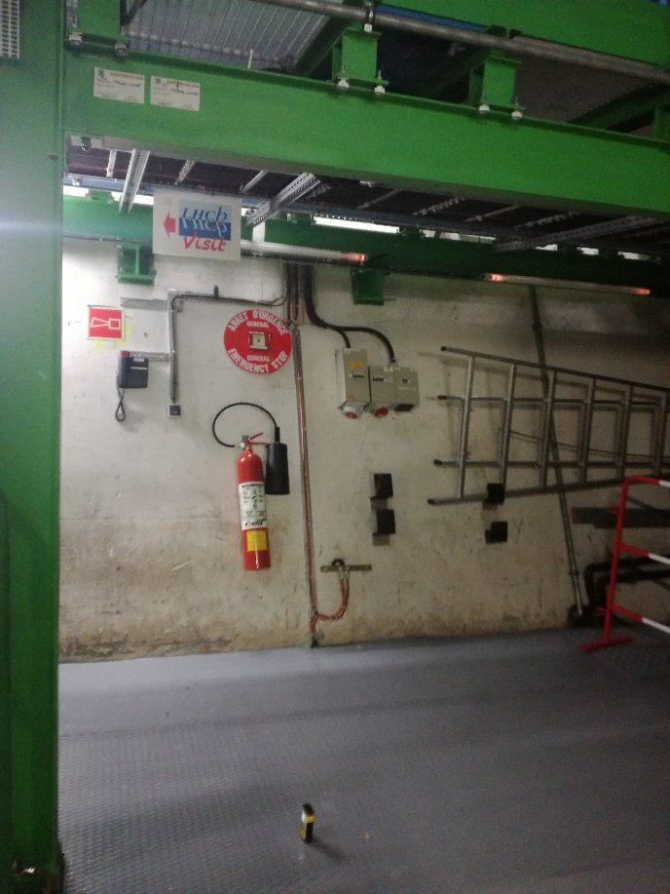
Measurements for the passage from the lift up to the alcove
H
L
H
H
W
LIFT
Width: 793 mm
Length: 1964 mm
Height: 2395 mm
ENTRANCE AFTER THE LIFT
Height: 2400 mm
PASSAGE
Height: 2090 mm

Slide 12
Dimensions of the shaft hole
(lifting platform)
964 mm
STAIRS
.
1436 mm
WALL
740 mm

Slide 13
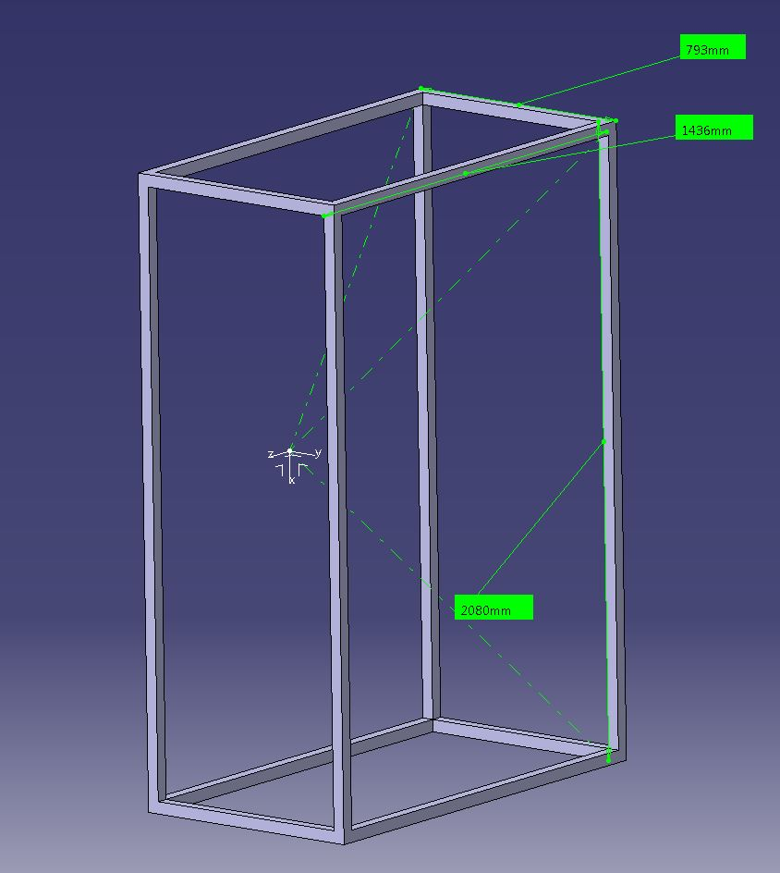
The biggest dimensions which we can transport vertically
793 mm – because of the width of the lift’s door – TO BE CHECKED WITH NEW LIFT
1436 mm – because of the size of the hole in the lifting platform in the alcove which is 964 mm x 1436mm
2080 mm – because of the height of the passage

