Slide 1
Fast timing with Micromegas: Status and Plans
Thomas Papaevangelou, IRFU-CEA/Saclay
Representing:
CEA (Saclay), CERN (GDD), NSRC “Demokritos”,
Princeton University, Thessaloniki University, USTC (Hefei)

Slide 2
The “Picosec” Project
Started as an RD51 common fund project:
Fast Timing for High-Rate Environments: A Micromegas Solution
Collaborating Institutes:
CEA (Saclay)
T. Papaevangelou , I Giomataris, F. Iguaz, M. Kebbiri, M. Pomorski, T. Gustavsson, E. Ferrer-Ribas, D. Desforge, I. Katsioulas, G. Tsiledakis, O. Malliard, P. Legou, C. Guyot, P. Schwemling
CERN
L. Ropelewski, E. Oliveri, F. Resnati, R. Veenhof, S. White, H. Muller, F. Brunbauer, J. Bortfeldt, M. van Stenis, M. Lupberger, T. Schneider, C. David, D. González Díaz*
NCSR Demokritos
G. Fanourakis
Princeton University
S.White, K.T. McDonald, Changguo Lu
University of Thessaloniki
S. Tzamarias
University of Science and Technology of China (USTC), Hefei
Zhiyong Zhang, Jianbei Liu, Zhou Yi
Awarded 3/2015
2014:
Submission of the proposal (June)
2015:
First prototype
Tests with fs laser
Publication at MPGD2015 proceedings
2016:
Laser test (May)
New chamber
3 runs with RD51 muon beam
2017:
Laser test with new chamber (January)
New detectors (resistive, pixelated)
New runs
* Present Institute: University of Santiago de Compostela

Slide 3
State-of-art precision timing
Solid state detectors
Avalanche PhotoDiodes: (σ_{t} ~ 30 ps)
Low Gain Avalanche Diodes (σ_{t} ~ 30 ps)
HV/HR CMOS (σ_{t} ~ 80 ps)
  Radiation hardness ?
Gaseous detectors
RPCs: (σ_{t} ~ 30 ps)
  ➔ High rate limitation
MPGDs (σ_{t} ~ 1 ns)
Question:
Can a MicroPattern Gaseous Detector reach a timing resolution of the order of few tens of picoseconds?
performance improvement by
~2 orders of magnitude
Motivation: HL-LHC
➔ Large-area, position-sensitive gaseous photomultipliers

Slide 4
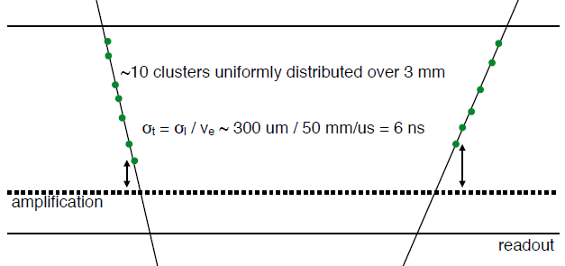
Main limitation on precision timing with MPGDs
Time response is limited by the continuous ionization on the drift region:
  spread of primary ionization clusters
  diffusion in the gas
  small drift velocity
Timing performance can be improved by
  simultaneous creation of primary electrons at the same distance from the mesh
  shorten the drift length
6 mm
100 μm
Direct ionization of the gas cannot be used and should be suppressed

Slide 5
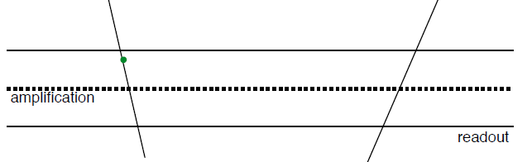
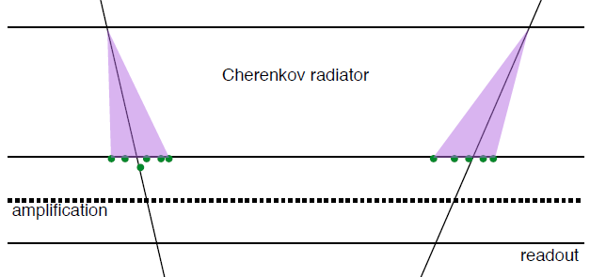
Improving MPGD timing
Suppress primary ionization by reducing the drift gap (200 nm)
  Limit diffusion
  Pre-amplification possible
200 μm
100 μm
Use a Cerenkov radiator
  Photoelectrons emitted at the cathode (fixed distance from the mesh)
  Pre-amplification will
  ➔ reduce the effect of longitudinal diffusion
  ➔ limit contribution of gas ionization
200 μm
100 μm
Project goal:
single photoelectron time jitter ~100 ps
sufficient photoelectrons to reach timing response ~20 ps.

Slide 6
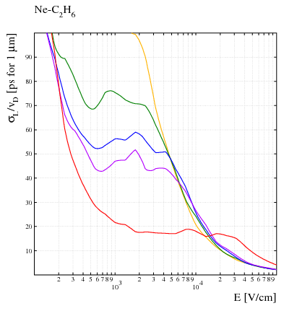
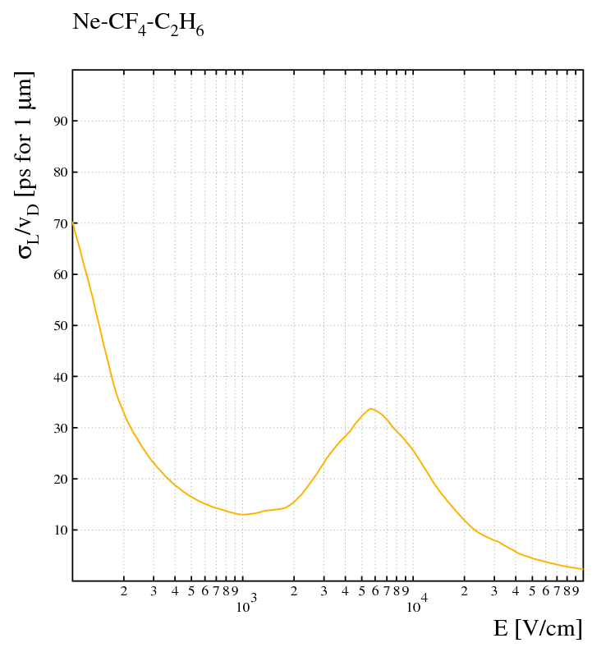
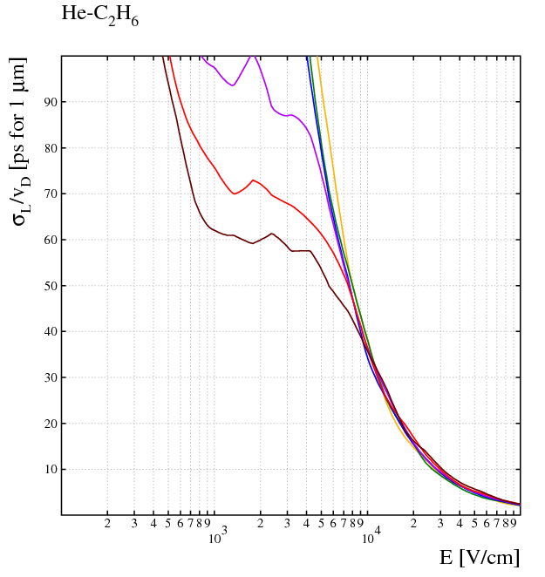
Limiting the e⁻ diffusion in the gap
Small drift gap + strong electric field
Gas choice – simulation studies
  Electron diffusion
  Gain
  Stability
  Ne mixtures
    Higher gain than Ar
    Less diffusion than He
➔ pre-amplification improves
time resolution!
5 %
10 %
15 %
20 %
100 %
@ 0.5 bar

Slide 7
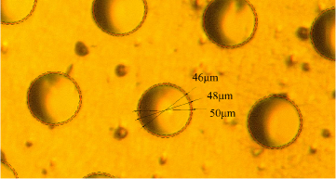
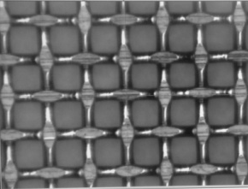
UV photon detection
Reflective photocathode:
Photosensitive material is deposited on the top surface of the micromesh.
Photoelectrons extracted by photons will follow the field lines to the amplification region
  Smaller ion backflow ➔ radiation hardness
  The photocathode does not “see” the avalanche ➔ no photon feedback ➔ higher gain in single stage (~ 10⁵)
  Higher electron extraction efficiency
  Reflection on the crystal
  e⁻ path variation
  Limitation to Microbulk / opaque meshes
Semi-transparent photocathode:
Photosensitive material is deposited on an aluminized MgF₂ window (drift electrode)
  Extra preamplification stage ➔ better long-term stability
  higher total gain
  Various MM technologies & gas mixtures possible
  Decoupling of sensor - photocathode
  Lower photon extraction efficiency
  Photocathode exposure to sparks
  Ion backflow ➔ radiation hardness (?)
crystal
photon
electron
photocathode
micromesh
avalanche
anode
insulator
crystal
photon
photocathode
electron
preamplification
micromesh
avalanche
anode
insulator

Slide 8
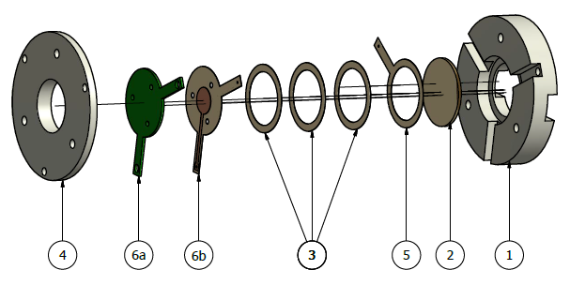
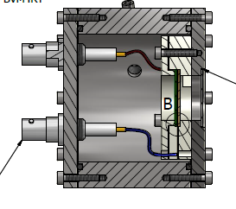
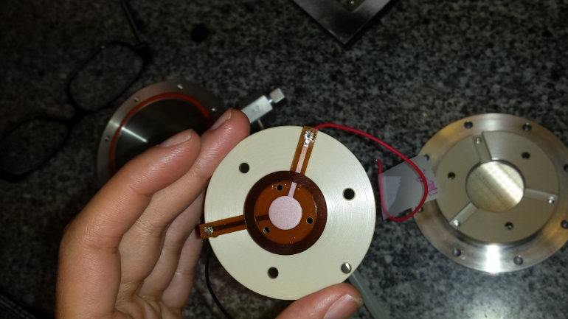
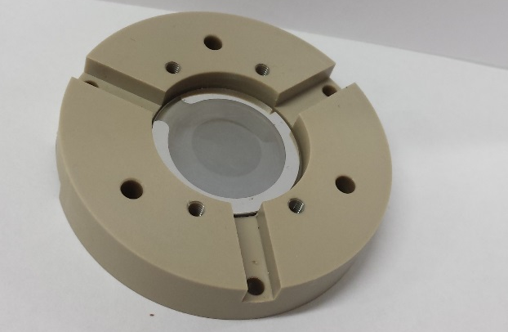
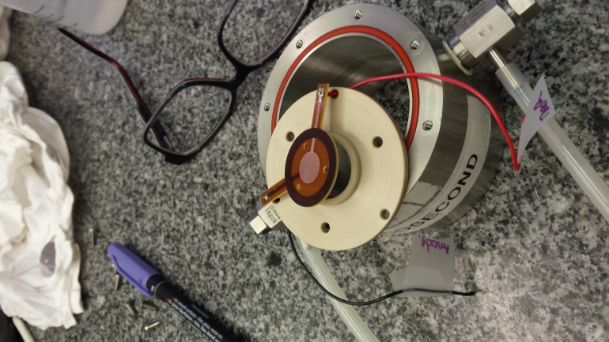
Single-anode prototype
Tests with UV lamp / laser ➔ quartz windows
Sensor:
Microbulk Micromegas ø 1cm
Possibility to deposit CsI on the mesh surface
Capacity ~ 35 pF
Bulk Micromegas ø 1cm
Capacity ~ 8 pF
Amplification gap 64 / 128 / 192 μm
Thin-mesh Bulk Micromegas (~5 μm)
High optical transparency
Amplification gap 128 μm
Ensure homogeneous small drift gap & photocathode polarization
Photocathodes: MgF2 crystal +
  Metallic substrate + CsI
  Metal (Cr, Al)
  Metallic substrate + polycrystalline diamond
  Boron-doped diamond
Very thin detector active part (<5 mm)

Slide 9
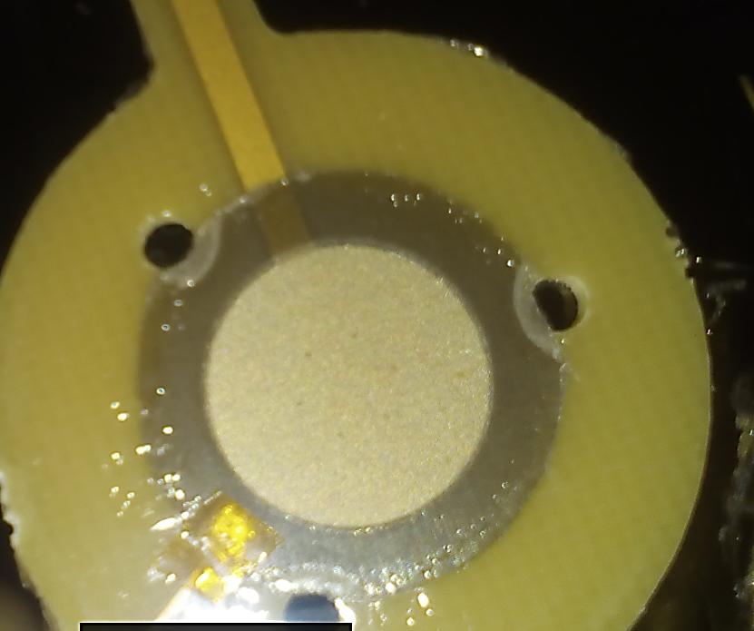
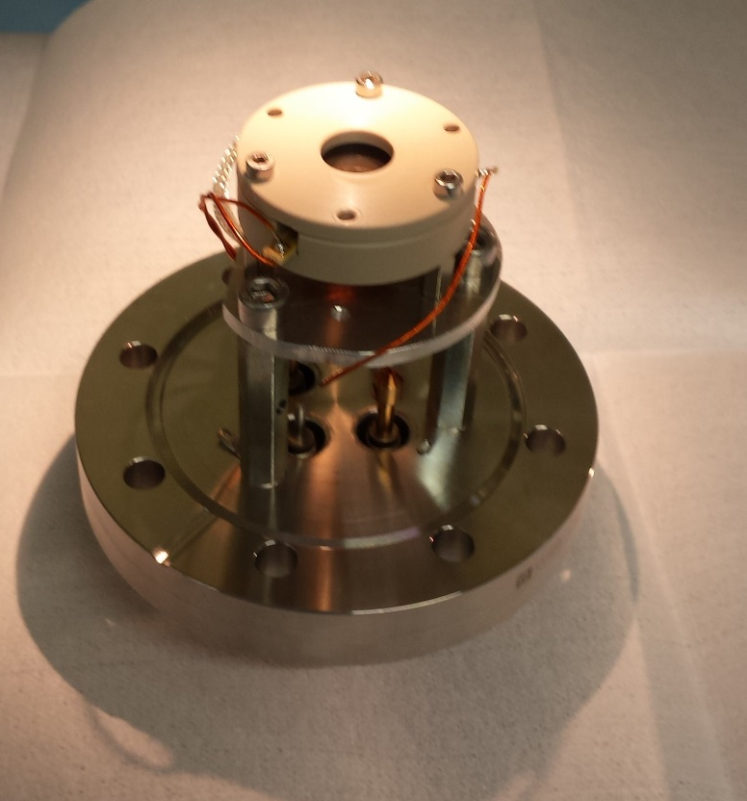
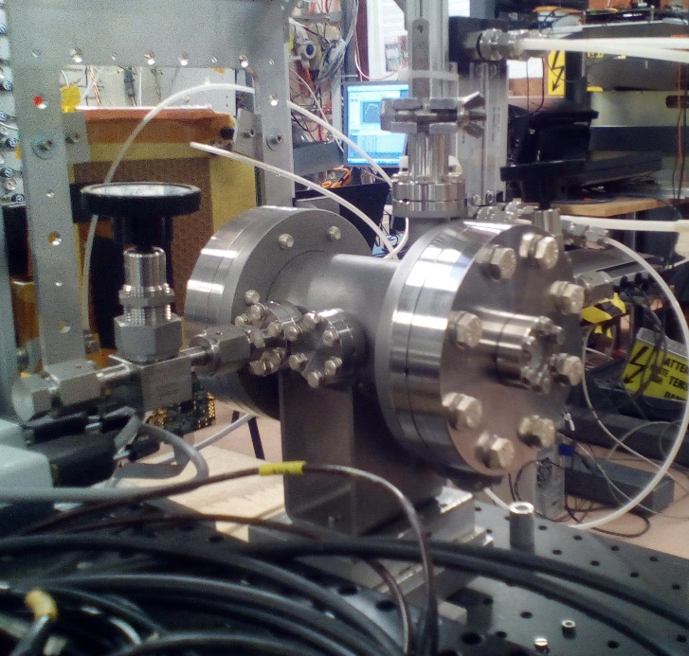
New stainless steel chamber for sealed mode operation
Same detector design
Similar support structure for Micromegas and crystal
Reduced pillar size / remove part above micromesh
Metalic joints (O-ring only for the pressure gauge)
SMA connector for anode signal
Mesh is grounded (short circuit). Positive voltage applied at the anode
  Significant improvement of signal shape
  No reflections
Ø 200 μm pillars UNDER the mesh

Slide 10
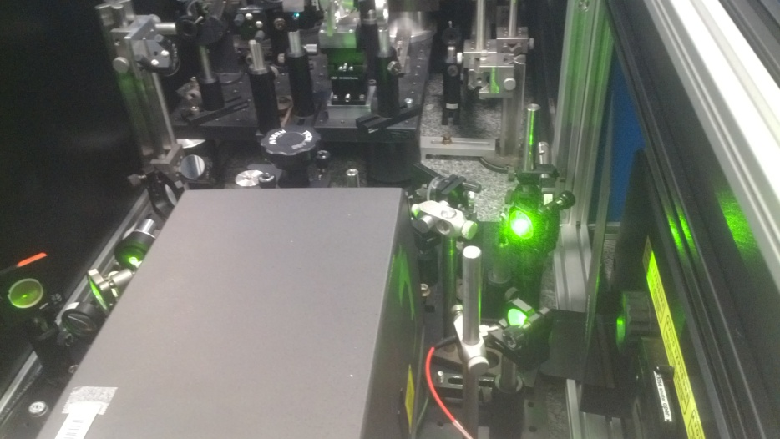
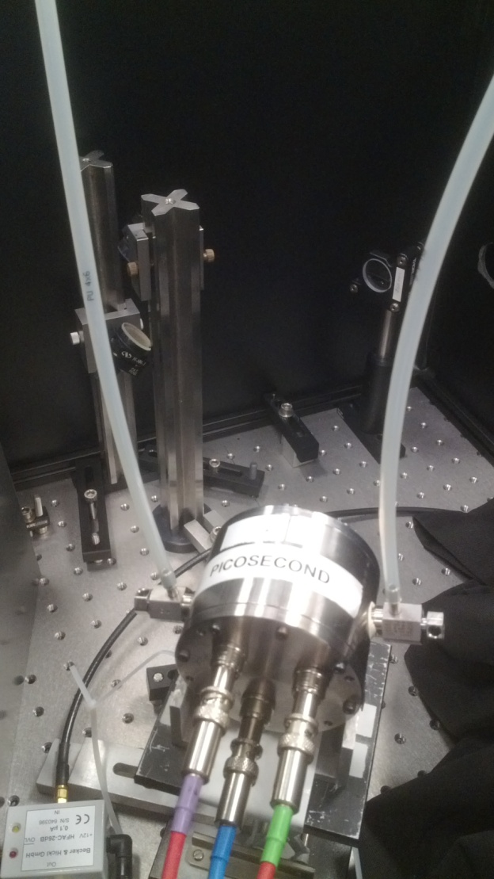
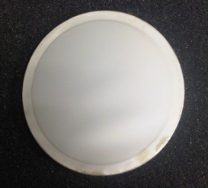
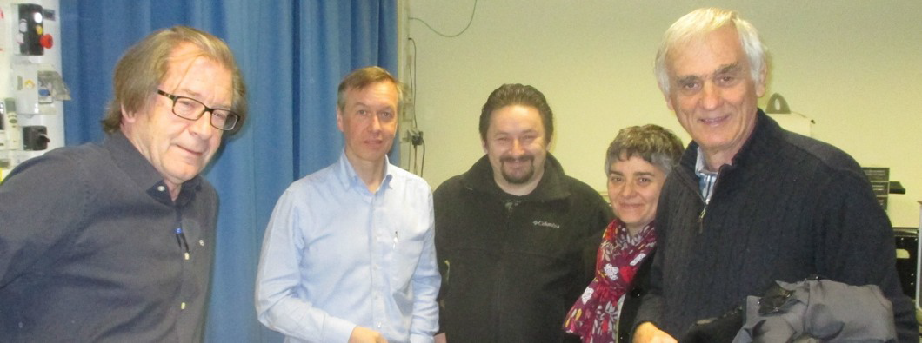
Test with UV fs laser
IRAMIS facility @ CEA Saclay
UV laser with σ_{t} << 100 fs
λ = 275-285 nm after doubling
intensity ~ 3 mJoule / sec
Repetition 9 kHz - 8 MHz
Light attenuators (fine micro-meshes 10-20% transparent)
Trigger from fast PD
Cividec 2 GHz, 40 db preamplifier
Single photoelectrons from
a candle’s flame using a charge preamplifier.

Slide 11
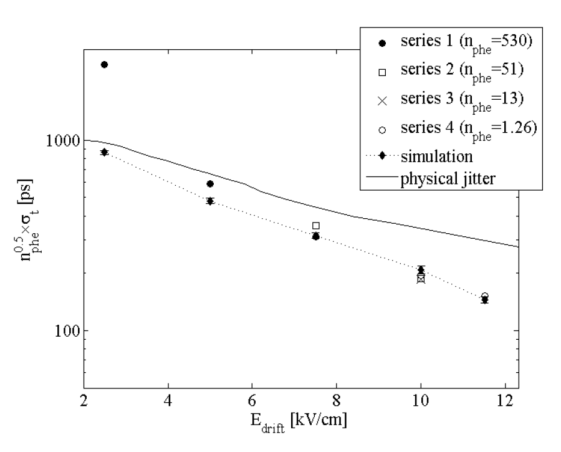
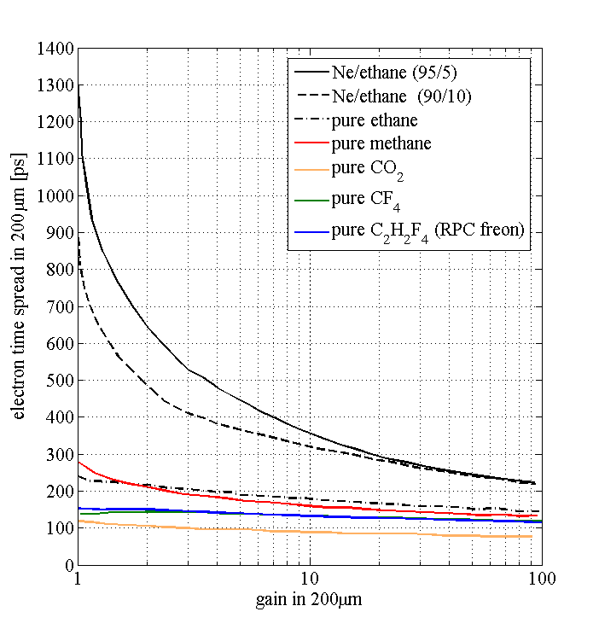
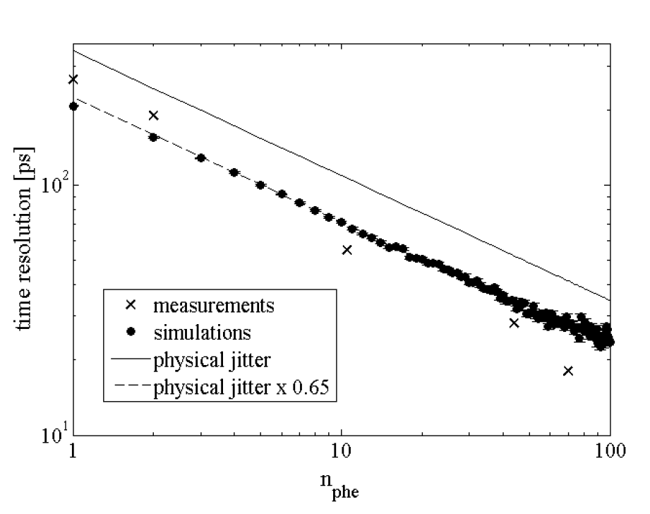
laser test results
Dependence with the drift field
Metallic photocathodes
(10 nm Al on quartz)
2015 run: Ne (90%) + C₂H₆ (10%)
  No gas circulation - gas renewed every 24 h
  Single p.e. σ_{t}~180 ps @ ~12 kV/cm²
May 2016 run: Ne (80%) + C₂H₆ (10%) + CF₄ (10%)
  No gas circulation. Gas renewed every 24 h
  Similar performance, analysis to be completed
  Single p.e. σ_{t} ~ 150 ps @ ~15kV/cm
  Gain degradation was observed => detector not leak tight
Improvement compared to the physical jitter due to the pre-amplification
Dependence with the number of photoelectrons
Conference: C15-10-12, arXiv:1601.00123[physics.ins-det]
2015 operation point
Improvement of single electron time
spread ➔ operation at few p.e. regime

Slide 12
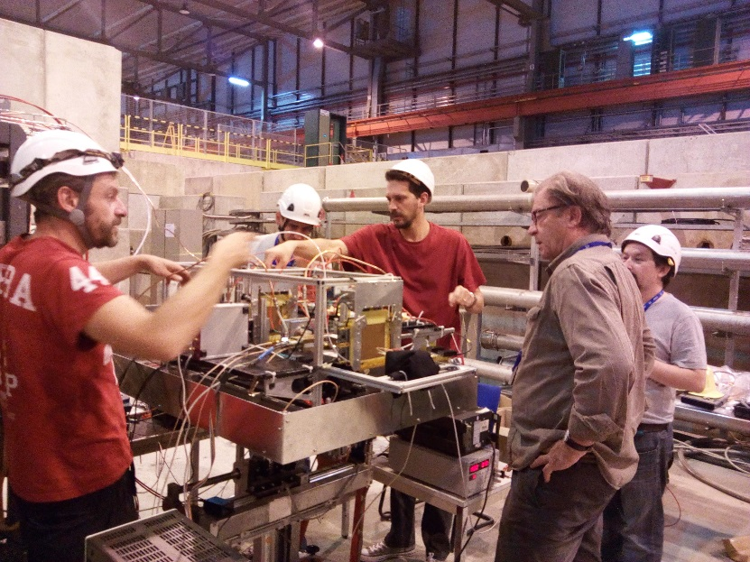
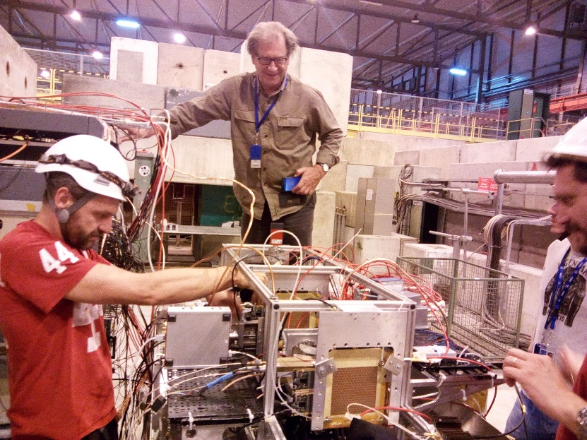
2016 beam tests with 150 GeV muons @ SPS H4
June 2016
Sensors:
  Standard bulk Micromegas
Photocathodes:
  CsI photocathodes (Saclay):
    3mm MgF₂ + 6 nm Al + 10.5 nm CsI
    3mm MgF₂ + 8 nm Al + 10.5 nm CsI
  Al photocathode (8 nm)
Gas mixtures:
  Ne/C₂H₆/CF₄ (80/10/10)
  Ne/CH₄ (95/5)
  No gas circulation. Gain deterioration observed
  CO₂ (sealed/flushed)
August 2016
Sensors:
  Bulk Micromegas with reduced pillars
  Thin mesh bulk Micromegas
Photocathodes:
  CsI photocathodes:
  2 mm / 3 mm MgF₂
  6 nm Al / 5.5 nm Cr substrate
  11 nm / 18 nm / 25 nm CsI (Saclay / CERN)
  Metallic photocathodes:
  3 mm / 5 mm MgF₂
  8 nm Al / 10 nm Cr
  Diamond photocathodes:
  3 mm MgF₂ + 6 nm Cr + B-doped diamond (100 nm)
  5 mm MgF₂ + B-doped diamond (100 nm) - failed
Gas mixtures:
  Ne/C₂H₆/CF₄ (80/10/10) (flashed / sealed mode)
  Ne / C₂H₆ (sealed mode / mixed by volume)
  CF4 / C₂H₆ (sealed mode / mixed by volume)
Sep. - Oct 2016
Sensors:
  Bulk Micromegas with reduced pillars
  Thin mesh bulk Micromegas
Photocathodes
  CsI photocathodes:
  2mm, 3mm, 5mm MgF₂
  6nm Al / 5.5 nm, 3nm, 4.5 Cr substrate
  11nm, 18nm, 25nm, 36 nm… CsI (CERN)
  Hamamatsu photocathode (?)
  Metallic photocathodes:
  3 mm / 5 mm MgF₂ (+new provider)
  6 nm, 9nm, 12 nm, 15nm… Cr
  Diamond photocathodes:
  3 mm / 5 mm MgF₂
  3 nm, 6 nm Cr + B-doped diamond (100 nm)
Gas mixtures:
  Ne/C₂H₆/CF₄ (80/10/10) (flashed / sealed mode)
  CF4 / C₂H₆ (sealed mode / low pressure)
Further studies:
  Trigger area (also) larger (border region)
  Improve signal quality (mesh at ground, better connectors, …)
  Different drift gaps
  Different and improved preamps
  Sampic acquisition

Slide 13
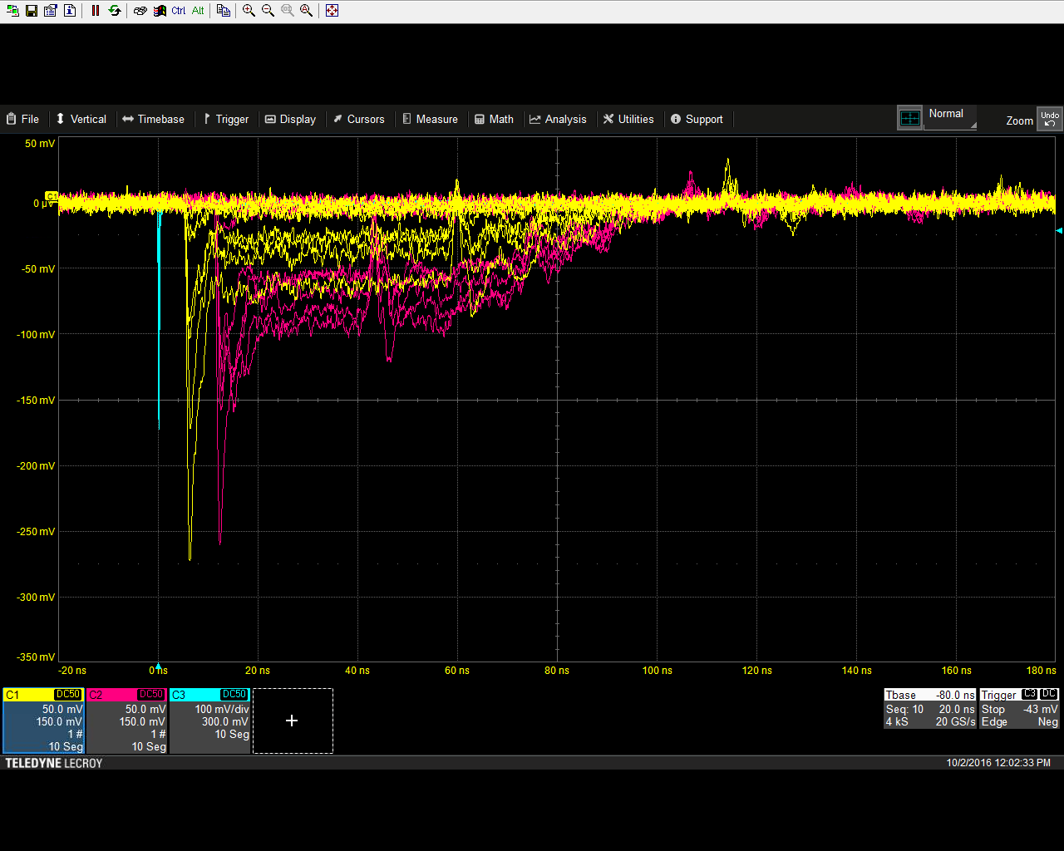
SPS measurement Setup
Trigger: coincidence of two 5x5 mm2 scintillators and a veto downstream (avoid showers)
Tracker: three GEMs to measure where the triggered particle passed (reject showers too)
Time reference: two Hamamatsu MCP-PMTs (160 ps rise time)
Tracking acquisition: APV25 + SRS
Timing acquisition: CIVIDEC C2 preamp + 2x 2.5 GHz LeCroy scopes (synchronised with the tracker) and SAMPIC

Slide 14
Data analysis (see later talk by Spyros Tzamarias)
46.2 ps
47.2 ps
Analysis by S. Tzamarias
46.2 ps
47.9 ps
Robust results, ~independent on the analysis
Asymmetry, deviation from Gaussian distribution
➔ Dependence on the amplitude

Slide 15
Preliminary results from beam tests
Data analysis in progress. Data from different detector configurations to be analyzed. Results for:
3mm MgF₂
5.5 nm Cr + 18 nm CsI (2 days old)
V_{a} = +450 V (36 kV/cm)
V_{m} = 0 V (grounded)
V_{d} = -350 V (17.5 kV/cm)
Sealed @ 1010 mbar, Ne + 10% iC₄H₁₀ + 10% CF₄
σ_{t} ≈ 45 ps, <N_{p.e.}> ≈ 10
Single p.e. from candle
100 % efficiency for MIPS from the scintillator trigger
Muons
More in the following talk by Spyros Tzamarias

Slide 16
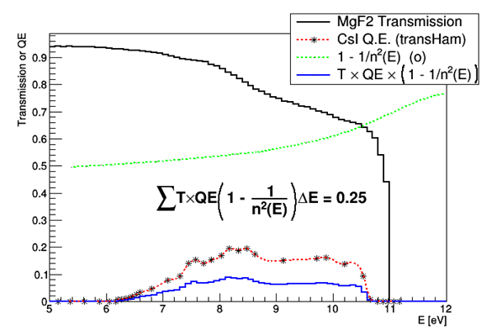
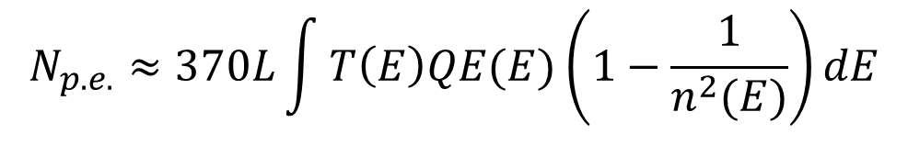
Expected number of p.e. per MIP
A MIP passing through a crystal will emit:
For a MgF₂ crystal and a CsI photocathode with typical bibliography values for QE(E), T(E) and n(E) as seen, we expect:
370 × 0.25 = 92 p.e./cm
for a 3 mm MgF₂ crystal we would expect ~28 p.e.
Single photoelectron calibration runs have been taken using a cigarette lighter’s flame for all detector settings. Analysis pending. For the time being matching the amplitude spectra with Poisson distributions we estimate ~10 p.e. per MIP
$$N_{p.e.}≈370L\int{T\left(E\right)QE(E)\left(1−\frac{1}{n^{2}(E)}\right)dE}$$
Margin for improvement!!

Slide 17
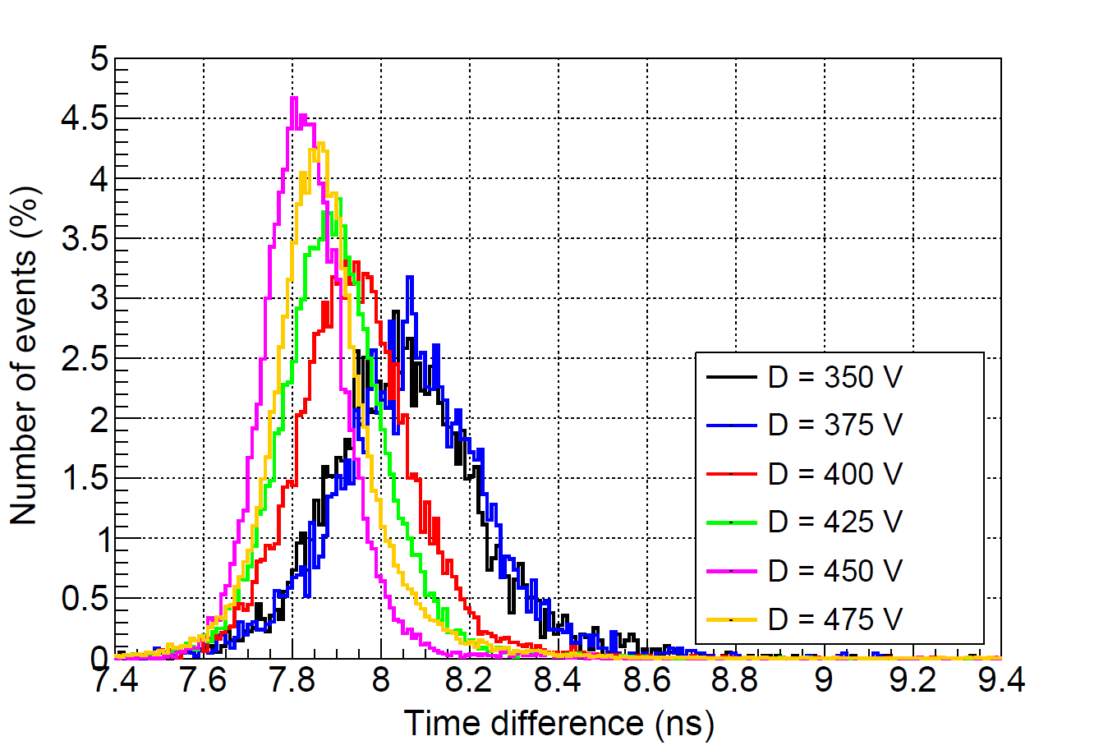
2017 laser test
Date | Gas | Anode [(+)V] | Drift [(-)V)
]24/01 | Ne+10%C₂H₆+10%CF₄ | 475 | 300, 325, 350, 375, 400
 |  | 500 | 300, 325, 350, 375
 |  | 525 | 250, 275, 300, 325, 350, 375
 |  | 550 | 225, 250, 275, 300, 325, 350
 |  | 590 | 50…225, 250, 275
25/01 | CF4+20%C₂H₆@0.5 bar | 600 | 425, 450, 475, 500
 |  | 625 | 350, 375, 400, 425, 450, 475
 |  | 650 | 350, 375, 400, 425, 450
25/01 | Ne+10%C₂H₆+10%CF₄ | 450 | 300, 325, 350, 375, 400, 425
 |  | 475 | 300, 325, 350, 375, 400
 |  | 500 | 275, 300, 325, 350, 375, 400
 |  | 525 | 200…275, 300, 325, 350
Laser data of January 2017:
  24th Jan, Ne+10%C₂H₆+10%CF₄ @ 1050 mbar.
  25th Jan, CF4+20%C₂H₆ @ 500 bar.
  25th Jan, Ne+10%C₂H₆+10%CF₄ @ 1050 bar.
128 μm Bulk MM detector, reduced pillars, 200 μm drift gap.
Chromium layer of 18 nm on a 3mm MgF₂ crystal.
New chamber (good tightness), mesh at ground.
120 fs pulses @ 288 nm, repetition rate between 9 kHz & 200 kHz, ~100pJ/pulse
Very low trigger rate (~0.1%).
Single p.e. only!
Trigger: coincidence between PD and Micromegas with threshold ~10 mV, within a time window 15 ns
Simple analysis: CF @ 20% of max amplitude + linear interpollation
25th January 2017
CF4+20%C₂H₆
Anode = 625 V

Slide 18
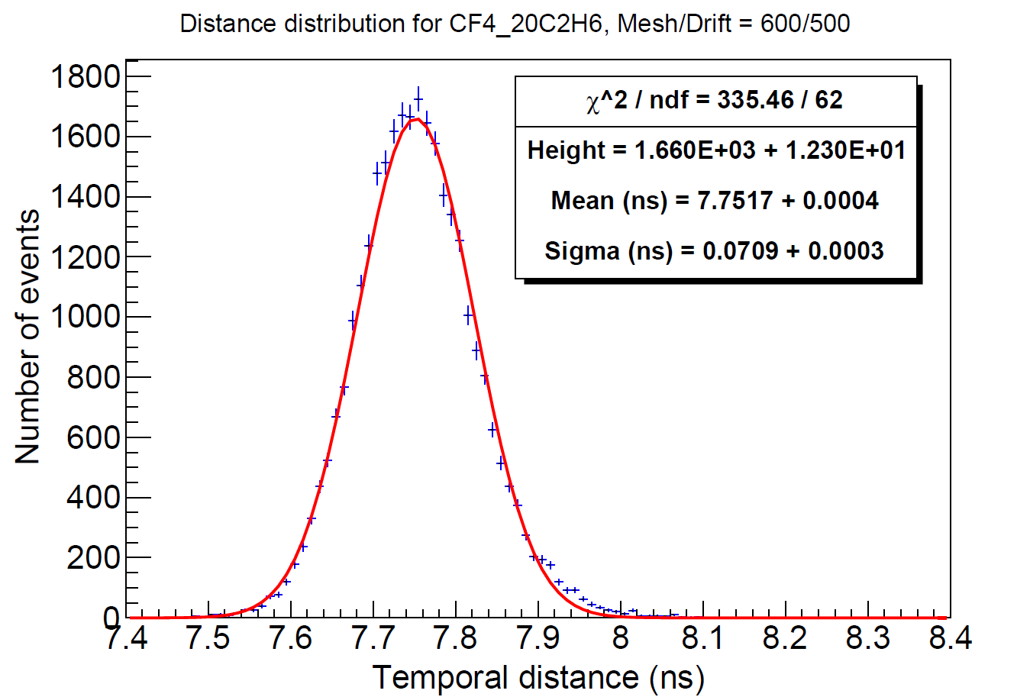
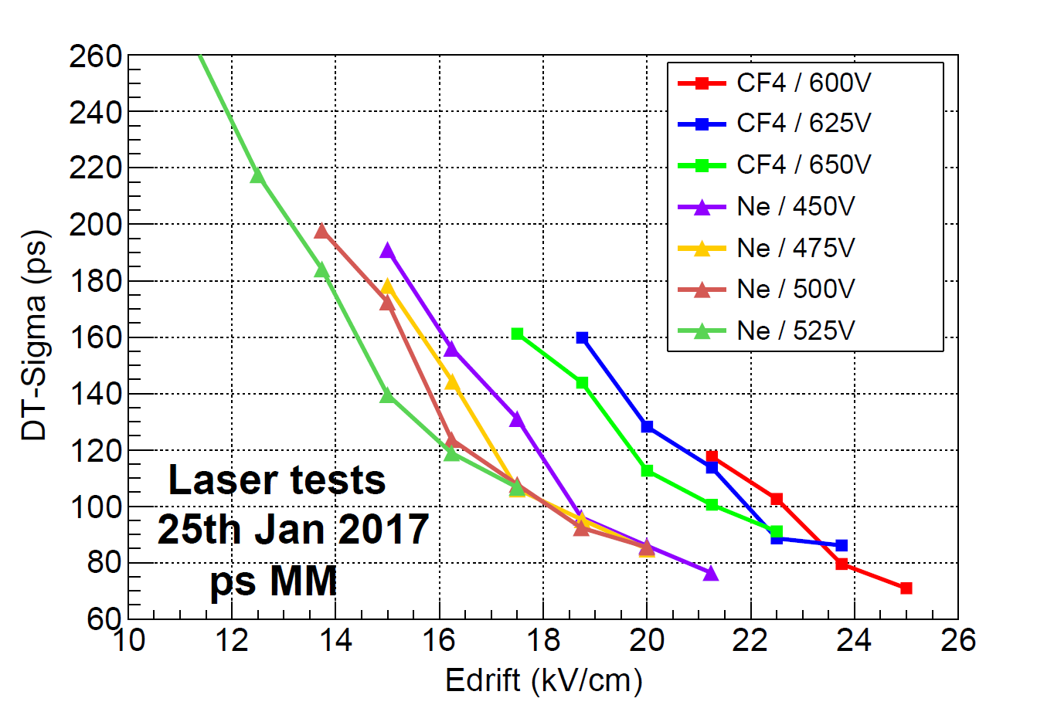
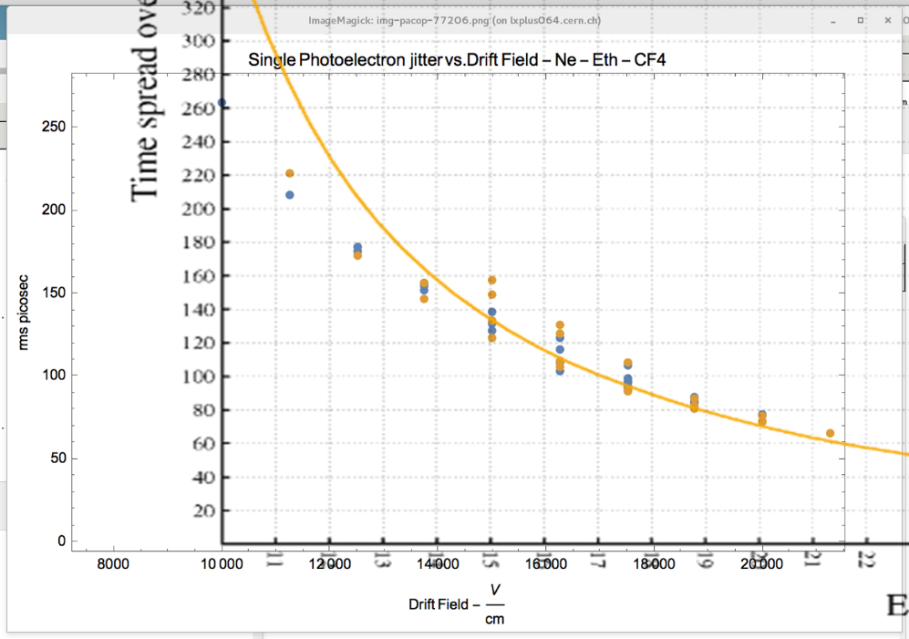
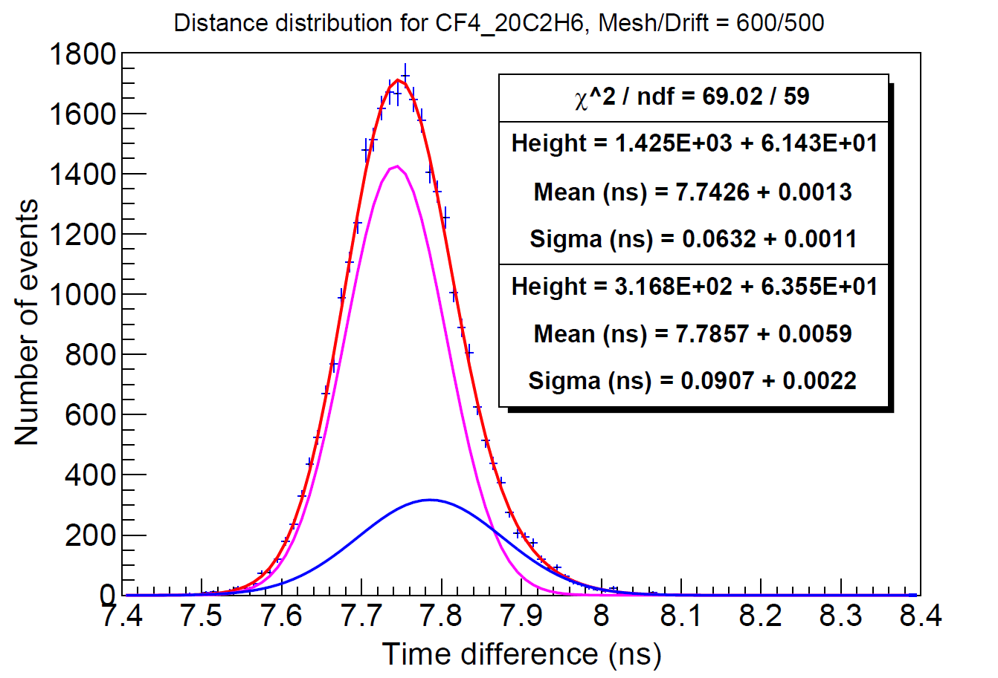
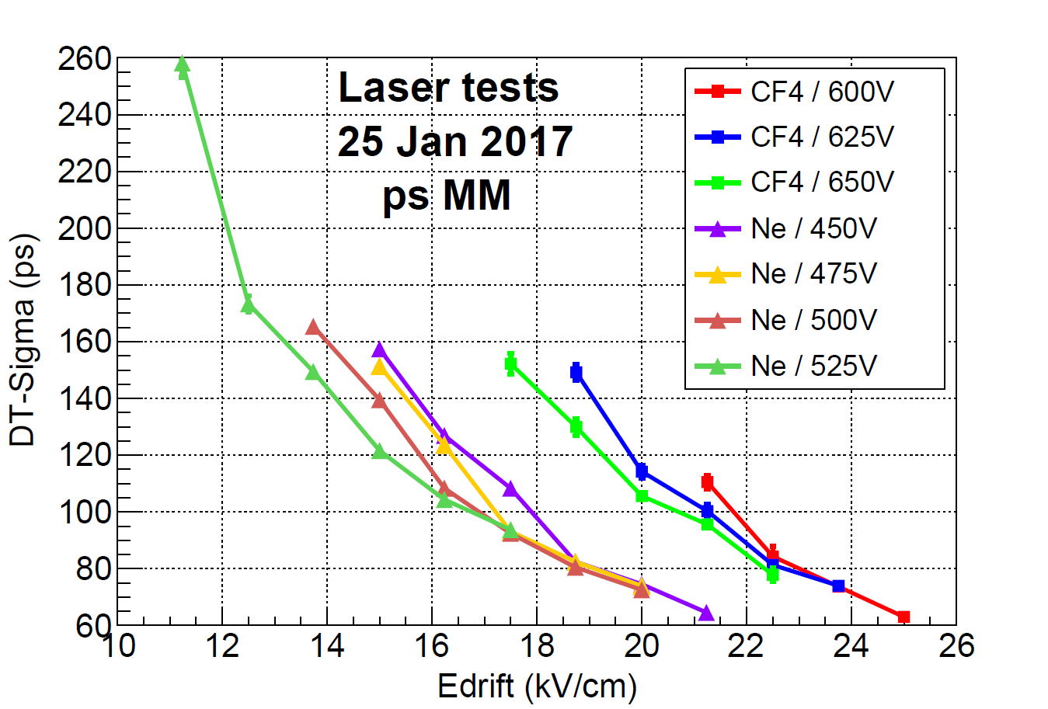
2017 laser test results
Results: projection of 2015 data to higher drift field.
Similar performance for Ne and CF₄ mixtures
Single p.e. resolution well below 100 ps for strong fields (high preamplification)
More on the analysis by Spyros Tzamarias
More on the modeling by Diego González
Plot by Rob Veenhof
Analysis by Francisco Iguaz

Slide 19
Plans for 2017
Spark quenching in the mm gap (ongoing)
  Resistive Micromegas
Spark quenching in the drift/preamp gap (under consideration)
  Resistive mesh
  Protection or robust photocathode
  Graphite - DLC
Multichannel readout (ongoing)
  Pads / pixels
  Strips
Plus:
Systematic analysis of existing data
Simulation / modeling of s.e. resolution
Muon runs (RD51 beam tests)
Laboratory runs (Laser / Calibrations / Cosmics / photocathode QE)
Alternative photocathodes / secondary emitters

Slide 20
Resistive Micromegas
keep the same layout (Ø 1cm active area and same fan-out)
Signal degradation?
cathode
-HV
mesh
Options:
  Resistive plane a la “mamma” (Ohms/Square: 1-10M/□, 100k/□)
    Better protection
  Discrete Resistors a la “compass”
    Larger flexibility on resistor value
  Embedded Resistors a la “Chefdeville-Geralis-Peskov-Rui”
    Resistive plane a la MAMMA with low resistivity will be used to mimic this
gnd
Resistive Layer
Readout pad
+HV
GND Plane

Slide 21
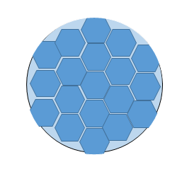
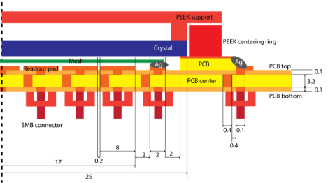
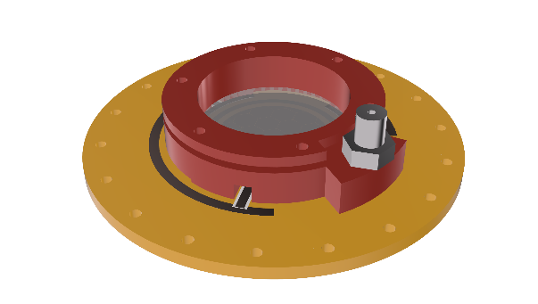
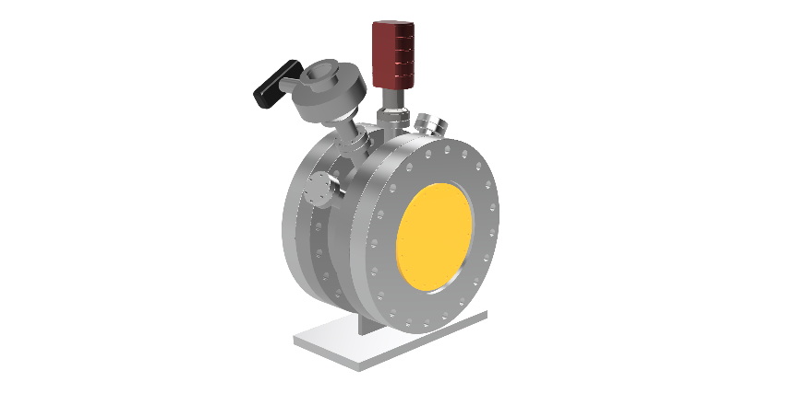
Multichannel readout
First Step: No resistive Layers (the resistive one eventually defined according to the previous tests)
Detector Assembly
  Everything in vacuum (more complex RO connectivity)
  mm PCB as detector cage wall – gas (vacuum) tight
  (Possibility to add an additional chamber to close the backplane during pumping if pumping (ΔP) is an issue).
Plane material: FR4, Ceramic
Pillars on top/bottom mm mesh
Readout options:
Simple
  Simple Pads readout with SMA connectors, HV provided with the preamp (not confortable)
Intermediate
  Pads readout with SMA connectors with HV network on the pcb (discrete resistors ).
Advanced version
  Pads readout capacitive coupled a la COMPASS RICH micromegas

Slide 22
Conclusions - Outlook
We have coupled a Micromegas detector with a radiator / photocathode in order to surpass the physical constrains on precise timing with MPGDs, aiming to an important improvement of their performance (~two orders or magnitude are needed in order to be considered for the HL-LHC upgrade)
The detector has been tested with a femtosecond UV laser in order to investigate the time spread of single photoelectrons.
σ_{t} ~ 70 ps for single p.e. has been measured for strong drift field with a standard bulk Micromegas in semi-transparent mode, without gas circulation.
The Micromegas photodetector has been tested with 150 GeV muon beam. Data taking is on-going.
σ_{t} ~ 45 ps has been measured for 3 mm MgF2 + 5.5 nm Cr substrate + 18 nm CsI photocathode. The estimated number of photoelectrons for this photocathode was: <N_{p.e.}> ≈ 10
Results from various radiator/photocathode setups are pending.
  Still some margin for improvement: gas / drift gap / photocathode studies & optimization
  Single p.e. result very interesting for less efficient but more robust photocathodes (metallic, praphite/DLC, polycrystalline diamond… )
Yet to be addressed:
Resistive detector
  discharge resistance
  dynamic range
  maintaining the signal quality
Multiple-pad readout performance
  Design a pixelated prototype (~5x5 cm²)
  Readout Electronics (Sampic, talk by Hans Muller)
Radiator & photocathode aging / radiation hardness
  IBF, photon feedback, discharges
  Particle flux (high rate tests @ IRAMIS / ORPHEE)
  Deterioration with time
  Metallic photocathodes
  DLC / polycrystalline diamond photocathodes
  Operation in reflective mode
Polycrystalline diamond as secondary emitter
  Replace the crystal + photocathode with secondary electron emitter
    Robustness / radiation hardness
    No radiator - flexible choice of substrate material
    Possibility to increase thickness towards 1 μm!
  Investigate materials with high secondary electron yield.
  (Doped-) diamond deposition, DLC, graphene…
  multi layer detector
  graphene layer for photocathode protection ?

Slide 23
Thank you!

Slide 24
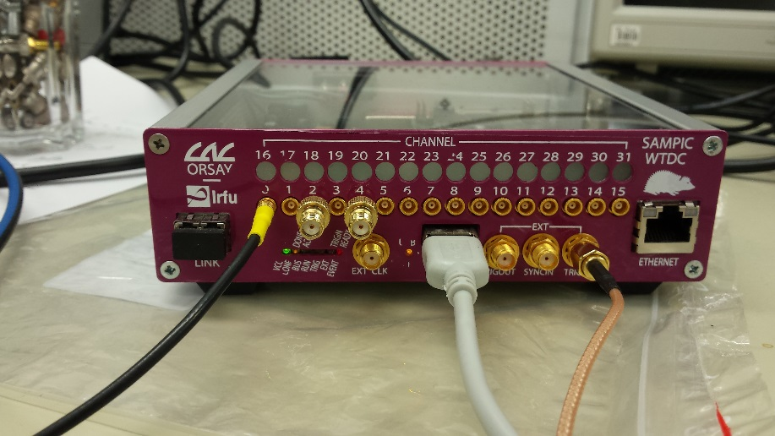
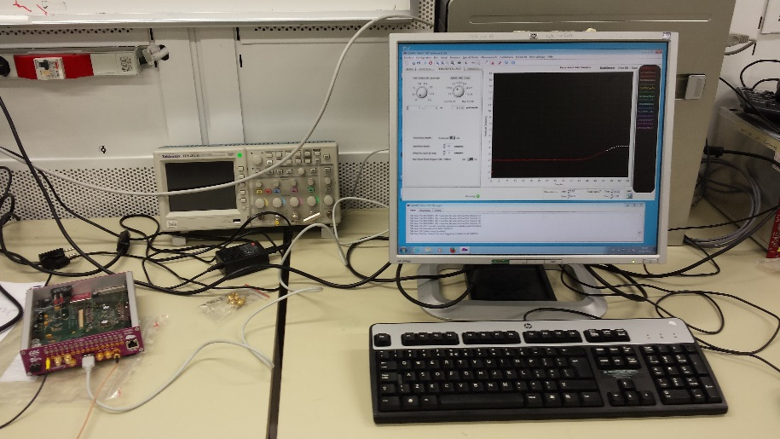
Next steps (Electronics)
Electronics for pixelated detector
  SAMPIC (D. Breton / LAL Orsay, E. Delagnes IRFU/CEA)
  Radiation hard amplifiers ➔ Mitch Newcomer / PENN
  Onboard electronics ?
  Improve signal transfer lines, bandwidth
SAMPIC
1.5 GHz bandwidth
10 Gs/s (used at 6.4 Gs/s
11 bit
64 samples
16 channels
Maximum rate ~500 kHz)
http://arxiv.org/abs/arXiv:1604.02385

