Slide 1
A NEW PHOTOCONVERTER ?
S. Dalla Torre
from A. Valentini,
INFN, CSN5, 2016

Slide 2
NOVEL DETECTOR HV ISSUES
Antonio Valentini – Sezione INFN di Bari
Italian patent application n. 102015000053374
Photocatodes: diamon film obtained with Spray Technique making use of NC powder
  Spray technique: T ~ 120° (insted of 800° as in standard techniques)

Slide 3
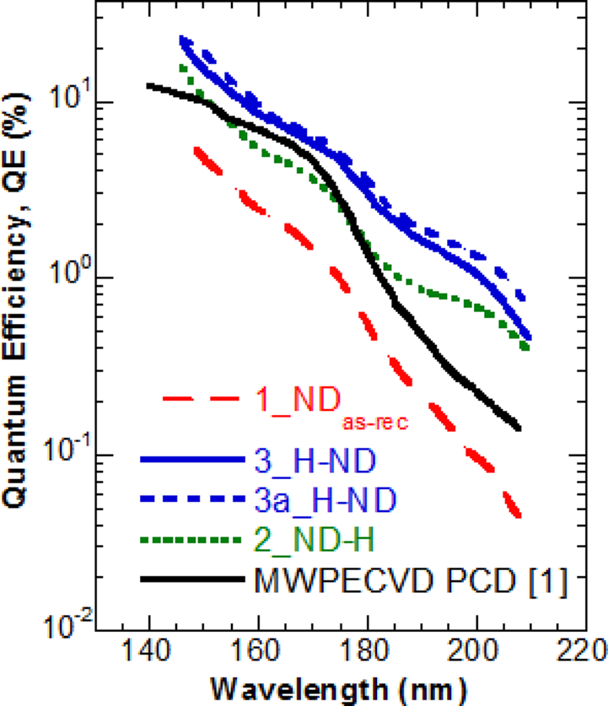
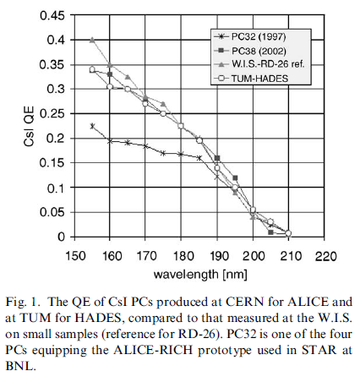
QE comparable to CsI
Higher QE recently obtained, submitted for publication
CsI (for comparison)
QE= 22% at 146 nm
A. Di Mauro, NIM A 525 (2004) 173.

